Slide 1
Medical Evaluation of Physical Abuse & Neglect in Children
Michael A. Taylor, M.D.
Professor of Pediatrics
Director, Child Abuse Pediatrics Division

Slide 2
Disclosures
I have no commercial endorsements or financial conflicts.
I will not be discussing any off label uses of drugs or equipment.

Slide 3
Objectives
Review the medical & legal definitions of child maltreatment with emphasis on physical abuse & trauma
Review the reported & estimated frequency of child abuse
Give an overview of the medical evaluation of child physical abuse
Review the frequency of significant findings in physical abuse medical evaluations
Relate the importance of the medical exam to child abuse investigations
Notes:
2

Slide 4
Case studies

Slide 5
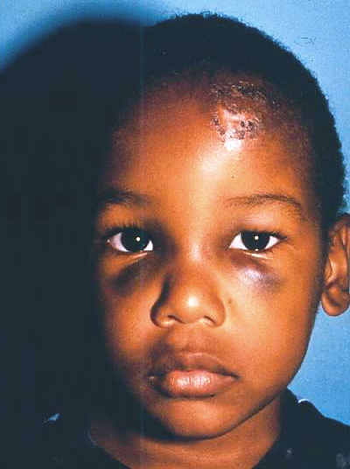
History
Child tripped while running and fell against a cabinet

Slide 6
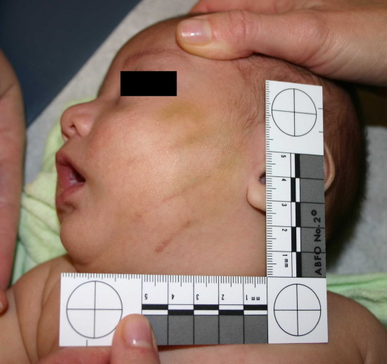
History
7 mo old fell from the couch onto the floor

Slide 7
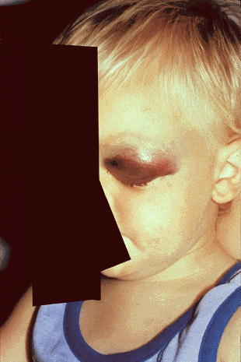
History:
toddler bumped into door while walking

Slide 8
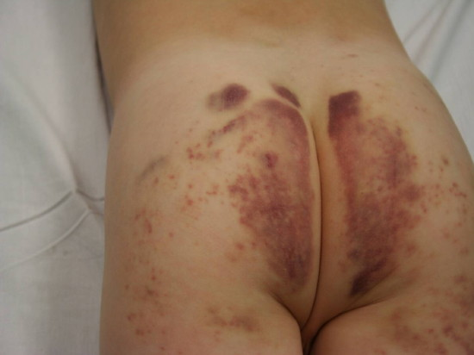
Hx: 6 yo girl fell off of the porch onto a walkway, landing on her buttocks wearing blue jeans & cotton underwear

Slide 9
Definition of child abuse
Any recent act or failure to act on the part of a parent or caretaker which results in death, serious physical or emotional harm, sexual abuse or exploitation; or an act or failure to act which presents an imminent risk of serious harm.
[from Child Abuse Prevention and Treatment Act (CAPTA) as amended by the Keeping Children and Families Safe Act of 2003]

Slide 10
Types of child abuse
neglect
physical, emotional, medical, dental, educational, supervisional
physical abuse
sexual abuse
emotional abuse (psychological)
rejection, isolation, terrorization, ignoring, corruption

Slide 11
Legal definitions
Child. A person under the age of 18 years.
Abuse. Harm or threatened harm to a child's health or welfare. Harm or threatened harm to a child's health or welfare can occur through nonaccidental physical or mental injury, sexual abuse or attempted sexual abuse, or sexual exploitation or attempted sexual exploitation.
Neglect. Negligent treatment or maltreatment of a child, including the failure to provide adequate food, medical treatment, supervision, clothing, or shelter.
Code of Alabama 1975, Section 26-14-1

Slide 12
Epidemiology

Slide 13
Child abuse incidence-2018
 | US | AL | MS | GA | SC | TN
Child population | 73,993,353 | 1,089,840 | 706,141 | 2,505,751 | 1,105,945 | 1,506,220
# child abuse reports | 2,402,827 | 28,748 | 50,672 | 126,013 | 56,724 | 136,625
# children involved | 3,533,597 | 42,379 | 50,672 | 205,216 | 82,617 | 104,250
% substant/indicated | 16.8 | 29.5 | 21.3 | 5.6 | 36.0 | 9.0
# abuse victims | 677,529 | 12,506 | 10,807 | 11,455 | 19,130 | 9,413
Victim rate per 1000 | 9.2 | 11.2 | 14.2 | 4.4 | 17.3 | 6.1
Caseworkers (#) | 29,754 | 575 | 833 | --- | --- | 1128
NCCAN 2018

Slide 14
AL DHR reports a drop of 28% in CA reports since March of 2020
Child Maltreatment 2018, NCCAN

Slide 15
Child victims by age
NCCAN 2018

Slide 16
Child abuse incidence by category -2018
Abuse Type | US | AL | MS | GA | SC | TN
Neglect | 60.8 | 31.3 | 58.1 | 61.8 | 40.6 | 9.5
Medical neglect | 0.8 | 0.3 | 1.8 | 1.1 | 0.9 | 0.6
Physical abuse | 10.7 | 42.0 | 8.1 | 7.7 | 35.5 | 48.2
Sexual abuse | 7.0 | 14.6 | 8.1 | 4.9 | 2.7 | 24.4
Psychological | 2.3 | 0.2 | 5.4 | 13.4 | 0.2 | 1.3
Multiple types | 15.5 | 11.6 | 19.2 | 10.9 | 20.0 | 15.3
NCCAN 2018

Slide 17
General statements
National rate of victimization in 2018 was 9.2 per 1000 children (roughly 1.0% of all US kids)
10% of all injuries to children < 5 yrs seen in ER
1,770 deaths reported in US (2.39/100,000 children)
43 deaths in Alabama (3.95/100,000, 2016)
68% of all child maltreatment cases go unreported (estimated)

Slide 18
General statements
Disorder | Frequency in Children
Cancer, all types | 3.5 per 1000
Diabetes | 1.54 per 1000
Cystic fibrosis | 0.33 per 1000
Child abuse, all types | 9.2 per 1000
Asthma | 100 per 1000

Slide 19
General statements
91.7% of cases involved a parent as a perpetrator
2.8% were unmarried partner of parent
an additional 4.7% were other relatives of the victim
83.3% of perpetrators were between ages 18-44 yrs
53.8% were female
¾’s of neglect and medical neglect were associated with female perpetrators, while ¾’s of sexual abuse cases were associated with male perpetrators
NCCAN 2018

Slide 20
Perpetrators
Relationship | All types* | Neglect** | Physical abuse** | Sexual abuse**
Parent | 91.7 | 86.6 | 75.7 | 27.0
Other relative | 4.7 | 4.6 | 6.9 | 29.3
Unmarried partner | 2.8 | 3.3 | 6.1 | 8.8
Friends-neighbors | 0.8 | 0.1 | 0.5 | 3.9
Substitute provider | 0.3 | 0.1 | 0.5 | 3.9
Other | 2.8 | 1.7 | 4.3 | 21.7
Unknown | 3.0 | 2.4 | 4.4 | 6.3
*NCCAN 2018-**NCCAN 2012

Slide 21
Mortality in child abuse
2018: 1,770 (2.39 per 100,000 population)
children under 4 years of age account for 77.9% of fatalities, 46.6% were under a year of age
actual number is 2500 cases per year in the U.S. (estimated)
72.8% neglect
46.1% from physical abuse
17.6% other forms
For physical abuse deaths, leading causes are head injury & abdominal injury

Slide 22
Mortality in child abuse
Type of abuse | % |  | Age | %
Neglect | 72.8 |  | < 1 yo | 46.6
Other | 7.8 |  | < 4 yo | 77.9
Physical | 46.1 |  | 4-7 yo | 10.1
Med neglect | 8.1 |  | 8-11 yo | 5.4
Psychological | 1.1 |  | 12-17 yo | 6.6
Sexual abuse | 0.6
NCCAN 2018

Slide 23
Mortality in child abuse
A parent was the perpetrator in 80.3% of CA fatalities
26.3% had current or prior contact (≤3 yrs) with local child protective agencies in US (2018 data)
1.7% had been in foster care & reunited with family (≤5 yrs)
more common than death due to meningitis
more frequent than death due to leukemia
20 times more common than death from AIDS
the only leading cause of death in children to increase in the past 30 years

Slide 24
Risk factors - Child
Premature birth
Disability in child
Boys are more likely to be physically abused
Girls are more likely to be sexually abused

Slide 25
Risk factors - Parental
Inappropriate expectations of child
Lack of empathy to child’s needs
Parents belief in physical punishment as form of discipline
Parental role reversal
Single head of household
Parental education ≤ high school degree
Mental health problems in parent
Substance abuse by parent
Young mothers (age ≤ 18 yrs)
Interpersonal violence between guardians in home

Slide 26
Prognosis for victims
Short Term
50% or more chance of further abuse
5% mortality and 25% serious morbidity <5 yrs of age
20% of siblings of abused children will have findings of abuse
Long term
90% abusers were abused
95% prostitutes were abused
school failure, violent acts, less socioeconomic status, early sexual activity all higher in abused children

Slide 27
Physical Abuse

Slide 28
Physical Abuse
Physical abuse of infants is often triggered by frustration of the caregiver due to inconsolable crying.
Physical abuse of children over 1 yr of age is often a result of excessive or inappropriate administration of corporal punishment.
The concept that pain is an effective negative reinforcement in teaching children is widely believed & utilized in the US.
As a result, physical abuse presentations often fall into common patterns of injury.

Slide 29
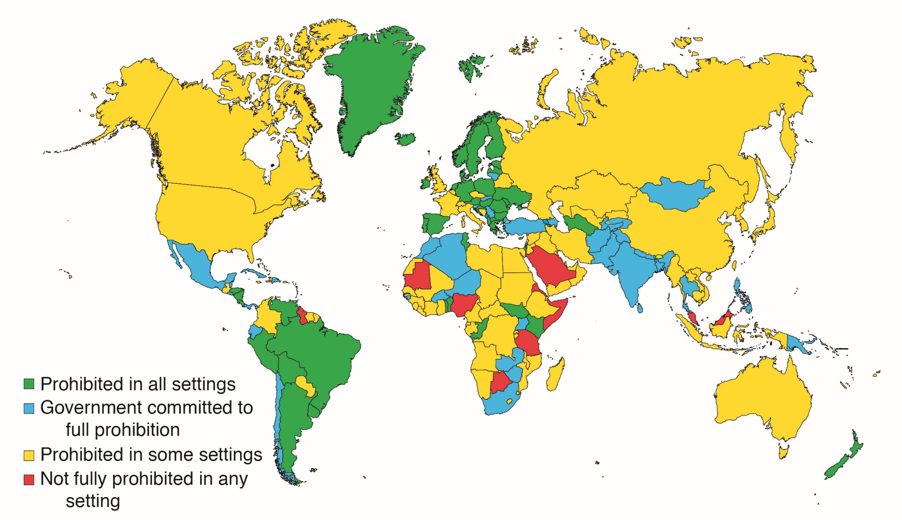
Countries that have banned corporal punishment in the home

Slide 30
Corporal punishment & child abuse
As of July 2020, corporal punishment of children by parents (or other adults) is banned in 64 countries.
Corporal punishment is legal in Alabama & the rest of the United States.
So, when should you report a child who has been administered corporal punishment?
When there is physical or emotional injury.

Slide 31
Physical abuse injuries
Bruises
Cuts & lacerations
Burns
Broken bones
Abdominal injuries
Head injuries

Slide 32
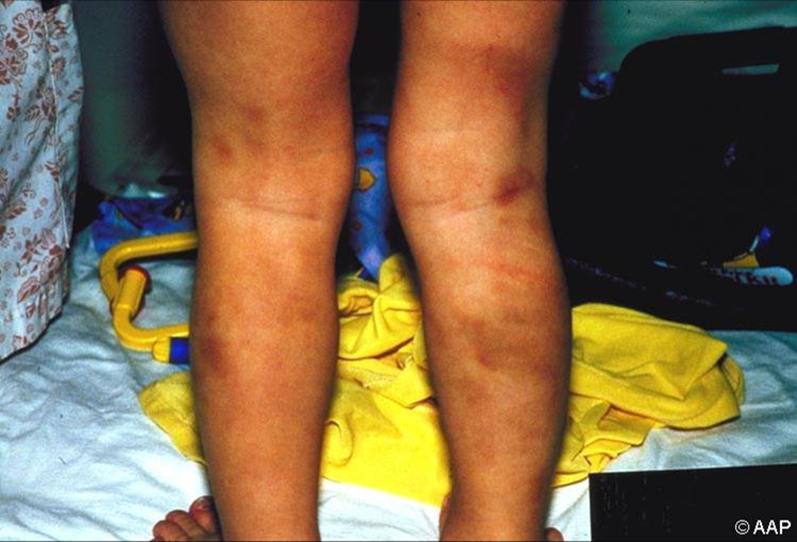
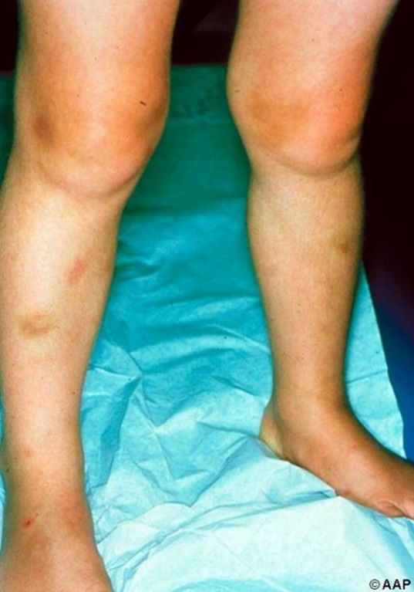
General Considerations
Bruising is the most common injury in children who have been physically abused (top image).
Bruising is also extremely common in healthy, active children (bottom image).
“A bruise…must always be assessed in the context of medical and social history, developmental stage, explanation given, full clinical examination, and relevant investigations.” (Maguire 2005)
TOP: The child in this image has bruising that is not compatible with typical childhood injury. This is an ambulatory child, so leg bruises are not unexpected. However, these bruises are multiple, with components that are linear and parallel (patterned). They are also concentrated on the back of the legs, which are well padded and less likely to be bruised non-abusively.
BOTTOM: The child in this image has bruising on the anterior, distal lower extremities, which is a common distribution of non-abusive bruises in a young mobile child.
32

Slide 33
Consider All of These Aspects
Age and developmental stage of the patient
Location of bruises and other marks
Shape and pattern, ie, multiple injuries with the same shape or pattern
Number and size
Distribution, ie, multiple injuries in a localized region versus diffusely distributed

Slide 34
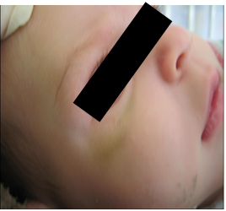
Age and Mobility
Bruising is rare in all pre-mobile children (ie, not yet crawling or cruising).
It is especially rare in children not yet rolling.
This 2-month-old’s mother said the baby hit herself with a pacifier. The history does not explain the injury.
34

Slide 35
Typical Locations of Bruises
Non-abusive | Abusive
Shins | Upper arms
Lower arms | Upper anterior thighs
Under chin | Trunk
Forehead | Genitalia
Hips | Buttocks
Elbows | Face
Ankles | Ears
Bony prominences | Neck

Slide 36
TEN-4 FACESp
Bruising or other injuries involving:
T= torso (chest, abdomen, back, genitals or buttocks)
E= ears
N= neck
4= under 4 years of age or any bruising <4 months of age
F= frenula (3, upper & lower lip & tongue)
A= angle of the jaw
C= cheek (buccal mucosa)
E= eyelids
S= Scleral hemorrhaging
P= Patterned bruising

Slide 37
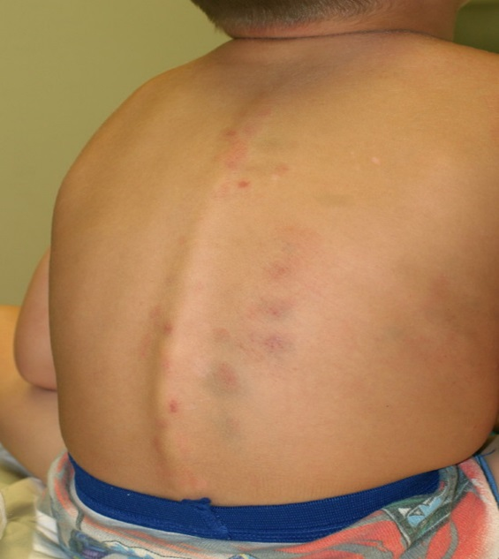
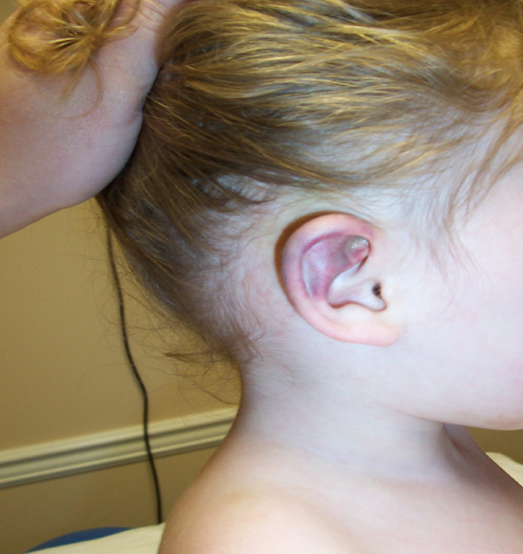
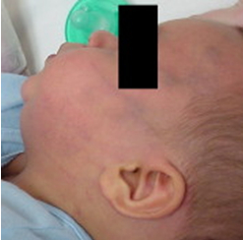
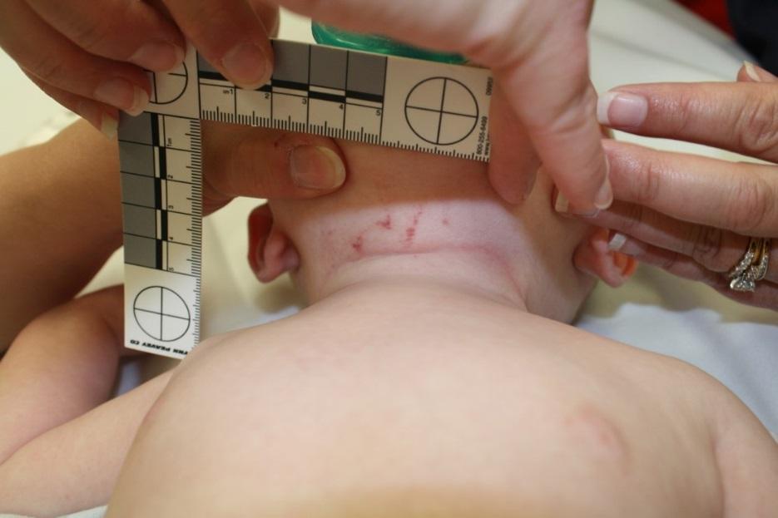
TEN-4 Rule: Location and Age
Pierce and her colleagues (2010) created the TEN-4 rule from their study of children admitted to an intensive care unit with inflicted or non-abusive injury.
There is concern for abuse if there are
Bruises on torso, ears, or neck (TEN) in children 4 years or younger
OR
Any bruise on an infant 4 months or younger
Third image courtesy of Jamie Hoffman-Rosenfeld, MD. Fourth image courtesy of James D. Anderst, MD, FAAP.

Slide 38
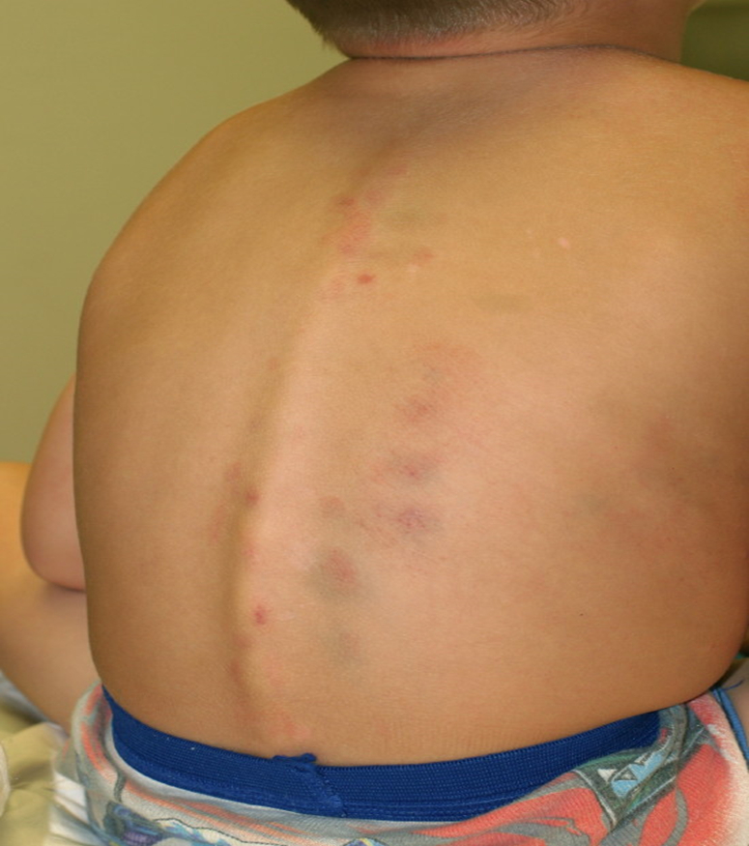
Location: Trunk
Day-to-day bruises in healthy children do sometimes occur on the trunk, often the lumbar region (Chang 2007) or, if on the front, over bony prominences such as iliac crests (Kemp 2015).
Trunk bruises, however, are associated with abuse (Kemp 2014) and, hence, must be carefully assessed.
The extensive bruising on the back of the child in this image is suspicious. Several clusters of 3 bruises evenly spaced should be thought of as patterned bruises. Pierce et al (2010) created the TEN-4 rule in a study of injured children 0 to 48 months of age admitted to an intensive care unit with injury. The authors concluded that bruising to the torso, ears, or neck (TEN) in a child 4 years or younger, or any bruise on an infant 4 months or younger, should be considered a possible indicator of child abuse.
38
38

Slide 39
Location: Ears
Studies of normal children reveal the ear is very rarely bruised (<0.2% of examinations) (Kemp 2014; Kemp 2015).
Ear bruising is strongly associated with abuse in comparative studies. Thus, the bruising of the pinna in this child is quite concerning.
39
39

Slide 40
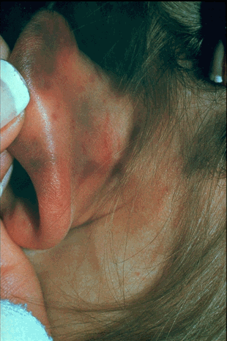
Ear lobe bruising from pulling on the ear

Slide 41
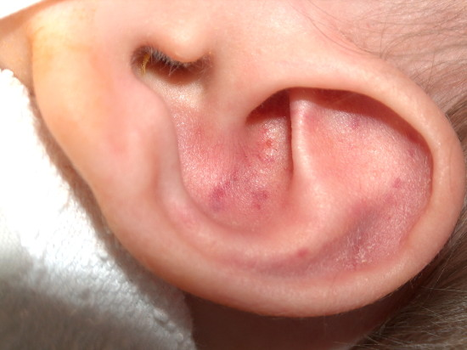
Pinna bruising

Slide 42
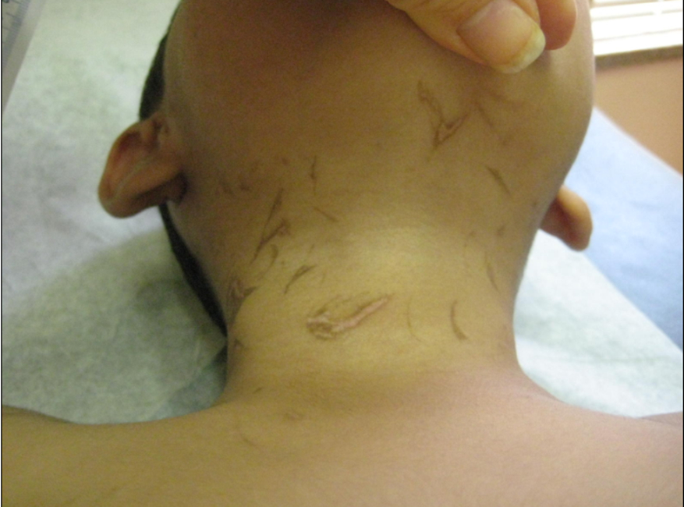
Location: Neck
Day-to-day bruises in healthy children are extremely rare on the neck (Kemp 2015).
Skin injury to the neck is strongly associated with abuse (Kemp 2014).
A 5-year-old boy with many short hyperpigmented marks on bilateral neck. These markings contain a mix of hypopigmentation and hyperpigmentation. They are healed abrasions from fingernails caused when the skin of the neck was being gripped and squeezed. Courtesy of Jamie Hoffman-Rosenfeld, MD.
42
42

Slide 43
Bruising in an Infant
Bruises in nonambulatory infants should raise suspicion for child physical abuse.
A bleeding diathesis should be considered, and testing for coagulopathy may be warranted.
Facial bruising can be a warning sign of intracranial trauma.
Children younger than 24 months with suspicious bruising should receive a full skeletal survey and may also warrant intracranial imaging. There should be a low threshold for obtaining a skeletal survey in young children when abuse is suspected.

Slide 44
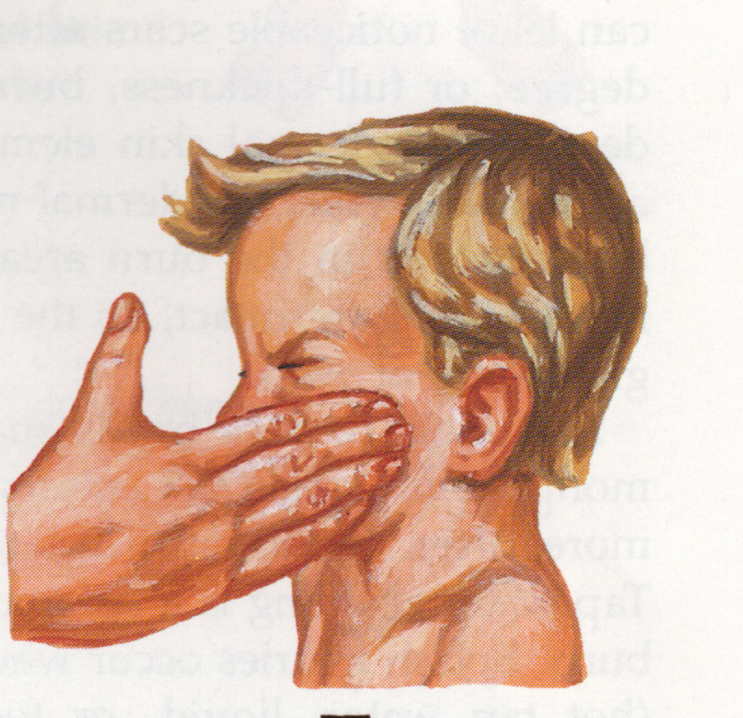
Hand slap to the face of a child

Slide 45
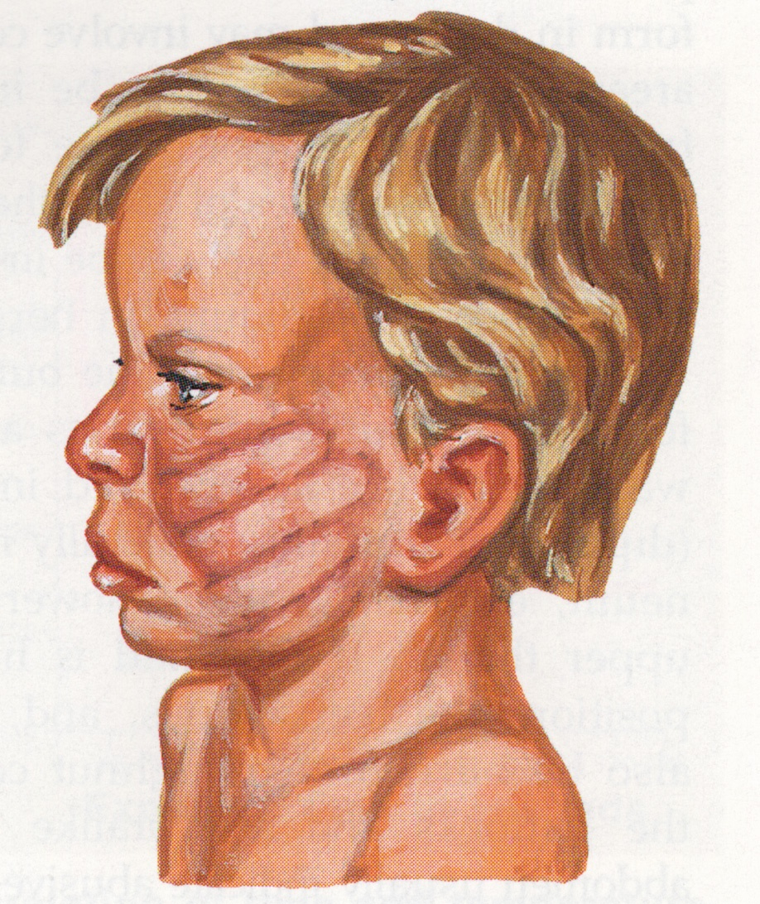
Hand slap to the face of a child

Slide 46
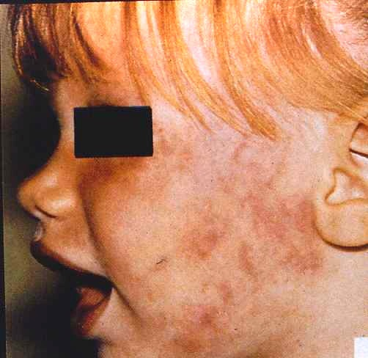
Slap to the face

Slide 47
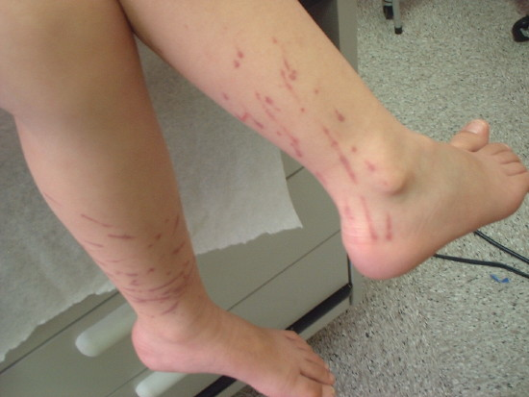
Bamboo switch marks

Slide 48
Belt marks

Slide 49
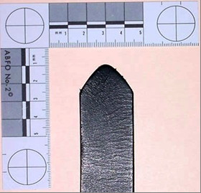
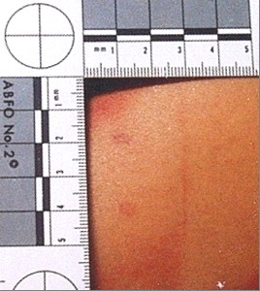
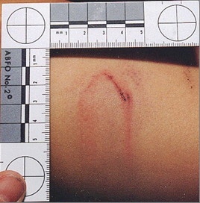
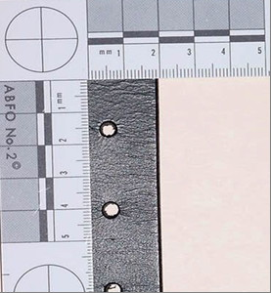
Belt mark

Slide 50
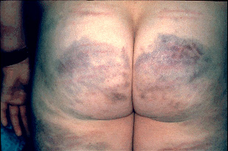
Corporal punishment bruising: plastic pipe

Slide 51
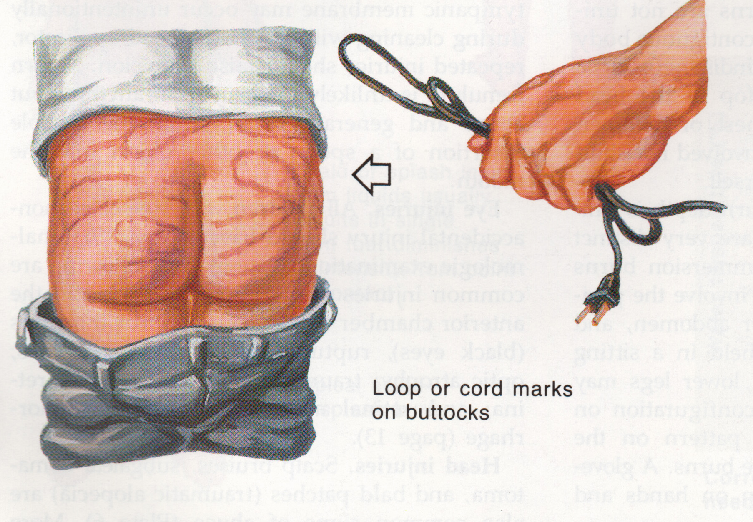

Slide 52
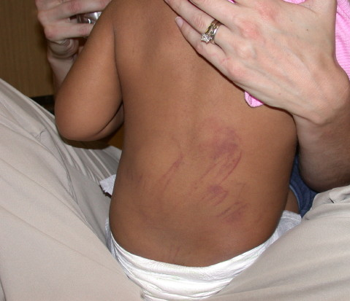
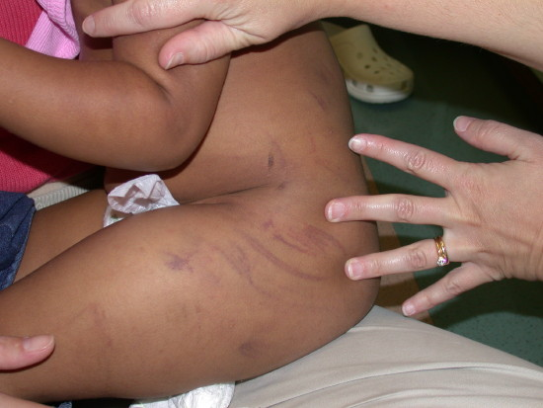
Looped cord marks

Slide 53
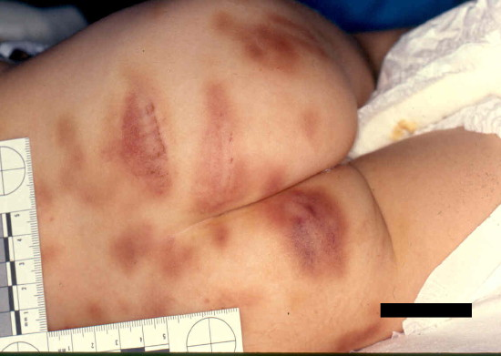
Pattern marks

Slide 54
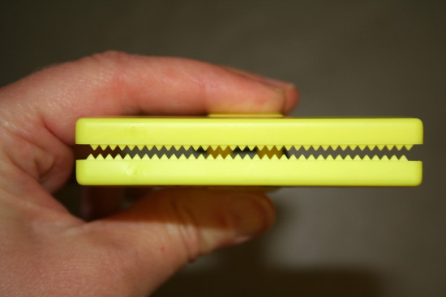
Plastic clip that caused marks

Slide 55
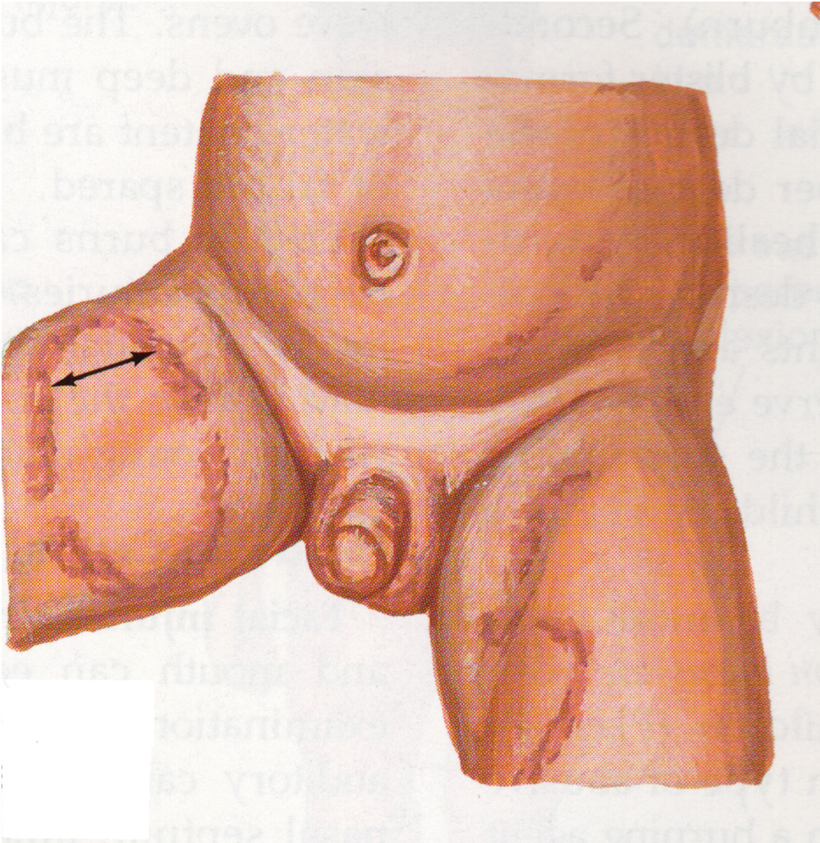
Bite marks

Slide 56
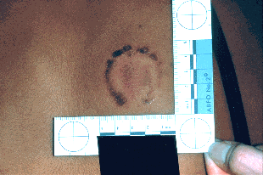
Human Bite Mark

Slide 57
Bruises – Lab evaluation
For excessive and/or concerning bruising:
CBC with platelet count
PT & aPTT
vWF panel & Factor IX level
For abusive head trauma:
CBC with platelet count
PT & aPTT
Factors VIII & IX levels
DIC panel

Slide 59
Lacerations & abrasions
rope burns on wrists, ankles, neck, or torso
(restraint marks)
marks on the palate, mouth, gums, lips, eyes, ears,
external genitalia
other body surfaces

Slide 60
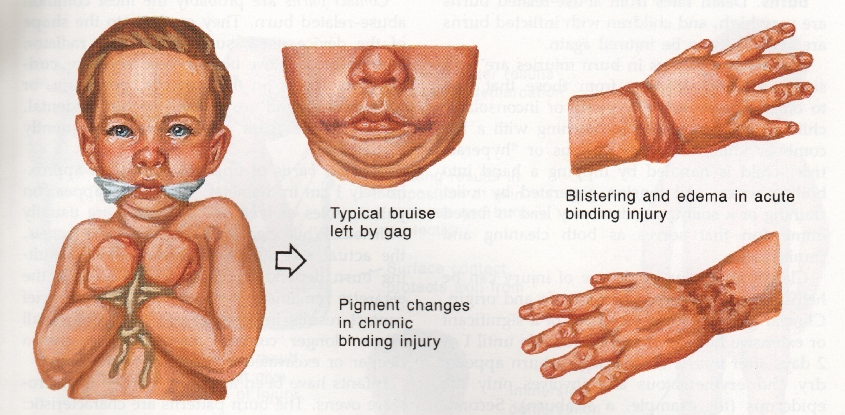
Ligature marks

Slide 61
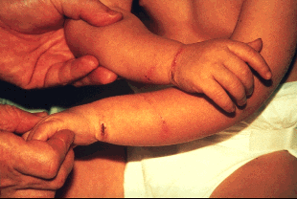
Ligature marks

Slide 62
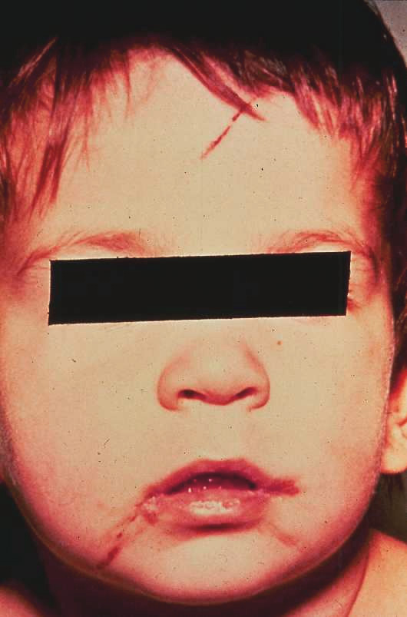
Gag marks

Slide 63
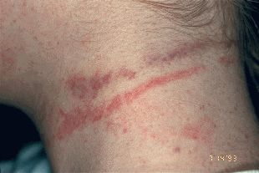
Attempted strangulation with rope during sexual assault

Slide 64
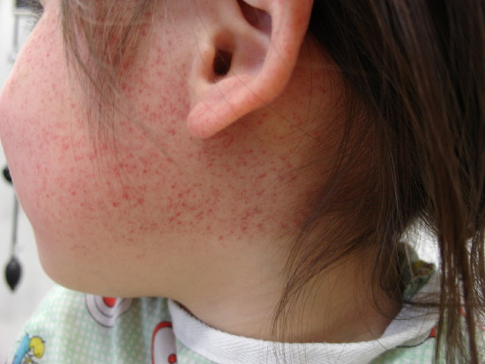
Strangulation petechiae

Slide 65
Burn injuries

Slide 66
Burns
Types of burns are:
Thermal
Electrical
Chemical
Radiation
Friction/pressure
Thermal burns are the most common with 80% of all childhood burns due to tap water burns

Slide 67
Burns – child abuse
10-20% of childhood burns are due to inflicted injury
Most abusive burns occur < 6 years of age
When there are multiple children in a home, the youngest sibling is the most likely to be the victim
Receptive & expressive language delay increases the risk of being a victim
The perpetrators are most often a parent or the mother’s boyfriend
Mortality rate from abusive burns is 10%

Slide 68
Burns – child abuse
Most abusive burns are due to immersion in tap water
Overall 14% of scald burns are due to abuse
Accidental burns are usually due to splash/spill injury by soups, beverages, and cooling liquids
Comfortable bath water is around 101⁰ F (38⁰ C)
Adults find water painful at 112-114⁰ F (43-45⁰ C)

Slide 69
Time of contact required to produce deep partial thickness burns
Temp Fahrenheit | Temp Celsius | Adults | Children
113 | 45 | 6 hours
120 | 49 | 10 minutes | 2-3 minutes
130 | 54 | 10 seconds | 2-3 seconds
140 | 60 | 3 seconds | 1 second

Slide 70
Burns
Document type, degree, size, & location
Forced immersion burns give doughnut shape burns with spared areas (buttocks or back)
Shape of object burns: iron, heating grates, cigarettes
Bilateral lower extremity burns are more frequent in child abuse
Uniformity of burn depth indicates child was restrained or not moving
Bilateral burn symmetry in absence of splash marks suggests forced immersion

Slide 71
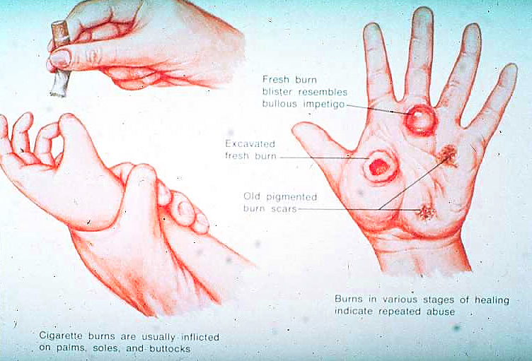
Intentional cigarette burns

Slide 72
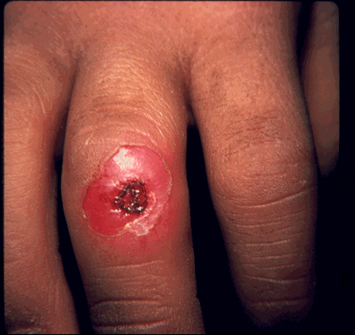
Cigarette burn on the hand
8 mm diameter ulcer

Slide 73
Cigarette Burn
Impetigo

Slide 74
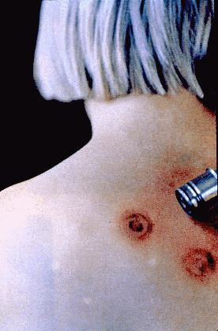
Automobile cigarette lighter burn pattern

Slide 75
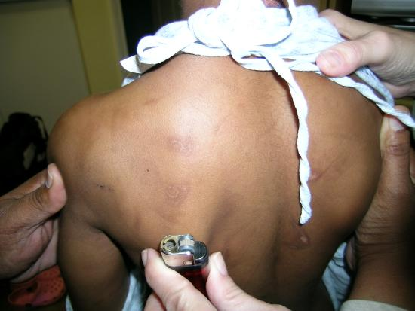
Lighter burns

Slide 76
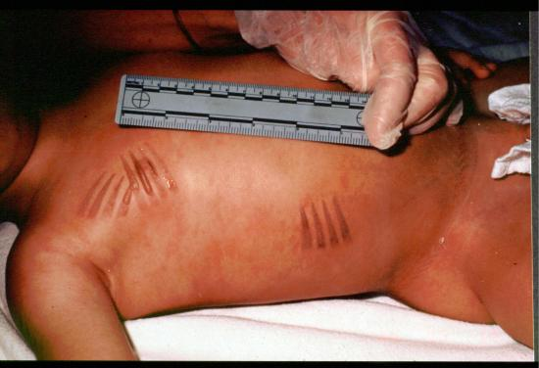
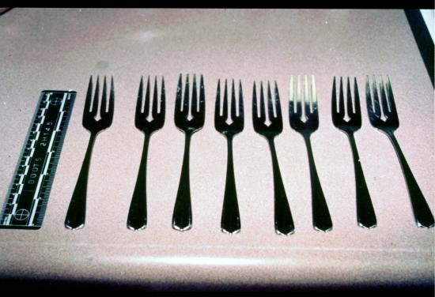
Pattern burns
From
heated forks

Slide 77
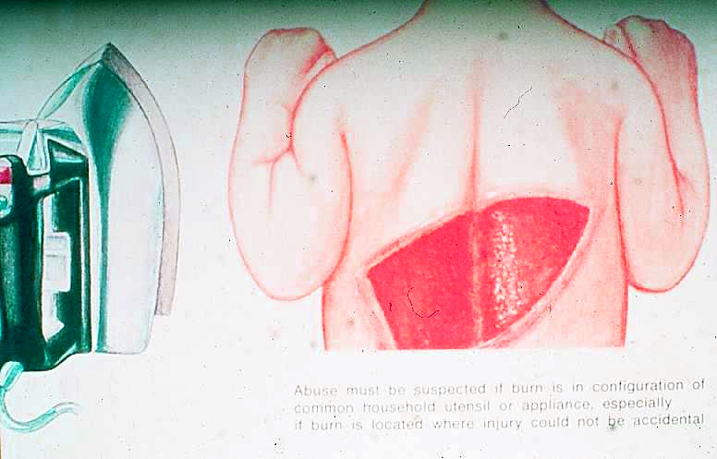
Inflicted burns from an iron

Slide 78
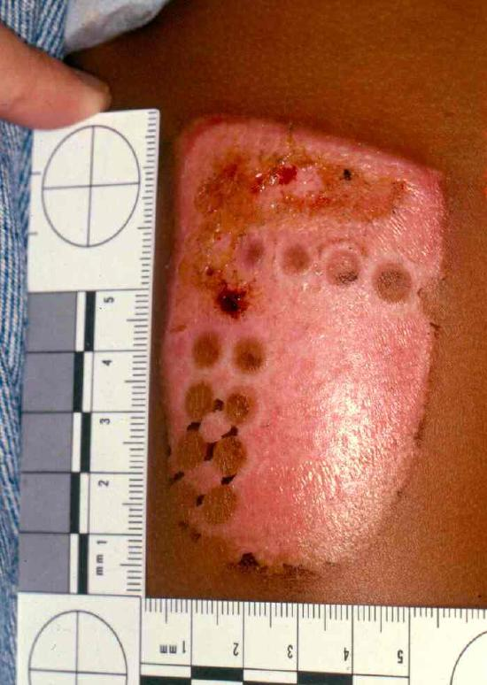
Inflicted iron burn
Note steam release hole marks

Slide 79
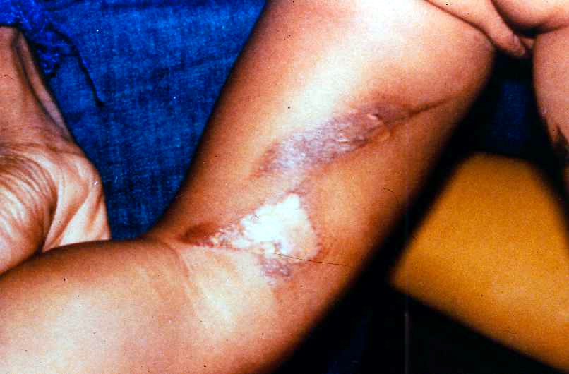
Accidental iron burn

Slide 80
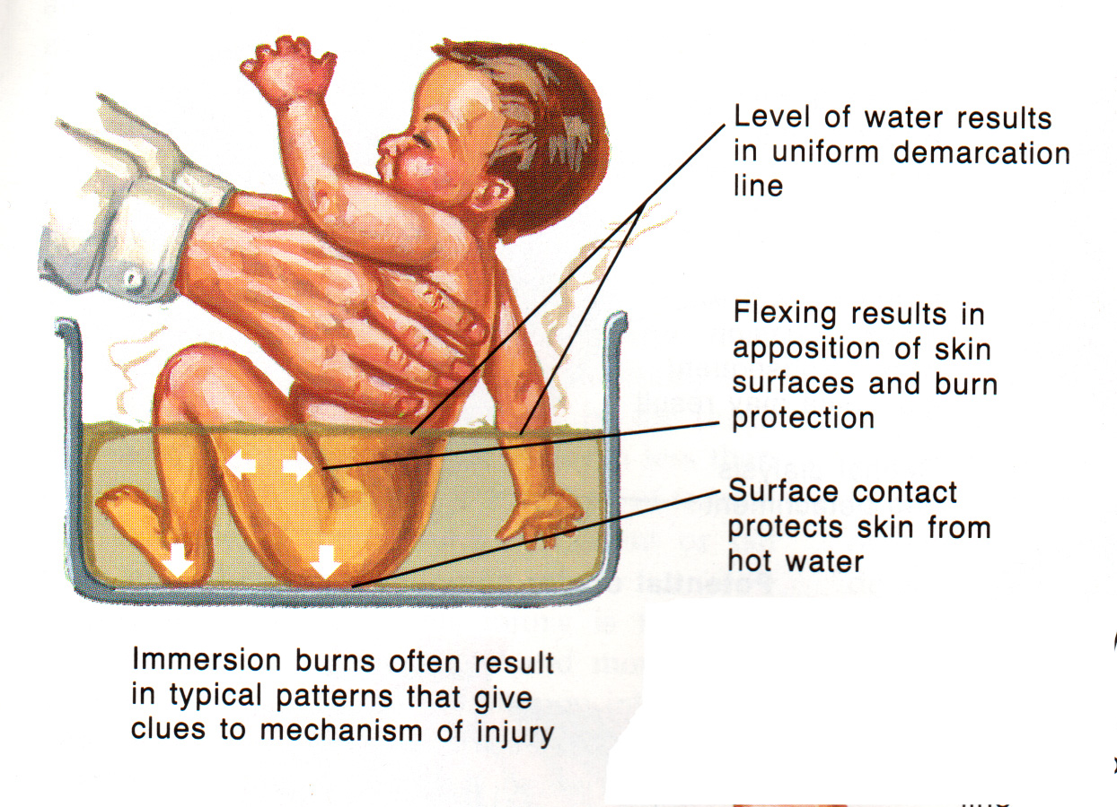
Hot water immersion burns

Slide 81
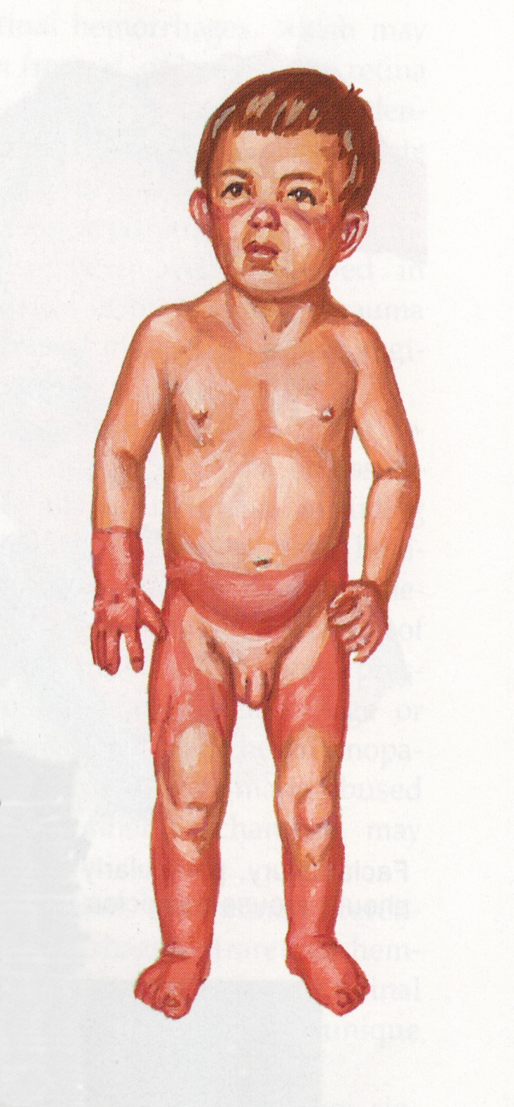
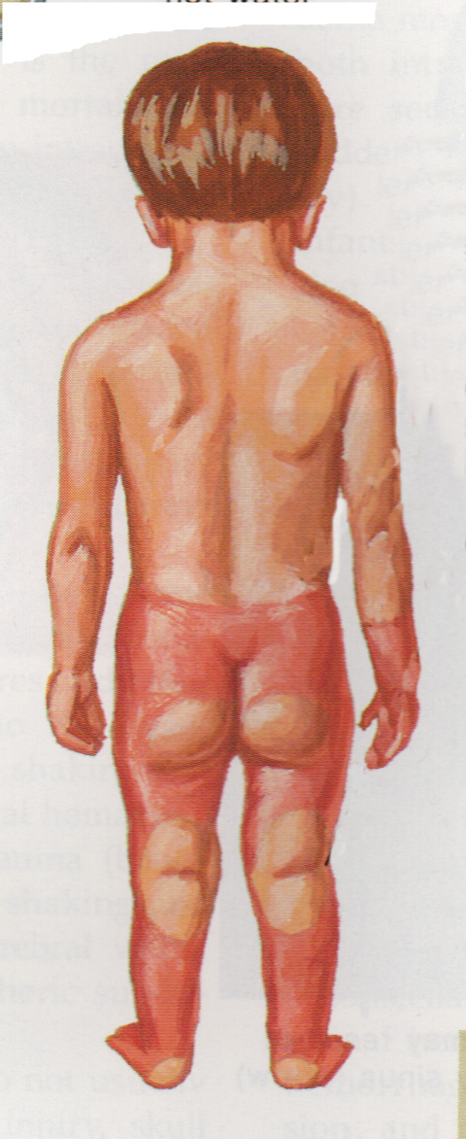
Immersion burn
“doughnut effect”
sparing of skin contacting the tub or flexural areas folded against each other

Slide 82
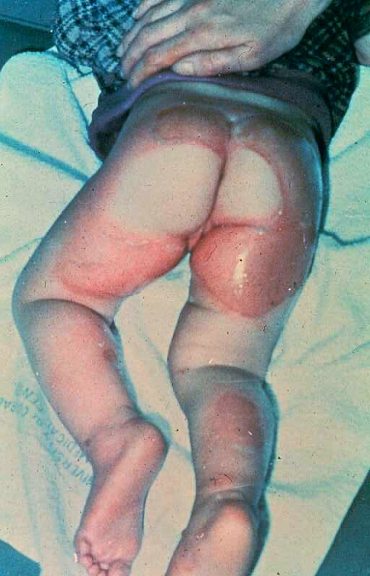
“Doughnut effect”
inflicted hot water burn pattern

Slide 83
Immersion burn: symmetrical
“glove pattern”

Slide 84
Splash burn

Slide 85
Cutaneous injuries that mimic abusive injury

Slide 86
Normal bruising pattern

Slide 87
Coin rubbing
Vietnamese folk remedy for fever management

Slide 88
Congenital dermal melanocytosis
(aka Mongolian spots, slate grey spots)
sometimes mistaken for bruises

Slide 89
Constriction marks from tight socks

Slide 90
2 children with similar injuries from same daycare
Chemical dermatitis, cleaning solution on toilet seat

Slide 91
Phytophotodermatitis

Slide 92
Paintball bruise

Slide 93
Toe blister from tight shoe

Slide 94
Impetigo mistaken for cigarette burn

Slide 95
Fractures in Child Abuse

Slide 96
Fractures in child abuse
Fractures are the 2nd most common injury in child physical abuse
(bruises are #1)
Fractures account for 8-12% of all pediatric injuries
12-20% of all childhood fractures are inflicted
80% of inflicted fractures occur < 18 mos of age
25% of all fractures < 12 mos of age are inflicted

Slide 97
Fractures in child abuse
Factors to consider to distinguish accident from abuse:
history doesn’t match the injury
age of the child
85% of accidental fractures are in children >5 years old
consider all fractures under 2 years of age
multiple fracture sites
84% of accidental fractures involve a single fracture
multiple stages of healing
location of fracture
unexplained rib fractures
skull fractures under 2 years of age

Slide 98
Complex skull fracture

Slide 99
Acromion fracture
Scapular fracture

Slide 100
Classic metaphyseal lesion (CML)

Slide 101
Rib fractures

Slide 102
Rib fractures, CT scan

Slide 103
Spiral fracture of the humerus

Slide 105
Metacarpel fractures

Slide 107
Abdominal injuries
2nd leading cause of death due to abuse
11% of all visceral injuries in children under 13
are inflicted
visceral injuries from abuse are more likely to:
occur in younger children
have poor histories
have delayed medical treatment
occur in hollow viscera more often than solid organs
mortality rates in inflicted versus accidental
visceral injuries were 53% vs. 21%

Slide 108
Order of involvement in inflicted abdominal injury
Hollow viscous: duodenum 30%, jejunum 60%,
terminal ileum 10%
Liver
Pancreas
Scrotal hematomas
Hypopharynx
Mesenteric tears
Kidneys (seldom involved)
Stomach (rarely involved)

Slide 109
Head injuries

Slide 110
CURRENT DEFINITION of ABUSIVE HEAD TRAUMA (AHT)
Head injury from inflicted trauma to the head & neck which can involve any or all of the following: scalp, face, skull, eyes, ears, mouth, brain, soft tissues, spine

Slide 111
Head injury – Abusive head trauma
Head injury is the leading cause of death due to child physical abuse
Abusive head trauma (AHT) is the leading cause of serious head injury in children <2 yrs
95% of serious head injury in <1 year
1/3 of head injury hospitalizations in <3 yr
2/3 of infant homicides are due to AHT
6 deaths each year due to AHT for each 100,000 children <1 year of age
2000 deaths/yr is likely an underestimate

Slide 112
Epidemiology of AHT
Incidence
< 1yr of age: 29.7 per 100,000 cases in children annually (range 16.1-33.8)
From 1-2 yrs of age: 3.8 per 100,000 cases
Mean age is 5.9 months
Median age age 2.2-5.9 months
Fatality rate is 22.5% (15-38%)
Gender: 60% male; 40% female

Slide 113
Epidemiology of AHT
Perpetrators
60% male
Fathers, mother’s boyfriends, stepfathers, babysitters
40% female
Mothers (15% overall)
Babysitters (11% overall)
Father’s girlfriends, stepmothers, grandmothers

Slide 114
Frenulum tears

Slide 115
Subconjunctival hemorrhage

Slide 116
Hair pulling may lead to traumatic alopecia and/or subgaleal hematomas

Slide 117
Subgaleal hematoma

Slide 118
Traumatic alopecia

Slide 119
Inflicted blows to the eyes

Slide 120
Note swelling of upper & lower lids

Slide 121
Blow to the eye producing bruising and a blowout fracture of the orbit
Subconjunctival hemorrhage

Slide 122
Components of AHT
Brain Injury
Subdural hemorrhages (or other intracranial bleeds/injury)
Retinal hemorrhages
Associated fractures
Paucity of external
physical findings

Slide 123
Associated injuries
Skull fracture or scalp swelling or bruise
Bruises, cuts, or scars on the rest of the body
1/3 of cases
Torn labial frenulum
Fractures such as CML’s &/or rib : which are highly specific for child abuse in infants
50-70% of cases
Abdominal trauma

Slide 124
Mechanism of Injury in AHT
Shaking alone – with rapid BRAIN acceleration/deceleration in a rotational manner, causing BRAIN deformation and tearing of bridging veins leading to SDH’s. Includes whiplash involving head and neck
Shaking plus impact to head

Slide 125
Long Term Outcomes of AHT
20-30% die immediately or within a year of the injury
70-80% live, many with disabilities
Ranges from apparently unimpaired (minority) to mild learning disabilities, attention problems, explosive disorders, cerebral palsy and visual impairment, feeding tubes and incontinence, and vegetative state

Slide 126
Caretaker History
Low fall (couch, bed, chair)
Fell and struck head on floor/furniture or hard object fell on child
Fell down stairs
Unexpectedly found unresponsive
Choked while eating and was then shaken or struck on chest/back
Suddenly turned blue or stopped breathing and then shaken

Slide 127
Summary Accidents vs Abuse
Differentiation between the two is challenging.
Infants rarely sustain intracranial injury after falls at home.
Intracranial injury (symptomatic) with retinal hemorrhages is usually child abuse.
Minor falls can cause contusions / simple skull fractures / epidural hemorrhages
Notes:
Shapiro MD
Warrington 2001 – 11,700 infants <6 months old. 2500 infants with 3300 falls. Most (>90%) had bruises on head. 1700 infants fell from bed/couch – 1 had fx (clavicle). None had intracranial bleed.

Slide 128
Accidents vs. Abuse
Lesion | Accident (67) | Abuse (15)
Scalp swelling | 34 (51%) | 1 (7%)
SDH | 18 (27%) | 12 (80%)
RH (totals) | 7 (10%) | 9 (60%)
RH (bilateral) | 1 (1%) | 6 (40%)
RH (unilateral) | 6 (9%) | 3 (20%)
Seizures | 4 (6%) | 8 (53%)
Abn Mental | 7 (10%) | 8 (53%)
Bechtel K, Stoessel K, Leventhal J et al Pediatrics 2004;114:165-8
Notes:
Prospective over 27 months, hospitalized children <age 2 years. HI, CT, Optho. Eval by nsurg and sw. Hx and pE classified by CA expert into acc vs abusive categories. Initial 87 – 5 excluded bc no eye exams.
Accidental (67 = 81%) – 65/67 witnessed falls (47 < 4ft, 9 5-20ft, 2 MV, 9 unknown)

Slide 129
Making the Diagnosis
HCP must think of AHT as a possibility
Presentation of child is usually the most important factor
Combination of clinical factors
Intracranial hemorrhage (SDH, SAH, ICH)
Retinal hemorrhages *
Associated skeletal findings
No history of accidental trauma to explain the injuries
No single finding or factor is diagnostic of AHT

Slide 130
Concerning injuries

Slide 131
Concerning injuries in children < 12 months
Candidate Injury | % w Abuse Diagnosis
Bruise(s) < 6 months old | 8.3%
Burn(s) < 6 months old | 3.5%
Oropharyngeal injury < 6 months old | 17.0%
Femur/humerus fracture | 18.9%
Radius/ulna/tibula/fibula fracture | 19.2%
Isolated skull fracture | 4.3%
Intracranial hemorrhage | 26.3%
Lindberg DM et al. Peds 2015;136:831-838.

Slide 132
Concerning injuries in children < 24 months
Candidate Injury | % w Abuse Diagnosis
Rib fractures | 56.1%
Abdominal trauma | 24.5%
Genital trauma | 12.3%
Subconjunctival hemorrhage | 8.6%
Lindberg DM et al. Peds 2015;136:831-838.

Slide 133
Skeletal Survey Recommendations
Do skeletal survey on all suspected victims of physical abuse younger than 2 years of age
Do skeletal survey selectively on child from 2-5 yrs of age
Consider on suspected inflicted burn injury patients <5 yrs
Not recommended at 5 yrs or older
Do repeat skeletal survey 10-14 days after the initial survey:
when abnormal or equivocal findings are present on the initial study & when abuse is suspected on clinical grounds
CAT and/or MRI scan of the head if <2 yrs and other injuries
Diagnostic imaging of child abuse. Pediatrics 2009;123:1430-1435.

Slide 134
Skeletal Survey Recommendations
Appendicular skeleton | #Xrays
Humeri (AP) | 2
Forearms (AP) | 2
Hands (PA) | 2
Femurs (AP) | 2
Lower legs (AP) | 2
Feet (PA or AP) | 2
Axial skeleton
Thorax (AP, lateral, right & left obliques, to include ribs, thoracic & upper lumbar spine | 4
Pelvis (AP), to include the mid lumbar spine | 1
Lumbosacral spine (lateral) | 1
Cervical spine (lateral) | 1
Skull (frontal & lateral) | 2
Total # of Xrays | 21
ACR-SPR Practice Guideline for skeletal surveys in children, Revised 2014 (Resolution 39).
Available at http://www.acr.org/~/media/ACR/Documents/PGTS/guidelines/Skeletal_Surveys.pdf

Slide 135
Skeletal Survey Protocol - COA
Description | # Xrays
Skull – AP & lateral | 2
Cervical spine – AP & lateral | 2
Thoracic spine – AP & lateral | 2
Lumbar spine – AP & lateral | 2
Chest – AP | 1
Chest – obliques | 2
Arm (humerus) – bilateral AP | 2
Forearm – bilateral AP | 2
Hands – bilateral oblique | 2
Pelvis – AP | 1
Thigh (femur) – bilateral AP | 2
Leg (tib/fib) – bilateral AP | 2
Feet – bilateral DP | 2
Total | 24

Slide 136
Reporting child abuse

Slide 137
Mandated Reporters
In the US, all 50 states & territories have mandated reporting laws since late 1960’s.
All healthcare providers are mandated reporters throughout the US.
As a mandated reporter, you are required to report suspected child maltreatment:
“when the child is known or suspected to be a victim of child abuse or neglect” (Alabama Code Title 26-14-3)

Slide 138
Reporting child abuse in Alabama
report to a “duly constituted authority”:
DHR
Chief of police
Sheriff
penalty for failure to report
For mandated reporter: misdemeanor, not more than 6 months imprisonment or a fine of not more than $500
For child: 50% will sustain continued abuse, 5% mortality in physical abuse

Slide 139
How to make the report
“shall be required to report orally, either by telephone or direct communication immediately”
“followed by a written report”
“to a duly constituted authority.”

Slide 140
Removing a child for protection
“A police officer, a law enforcement official or a designated employee of the State or County Department of Human Resources may take a child into protective custody, or any person in charge of a hospital or similar institution or any physician treating a child may keep that child in his custody, without the consent of the parent or guardian, whether or not additional medical treatment is required, if the circumstances or conditions of the child are such that continuing in its place or residence or in the care and custody of the parent, guardian, custodian, or other person responsible for the child’s care presents an imminent danger to that child’s life or health….”
Alabama Code Title 26-14-6

Slide 141
Temporary Protective Custody
In Alabama, the following are authorized to take custody of a child:
Law enforcement officer
DHR designated employee
Person in charge of a hospital
Physician treating a child

Slide 142
Back to the case studies

Slide 143
History
Child tripped while running and fell against a cabinet

Slide 144
History
7 mo old fell from the couch onto the floor

Slide 145
History: toddler bumped into door while walking

Slide 146
Idiopathic Thrombocytopenic Purpura
LEFT: The school-aged boy in this image reported in school that he would get hit by his brother. He had abundant bruising, including a very large bruise on the lower back. He also had scattered clusters of petechiae in areas of friction. Complete blood and platelet count revealed thrombocytopenia, and he was ultimately diagnosed with idiopathic thrombocytopenic purpura.
RIGHT: Clues to a coagulopathy include petechiae at clothing line pressure sites; bruising at sites of object pressure, such as in the pattern and location of infant seat fasteners; and excessive diffuse bleeding if the child has a severe bleeding disorder. The presence of a bleeding disorder does not rule out inflicted injuries.

Slide 147
Hx: 6 yo girl fell off of the porch onto a walkway, landing on her buttocks wearing blue jeans & cotton underwear

Slide 148
Conclusion Child abuse
Child abuse is still far too common
Most children are abused or neglected by their parents or other related caretakers
Abuse often leads to serious injuries, long-term physical & psychological trauma, & even death
Skilled medical evaluation can assist in determining accidental vs. abusive injuries
It would be better to prevent the injuries, than to have to deal with determining causation

Slide 149
Conclusion Child abuse
Healthcare providers (HCPs) are mandated reporters everywhere in the United States.
If the history does not fit the injury, consider child abuse
Corporal punishment is reportable if it leads to a physical or emotional injury.
If you conclude that an injury was inflicted, the diagnosis is CHILD ABUSE
Report should be made verbally directly (usually by phone) followed by a written report.
When you are not sure whether to report or not, consult someone, don’t just walk away.

Slide 150
Questions?

