Slide 1
Evaluation Activities and Scope of Our MHEF Work State Alliance of Michigan YMCAs Michigan Health Endowment Fund Project
Karah Mantinan
Altarum Institute
August 25, 2015

Slide 2
Objectives
Introduce Altarum Institute and provide a brief overview of our qualifications and history with this work.
Discuss evaluation approach and data collection activities.
Discuss the role of evaluation in the MHEF grant project.
Highlight deliverables for MHEF grant alongside plans gathered from Year One Work Plan Survey.
Discuss next steps and opportunities to strengthen our collective work.

Slide 3
Altarum Institute – Overview
Mission: Altarum serves the public good by solving complex systems problems to improve human health, integrating research, technology, analysis, and consulting skills.
Altarum Institute
Non-profit health research and consulting organization
60 year history, 400 staff all focused on health and health care
Headquartered in Ann Arbor, MI with multiple sites in Washington,DC
Clients include local, state, and national level non-profit agencies, government agencies, and foundations.
Technical Service Offerings
Health Research, Policy, and Analysis
Strategic Communications
Health Information and Technology Strategies
Clinical Research Support, Registry and Pharmacovigilance

Slide 4
Qualifications
Strong understanding of YMCA organizational culture and structure
Experienced in out-of-school time settings
Experienced in chronic disease initiatives and implementation of evidence-based programs
Experienced in providing actionable recommendations designed to improve programs and position them for future funding

Slide 5
Select Project Experience
Healthy Eating and Physical Activity (HEPA)
Y-USA Commitment to Partnership for a Healthier America
Y-USA HEPA training for afterschool providers
Y-USA HEPA Document Review 2013, 2014 pre and post, 2015
Y-USA Year Round Feeding Program (Walmart grants) evaluation and in-depth partnership study
Michigan Dept of Health and Human Services Physical Activity and Healthy Eating Before/After and Summer (BAS) Program evaluation
Chronic Disease
Y-USA Community Transformation Grant (Y Diabetes Prevention Program)
Y-USA EnhanceFitness
Organizational Assessments
Y-USA Evaluation capacity assessment
Y-USA Assessment of ability to implement tertiary prevention childhood obesity programs (MEND)

Slide 6
Brief History of HEPA Work
2011-Y-USA makes commitment to Partnership to a Healthier America to implement HEPA standards in 85% of early childhood and afterschool programs. Y-USA creates training program, grant programs, TA resources, and other support materials for Ys over the next 4 years to improve implementation.
2012-MDHHS starts BAS pilot program in Michigan to increase access to afterschool programming and physical activity within it.
2014-MDHHS begins funding State Alliance of Michigan Ys for BAS program, funds distributed to Ys only.
2014-State Alliance of MI Ys is successful in proposal to MHEF to implement HEPA standards statewide in summer and school year programming.
2015-MHEF project begins in May.

Slide 7
Evaluation Approach
We view evaluation as a partnership. We cannot succeed without you!
We appreciate your time and effort and value your feedback.
We want to collect data that is usable to our stakeholders, including you! If you are not finding reports useful, we welcome your suggestions.
We know sometimes you don’t understand why we are asking you certain things or taking you away from program time to complete evaluation activities. Know that all of these activities are important for the success of this project. If you don’t understand why something is being collected and you want to know, we are happy to share with you.
Remember that we are all on the same team. We aren’t out to “get you” ☺, if you are facing challenges and things aren’t going as planned, let us know. These can be opportunities!
We are all working together for the success of the MHEF project and we all play important roles in achieving success!

Slide 8
Evaluation Approach
Source: CDC

Slide 9
How will Evaluation Benefit the MHEF Project?
Demonstrate accountability
Understand and improve project implementation
Identify successes, barriers and lessons learned
Demonstrate and improve effectiveness
Justify the need for additional funding and resources
What needs remain?
What activities did not go as planned?
What audiences could not be reached?
What is needed to be more effective?
How can capacity/implementation framework built be used to scale project and achieve broader impact?
How can the project help the funder achieve their goals?

Slide 10
Data Collection Methods
Method | Description
Surveys | Work Plan Surveys, Progress Report Surveys-Collect information on operational characteristics and plans, participant reach, curriculum usage, HEPA standard implementation.
Interviews | One-on-one or group interviews in person or via conference call. Capture in-depth information and context about program activities successes and challenges. Gather quotes, lessons learned, and stories.
Site Visits | On-site visits to conduct interviews with program coordinators and staff, gather observational data regarding program operations and HEPA implementation. Gather quotes, lessons learned, and stories.
Document Reviews | Documents such as activity logs, parent and staff handbooks, meal and snack menus, shared-use agreements or memoranda of understanding, parent engagement materials, training agendas and rosters, etc. that are used to document and describe program implementation characteristics.
Self-assessment app | HEPA Mobile self-assessment checklists for snacks, meals, and physical activity designed to document implementation of HEPA characteristics and activities, and provide feedback and TA to user on implementation status and areas for improvement.

Slide 11
Work Plan Survey
Goals
To collect data in a systematic manner so that we can have the same types of information about your activities despite variability in programming.
To confirm the number and types of sites that you plan to conduct programming/activities at, since there might have been changes after you wrote your initial proposal and then were allocated funding.
To obtain baseline data on your sites so that we can measure your progress and ensure accountability.
Methods
Online survey, distributed in May 2015.
Data was exported to Excel, analyzed, and reported by Y and cumulative for the entire project.

Slide 12
Healthy Out of School Time (HOST)
What was promised to MHEF
Statewide scaling of a HOST pilot initiative to improve physical activity and healthy eating in before/afterschool and summer programs
Key Program Components | Key Evaluation Questions
Develop low-income school and community-based partnerships. | What school-community partnerships were formed as a result of the HOST Initiative? How did these partnerships help the Y to reach vulnerable populations?
Implementation of evidence-based curricula that supports best practice recommendations in physical activity and healthy eating. | How many programs implemented evidence-based curricula? How many students participated in programs that utilized evidence-based curricula? What were the types of evidence-based curricula used by program sites?
Tailor the HOST Initiative program model to meet the unique needs of the community through add-on programs, such as summer learning loss, food access, school readiness, or other community priorities. | How did communities request to tailor the program delivery model to meet the needs of their community?
Implement the Healthy Eating and Physical Activity (HEPA) standards in all HOST program sites. | What progress did communities make in implementing the HEPA standards?

Slide 13
Work Plan Survey Results: Healthy Out of School Time—Summer
26 Y Associations conducting summer programming at 84 sites
63 day camps
6 residential camps
6 both day/residential camp
9 other
Projected reach of 18,259 youth
39 sites offering 60 min physical activity/day
Sites projected to serve 178 meals and snacks per week
Forty percent of program sites (n=34) are meeting 75% of the HEPA standards.

Slide 14
Work Plan Survey Results: Healthy Out of School Time—School Year
22 YMCA associations plan to conduct HOST Summer Programming at 110 program sites:
72 are afterschool programs
36 are before and afterschool programs, and
2 are another type of out-of-school-time program.
Projected reach 7,320 youth
74 sites providing 60 min physical activity/day
Sites projected to serve 133 meals and snacks per week.
63% of sites (n=69) are meeting 75% of the HEPA standards

Slide 15
HEPA Standards Programs Are Evaluated On
Category | Standard
Parent Engagement | 1. Engage parents/care givers using informational materials and/or activities focused on healthy eating and/or physical activity a minimum of once a quarter while in session (three times per year for a school year program).
Physical Activity | 2. Provide opportunities for moderate and vigorous physical activity for at least 60 minutes per day while children are in care for a full-day program and 30 minutes for half-day day program (morning and afternoon programs are each considered half-day programs). Include a mixture of moderate and vigorous activity (that increase heart rate and make you breathe hard), as well as bone and muscle strengthening activities. 3. Active play will take place outdoors whenever possible.
Screen Time | 4. No access to TV or movies. Limit digital device time to one hour or less per day. Digital device use is limited to homework or programs that actively engage children in physical activity.
Food | 5. Serve a fruit or vegetable at every meal and snack. 6. Serve all meal and snacks family style. 7. Do not serve fried foods and do not allow fried foods to be brought into the program.
Beverages | 8. Offer water at the table during every meal and snack, and have water accessible at all program times. 9. Do not serve sugar-sweetened beverages (SSBs) and do not allow SSBs to be brought into the program. 10. Serve healthier beverages, including water, non-flavored low fat (1%) or nonfat milk, or 100% fruit juice (no more than one, 6-8 ounce serving per day). It is not required to serve milk or juice.

Slide 16
What About Other HEPA Standards?
Additional HEPA standards have been added to clarify existing standards and make the standards more comprehensive; however, they are not part of the commitment Y-USA made and thus, are currently not evaluated.
Focus your efforts first on the 10 primary HEPA standards and reaching 100% compliance consistently.
When you have built capacity, move onto working on standards that have been clarified, including increasing whole grains, reducing added sugars, and eliminating trans fats.

Slide 17
Findings from Previous HEPA Work
First sites successfully implementing 100% of HEPA standards in 2014 and number of sites fully compliant continues to rise
Successes Commonly met standards | Challenges Commonly missed standards
Offering daily outdoor play | Serving fruit or vegetable at every meal and snack
Not serving sugar-sweetened beverages | Not serving fried foods
Offering 30 min (half day) or 60 min (full day) of physical activity daily | Prohibiting fried foods and sugar-sweetened beverages

Slide 18
Michigan Swims
What was promised to MHEF
Utilize the Y’s Safety Around Water curriculum to increase participant knowledge of water safety and emergency response and to improve participants’ swimming skills.
Key Program Components | Key Evaluation Questions
Statewide delivery of Michigan Swims program using the Safety Around Water curriculum. | How many communities implemented the Michigan Swims program? What were the demographic characteristics of communities that implemented the Michigan Swims program? How did grantees target low-income populations?
Formation of partnerships with community schools, municipal parks, and apartment complexes targeted at shared use. | How many shared use partnerships were formed between Ys and community organizations? How did Ys go about forming these partnerships? How did Y/community partnerships meet the needs of the local community?

Slide 19
Work Plan Survey Results: Michigan Swims
24 YMCA associations plan to conduct Michigan Swims Programming at 92 program sites:
29 YMCA sites
27 community sites
12 apartment complexes
7 community pools
8 lakes
26 school sites
10 camp sites
Projected enrollment for all sites is 17,711 children
All sites are using the Safety Around Water curriculum

Slide 20
Chronic Disease Prevention
Leverage Y-USA national partnerships and networks and expand the reach of evidence-based chronic disease prevention programs to 20 YMCAs in Michigan.
Key Program Components | Key Evaluation Questions
Training of appropriate staff to deliver program components | What programs are Ys implementing? How many Y staff were trained to deliver the program? What steps were taken to ensure that Ys trained appropriate staff?
Development of improved referral systems to enable recruitment of participants into evidence-based programs. | How have referral systems improved? How will these referral systems enable recruitments of participants into evidence-based programs?
Readiness to implement or expand program | Have Ys developed plans for implementing or expanding their evidence-based programs? What resource needs have Ys identified for implementing or expanding their evidence-based programs? What sources of support have Ys identified for implementing and sustaining evidence-based programs?

Slide 21
Work Plan Survey Results: Healthy Living Capacity Building
 | # Associations | # Adults Projected to Enroll | # Staff Projected to Train
EnhanceFitness | 13 | 569 | 42
Moving For Better Balance | 8 | 94 | 17
Y Diabetes Prevention Program | 11 | 151 | 18
 | 15 unique (not mutually exclusive) | 814 | 77

Slide 22
What’s Happening Next in Evaluation?
Progress Reporting
Look at areas to strengthen programming and evaluation
Key Informant Interviews/site visits
1 Year—Interim Report

Slide 23
Areas for Strengthening Programming and Evaluation
Strengthening curriculum-CATCH training
Provides more youth with evidence-based instruction
Evaluation activities to asses implementation of curriculum
Synergies with MDHHS BAS Program
Ys working with both MDHHS and State Alliance will have opportunities to build capacity and success using both funding streams-look for synergies in activities to:
Reach more youth
Provide better quality programming to youth
HEPA Mobile
Increase awareness and implementation of HEPA standards

Slide 24
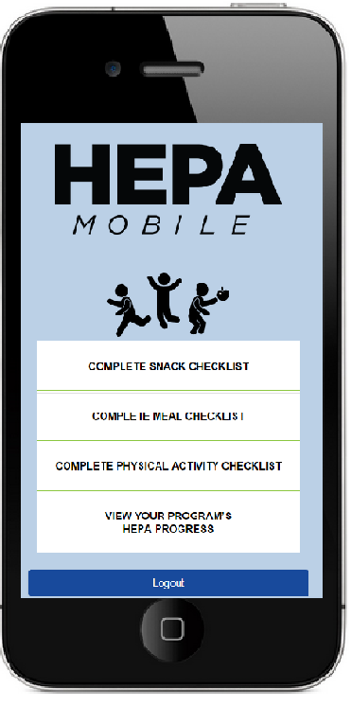
HEPA Mobile
Developed by researchers at University of South Carolina to use with afterschool programs (note: not Y specific)
Designed as a diagnostic tool to identify areas of need and training on HEPA standards
3 Checklists completed at site-level:
Snack
Meal
Physical Activity
View Your Progress tool to see how your site is doing
Access TA resources

Slide 25
Sample Data from HEPA Mobile (South Carolina)

Slide 26
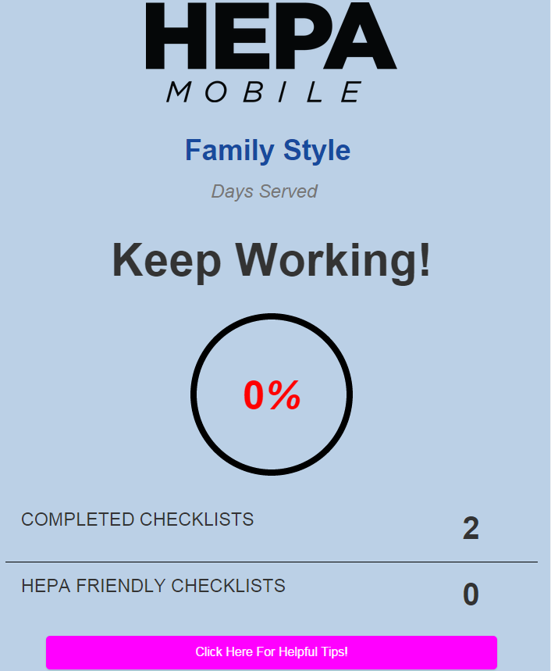
HEPA Mobile Plans for MHEF Project
MI will be piloting use of HEPA Mobile app Sept-Dec 2015
We will encourage each site to complete each checklist 1x/week or more
Goals for HEPA Mobile use:
Increase frequency of HEPA standards self-assessment
Connect you to TA materials
Gather feedback on feasibility and utility of app
Training on app scheduled for September 24, sites can begin entering data after training

Slide 27
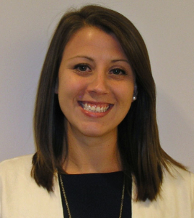
We Look Forward to Working with You!
Center for Healthy Child and Youth Development Evaluation Team
Karah Mantinan
Chris Botsko
Kara Wise
Shannon Raymond
Sarah Lifsey

Slide 28
Karah Mantinan, MPH, RD
Deputy Director,
Center for Healthy Child and Youth Development
Altarum Institute
2000 M St, NW Suite 400
Washington, DC 20036
(202) 776-5175
Karah.Mantinan@altarum.org

