Slide 1
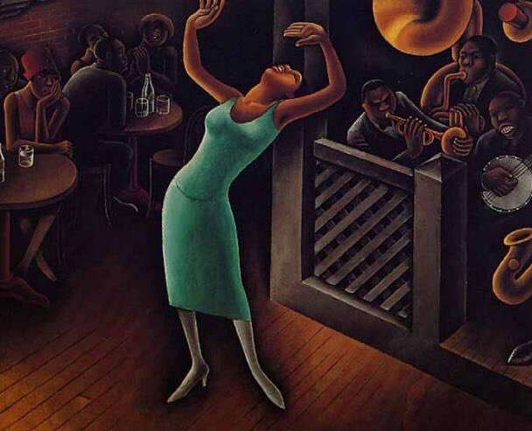
Miguel Covarrubias 1925

Slide 3
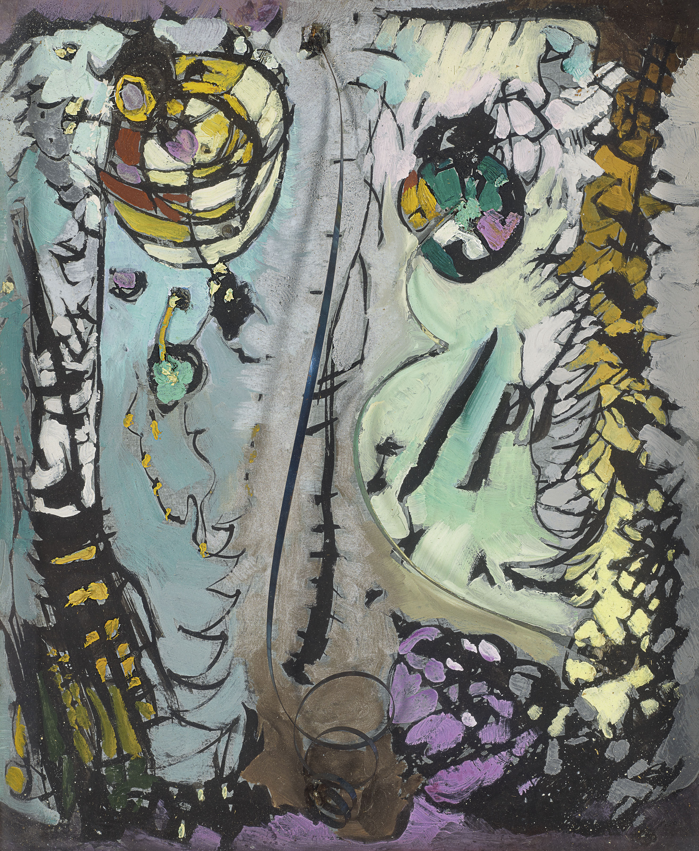
Arthur Dove 1927

Slide 5
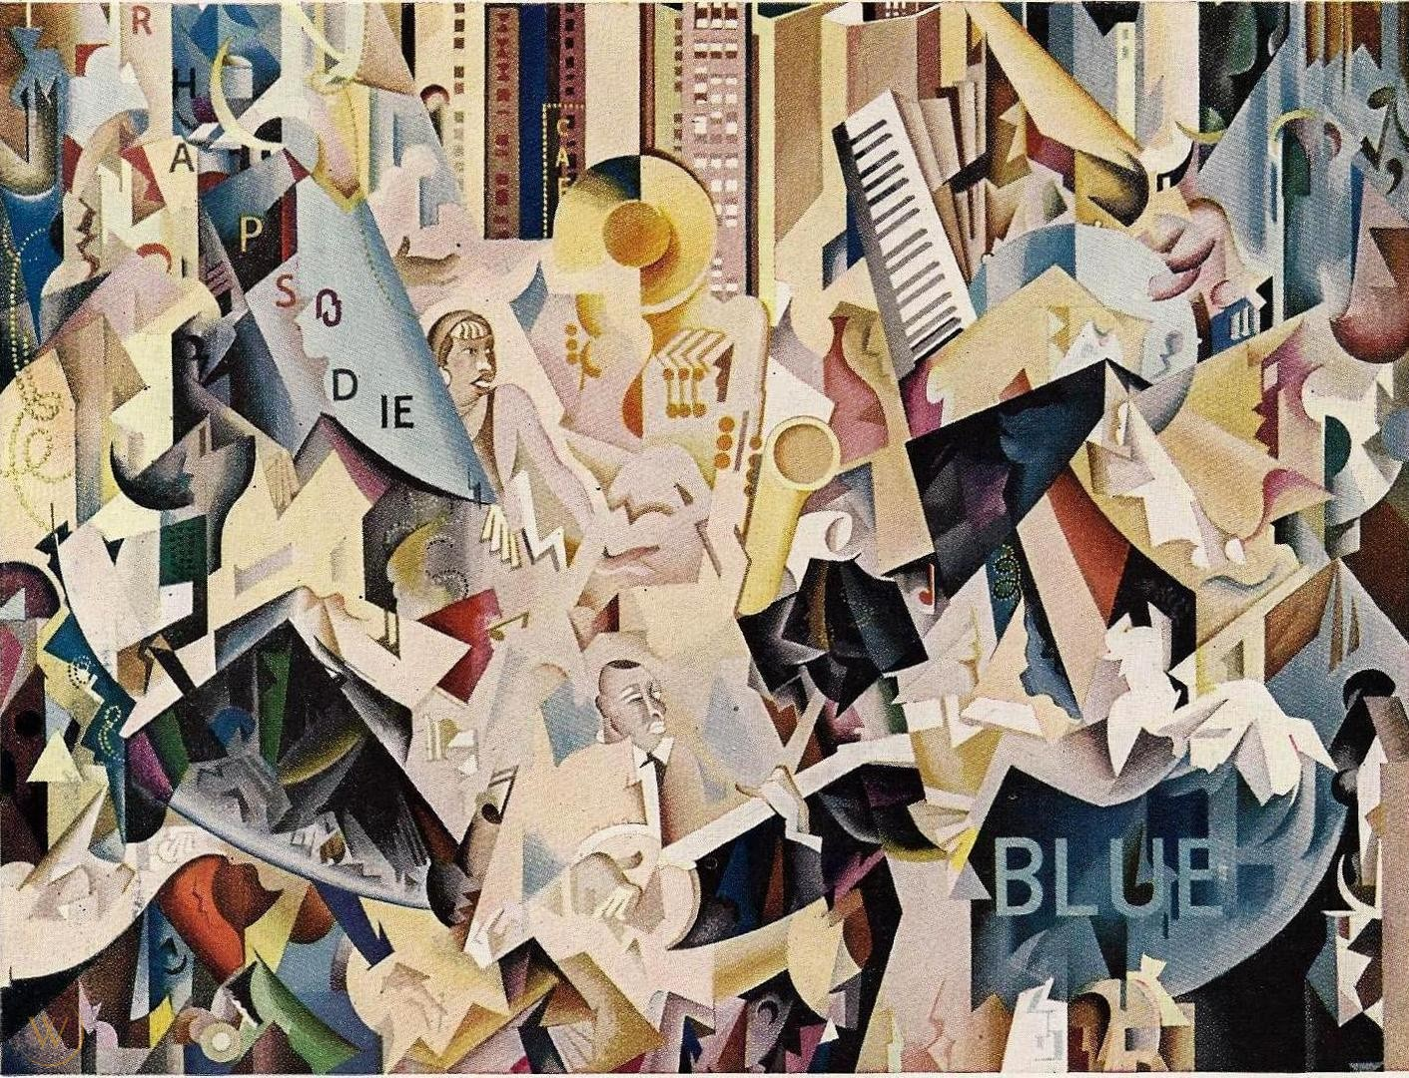
Earl Horter 1928

Slide 7
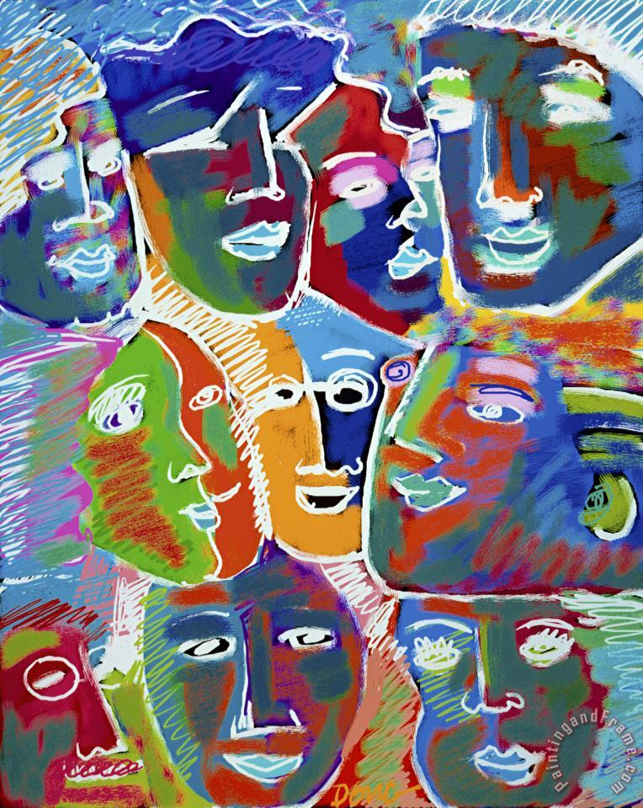
Diana Ong
Blue Rhapsody

Slide 9
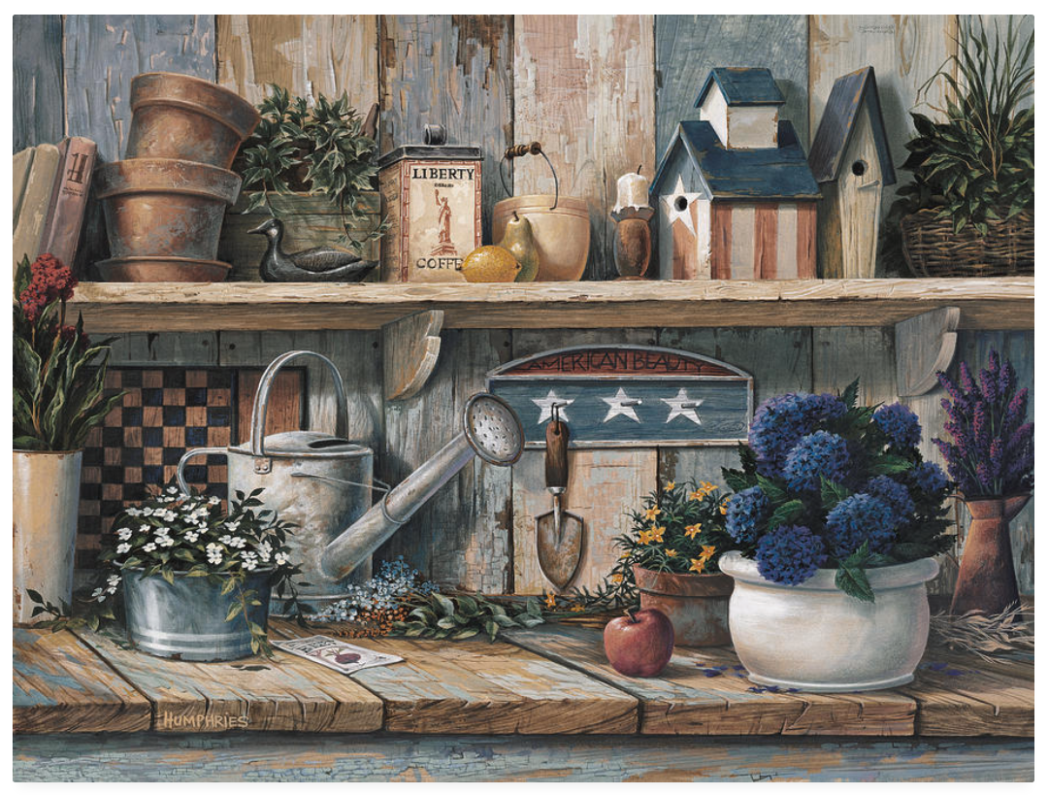
Michael Humphries 2001

Slide 10
Mr. Humphries responded to an email from music teacher Judy Meyer Hays in July 2011 answering the following questions:
t
What were you thinking about when you titled your work “Rhapsody in Blue?”
Did you start with the title or did it come to you during or after you’d created the piece?
Did Gershwin cross your mind at all in the process? Did your “Rhapsody in Rose” come before or after? Is there anything else you’d like to share with my students?
Here are his answers:
Michael Humphries is a professional artist who currently lives in California. His newest project is a book titled Visual Storytelling.
“I did the painting as a patriotic response to the 911 tragedy. I had already painted "Rhapsody in Rose," and it was a big success with my publisher so I wanted to do a follow-up piece. My mother was a professional musician (pianist), and Rhapsody in Blue was her favorite song and Gershwin her favorite composer.”
“I had already art directed "The Tin Soldier" segment of Fantasia 2000, and my friend Eric Goldberg and his wife Susan (art director) were creating the "Rhapsody in Blue" segment at the same time I was doing the "The Tin Soldier." I guess it all just came together as a concept because of my familiarity with the music, and because of my mom's love of the song. The real trigger unfortunately, was the 911 incident. I hope this gives you a better insight to my creative process for the painting!”

