Slide 1
Craig vincent mitchell, phd associate professor of christian ethics southwestern baptist theological seminary
PHILOSOPHY OF LAW

Slide 2
Overview
Legal Philosophies
Legal Ethics
Business Law

Slide 3
Philosophies of Law
Philosophy | Metaphysics | Ethics
Natural Law | Realism | Teleological- Virtue Ethics
Legal Positivism | Nominalism | Deontology-Utilitarianism
Legal Realism | Nominalism | Deontology-
Critical Legal Theory | Nominalism | Deontology-

Slide 4
Legal Theories
Legal
Theories
Natural
Law
Legal
Realism
Law and Economics
Legal
Positivism

Slide 5
PREMODERN VIEW OF
MORAL PHILOSOPHY
METAPHYSICS
ACTION
THEORY
MORAL PHILOSOPHY

Slide 6
PREMODERN VIEW OF
MORAL PHILOSOPHY
MORAL PHILOSOPHY
POLITICS
ECONOMICS
LAW

Slide 7
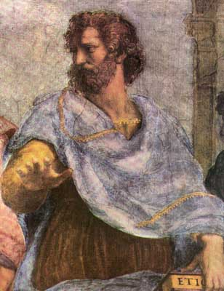
Natural Law
Aristotle argued that there is a natural law that affects all men everywhere. (Nicomachean Ethics)
We know this natural law through reason.
To be virtuous is to act in accordance with this law. To be vicious is to act contrary to it.

Slide 8
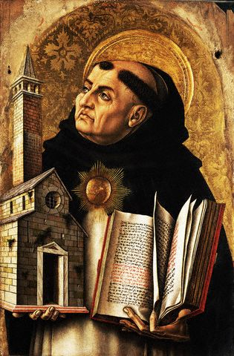
Natural Law
St Thomas Aquinas combined the theology of Augustine with the philosophy of Aristotle
He argued that the natural law is in accordance with the 10 commandments
He also argued that civil law should be based on natural law

Slide 9
Thomas Aquinas
Type of Law | Explanation
Eternal Law | The laws of God. This includes both the revealed and unrevealed laws. This includes the laws of science
Divine Law | The old law and the new law. The Old and New Testaments
Natural Law | The aspect of general revelation made available to all men by reason. It is consistent with the created order and conscience is tied to it.
Positive Law | The laws of men. These laws are good only to the extent that they are consistant with the natural law

Slide 10
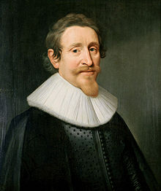
Hugo Grotius
Hugo Grotius made the connection between the natural law and international law

Slide 11
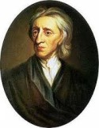
John Locke
John Locke based natural rights upon the natural law
All men have these rights (in opposition to the divine right of kings)

Slide 12
John Locke
Natural rights are based upon natural law
Natural rights include the right to:
  Life
  Liberty
  Property
It is wrong for the government to interfere with these rights

Slide 13
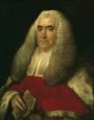
Natural Law
William Blackstone argued for natural law in his Commentaries on the Law of England volume 1, section 2.
He argued that law and morality rests upon a God who set everything in order.

Slide 14
Legal Positivism
Legal Positivism
Empiricism
Metaphysical Nominalism
Positivism

Slide 15
Positivism
Morality
Law

Slide 16
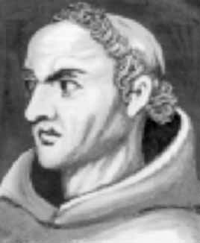
Positivism: William Ockham
William of Ockham was a Franciscan scholar who was a radical empiricist
Ockham led the modern movement towards metaphysical nominalism
He also separated philosophy from theology
He still held to natural law

Slide 17
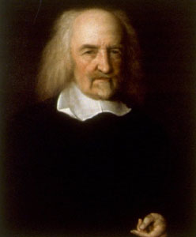
Positivism: Thomas Hobbes
Thomas Hobbes continued the separation of philosophy from theology
He also started social contract theory
His reduced view of natural law resulted in man’s “state of nature”

Slide 18
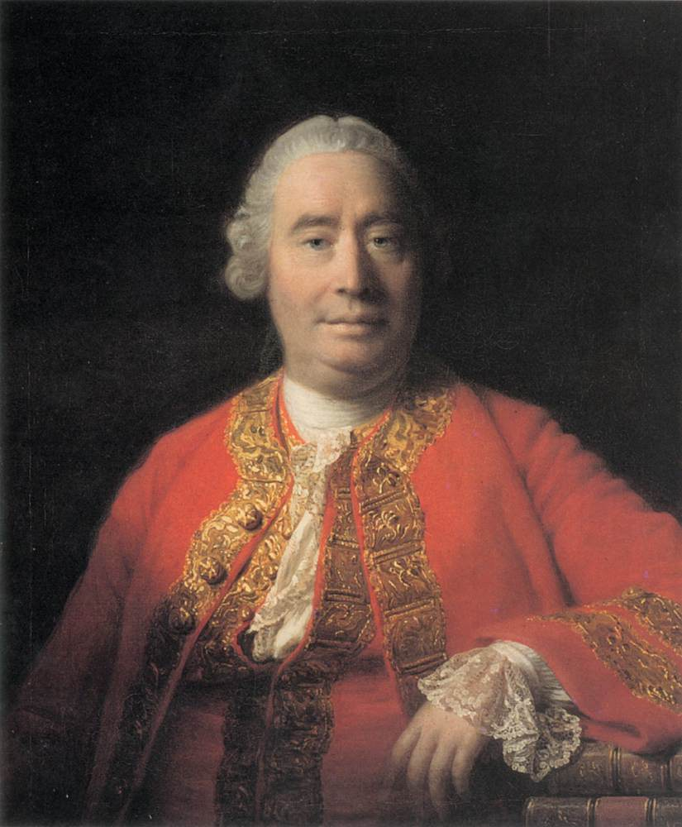
POSITIVISM: David Hume
David Hume argued against the natural law with his fact/ value dichotomy
This dichotomy teaches that morality is based on the passions while facts are judged by reason
This resulted in positivism

Slide 19
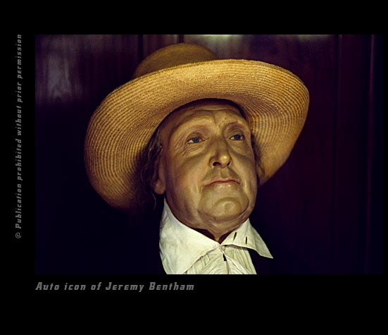
Positivism: Jeremy Bentham
Jeremy Bentham attacked Blackstone’s Commentaries on the Laws of England.
He referred to what happened in English coursts as “dog law”
He advocated the separation of law from morality
Rights are a legal fiction

Slide 20
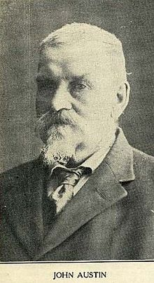
Positivism: John Austin
John Austin is best known for his work developing the theory of legal positivism. He attempted to clearly separate moral rules from "positive law."
Austin was greatly influenced in his utilitarian approach to law by Jeremy Bentham. Austin took a positivist approach to jurisprudence; he viewed the law as commands from a sovereign that are backed by a threat of sanction. In determining 'a sovereign', Austin recognized it as one who society obeys habitually.

Slide 21
Legal Realism
Justice
Fairness

Slide 22
Legal Realism
Began in American schools of law
It is closer to positivism than it is to natural law
Rights are created and backed by the state
There is no single outlook shared by all of the realists
Based on the pragmatism of Charles Sanders Peirce
It has a pragmatic conception of the law which undermines the plausibility of orthodox legal positivism and natural law

Slide 23
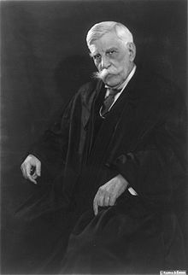
Legal Realism:
Oliver Wendell Holmes
Holmes espoused a form of moral skepticism and opposed the doctrine of natural law, marking a significant shift in American jurisprudence. As he wrote in one of his most famous decisions, his dissent in Abrams v. United States (1919), he regarded the United States Constitution as "an experiment, as all life is an experiment" and believed that as a consequence "we should be eternally vigilant against attempts to check the expression of opinions that we loathe and believe to be fraught with death."

Slide 24
Critical Legal Theory
Critical Legal Theory
Feminist Theory
Critical Race Theory
Eco-feminist Theory

Slide 25
Critical Legal Theory
Critical Legal Theory can be traced to American Legal Realism, as a distinct scholarly movement CLS fully emerged only in the late 1970s.
Many founding American Critical Legal Theory scholars were profoundly influenced by the experiences of the civil rights movement, women's rights movement, and the anti-war movement of the 1960s and 1970s.
What started off as a critical stance towards American domestic politics eventually translated into a critical stance towards the dominant legal ideology of modern Western society.

Slide 26
Critical Legal Theory
Sociology of Law is a sub-discipline within Critical Legal Theory
Sociology of Law consists of various sociological approaches to the study of law in society.
These approaches empirically examine and theorize the interaction between law and legal institutions, on the one hand, and other (non-legal) social institutions and social factors, on the other

Slide 27
Critical Legal Theory
Sociology of Law
Social Control
Legal Regulation
Legal Cultures

Slide 28
Law and Economics
Law and economics or economic analysis of law is the application of economic methods to analysis of law.
Economic concepts are used to explain the effects of laws, to assess which legal rules are economically efficient, and to predict which legal rules will be promulgated.
Because of the overlap between legal systems and political systems, some of the issues in law and economics are also raised in political economy, constitutional economics and political science.
Most formal academic work done in law and economics is broadly within the Neoclassical tradition
Economics is not everything. Other considerations like morality are important

Slide 29
Law and Economics
Law and Economics
Positive Law and Economics
Normative law and Economics

Slide 30
Law and Economics
Positive law and economics
Positive law and economics uses economic analysis to predict the effects of various legal rules. So, for example, a positive economic analysis of tort law would predict the effects of a strict liability rule as opposed to the effects of a negligence rule. Positive law and economics has also at times purported to explain the development of legal rules, for example the common law of torts, in terms of their economic efficiency.

Slide 31
Law and Economics
Normative law and economics
Normative law and economics goes one step further and makes policy recommendations based on the economic consequences of various policies. The key concept for normative economic analysis is efficiency, in particular, allocative efficiency.

Slide 32
Law and Economics
A common concept of efficiency used by law and economics scholars is Pareto efficiency. A legal rule is Pareto efficient if it could not be changed so as to make one person better off without making another person worse off. A weaker conception of efficiency is Kaldor-Hicks efficiency. A legal rule is Kaldor-Hicks efficient if it could be made Pareto efficient by some parties compensating others as to offset their loss.

Slide 33
Law and Economics
One important trend has been the application of game theory to legal problems. Other developments have been the incorporation of behavioral economics into economic analysis of law, and the increasing use of statistical and econometrics techniques. Within the legal academy, the term socio-economics has been applied to economic approaches that are self-consciously broader than the neoclassical tradition.

Slide 34
Overview
Legal Philosophies
Legal Ethics
Business Law

Slide 35
American Legal Ethics
Legal ethics are inherently deontological: whether any particular action on the part of an officer of the court is ethical is dependent on competing obligations that that officer may have

Slide 36
American Legal Ethics
--Legal ethics are internally consistent, but not necessarily consistent with a metaphysical realist conception of morality.
--this is the source of the technical legal terms “matter of fact” and “matter of law” and the usage of “guilty” and “not guilty” (rather than “innocent”) in legal terminology
--ex. John commits a robbery and is arrested and tried for the robbery, but at trial, a jury acquits John. John did actually commit the robbery, so he is guilty of robbery as a matter of fact, but a jury found him to be not guilty so as a matter of law, John is not guilty.

Slide 37
American Legal Ethics
-The statement “John is guilty of robbery” is true when the correspondence theory of truth is applied to his circumstance. (He is guilty as a matter of fact.)
-While not innocent, “John is not guilty of robbery” is true when a coherence theory of truth is applied to his circumstance. (The statement is coherent with its context: He is not guilty as a matter of law.)

Slide 38
American Legal Ethics
--the goal of the American adversarial system is justice rather than truth:
--due process is a concept to insure a level playing field for all who come before the courts for redress
--given the fallen state of man, the Founding Father’s system is better than most, BUT not aimed at finding truth, just designed to assure fairness and reduce the opportunity for making the prosecutor a tyrannical agent of the government

Slide 39
American Legal Ethics
The Christian lawyer’s dilemma:
--in order to become an attorney, one must take an oath that obligates him or her to the ethical standards of the profession so in order to honor this oath
--we have to have a system and any system devised by men will be flawed—functioning within the system ethically is possible

Slide 40
American Legal Ethics
--defending John in the case mentioned above becomes larger than the one client—John’s attorney is making sure that the prosecutor is forced to present proper evidence in the proper way so that he isn’t free to simply convict any person who appears guilty. By defending John, John’s attorney is defending the system and anyone else who may one day be subject to that system.

Slide 41
Overview
Legal Philosophies
Legal Ethics
Business Law

Slide 42
Business Law:
Property Rights
Type of Law | Consequences
Natural Law | Property rights are consistent with natural law
Positive Law | Rights are a legal fiction
Legal Realism | Property rights are not sancrosanct
Law and Economics | Property rights are essential

Slide 43
Business Law: Contracts
Types of Law | Consequences
Natural Law | Contracts are rooted in the right of self-determination. Enforceable because of natural rights
Legal Positivism | Contracts are private law because the source of the la.ws are private individuals. Enforceable as long as it does not transgress public law
Legal Realism | Contracts are private law because the source of the laws are private individuals. Enforceable outside of the legal system
Law and Economics | Contracts are private law because the source of the laws are private individuals. . Enforceable as long as it does not transgress public law

Slide 44
Business Law: Corporations
Type of Law | Consequences
Natural Law | Corporate law is rooted in partnership, which flows out of contract law
Positive Law | Corporations are legal fictions designed to shield owners from personal liability
Legal Realism | Corporations are legal fictions that may or may not exist in reality irrespective of the law. Corporations do have legal personhood.
Law and Economics | Corporations are aggregates of contracts so a corporation has no legal personhood.

Slide 45
Business Law: Torts
Types of Law | Consequences
Natural Law | Tort liability comes from transgressing the natural rights of another
Positive Law | Liability arises from transgressing the civil rights of another
Legal Realism | Liability arises from committing a wrong against another
Law and Economics | Liability arises from transgressing the civil rights of another

Slide 46
Business Law/Environment
Types of Law | Consequences
Natural Law | Pigouvian taxation and regulation moves the equilibrium to the social optimal position Coasian bargaining reduces transaction costs and respects property rights
Positive Law | Pigouvian taxation and regulation moves the equilibrium to the social optimal position
Legal Realism | Pigouvian taxation and regulation moves the equilibrium to the social optimal position
Law and Economics | Coasian bargaining reduces transaction costs and respects property rights

