Slide 1
Family History
Researching on FamilySearch.org

Slide 2
Objectives
Record hints
Connect your FamilySearch account to research websites
Notes:
Stop me if I go to fast.
If you have a question, others more than likely have the same question.
http://www.funinfamilyhistory.com/5-take-names-to-temple.html

Slide 3
A Bit of Research

Slide 4
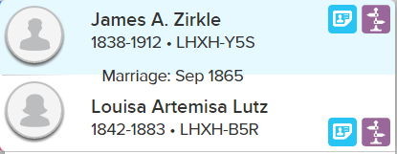
Record Hints
Indicates that after automatically comparing the person’s information with its indexed records, FamilySearch has found potential matches
More indexed sources available all the time
Use them too see if new information is available on the newly indexed source
Notes:
Demo: James A. Zirkle LHXH-Y5S

Slide 5
Research Suggestions
Shows you where a family member or event such as a birth, marriage, or death may be missing from Family Tree
Makes suggestions on what to research
Notes:
Demo: James A. Zirkle LHXH-Y5S

Slide 6
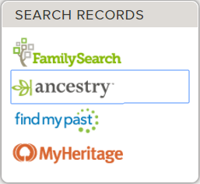
Finding Missing Data
If your ancestor is missing data
Go into the Details view of the person
Click one of the Search Records
On the right hand side of the screen
Remember that the Church now has a partnership with Ancestry
You don’t have to purchase a license any more
Just have to link your account
Notes:
Demo: Lydia
Deceased • MQP2-2Y1​
View Tree
Family Members
Close
SPOUSES AND CHILDREN
Hide All Add Spouse
Alexander Lutz
Deceased • MQP2-2Y6​
Lydia
Deceased • MQP2-2Y1​
No Marriage Events
Children (1)
Louisa Artemisa Lutz
1842-1883 • LHXH-B5R

Slide 7
Ancestry.com
After clicking the link, you will be taken to Ancestry.com, where it will automatically search for the person you were highlighted on in Family Tree
Find records that may match your ancestor

Slide 8
Other Search Records
Remember to check the other sites suggested under Search Records
Each site searches just a little differently
Can find different types of records

Slide 9
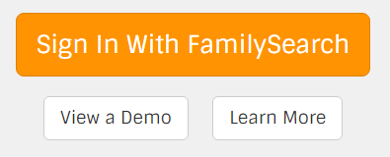
www.findarecord.com
New research website
Go to the site then scroll down to the bottom and select “Sign In With FamilySearch”
Scans your tree
Creates Opportunities list

Slide 10
Select Which Ancestors To Submit For Temple Work

Slide 11
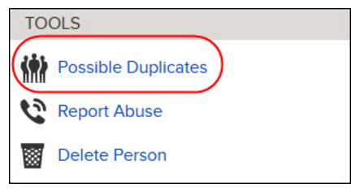
Before Submitting Names
Confirm the person’s record is
As complete as possible
Correct
Rasonably documented with accurate reliable source(s)
Check for Possible Duplicates
The temple work on a duplicate record may have already been submitted and complete
On the right-hand side of the screen
Notes:
https://familysearch.org/blog/en/follow-green-arrow-caution/

Slide 12
Temple Ordinances

Slide 13
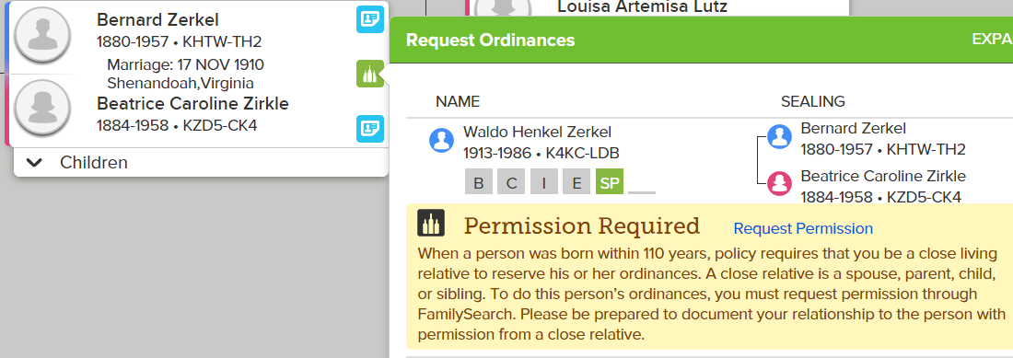
Temple Ordinances
Click Request Ordinances (green temple) from the Tree view
Ordinances that need to be performed are listed
Click Expand for more details on the ordinances

Slide 14
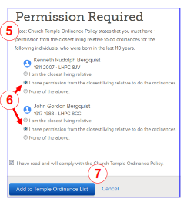
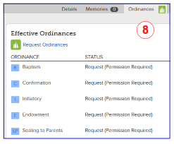
Temple Ordinances - Continued
Read the Church’s policy on performing temple work on people who have died within the last 110 years
Select the radio button that applies
I am the closest living relative
I have permission
Click the “Add to Temple Ordinance List” button
Ordinance for individuals can be selected from the person’s Details page, under Temple Ordinances
CC

Slide 15
Print a Family Ordinance Request
Temple at the top right of the screen
Display the section of your temple list that contains the family ordinance cards you want to print
If you have not yet printed a Family Ordinance Request, click Reserved
To reprint a Family Ordinance Request, click Printed
Click the check box for each card that you want to print
You can click up to about 50 check boxes for one Family Ordinance Request
Select only the number of ordinances that you can complete in a reasonable amount of time
After having a request out for two years, it will automatically be removed from your requested list and become available to others to request

Slide 16
Perform The Temple Ordinances

Slide 17
After Printing the Family Ordinance Request
Take the Family Ordinance Request to the temple
Workers will print the family ordinance cards for you
Do the ordinances
The information about the completed ordinances is automatically added to Family Tree.

