Slide 1

Oral Oncolytics in
CLL Treatment
The Vital Role of the Oncology Nurse
This activity is supported by educational grants from AbbVie, BeiGene USA, Inc., Janssen Biotech, Inc., administered by Janssen Scientific Affairs, LLC.- both are Johnson & Johnson companies; and Lilly.

Slide 2

In support of improving patient care, Creative Educational Concepts, LLC, is jointly accredited by the Accreditation Council for Continuing Medical Education (ACCME), the Accreditation Council for Pharmacy Education (ACPE), and the American Nurses Credentialing Center (ANCC), to provide continuing education for the health care team.

Slide 3
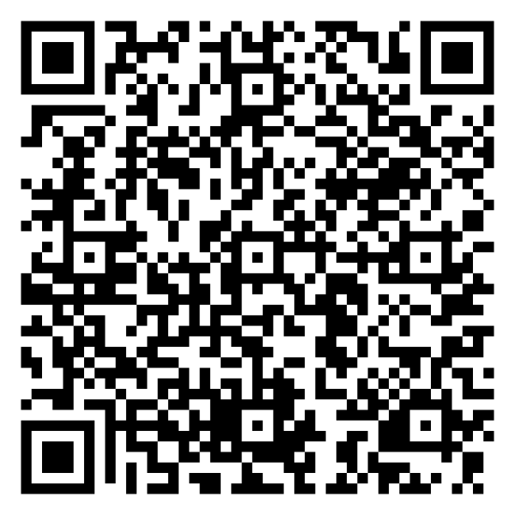
Claim Credit
QR Code
Scan the QR code, create an account, complete the pre-evaluation and the
post-evaluation, and then claim credit. ​
Thank you for your participation! ​

Slide 4
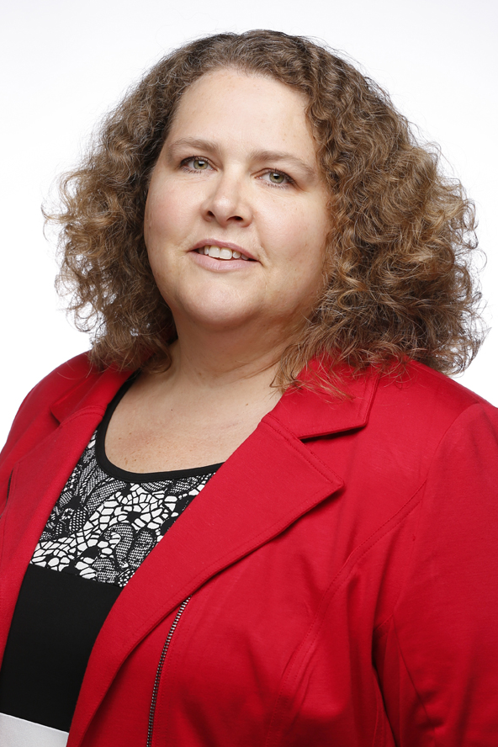
Amy Goodrich, RN, BSN, MSN, CRNP-AC
Nurse Practitioner
Johns Hopkins Kimmel Cancer Center
Baltimore, MD

Slide 5
Disclosures
Faculty
Amy Goodrich, RN, BSN, MSN, CRNP-AC, reports the following financial relationships:
Advisory Board—AbbVie Inc.; AstraZeneca; BeiGene, Inc.; Epizyme, Inc.; Genentech, Inc.; and Janssen Pharmaceuticals, Inc
Disclosures were obtained from the peer reviewer and Creative Educational Concepts staff—no disclosures to report.
Alaa Bawaneh, MD, PhD, (peer reviewer)
Albert Eubanks, Jr., RN (peer reviewer)
David Modrak, PhD (peer reviewer)
Katherine Lee, PharmD (planning committee)
Evan Luberger (planning committee)
Sandra Caballero, PharmD (planning committee)
Sharon Tordoff (planning committee)
Scott J. Hershman, MD, FACEHP, CHCP

Slide 6
Learning Objectives
1. Differentiate patient- and disease-specific variables that inform CLL treatment selection.
2. Develop plans for managing AEs arising from new and emerging CLL treatment approaches, as well as long-term and late effects of treatments.
3. Incorporate strategies to address patient-related treatment barriers to improve adherence to CLL therapy.

Slide 7
Clinical Trial and Real-world Evidence Supporting the Use of Targeted Therapies in CLL

Slide 8
Etiology, Pathophysiology, and Risk Factors
CLL is the most common type of leukemia in adults the United States (25% of cases), but it is rare when considering all types of cancer
The average age of diagnosis is 70; it is rare under age 40 and is extremely rare in children
CLL is a disorder of lymphocytes that are morphologically mature but immunologically less mature
It is incurable with standard treatment, and risk score is tied to prognosis
  Historical overall survival at 5 years ranges from 20% (very high risk) to more than 90% (low risk)
American Cancer Society [ACS]. Key statistics for chronic lymphocytic leukemia. 2024. https://www.cancer.org/cancer/types/chronic-lymphocytic-leukemia/about/key-statistics.html.
ACS. What are the risk factors for chronic lymphocytic leukemia?. Https://www.cancer.org/cancer/chronic-lymphocytic-leukemia/causes-risks-prevention/risk-factors.html.
Wierda WG, et al. J Natl Compr Canc Netw. 2024;22(3):175–204.

Slide 9
Chronic Lymphocytic Leukemia/Small Lymphocytic Lymphoma
Monoclonal mature B lymphocytes expressing CD5 in the blood, bone marrow, and secondary lymphatic organs
B-cell receptor (BCR) and its downstream signaling cascade is a main driver of proliferation and survival
CLL cells depend on B-cell lymphoma 2 (BCL-2) proteins for survival
Biomarker testing can predict time to first treatment, treatment outcomes, and survival
  IGHV mutational status (higher-risk: unmutated)
  FISH testing (high-risk: del17p)
  Karyotype (high-risk: complex)
  Mutation testing (high-risk: TP53 mutations)
FISH = fluorescence in situ hybridization; IGVH = immunoglobulin variable heavy chain.
Koehrer S, Burger JA. Acta Haematologica. 2023:1-14.

Slide 10
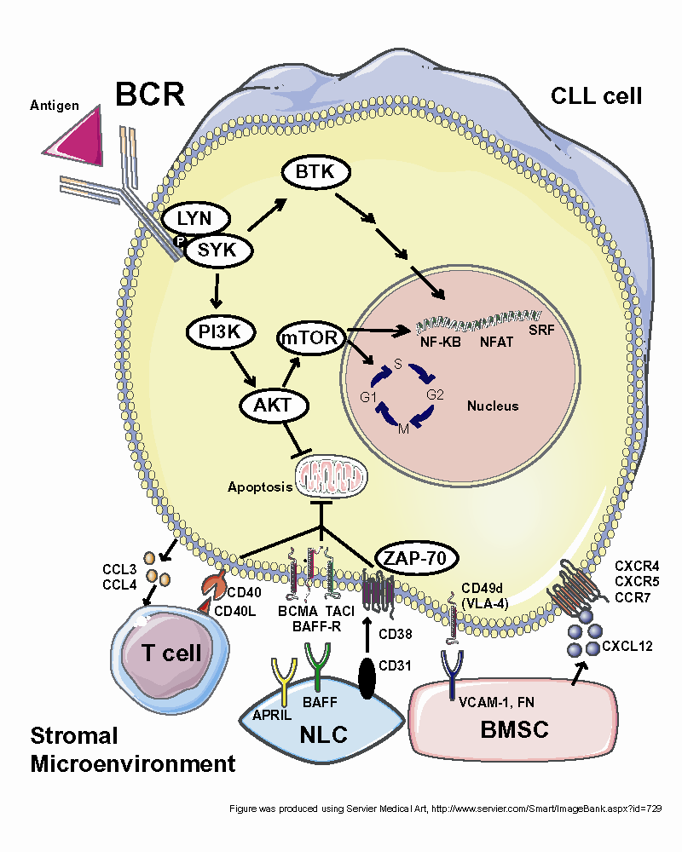
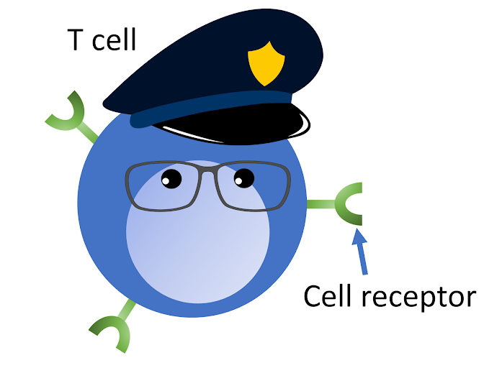
A Diverse Array of Novel Agents are
Highly Active in CLL
CLL cell
BTKi
Ibrutinib
Acalabrutinib
Zanubrutinib
Pirtobrutinib
Y
Anti-CD20 mAb
BCR
Rituximab
Obinutuzumab
CD20
PI3Ki
Idelalisib
Duvelisib
Liso-cel CAR-T
FDA-approved
14 March 2024!
BCL-2i
Venetoclax
BCL-2
Stromal Microenvironment
Adapted from Davids MS, et al. Leuk Lymph. 2012;120(17):3501-3509. Lokaj R. Cancer Network. FDA approves Liso-cel for relapsed/refractory CLL/SLL. 2024. https://www.cancernetwork.com/view/fda-approves-liso-cel-for-relapsed-refractory-cll-sll.

Slide 11
Clinical Presentation
Some patients have “B symptoms”
  Severe fatigue
  Drenching night sweats
  Unintentional weight loss*
  Fever without infection
Most patients have no symptoms but
an abnormal CBC is noted on routine
blood work
Liver and spleen may be enlarged and
can cause early satiety
Lymphadenopathy can be present
Recurrent infections can be a problem due to immunologically immature lymphocytes and hypogammaglobulinemia
Variable | Acute Leukemia | Chronic Leukemia
Age | All ages | Adults
Clinical onset | Sudden | Slow growing
Lymphocytes | Immature | Mature
Anemia | Mild to severe | Mild
Thrombocytopenia | Mild to severe | Mild
White blood cells | Variable (high or low) | Elevated
Organomegaly | Mild | Prominent (especially spleen and liver)
*(≥ 10% in the previous 6 months)
Bispo JAB, et al. Cold Spring Harb Perspect Med. 2020;10(6):a034819. Wierda WG, et al. J Natl Compr Canc Netw. 2024;22(3):175–204.

Slide 12
Recommended Testing
For diagnosis
  Flow cytometry analysis of the blood; could also use lymph node biopsy
  Immunophenotyping for kappa/lambda, CD19, CD20, CD5, CD23, CD10, CD200; also recommended to include cytospin for cyclin D1 or FISH for t(11;14), t(11q;v)
Biomarker testing
  Minimum testing should include fluorescence in situ hybridization (FISH), TP53, and immunoglobulin heavy chain variable region (IGHV) mutation
  Retest FISH and TP53 before each line of treatment if not high risk on prior testing
  Access to testing varies by location
    Resource-limited settings pose greater challenges
Wierda G, et al. J Natl Compr Canc Netw. 2024;22(3):175–204.

Slide 13
Risk Stratification and Prognosis
Method of Detection | Prognostic Variable | Risk Category
Interphase cytogenetics (FISH) | Del(17p) | Unfavorable
 | Del(11q) | Intermediate
 | Trisomy 12 | Intermediate
 | Normal | Intermediate
 | Del(13q) (as a sole abnormality) | Favorable
DNA sequencing | TP53 | Wild-type: favorable Mutated: unfavorable
 | IGHV | > 2% Mutation: favorable* ≤ 2% Mutation: unfavorable
CpG-stimulated metaphase karyotype | Complex karyotype (≥ 5 abnormalities) | Unfavorable
Del(17p) reflects the loss of the TP53 gene and is frequently associated with mutations in the remaining TP53 allele
TP53 mutations can happen without del(17p)
Independent of 17p status, TP53 mutations are predictors of resistance fludarabine- or bendamustine-based regimens and poor survival
Wierda G, et al. J Natl Compr Canc Netw. 2024;22(3):175–204.

Slide 14
Real-world Data:
Testing for Prognostic Factors
informCLL showed prognostic testing rates were poor among community-based providers
  Low rates of testing led to treatment decisions that contradicted consensus guidelines
Lack of testing in the community was confirmed by another study that identified newly diagnosed CLL patients via the Flatiron Health EHR database
  Found that patients who were 65 and older, female, or lived in the western United States were significantly less likely to receive recommended prognostic testing
We must do better!
Mato AR, et al. Clin Lymphoma Myeloma Leuk. 2020;20(3):174-183.e3.; Chanan-Khan A, et al. Blood. 2021;142(1):5144.

Slide 15
Indications for Treatment
Active disease should be clearly documented. At least 1 of these criteria should be met:
Progressive marrow failure, Hgb < 10 gm/dL, or PLT < 100 × 10⁹/L
Massive (≥ 6 cm below left costal margin) or progressive or symptomatic splenomegaly
Massive (≥ 10 cm in longest diameter) or progressive or symptomatic lymphadenopathy
Progressive lymphocytosis + increase of ≥ 50% over a 2-month period or lymphocyte doubling time of < 6 months
Autoimmune complications of CLL that are poorly responsive to corticosteroids
Symptomatic extranodal involvement (e.g., skin, kidney, lung, and spine)
Disease-related symptoms (unintended weigh-loss ≥ 10%, significant fatigue, persistent fevers with no infection, persistent nigh sweats with no infection)
Hallek M, et al. Blood. 2018;131:2745-2760.

Slide 16
1L Therapy for CLL/SLL –
NCCN Guidelines
Preferred regimens | Other recommended regimens | Useful in certain circumstances
Without del(17)p/TP53 mutation
Acalabrutinib ± obinutuzumab Venetoclax + obinutuzumab Zanubrutinib | Ibrutinib Ibrutinib + obinutuzumab Ibrutinib + rituximab Ibrutinib + venetoclax | Consider for IGHV-mutated CLL in patients aged < 65 w/o significant comorbidities FCR Consider when BTKi and venetoclax are not available or contraindicated or rapid disease debulking needed Bendamustine + anti-CD20 mAb Chlorambucil ± obinutuzumab HDMP + anti-CD20 mAb
With del(17)p/TP53 mutation
Acalabrutinib ± obinutuzumab Venetoclax + obinutuzumab Zanubrutinib | Ibrutinib Ibrutinib + venetoclax | Consider when BTKi and venetoclax are not available or contraindicated or rapid disease debulking needed HDMP + anti-CD20 mAb Obinutuzumab
mAb = monoclonal antibody; HDMP = high dose methylprednisolone; FCR = fludarabine, cyclophosphamide, rituximab.
Wierda WG, et al. J Natl Compr Canc Netw. 2024;22(3):175–204.

Slide 17
CIT for 1L Therapy for CLL/SLL
Chemoimmunotherapy (CIT) used to be standard of care
  No longer a category 1 recommendation
  Not recommended for patients with
  del(17p)/TP53 Mutation given low response rates
Now, only considered for patients who are:
  Young
  Fit
  IGHV mutated
Yet, in the inform CLL registry, 40% of patients with unmutated IGHV received CIT, despite decreased efficacy
Mato A et al. Clin Lymphoma Myeloma Leuk. 2020;20:174-183.

Slide 18
Current NCCN Guidelines for CLL/SLL:
Second- or Third-line Therapy
Second- or Third-line Therapy | Without (del)17p/TP53 Mutation | With (del)17p/TP53 Mutation
Preferred | Acalabrutinib Venetoclax +rituximab Zanubrutinib | Acalabrutinib Venetoclax + rituximab Zanubrutinib Venetoclax
Other Recommended | Ibrutinib Venetoclax Ibrutinib + Venetoclax | Ibrutinib Ibrutinib + Venetoclax
Useful in Certain Circumstances | Resistance or intolerance to prior covalent BTKi therapy: Pirtobrutinib For relapse after a period of remission (if previously used): Venetoclax ± anti-CD20 mAb*
CAR-T (3rd line and beyond, must have received prior BTKi and BCL2 inhibitor) | Lisocabtagene maraleucel
Category 1 Recommendation
*(venetoclax + obinutuzumab preferred)
BTKi = Bruton’s tyrosine kinase inhibitor; CLL = chronic lymphocytic leukemia; NCCN = National Comprehensive Cancer Network; mAb = monoclonal antibody; CAR-T = chimeric antigen receptor T-cell therapy..
Wierda G, et al. J Natl Compr Canc Netw. 2024;22(3):175–204.

Slide 19
Long-term Evidence Supporting
Continuous BTKi Therapy – RESONATE-2
Ibrutinib versus chlorambucil in treatment-naïve CLL
  8 years of follow-up
PFS benefit with ibrutinib
  59% vs 9% at 7 years
  Benefit in del(11q) and unmutated IGVH patients
  OS at 7 years was 78% with ibrutinib
Sustained benefit with 1L ibrutinib including patients with high-risk genomic features
PFS = progression-free survival; OS = overall survival; 1L = first line.
Barr PM, et al. Blood Adv. 2022;6:3440-3450.

Slide 20
Long-term Evidence Supporting
Continuous BTKi Therapy – ELEVATE-TN
Acalabrutinib versus acalabrutinib + obinutuzumab versus obinutuzumab + chlorambucil (O-Clb)
  6 years of follow-up
PFS benefit with acalabrutinib regimens sustained at median follow-up of 74.5 months
  PFS not reached for for A+O and A vs 27.8 mo for O+Clb
A+O reduced the risk for death by 38% compared with O+Clb
Sustained benefit with acalabrutinib regimens compared to O-Clb in treatment-naïve CLL
Sharman JP, et al. Blood. 2023;142(Suppl1):636.

Slide 21
Long-term Evidence Supporting
Continuous BTKi Therapy – SEQUOIA
Zanubrutinib versus bendamustine + rituximab (BR)
  42-month follow-up
PFS benefit with zanubrutinib sustained at median follow-up of 43.7 months
  PFS was not reached for zanubrutinib versus 42.2 mo for BR
  42-month PFS rates were 82.4% for zanubrutinib
  OS NR in either arm
With long-term follow-up, benefit demonstrated in patients with mutated IGHV in addition to the previously reported benefit in those with unmutated IGHV
Patients with del(17p) continue to demonstrate PFS benefits consistent with the randomized cohort
Sustained benefit with zanubrutinib compared to BR in treatment-naïve CLL
Munir T, et al. Hemasphere. 2023;7(Suppl):e15364af.

Slide 22
CLL14 Trial Design
Venetoclax–Obinutuzumab
6 cycles
Venetoclax
6 cycles
Previously untreated patients with CLL and coexisting medical conditions
CIRS > 6 and/or CrCl < 70mL/min
Enrollment from 2015 to 2016
Follow-up Phase
Primary endpoint:
Progression-free survival
Key secondary endpoints:
Response
Minimal residual disease
Overall survival
1:1 randomization
Chlorambucil–Obinutuzumab
6 cycles
Chlorambucil
6 cycles
Current median observation time: 76.4 months
CIRS = cumulative illness rating scale; CrCl = creatinine clearance.
Fischer K, et al. N Engl J Med. 2019;380(23):2225-2236.

Slide 23
CLL14: PFS by TP53 Status
Median PFS
Ven-Obi & none 76.2 months
Ven-Obi & TP53 deletion and/or mutation 51.9 months
Clb-Obi & none 36.4 month
Clb-Obi & TP53 deletion and/or mutation 20.8 months
Cumulative PFS
no TP53 del/mut
TP53 del/mut
no TP53del/mut
TP53 del/mut
Time to event [PFS] from randomization (months)
Al-Sawaf O, et al. Hematol Oncol. 2023;41(S2):58–60.

Slide 24
Efficacy of Fixed-duration Regimens: Undetectable MRD
Agents | 1y uMRD | 2y uMRD | PFS & DFS
Obinutuzumab + venetoclax^{1,2} | 57% BM 76% PB | 26.9% PB | Estimated 4-year PFS 74%
Ibrutinib + venetoclax CAPTIVATE^{3,4} | 68% BM 74% PB |  | Fixed-duration: 5-year PFS 70% MRD-directed continuation of therapy: 3 y PFS ≥ 95%
Ibrutinib + venetoclax MD Anderson⁵ | 56% BM | 66% BM
Ibrutinib + venetoclax GLOW^{6,7} | 40.6% BM 80.4% PB |  | 4-year PFS: 75%
Combination associated with higher incidence of GI events and neutropenia than single-agent ibrutinib
Toxicities tend to occur early and decrease over time
PB = peripheral blood; BM = bone marrow; DFS = disease-free survival; uMRD =undetectable minimal/measurable residual disease.
1. Fischer K, et al. NEJM. 2019;380:2225-2236; 2. Al-Sawaf O, et al. JCO. 2021;39:4049-4061; 3. Ghia P, et al. Blood. 2023;142(Suppl 1):642; 4. Barr PM, et al. JCO. 2023; 41: 7535-75355; Jain N, et al. JAMA Oncol. 2021;7:1213-1219; 6. Munir T, et al. Clin Lymphoma Myeloma Leuk. 2022;22:S264-S265; 7. Niemann CU, et al. Lancet Oncol. 2023;24(12):1423-1433.

Slide 25



Goals of Continuous- vs.
Fixed-duration Therapy in CLL/SLL
Disease control
Prolonged PFS
Independent from response, MRD
Disease eradication
Prolonged PFS
Undetectable MRD
Be prepared to review goals of care with patients and empower their decision-making
Goals of
continuous
therapy
Goals of fixed-duration therapy
MRD = minimal/measurable residual disease.

Slide 26

Front-Line BTKi vs. Ven + Obi:
Factors to Consider
BTKi
Ven + Obi
Convenience (no infusions, TLS monitoring)
Longer-term efficacy data
More effective in TP53 disrupted CLL
More data for efficacy of Ven at time of BTKi progression (ibrutinib)
1-year time-limited therapy
No known cardiac or bleeding risks
Less concern for long-term adherence
Potential for retreatment
Cost-saving

Slide 27
BTKi Resistance
16%–23% of patients on continuous BTKi therapy develop BTKi resistance
  Most information comes from studies with ibrutinib
    However, similar mechanisms were reported for acalabrutinib
  The two most common alterations are C481S in the ATP binding site of BTK
    The mutations prevent attachment of covalent BTKis
More common in previously treated patients and patients with TP53 abnormalities
Resistance typically arises with indefinite treatment
Munir T, et al. Am J Hematol. 2019;94(12):1353–1363. Hampel PJ, et al. Blood Cancer J. 2022;12(9):124.
Barr PM, et al. Blood Adv. 2022;6(11):3440–3450. Frustaci AM, et al. Cancers (Basel). 2023;15(5). Kaptein A et al. Blood. 2018;132(Suppl 1):1871.

Slide 28
Covalent vs. Noncovalent BTKis
Covalent BTKi | Noncovalent BTKi
Ibrutinib Acalabrutinib Zanubrutinib | Pirtobrutinib Nemtabrutinib*
Inhibited No inhibition | Both wild type and mutant BTK inhibited
C
C
BTK
C
C
BTK
S
BTK
C
BTK
S
* Nemtabrutinib is not FDA-approved for the treatment of CLL
Tambaro FP, et al. J Exp Pharmacol. 2021;13:923-935.

Slide 29
Pirtobrutinib in Covalent BTK-Inhibitor Pre-Treated R/R CLL/SLL and
MCL Phase 1/2 BRUIN Study: Design, Eligibility, and Enrollment
Phase 1 Escalation + Expansion (25 to 300 mg QD)
Phase 2 (200 mg QD) N=773
Phase 1 3+3 design
28-day cycles
Intra-patient dose escalation allowed
Cohort expansion permitted at doses deemed safe
CLL/SLL
n=317
MCL
n=166
Other^{b}
n=290
Eligibility
Age ≥18
ECOG PS 0-2
Active disease and in need of treatment
Previously treated
Safety population
Prior BTKi
n=282
BTKi Naïve
n=35
Key endpoints
Safety/tolerability
Determine MTD and recommended phase 2 dose
Pharmacokinetics
Efficacy according to ORR and DOR (iwCLL) as assessed by IRC
Enrolled after
5 November 2021
Supplemental Cohort
n=35
Primary efficacy populationª
Enrolled in phase 1 or 2
Treated with prior BTK inhibitor containing regimen
Received one or more doses of pirtobrutinib monotherapy
Primary Efficacy population
Prior BTKiª
n=247
DOR = duration of response; MCL = mantle cell lymphoma; MTD = maximum tolerated dose; ORR = overall response rate.
Mato AR, et al. Blood. 2022;140(suppl 1):2316-2320.
Notes:
Mato AR, Woyach JA, Brown JR, et al. Efficacy of pirtobrutinib in covalent btk-inhibitor pre-treated relapsed / refractory CLL/SLL: additional patients and extended follow-up from the phase 1/2 BRUIN study. Blood. 2022;140(suppl 1):2316-2320.

Slide 30
BRUIN:
PFS in High-Risk CLL Subgroups
100
80
60
Patients Free From Progression (%)
40
BTK C481 mutated
BTK C481 wild type
20
0
0
2
4
6
8
10
12
14
16
18
20
22
24
Patients at Risk, n
Mo From Start of Treatment
BTK C481 mutated
84
68
54
49
40
33
18
10
7
3
1
1
0
BTK C481 wild type
74
62
52
40
35
23
19
13
11
5
1
0
Mato AR, et al. European Hematology Association Annual Congress; Vienna, Austria; June 9-17, 2022. Abstract S147.
Notes:
Mato AR, Pagel JM, Coombs CC, et al. Pirtobrutinib, a highly selective, non-covalent (reversible) BTK inhibitor in previously treated CLL/SLL: updated results from the phase 1/2 bruin study. Abstract presented at: European Hematology Association Annual Congress; Vienna, Austria; June 9-17, 2022. Abstract S147.

Slide 31
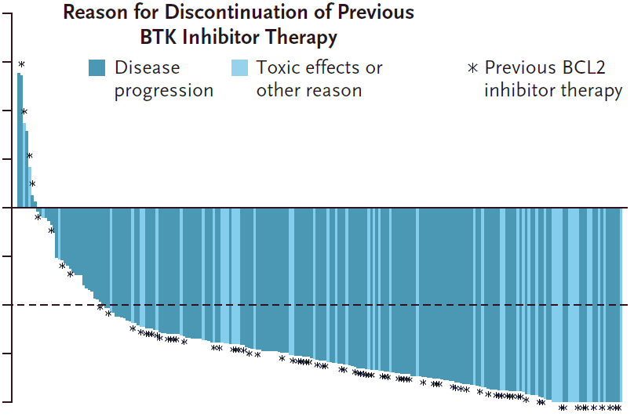
BRUIN Phase I/II Trial:
Efficacy of Pirtobrutinib in R/R CLL/SLL
100
Reason for discontinuation of previous
BTK inhibitor therapy
Variable | Previous BTKi (n = 247) | Previous BTKi + BCL2i (n = 100)
ORR, % (95% CI) Including CR, nodular PR, or PR Including CR, nodular PR, PR, or PR with lymphocytosis | 73.3 (67.3–78.7) 82.2 (76.8–86.7) | 70.0 (60.0–78.8) 79.0 (69.7–86.5)
Best response, % CR Nodular PR PR PR with lymphocytosis SD | 1.6 0.4 71.3 8.9 10.5 | 0 0 70.0 9.0 11.0
mPFS, months (95% CI) | 19.6 (16.9–22.1) | 16.8 (13.2–18.7)
Median follow-up, months | 19.4 | 18.2
75
Disease
progression
Toxic effects or
other reasons
*
Previous BCL2
inhibitor therapy
50
25
Change in tumor size
Percent change from baseline
0
-25
-50
-75
-100
PFS
100
87.4
90
80
68.9
70
56.2
60
Percentage of patients
50
40
30
20
126 Patients (51.0%) had censored data
10
0
0
2
4
6
8
10
12
14
16
18
20
22
24
26
28
30
32
34
36
No. at risk
247
Months since first dose
228
215
202
182
162
144
113
103
82
57
46
22
19
5
4
4
1
0
BCL2i = B-cell lymphoma 2 inhibitor.
Mato AR, et al. N Engl J Med. 2023;389:33-44.

Slide 32
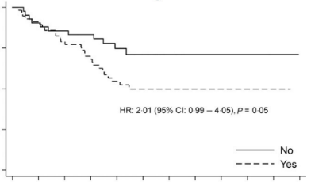
Venetoclax after BTK Inhibitor
100
Risk of progression or death after stopping a prior BCR inhibitor (Pi3Ki and/or BTKi
Multicenter retrospective: 98 patients with R/R CLL who received venetoclax after BCR inhibitor
(Pi3Ki and/or BTKi). At ≥ 2 lines:
60% previously received a BTKi
25% previously received a Pi3Ki
10% previously received both
75
PFS probability (%)
50
HR: 2.01
95% CI: 0.99 – 4.05
P = 0.05
25
Stopped previous BCRi therapy due to reasons
other than progression (predominantly toxicity)
Stopped previous BCRi therapy due to progression
0
0
3
6
9
12
15
18
21
24
27
30
33
Time since starting venetoclax (months)
Challenges to utilizing venetoclax include complexity of the ramp-up and caution in patients with significant renal dysfunction
Takeaway: Reason(s) for stopping BCR inhibitor (Pi3Ki and/or BTKi) influences venetoclax outcomes
BCRi = B cell receptor inhibitor; BTKi = Bruton Tyrosine Kinase inhibitor; Pi3Ki = phosphoinositide 3-kinase inhibitor;. R/R = relapsed/refractory.
Eyre TA, et al. Br J Haematol. 2019;185:656-669.
Notes:
Risk of progression or death after stopping a prior BCRi for progression was double compared to those stopping for other reasons (predominantly toxicity)

Slide 33
Differentiating Common and Serious Adverse
Effects with CLL
Treatments

Slide 34
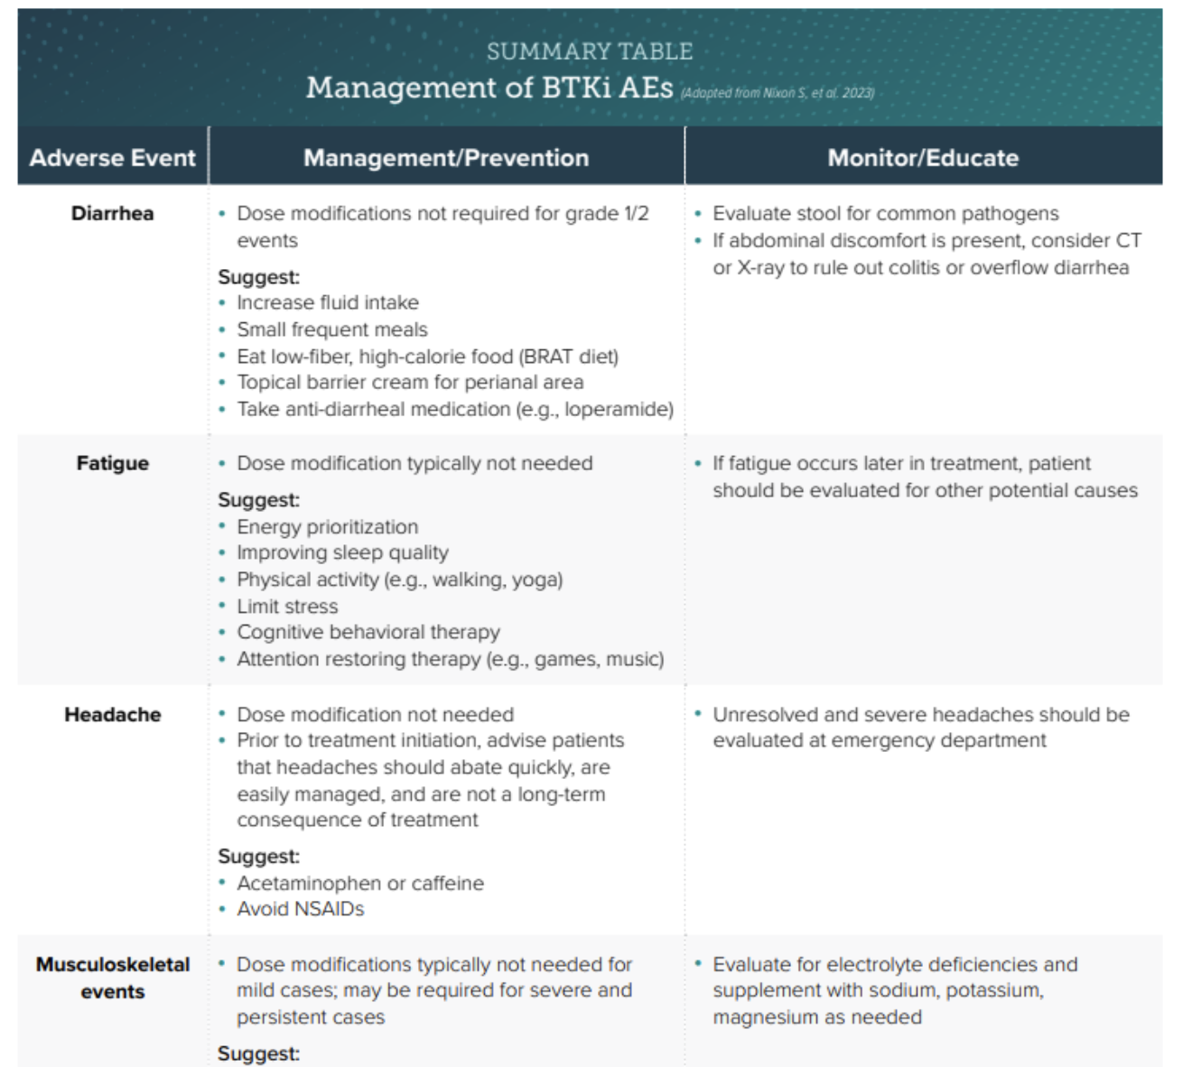

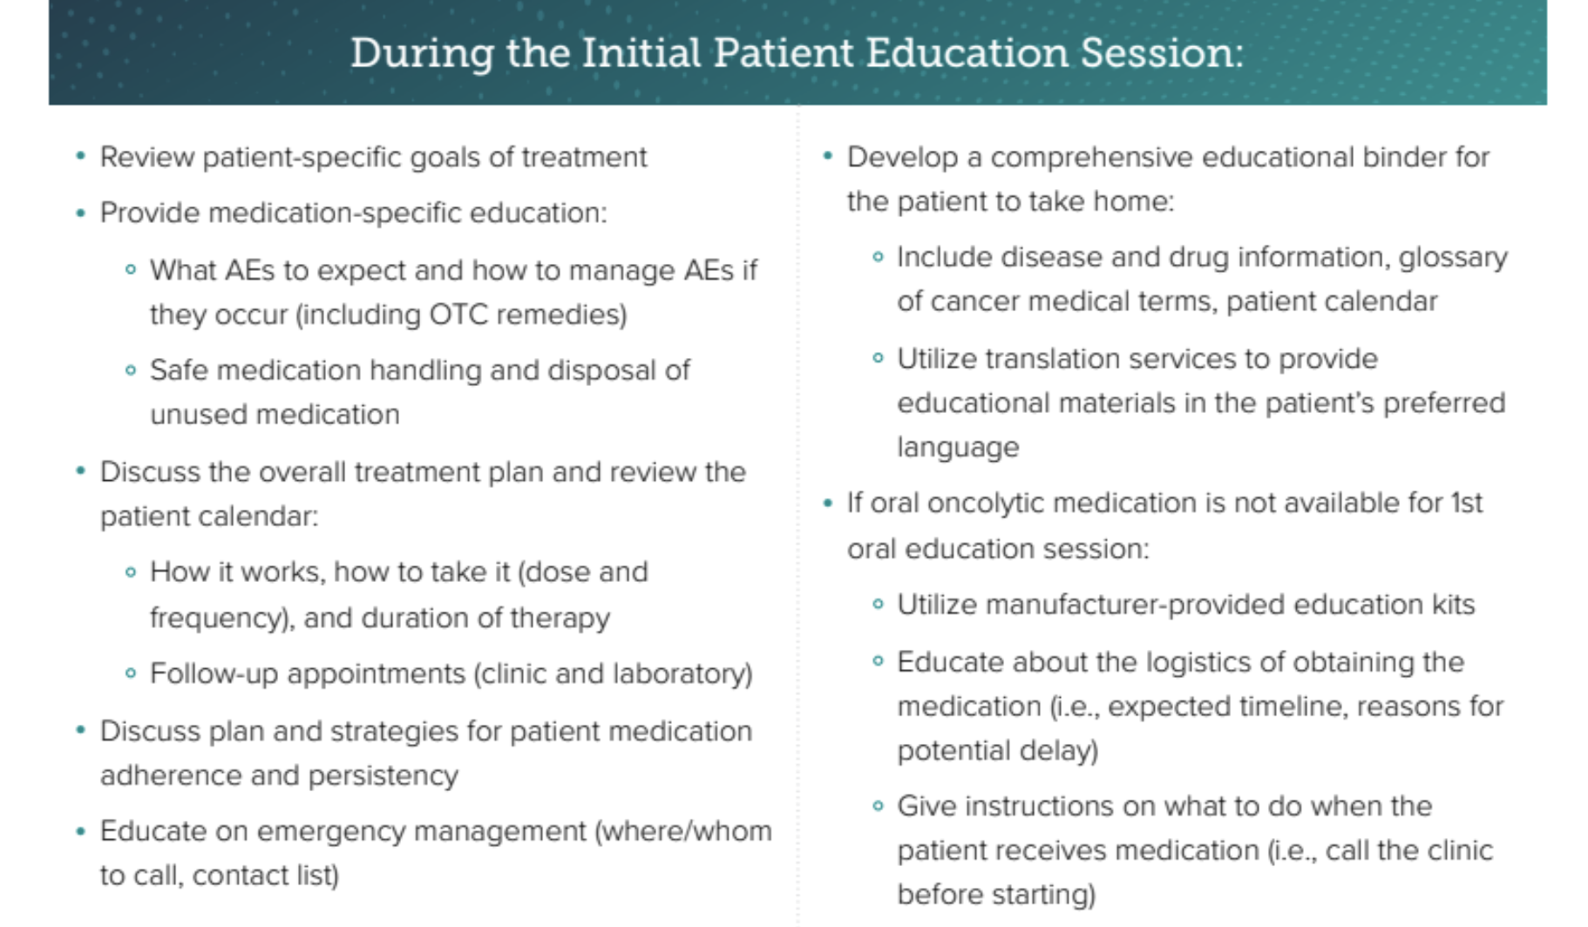
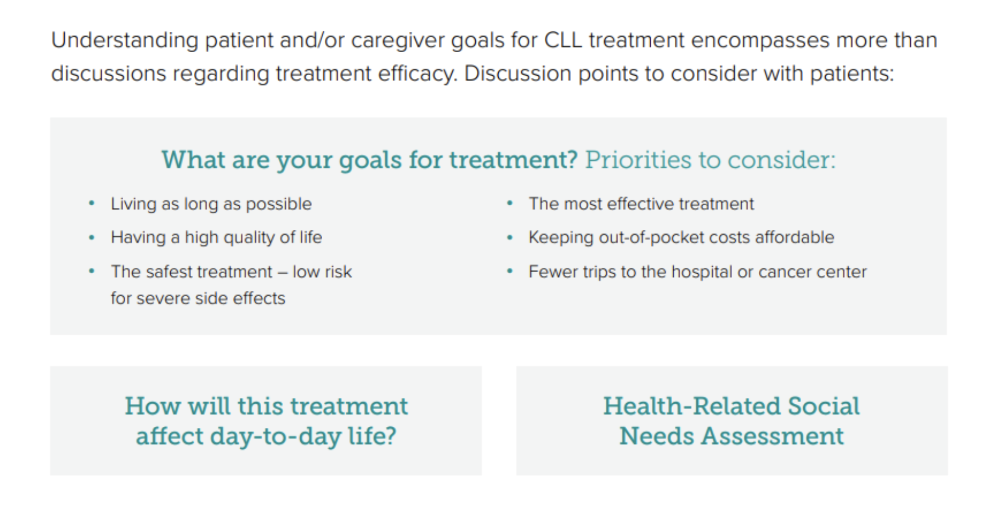
Resource
Scan the QR Code or click resources tab during the program
Access a digital online pocket guide for oncology nurses on oral Oncolytics that includes information on assessing patient goals for therapy and quick references for adverse event counseling and management
Notes:
To access an online pocket guide for oncology nurses on oral Oncolytics in CLL, scan the QR code, make an account, and click on the Materials tab

Slide 35
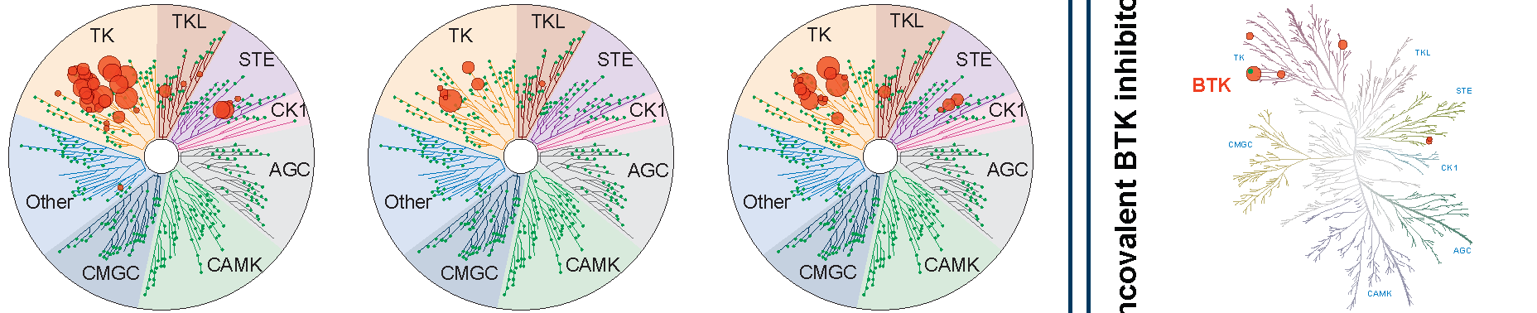
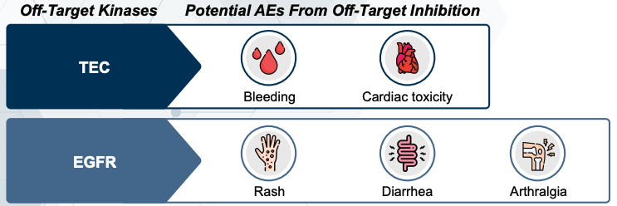
What Are the Implications of Covalent and
Noncovalent BTKi Selectivity for Off-Target Effects
Ibrutinib
Acalabrutinib
Zanubrutinib
Pirtobrutinib
Noncovalent BTK inhibitor
Covalent BTK inhibitors
Less selective/
more off-target effects
More selective/less off-target effects
More selective/
less off-target effects
Less selective BTK inhibitors (e.g., ibrutinib) have more off-target effects,
which contribute to more toxicity compared with more selective agents
Potential off-target effects include:
AGC = containing PKA, PKG, PKC families; BTK = Bruton’s tyrosine kinase; BTKi = Bruton’s tyrosine kinase inhibitor; CAMK = calcium/calmodulin-dependent protein kinase; CK1 = casein kinase 1; CMGC = containing CDK, MAPK, GSK3, CLK families; EGFR = epidermal growth factor receptor; STE = homologs of yeast Sterile 7, Sterile 11, Sterile 20 kinases; TEC = tyrosine kinase expressed in hepatocellular carcinoma; TK = tyrosine kinase; TKL = tyrosine kinase-like. Gaballa S, et al. Curr Hematol Malig Rep. 2021;16(5):422-432. Kaptein A, et al. Blood. 2018;132(Suppl 1):1871. Thompson PA, Tam CS. Blood.2023;141(26):3137-3142.
Notes:
Gaballa S, Pinilla-Ibarz J. BTK Inhibitors in Chronic Lymphocytic Leukemia. Curr Hematol Malig Rep. 2021;16(5):422-432.
Kaptein A, de Bruin G, Emmelot-van Hoek M, van de Kar B, de Jong A, Gulrajani M, et al. Potency and Selectivity of BTK Inhibitors in Clinical Development for B-Cell Malignancies. Blood. 2018;132(Supplement 1):1871.
Thompson PA, Tam CS. Pirtobrutinib: a new hope for patients with BTK inhibitor-refractory lymphoproliferative disorders. Blood. 2023;141(26):3137-3142.

Slide 36










Overview of BTK Inhibitor Toxicities in CLL
Common Toxicities
Additional Important Toxicities
Dermatologic changes
Atrial fibrillation
Arthralgia
Fatigue
BTK Inhibitors
Bleeding
Infection
Ventricular arrhythmia
Cytopenias
Hypertension
Diarrhea
Nixon S, et al. Curr Oncol. 2023;30(4):4222-4245.

Slide 37
Common Adverse Events (AEs) of BTK Inhibitors in CLL (≥ 25%)
Adverse Event | Ibrutinib | Acalabrutinib | Zanubrutinib | Pirtobrutinib
Cytopenias (neutropenia, anemia, thrombocytopenia) | ✓ | ✓ | ✓ | ✓
Diarrhea | ✓ | ✓ | ✓ | ✓
Myalgia, arthralgia, or musculoskeletal pain | ✓ | ✓ | ✓ | ✓
Rash | ✓ | ✓ | ✓
Fatigue | ✓ | ✓ | ✓ | ✓
Upper respiratory tract infection | ✓ | ✓ | ✓
Bruising | ✓ | ✓ |  | ✓
Headache | ✓ | ✓
Pyrexia and general infections | ✓ | ✓
Peripheral edema | ✓
Nausea | ✓
Cough |  |  |  | ✓
BRUKINSA® (zanubrutinib) [package insert]. https://www.accessdata.fda.gov/drugsatfda_docs/label/2024/213217s011lbl.pdf.
CALQUENCE® (acalabrutinib capsules) [package insert]. https://www.accessdata.fda.gov/drugsatfda_docs/label/2022/210259s009lbl.pdf.
CALQUENCE® (acalabrutinib maleate tablets) [package insert]. https://www.accessdata.fda.gov/drugsatfda_docs/label/2022/216387Orig2s000Correctedlbl.pdf.
IMBRUVICA® (ibrutinib) [package insert]. https://www.accessdata.fda.gov/drugsatfda_docs/label/2024/217003s002lbl.pdf.
JAYPIRCA® (pirtobrutinib) [package insert]. https://www.accessdata.fda.gov/drugsatfda_docs/label/2023/216059s001lbl.pdf.

Slide 38
Serious AEs of BTK Inhibitors
Hemorrhage
Atrial fibrillation and flutter; risk factors include:
  Age ≥ 65, male, history of Afib, hypertension, hyperlipidemia, or pre-existing cardiac disease
Grade ≥ 3 infections, including opportunistic infections
Grade 3-4 cytopenias
Secondary primary malignancies
BTKi | Secondary Primary Malignancies
Ibrutinib | 10% total, most common was non-melanoma skin cancer 4%
Acalabrutinib | 12% total, most common was skin cancer 6%
Zanubrutinib | 14% total, most common is non-melanoma skin cancer 8%, solid tumors 4%
Pirtobrutinib | 9% total, most common was non-melanoma skin cancer 4%
Afib = atrial fibrillation.
Lipsky A, Lamanna N. Am Soc Hematol Educ Program. 2020;(1):336-345. Mato AR, et al. N Engl J Med. 2023;389:33-44. Nixon S, et al. Curr Oncol. 2023;30(4):4222-4245.
Notes:
-Serious AEs of BTK inhibitors include hemorrhage, atrial fibrillation and flutter, severe infections and cytopenias, and secondary primary malignancies
-The most common secondary primary malignancies are non-melanoma skin cancers, so a counseling point I always discuss with my patients is to notify their clinic team of any new skin lesions while they are on treatment with a BTK inhibitor

Slide 39
Management of BTKi AEs
Summary Table
Adverse Event | Management Strategy
Atrial fibrillation | Monitor for Afib during treatment, administer DOACs, discontinue BTKi if Afib is not medically controllable
Bleeding events | Monitor for signs of bleeding, hold BTKi for 3–7 days before and after surgery, depending on the type of surgery and bleeding risk
Diarrhea | Use antidiarrheal medication (e.g., loperamide) as needed
Headache | Prior to treatment initiation, advise patients that headaches should abate quickly, are easily managed, and are not a long-term consequence of treatment; after treatment initiation, use acetaminophen or caffeine and avoid NSAIDS
Hypertension | Monitor for treatment-emergent HTN, manage with anti-HTN medication, reduce anti-HTN medication dose once BTKis are discontinued
O’Brien SM, et al. Front Oncol. 2021;11:720704. Nixon S, et al. Curr Oncol. 2023;30(4):4222-4245.

Slide 40
Management of BTKi AEs
Summary Table (cont.)
Adverse Event | Management Strategy
Infection | Consider prophylaxis for patients at an increased risk of opportunistic infection, monitor for signs/symptoms of infection and treat as needed (consider drug-drug interactions with BTKi)
Myalgia/arthralgia | Grade 1 myalgias/arthralgias may not need intervention, use dose reduction or dose interruption as appropriate
Nausea | BTKis can be taken at night, but also utilize antinausea therapies to manage
Neutropenia | 1st–3rd occurrences of grade 3–4: growth factor support is recommended, and dose interruptions can be considered 4th occurrence: discontinuation of the BTKi should be considered
Rash | Topical steroids and/or oral antihistamines
Thrombocytopenia | 1st–3rd occurrences of grade 3–4: dose interruptions should be considered 4th occurrence: discontinuation of the BTKi is recommended (unless thrombocytopenia is related to CLL infiltration in the bone marrow)
O’Brien SM, et al. Front Oncol. 2021;11:720704. Nixon S, et al. Curr Oncol. 2023;30(4):4222-4245.

Slide 41
ELEVATE-RR (Acalabrutinib vs. Ibrutinib):
PFS and OS
PFS
+
OS
+
+
+
+
+
+
+
+
+
+
+
+
+
+
+
+
+
+
+
+
+
+
+
+
+
+
+
+
+
+
+
+
+
+
+
+
+
+
+
+
+
+
+
+
+
+
+
+
+
+
+
+
+
+
+
+
+
+
+
+
+
+
+
+
+
+
+
+
+
+
+
+
+
+
+
+
+
+
+
+
+
+
+
+
+
+
+
+
+
+
+
+
+
+
+
+
+
+
+
+
+
+
+
+
+
+
+
+
+
+
+
+
+
+
+
+
+
+
+
+
+
+
+
+
+
+
+
+
+
+
+
+
+
+
+
+
+
+
+
+
+
+
+
+
+
+
+
+
+
+
+
+
+
+
+
+
+
+
+
+
+
+
+
+
+
+
+
+
+
+
+
+
+
+
+
+
+
+
+
+
+
+
+
+
+
+
+
+
+
+
+
+
+
+
+
+
+
+
+
+
+
+
+
+
+
+
+
+
+
+
PFS, %
OS, %
 | Events, n (%) | Median (95% CI) | HR (95% CI)
Acalabrutinib | 143 (53.4) | 38.4 (33.0-38.6) | 1.00 (0.79-1.27)
Ibrutinib | 136 (51.3) | 38.4 (33.0-41.6)
 | Events, n (%) | Median (95% CI) | HR (95% CI)
Acalabrutinib | 63 (23.5) | NE (NE-NE) | 0.82 (0.59-1.15)
Ibrutinib | 73 (27.5) | NE (NE-NE)
Time, mo
Time, mo
No. at Risk
Acalabrutinib
Ibrutinib
No. at Risk
Acalabrutinib | 268 | 259 | 247 | 242 | 236 | 231 | 223 | 218 | 210 | 207 | 201 | 196 | 183 | 155 | 127 | 95 | 59 | 32 | 18 | 4 | 0
Ibrutinib | 265 | 252 | 241 | 233 | 227 | 220 | 212 | 205 | 203 | 194 | 191 | 186 | 173 | 143 | 121 | 88 | 60 | 28 | 15 | 2 | 0
268 | 250 | 235 | 227 | 219 | 207 | 200 | 193 | 173 | 163 | 148 | 110 | 84 | 59 | 31 | 21 | 13 | 3 | 1 | 0
265 | 240 | 221 | 205 | 186 | 178 | 168 | 160 | 148 | 142 | 130 | 108 | 81 | 66 | 41 | 26 | 15 | 8 | 2 | 0
OS = overall survival; PFS = progression free survival.
Byrd JC, et al. J Clin Oncol. 2021;39(31):3441-3452.
Notes:
Byrd JC, Hillmen P, Ghia P, et al. Acalabrutinib versus ibrutinib in previously treated chronic lymphocytic leukemia: results of the first randomized phase III trial. J Clin Oncol. 2021;39(31):3441-3452.

Slide 42
ELEVATE-RR:
Cardiac AEs of Interest
Atrial Fibrillation
Hypertension
Cumulative Event Rate, %
HR = 0.52 (95% CI, 0.32-0.86)
Cumulative Event Rate, %
HR = 0.34 (95% CI, 0.21-0.54)
Acalabrutinib
Ibrutinib
Acalabrutinib
Ibrutinib
l
l
l
l
l
l
l
l
l
l
l
l
l
l
l
l
l
l
l
l
l
l
l
l
l
l
l
l
l
l
l
l
l
l
l
l
l
l
l
l
l
l
l
l
l
l
l
l
l
l
l
l
l
l
l
l
l
l
l
l
l
l
l
l
l
l
l
l
l
l
l
l
l
l
l
l
l
l
l
l
l
l
l
l
l
l
l
l
l
l
l
l
l
l
l
l
l
l
l
l
l
l
l
l
l
l
l
l
l
l
l
l
l
l
l
l
l
l
l
l
l
l
l
l
l
l
l
l
l
l
l
l
l
l
l
l
l
l
l
l
l
l
l
l
l
l
l
l
l
l
l
l
l
l
l
l
l
l
l
l
l
l
l
l
l
l
l
l
l
l
l
l
l
l
l
l
l
l
l
l
l
l
l
l
l
l
l
l
l
l
l
l
l
l
l
l
l
l
l
l
l
l
l
l
l
l
l
l
l
l
l
l
l
l
l
l
l
l
l
l
l
l
l
l
l
l
l
l
l
l
l
l
l
l
l
l
l
l
l
l
l
l
l
l
l
l
l
l
l
l
l
l
l
l
l
l
l
l
l
l
l
l
l
l
l
l
l
l
l
l
l
l
l
l
l
l
l
l
l
l
l
l
l
l
l
l
l
l
l
l
l
l
l
l
l
l
l
l
l
l
l
l
l
l
l
l
l
l
l
l
l
l
l
l
l
l
l
l
l
l
l
l
l
l
l
l
l
l
l
l
l
l
l
l
l
l
l
l
l
l
l
l
l
l
l
l
l
l
l
l
l
l
l
l
l
l
l
l
l
l
l
l
l
l
l
l
l
l
l
l
l
l
l
l
l
l
l
l
l
l
l
l
l
l
l
l
l
l
l
l
l
l
l
l
l
l
l
l
l
l
l
l
l
l
l
l
l
l
l
l
l
l
l
l
l
l
l
l
l
l
l
l
l
l
l
l
l
l
l
l
l
l
l
l
l
l
l
l
l
l
l
l
l
l
l
l
l
l
l
l
l
l
l
l
l
l
l
l
l
l
l
l
l
l
l
l
l
l
l
l
l
l
l
l
l
l
l
l
l
l
l
l
l
l
l
l
l
l
l
l
l
l
l
l
l
l
l
l
l
l
l
l
l
l
l
l
l
l
l
l
l
l
l
l
l
l
l
l
l
l
l
l
l
l
l
l
l
l
l
l
l
l
l
l
l
l
l
l
l
l
l
l
l
l
l
l
l
l
l
l
l
l
l
l
l
l
l
l
l
l
l
l
Time, mo
Time, mo
No. at Risk
Acalabrutinib
Ibrutinib
No. at Risk
Acalabrutinib
Ibrutinib
268
263
255
241
240
224
231
208
228
199
218
185
206
176
197
166
188
156
183
143
172
136
167
128
142
117
115
96
89
73
58
56
35
26
19
18
8
8
0
0
266
263
246
230
229
203
220
183
216
170
205
153
193
141
184
130
176
120
169
111
157
104
153
98
136
85
114
69
89
48
60
40
34
27
17
15
5
7
0
1
0
0
Byrd JC, et al. J Clin Oncol. 2021;39(31):3441-3452.
Notes:
Byrd JC, Hillmen P, Ghia P, et al. Acalabrutinib versus ibrutinib in previously treated chronic lymphocytic leukemia: results of the first randomized phase III trial. J Clin Oncol. 2021;39(31):3441-3452.

Slide 43
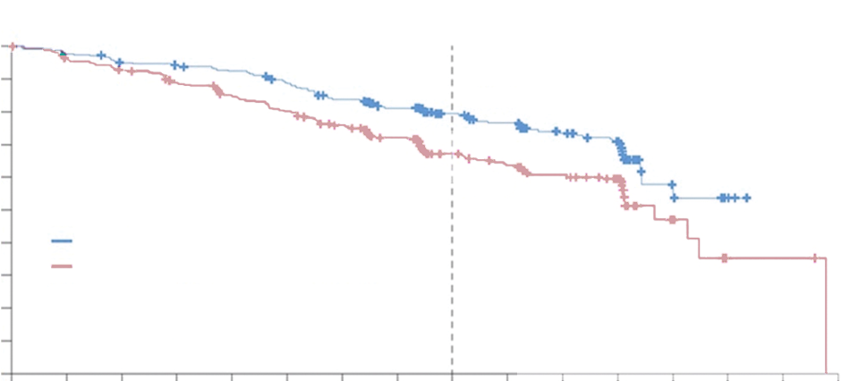
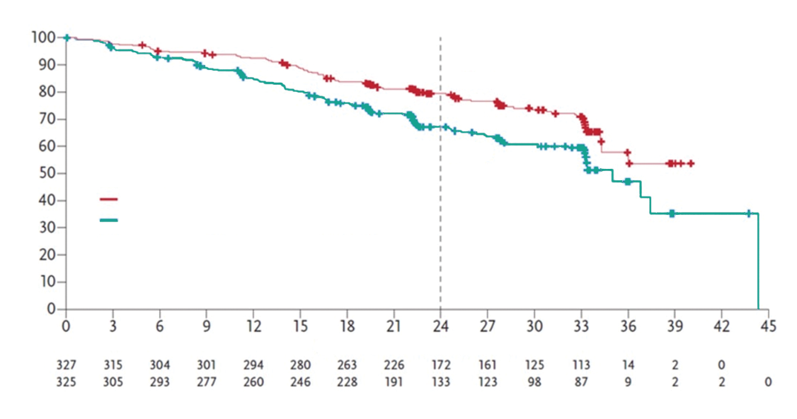
ALPINE: Improved ORR and PFS With
Zanubrutinib vs. Ibrutinib in R/R CLL/SLL
After a median follow-up of 29.6 months, improved PFS with
zanubrutinib intent-to-treat population
100
90
79.5%
80
70
60
67.3%
PFS probability (%)
PFS Events
n (%)
88 (26.9)
120 (36.9)
50
Progression-free Survival Probability (%)
40
Zanubrutinib
30
Ibrutinib
20
Hazard Ratio (95% Cl)=0.65 (0.49-0.86)
Two-Sided P=0.0024
10
0
0
3
6
9
12
15
18
21
24
27
30
33
36
39
42
45
Months from Randomization
No. at Risk
Zanubrutinib
Ibrutinib
Brown JR, et al. 64th American Society of Hematology Annual Meeting: New Orleans, LA;2022. Abstract LBA-6.
Notes:
Brown JR, Eichhorst B, Hillmen P, et al. Zanubrutinib demonstrates superior progression-free survival (PFS) compared with ibrutinib for treatment of relapsed/refractory chronic lymphocytic leukemia and small lymphocytic lymphoma (R/R CLL/SLL): results from final analysis of ALPINE randomized phase 3 study. Abstract presented at: 64th American Society of Hematology Annual Meeting; New Orleans, LA; December 10-13, 2022. Abstract LBA-6.

Slide 44
ALPINE: Safety Analysis Showed Lower Rates of AF/Flutter With Zanubrutinib
AF/Flutter
 | Incidence, %
Zanubrutinib | 2.5
Ibrutinib | 10.1
2-sided P = .0014 Compared with prespecified alpha of .0099 for interim analysis
Cumulative Event Rate, %
Zanubrutinib
Ibrutinib
Censored
+
+
+
+
+
+
+
+
+
+
+
+
+
+
+
+
+
+
+
+
+
+
+
+
+
+
+
+
+
+
+
+
+
+
+
+
+
+
+
+
+
+
+
+
+
+
+
+
+
+
+
+
+
+
+
+
+
+
+
+
+
+
+
+
+
+
+
+
+
+
+
+
+
+
+
+
+
+
+
+
+
+
+
+
+
+
+
+
+
+
+
+
+
+
+
+
+
+
+
+
+
+
+
+
+
+
+
+
+
+
+
+
+
+
+
+
+
+
+
+
+
+
+
+
+
+
+
+
+
+
+
+
+
+
+
+
+
+
+
+
+
+
+
+
+
+
+
+
+
+
+
+
+
+
+
+
+
+
+
+
+
+
+
+
+
+
+
+
+
+
+
+
+
+
+
+
+
+
+
+
+
+
+
+
+
+
+
+
+
+
+
+
+
+
+
+
+
+
+
+
+
+
+
+
+
+
+
+
+
+
+
+
+
+
+
+
+
+
+
+
+
Time From First Dose, mo
No. at Risk
Zanubrutinib | 204 | 197 | 194 | 190 | 187 | 114 | 40 | 9 | 0 | 0
Ibrutinib | 207 | 190 | 179 | 168 | 160 | 91 | 26 | 3 | 3 | 0
Hillmen P, et al. European Hematology Association Annual Congress; 2021. Abstract LB1900.
Notes:
Hillmen P, Eichhorst B, Brown JR, et al. First interim analysis of ALPINE study: results of a phase 3 randomized study of zanubrutinib vs ibrutinib in patients with relapsed/refractory chronic lymphocytic leukemia/small lymphocytic lymphoma. Abstract presented at: European Hematology Association Annual Congress; June 9-17, 2021. Abstract LB1900.

Slide 45
Sequential Use of Acalabrutinib in Patients with
Ibrutinib Intolerance Is an Effective and Safe Option
AE | No. of Patients With Ibrutinib Intoleranceª | Acalabrutinib Experience for Same Patients, n
 |  | Total | Lower Grade | Same Grade | Higher Grade
Atrial fibrillation | 16^{b} | 2 | 2 | 0 | 0
Diarrhea | 7 | 5 | 3 | 2 | 0
Rash | 7 | 3 | 3 | 0 | 0
Bleeding^{c,d} | 6 | 5 | 3 | 2 | 0
Arthralgia | 7e | 2 | 1 | 1 | 0
Total | 41 | 24 | 18 | 6 | 1
ªAmong 60 patients meeting the study enrollment criteria, 41 patients had a medical history of ≥ 1 (43 events in total) of the following categories of ibrutinib-intolerance events: AF, diarrhea, rash, bleeding, or arthralgia. ^{b} Includes patients with atrial flutter (n = 2). ^{c} Events categorized as bleeding included ecchymosis, hemorrhage, epistaxis, contusion, hematuria, and subdural hematoma. ^{d} All but 1 patient experienced a different type of bleeding event
with acalabrutinib compared with ibrutinib treatment. ^{e} Includes 1 patient with arthritis.
Rogers KA, et al. Haematologica. 2021;106(9):2364-2373.

Slide 46
Zanubrutinib:
BTK Inhibitor Intolerance
Prior evidence has shown that zanubrutinib was effective in B-cell cancer patients intolerant of ibrutinib or acalabrutinib¹
For example, of 87 ibrutinib-intolerant events, 72 intolerant events (83%) did not recur
Disease was controlled in 13 (93%) of 14 efficacy-evaluable patients treated with zanubrutinib, and 11 (65%) did not experience any recurrence of prior intolerance events
  ASH 2022: zanubrutinib in
  acalabrutinib-intolerant patients
  with B-cell malignancies²
ªNo intolerance AEs recurred at a higher grade. ASH, American Society of Hematology;
1. Shadman M, et al. ASCO 2021. Abstract e19506. 2. Shadman M, et al. ASH 2022. Abstract 1587.
Notes:
Shadman M, Sharman JP, Levy MY, et al. Preliminary results of the phase 2 study of zanubrutinib in patients with previously treated B-cell malignancies intolerant to ibrutinib and/or acalabrutinib. Abstract presented at: American Society of Clinical Oncology Annual Meeting; June 4-8, 2021. Abstract e19506.
Shadman M, Flinn IW, Kingsley EC, et al. Zanubrutinib in acalabrutinib-intolerant patients with B-cell malignancies. Abstract presented at: 64th American Society of Hematology Annual Meeting; New Orleans, LA; December 10-13, 2022. Abstract 1587.

Slide 47
Important Drug Interactions with BTK Inhibitors
 | Ibrutinib | Acalabrutinib | Zanubrutinib | Pirtobrutinib
Strong CYP3A Inhibitors | Avoid | Avoid | Reduce dose | Avoid
Moderate CYP3A Inhibitors | Reduce dose | Reduce dose | Reduce dose
CYP3A Inducers | Avoid | Avoid | Avoid | Avoid
Warfarin/Vitamin K antagonists | Avoid
Proton pump inhibitors | Avoid only with capsule formulation
Renal impairment | Mild/moderate: no dose adjustment needed | Mild/moderate: no dose adjustment needed |  | Severe: Reduce dose
Hepatic Impairment | Mild/moderate: reduce dose Severe: avoid | Severe: avoid | Severe: reduce dose
Administer with caution | Drugs that prolong the PR interval Anticoagulants/antiplatelets BCRP and P-gp substrates | BCRP and MATE1 substrates |  | Sensitive CYP2C8, CYP2C19, CYP3A, P-gp, or BCRP Substrates
 |  | Consider the risk/benefit of anticoagulants or antiplatelets
Nixon S, et al. Curr Oncol. 2023;30(4):4222-4245. Nixon S, et al. Curr Oncol. 2023;30(4):4222-4245. BRUKINSA® (zanubrutinib) [package inserthttps://www.accessdata.fda.gov/drugsatfda_docs/label/2024/213217s011lbl.pdf.
CALQUENCE® (acalabrutinib capsules) [package inserthttps://www.accessdata.fda.gov/drugsatfda_docs/label/2022/210259s009lbl.pdf. CALQUENCE® (acalabrutinib maleate tablets) [package insert]. https://www.accessdata.fda.gov/drugsatfda_docs/label/2022/216387Orig2s000Correctedlbl.pdf. IMBRUVICA® (ibrutinib) [package insert]. https://www.accessdata.fda.gov/drugsatfda_docs/label/2024/217003s002lbl.pdf.
JAYPIRCA® (pirtobrutinib) [package insert]. https://www.accessdata.fda.gov/drugsatfda_docs/label/2023/216059s001lbl.pdf.
Notes:
Trade Name with superscripted ® or ™ (generic name⁴³) [package insert]. City, State Abbreviation of Place of Manufacturing: Manufacturer Full Name⁴⁴; Published/Updated/Revised Year.⁴⁵ URL from Drugs@FDA site

Slide 48
BTKi Therapy Sequencing
Covalent BTKi Resistance
Ibrutinib
Acalabrutinib
Zanubrutinib
Ibrutinib
Acalabrutinib
Zanubrutinib
Noncovalent (pirtobrutinib)
Noncovalent (pirtobrutinib)
Noncovalent (pirtobrutinib)
Acalabrutinib or zanubrutinib or noncovalent (pirtobrutinib)
Zanubrutinib or noncovalent (pirtobrutinib)
Acalabrutinib or noncovalent (pirtobrutinib)
Covalent BTKi Intolerance
Shadman M, et al. Blood. 2023;142(suppl 1):3279. Mato AR, et al. N Engl J Med. 2023;389:33-44. Wierda G, et al. J Natl Compr Canc Netw. 2024;22(3):175–204.
Notes:
Shadman M, Flinn IW, Kingsley E, et al. Zanubrutinib in acalabrutinib-intolerant patients (pts) with B-cell malignancies. Blood. 2023;142(suppl 1):3279. doi:10.1182/blood-2023-174096

Slide 49
Differentiating Factors BTK Inhibitors (BTKi)
 | Ibrutinib | Acalabrutinib | Zanubrutinib | Pirtobrutinib
Dose | 420 mg PO daily | 100 mg PO Q12H | 160 mg PO BID or 320 mg PO daily | 200 mg PO daily
Dose modifications needed when | Used with CYP3A inhibitors; mild-moderate hepatic impairment | Used with CYP3A inhibitors or inducers | Used with CYP3A inhibitors; severe hepatic impairment | Used with CYP3A inhibitors or inducers; severe renal impairment.
Administration | Take with or without food at approximately the same time(s) each day
Dosage forms | Capsules: 70 mg, 140 mg Tablets: 140 mg, 280 mg, 420 mg Oral Suspension: 70 mg/ml | Capsules: 100 mg Tablets: 100 mg | Capsules: 80 mg | Tablets: 50 mg, 100 mg
Drug interactions | Avoid P-gp substrates | Capsules: avoid PPIs; take acala at least 2 hours before H2RAs or antacids Tablets: no issues using concurrent acid reducing agents |  | Sensitive CYP2C8, CYP2C19, CYP3A, P-gp, or BCRP Substrates
 | Avoid concomitant use of CYP3A inhibitors and inducers
Food interactions | Avoid grapefruit/grapefruit juice, Seville oranges (often in orange marmalade), and starfruit
BTK C481S mutation associated resistance | Yes | Yes | Yes | No
Nixon S, et al. Curr Oncol. 2023;30(4):4222-4245. BRUKINSA® (zanubrutinib) [package inserthttps://www.accessdata.fda.gov/drugsatfda_docs/label/2024/213217s011lbl.pdf.
CALQUENCE® (acalabrutinib capsules) [package inserthttps://www.accessdata.fda.gov/drugsatfda_docs/label/2022/210259s009lbl.pdf. CALQUENCE® (acalabrutinib maleate tablets) [package insert]. https://www.accessdata.fda.gov/drugsatfda_docs/label/2022/216387Orig2s000Correctedlbl.pdf. IMBRUVICA® (ibrutinib) [package insert]. https://www.accessdata.fda.gov/drugsatfda_docs/label/2024/217003s002lbl.pdf.
JAYPIRCA® (pirtobrutinib) [package insert]. https://www.accessdata.fda.gov/drugsatfda_docs/label/2023/216059s001lbl.pdf.
Notes:
FDA prescribing information. Nixon S, Duquette D, Doucette S, Larouche JF. How We Manage Patients with Indolent B-Cell Malignancies on Bruton's Tyrosine Kinase Inhibitors: Practical Considerations for Nurses and Pharmacists. Curr Oncol. 2023;30(4):4222-4245.

Slide 50
Using Venetoclax in CLL
Dose modifications are needed when… | Used with CYP3A or P-glycoprotein inhibitors, or in patients with severe hepatic impairment
Administration | Take with food around the same time each day
Dosage forms | Tablets: 10 mg, 50 mg, 100 mg; starter pack as well as 100 mg tablets, which are used for weeks 5 and beyond (28, 120, 180 count/bottle) Each starter pack contains four weekly wallet blister packs Week 1 (14 × 10 mg tablets) Week 2 (7 × 50 mg tablets) Week 3 (7 × 100 mg tablets) Week 4 (14 × 100 mg tablets)
Drug interactions | CYP3A inhibitors, P-gp inhibitors
Food interactions | Avoid grapefruit/grapefruit juice, Seville oranges (often in marmalade), and starfruit
VENCLEXTA® (venetoclax tablets) [package insert]. North Chicago, IL: AbbVie Inc.; Revised 2022. https://www.accessdata.fda.gov/drugsatfda_docs/label/2022/208573s027lbl.pdf.
Notes:
-Similar to BTK inhibitors, venetoclax interacts with CYP3A inhibitors, but it also interacts with P-gp inhibitors
-Baseline dose reductions are listed in the package insert depending on the strength of the drug interaction or baseline hepatic impairment
-Venetoclax should be taken with food once per day
-The starter pack includes tablets for the first 4 weeks of treatment to aid in the dose ramp-up
-The 5th week of treatment will ramp up to the full dose of 400 mg daily and the 100 mg tablets are dispensed from a bottle at that point
-Patients should be instructed to avoid grapefruit, orange marmalade, and starfruit while taking venetoclax

Slide 51
Common AEs with Venetoclax in CLL (≥ 20%)
When used in combination with obinutuzumab or rituximab or alone:
Cytopenias (neutropenia, thrombocytopenia, anemia)
Diarrhea
Nausea
Upper respiratory tract infection and cough
Myalgia
Pain
Fatigue
Edema
Grade 3–4 neutropenia occurs in about 40% of patients on single-agent venetoclax
  Increases to about 60% with the addition of anti-CD20 monoclonal antibodies
  Increases to about 70% when used with BTKi
Rates of febrile neutropenia are typically low, 3%–5%
VENCLEXTA® (venetoclax tablets) [package insert]. North Chicago, IL: AbbVie Inc.; Revised 2022. https://www.accessdata.fda.gov/drugsatfda_docs/label/2022/208573s027lbl.pdf. Fischer K, et al. Hematology Am Soc Hemaol Educ Program. 2020(1):357-362.
Notes:
-For common AEs with venetoclax, you will notice a similar list to the BTK inhibitor slide with the check marks
-Regarding the hematologic toxicities, they can occur early or late in treatment and we’ll discuss management later in the presentation
-Gastrointestinal AEs are usually mild and occur relatively early. They usually resolve on their own, however some patients may need supportive care

Slide 52
Serious AEs with Venetoclax in CLL
Tumor lysis syndrome (TLS)
  TLS is when a large number of cancer cells die within a short period of time, releasing their contents into the blood
  For patients with CLL who followed the 5-week dose ramp up and TLS prophylaxis and monitoring measures, rates of TLS = 2%
  Co-administration of venetoclax with strong CYP3A inhibitors at initiation and during the 5-week ramp-up phase is contraindicated
Fatal and serious infections, such as pneumonia and sepsis, have occurred; monitor for signs and symptoms of infections and treat source of infection promptly, should they occur
Gupta A, Moore JA. JAMA Oncol. 2018; 4(6):895. VENCLEXTA® (venetoclax tablets) [package insert]. North Chicago, IL: AbbVie Inc.; Revised 2022. https://www.accessdata.fda.gov/drugsatfda_docs/label/2022/208573s027lbl.pdf.
Notes:
2018 Jun 1;4(6):895.
-TLS is when a large number of cancer cells die within a short period of time and release their contents into the blood
-Many clinicians may think of venetoclax when they hear tumor lysis syndrome
-However, when the 5-week dose ramp-up is followed and TLS prophylaxis is implemented, the rates of TLS are very low, only 2%
-Of course, you would want to avoid concurrent use of strong CYP3A inhibitors when starting venetoclax and during the ramp-up because that would significantly increase the risk of TLS
-I mentioned that neutropenia does occur and can sometimes be severe, later in the presentation we will talk about how to manage venetoclax-related neutropenia in order to try to keep patients on treatment

Slide 53
Tumor Lysis Risk Factors
Increased risk of TLS
  When starting venetoclax therapy and during any dose increases (includes the ramp-up period)
  High tumor burden
  Decreased renal function
  Splenomegaly
  Concomitant use of venetoclax with P-gp inhibitors or strong/moderate CYP3A inhibitors
Lab abnormalities
  Increased potassium, uric acid, LDH, phosphorus
  Decreased calcium
Requires measure of absolute lymphocyte count (ALC) and imaging to determine disease burden and risk of TLS
Pre-treatment labs to include TLS panel:
  CBC, diff, platelets
  CMPNL
  Phosphorus
  Uric Acid
  Lactate dehydrogenase
Gupta A, Moore JA. JAMA Oncol. 2018; 4(6):895. VENCLEXTA® (venetoclax tablets) [package insert]. North Chicago, IL: AbbVie Inc.; Revised 2022. https://www.accessdata.fda.gov/drugsatfda_docs/label/2022/208573s027lbl.pdf.

Slide 54
Key Questions to Ask When Considering
Fixed-duration Regimens
There is an increased risk for tumor lysis with venetoclax/obinutuzumab
Can the patient stay adequately hydrated (1.2-2 L daily)?
Ramp-up dosing with venetoclax
Can the patient be compliant with medications?
Frequent, long clinic visits are required for multiple labs and IV hydration
Does the patient have transportation to and from the clinic?
IV = intravenous

Slide 55
Patient-tethered
Treatment Approaches

Slide 56
Key Components of Patient Counseling
Dosing
Drug-drug and drug-food interactions
Common and rare, but serious AEs
Administration and dosing schedule
Missed dose management
Storage and disposal of unused medication
Signs/symptoms and self-monitoring at home
When to call the clinic and when to seek immediate medical attention

Slide 57
Shared Decision-making Tools
S
H
A
R
E
Seek your patient’s participation
Help your patient explore and compare treatment options
Assess your patient’s values and preferences
Reach a decision with your patient
Evaluate your patient’s decision
Assess
Patient’s beliefs, behavior, knowledge
Advise
Provide specific information about health risks and benefits of change
Agree
Collaboratively set goals based on patient’s interest and confidence in ability to change behavior
Assist
Identify personal barriers, strategies, problem-solving techniques, and social support
Arrange
Specify a plan for follow-up
Agency for Healthcare Research and Quality [AHRQ]. The SHARE Approach. 2014. http:// www.ahrq.gov/professionals/education/curriculum-tools/shareddecisionmaking/index.html. Sheridan SL, et al. Am J Prev Med. 2004;26(1):56-66.
Notes:
http:// www.ahrq.gov/professionals/education/curriculum-tools/shareddecisionmaking/index.html; Sheridan SL, et al. Am J Prev Med. 2004. 2004 Jan;26(1):56-66.

Slide 58
Keys for Discussing CLL Treatment Options with Your Patients (cont.)
Considerations when recommending treatment to your patients
Patient-centric Approach
Patient factors: comorbidities and past medical history
Goal Concordant Care
Understanding patient goals
Therapy factors: adverse events and intangible things (logistics), such as distance of travel to the clinic, ability to pay for medications, insurance coverage
Setting expectations together
Realigning expectations as needed
Measuring success
Schrager SB, et al. Fam Pract Manag. 2017;24(3):5-10. Sanders JJ, et al. J Palliat Med. 2018;21(S2):S17-S27.

Slide 59
Optimizing Care for Patients on
Oral Therapies
Education by an oncology pharmacist or advanced practice provider or oncology nurse with planned follow-up
Many specialty pharmacies conduct refill outreach, adherence assessments, quality of life, and clinical assessments at several timepoints during the patient’s care
Team approach to prevent or promptly manage adverse events is critical
  Goal: prolong time on each treatment before needing to move to the next
  Poorly managed AEs can compromise adherence and quality of life
  Adherence impacts outcomes
    Poor adherence to ibrutinib (missing 8 or more doses) was related to worse progression-free survival and this may also be applicable to other oral CLL therapies
Association of Community Cancer Centers (ACCC). STEPS TO SUCCESS: Implementing Oral Oncolytics. 2016.
https://www.accc-cancer.org/docs/projects/pdf/implementing-oral-oncolytics-final.pdf?sfvrsn=274a112_0.

Slide 60
Key Takeaways
BTK and BCL2 inhibitors are widely utilized in CLL
Covalent BTKIs are safe and effective
Noncovalent BTKis can overcome resistance to covalent BTKis
Combination regimens being used
First CAR-T recently approved (2024)
Shared decision making is needed due to multiple options
Comprehensive and ongoing patient education and diligent monitoring is critical to optimizing patient outcomes

Slide 61
&
QUESTIONS
ANSWERS
Thank you for joining us.
Don’t forget to collect your credit.

Slide 62
Resource
Scan the QR Code or click resources tab during the program
Access a digital online pocket guide for oncology nurses on oral Oncolytics that includes information on assessing patient goals for therapy and quick references for adverse event counseling and management
Notes:
To access an online pocket guide for oncology nurses on oral Oncolytics in CLL, scan the QR code, make an account, and click on the Materials tab

Slide 63
Claim Credit
QR Code
Scan the QR code, create an account, complete the pre-evaluation and the
post-evaluation, and then claim credit. ​
Thank you for your participation! ​

Slide 64
Oral Oncolytics in
CLL Treatment
The Vital Role of the Oncology Nurse
This activity is supported by educational grants from AbbVie, BeiGene USA, Inc., Janssen Biotech, Inc., administered by Janssen Scientific Affairs, LLC.- both are Johnson & Johnson companies; and Lilly.

