Slide 1
Meeting the Many Challenges of AML
Oncology Nurse Tactics in an Era of Novel Therapies
Faculty First Last Name, MD Official Title Institution Department
City, State

Slide 2
Disclosures
First Name Last Name, Degree(s), has a financial interest/relationship or affiliation in the form of:
Consultant for xxxxx
Grant/Research Support from xxxxxx
Advisory Board for xxxxxx
Other Financial or Material Support from xxxxxx

Slide 3
Unmet Treatment Needs in AML^{1,2}
AML is the most common acute leukemia
Nearly 20,000 cases are estimated for 2020
A disease of older adults
Median age at presentation is 68 years
Older patients are generally undertreated
Although selected older adults may benefit from intensive therapies, as a group they exhibit …
CR rates
Relapse rates
Treatment-related mortality and morbidity
Survival

Slide 4
Symptoms of AML at Presentation
Neutropenia
Leukocytosis
Fever
Infection vs tumor fever
Anemia
Fatigue
Thrombocytopenia
Bleeding (eg, gingival, easy bruising, epistaxis)
Hepatomegaly or splenomegaly
Pallor
Dyspnea

Slide 5
Helping Patients Understand the Diagnostic Process in AML
When patients ask “What can you tell me about my disease?” our answers can be informed by what we learn from our initial assessment
History, physical examination, assessment for comorbidities
CBC, differential, platelets, chemistry profile
PT, PTT, fibrinogen
CT/MRI, lumbar puncture
HLA typing for potential HCT candidates
Bone marrow biopsy with cytogenetics and molecular analysis
Myocardial function in patients with history or symptoms of cardiac disease prior to exposure to cardiotoxic drugs or radiation to thorax

Slide 6
Older Patients Can Tolerate Intensive Therapy and Achieve Improved QOL—Beware of “Age Bias”¹
Watch out for “age bias”
Good PS patients can potentially benefit from intensive treatment
Discuss currently available options; undertreatment is a concern
In one QOL study of older patients with AML…¹
Intensive chemotherapy patients
Had significant improvement in QOL scores at 1 month
Nonintensive chemo patients had stable QOL at 1 month
QOL predictors
Fatigue
Comorbidity NOT predictive

Slide 7
Tools for Calculating Mortality Risk
An AML Composite Model can guide decision-making about treatment of AML
In other words: Patient-specific (eg, comorbidities, age) and AML-specific features (eg, cytogenetic and molecular alterations) predict mortality after AML treatment
Multiple Tools Are Available
AML Composite Model http://www.amlcompositemodel.org FHCRC Model https://cstaging.fhcrc-research.org/TRM/default.aspx

Slide 8
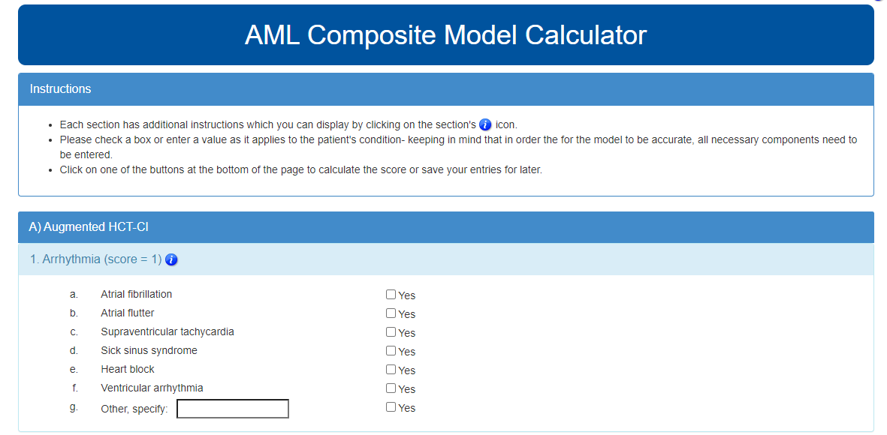
AML Composite Model Calculator¹

Slide 9
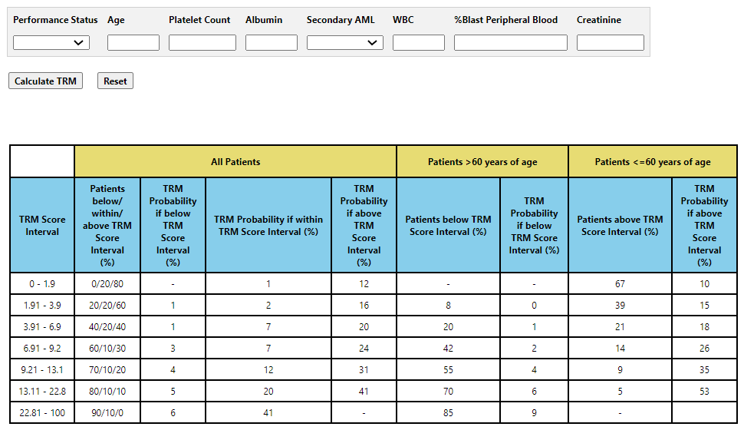
FHCRC Model¹

Slide 10
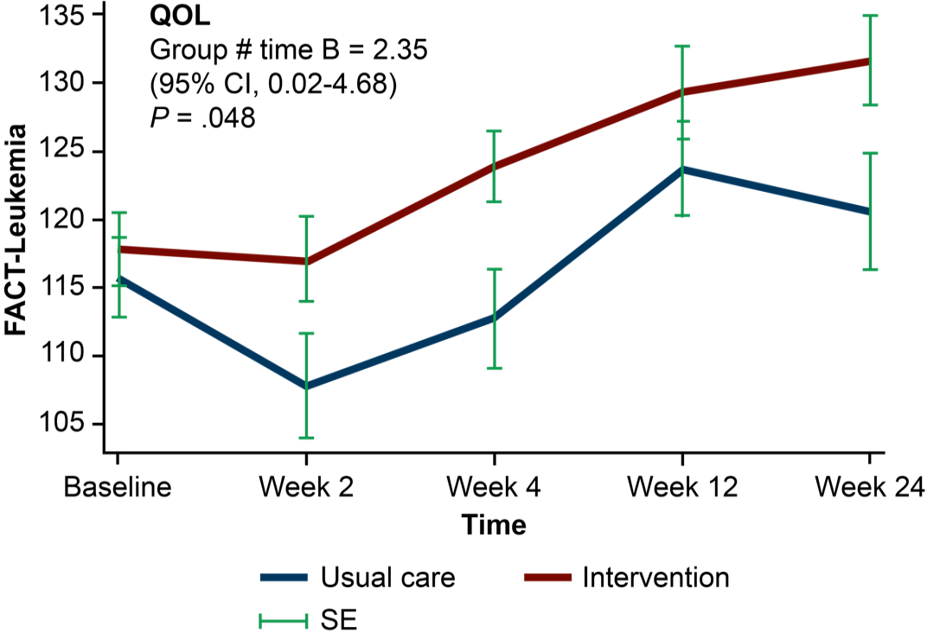
Integrating Palliative Care With AML Therapy Role of the Nurse¹
Patients with AML receiving intensive chemotherapy experience substantial decline in QOL and mood during their hospitalization¹
Integrating palliative care with anticancer treatment in the AML setting can lead to substantial improvements in patients’ QOL, psychological distress, and EOL care

Slide 11
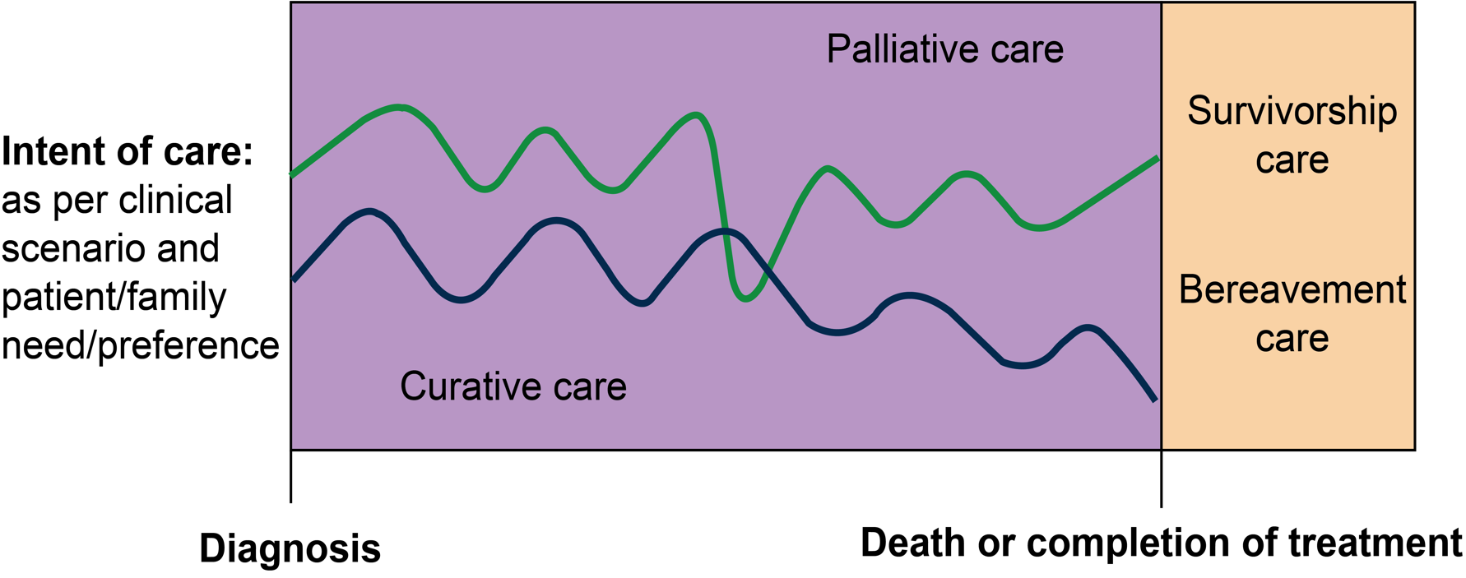
Integrating Palliative Care With AML Therapy Across the Patient Journey¹
Nurses can discuss palliative options at diagnosis alongside AML management plans and continue palliative management throughout the patient’s journey
Notes:
Button Eet al. Palliative Medicine. 2019;33:483–485

Slide 12
An Older Patient With AML-MRC
William is aged 75 years and has lived an active life despite a recent diagnosis of AML-MRC
He is active and fit, remains close to his wife of 40 years, and has 3 children and 7 grandchildren
During diagnostic testing, MDS panel shows del(5q)
PS 0-1
William admits to anxiety over his diagnosis, but is eager to learn more about his disease and willing to pursue aggressive treatment
What is the nurse’s role as educator/advocate?

Slide 13
Educating William on the Next Step in His AML Journey
1. Be honest; let William know that AML-MRC is usually a challenging disease
2. Explain the link between del(5q) and his diagnosis
3. “Your AML is certainly hard to treat, but the good news is that we have options, including newly approved agents. Let’s talk about that together with your family.”
4. Families can be an “extension” of care in cases such as William’s; encourage outreach to AML support groups
Support groups for patients with a new and threatening diagnosis of AML
https://www.lls.org/support/support-groups
https://www.dailystrength.org/group/ acute-myelogenous-leukemia-aml
Notes:
One of the ways we try to support our patients is through referral to our social worker, and also supportive medicine consultation to discuss goals of care. This is not to be confused with a Hospice referral. Supportive medicine is an additional source of support for patients and their family members during their treatment.

Slide 14
Explaining Prognosis With AML Subtypes¹
Good Response to Chemotherapy
Poor Response to Chemotherapy
Core-binding factor leukemias (without c‐KIT mutation) → t(8;21), t(16;16), inv(16)
Diploid AML with NPM1 and CEBPA mutation (without FLT3 mutation)
AML with adverse cytogeneticsª
AML with FLT3‐ITD
Secondary AML (tAML, AML-MRC)
Older patients
New ASH guidelines on AML management in older patients are available: https://ashpublications.org/bloodadvances/article/4/15/3528/461693/American-Society-of-Hematology-2020-guidelines-for

Slide 15
An Older Patient With AML-MRC
What are the treatment options for William?
Conventional chemotherapy (7+3)?
CPX-351 followed by HCT?
Venetoclax-based therapy?
William is interested in pursuing the HCT option and prepares to receive induction therapy with CPX-351.
How should we approach patient management? What is the evidence supporting this choice?

Slide 16
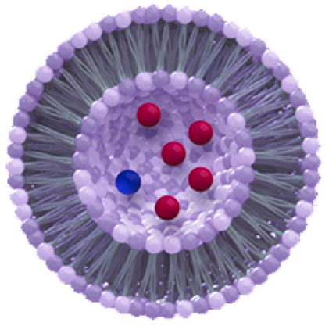
Cytarabine/Daunorubicin Liposome: CPX-351¹⁻³
CPX-351 Timeline
2014-2015: phase 2 results in pretreated and newly diagnosed AML
2016: phase 3 results in newly diagnosed older patients with high-risk AML
2017: approval
What is CPX-351?
5:1 molar ratio of cytarabine to daunorubicin
Be mindful of lifetime anthracycline dose
Notes:
- CPX-351 combines 2 antineoplastic agents, cytarabine and daunorubicin, that we have been using for quite some time, but delivers them in a liposomal formulation at a 5:1 molar ratio that in preclinical studies showed to be most synergistic at this concentration compared to conventional administration as what is known as 7+3. It seems that it accumulates within the bone marrow with preferential uptake of liposome’s by leukemic cells leading to cell death.
- In the phase 2 and 3 studies we will discuss, patients in the CPX arm received 100U/m2 of CPX which is equivalent to 100mg/m2 of cytarabine and 44mg/m2 of daunorobicin. Knowing daunorubicin is an antracycline, we need to be mindful of the
lifetime cumulative dose, especially in our. tAML pt’s that may have received anthracyclines in the past for breast cancer treatment.
- We will discuss results a the phase 2 and 3 study. Currently, CPX is in under a phase 4 expanded access protocol

Slide 17
CPX-351 Versus 7+3: Improvement in OS
Long-Term, 5-Year Results²
 | Events/N | Median OS (95% CI) | HR (95% CI)
CPX-351 | 124/153 | 9.33 (6.37-11.86) | 0.70 (0.55-0.91)
7+3 | 145/156 | 5.95 (4.99-7.75)
Nursing Take-Homes
CPX-351 substantially improved OS and remission rates vs 7+3 in patients with high-risk AML (including AML-MRC)^{1,2}
 | 3-y KM-Estimated Survival Rate, % | 5-y KM-Estimated Survival Rate, %
CPX-351 | 21 | 18
7+3 | 9 | 8
Survival, %
Time From Randomization, mo
CPX-351 | 153 | 122 | 92 | 79 | 62 | 52 | 49 | 45 | 40 | 35 | 33 | 31 | 30 | 29 | 29 | 29 | 29 | 28 | 28 | 26 | 22 | 6 | 2 | 1 | 0
7+3 | 156 | 110 | 77 | 56 | 43 | 35 | 28 | 25 | 20 | 19 | 17 | 14 | 14 | 13 | 13 | 12 | 12 | 12 | 12 | 11 | 5 | 1 | 0 | 0 | 0

Slide 18
CPX-351 Versus 7+3: Improvement in OS From HCT
Survival Landmarked From Time of HCT
 | Events/N | Median OS (95% CI) | HR (95% CI)
CPX-351 | 25/53 | Not reached | 0.51 (0.28-0.90)
7+3 | 30/39 | 10.25 (6.21-16.69)
Nursing Take-Homes
Significant OS improvement also noted with CPX-351 from time of HCT^{1,2}
 | 3-y KM-Estimated Survival Rate, % | 5-y KM-Estimated Survival Rate, %
CPX-351 | 56 | 52
7+3 | 23 | Not estimable
Survival, %
Time From HCT, mo
CPX-351 | 53 | 48 | 42 | 37 | 35 | 35 | 32 | 32 | 31 | 29 | 28 | 28 | 28 | 27 | 27 | 26 | 24 | 24 | 21 | 15 | 6 | 2 | 0 | 0 | 0
7+3 | 39 | 31 | 27 | 20 | 18 | 14 | 12 | 12 | 12 | 9 | 9 | 9 | 9 | 9 | 9 | 9 | 9 | 9 | 8 | 2 | 0 | 0 | 0 | 0 | 0

Slide 19
CPX-351: Managing Count Recovery and Outpatient Use¹
Regimen | Early Mortality
 | Day 30 | Day 60
CPX-351 | 5.9% | 13.7%
7+3 | 10.6% | 21.2%
 | Two-sided P = .149 | Two-sided P = . 097
Less Early Mortality With CPX-351 vs 7+3
CPX-351
7+3
Febrile neutropenia
Fatigue
Pneumonia
Hypoxia
Hypertension
Bacteremia
Sepsis
Respiratory failure
Ejection fraction decreased
Overall safety profile is generally consistent with what we know about cytotoxic therapy, with some differences (such as delayed count recovery)
Grades 1 and 2
Grades 3 to 5
Notes:
Delayed count recovery with CPX-351
≈6 days longer prolonged recovery from neutropenia and thrombocytopenia vs 7+3
MDACC management strategies
Admit patient/start outpatient induction → close monitoring after day 3-4
Lab assessment 3 time a week recommended for outpatinet
Consider frequent blood and platelet transfusions (eg, Hg thresholds >8.5 g/dL; PLT > 15,000/mcL)

Slide 20
The Nurse’s Approach to Delayed Count Recovery With CPX-351
Counsel patients on ANC (neutrophil levels)
Explain thresholds for packed red cell transfusions
Explain thresholds for platelet transfusions
ANC <500- 1,000 cells/mcL
Neutropenic precautions needed
Avoid fever-reducing medication
Hb ≤7 g/dL
In ambulatory patients, symptoms/ comorbid illnesses rather than counts, may trigger transfusion
Platelets ≤10,000/mcL
Consider 30,000-50,000/mcL in patients with bleeding concerns
Patients should have labs assessed ≥1 times/day while they are inpatient
and 2 to 3 times per/week when they are seen in clinic
Notes:
- Patients need to have their labs assessed 2x/wk, sometimes even 3x if they are severely thrombocytopenic.
- As nurses, this is right up our alley. Upon being discharged from induction chemotherapy and when patients are first seen in clinic, it is very important to review their CBC/diff and explain the biological functions of their WBC, Hgb and platelets and discuss pancytopenia.
- Many patients do not understand what ANC stands for. As nurses, we need to discuss neutropenic precautions and instruct patients to avoid fever reducing medication and the importance of notifying the provider as soon as possible if they develop a fever, we need to emphasize the seriousness of sepsis.
Explain the threshold for transfusions and discussing symptoms of anemia and thrombocytopenia. It’s very important in ambulatory patients to consider their symptoms and not only follow numbers as we mentioned earlier. Teach patients what NSAIDs are and that these need to be avoided when they’re platelets are less than 50,000. Many of our patients are on anticoagulation medication, we need to inform them when to hold their anticoagulation medication and we may also need to collaborate with her cardiologist.

Slide 21
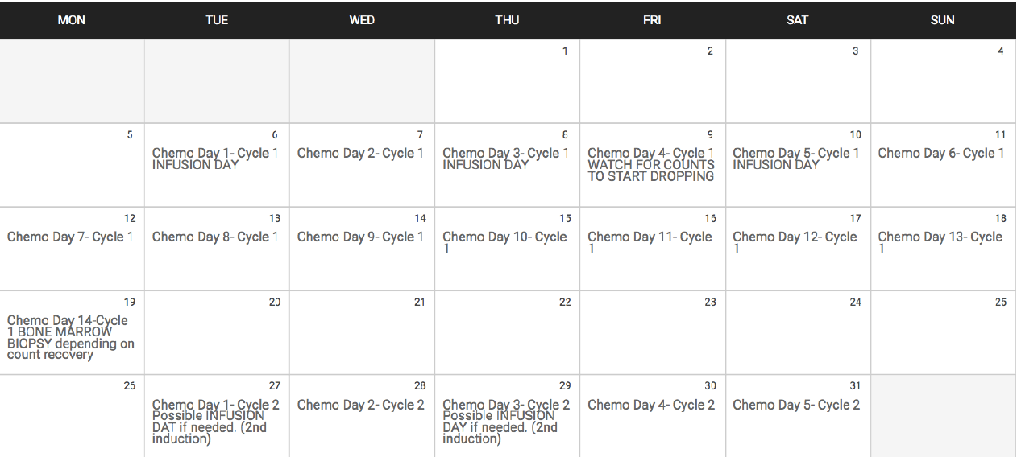
CPX-351: Dosing Calendars Are Useful for Patient Education
CPX-351 dosing¹
Induction: dual-drug daunorubicin 44 mg/m² and cytarabine 100 mg/m² liposome IV over 90 min d 1, 3, and 5 and on d 1 and 3 for subsequent cycles of induction, if needed
Consolidation: dual-drug daunorubicin 29 mg/m² and cytarabine 65 mg/m² IV over 90 min d 1 and 3
Outpatient consolidation can be an option for many patients with AML receiving CPX-351 for their disease²

Slide 22
Tumor Board: An Older Patient With Intermediate-Risk AML
Alex is aged 65 years, has pancytopenia, and is diagnosed with normal karyotype AML without a FLT3 mutation
Alex is generally fit (lifetime jogger/nonsmoker) with a PS of 0-1
Wants to pursue aggressive therapy but is unwilling to consider HCT
After initial consultation, standard 7+3 recommended
Alex responds well to chemotherapy and is in CR1 after standard 7+3 and 1 cycle of intermediate-dose ara-C

Slide 23
Novel HMA Maintenance Strategies
revised slide
CC-486 is an oral formulation of azacitidine
In the recent phase 3 QUAZAR AML maintenance trial, this agent was assessed vs placebo in patients aged ≥55 years with AML in first complete remission
Dosage: 300 mg/day for 14 days of 28-day treatment cycles for patients aged ≥55 years with AML
Oral AZA/CC-486 is FDA approved (September 2020) for the continued treatment of patients with AML in first CR or CRi following intensive induction chemotherapy who are unable to complete intensive curative therapy¹
Notes:
CME: slide revised w/addition of new FDA approval (9/3/20)

Slide 24
QUAZAR: Efficacy Outcomes¹
Overall Survival
1.0
Stratified P = .0009
Stratified HR = 0.69 (95% Cl, 0.55-0.86)
CC-486
Placebo
Nursing Take-Homes
The use of CC-486 significantly prolonged OS vs placebo
Median RFS was also improved with CC-486 (10.2 vs 4.8 mo; P = .0001)
Survival Probability
24.7 mo
14.8 mo
No. at Risk
CC-486 | 238 | 224 | 200 | 168 | 147 | 124 | 115 | 98 | 75 | 59 | 44 | 35 | 26 | 22 | 16 | 15 | 6 | 5 | 1 | 0
Placebo | 234 | 206 | 164 | 127 | 103 | 92 | 82 | 70 | 52 | 34 | 28 | 23 | 19 | 16 | 14 | 11 | 8 | 6 | 1 | 0
Notes:
Benefit even if MRD positive prior to registration

Slide 25
QOL Was Preserved With Maintenance Therapy¹
HR-QOL and low levels of fatigue were preserved with CC-486 maintenance treatment¹
No. of Patients
CC-486 | 200 | 190 | 185 | 176 | 167 | 152 | 146 | 139 | 130 | 125 | 121 | 109 | 102 | 96 | 92 | 86 | 87 | 79 | 76 | 75 | 68 | 72 | 70 | 68 | 65 | 62 | 61 | 59 | 53 | 48 | 49 | 46 | 44
Placebo | 205 | 183 | 160 | 144 | 128 | 98 | 100 | 87 | 78 | 78 | 71 | 60 | 62 | 55 | 51 | 47 | 44 | 41 | 40 | 40 | 38 | 35 | 34 | 31 | 30 | 32 | 31 | 31 | 32 | 32 | 29 | 24 | 26

Slide 26
Safety With Oral HMA Therapy
In the QUAZAR trial, the most common AEs in the CC-486 arm were gastrointestinal¹
Nausea in 65%, vomiting in 60%, diarrhea in 50%, and constipation in 39% of patients
Gastrointestinal events were predominantly noted during the first 2 treatment cycles
Although safety was comparable with the injectable formulation of azacitidine, be prepared to discuss
Principles of oral therapy
GI-related events such as nausea, vomiting, diarrhea, and constipation

Slide 27
An Older Unfit Patient With Intermediate-Risk AML
Michelle is aged 76 years with normal karyotype AML without FLT3 or IDH mutations
WBC 26 x 10⁹/L, ANC 0.5 x 10⁹/L, Hb 5.7 mmol/L, platelets 23 x 10⁹/L
Hypertension, PS 2
Michelle is a widow with no children; she lives alone but is active in her local church
She is somewhat health literate, but shows signs of anxiety and depression over her diagnosis; she feels she has “run out of options” given her age
How should we counsel Michelle on her disease and treatment options?

Slide 28
Counseling Strategies for Patients Unfit for Intensive Therapy¹
How to explain the goals of therapy to Michelle?
1. Be honest about what can be accomplished
2. Counsel her on how some therapies may too intensive for her disease, but that there are effective options available
3. Educate her on the goals of treatment for older patients unfit for intensive therapy: achieving remission and improving quality of life

Slide 29
What Are the Lower-Intensity Treatment Options for Michelle?¹⁻³
Less-intensive therapies include
LDAC or HMAs (azacitidine, decitabine)
What about targeted agents?
Venetoclax + HMA (superior to venetoclax + LDAC)
Glasdegib
In consultation with the management team, Michelle elects to pursue therapy with venetoclax + azacitidine.
What is the evidence, and how can nurses ensure successful therapy?
Notes:
Kantarjian H.M. et al., Multicenter, randomized, open-label, phase III trial of decitabine versus patient choice, with physician advice, of either supportive care or low-dose cytarabine for the treatment of older patients with newly diagnosed acute myeloid leukemia. J. Clin. Oncol. 2012;30(21):2670-2677 DOI: 10.1200/JCO.2011.38.9429
Cortes J.E. et al., Randomized comparison of low dose cytarabine with or without glasdegib in patients with newly diagnosed acute myeloid leukemia or high-risk myelodysplastic syndrome. Leukemia. 2019;33(2):379 DOI: 10.1038/s41375-018-0312-9
Strickland S.A. et al., Cytogenetic and Molecular Drivers of Outcome with Venetoclax-Based Combination Therapies in Treatment-Naïve Elderly Patients with Acute Myeloid Leukemia (AML). Clin Lymphoma Myeloma Leuk. 2018;18(S1):S202. DOI: 10.1010/j.clml.2018.07.052

Slide 30
Phase 3 VIALE-A Trial: Venetoclax + AZA in Older Patients Unfit for Intensive Therapy
Nursing Take-Homes
Among treatment-naïve, predominantly elderly patients with AML ineligible for intensive therapy, AZA + VEN led to statistically significant and clinically meaningful improvement in response rates and OS compared with AZA¹
Safety: Notable serious AEs (grade ≥3) were febrile neutropenia and pneumonia. Laboratory tumor lysis syndrome was rare at 1%
 | Median OS, mo (95% CI)
AZA + VEN | 14.7 (11.9-18.7)
AZA + placebo | 9.6 (7.4-12.7)
1.0
HR = 0.66 (95% CI, 0.52-0.85)
P < .001
Time, mo
Notes:
VIALE-A.

Slide 31
Before Initiating Therapy With Venetoclax…¹
WBC <25 x 10⁹/L required
Review ramp-up dosing
Take venetoclax tablets with food and water at around the same time each day; swallow whole, do not crush or break first
No biomarker or cytogenetic testing required prior to initiation
Assess individual patient risk of TLS
In addition to neutropenia, be prepared to address diarrhea, nausea, anemia, upper respiratory tract infection, thrombocytopenia, and fatigue

Slide 32
Venetoclax Dose Schedule in AML¹
Day 4 and onward
Day 3
Day 2
400 mg is the recommended dose in AML when combining venetoclax with azacitidine
Day 1
400 mg
400 mg
200 mg
100 mg
On day 4, increase to 600 mg daily dose when combined with LDAC
Continue venetoclax, in combination with azacitidine or decitabine or LDAC, until disease progression or unacceptable toxicity is observed

Slide 33
Patient Education on TLS Risk^{1,2}
Patient education should be part of the care plan for patients at risk for TLS
Patients need to know the signs and symptoms of hyperuricemia
Encourage patients to limit foods/fluids containing potassium and phosphorus
Oral intake of fluids should be encouraged
Risk factors for TLS in AML include
Circulating blasts
High burden of leukemia involvement in BM
Elevated pretreatment LDH
Reduced renal function
Hyperuricemia Symptoms
Nausea and vomiting
Shortness of breath
Irregular heartbeat
Clouding of urine
Lethargy
Joint discomfort

Slide 34
TLS Prevention and Assessment With Venetoclax in AML
WBC <25 × 10⁹/L prior to initiation
Cytoreduction prior to treatment may be required
Assess individual patient risk of TLS
Prophylactic hydration and anti-hyperuricemic agents (eg, allopurinol) prior to first dose of venetoclax, then continue through ramp-up phase
Assess blood chemistry
Potassium, uric acid, phosphorus, calcium, and creatinine
Correct pre-existing abnormalities prior to initiation of treatment with venetoclax
For patients with risk factors for TLS
Additional measures should be considered, including increasing laboratory monitoring and reducing venetoclax starting dose
Monitor blood chemistries for TLS
At predose, 6-8 hours after each new dose during ramp-up, and 24 hours after reaching final dose

Slide 35
Dose Modifications for Myelosuppression (Neutropenia)
Managing Neutropenia (± Fever) or Thrombocytopenia Associated With Venetoclax (Grade 4) in AML¹
Occurrence prior to achieving remission | Transfuse blood products and administer prophylactic and treatment anti-infectives as clinically indicated In most instances, venetoclax combination therapy should not be interrupted because of cytopenias prior to achieving remission
First occurrence after achieving remission and lasting ≥7 days | Delay subsequent treatment cycle of venetoclax-based treatment; monitor blood counts; administer G-CSF if clinically indicated for neutropenia Once toxicity resolves to grade 1 or 2, resume venetoclax at the same dose in combination with azacitidine or decitabine or LDAC
Subsequent occurrences in cycles after achieving remission and lasting ≥7 days | Delay subsequent treatment cycle of venetoclax-based treatment; monitor blood counts; administer G-CSF if clinically indicated for neutropenia Once toxicity resolves to grade 1 or 2, resume venetoclax therapy at the same dose, with reductions in duration of therapy (7 days for each subsequent cycle; example: administer days 1-21 of a 28-day cycle rather than daily)

Slide 36
Monitor for Drug–Drug Interactions: Be Prepared to Modify Venetoclax Dosing¹
Agent | Venetoclax Dosing Modifications
Moderate CYP3A4 inhibitors | Reduce dose by 50%
Strong CYP3A4 inhibitors | Reduce dose by 75%
CYP3A4 inducers | Avoid concomitant administration; consider switching to alternative agents

Slide 37
A 60-Year-Old Woman With Newly Diagnosed AML
Emily is aged 60 years; she presents with de novo AML and fatigue, presyncopal symptoms, and night sweats
WBC 75 x 10⁹/L, Hb 7.6 mmol/L, platelets 22 x 10⁹/L
Testing confirms FLT3-ITD mutation
Although fit, a back injury led to an early retirement from the post office
She is divorced, with no immediate family
Emily has poor health literacy; she does not fully understand the effects of AML symptoms, including blood-related symptoms
What are some strategies for counseling Emily during this challenging time and for educating her on the nature of her disease?

Slide 38
Explaining Prognosis With AML Subtypes¹
Good Response to Chemotherapy
Poor Response to Chemotherapy
Core-binding factor leukemias (without c‐KIT mutation) → t(8;21), t(16;16), inv(16)
Diploid AML with NPM1 and CEBPA mutation (without FLT3 mutation)
AML with adverse cytogeneticsª
AML with FLT3‐ITD
Secondary AML (tAML, AML-MRC)
Older patients
New ASH guidelines on AML management in older patients are available: https://ashpublications.org/bloodadvances/article/4/15/3528/461693/American-Society-of-Hematology-2020-guidelines-for

Slide 39
Answer Emily’s Questions and Provide Support
1. Develop a plan for educating Emily and reducing her isolation
2. Explain the results of FLT3 testing
3. “You may be looking at an aggressive disease that is more likely to relapse despite our current therapies, but we do have some options we can think about, and they might be effective against your cancer.”
FLT3 Internal Tandem Duplication (ITD) and FLT3 TKD Mutation
Specimen Type Isolated DNA
Date of Collection 07/07/2019
Final Diagnosis
Positive for the FLT3 Internal Tandem Duplication (ITD)
Not Detected for the FLT3 TKD Mutation
Notes:
The FLT3 ITD mutation is an adverse prognostic marker in patients with
cytogenetically normal acute myeloid leukemia. A patient with a
detectable FLT3 ITD mutation generally has a less favorable
prognosis than patients without a FLT3 ITD mutation. The FLT3
ITD mutation status must be considered together with all other
clinical, molecular, and cytogenetic markers to determine
accurate prognosis.

Slide 40
Educating Patients on FLT3-Mutant AML¹⁻³
Be prepared to explain what FLT3 mutations mean to patients
High white count
Worse prognosis/high relapse rate
Can occur across different subtypes of AML (eg, ~30% of NPM1-mutated AML, ~30% to 40% of APL)
Notes:
1. Levis. Hematology Am Soc Hematol Educ Program. 2013;2013:220. 2. Gorin. Haematologica. 2013;98:e12. 3. Barragán. Haematologica. 2011;96:1470.

Slide 41
A Snapshot of FLT3 Inhibitors in AML
Preclinical
Phase 1
Phase 2
Phase 3
Approved
Midostaurin¹
Phase 3 RATIFY study (newly diagnosed AML): addition of midostaurin to 7+3 improved OS vs chemo
Gilteritinib (approved in United States)²
Phase 3 ADMIRAL trial (R/R AML): improvement in OS with gilteritinib vs salvage chemo
Quizartinib (approved in Japan)³
QuANTUM-R (R/R AML): improvement in OS with quizartinib vs salvage chemo
Sorafenib, crenolanib

Slide 42
Emily Is a Candidate for 7+3 Plus a FLT3 Inhibitor
After several counseling sessions, Emily initiates treatment with 7+3 plus midostaurin followed by intermediate-dose ara-C with midostaurin
What can Emily expect with FLT3 inhibitor therapy?

Slide 43
The Nurse’s Approach to Safety Management With FLT3 Inhibitors
Watch for GI toxicities
Drug–drug interactions: Educate on notifying provider about OTC/ any new medications
Proactive use of antiemetics and antidiarrheals
Encourage fluid intake
Azole use
QTc prolongation

Slide 44
The Nurse’s Approach to Safety Management With FLT3 Inhibitors (Cont’d)
Drug compliance: Educate on importance of taking medication daily
Overall, watch for common FLT3 inhibitor AEs: nausea, vomiting, skin rash
Advise patient on compliance and side effect reporting
For skin rash, advise patients to notify their provider
Emollients can be used

Slide 45
What If Emily Had Been a Less Fit Patient and Presented With an IDH Mutation?¹
Mutations in IDH1/2 (cytoplasm/mitochondria) are present in 15% to 20% of AML
Acquired early in leukemia development
Implications for prognosis are unclear
Agents targeting IDH1 and IDH2 mutations are approved in AML
Ivosidenib²: IDH1-mutant newly diagnosed AML patients ≥75 years or who have comorbidities that preclude the use of intensive induction chemotherapy or R/R AML
Enasidenib³: Adults with R/R IDH2-mutant AML

Slide 46
Summary of Current Evidence With IDH Inhibitors in AML
In R/R AML^{1,2}
IDH1: ivosidenib induced ~20% CR, median OS of 9 months
IDH2: enasidenib induced ~22% CR, median OS of 9 months
In newly diagnosed AML^{3,4}
IDH1: ivosidenib induced a 42% CR/CRh, median OS of 12.6 months
IDH2: enasidenib + AZA highly active: 71% ORR vs 42% for AZA alone

Slide 47
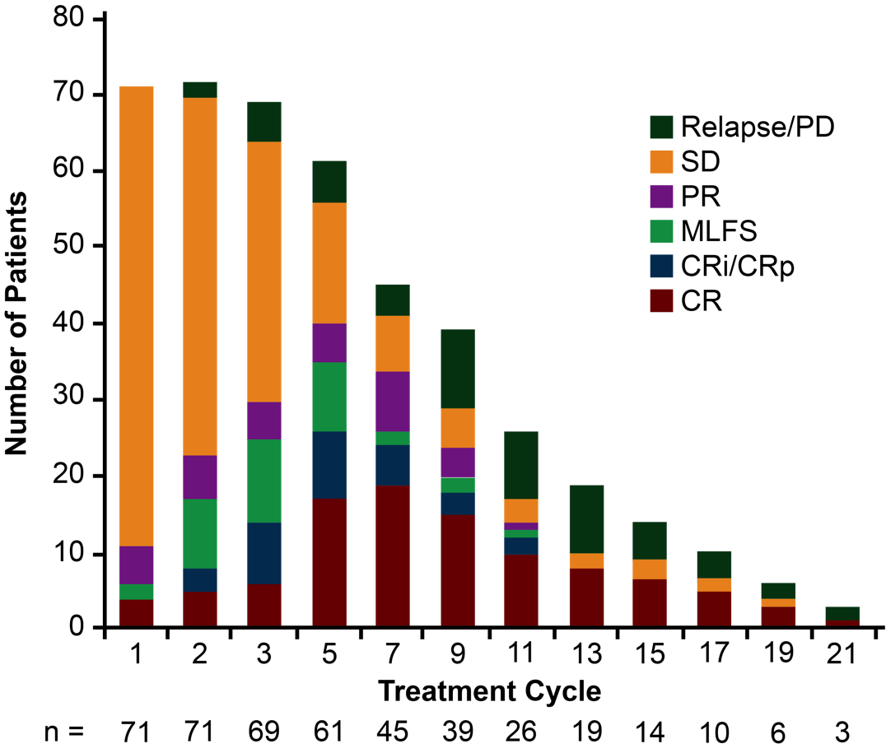
Educate Patients on IDH Inhibitor Activity¹
Response may occur in later treatment cycles
Example: responses over time with enasidenib

Slide 48
Summary of Nursing Considerations With IDH Inhibitors¹⁻³
Relatively few grade 3 nonhematologic toxicities
Including diarrhea, fatigue, and pyrexia
May take 3 to 4 cycles to respond—late responders have been seen in studies to date
Hematologic toxicities are common, at least during the first cycle
Monitor azoles and CYP drug–drug interactions
Differentiation syndrome: seen during first 2 cycles

Slide 49
Review Committee Amended Protocol for IDH-DS Diagnosis and Management¹
Suspicion of IDH-DS
New onset or worsening of characteristic symptoms of unexplained etiology, including
Fever, rapid weight gain, or edema
Respiratory symptoms with or without infiltrates
Pleural or pericardial effusions
Hypotension
Acute renal failure
Initiate treatment with DEX 10 mg twice daily, as indicated
Empiric therapy for other possible causes (eg, anti-infective agents)
Hydroxyurea for management of co-occurring leukocytosis
Hyperuricemia agents for co-occurring tumor lysis syndrome
Hospitalization indicated in setting of rapidly progressing symptoms (especially respiratory symptoms), development of hypoxia, renal failure, rising WBC count, or DIC
Stop/interrupt enasidenib treatment^{b}
Improvement of IDH-DS signs/symptoms
Continue DEX until significant improvement or resolution of signs/symptoms, then taper per institutional guidelines

Slide 50
Summary and Implications for Nurses
The recent approval of many of newer therapies across different AML settings has transformed the care of our patients
FLT3-mutant AML
IDH-mutant AML
CD33-positive AML
Midostaurin for newly diagnosed (with intensive chemo)
Ivosidenib (IDH1)
Gemtuzumab ozogamicin
Gilteritinib for relapsed/refractory (single agent)
Enasidenib (IDH2)
Secondary AML
Older/unfit patients
CPX-351
Venetoclax/HMA (or LDAC)
Glasdegib

Slide 51
Summary and Implications for Nurses (Cont’d)
Hematology-oncology nurse professionals have a vital role in educating patients about what to expect with newer agents in AML
Nurses are on the “frontlines” of care
Explaining the diversity of AML and what a certain prognostic feature might mean for a patient
Educating the patient on potential therapeutic options in the aftermath of a confirmed diagnosis: side effects, dosing, efficacy expectations
Offering emotional and logistical support to patients as they go through the AML treatment journey

Slide 52
Audience Q&A
Notes:
CME: slide added

Slide 53
Please remember to complete and submit your Post-Test and Evaluation for CNE credit. Missed anything?
Visit us at: PeerView.com/AML-Survey-TZV
Download slides and Practice Aids
Watch the online version of this activity
Join the conversation on Twitter @PeerView
Thank you and have a good day.
Notes:
CME: slide added

