Slide 1
Tuesday 5th January 2021

Slide 2
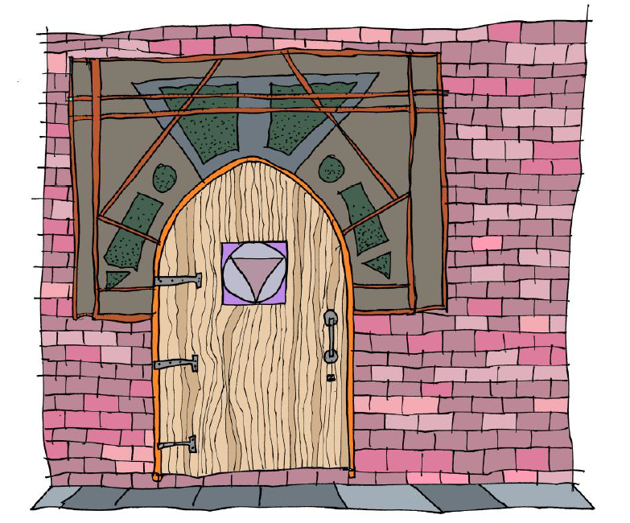

Slide 3
Best to complete this list in a lined exercise book But if not, any paper you can find at home.

Slide 4
Wednesday 6th January 2021

Slide 5
This is an idea inspired by Kit Wright’s poem ‘The Magic Box’. Click on the link below to listen to the author perform the poem. Alternatively, you can read his poem on the following slides. In the poem, Kit imagines what may be contained inside a magical box. We can use this idea to connect to what could be behind the magical door.
https://www.bbc.co.uk/bitesize/clips/zkpmhyc

Slide 9
Now have a go at editing your writing to make it more descriptive.

Slide 10
Thursday 7th January 2021

Slide 11
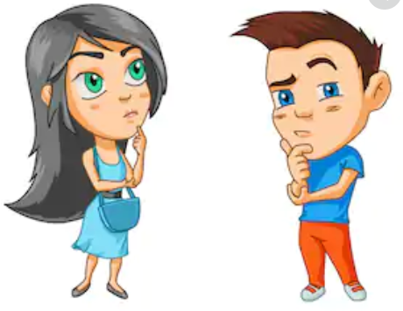
Reflection
How did you get on with your poems yesterday?
Did you get a chance to edit them?
Read through them again today, with a fresh mind to see if
there is anything you would change
or perhaps add to your poems. Have fun
adding to your ideas and let your
imagination run wild!

Slide 12
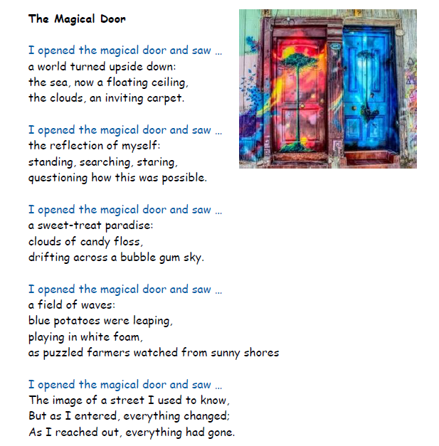
Have a read of this poem by a teacher and some Year 6 children.

Slide 13
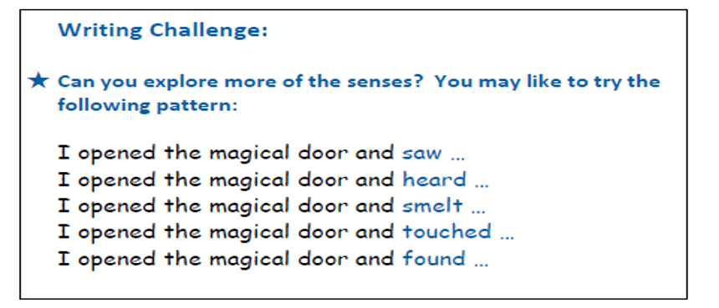
Rewrite what you have written and change some of the words so that it says exactly what you want it to say. You may want to look at the writing challenge below and add in some of these ideas.

Slide 14
Friday 8th January 2021

Slide 17
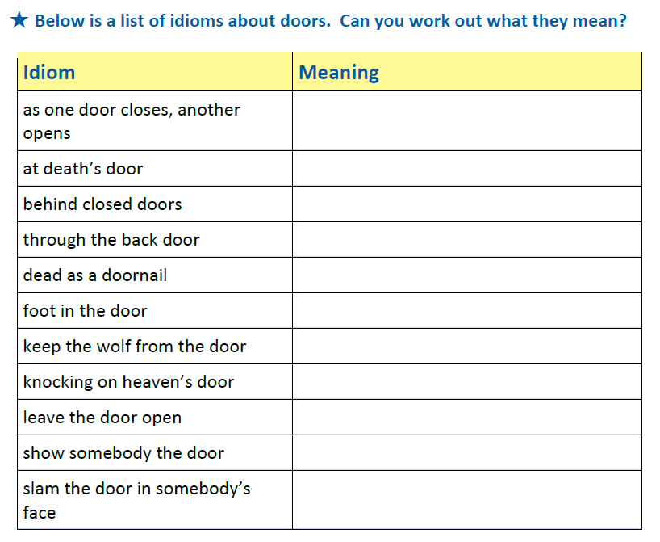
Extension Using IPADS, search for the meanings on the internet.

Slide 18
https://www.bbc.co.uk/bitesize/clips/zkpmhyc

