Slide 1
Positive, Neutral, or Negative Rake?
By Lyndal Anthony
These angles can be equated to buttering toast
If you burn the toast, you use a neutral rake to scrape the black off
To butter the toast, you use a negative rake to push the butter into the toast
If you want to slice/cut the toast, you use a positive rake

Slide 2
Neutral Rake
A neutral rake is held flat and level with the tool rest.
A neutral rake tends to scrape/grab wood fibers but is very easy to manipulate because it can go with or against the grain.

Slide 3
Negative Rake
The negative rake does not like to cut. It tends to push the wood fibers back down into the wood/work/piece before it scrapes them off
The other advantage of negative rake is: It does not like to cut. This alone reduces the “grab-iness” of the scraper reducing catches

Slide 4
Positive rake
Think of this as the Archimedes Screw (a helical surface surrounding a central cylindrical shaft)
This was designed by Archimedes to move water vertically. It is just a screw and if you twist a screw, the screw threads “Self Feed” into the work piece.

Slide 5
The positive rake on a gouge will tend to “Self Feed” aggressively into the work piece, but if it is angled correctly, it will help the tool self feed and make it easier to control the tool

Slide 6
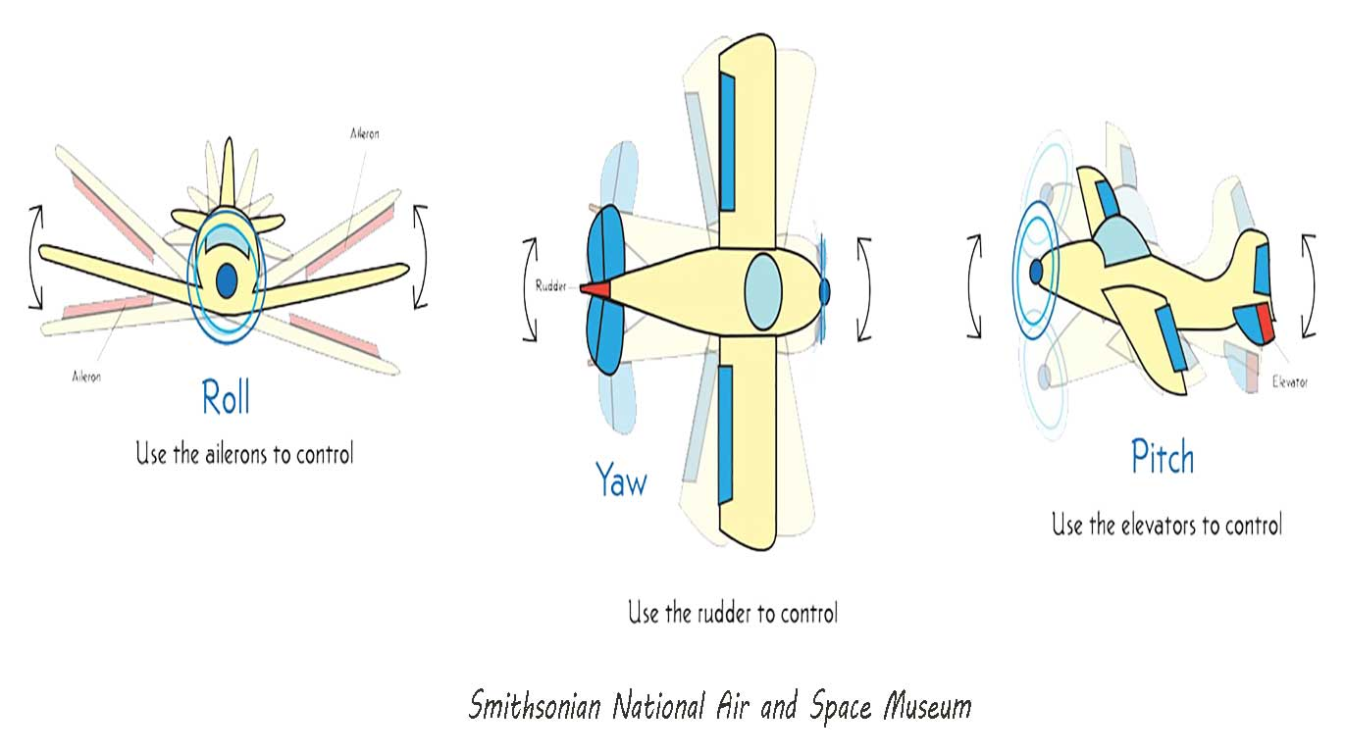
Using the gouge angle is just like flying an airplane

Slide 7
The angle can be “micro adjusted” through the roll/yaw/pitch of the gouge as you maneuver it through the cut. This will also change how the tool cuts and will affect the shape/texture/efficiency of the shavings/cut.

