Slide 1
Ending and Starting the School Year
Tennessee Data and Attendance Supervisors Conference
Trish Kelly, Data Manager | Consolidated Planning & Monitoring (CPM) | April 4, 2019
Notes:
Consolidated Planning & Monitoring (CPM), Data Mini-Webinar: EIS, June 22, 2018 (slide title)
Welcome to the Consolidated Planning & Monitoring, EIS Data Mini-Webinar.

Slide 2
Agenda
Rollovers
Student Classifications
English Language Background (ELB) Progression
Homeless Residence Discrepancies
Immigrant Flag
Extract 40 Overwrites
Forms for Migratory Students: Individual Student Record (ISR) and Occupational Survey
Activities During the School Year
Checking Your Data in EIS
Resources and Contacts
Notes:
Agenda (slide title)
This session will begin with an overview of how to review your data in SIS and EIS.
Next, we will examine extract 40 rollovers and overwrites as well as student classification procedures at the beginning and end of the school year.
We will also discuss resources available on the EIS home page, ____EIS and how to check your data in EIS.
We will conclude with suggestions for post-session follow up and contact information.

Slide 3
Rollovers

Slide 4
Rollovers
Fields that are tied to enrollments should not roll over to the next year.
Name, date of birth, native language, immigrant status, and other fields that are a permanent part of the student record may roll over to the next school year.
Notes:
Extract 40: Rollovers and Overwrites (slide title)
Demographic fields such as name and date of birth that are uploaded to EIS on extract 40 are:
a permanent part of the student record, and
may be rolled over to the next school year.
When districts change the previously submitted value of the five fields listed below, EIS will generate an informational error message that contains the previous value and a request to confirm the new value.
This is a new informational message for the 18-19 school year.
The five affected fields are:
birth country,
date first enrolled in U.S. school,
immigrant,
native language, and
year entered 9th grade.

Slide 5
Student Classifications

Slide 6
Student Classifications: School Year Start
The ADM audit report requires students to have at least one student classification.
  To satisfy the requirement, upload the Regular (R) student classification for all students at the beginning of the school year.
Enter begin and end dates for student classifications and similar fields that are tied to enrollments.
  The begin date is the enrollment date or the date the status begins (depending on the situation).
  The end date is the withdrawal date, the last day of the school year, or the date the status ends (depending on the situation).
Notes:
Student Classifications: Starting and Ending the School Year (slide title)
At the beginning of the school year, code all students with the Regular (R) student classification and upload to EIS. This will satisfy the ADM audit report requirement that students have at least one student classification.
Student classifications and similar fields that:
are tied to enrollments
should not be rolled over to the next school year.
Enter begin and end dates for student classifications and similar fields.
The begin date is the enrollment date or the date the status began (depending on the situation).
The end date is the withdrawal date or the date the status ended (depending on the situation).

Slide 7
Student Classifications: School Year End
At the end of the school year, do not roll over student classifications and similar fields that are tied to enrollments.
Use the last day of the school year as the student classification end date.
Do not remove student classifications at the end of the enrollment or school year.
Student classifications identify students as part of subgroups for accountability, funding, reporting, and other purposes.
Notes:
Student Classifications: Starting and Ending the School Year (slide title)
At the beginning of the school year, code all students with the Regular (R) student classification and upload to EIS. This will satisfy the ADM audit report requirement that students have at least one student classification.
Student classifications and similar fields that:
are tied to enrollments
should not be rolled over to the next school year.
Enter begin and end dates for student classifications and similar fields.
The begin date is the enrollment date or the date the status began (depending on the situation).
The end date is the withdrawal date or the date the status ended (depending on the situation).

Slide 8
Begin and End Date Example
Suppose that Mary Smith enrolls as an eighth grader in School 1, a Title I schoolwide school, on Aug. 8 and withdraws on Nov. 14.
Mary enrolls in School 2, a non-Title I school, on Nov. 15.
At School 1:
  Mary is flagged with the Title I (T) student classification;
  the Title I (T) student classification begin and end dates are Aug. 8 and Nov. 14, respectively.
When Mary enrolls in School 2 on Nov. 15, she is no longer a Title I student.
The Title I (T) student classification and student classification begin and end dates at School 1 ensure that Mary is identified as Title I for her enrollment at School 1 for accountability, funding, reporting, and other purposes.
Notes:
Begin and End Date Example (slide title)
Suppose that Mary Smith enrolls as an eighth grader in School 1, a Title I schoolwide school, on Aug. 8.
Mary transfers to School 2, a non-Title I school, on Nov. 15.
At School 1:
Mary is flagged with the Title I (T) student classification;
the student classification begin and end dates are Aug. 8 and Nov. 15, respectively.
When Mary enrolls in School 2 on Nov. 15, she is no longer a Title I student.
The Title I (T) student classification and the student classification begin and end dates ensure that Mary is identified as Title I for her enrollment at School 1.

Slide 9
Which School?
Which enrollment/school will be included in
  Oct. 1 membership counts?
  spring assessment provisioning and related reporting?
  Title I counts of students enrolled anytime during the school year?

Slide 10
English Language Background Progression

Slide 11
WIDA ACCESS Results & ELB Classifications
English learners (L & W) take the WIDA Access assessment each spring to measure their progress in learning English.
WIDA ACCESS results from the spring of 2019 determine English language background (ELB) classifications for the next school year, the 2019-20 school year.
  Students who do not meet the exit criteria will be coded as L or W in 2019-20.
  Students who meet the exit criteria will be coded as T1 or 1 in 2019-20, the first transition year from ESL.
    The English language background classification changes to T1 or 1 only for the 2019-20 school year – not for the current year or prior years.
Notes:
WIDA ACCESS Results and ELB Classifications (slide title)
WIDA ACCESS results from the spring of 2018 determine English language background (ELB) classifications for the next school year, the 2018-19 school year.
Students with L and W English language background classifications in 2017-18 took WIDA ACCESS in spring 2018.
Students who did not meet the exit criteria are coded as L or W in 2018-19.
Students who met the exit criteria are coded as T1 or 1 in 2018-19, the first transition year from ESL.

Slide 12
Transitioning from ESL
The transition from ESL is a four-year process.
There is an English language background classification for each year:
  T1 or 1 - Transitional Year 1 - first transition year from ESL,
  T2 or 2 - Transitional Year 2 - second transition year from ESL,
  T3 or 3 - Transitional Year 3 - third transition year from ESL, and
  T4 or 4 - Transitional Year 4 - fourth transition year from ESL.
If the transition process progresses without interruptions, the fifth year after exiting ESL, the student:
  becomes a former English Learner and
  is coded as F, which is defined as former EL status attained upon completion of the fourth transitional year.
Notes:
Transitioning from ESL (slide title)
The transition from ESL is a four-year process.
There is an English language background classification for each year:
T1 or 1 - Transitional Year 1 - first transition year from ESL,
T2 or 2 - Transitional Year 2 - second transition year from ESL,
T3 or 3 - Transitional Year 3 - third transition year from ESL, and
T4 or 4 - Transitional Year 4 - fourth transition year from ESL.
If the transition process progresses without interruptions, the fifth year after exiting ESL, the student:
becomes a former English Learner and
is coded as F, which is defined as former EL status attained upon completion of the fourth transitional year.

Slide 13
English Language Background Classifications: Anticipated Progression
Students who progress as expected and were classified in the current year as:
  E and N should have the same code in prior and subsequent years.
  L and W were L or W the prior year and will be L, W, or 1 the next year depending on the results of the WIDA Access assessment.
  1 were L or W the prior year and will be 2 the next year.
  2 were 1 the prior year and will be 3 the next year.
  3 were 2 the prior year and will be 4 the next year.
  4 were 3 the prior year and will be F the next year.
  F were 4 or F the prior year and will be F the next year.
Notes:
English Language Background Classifications: Anticipated Progression (slide title)
As shown in the table, students who progress as expected and were classified as:
E and N in the current year should have the same code in prior and subsequent years.
L and W in the current year were L or W the prior year and will be L, W, or 1 the next year depending on the results of the WIDA Access assessment.
1 in the current year were L or W the prior year and will be 2 the next year.
2 in the current year were 1 the prior year and will be 3 the next year.
3 in the current year were 2 the prior year and will be 4 the next year.
4 in the current year were 3 the prior year and will be F the next year.
F in the current year were 4 or F the prior year and will be F the next year.
(Table with the anticipated progression of the English language background (ELB) classifications.)

Slide 14
Homeless Residence Discrepancy

Slide 15
Homeless Residence Discrepancy: 2018-19
Homeless students should be identified with the homeless (H) student classification AND one of the four primary nighttime residence codes (01-04).
However, as of March, over 1,200 students were flagged with only a homeless residence code.
  Most of these students are not homeless in 2018-19; the residence code rolled over from the prior year.
  Use the Homeless Student List research query to identify these discrepancies.
    The homeless student classification will be listed as “N” and primary nighttime residence will be coded as “01-04”.
  Please remove the residence code from your student information system and restage your data in EIS.

Slide 16
Homeless Residence Discrepancy: 2019-20
Work with your vendor to ensure that the homeless residence codes
  do not rollover to the next school year and
  cross validate against the homeless (H) student classification.

Slide 17
Immigrant Flag

Slide 18
Immigrant Flag
The immigrant flag is:
  “Yes” for students who were not born in one of the fifty U.S. states, the District of Columbia, or Puerto Rico.
  “No” for students born in the U.S.
The immigrant flag:
  is a permanent part of the student record, and
  is “Yes” for students who were not born in the United States for their entire enrollment history.
Country of Birth should not be:
  missing or identified as unknown, Puerto Rico, or U.S. for immigrant students.
Notes:
Immigrant Flag (slide title)
The immigrant flag is:
“Yes” for students who were not born in one of the fifty U.S. states, the District of Columbia, or Puerto Rico.
“No” for students born in the U.S.
The immigrant flag:
is a permanent part of the student record, and
is “Yes” for students who were not born in the United States for their entire enrollment history.

Slide 19
Immigrant Data
As of March, over 31,000 students were identified as immigrant for the 2018-19 school year.
However, 890 students were excluded from the immigrant count because country of birth was missing or identified as unknown, Puerto Rico, or U.S.
If country of birth is missing or identified as unknown, Puerto Rico, or U.S. for immigrant students in your district, please correct your data and submit revisions to your student information system and EIS.

Slide 20
Extract 40 Overwrites

Slide 21
Birth Country, Immigrant, and
Year Entered 9th Grade
When districts change the previously submitted value of birth country, immigrant, and year entered 9th grade, EIS generates an informational error message that contains
  the previous value and
  a request to confirm the new value.
If the new value is correct, no further action is needed.
If the new value is incorrect, please revise and restage your data.
Notes:
Extract 40: Rollovers and Overwrites (slide title)
Demographic fields such as name and date of birth that are uploaded to EIS on extract 40 are:
a permanent part of the student record, and
may be rolled over to the next school year.
When districts change the previously submitted value of the five fields listed below, EIS will generate an informational error message that contains the previous value and a request to confirm the new value.
This is a new informational message for the 18-19 school year.
The five affected fields are:
birth country,
date first enrolled in U.S. school,
immigrant,
native language, and
year entered 9th grade.

Slide 22
Date First Enrolled in U.S. School
Date first enrolled in U.S. school cannot be uploaded as blank if
  English language background was a value other than “E” in 2017-18 or later, or
  Immigrant = “Y” in 2017-18 or later.
Other changes to date first enrolled in U.S. school will generate informational messages, but records will not be blocked.
  If the new value is correct, no further action is needed.
  If the new value is incorrect, please revise and restage your data.

Slide 23
Native Language
Native language will not upload as blank or “ENG” if English language background was a value other than “E” in 2017-18 or later.
Other changes to native language will generate informational messages, but records will not be blocked.
  If the new value is correct, no further action is needed.
  If the new value is incorrect, please revise and restage your data.

Slide 24
English Language Background
Since the business rules for date first enrolled in U.S. school and native language on extract 40 are tied to English language background (ELB) on extract 41,
  English language background is a required field on extracts 40 and 41 for 2017-18 and subsequent years.
The English language background (ELB) field on extract 40 is for validation only.
  The ELB field on extract 40 will not set or edit a student’s English language background.
  The ELB field value is set and edited on extract 41.
Extracts that include blank or invalid ELB values generate fatal errors and will not load.

Slide 25
Forms for Migratory Students: ISR and Occupational Survey

Slide 26
The ISR and MSIX
The individual student record (ISR) contains demographic, health, and academic information for migratory students and is exchanged in MSIX.
The U.S. Department of Education (USEd) established the MSIX data system to facilitate the exchange of school records for migratory students.
Districts submit an individual student record (ISR) form for each migratory student to the state migrant education program.
In Tennessee, Conexión Americas collects the ISR on behalf of the department.

Slide 27
ISR Timeline
During the school year, districts must submit the ISR
  within 14 days of the student’s departure, or
  within 4 days of the receiving school’s request via MSIX.
If the student is enrolled on the last day of school, the ISR is due at the end of the school year (no later than June 30).
Districts use the TNMigrant website (http://tn.msedd.com) to exchange ISRs and other documents securely with Conexión Americas.
For ISR forms and additional information, please contact Elena Cruz at Conexión Américas (elena@conexionamericas.org).

Slide 28
Occupational Survey
At the beginning of school year or enrollment, families complete an occupational survey.
Districts help identify migratory students by forwarding occupational surveys to Conexión Americas via the TNMigrant website when the family answers “Yes” to the first two questions.
Within the last three years,
  Has a child in your family moved to another city, state, and/or country?
  Has anyone in your immediate family been employed in
    agriculture/field work,
    processing and packing,
    dairy/cattle raising
    nursery/greenhouse
    forestry, or
    fishing/fish processing?
Conexión Americas contacts the family and determines whether the move and employment qualify the children for migratory status.

Slide 29
Activities During the School Year

Slide 30
Activities During the School Year
  Collaborate with attendance, federal programs, technology, and EIS contacts to ensure that your data are coded properly.
  Regularly check your data in your student information system (SIS) and EIS, and upload revisions as needed.
  For additional information about EIS and consolidated planning & monitoring (CPM) data, view the CPM data mini-webinars and refer to the CPM Data Manual.
  Contact the department if you have questions.
Notes:
After the Session (slide title)
After the session, please
Collaborate with attendance, federal programs, technology, and EIS contacts to ensure that your data are coded properly.
Regularly check your data in your student information system (SIS) and EIS, and upload revisions as needed.
For additional information about EIS and CPM data, please refer to the CPM Data Manual, which is located in
ePlan / TDOE Resources / CPM / CPM Data and the
department’s Planning and Monitoring, Guidance & Reference Materials web page.
Contact the department if you have questions.

Slide 31
Checking Your Data in EIS

Slide 32
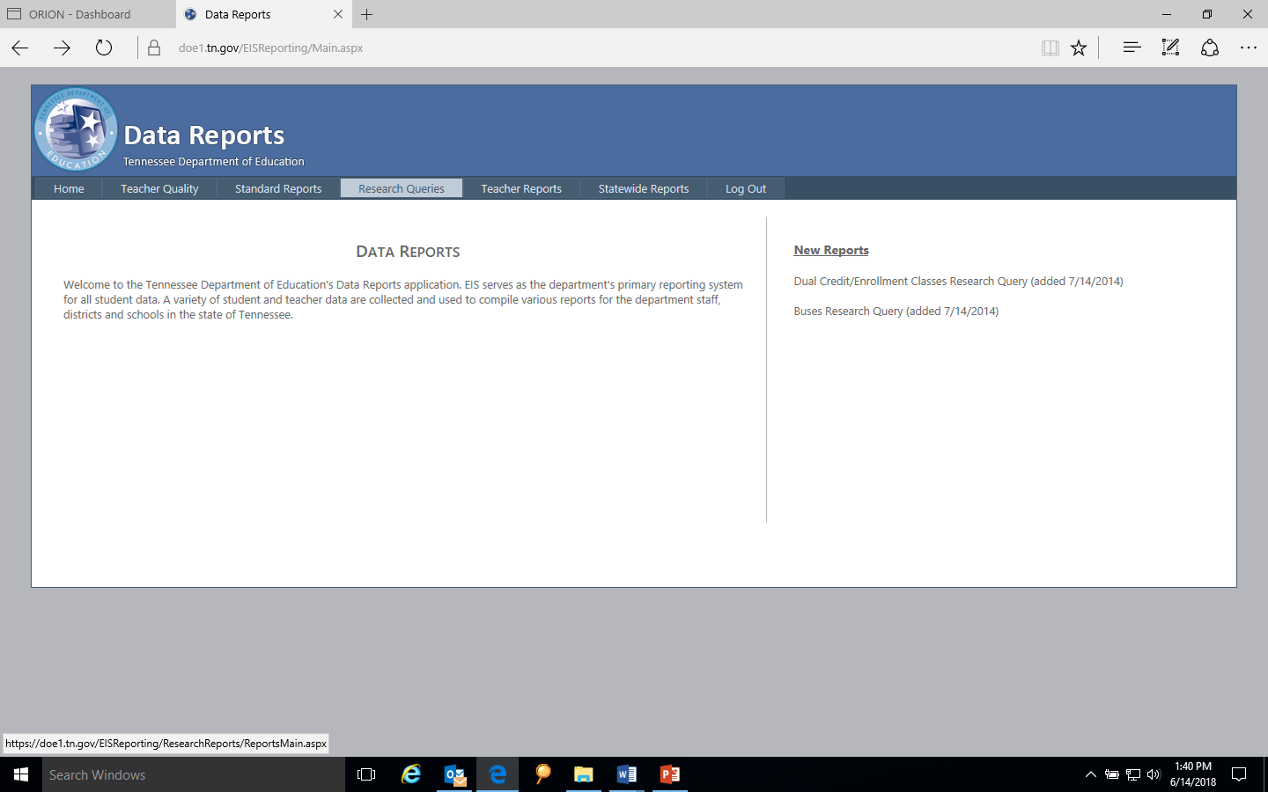
Data Reports / Research Queries
To check your data in EIS, login as a district or school user.
Select “Data Reports” / “Research Queries.”

Slide 33
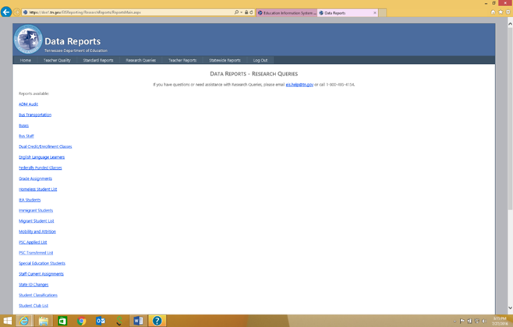
Research Queries
Choose a research query from the list on the left side of the screen.
Notes:
Research Queries (slide title)
Choose a research query from the list on the left side of the screen.
Research query list (screen shot).

Slide 34
CPM Research Queries
To review CPM data, use:
  English Language Learners,
  Homeless Student List,
  Immigrant Students,
  Staff Current Assignments,
  Student Classifications,
  Student Withdrawals, and
  Targeted Assistance List.
Notes:
CPM Research Queries (slide title)
Use the research queries listed below to review CPM data:
English Language Learners,
Homeless Student List,
Immigrant Students,
Staff Current Assignments,
Student Classifications,
Student Withdrawals, and
Targeted Assistance List.

Slide 35
Student Classifications Research Query
The student classifications research query addresses many key fields including:
  active duty military dependent (4),
  direct certification of economic disadvantage (J),
  foster care (FOS01),
  juvenile detention centers (JDC01-JDC17),
  migrant (I),
  national guard military dependent (5),
  reserve military dependent (6),
  runaway (U), and
  Title I (T).
Notes:
Student Classification Research Query (slide title)
The student classifications research query addresses many key fields including:
active duty military dependent (4),
direct certification of economic disadvantage (J),
foster care (FOS01),
juvenile detention centers (JDC01-JDC17),
migrant (I),
national guard military dependent (5),
reserve military dependent (6),
runaway (U), and
Title I (T).

Slide 36
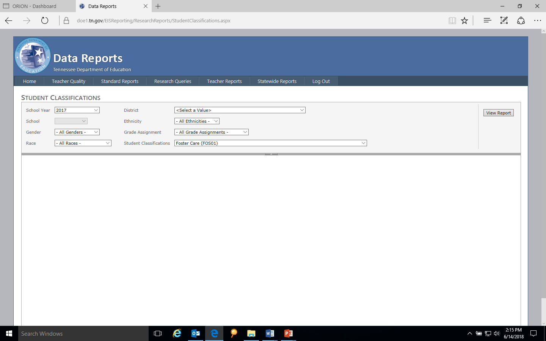
Student Classifications Research Query: Foster Care (FOS01)
For example, to check your foster care data, choose the Student Classifications research query.
Select “Student Classifications” and “Foster Care (FOS01).”
Enter year as 2018 for 2018-19.
Select a “School” or “All Schools.”

Slide 37
Student Classifications Research Query Results: Foster Care (FOS01)
To run the query, select “View Report.”
Download in csv or Excel format using the file icon to the right of “Find” | “Next.”
The research query results follow a standard format.
School and student identifiers are on the left.
The variable of interest, foster care (FOS01), is on the right.

Slide 38
Resources and Contacts

Slide 39
CPM Data Mini-Webinars
For additional information, use the links on this slide to access the CPM data mini-webinars (5-15 minutes) on eight topics from the CPM Data Manual.
    EIS
    English Learners
    Homeless
    Immigrant
    Juvenile justice
    Migrant
    Military Status of Parent/Legal Guardian
    Title I
The links are also available in ePlan / TDOE Resources / Consolidated Planning & Monitoring / CPM Data / Webinar Presentations & Recordings / Data Mini-Webinars.
A login to ePlan is not required to access the links to the recordings.

Slide 40
CPM Data Manual
For additional details on each topic, please use the link on this slide to access the CPM Data Manual.
The manual is also available in
  ePlan / TDOE Resources / Consolidated Planning & Monitoring / CPM Data as well as
  the department’s Planning and Monitoring, Guidance & Reference Materials web page.

Slide 41
Contact Information
For questions about CPM data, please contact Trish Kelly (Trish.Kelly@tn.gov), Consolidated Planning & Monitoring (CPM) Data Manager.
For EIS errors and restaging problems, please contact the District Technology Support Team (DT.Support@tn.gov).
Notes:
Contact Information (slide title)
If you have questions about coding and migrant data, please contact Trish Kelly (Trish.Kelly@tn.gov), CPM Data Manager.
For questions about the migrant program, please contact Jan Lanier (Jan.Lanier@tn.gov), Director, English Learner, Immigrant & Migrant Programs.
For information about the TNMigrant website, please contact Elena Cruz at Conexión Américas (elena@conexionamericas.org).
For EIS errors and restaging problems, please contact the District Technology Support Team (DT.Support@tn.gov).
Thank you for joining me/us in this session. I hope it was helpful to you.

