Slide 1
Mine Floors Material Vacuuming not yet Part of Life of Mine Plan and Normal Mining Cycle in Most Countries in the World and Governments, Mining Companies Executives and Shareholders Allow to Leave Behind Never to be Recovered Capitally and Operationally Accessed Already Broken High-Grade Ore Underground Worth Billions of Dollars⁺⁺⁺⁺⁺⁺⁺⁺⁺
MINEX Forum Europe 2020 London
July 2020 (updated/modified on 24 10 2020)
By Krzysztof (Kris) Biegaj
Ausvac Mining Pty Ltd
Australia

Slide 2
House Vacuuming Invented and World-wide Implemented in Late 19th/Early 20th Century
Highly-efficient Mine Floor Material Vacuuming Technology invented, developed and available in Australia since 2003

Slide 3
Mining Project Stages
Exploration
Pre-feasibility/Feasibility Studies/Ore Resources/Ore Reserves/Life of Mine Plan Calculations, Governmental & Financial Approvals
Approved
Access development in waste and mine waste disposal off - majority on surface
Mining
Rehabilitation of mining waste disposed off on surface

Slide 4
Mining - Continued
Cleaning - vacuuming/vamping of mine floors not yet part of mining cycle in Australia and most Countries in the World
Various reconciliation factors still allowed to be used to hide high-grade broken ore left behind on mine floors never to be recovered
Floors of the excavations to be cleaned/vamped/vacuumed:
Ore drives
Stopes
Top of last lift in cut & fill/under-hand cut & fill mining - remotely controlled vacuuming only in open stoping
Top of mine pillars left behind for geotechnical reasons – remotely controlled vacuuming only in open stopes
Rehabilitation of disposed off on surface capital and operational waste generated to access the left behind high-grade ore on mine floors has not yet being compensated for

Slide 5
Mine Floors Cleaning/Vacuuming Must become part of Mining Cycle
Mine floors material recovery Must be included in Pre-feasibility/Feasibility Studies and Ore Resources/Reserves Calculations/Life of Mine Plans – including compensation for surface rehabilitation of waste generated when accessing the ore left behind on mine floors
Timing - Mine floors material recovery (in stopes & ore drives) must be conducted whilst mine ventilation/fresh water/compressed air supply/dewatering plus other infrastructures are fully operational
Needs to be carried out immediately after “normal mining activities” in mining areas/sections have been completed as planned
Not after mine was flooded/put on care and maintenance
Including recovery of high-grade broken ore from top of pillars to be left for geotechnical reasons
With remotely controlled vacuuming (in open stopes)

Slide 6
Post “normal” mining activities currently/already used/trialled – cont.
Stopes wash-down/vamping/vacuuming
In South Africa even gold left in stopes’ floor cracks has being recovered for many years
And being a part of normal mining cycle for years
Stopes wash-down carried out on Central Norseman Gold Corporation (CNGC) Gold Mines, Western Australia in 2000-2001
More recently (2010-2011) - highly successful ore drives and stope floor material recovery in Norseman Gold NL (previously CNGC) at Harlequin Mine with the Mobile Supersucker conducted by Ausvac Mining PL

Slide 7
Floor sampling at CNGC Harlequin Gold Mine in Norseman, Western Australia (April 2001)
Harlequin Gold Mine Ore Tones Hoisted in 1998-2001:
61,019t @ 17.56 g/t, 90,034t @ 15.71 g/t, 133,325t @ 12.22 g/t and 149,358t @ 14.07 g/t respectively
Conducted by Kris Biegaj in 3.5m x 3.5m HV5F –41mRL freshly excavated in-stope single boom jumbo decline mined through semi-horizontal quartz reef ~300mm thick containing 100-300g/t of nuggetty-type Au
Five (5) separate sampling layers taken across the floor of 3.5m wide decline with a pelican pick
Last bottom layers taken with a small dust-buster/vacuum cleaner to the decline’s solid floor/cleaned
Nine (9) separate samples in total taken and analysed
Total weight of samples – 131.9 kg
Unfortunately photos taken during sampling did not come out
Grade: 40.02 g/t of Au – next slide with sample details

Slide 8
From: Briggs, Matthew Sent: Tuesday, April 03, 2001 2:36 PM To: Biegaj, Kris Subject: Channel sample from 41dec.xls
Au1 (ppm)
Au2 (ppm)
av gold (ppm)
sample mass (kg)
HA20711
44.13
39.17
41.65
5.44
226.5869
1.717869
HA20712
61.62
69.10
65.36
6.88
449.6734
3.409199
HA20713
46.24
49.09
47.67
4.94
235.4799
1.785291
HA20714
35.61
42.47
39.04
20.50
800.361
6.067938
HA20715
83.31
65.45
74.38
10.30
766.1037
5.808216
HA20716
36.60
39.21
37.91
19.44
736.9121
5.5869
HA20717
28.23
40.11
34.17
23.18
792.0374
6.004833
HA20718
31.00
33.01
32.01
19.46
622.8562
4.722185
HA20720
30.81
28.77
29.79
21.76
648.2304
4.91456
40.02
Weighted average grade:
g/t

Slide 9
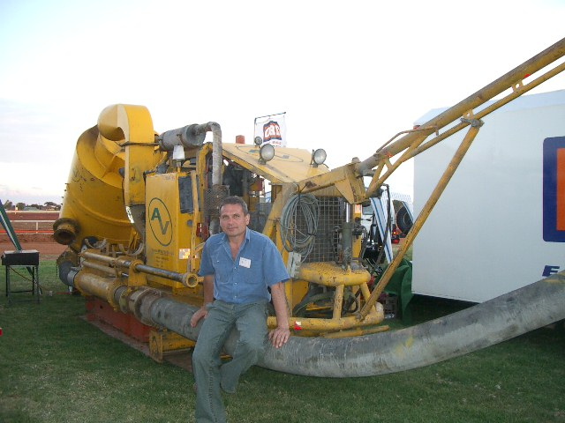

Slide 10
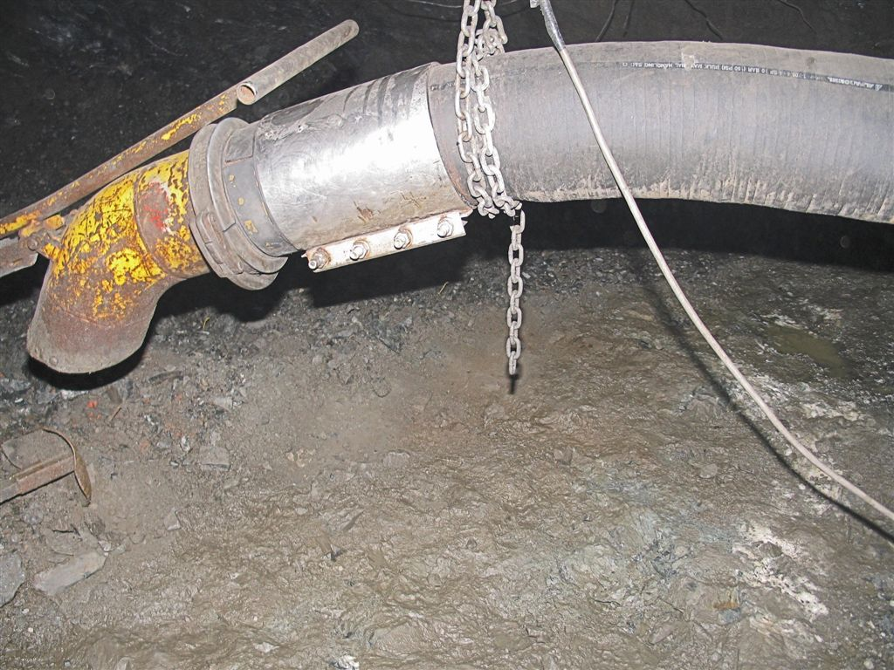
~0.35m thick broken ore left behind on ore drive floor on the nickel mine located near Kambalda - before and after vacuuming; Western Australia – 2007
Suction hose Dia. 200mm/8 inch
Commonly up to 0.5m thick high-grade mine floor material “normally” left behind had been vacuumed on gold and nickel mines in Australia by Ausvac Mining PL in 2003-2011

Slide 11
Underground Mobile Supersucker – Giant Mobile Vacuum Cleaner
Construction/features
First in the World truly mobile highly efficient giant vacuum cleaner – designed and built in Australia for underground and surface applications
Initially (2000-2002) designed by Ausvac Mining P/L to carry-out underground exploration winzing in nuggety-type ore-bodies in a safe and highly efficient way
First vacuuming units of that suction type and capabilities invented and built in Australia in the late 60-ties of the previous Century
Also widely used for shafts sinking
Size: 2.2mW, 2.95mH and 5.3mL (excluding 3.5m easily detachable clean-down jib)
Weight – 8.3 tonnes
Track mounted, diesel-powered self-propelled unit
Easily detachable heavy-duty wheels for longer distance towing
To reduce exhaust emissions, pollutions to environment and vacuuming in mines located in high altitudes can be modified to be electrically powered
Safety features installed on it:
Devices to eliminate potential dust problems
ROPS/FOPS
Remotely-controlled capabilities can be installed

Slide 12
Underground Mobile Supersucker
Projects to date by Ausvac Mining Pty Ltd
May 2003 – Mt Pleasant Gold Mine located near Kalgoorlie, WA (Western Australia) - First Project
Ore drives clean-down Plus cleaning of mining equipment wash-down sump on surface (Photos in Appendices slide at the end)
Aug 2003 – Otter-Juan Nickel Mine, Kambalda, WA 15 deg. air-leg stope and ore drives clean-down
Oct 2003 – Bendigo Gold Project, State of Victoria
Ore drives clean-down
Dec 2003 – Cosmos Nickel Project, WA
Ore drives clean-down
Feb 2004 – Agnew Gold Project, WA
Ore drives clean down
Oct 2005 – Long-Victor Nickel Complex, WA
Stopes and ore drives clean-down at Gibb South
Feb 2007 – Redross Nickel Mine, WA
Ore drives clean-down
Nov 2010- Jan 2011 – Norseman Gold NL, WA
Stopes and ore drives clean-down at Harlequin Mine

Slide 13
Underground Mobile Supersucker
Excavation size requirements for the Supersucker
3.2mW x 3.5mH drive
Designed to fit into small 2 cubic yard LHD size ore drives
Depends on ore-body dip angle
Secondary ventilation required
~ 10 m³/s - for Supersucker + bobcat or small LHD
Based on Western Australian (WA) Mines Regulations
Fresh water supply required – in high water salinity mines
To wash out the Supersucker at the end of each shift

Slide 14
Underground Mobile Supersucker
Capabilities/parameters
Suction hose diameter - 200mm (8 inch)
To increase productivity - can be upgraded to bigger diameter
Vertical lifting/suction - up to 50m
Horizontal vacuuming - up to 50m +

Slide 15
Underground Mobile Supersucker
Due to the mine floor material “milling” effect when using conventional LHD bogging/scraping equipment, gravity force and water, the ore grade of gold and metals left on operational mine floors for longer period is much higher then ore grade on mine floors in fresh excavations
Vacuuming productivities in ore drives and stopes
40 t/10-12 hr shift with two (2) Operators
80 t/day with two (2) shifts/day
Started with ~5 t/shift with two (2) Operators in 2003 – First trial
Now 2,000 t/month (with 80% availability of equipment and working places)
The Ore “normally” wasted

Slide 16
Extra Gold Revenue Recovered from mine floors with Supersucker
Gold Normally Left Behind on mine floors per m²
(18 10 2020 Au price; Vacuumed ore tones used for calculations: only 1,360 t)
US$1,900.07/oz; Aus$/US$ Exchange Rate: 0.71
Vacuumed mine floor material thickness of 0.4m most commonly left behind used in calculations of Extra Revenue:
Ore drives floor sizes (140m + 200m) x 4.0m: 1,360 m²
Thickness of floor material: 04.m
Vacuumed Au ore tones (SG - 2.5): 1,360 t
Grade: 5.0g/t – 120 g/t
Total Au oz (respectively of grade above): 218.6 - 5,247.6
Au ore t/m²: 1.0 t
Gold oz/m²: 0.16 oz – 3.86 oz
Gold value/m² left behind on mine floors: Aus$290/m² to Aus$6,966/m²
Extra Gold Revenue/m² after deduction of all costs
Aus$133.0/m² to Aus$6,809 per m²

Slide 17
Extra Nickel Revenue Recovered from mine floors with Supersucker
Nickel Left Behind on mine floors per m²
(18 10 2020 Ni Prices; Vacuumed ore tones used for calculations : only 1,632t
US$15,603/t; Aus$/US$ Exchange Rate: 0.71;
65% Toll Treatment/Roasting/Refining credit used in calculations below
Vacuumed mine floor material thickness of 0.4m most commonly left behind used in calculations of Extra Revenue:
Ore drives floor sizes (140m + 200m) x 4.0m: 1,360 m²
Thickness of floor material: 04.m
Vacuumed Ni ore tonnes (SG - 3.0) 1,632 t
Grade: 1.5% – 8.6%
Total Ni tonnes (respectively of grade above): 15.9 t – 91.2 t
Total Ni ore t/m² 1.2 t
Ni t/m² 0.012 t – 0.067 t
Nickel value/m² : Aus$219/m² to Aus$1,253/m²
Extra Ni Revenue/m² after deduction of all costs
Aus$171.5/m² to Aus$1,205.9/m²

Slide 18
Summary of Extra Revenue from Vacuuming
(With vacuumed mine floor material of only 1,360 t of Au ore and 1,632 t of Ni ore per month respectively)
Gold:
Grade 5.0 g/t to 120 g/t respectively:
Monthly: Aus$ 180,508 to Aus$ 9,260,072
Yearly: Aus$2,166,096 to Aus$111,120,864
Nickel:
Grade 1.5% to 8.6% respectively:
Monthly: Aus$ 233,175 to Aus$ 1,640,066
Yearly: Aus$2,798,100 to Aus$19,680,792
2,000 t/month of mine floor material can be vacuumed with Supersucker

Slide 19
Extra Gold and Nickel Revenue left behind and recovered from mine floors with Supersucker vacuuming – Details (Summary of Extra Revenue for other metals and precious stones can be provided)
Go to: www.ausvacmining.com.au/Services - for updates

Slide 20
Cleaning of Mine Floors still has not being included in Life of Mine Plans to be part of Normal Mining Cycle

Slide 21
Mobile Supersucker – Other Applications
Go to next/last PP Slide - Appendices

Slide 22
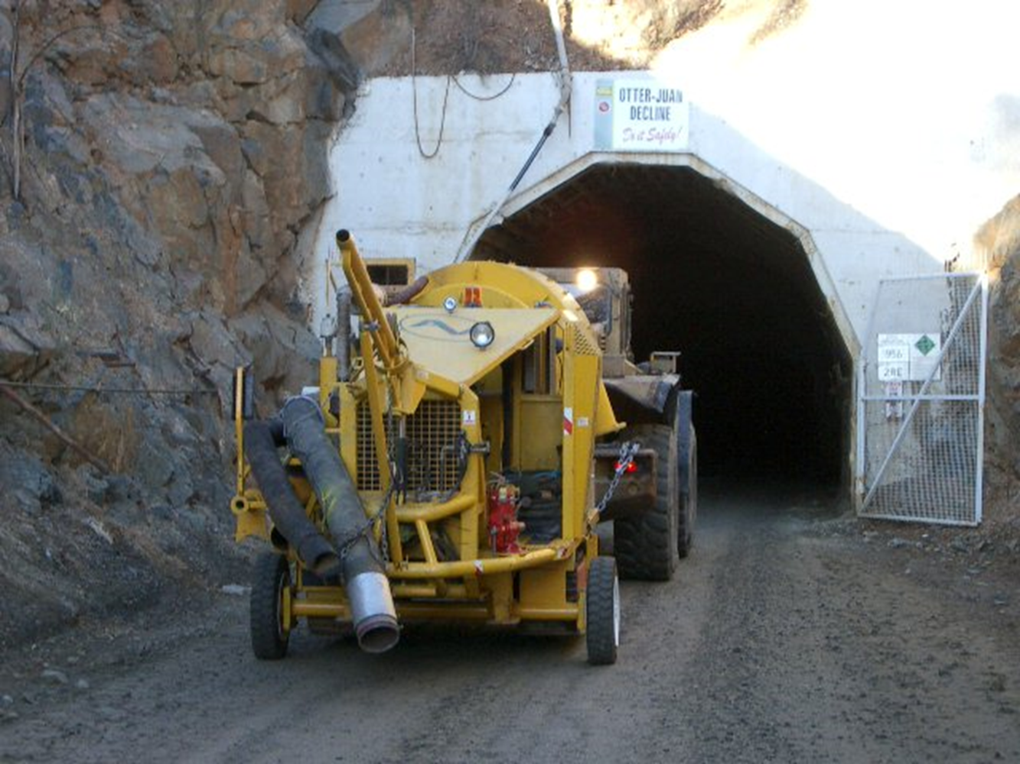
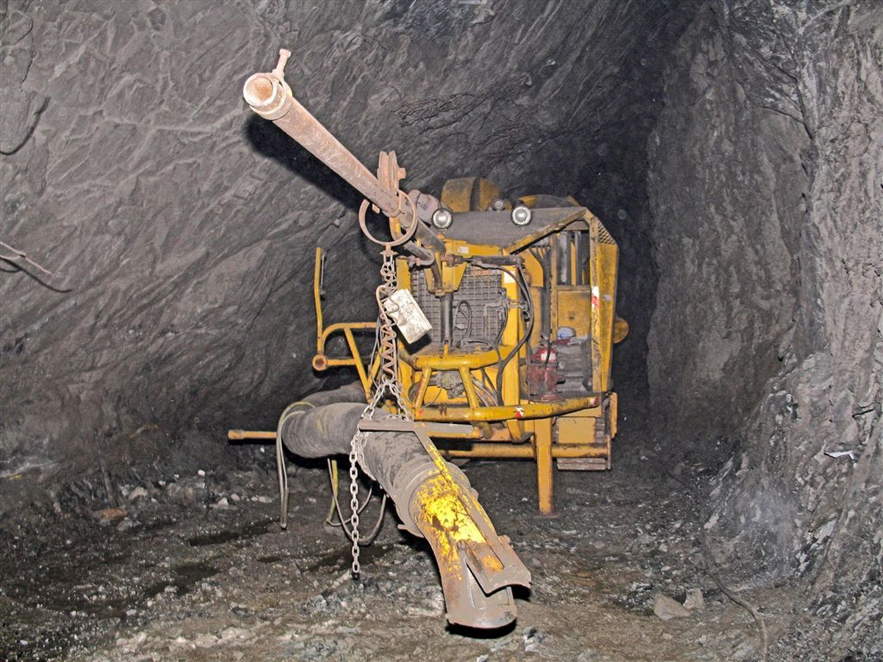
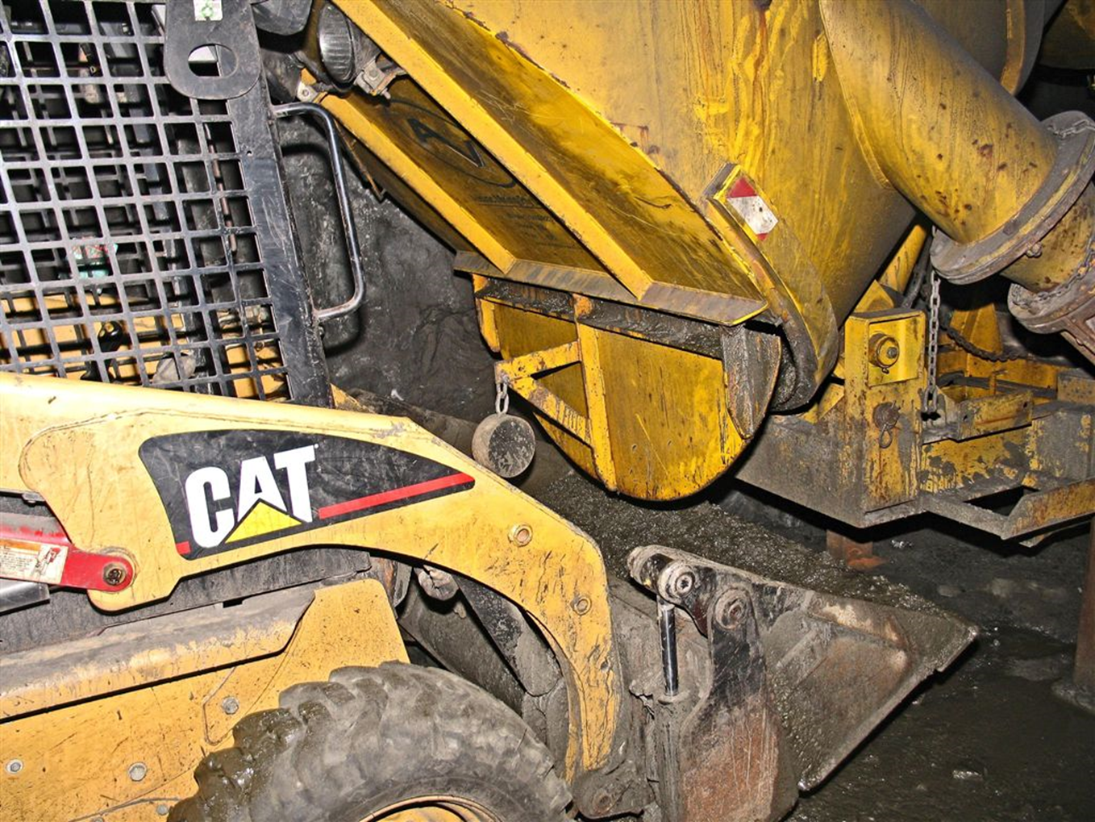
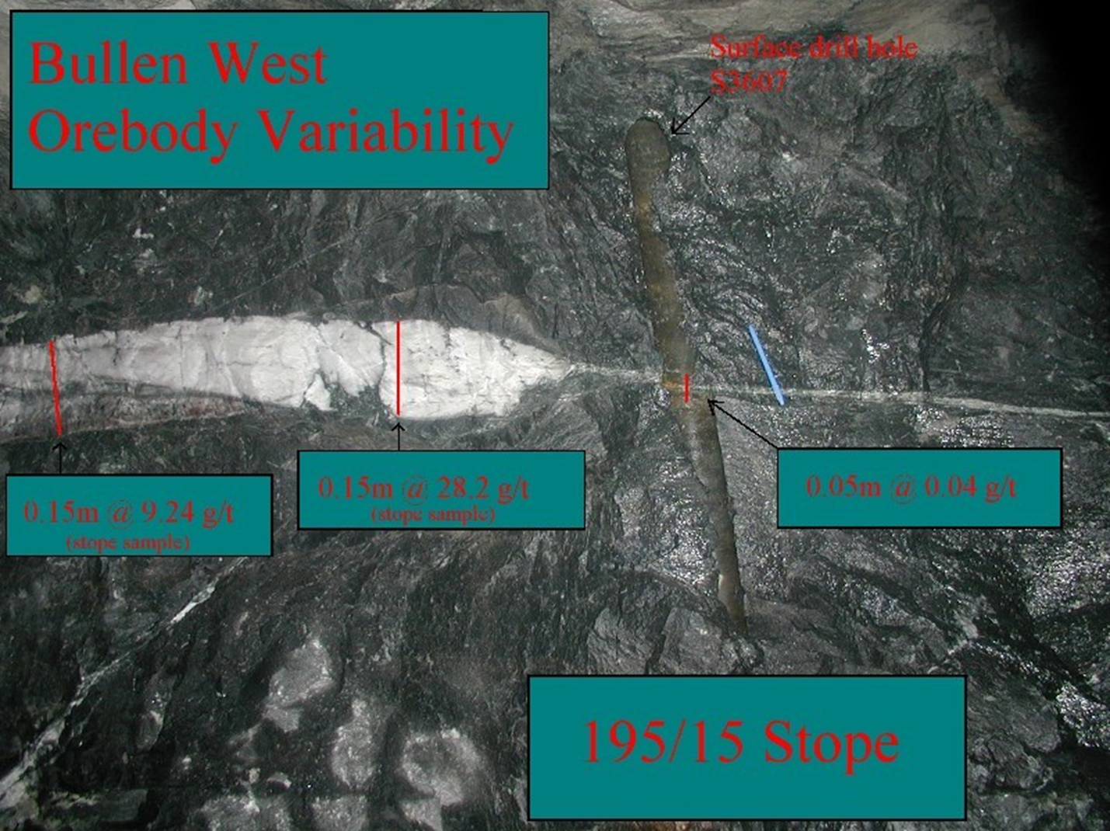
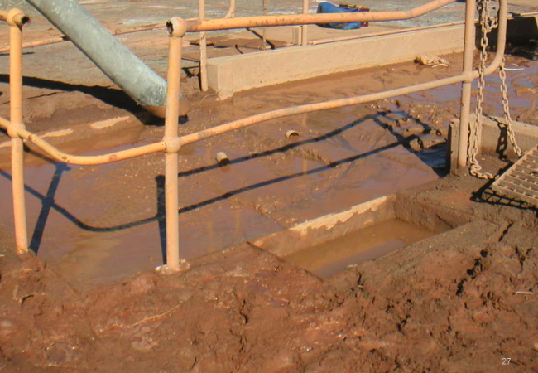
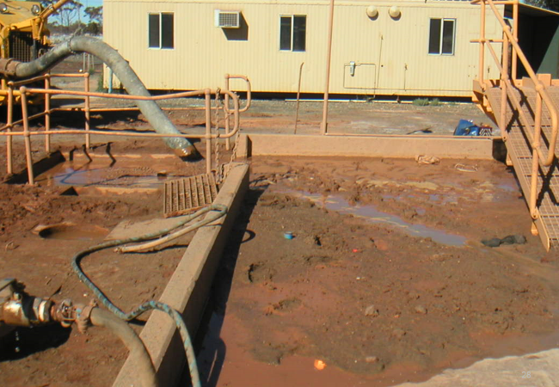
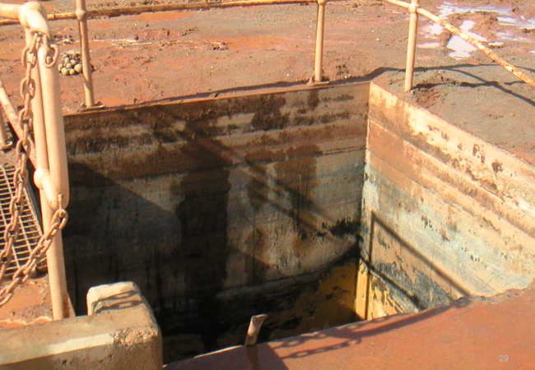
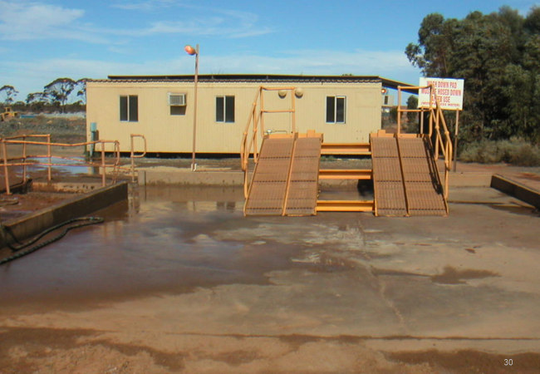
Appendices

