Slide 1
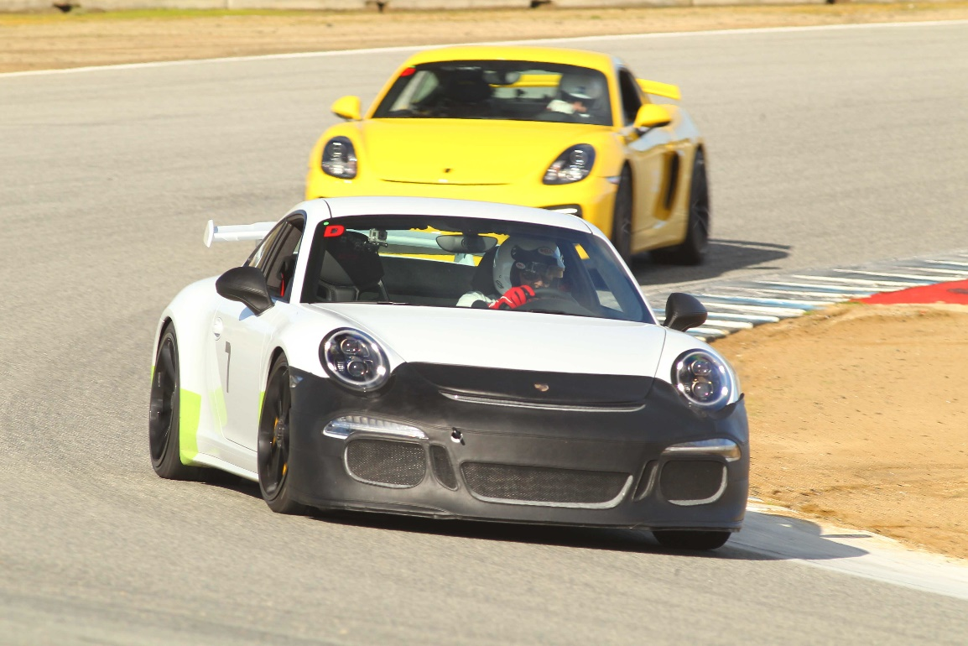
Diablo PCA DE 101 Chalk Talk
2020 Health & Safety Protocols
Prepare & Pack
At & On The Track
Flags & Co-Operation
Top Tips: Apexing
Secrets to Success
“Drive fast, be safe, have fun!”

Slide 2
Thunderhill Health & Safety Requirements
Masks/face coverings are REQUIRED AT ALL TIMES
Clubhouses are CLOSED
NO SPECTATORS – drivers/riders and crew ONLY.
NO ANIMALS
Body count limit per track = 200
The Thunderhill Grill is OPEN
Anyone entering the park will be required to sign a communicable disease waiver in addition to the general liability waiver.
Temperatures will be verified by non-contact infrared thermometer upon entry to the park, and anyone who measures over 100.4°F will not be admitted.
Please treat our local businesses with care, caution, and respect if you have a reason to visit them. The town of Willows is thankful for your business, but understandably concerned about exposure.

Slide 3
Diablo PCA Region Thunderhill DE 9/25/2020 Protocols
COVID-19 INFORMATION
If you are sick, not feeling well, have a temperature or cough, do not come to the track. A full refund will be sent to you. Temperatures will be checked at the gate. Any temperature 100.4 degrees or higher will not be allowed on the property.
All participants will follow Track, County and State COVID-19 protocols.
Nose and mouth coverings are required while on Thunderhill property other than when you are in the car. These can be homemade, a bandana, medical mask, etc, but they must stay in position without the use of hands. You will sign the liability release forms at the gate to the track. You will also sign a communicable disease waiver. Please have your mask on, use your own pen to protect the workers and yourself.
While on the property, social distancing of a minimum of six feet is required. No social grouping.
Other than the typical track day items, you should bring hand sanitizer, mask, pen, wipes and gloves.

Slide 4
Diablo PCA Region Thunderhill DE 9/25/2020 Protocols
PARTICIPANT INFORMATION
Instruction is not allowed, including lead-follow.
Paddock parking layout allows spacing between vehicles.
Anyone leaving the paddock area will be required to fulfill all the established protocols to re-enter the paddock.
The paddock will be monitored by on-site personnel and security.
Only participant drivers are allowed. No guests are allowed.
DE 101/201 will be held via a Zoom online session on September 9 at 6:30pm.

Slide 5
Diablo PCA Region Thunderhill DE 9/25/2020 Protocols
FORMS AND REQUIRED INFORMATION
Car Tech inspections must be completed prior to coming to the track. Tech forms are available on the Diablo DE website. (www.diablo-de.org)
To eliminate possible COVID-19 spread, PCA Communicable Disease Exposure Release form and PCA Liability Release forms will be emailed to all participants. Please return in an email to maloykay@comcast.net no later than September 20th. You may not be able to enter the facilities if the documents are not completed and returned. If you cannot scan the forms and email them, bring the forms with you to the event. After placing the forms in the labeled boxes, you will receive your packet.
No in-person registration (just packet pick-up). All MSR registration must be completed prior to the event.

Slide 6
Prep at Home
Register on MSR
Sign the Covid Waivers and send to Kay Maloy
Inspect Your Car:
The driver certifies their car is safe to run on track and has had an inspection within 30 days of the DE event
Inspection form at diablo-de.org
Get your helmet
Snell rating of SA2010 or newer (Closed or open face) – no motorcycle helmets!
Helmet rental at Thunderhill, None at Laguna Seca
Watch videos/check out information at:
www.diablo-de.org
Stay near the track if it’s a long drive.....

Slide 7
Pack Smart
Flat soled shoes
Sunscreen, Lip balm, Hat
Camera/GoPro/Cellphone mount
Folding chair
Tire pressure gauge
Torque wrench for wheel lugs, essential tools, flashlight
Work gloves, hand cleaner and a rag
Extra engine oil and brake fluid
Masks, (latex) gloves, hand sanitizer, soap, water

Slide 8
Last Minute Car Prep
Fill up with Gas before (check fuel gauge throughout day!)
Find parking place (not so) near the others
Check in – get car numbers and,
run group letter, wristband, schedule, track map, passing zones
Empty your car....No loose objects (especially under your seats)
Put in tow hook
Letter on windshield
Numbers on all four sides
Get Helmet + Safety Inspection form ready
Wait with your car for ‘Grid Tech’

Slide 9
Get Your Mind Right Meet the Team
Been a while? Take it easy.
Review Flag Stations / Corner Worker locations
Drivers meetings are mandatory and each run group will have their own meetings outdoors.
Group leaders are:
A Group / Yellow – Dave Ogiba
B Group / Green – Ken Wu
C Group / Blue – Tom Davenport
I Group / Red – Jeff Urnes

Slide 10
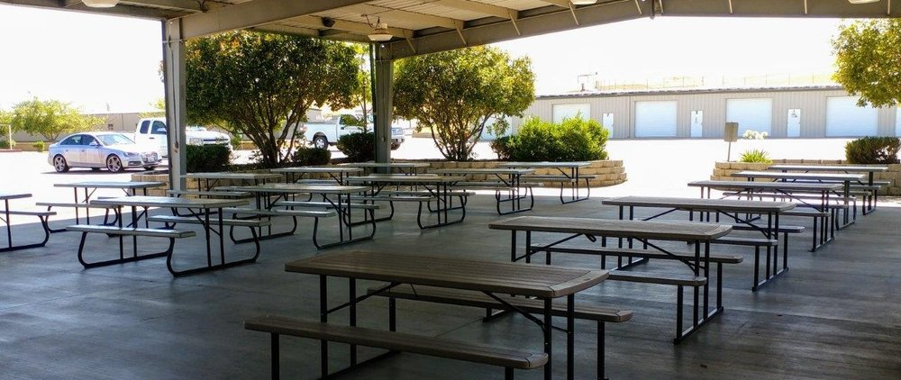
Mandatory Morning Drivers Meetings (Outdoors, The Grill and Canopy)
Your rapt attention is required for the:
Passing rules
Updates on groups, run times...
Track condition report
Meeting the ‘go to’ people
Advice to make the day go smoothly
A + B Groups will have briefing before first session and after each session.
C + I groups will de-brief as required by Run Group Leader

Slide 11
Track Sessions - Grid & Hot Pits
Line up at the Grid, 5+ minutes before sessions with helmet on, windows down
Grid will check wristband, run group and numbers
They will give a two minute warning and a 30 second alert
They point to you when to go out - acknowledge with ‘thumbs-up’
Pay attention when entering track
Keep right of ‘blend line’ at Thunderhill
Give way to cars on track
Build speed gradually
Yellow flag – first lap No Passing!!!
It’s intense but it’s fun...stay loose!

Slide 12
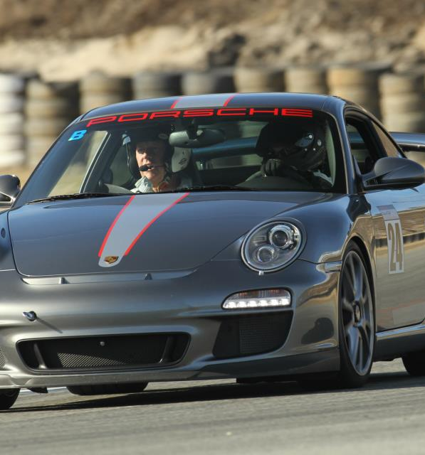
Your First Track Session
These are your safety inspection recon laps. Pay attention to any hazards or things that look out of place and let us know about them.
Track Rules:
First lap under yellow flag – no passing
Get used to seeing ALL corner workers
Eyes up!
Try to be smooth
Practice the line

Slide 13
Flags: They Keep Us Safe
Yellow Flag
Caution! Slow down! Danger ahead!
No Passing!
Standing yellow flag – it’s ahead somewhere
Waving yellow flag – it’s here!
Surface Flag (yellow/red stripes)
There is something on track
Be aware – slow down
Red flag
Stop to the side where you can see flagger
Stay in your car and wait

Slide 14
Co-operative Passing Rules
Being passed
Complete your turn
Check mirror
Give a “point by”
Do not push on the gas!
Your responsibility to let them pass
Passing someone
Set up so the other driver can see you
Wait for the point by!
Complete pass by end of zone
You don’t need to take a pass – you can wave it off
Don’t push yourself into the next turn too fast
Blue flag - you must let other cars pass

Slide 15
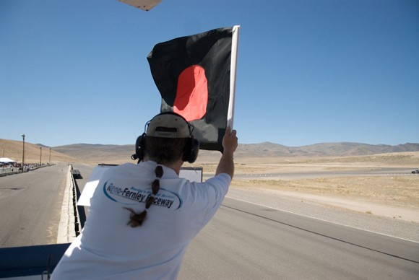
Black Flags
Furled and pointed at you
Behave! Don’t do it again...
Waved and pointed at you
You must leave the track
Go into hot pits to see Safety Officer
Black flag waved at all
All cars must exit to pits
If session still going, come into hot pits
Safety team will indicate where to stop
Meatball flag -- waved and pointed at you
Come in to the hot pits
Something wrong – could be sound (MLRS)
Common Causes:
Overtaking on Yellow, Missing blend line, 2 or 4 wheels off, sound violation...

Slide 16
Elements of the Common Corner Terms your instructor will use
“Turn in”
You begin to turn for the corner
“Apex”
Where car is closest to inside of the corner. The point you begin exiting the corner
“Track out”
The outside edge of the corner and start of the next straightaway
Track out
Apex
Turn in

Slide 17
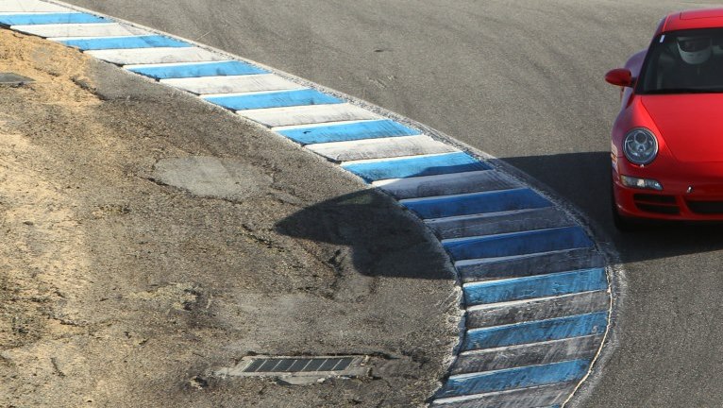
Taking Turns
- the fast and safe way...
Track Out
Berms – don’t go on them unless they have grip and are smooth!!!
ACCELERATING
Track out all the way
to side after turn in
Apex
TURNING
Turn-In
Late apex is fastest
because cars brake faster than they accelerate!
The sharper the turn, the later the turn-in
BRAKING

Slide 18
End of track session
Checkered flag – begin cool down
Wave to the corner workers
Exit track next time you pass pits
As you approach the pit lane, hold your arm out the window
Fist raised high signals you are entering the pits
Drive slowly – 5 mph – through Paddock to your parking spot
Don’t park with emergency brake – your brake pads will stick!
Go to de-briefing session.
Don’t run out of gas – check your gauge frequently!!!

Slide 19
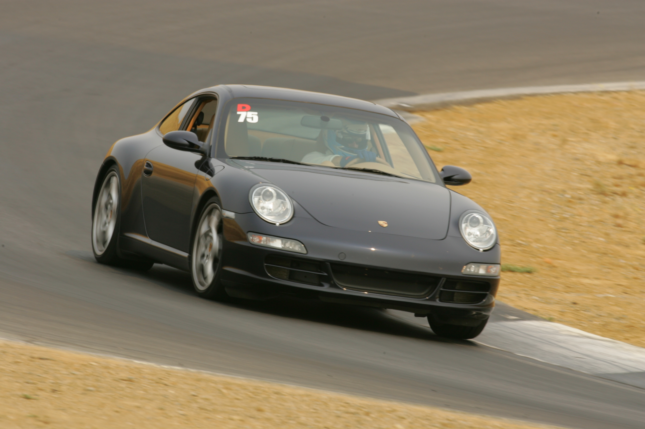
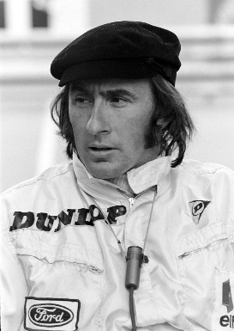
Secrets to Success: Look Up & Be Smooth
Look where you want the car to go
The car will go where you’re looking!
The farther out you look, the more time you have to anticipate
Smooth transitions; braking, shifting, turning, accelerating
– means you maintain more traction through the turn
Interact with other drivers, on and off the track....
“A driver should never feel the end of a corner - the transition from cornering to acceleration should be so smooth as to be imperceptible”
Jackie Stewart, 3 time F1 Champion

Slide 20
Now let’s go have some fun!
www.diablo-de.org

