Slide 1
Emergency Medical Responder
Chapin Area Rescue Squad

Slide 2
Chapter 6: Airway Management

Slide 3
Objectives
Understand how the respiratory system works
Demonstrate the ability to use basic airway adjuncts
Identify the sequence for patient care of ABC and transitions into CAB

Slide 4
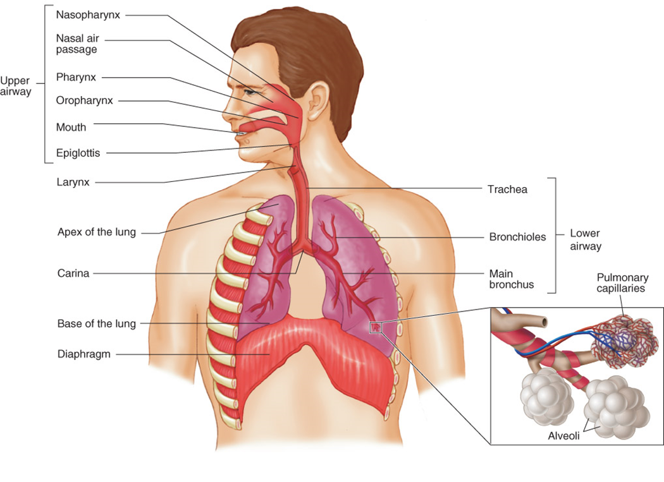
Introduction
Airway
Upper Airway
Lower Airway
Positioning is #1 way to open the airway

Slide 5
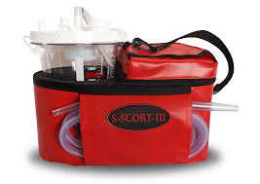
The Blocked Airway
Head Tilt Chin Lift
Jaw Thrust
Blocks
Fluid
Objects
Suctioning
Rigid Suction
Soft Suction

Slide 6
Airway Adjuncts
OPA- Oral Airway
Indication
Maintain an open airway
Pathway for suctioning
Contraindication-Gag Reflex
NPA-Nasal Airway
Same indication
Contraindication-Head Injury of any type

Slide 7
Inadequate Breathing
Noisy respirations, wheezing, or gurgling
Rapid or gasping respirations
Pale or blue skin
The most critical sign is respiratory arrest, which is characterized by:
Lack of chest movements
Lack of breath sounds
Lack of air against the side of your face

Slide 8
Oxygen Delivery
Oxygen Regulation
Must have a ‘O’ Ring
Nasal Cannula
35%-50% oxygen delivery
Non-Rebreather Mask
Up to 90%
Bag Valve Mask
For conscious and unconscious patients
For inadequate breathing

Slide 9
Review

