Slide 1
Governments, Mining Companies Executives and Shareholders Allow to Leave Behind and Never to be Recovered Capitally Accessed and Broken High-grade Ore Underground Worth Billions of Dollars – Why??? MINEX Europe Forum 2020 July 2020 London (Updated 18 01 2021)
By Krzysztof (Kris) Biegaj
Director of Ausvac Mining Pty Ltd
Australia

Slide 2
INTRODUCTION
Billions of Dollars have been (and continue to be) wasted by Mining Companies and Governments across the World due to the lack of mining legislation for mandatory recovery of high-grade already broken ore. Ore is being left behind on mine floors never to be recovered
Recovery of the high-grade broken ore left behind on mine floors will provide additional revenue for the mine as well as increased royalties for governments funds for rehabilitation of mined waste disposed of on surface
By Krzysztof (Kris) Biegaj
Director of Ausvac Mining Pty Ltd
Perth, Western Australia
18 01 2021

Slide 3
Mine Floor Material Vacuuming/Vamping not yet Part of Life of Mine Plans and Normal Mining Cycle in Most Countries in the World - Australia included
Due to the Lack of Legislative Requirements Governments Allow to Leave Behind Capitally and Operationally Accessed Already Broken High-Grade Ore Underground Never to be Recovered Worth Billions of Dollars⁺⁺⁺⁺⁺⁺⁺

Slide 4
House Vacuuming Invented and World-wide Implemented in Late 19th/Early 20th Century
First underground vacuuming machines invented and have been widely used in South Africa and few other countries for many years. The Ausvac Mining PL vacuuming machine has been based on South Australian late 60-ties of the 20th Century machine designed to mine opals at Coober Pedy Area
Currently widely used for shafts sinking
Best in the World Highly-efficient truly Mobile Mine Floor Material Vacuuming Technology invented, developed and available in Australia since 2003

Slide 5
Mining Project Stages
Exploration
Pre-feasibility study
Feasibility study
Ore Resources/Ore Reserves/Life of Mine Plans
Approvals and finance secured/obtained
Development in waste to access ore and mined waste disposal
Mining
Rehabilitation of mined waste disposed of on surface

Slide 6
Mining – what is being missed
Cleaning - vacuuming/vamping of mine floors not yet part of mining cycle in Australia and most Countries in the World
Various reconciliation (recovery) factors continue to be used to hide high-grade broken ore left behind on mine floors never to be recovered
Floors of the excavations to be cleaned/vamped/vacuumed:
Ore drives
Stopes
Top of last lift in cut & fill/under-hand cut & fill mining - remotely controlled vacuuming only in open stoping
Top of mine pillars left behind for geotechnical reasons – remotely controlled vacuuming only in open stopes

Slide 7
Post “normal” mining activities
Pillars recovery
Expertise still available in Australia and other Countries
Artificial pillars
Cement grout packs
Gypsum packs
Steel props
Other
Diamond wire saw
Jack pots

Slide 8
Mine Floors Cleaning/Vacuuming Must become part of the Mining Cycle
Mine floors material recovery Must be included in Pre-feasibility/Feasibility Studies and Ore Resources/Reserves Calculations/Life of Mine Plans – including compensation for surface rehabilitation of waste generated when accessing the ore left behind on mine f
Timing - Mine floors material recovery (in stopes & ore drives) must be conducted whilst mine ventilation/fresh water/compressed air supply/dewatering plus other infrastructures are fully operational
Needs to be carried out immediately after “normal mining activities” in mining areas/sections have been completed as planned
Not after mine was flooded/put on care and maintenance
Including recovery of high-grade broken ore from top of pillars to be left for geotechnical reasons

Slide 9
Post “normal” mining activities currently/already used/trialled – cont.
Stopes wash-down/vamping/vacuuming
In South Africa even gold left in stopes’ floor cracks has been recovered for many years
And has been a part of normal mining cycle
Stopes wash-down carried out on Central Norseman Gold Corporation (CNGC) Gold Mines, Western Australia in 2000-2001
More recently (2010-2011) - highly successful ore drives and stope floor material recovery in Norseman Gold NL (previously CNGC) at Harlequin Mine with the Mobile Supersucker conducted by Ausvac Mining PL

Slide 10
Supersucker – Giant Vacuum Cleaner Construction/features
First in the World truly mobile highly efficient giant vacuum cleaner – designed and built in Australia for underground and surface applications
Initially (2000-2002) designed by Ausvac Mining P/L to carry-out underground exploration winzing in nuggety-type ore-bodies in a safe and highly efficient way
Refer to Appendices Slide – App 11 & App 11A
Size: 2.2mW, 2.95mH and 5.3mL (excluding 3.5m easily detachable clean-down jib)
Weight – 8.3 tonnes
Track mounted, diesel-powered self-propelled unit
Easily detachable heavy-duty wheels for longer distance towing
To reduce exhaust emissions/pollution to environment and vacuuming in mines located in high altitudes can be modified to be electrically powered for vacuuming operations
Safety features installed on it:
Devices to eliminate potential dust problems
ROPS/FOPS
Remotely-controlled capabilities can be installed

Slide 11
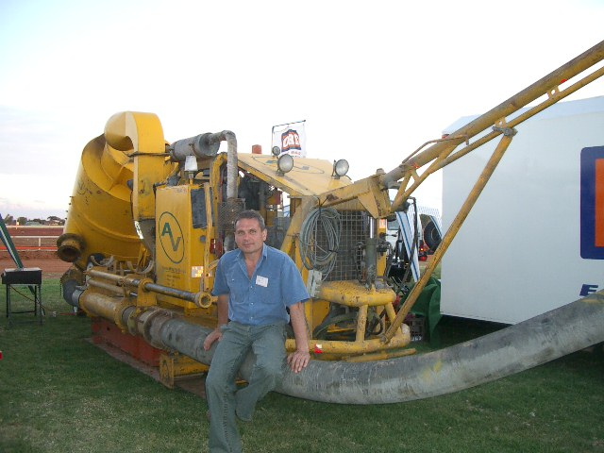

Slide 12
Underground Mobile Supersucker
Projects to date by Ausvac Mining Pty Ltd:
May 2003 – Mt Pleasant Gold Mine located near Kalgoorlie, WA (Western Australia) - First Project
Ore drives clean-down Plus fast-cleaning of mining equipment wash-down sump on surface (Photos in Appendices Slide at the end)
Aug 2003 – Otter-Juan Nickel Mine, Kambalda, WA
15 deg. air-leg stope and ore drives clean-down
Oct 2003 – Bendigo Gold Project, State of Victoria
Ore drives clean-down
Dec 2003 – Cosmos Nickel Project, WA
Ore drives clean-down
Feb 2004 – Agnew Gold Project, WA
Ore drives clean down
Oct 2005 – Long-Victor Nickel Complex, WA
Stopes and ore drives clean-down at Gibb South
Feb 2007 – Redross Nickel Mine, WA
Ore drives clean-down
Nov 2010- Jan 2011 – Norseman Gold NL, WA
Stopes and ore drives clean-down at Harlequin Mine

Slide 13
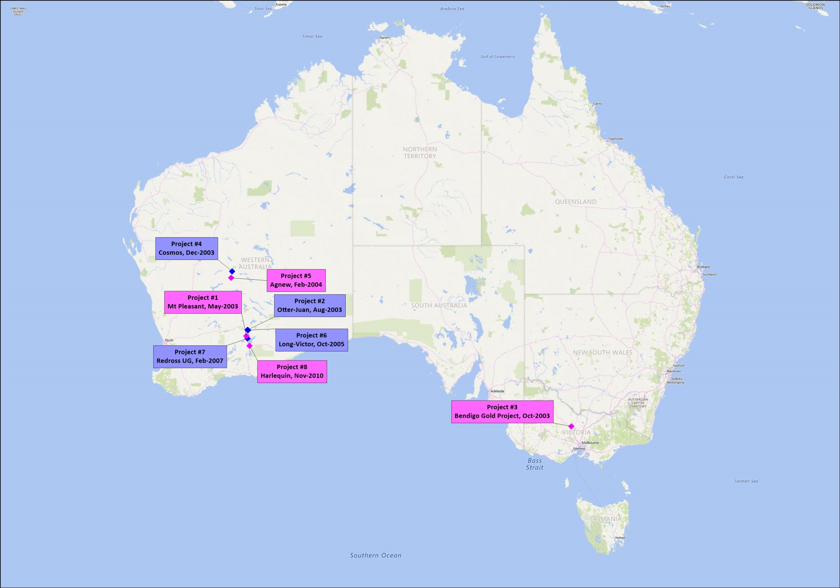

Slide 14
Underground Mobile Supersucker
Excavation size requirements for the Supersucker
3.2mW x 3.5mH drive
Designed to fit into small 2-3 cubic yard LHD size ore drives
Depending on ore-body dip angle
Secondary ventilation required
~ 10 m³/s - for Supersucker + bobcat or small LHD
Based on Western Australian (WA) Mines Regulations
Fresh water supply required – in high water salinity mines
To wash out the Supersucker at the end of each shift

Slide 15
Underground Mobile Supersucker
Capabilities/parameters
Suction hose diameter - 200mm (8 inch)
Can be upgraded to bigger diameter to increase productivity
Vertical lifting/suction - up to 50m
Horizontal lifting - up to 50m +

Slide 16
Underground Mobile Supersucker
Due to the mine floor material “milling” effect when using conventional LHD bogging/scraping equipment, gravity force and water, the ore grade of gold and metals left on operational mine floors for longer period is much higher then ore grade on mine floors in fresh excavations
Vacuuming productivities in ore drives and stopes
40 t/10-12 hr shift with two (2) Operators
80 t/day with two (2) shifts/day
Started with ~5 t/shift with two (2) Operators in 2003 – First Project
Now up to 2,000 t/month (with 80% availability of equipment and working places)
Vacuumed ore “normally” wasted

Slide 17
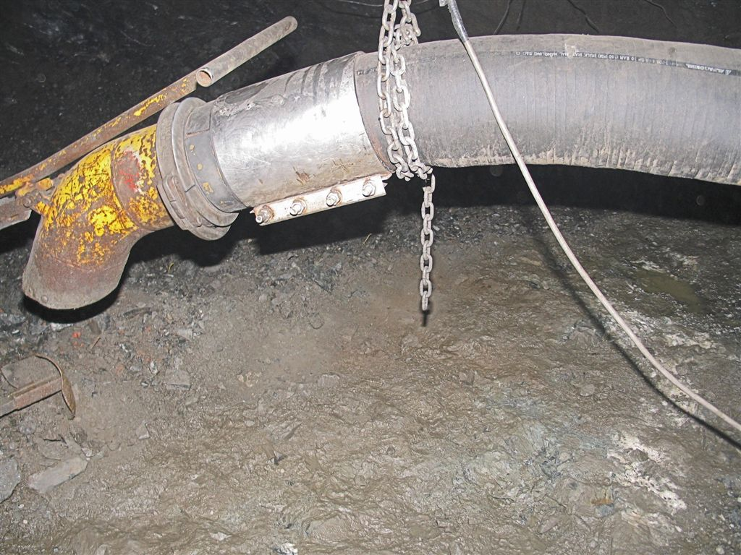
~0.35m thick broken ore left behind on ore drive floor on the nickel mine located near Kambalda - before and after vacuuming; Western Australia – 2007
Suction hose Dia. 200mm/8 inch
Commonly up to 0.5m thick high-grade mine floor material “normally” left behind had been vacuumed on gold and nickel mines in Australia by Ausvac Mining PL in 2003-2011

Slide 18
Summary of Extra Revenue from Vacuuming
(With vacuumed mine floor material of only 1,360 t of Au ore and 1,632 t of Ni ore per month respectively) after all costs deducted (Au & Ni Prices on 18 01 2021)
Gold:
Grade 5.0 g/t to 120 g/t respectively:
Monthly: Aus$0.17M to Aus$1.98M
Yearly: Aus$1.99M to Aus$106.8M
Nickel:
Grade 1.5% to 8.6% respectively:
Monthly: Aus$0.25M to Aus$3.02M
Yearly: Aus$3.02M to Aus$20.95M
Up to 2,000 t/month of mine floor material can be vacuumed with Supersucker
Details for Gold and Nickel in the last Slide - Appendices

Slide 19
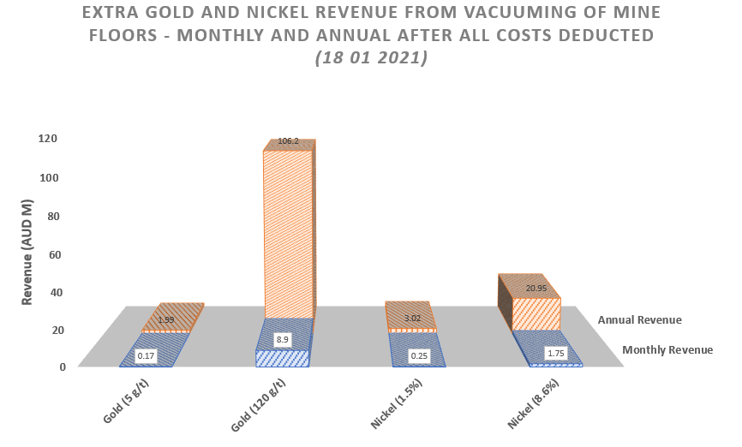

Slide 20
Extra Gold and Nickel Revenue left behind and recovered from mine floors with Supersucker vacuuming – Calculation Details in the Excel spread-sheet attached (Summary of Extra Revenue for other metals and precious stones can be provided)
Go to: www.ausvacmining.com.au/Services - for updates

Slide 21
Cleaning of Mine Floors still has not being included in Life of Mine Plans to be part of Normal Mining Cycle
Cleaning of Mine Floors still has not been included in Life of Mine Plans to be part of Normal Mining Cycle

Slide 22
Mobile Supersucker – Other Applications
Go to next/last PP Slide - Appendices

Slide 23
Appendices

