Slide 1
Ho! Ho! Haunting Speaker: Rich Bryan

Slide 2
Overview
This presentation will focus on use of weather resistant hardware and software originally designed for Christmas displays to create an automated and integrated haunt or display.
Topics:
Controllers (LOR)
DMX control of Accessories/Props
Interaction
Weather Proofing
Notes:
This is not going to be a “how to” as this can’t be done in 1 hour. Instead it is a introduction to get you pointed in the right direction.
PLUG PROGRAMMING CLASS SUNDAY AFTERNOON

Slide 3
DISCLAIMER!!!!
I am NOT expert! I am not an engineer or electrician and I didn’t even stay at a Holiday Inn Last night!
The information presented is only how this amateur home haunter has set up his yard and show. Please ensure that your haunt follows all local codes, rules and laws to keep you and your guests safe. Electricity is dangerous! If you don’t know what you are doing seek expert help.

Slide 4
Introduction (AKA: why should we listen to you?)
Home yard haunt in Corvallis, Oregon ‘CITY of the DAMMED’
Graveyard with 12 minute musical, light, video, laser, fog, fire and animatronic show every 20 minutes on Halloween night/weekends.
Notes:
NOTE NOT MISPELLED!

Slide 5
CITY of the DAMMED
Our haunt is 100% outdoors. We do not have a walkthrough attraction.
Less Space Requirements in a standard home.
No Permits-A seasonal display viewed from outside does not need fire/city inspections.*
Reduced Liability
Notes:
Reduced liability does not equal NO liability. A yard display is still public nuisance. Consult your Ins. Agent, MAKE NOTES OF THE CONVERSATION during the sale-Better yet confirm your understanding with a follow up email.
* Event permit for over 50 people at any one time.

Slide 6
Oregon = Rain
Store bought props traditionally= inside use
Consumer level props are not typically coordinated to work together.
We wanted a “themepark” experience.
Notes:
Christmas displays caught my eye and were the solution

Slide 7
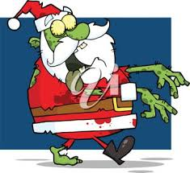
Santa to the rescue
Christmas light controllers are a great solution for an outdoor haunt.
Weather resistant/robust
Reliable/pre-engineered
Easy to use/set up
Supported with IT/ and user forums
Typically code compliant
Pre-Set “Shows” on your designed schedule
Notes:
SHOW VIDEO OF X-Mas
-program to go on/off different times/days.

Slide 8
Light Controllers
Light O Rama
VSA by Brookshire Software
Vixen
Notes:
Don’t waste time/money with Mr. Christmas = crap. Not programmable.

Slide 9
VSA
VSA is produced by Brookshire Software
Software only
Best program for control of servo and animatronic props such as 3 axis skull. **
Great flexibility
Requires outside vendor hardware
No supported hardware
Limited channel count
110 requires relay packs
Notes:
BOC is VSA Only
VSA will now run multiple projection sources.

Slide 10
Light O Rama
Commercially manufactured hardware and software designed for outdoor light displays.
No guess work
Scalable to 1000’s of channels
Controls 110v and DMX
Visualizer
Audio and Video control
Not as servo friendly as VSA (GETTING CLOSE!)
Notes:
LOR is the industry standard
Hardware and software is integrated
SERVO DOG
MONKEY BASIC now works with LOR

Slide 11
Vixen
Geared towards DIY
Freeware
Not as powerful
(Did I mention it’s FREE??)

Slide 12
Light Controller System
Notes:
- Show Hardware on the table
- 16 channels per controller
- At it’s core the system turns each channel on/off
- DMX DONGLE

Slide 13
Getting Started
Soundtrack
Audacity
Video
MS Movie Maker/Adobe
Sequence
Notes:
Soundtrack Audacity, will require conversion to other formats typically
Video
Sequence

Slide 14
LOR Program
Notes:
-Show program (program a DMX Light)
-Timing Grid
-Basically turn each channel on/off
-Show show builder.

Slide 15
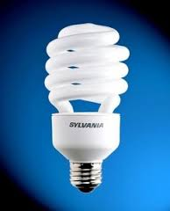
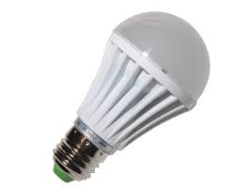
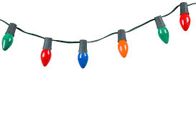
Lights
110v lights
CFL
Incan
LED
Christmas
Notes:
CFL: Color is great in primary colors, inexpensive, low wattage
LED: LED bulbs from big box = Expensive, life span with LOR cycles not known.
LED Grids = IDEAL.
INCAN: inexpensive, hot, high current draw.

Slide 16
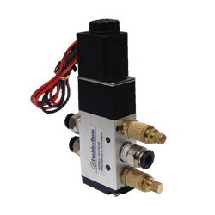
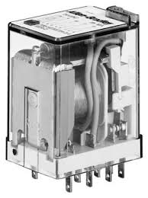
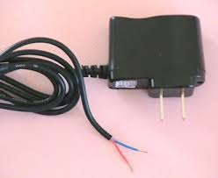
Beyond Lights 110V
Relays
Rain deer motors
110 gear motors
Wall warts
Pneumatic controllers
Notes:
-Relays for non-DMX foggers
-Deer motors for basic props
-Gear motors from Granger
-Wall Warts: GOOD WILL!
DMX CONTROLLER!!!

Slide 17
DMX 512
DMX is now the standard for digital communication networks. It allows for very low cost per channel of control.
DMX is based on a 512 channel “universe”
Each device has it’s own address, some devices require multiple addresses
Notes:
Multiple universes can be created
RGB requires 3 channels per light.

Slide 18
DMX (DMX512)

Slide 19
DMX Addressing
Dip Switch
Programmed
Notes:
SHOW CONTROLLER

Slide 20
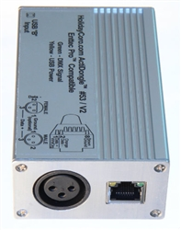
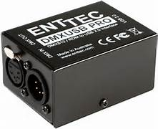
DMX
DMX requires a “Dongle” to output the signal from the computer to devices.
Holiday Coro, ENTTEC
Notes:
NOTE CABLE CONNECTORS
CAT 5
5 PIN
3PIN

Slide 21
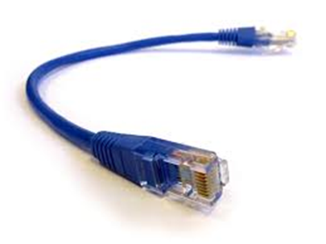
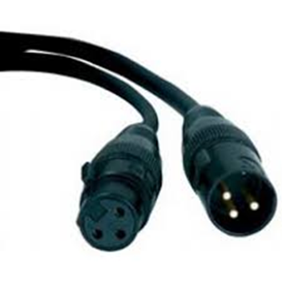
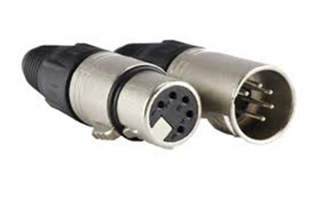
DMX Cables
5 pin is the standard for theater/music
Many haunt items such as foggers use 3 pin which can be microphone cables
CAT 5

Slide 22
DMX Lights
Notes:
Show flood light kit and demo lights.

Slide 23
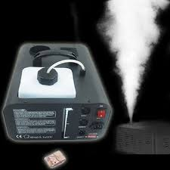
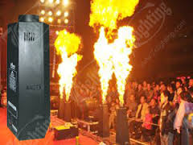
DMX Devices
Foggers
Fire Machine!

Slide 24
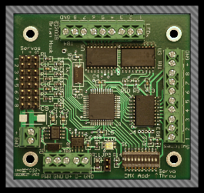
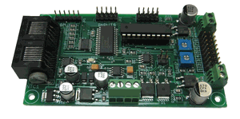
DMX Servo/Motor
Servo control boards
Medusa
LOR ServoDog
Board of Chucky (BOC)
SOS
Servo, LED and Relay
Notes:
SHOW BOARD/MOVEMENT WITH SKULL

Slide 25
Notes:
DMX CONTROL DISPLAY-3 AXIS

Slide 26
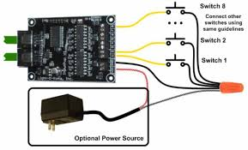
Interaction
LOR Input Pup
Notes:
Standard sensors/switches/inputs.

Slide 27
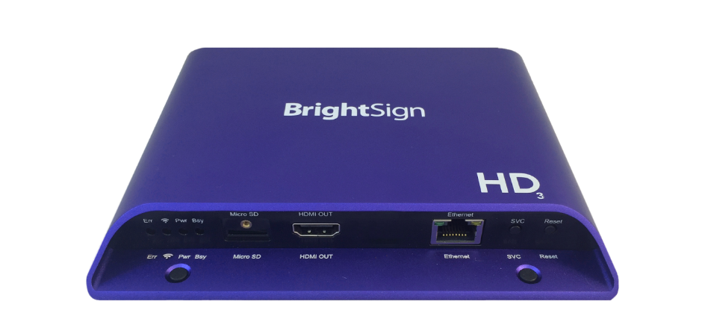
Video Control/Projection Map
Single Channel is only option without extra hardware.
Triggerable Video Player
Lower cost options
Notes:
Multiple video feeds are not supported by any commercial controller to date. However, there are options to control multiple video feeds.
-Bright Sign, Fright Props, J-man’s $30 unit
-Dirty hack to projector by blocking lens.
-Short throw projector.
-$$$$

Slide 28
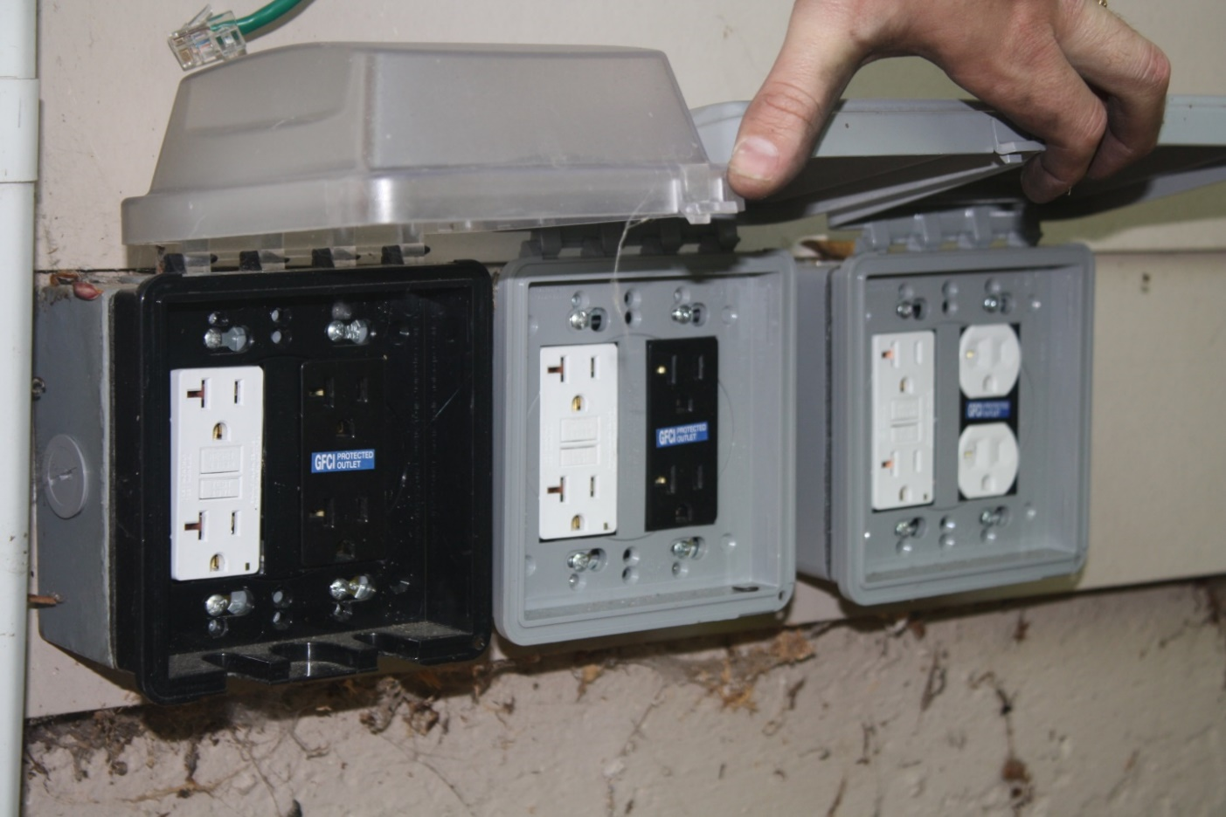
Outdoor Haunt Tips
GFCI
Max Outlets
Use real cords
Notes:
3 20 amp circuits.
Cord management-tie line onto cords.

Slide 29
Wired For Sound

Slide 30
Use House Protection

Slide 31
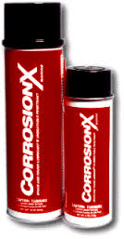
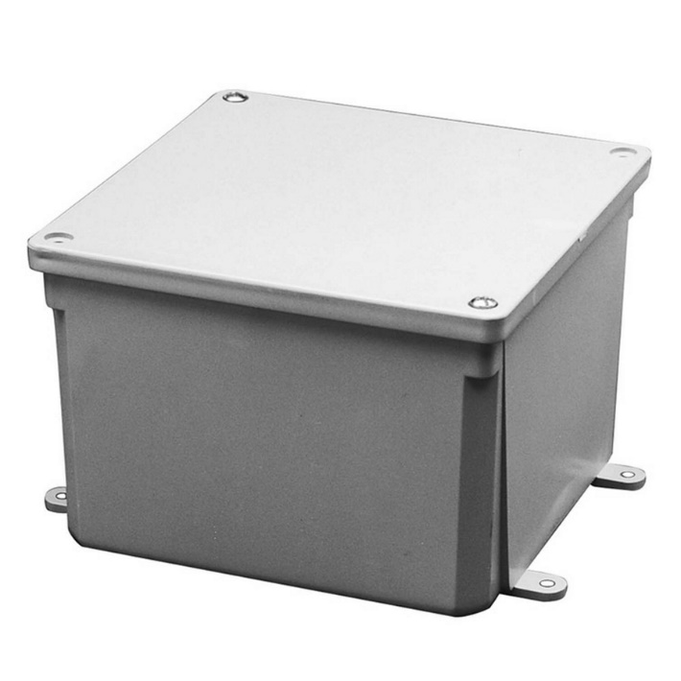
Weatherproofing
CorrosionX
Plasti Dip
Silicone

Slide 32
Questions?
Notes:
BRING IT ALL TOGETHER!!

