Slide 1
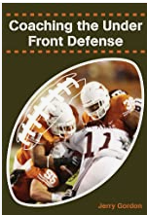

Defending Heavy Sets with Under Defense
jgordon0508@yahoo.com
@JerryGordonFB
CoachJerryGordon.com
Thank you Thom Propson @ThomPropson

Slide 2
Under vs Run Clinic Agenda
Why we like it
When we use it
Common Principles
Common Plays
How we adjust
Common Problems and How we FIX them

Slide 3
We will NOT talk about
Statistics
My Defensive Philosophy
Stuff that Bama Does
This is the…..

Slide 4

No BS Zone

Slide 5
Play Defense…..
…..Not Defenses
Shed….. Pursuit… Tackle
Good Run Game
Solid Special Teams

Slide 6
Who are we
Been running this package as a DC since 2000
learned from failure and frustration
1 to 1.5 platoon
40 to 80 kids in program
We are not Texas or Oklahoma 6A
We need to stop: Last couple of years: Triple and Wing T
Previous: Single Wing and Shotgun I
We see very little teams the are good running spread

Slide 7
Pro Split
Quick Rules

Slide 8
Who is the Sam?
He will only be on the LOS vs a TE
He will never be on the hash
He always gets told how to line up
Will only be asked to run with #2 with help or a blitz
For some reason usually a baseball player
Corners: Field and Boundary or follow WR

Slide 9
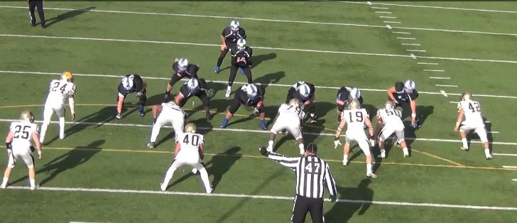
Why we like Under Front
3
5 Players on LOS Not a lot of teams play it

Slide 10
Why we like Under Front
3
3, 5 and 5, 9 Pound the center

Slide 11
Why we like Under Front
3
Gap Control, Outside Shades, Flip/Flop

Slide 12
Why we like Under Front
3
Play fast and downhill, we have numbers

Slide 13
Why we like Under Front
3
We “Set it and Forget it” No Easy TE Release

Slide 14
Why we like Under Front
3
Good for Sims and Pass Blitz

Slide 15
When do we call Under Read
21 22 12 11 Good chance of run
4 Ways to call it (Tool Belt)
Split Set Front away TE Shifts? Motions Trades Double Tite
Sara/Sally Set front to the boundary WHY?
Fat Set Front away TE unless Queen 9,5,3 and shade 5 to the other side
Wide- Tackle 4i and Buck Line up and 9 (hip)
3

Slide 18
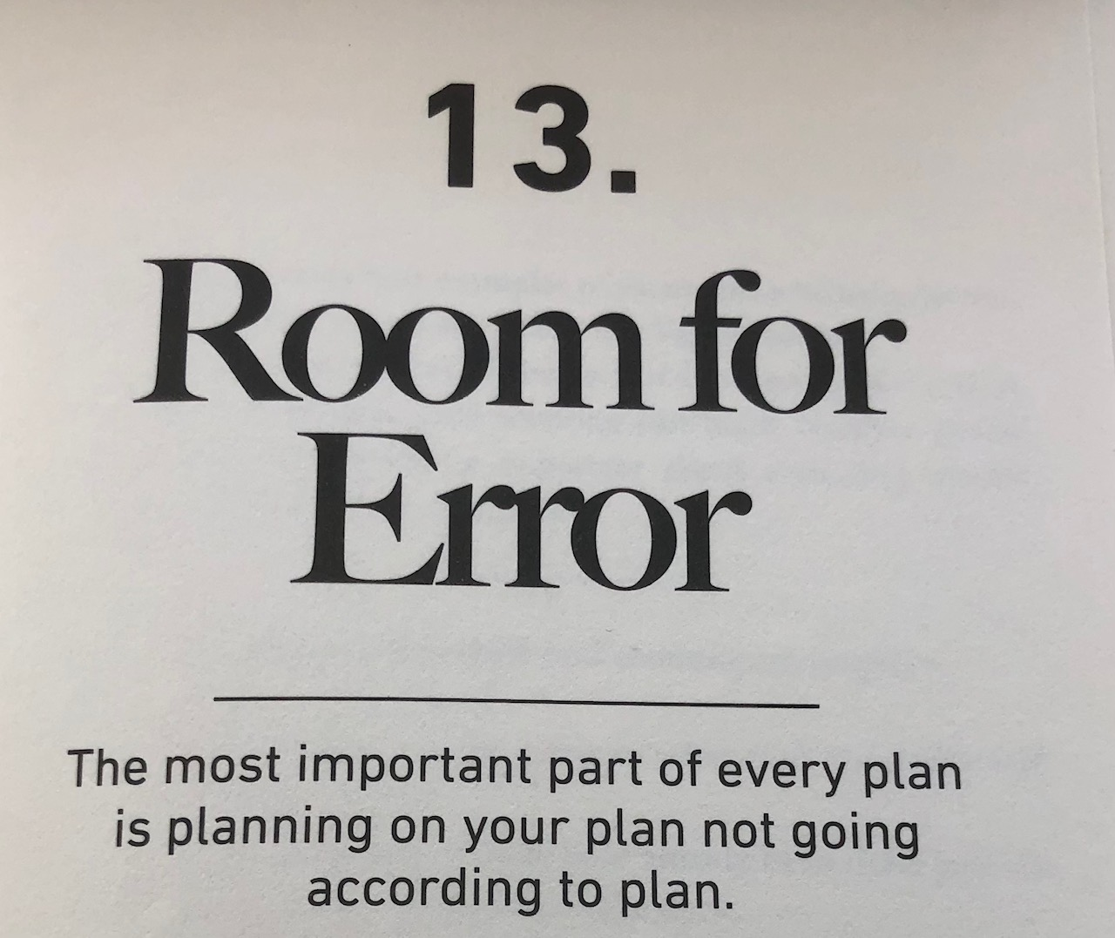

Slide 19
Problems with Under
Come out with TE but don’t line him up as a TE
Come out with 2 TE’s and only line up with one TE
Trades
FIB and then Weak and Wide (Call wide)
Pounding you with the FB (Iso/Power)

Slide 20
Double Tight Attack

Slide 21
Double Tight FIB ←Field

Slide 22
Few principles over many situations
Block Down Step Down Spill team
Cloudy/Clear Rules
Over the Load and Under the Load
Look Tech
High/Low Concept: Zone Read vs Speed vs Power Read vs Midline
Triple Ready!

Slide 23
Block Down, Step Down Rule
If the offensive lineman blocks down or inside releases,the defensive lineman must step down. This is called the block down, step down rule. As the offensive lineman inside releases, the defensive lineman now must adjust his first step inside with the offensive lineman. The goal of the defensive lineman is to get his hands on the offensive lineman and drive him down towards the ball and to come off the offensive lineman’s butt with his eyes up and his shoulders perpendicular to the line of scrimmage. The defensive lineman drives the offensive player down to keep him off of the linebackers so they are free to make plays

Slide 24
Spill
If the defensive lineman is being kicked out, he must spill this blocker.
• To spill means that the defensive lineman should hit the offensive player trying to kick him out with his outside shoulder and get as far inside as he can and then drive his inside hand up field getting his shoulder square again with the line of scrimmage.
• The defensive lineman wants to contact the offensive player low and on the inside third of his body.

Slide 25
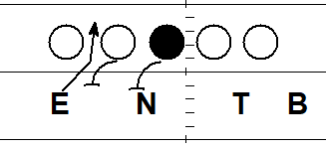
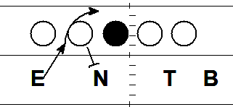
Tag Technique
Move or a slant into an adjacent gap

Slide 26
Common Teaching Techniques: LB
Read Guard to Backs---Downhill assassins
Cloudy and Clear gap
Over the Load and Under the Load concept

Slide 27
Under the Load, Over the load
Scallop

Slide 28
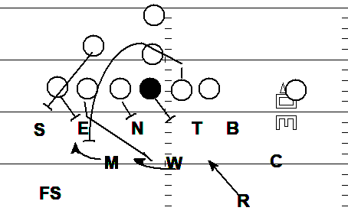
Under the Load, Over the Load

Slide 29
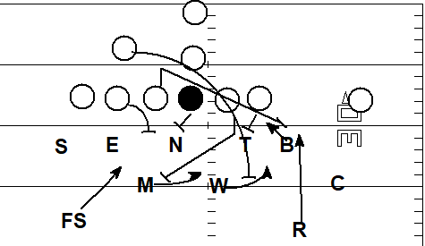
Under the Load, Over the Load

Slide 30
Mid Line

Slide 31
High Low Guy

Slide 32
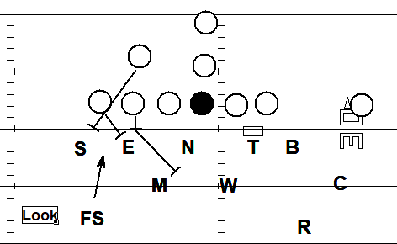
Common Teaching Techniques Look Tech

Slide 33
Look vs Arc TE

Slide 34
3/6 side (Over)

Slide 35
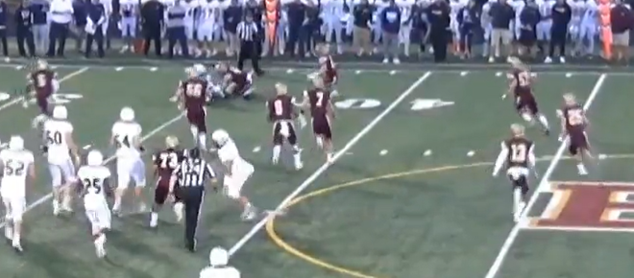
Defending Plays

Slide 36
Triple 3MS

Slide 37
Triple 2 MS

Slide 38
Zone Read Lead 2M/S

Slide 39
Zone Read 3 MS Full Flow

Slide 40
Midline

Slide 41
Buck 3MS

Slide 42
Belly Iso and Option

Slide 43
Trap 35 side

Slide 44
Zone Read Arc vs DTDF

Slide 45
Zone Read Stick vs DTDF

Slide 46
QB Iso vs Trey Open

Slide 47
Power Read 3 Trey Open

Slide 48
Power Read 2 Vs Trey Open

Slide 49
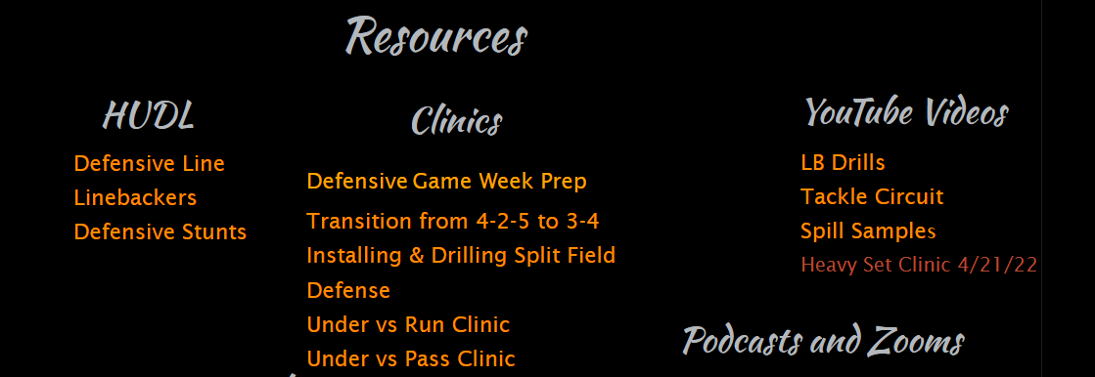

Slide 50
Favorite Resources
Complete Linebacking - Lou Tepper
Football’s Eagle and Stack Defense Vanderlinden
Quarters Coverage Made Simple - Shap Boyd
Glazier Clinics XandO Labs CoachHuey
Fav Follows: Adam Gaylor, Coach Vass, Craig Roh, Cody Alexander, Andy Ryland, Blitzology, James Light, Kyle Cogan, Bill Williams, Barry Hoover
Twitter: @JerryGordonFB Email: jgordon0508@yahoo.com
CoachJerry Gordon.com

Slide 51
Buck 2 MS

Slide 52
Zone Read 3MS split flow

Slide 53
Trap 15

Slide 54
Waggle 2

Slide 55
Waggle 3

