Slide 1
Aquatic Ecosystems
Saltwater Ecosystems
Marisa Boan

Slide 2
Saltwater Ecosystems
About 95% of the water on the surface of Earth contains high concentration of various salts
The amount of dissolved water is called salinity
Saltwater ecosystems include oceans, seas, a few lakes, coastal inlets, and estuaries

Slide 3
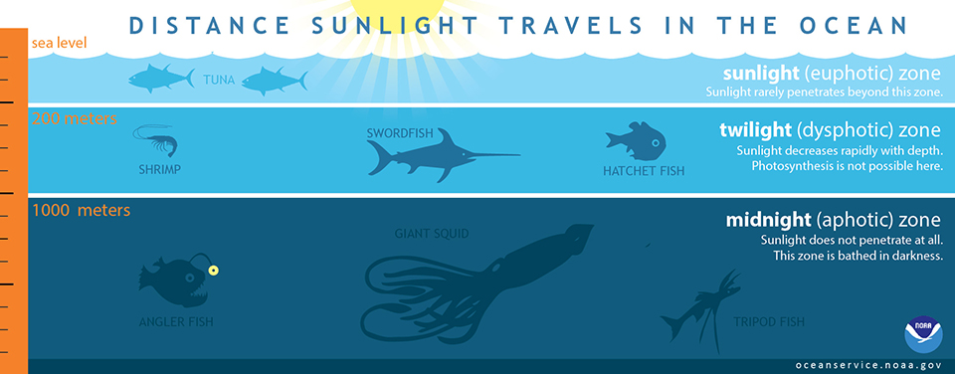
Open Oceans
There is lots of life in the oceans
Scientists divide the ocean into different life zones based on the depth and how much sunlight penetrates the water.

Slide 4
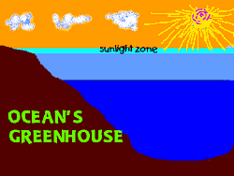
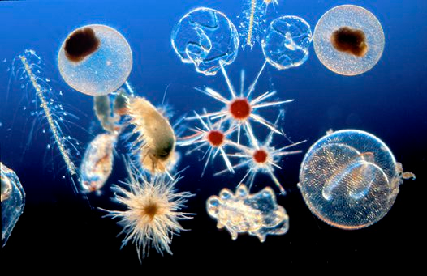
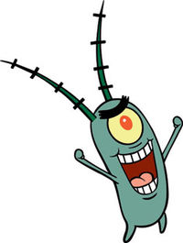
Oceans: Lighted (Sunlight) Zone
The upper 200m is the lighted (sunlight) zone.
It is full of plankton that make up the foundation of the food chain

Slide 5
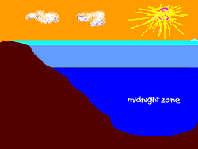
Oceans: Dark (Midnight) Zone
Below 200 m is the dark zone of the ocean
Animals living in the dark zone feed on material that floats down form the lighted zone, or they feed on each other!
Very few organism are able to produce their own food.

Slide 6
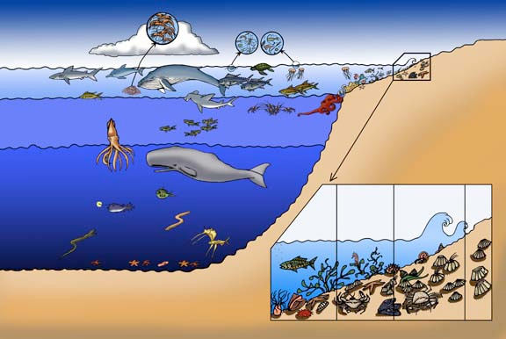
Ocean Zones

Slide 7
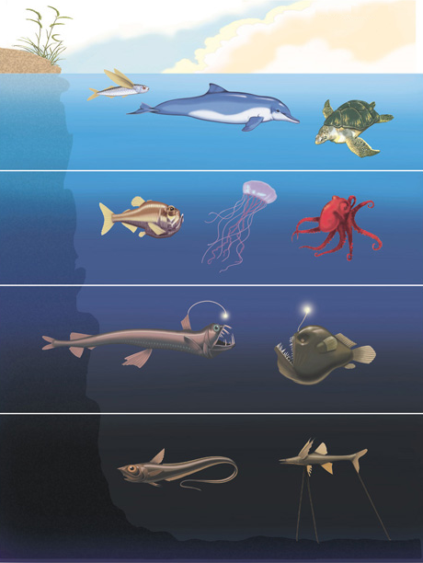
Identify Each Ocean Zone

Slide 8
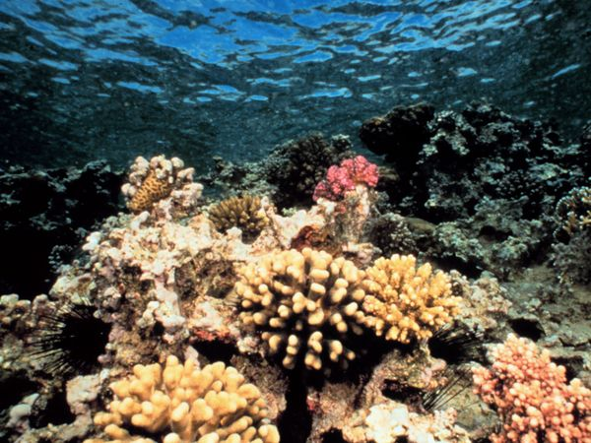
Coral Reefs
One of the most diverse ecosystems in the world
Formed over long periods of time from calcium carbonate skeletons secreted by animals called corals
Over time the skeletal deposits form reefs

Slide 9
Learning Check
What does salinity mean?
What are two ocean zones? What is the difference between these zones?
3. How are coral reefs formed?

Slide 10
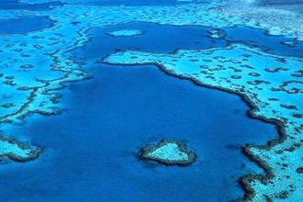
Coral Reefs
One of the greatest coral reefs in the Great Barrier Reef located off the coast of Australia

Slide 11
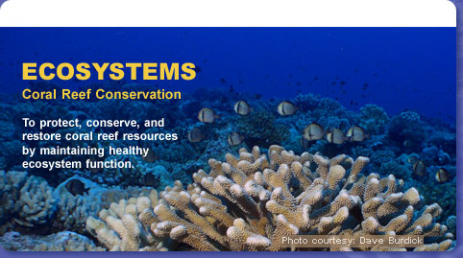
Coral Reefs - Endangered
Reefs do not adapt will to long-term stress
Run-off from fields, sewage, and sediment from cleared land harm coral reefs
The Environmental Protection Agency (EPA) have developed plans to protect reefs
They try to keep the areas around reefs healthy so that the coral reef ecosystem can strive

Slide 12
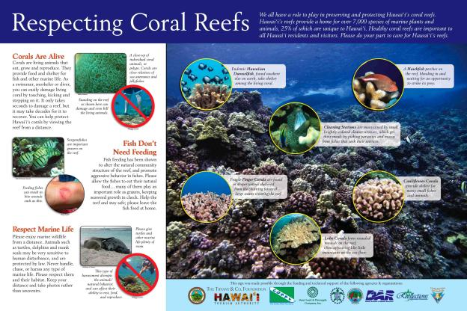

Slide 13
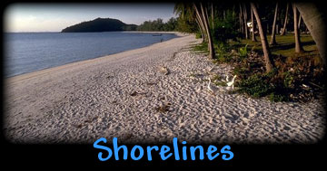
Seashores
All of Earth’s land masses are bordered by ocean water
The shallow waters along the coast contain saltwater ecosystems all which are influenced by tides and waves

Slide 14
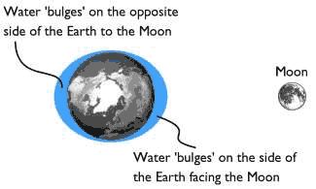
Seashores
The gravitational pull of the Moon, causes the tides to rise and fall each day
The height of the tides varies with the phases of the m00n, the seasons, and the slope of the shorelines

Slide 15
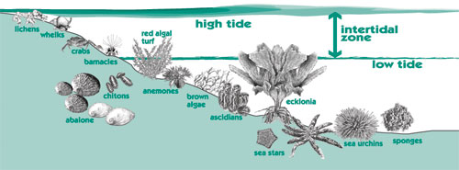
Seashores: Intertidal Zone
The intertidal zone is the portion of the shoreline that is covered with water at high tide and exposed to the air during low tide.

Slide 16
Learning Check
What causes the tides to go up and down at the seashores?
What is the Intertidal zone?

Slide 17
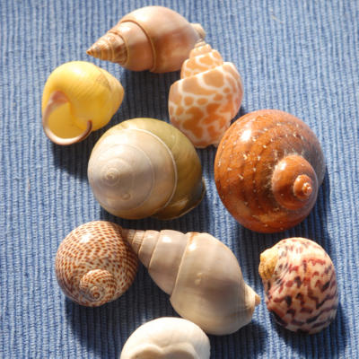
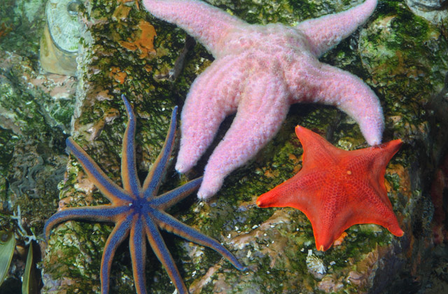
Intertidal Zone - Organisms
Organisms that live in the intertidal zone, such as sea stars and periwinkles, must be adapted to dramatic changes in temperature, moisture, and salinity and must be able to withstand the force of wave action.

Slide 18
Learning Check
What type of organism live in the intertidal zone?
What special adaptations do these organisms need to have?

Slide 19
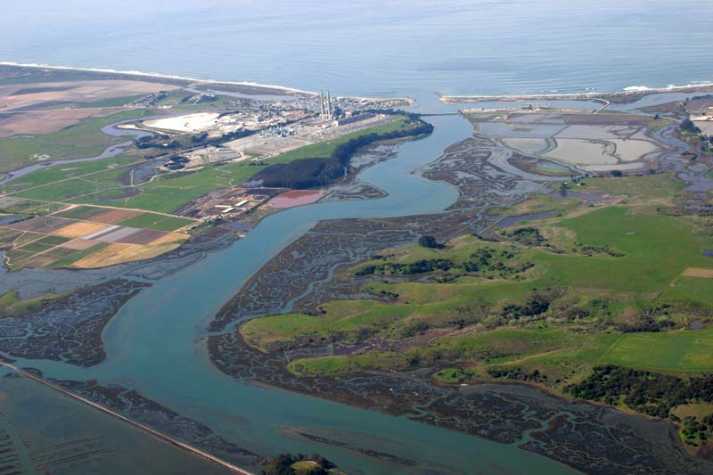
Estuaries
Almost every river on Earth flows into an ocean
The area where a river meets an ocean and contains a mixture of freshwater and salt water is called an estuary

Slide 20
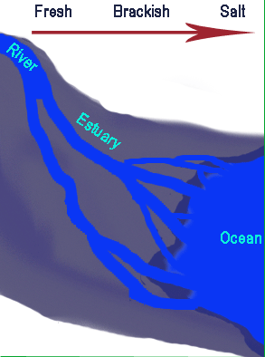
Estuaries
Other names for estuaries include bays, lagoons, harbors, inlets, and sounds
They are located near coastlines and boarder the land
Salinity in estuaries changes with the amount of freshwater brought in by rivers and streams, and the amount of salt water pushed inland by the ocean tides

Slide 21
Learning Check
What are estuaries?
List other names for estuaries.

Slide 22
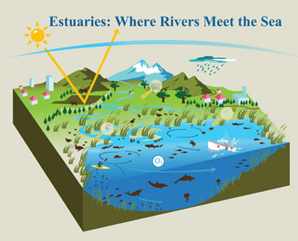
Estuaries
Estuaries are extremely fertile, productive environments because freshwater streams bring in tons of nutrients washed from inland soils
Nutrient levels in estuaries are higher than freshwater ecosystems or other saltwater ecosystems

Slide 23
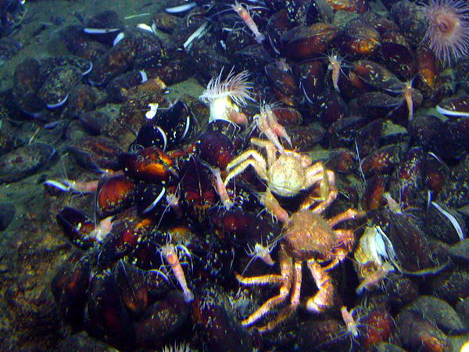
Estuary Life
Organisms found in estuaries include many species of algae, grasses, shrimp, crabs, oysters, snails, worms, and fish.
Estuaries provide much of the seafood consumed by humans

Slide 24
Learning Check
Why are estuaries so rich and fertile?
List the type of organisms that are forund in estuaries.

Slide 25
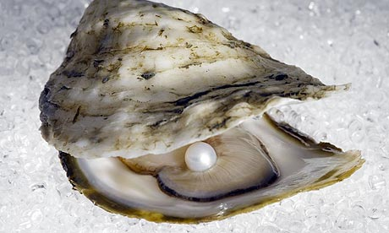
Oysters

Slide 26
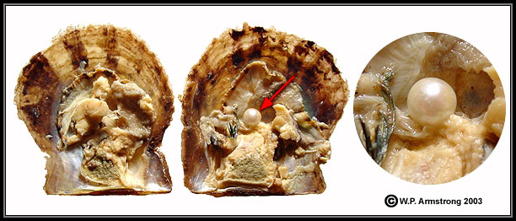
Oysters and Pearls
A natural pearl begins its life inside an oyster's shell when an intruder, such as a grain of sand or bit of floating food, slips in between one of the two shells of the oyster, a type of mollusk, and the protective layer that covers the mollusk's organs, called the mantle.

Slide 27
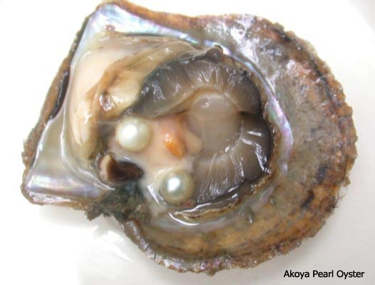
Pearls
In order to protect itself from irritation, the oyster will quickly begin covering the uninvited visitor with layers of nacre — the mineral substance that fashions the mollusk's shells. Layer upon layer of nacre, also known as mother-of-pearl, coat the grain of sand until the iridescent gem is formed.

Slide 28
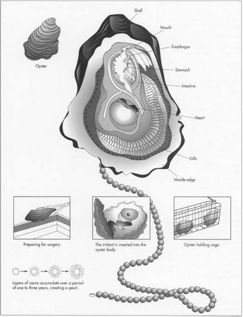
Cultured Pearls
Cultured pearls are made in the same way. The only difference is that instead of accidental circumstances, a "pearl farmer" embeds a grain of sand into the mollusk.

Slide 29
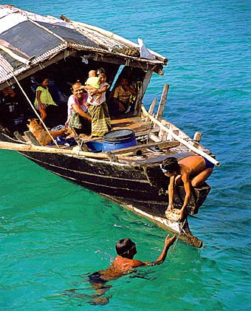
Pearl Divers
What dangers do pearl divers face?
What kinds of people were pearl divers?
What kind of life did pearl divers live?
How do pearl divers adapt their bodies to the ocean?
What are the bends?
http://www.amnh.org/exhibitions/past-exhibitions/pearls

Slide 30
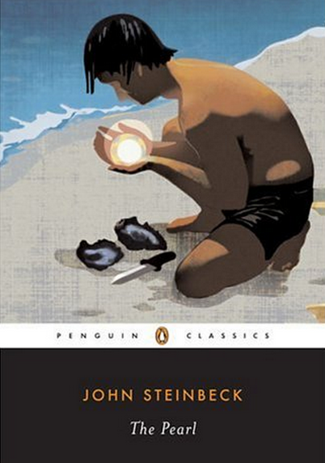
The Pearl – John Steinbeck
The Pearl is a novel set in the coastal village of La Paz, Mexico in the late 19th, early 20th century. The characters in the book are Kino, Juana, Coyotito and “The Pearl”.
Kino is a pearl diver

Slide 31
Pearl Exhibit at AMNH
Link to Pearl Exhibit
http://www.marthastewart.com/913065/museum-natural-historys-pearl-exhibit

