Slide 1
St John’s
Solar Project
St John’s Solar Study Group

Slide 2
Why Solar Panels?
Reduces St Johns’ cost of energy
  Net savings of $800/yr to start, $80K+ over 20 years
Reduces St Johns’ carbon footprint
  Avoids 45 tons/yr of CO2 production at Valmont
  Like taking 9 cars off the road, or planting 231 trees
Visible declaration of St Johns’ concern for the environment
Financial incentives are available
Generates revenue for St John's from Xcel
“Christ is the light of the world and in him all things are made new. Or as the psalmist said to God, ‘with you is the fountain of life. In your light so we see light.’ A solar panel installation would bring new meaning to this theology of God in Christ as life-giving light“
- Pastor Susan, 18 Oct 2015

Slide 3
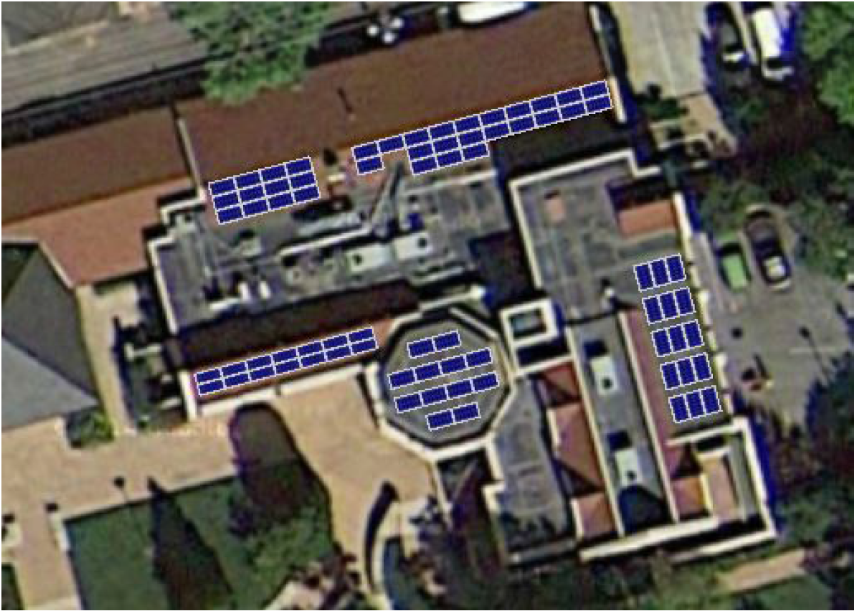
St John’s Solar Array - Proposed

Slide 4
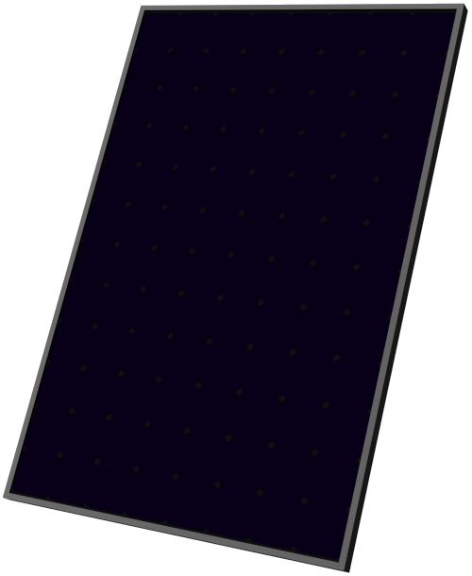
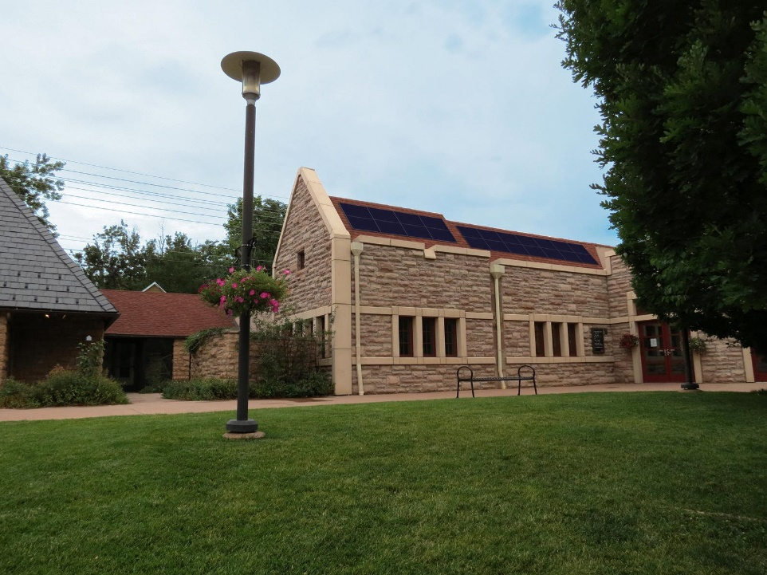
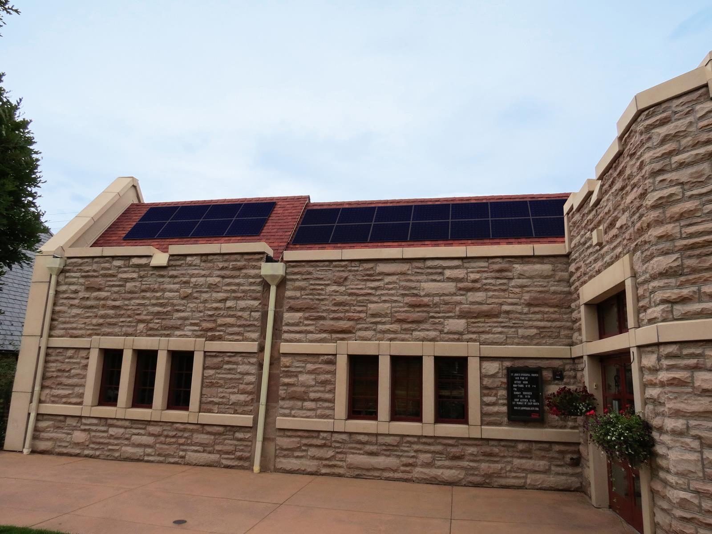
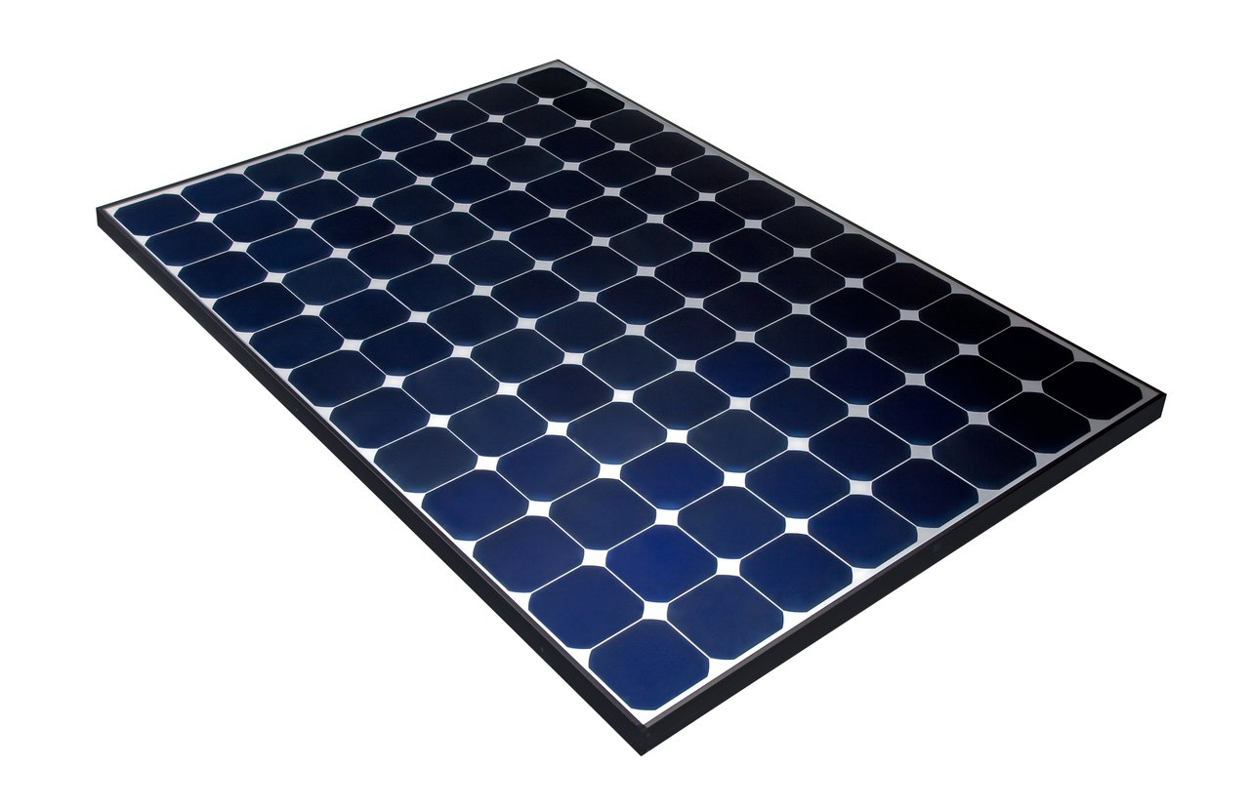
St John’s Solar Array - Proposed
Front – visible panels
Rooftop – non-visible panels

Slide 5
What are the solar project options?
Purchase price of system = $95,000
Options:
St John's Purchase
Community Solar / Solar Garden
St John's Investors

Slide 6
Option 1: St John's Purchase
St John's purchases, owns and maintains the system from day 1.
Cash outlay of $95,000
St John's is a non-profit, thus tax-based incentives are not available for this option.

Slide 7
Option 2: Community Solar
St John’s purchases solar panels installed in a Boulder County site, not at the church
St John’s receives “bill credit” for electricity produced, monthly checks for Renewable Energy Credits (RECs)
St John’s would need to finance $87,000 purchase
Payback period – 15 years
Costs St John’s additional $2,500/yr in first year

Slide 8
Option 3: St John's Investors
Form an independent, for-profit LLC comprised of parishioners
  Can monetize 30% Federal Investment Tax Credit and accelerated depreciation
LLC members purchase, own, and maintain system for six years
St John's pays LLC for electricity produced
for six years (lower, fixed cost vs Xcel)
After six years St John's pays LLC $56,500 for the array, and then owns and operates the system

Slide 9
Pros and Cons; Option 1
Pros
St John's pays reduced cost for electricity produced (40%+ of annual electric usage)
St John's receives $150 monthly REC payment from Xcel for 20 years
Cons
St John's required to finance $95,000 up front
St John's unable to take advantage of gov’t tax credits, depreciation, etc.

Slide 10
Pros and Cons; Option 2
Pros
Xcel Energy’s preferred method of solar
No solar panels on St John’s campus
Production per panel higher
Cons
Church required to finance $87,000 up front
Higher overall cost
No visible sign of St John’s commitment to saving the environment

Slide 11
Pros and Cons; Option 3
Pros
No initial financing required
After six years St John's no longer has to pay for electricity produced by array (worth $7,000+/yr)
After six years, St John's receives approx. $1,800/yr for 14 years from Xcel REC payment
Reduced Year 7 purchase cost due to tax credits and other financial incentives received by investors
Cons
Church would need to raise $56,500 over 6 years, or finance the purchase of the array in year 7

Slide 12
Pros and Cons; Option 3
Pros
No initial financing required
After six years St John's no longer has to pay for electricity produced by array (worth $7,000+/yr)
After six years, St John's receives approx. $1,800/yr for 14 years from Xcel REC payment
Reduced Year 7 purchase cost due to tax credits and other financial incentives received by investors
Cons
Church would need to raise $45,000-$57,000 over 6 years, or finance the purchase of the array in year 7
RECOMMENDED

Slide 13
Financial Summary of Option 3
Electricity cost for next 20 years – no solar panels | $407,000
Sum of all St John’s payments w/solar | $326,000
Savings for St John’s | $81,000
Assumes
3.1% inflation of electricity cost per year (national 12 year average - US Energy Information Administration)
LLC monetizes all tax benefits and PACE grant
St John’s finances Year 7 array purchase, 15 yr 7.0% loan

Slide 14
Announcement to Congregation
Susan’s reflection 18 Oct
Rector’s Pen 20 Oct
25 Oct Bulletin, eAGLE, website in the works
NO negative feedback so far
43 potential investors took information

Slide 15
Investor Highlights (subject to change)
Ten investors each invest ~$10,000 to fund $100,000 for purchase and construction of system in 2016
2017 - investors receive 30% federal tax credit and $10,000 Boulder County grant
Investors realize depreciation on system over six years (front end loaded)
Income from investment distributed annually to investors
  $1,800/yr for REC incentive from Xcel
  $4,800/yr from St John's for electricity
After Year 6, St John's purchases the system for $56,500 and investors receive their capital back.

Slide 16
Selecting Investors
10 members easy to manage, lowers costs, benefits church more
Qualified participants able to provide $10,000 by 20 Nov
If more than 10 qualified parishioners express interest in joining the LLC, a lottery will be held to select the 10 final members
One LLC member will act as managing member*. The duties of the managing member are estimated to require 40-60 hr/yr, such as:
  maintain the communication, accounting and legal records of the LLC
  provide day-to-day operations, such as managing maintenance or repairs
  produce invoices and payments as required
  maintain the LLC bank accounts
  manage the preparation of tax returns annually
* - To incentivize someone to volunteer as managing member, the Solar Study Group recommends the managing member volunteer be exempt from the member lottery, and will automatically be one of the 10 members. Managing member volunteer should have demonstrated ability to manage large projects and prepare tax docs

Slide 17
How is investment handled?
SJ Solar 1 LLC registered at Xcel as the legal entity of the investor group (we can change the name…)
Each investor sends LLC a $10,000 check
Managing member pays bills, signs contracts, establishes bank account, calculates and pays per-member benefits, etc
Each investor files their own personal income taxes including income, tax credit (year one only), and depreciation

Slide 18
Risks to Investors
There are risks associated with investing money in this project, as with any investment
Inability to monetize depreciation or tax credit
No PACE grant
Municipalization of Boulder electric utility
Loss of capital
Church cannot fund purchase in year 7
Damage to or failure of some or all of array
Church cannot pay monthly PPA payments

Slide 19
Risks to Investors (cont’d)
Xcel Energy changes REC rules
Tax liabilities when array sold to church
Regulatory or legal changes
Underperformance of the array

Slide 20
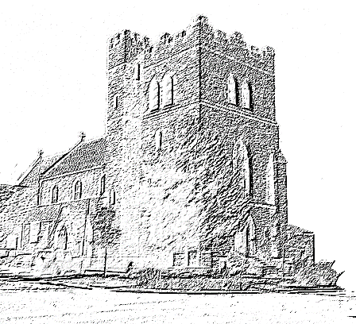

St John’s Solar Project Financials
St Johns Solar LLC
St Johns Church
For-profit, independent company
Formed to benefit the church
10 parishioners
$10,000 each
Estimated 7-12% per year returns
7 years commitment
Purchases, owns, operates for 6 years
Installation site, Future owner
Purchases all electricity from array
Saves $800-$1000 first year
Total 20 yr savings > $80,000
PPA commits to purchasing in Year 7
PPA commits future purchase price
Year 7: purchase w/loan or capital

Slide 21

St John’s Solar Project Financials
Year 0
(2015)
St Johns Solar LLC
St Johns Church
Forms and recruits 10 members from parish
Collects $10,000 each from members
Contracts with Custom Solar
Pays for $95,000 install cost of array
Signs Power Purchase
Agreement (PPA) with
St John’s
Cooperates with design & install
Signs PPA with Solar LLC
Pays Xcel ~$1,250/mo for electricity
Designs, procures, builds system

Slide 22
St John’s Solar Project Financials
Year 1
(2016)
St Johns Solar LLC
St Johns Church
Collects payments from St John’s for electricity produced (~$400/mo)
Collects payments from Xcel Energy for solar RECs (~$150/mo)
Prepares annual tax filings
Distributes benefits to
members ($$, tax benefits)
Maintains array
(repairs, maintenance)
Files for Federal tax credit
(~$28,500); pays to members
Files for PACE grant
($10,000); pays
to members
Pays LLC ~$400/mo for electricity
Pays Xcel ~$750/mo for electricity
Saves ~$100-$250/mo compared to 2015 electric costs
Finishes install and turn on
Performs maintenance and repairs (if needed)

Slide 23
St John’s Solar Project Financials
Years 2-6
(2017-2021)
St Johns Solar LLC
St Johns Church
Collects payments from St John’s for electricity produced (~$400/mo)
Collects payments from Xcel Energy for solar RECs (~$150/mo)
Prepares annual tax filings
Distributes benefits to
members ($$, tax benefits)
Maintains array
(repairs, maintenance)
Pays LLC ~$400/mo for electricity
(solar payment stays constant)
Pays Xcel ~$800-$900/mo for electricity (electric costs increase 3-4% per year)
Performs maintenance and repairs (if needed)

Slide 24
St John’s Solar Project Financials
Year 7
(2022)
St Johns Solar LLC
St Johns Church
Sells array to St John’s for pre-arranged price (e.g., $56,500)
Distributes capital to members
Dissolves
Arranges financing for array purchase, e.g., 15 year, 7% interest
Purchases array from LLC
Pays ~$400/mo for loan payments
(loan payment stays constant for 15 yrs)
Pays Xcel ~$940/mo for electricity
(estimated Xcel bill w/o solar: $1,500/mo)
(electric costs increase 3-4% per year)
Collects payments from Xcel Energy for solar RECs (~$150/mo) thru 2036
Maintains and operates array
Performs maintenance and repairs (if needed)

Slide 25
Year 7 Array Transfer Price
$94,589 purchase price
Minus 30% Federal Tax Credit, $28,467
Minus $10,000 PACE grant
LLC investors receive their portions of Federal tax credit, PACE grant, and proceeds of sale to St John’s
$94,889
($28,467)
Federal
Tax Credit
($10,000)
PACE Grant
$56,422
$56,422
Transfer
Price to
St John’s

Slide 26
End of Slides
Backup slides follow

Slide 27
St John’s Solar Array - Technical
25.2 kilowatts (kW) peak capacity
Estimated production 38,000 kWh per year
  40-50% of St John’s annual electricity
63 x 327W SunPower E20 panels
14 x 335W SunPower “Signature Black” panels
2 x Solar Edge SE10000A-US inverters
Solar Edge power optimizers
E-Gauge power monitoring system
25-year warranty on panels & optimizers
15-year warranty on inverters

Slide 28
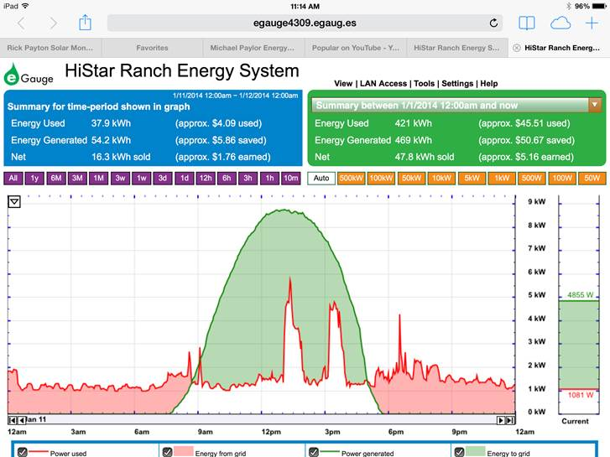
E-Gauge Monitoring System

