Slide 1
Do Students Understand the Language of Math?
Sarah R. Powell, Melissa K. Driver,
Suzanne R. Forsyth, & Gena Nelson

Slide 2
Research Team
Sarah R. Powell, University of Texas at Austin
srpowell@austin.utexas.edu
@sarahpowellphd
Melissa K. Driver, Kennesaw State University
Suzanne R. Forsyth, University of Texas at Austin
Gena Nelson, American Institutes for Research

Slide 3
Thanks

Slide 4
Language of Mathematics
2,450
+
thousands
>
add
$$\frac{2}{3}$$
greater
numerator

Slide 5
Language of Mathematics
temperature
median
associative property
take away
variable
thousands
degrees
Mathematics Vocabulary
add
parallelogram
skip counting
greater
denominator
quotient
numerator
cube

Slide 6
Mathematics Vocabulary

Slide 7
Mathematics Vocabulary

Slide 8
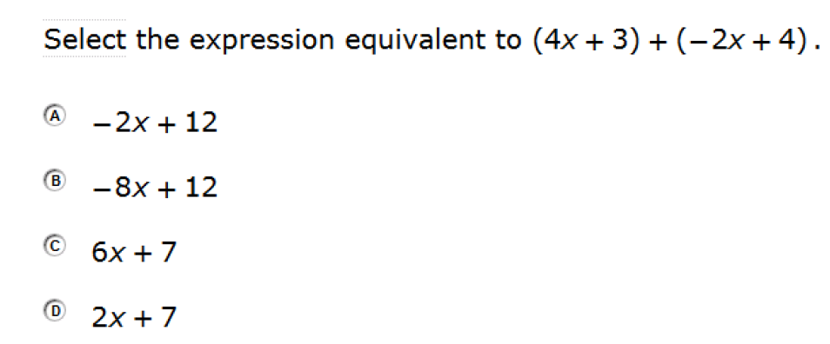
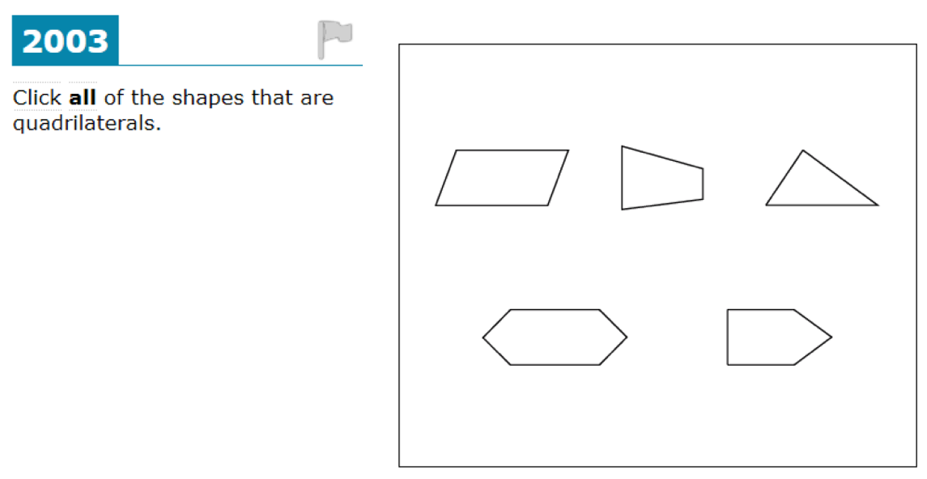
Mathematics Vocabulary

Slide 9
Development of Measures

Slide 10
Grade 1
40
1. Term appeared in 2 of 3 first-grade textbook glossaries
Go Math! enVisionMATH Everyday Math
2. Term appeared in a textbook glossary and a standard
Common Core
3. Term was opposite of selected term
longest
4. Terms included to alleviate ceiling effects
19
1
4

Slide 11
Grade 1
64
31 terms appeared in kindergarten glossaries
45 terms appeared in second-grade glossaries

Slide 12
Grade 1
Each item read aloud to a class of students
Students had 20-40 sec to respond
Approximately 25-30 minutes to administer entire measure

Slide 13
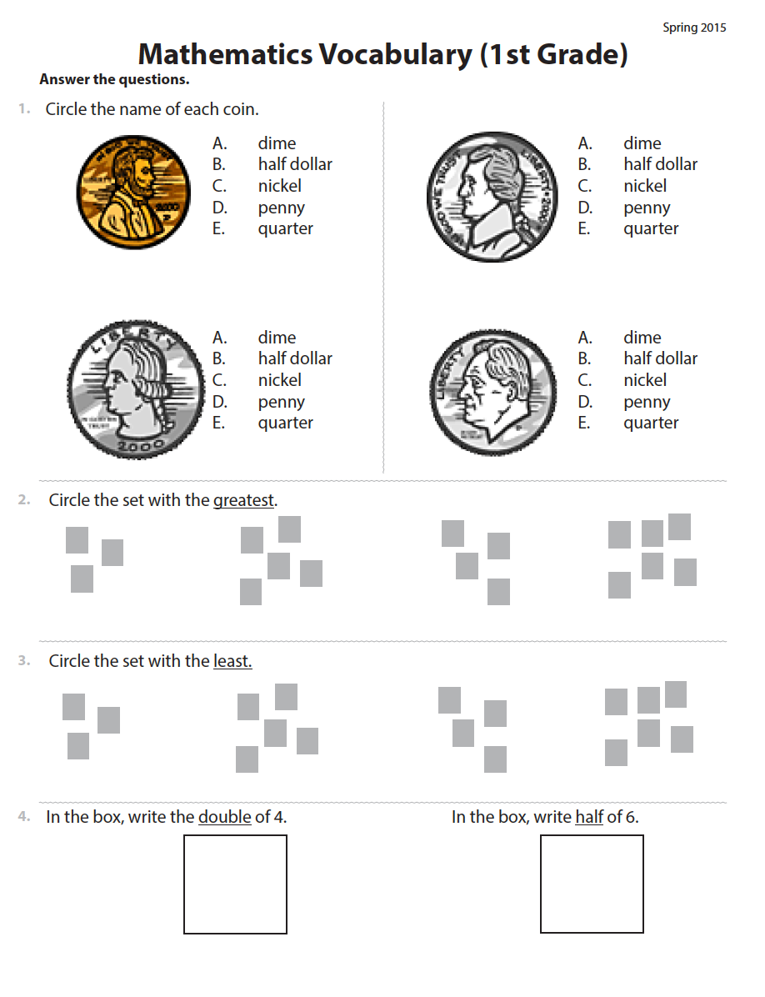
Three types of questions
Recall
Define
Use

Slide 14
penny
nickel
dime
quarter
greatest
least
double
half

Slide 15
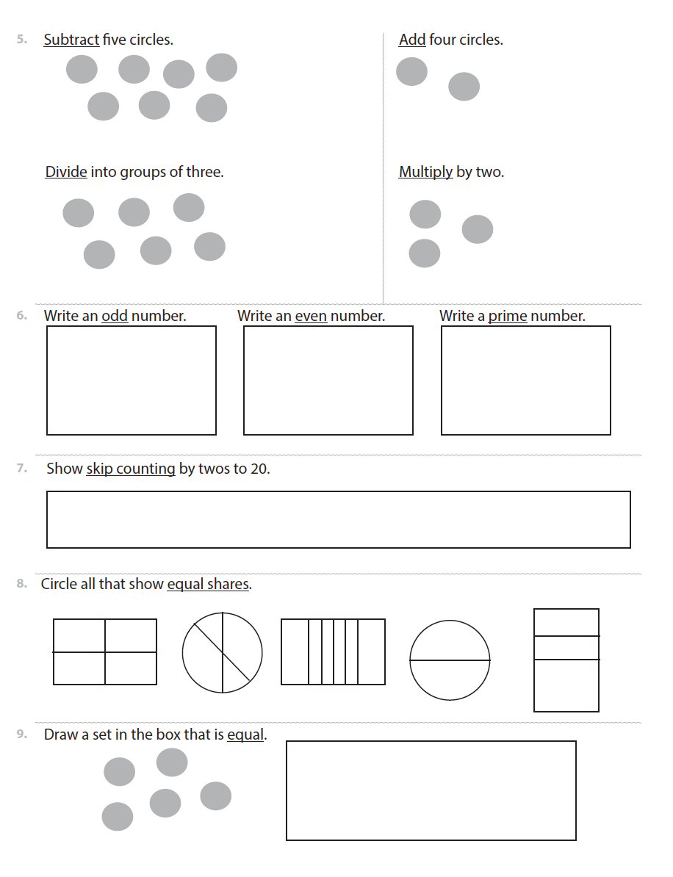
add
subtract
divide
multiply
odd
even
prime
skip counting
equal shares
equal

Slide 16
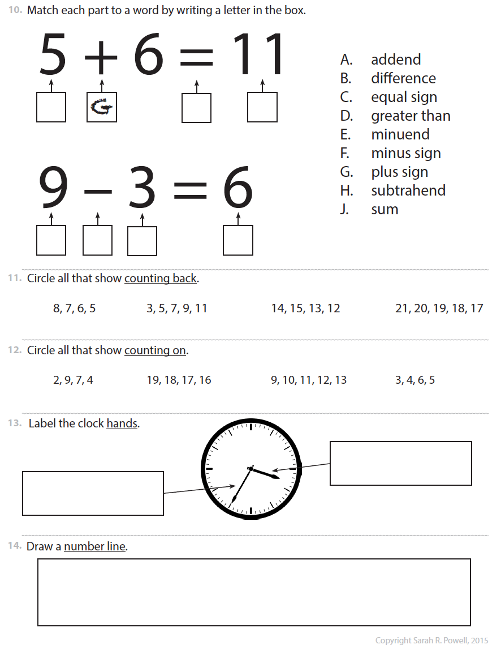
addend
difference
equal sign
greater than
minuend
minus sign
plus sign
subtrahend
sum
counting back
counting on
minute
hour
number line

Slide 17
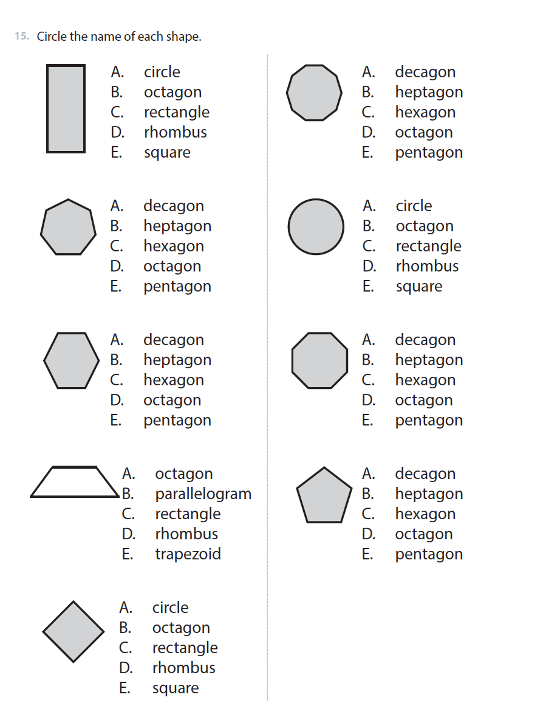
rectangle
decagon
heptagon
circle
hexagon
octagon
trapezoid
pentagon
rhombus

Slide 18
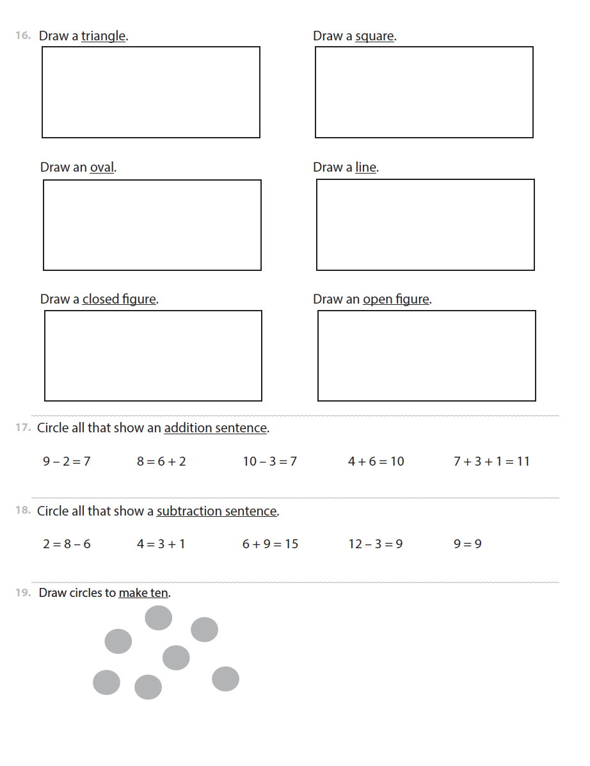
triangle
square
oval
line
closed figure
open figure
addition sentence
subtraction sentence
make ten

Slide 19
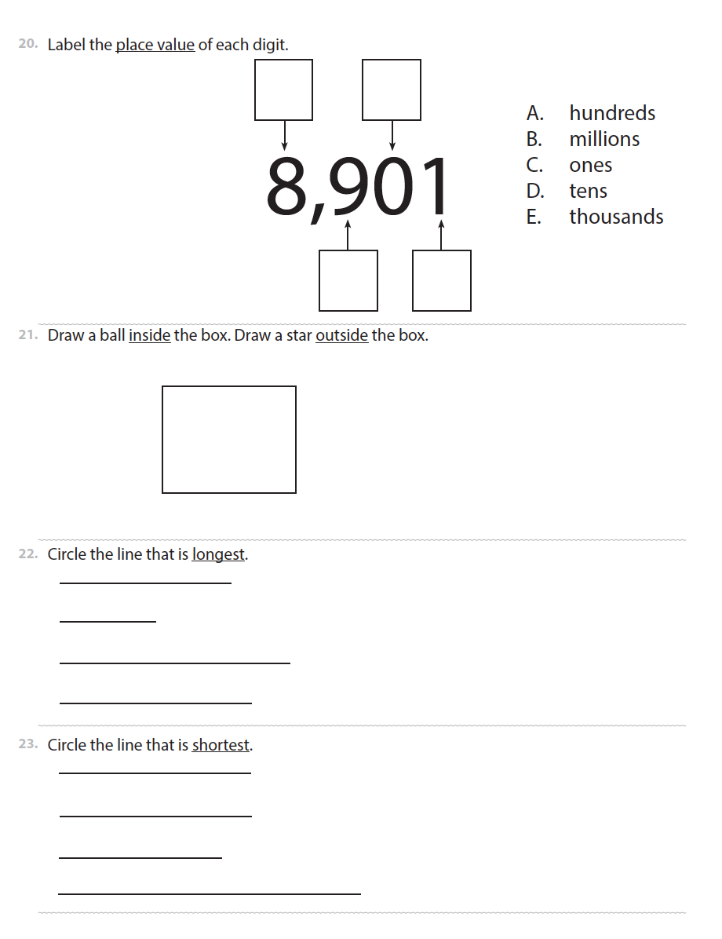
hundreds
millions
ones
tens
thousands
inside
outside
longest
shortest

Slide 20
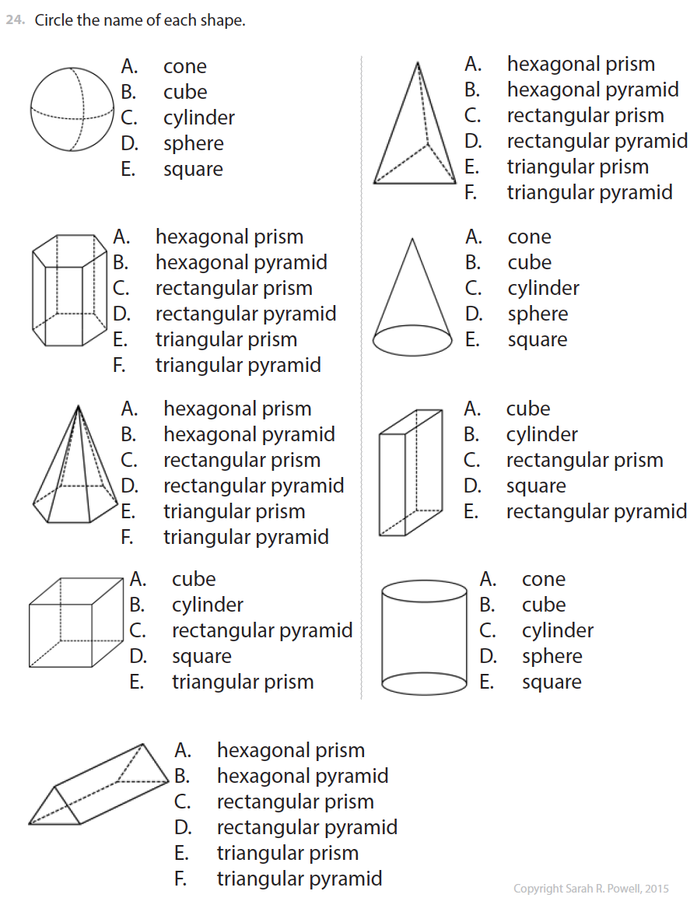
sphere
hexagonal prism
hexagonal pyramid
cube
triangular prism
triangular pyramid
cone
rectangular prism
cylinder

Slide 21
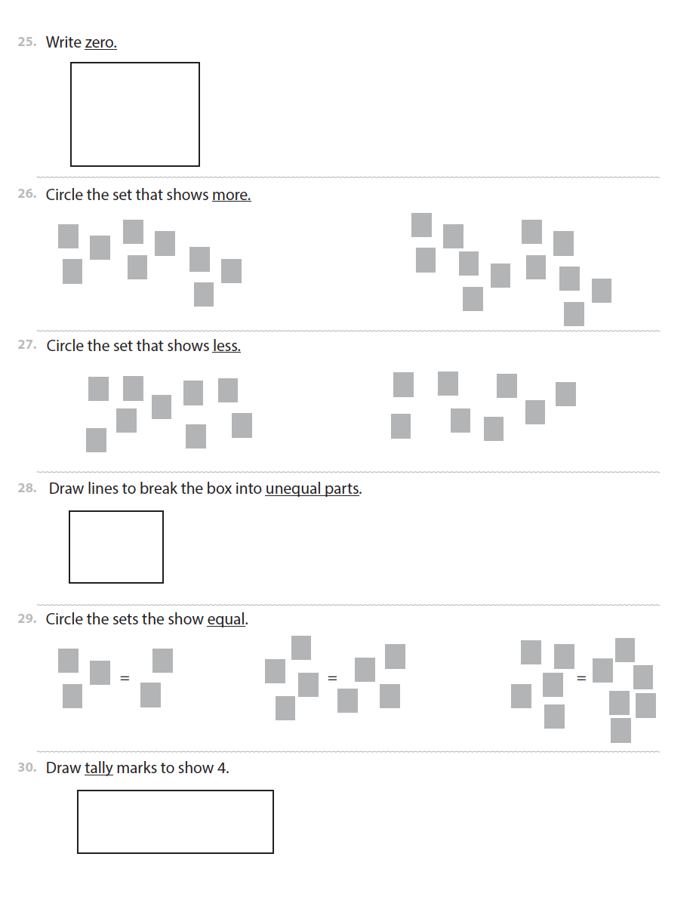
zero
more
less
unequal parts
equal
tally

Slide 22
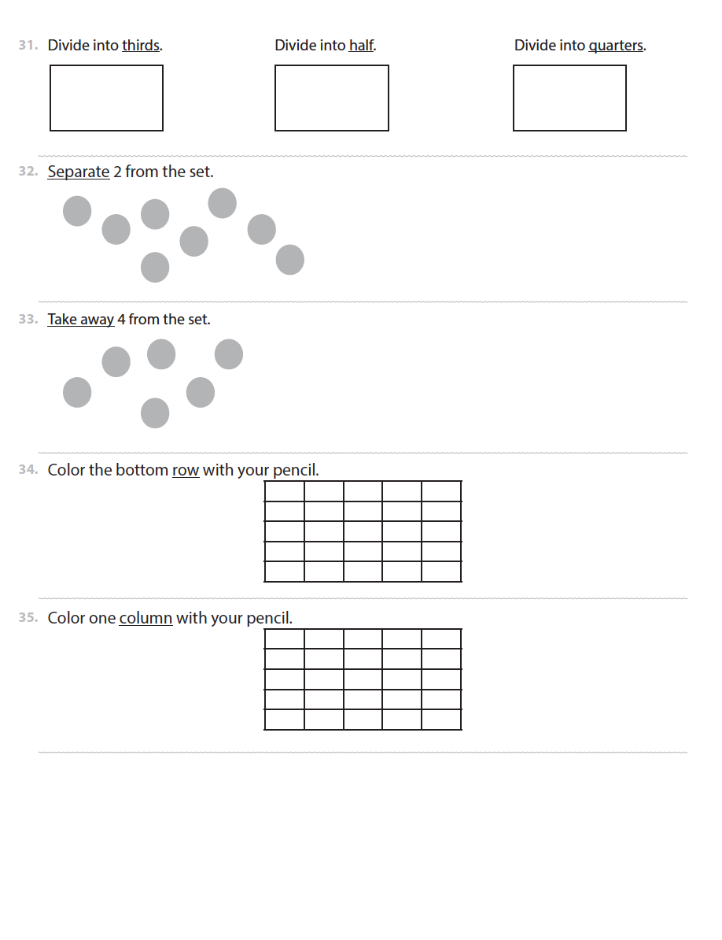
thirds
half
quarters
separate
take away
row
column

Slide 23
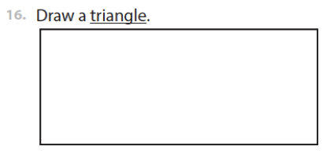
Grade 1
Scoring
1 point for each correct answer
3 pts
1 pt
0 pt

Slide 24
Grades 3 and 5
77
1. Term appeared a textbook glossary at grade 3 and 5
Go Math! enVisionMATH Everyday Math
2. Term appeared in a textbook glossary and a standard
Common Core
3. Term in a glossary but not explicit in a standard
4. Term explicitly named in standards but not a glossary
5. Term related to previously-selected terms
22
6
16
12

Slide 25
Grades 3 and 5
133
In the Common Core:
22 introduced in kindergarten
9 in grade 1
18 in grade 2
13 in grade 3
14 in grade 4
4 in grade 5
14 in grade 6 or above

Slide 26
Grades 3 and 5
Administered to an entire class of students
Students had 30 minutes to answer as many questions as possible

Slide 27
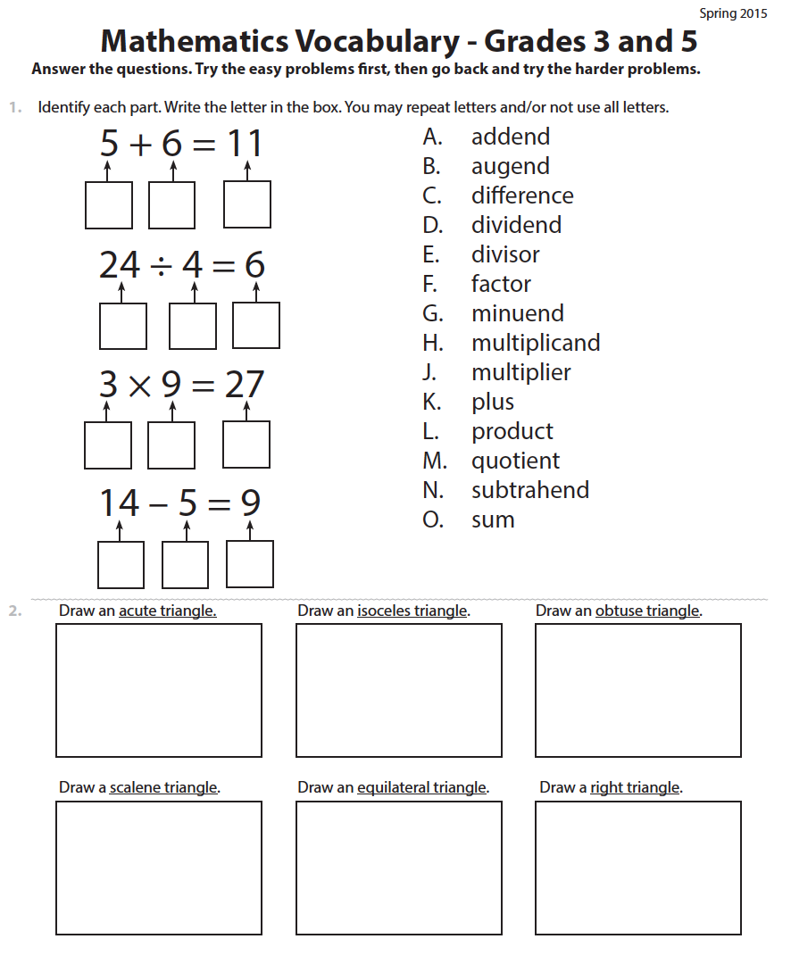
addend
augend
difference
dividend
divisor
factor
minuend
multiplicand
multiplier
plus
product
quotient
subtrahend
sum
acute triangle
isosceles triangle
obtuse triangle
scalene triangle
equilateral triangle
right triangle

Slide 28
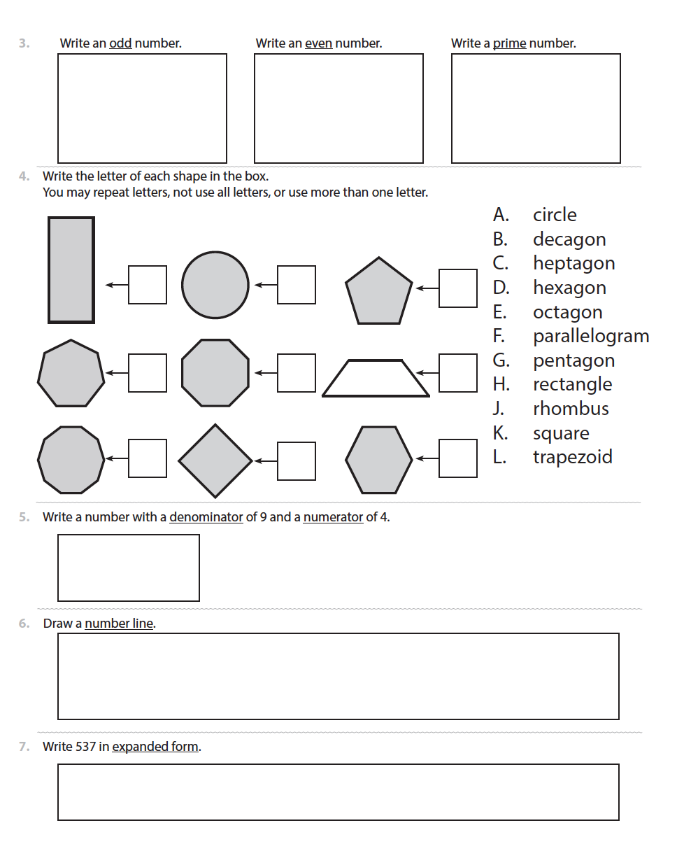
odd
even
prime
circle
decagon
heptagon
hexagon
octagon
parallelogram
pentagon
rectangle
rhombus
square
trapezoid
numerator
denominator
number line
expanded form

Slide 29
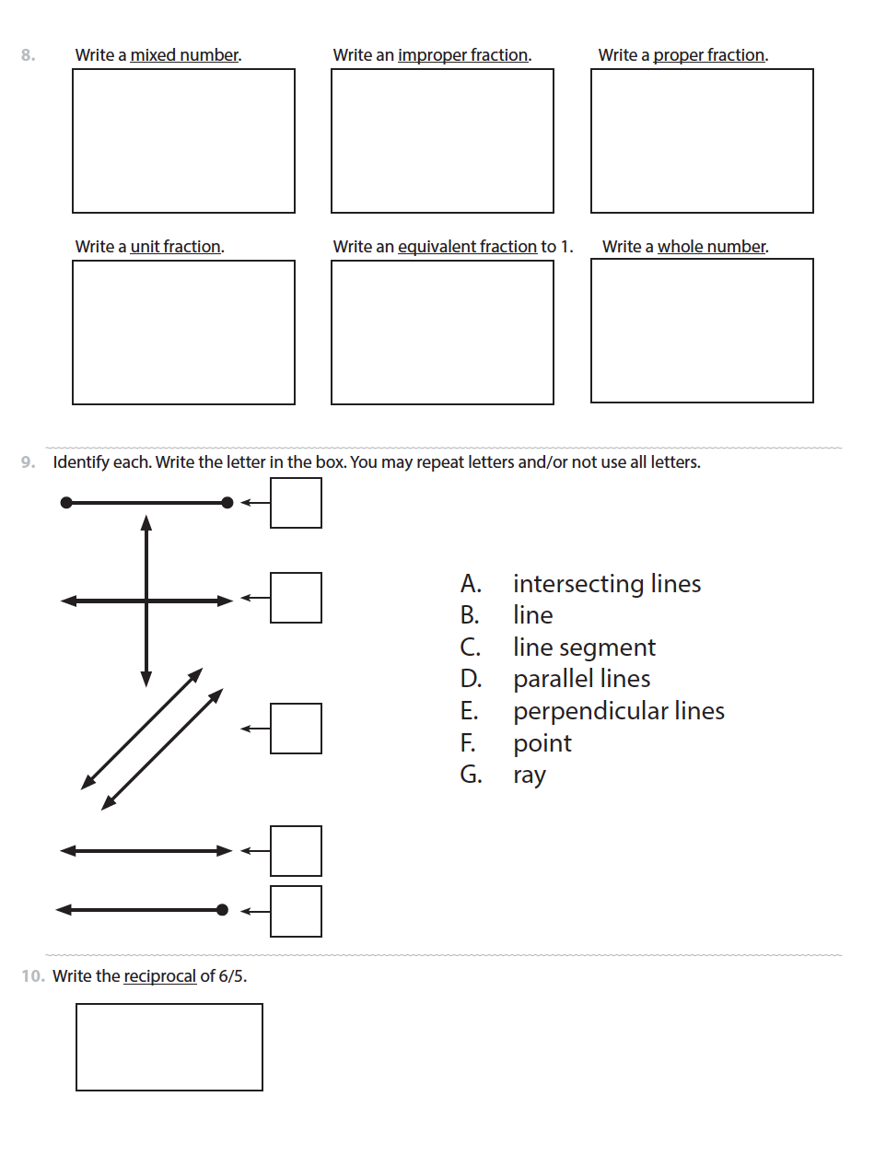
mixed number
improper fraction
proper fraction
unit fraction
equivalent fraction
whole number
intersecting lines
line
line segment
parallel lines
perpendicular lines
point
ray
reciprocal

Slide 30
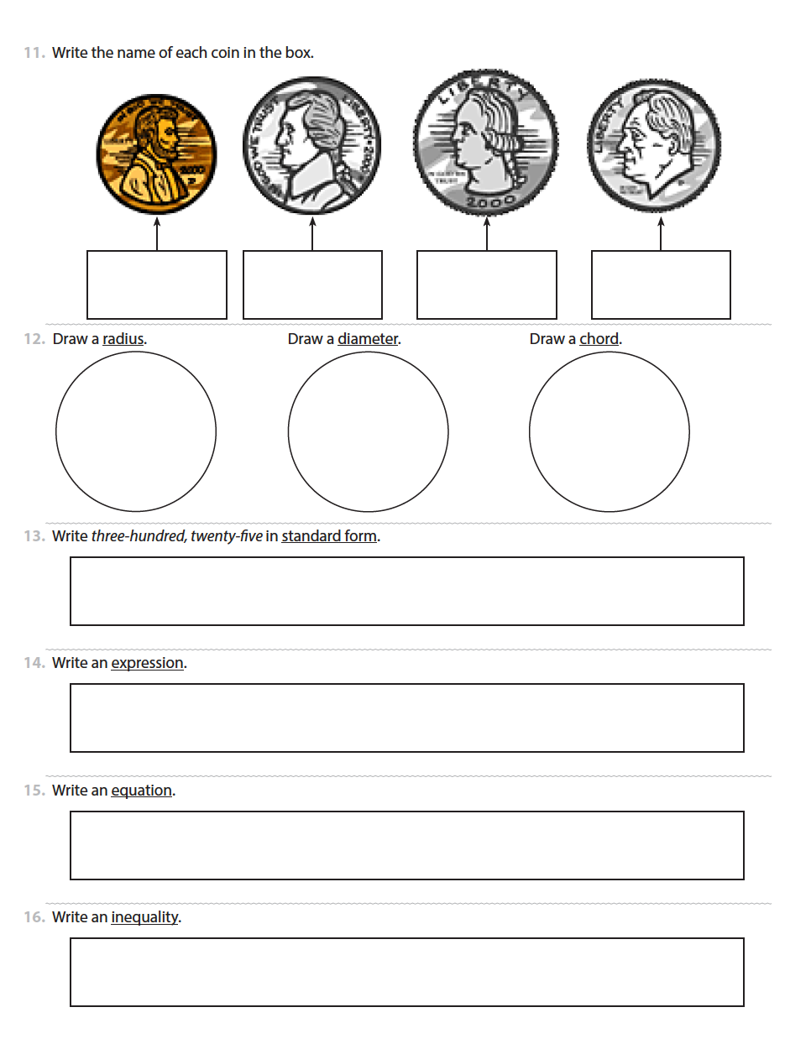
penny
nickel
dime
quarter
radius
diameter
chord
standard form
expression
equation
inequality

Slide 31
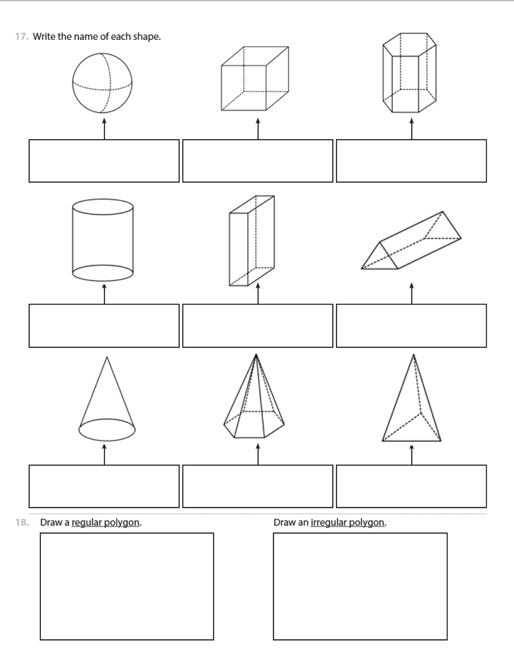
sphere
cube
hexagonal prism
cylinder
rectangular prism
triangular prism
cone
hexagonal pyramid
triangular pyramid
regular polygon
irregular polygon

Slide 32
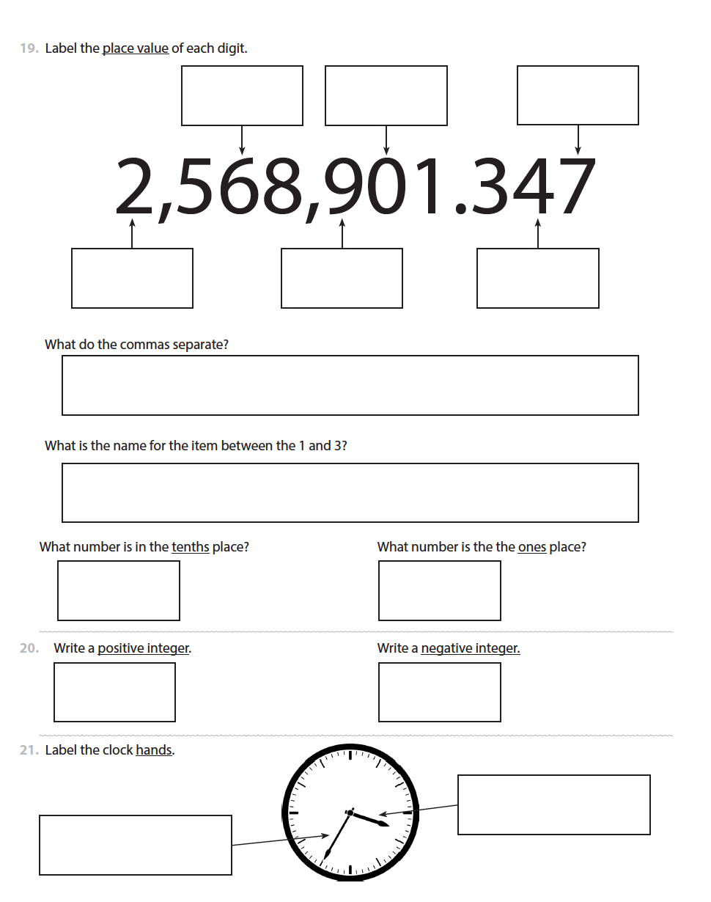
millions
hundred thousands
thousands
tens
hundredths
thousandths
periods
decimal point
tenths
ones
positive integer
negative integer
minute
hour

Slide 33
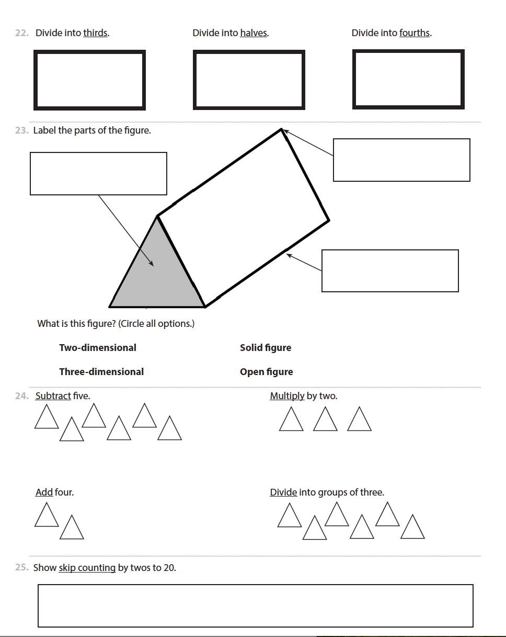
thirds
halves
fourths
face
edge
vertex
three-dimensional
solid figure
add
subtract
multiply
divide
skip counting

Slide 34
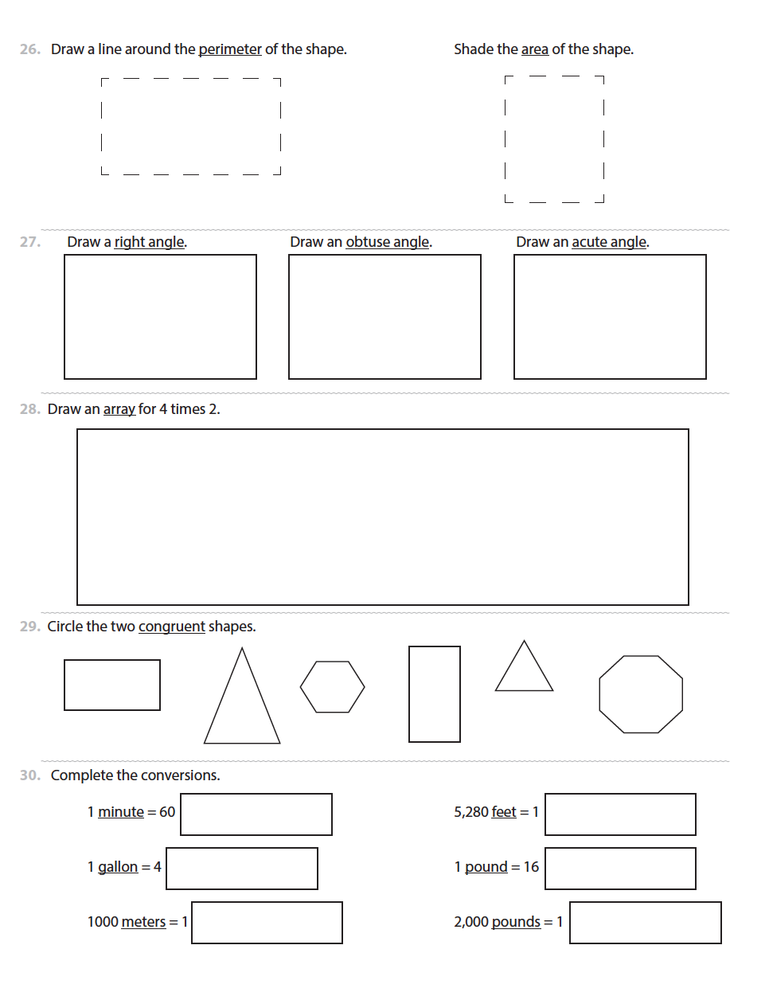
perimeter
area
right angle
obtuse angle
acute angle
array
congruent
minute
gallon
meters
feet
pound
hour
quarts
kilometer
mile
ounces
ton

Slide 35
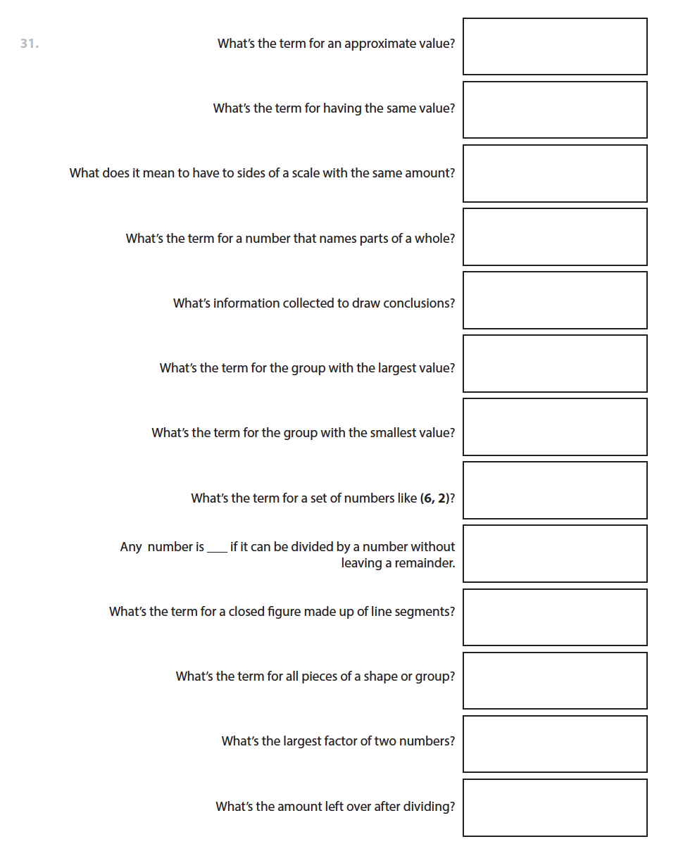
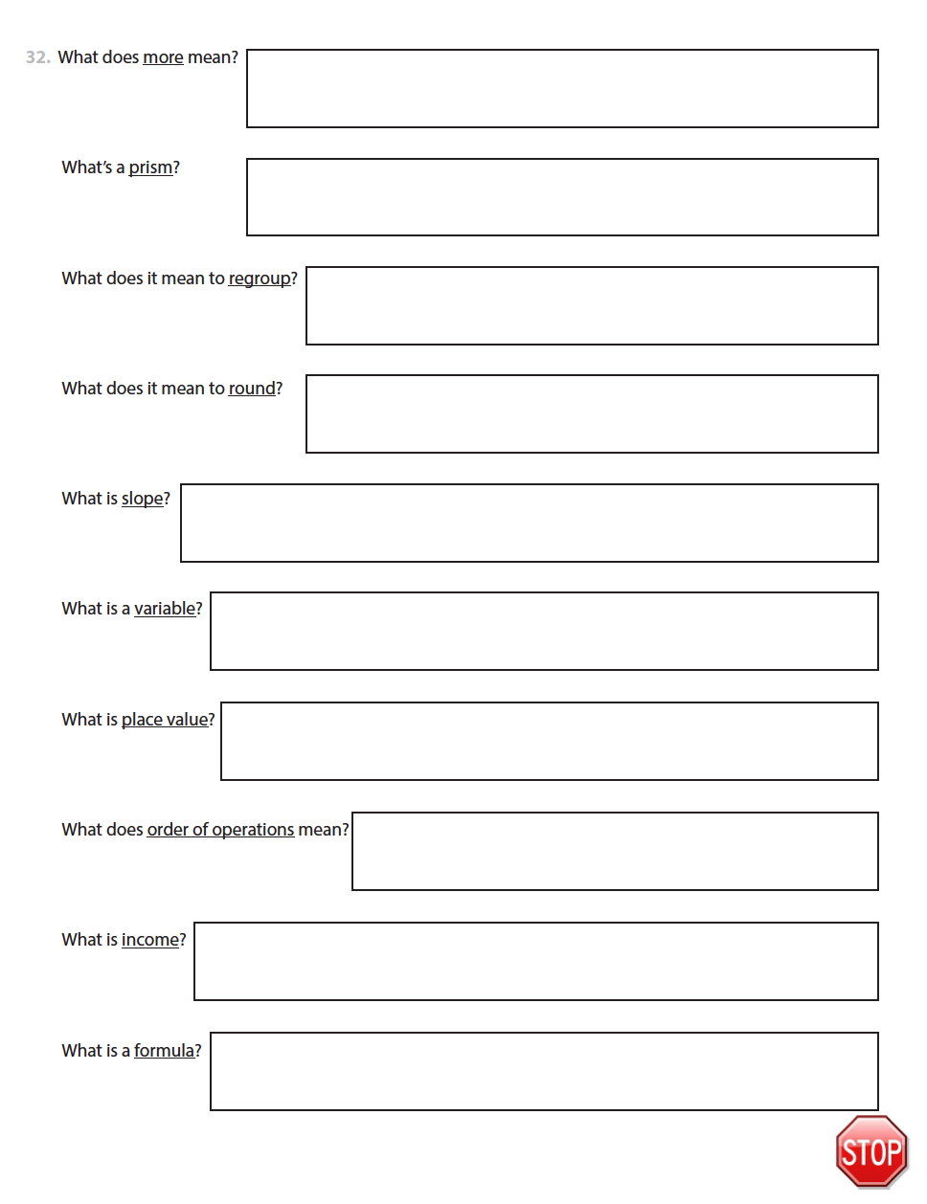

Slide 36
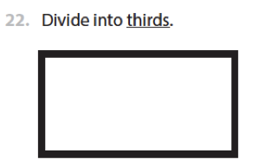
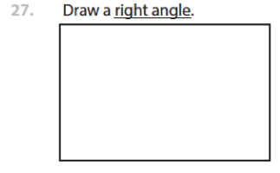
Grade 3 and 5
Scoring
1 point for each correct answer
0
1 pt
1 pt
0 pt
0 pt
0

Slide 37
Pilot Studies

Slide 38
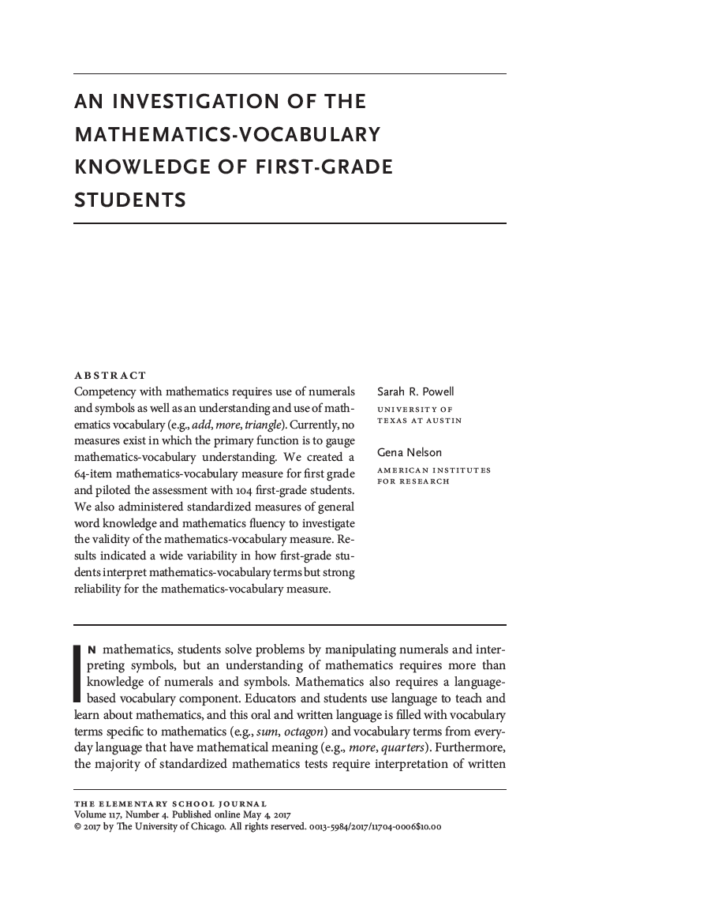

Slide 39
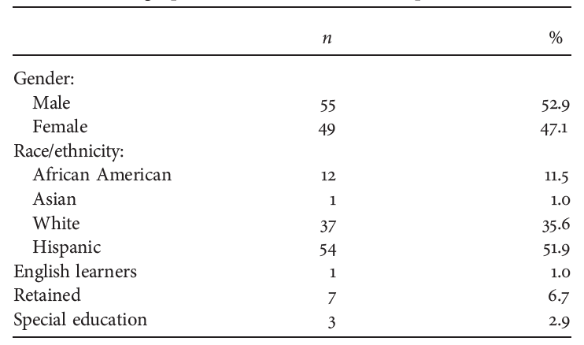
Grade 1
104 first-grade students from 6 classrooms

Slide 40
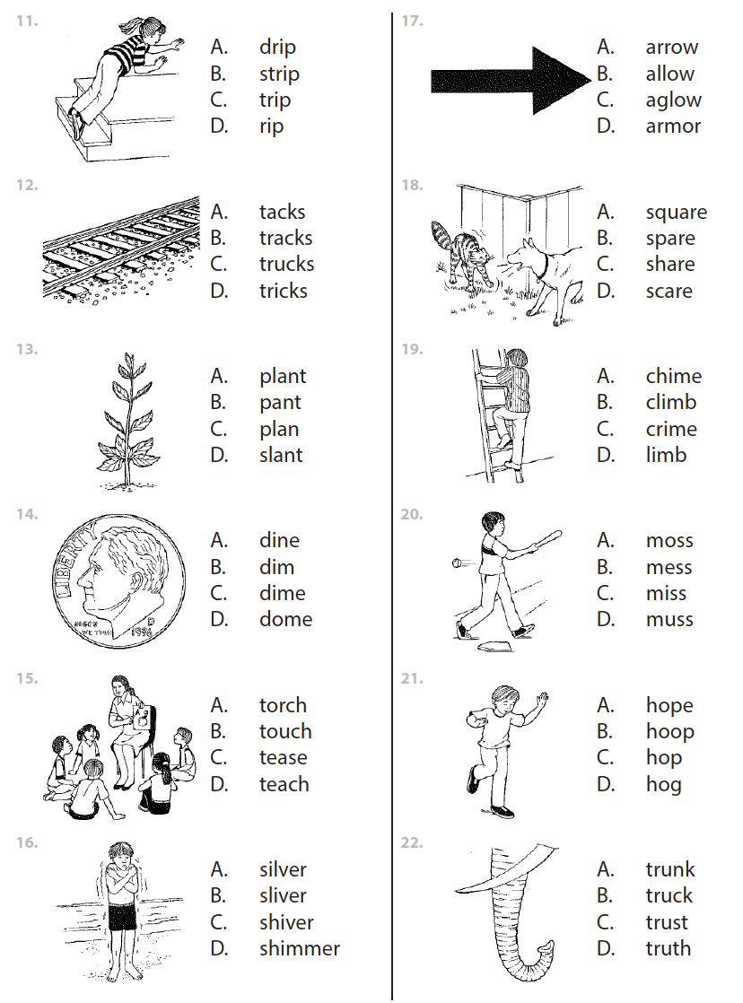
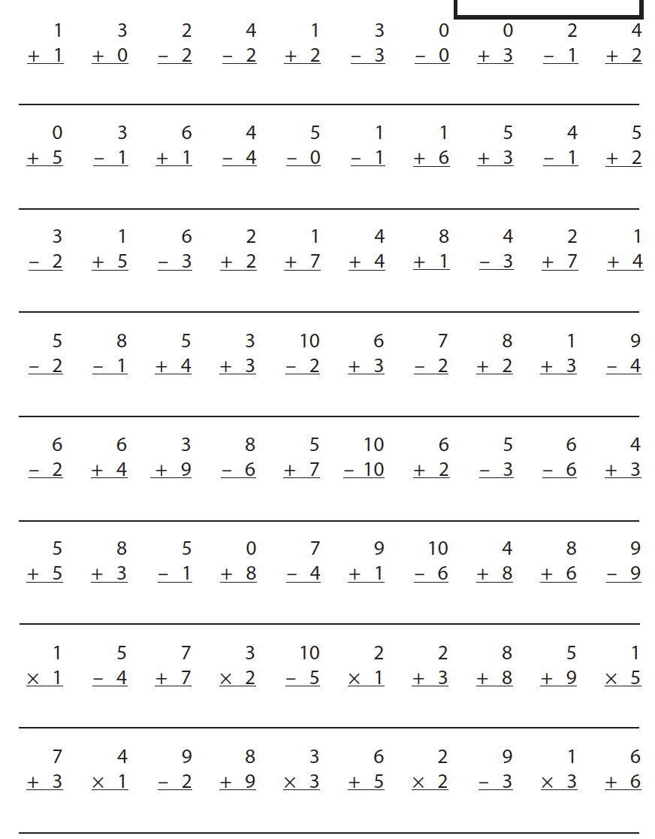
General Vocabulary
Math Fluency

Slide 41
Grade 1 Mathematics Vocabulary
⍺ = .85
Item-by-item analysis for reliability
Deletion of only five terms would have increased ⍺ by .02
Opted to keep all terms for analysis

Slide 42
Grade 1 Mathematics Vocabulary
Range: 15 – 55
No significant differences based on gender or retained status
Significant differences:
For English learner (n = 1)
Students with disabilities < students without disabilities
African American < Hispanic < Caucasian

Slide 43
Grade 1 Mathematics Vocabulary

Slide 44
Grade 1 Mathematics Vocabulary

Slide 45
Grade 1 Mathematics Vocabulary
Accuracy by item introduction:
Kindergarten 67.1%
First grade 48.8%
Second grade 29.2%

Slide 46
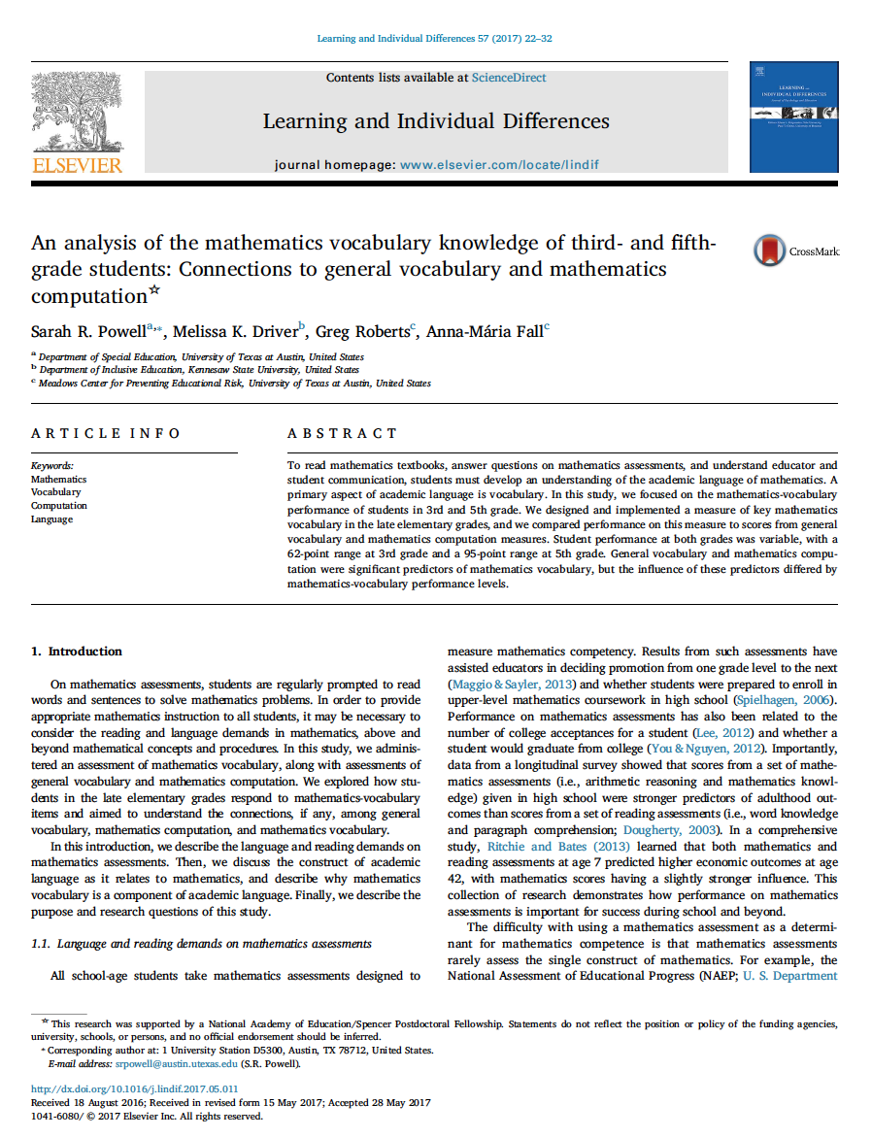

Slide 47
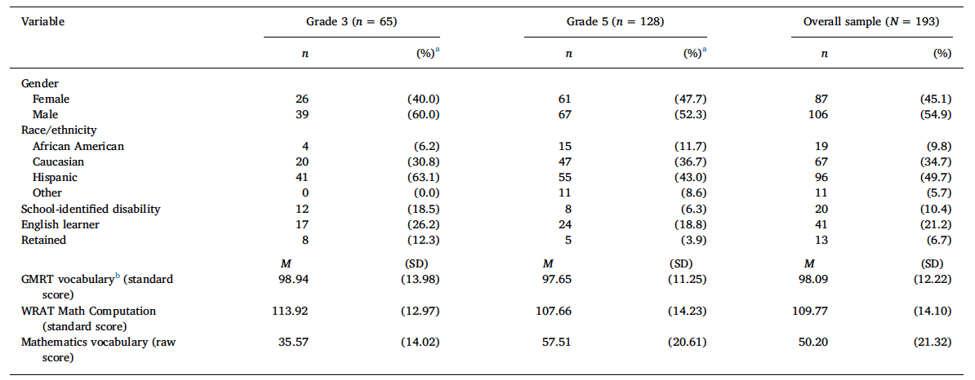
Grades 3 and 5

Slide 48
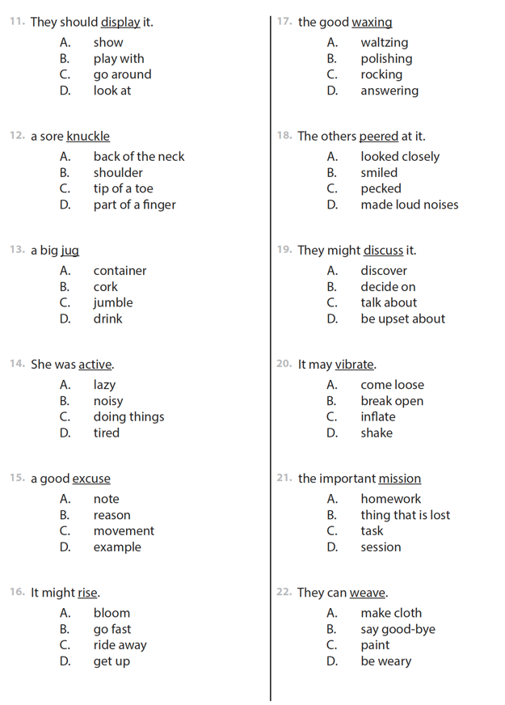
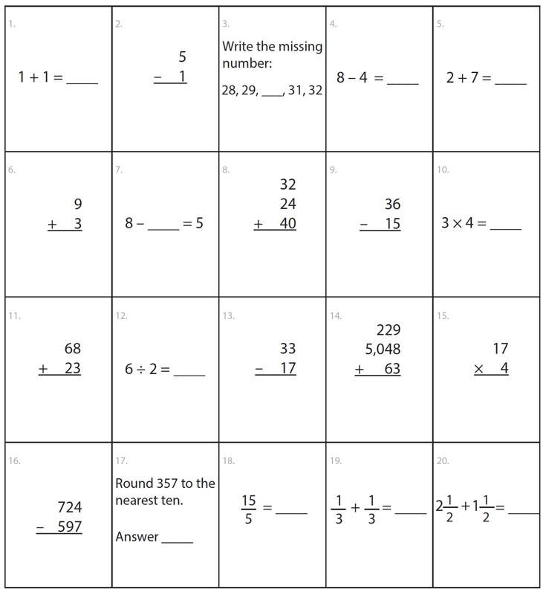
Math Fluency
General Vocabulary

Slide 49
Grades 3 and 5 Mathematics Vocabulary
Grade 3
Range = 6 – 68
M = 35.57 (14.02)
Grade 5
Range = 5 – 100
M = 57.51 (20.61)
No significant differences based on gender or retained status

Slide 50
Grades 3 and 5 Mathematics Vocabulary
⍺ = .92 at Grade 3
⍺ = .96 at Grade 3

Slide 51
Grades 3 and 5 Mathematics Vocabulary

Slide 52
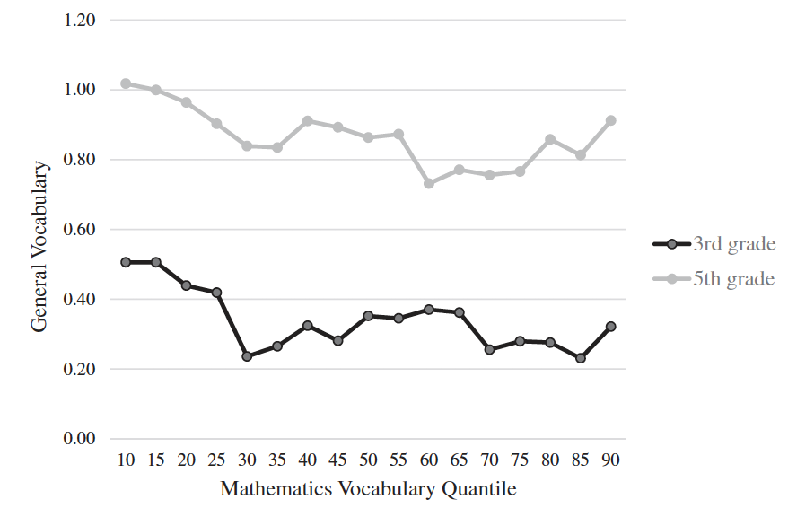
Grades 3 and 5 Mathematics Vocabulary

Slide 53
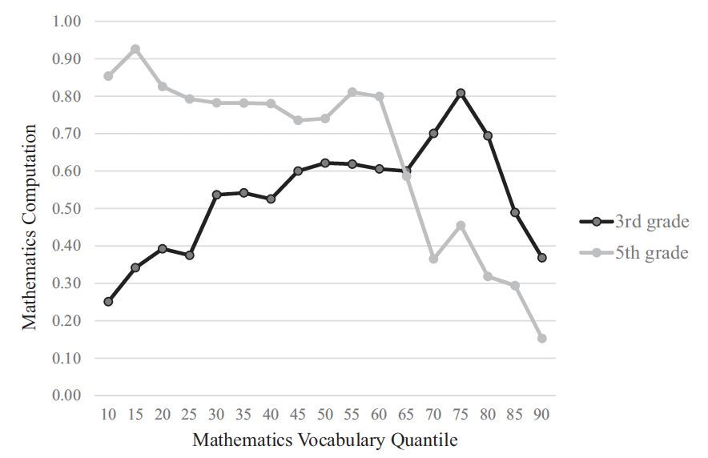
Grades 3 and 5 Mathematics Vocabulary

Slide 54
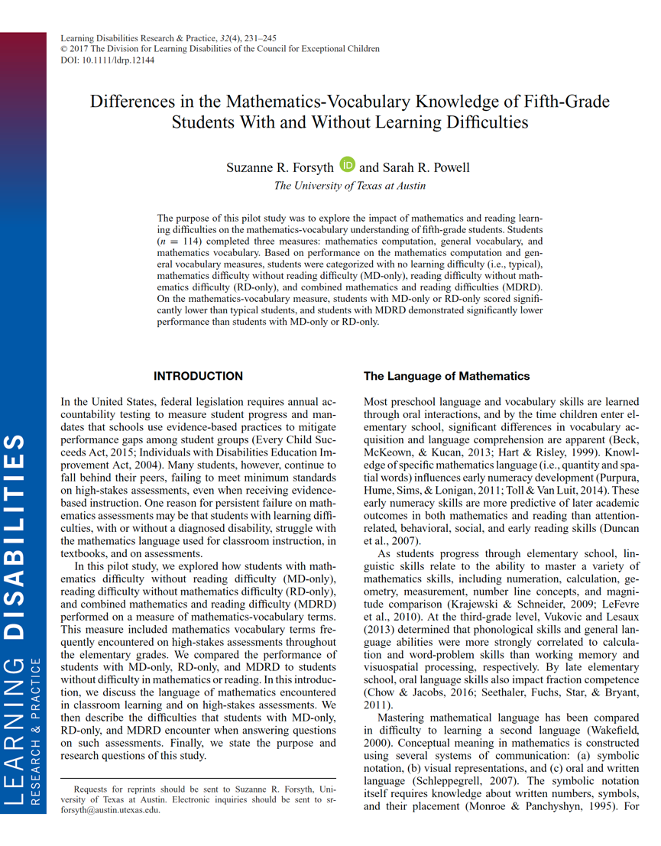

Slide 55
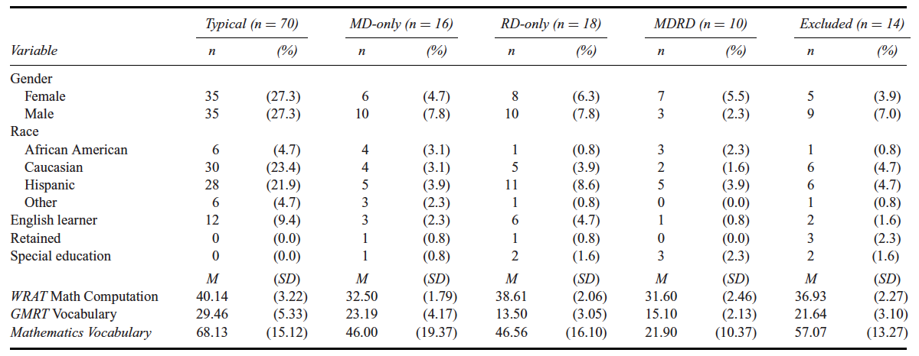
Grade 5 Mathematics Vocabulary

Slide 56
Grade 5 Mathematics Vocabulary
Typical > MD = RD > MDRD
MD > MDRD
RD > MDRD
Typical > MDRD
Typical > MD
Typical > RD
ES = 1.41
ES = 1.67
ES = 3.12
ES = 1.32
ES = 1.40

Slide 57
Grade 3
Developed a measure only for third grade
Have not analyzed data thoroughly

Slide 58
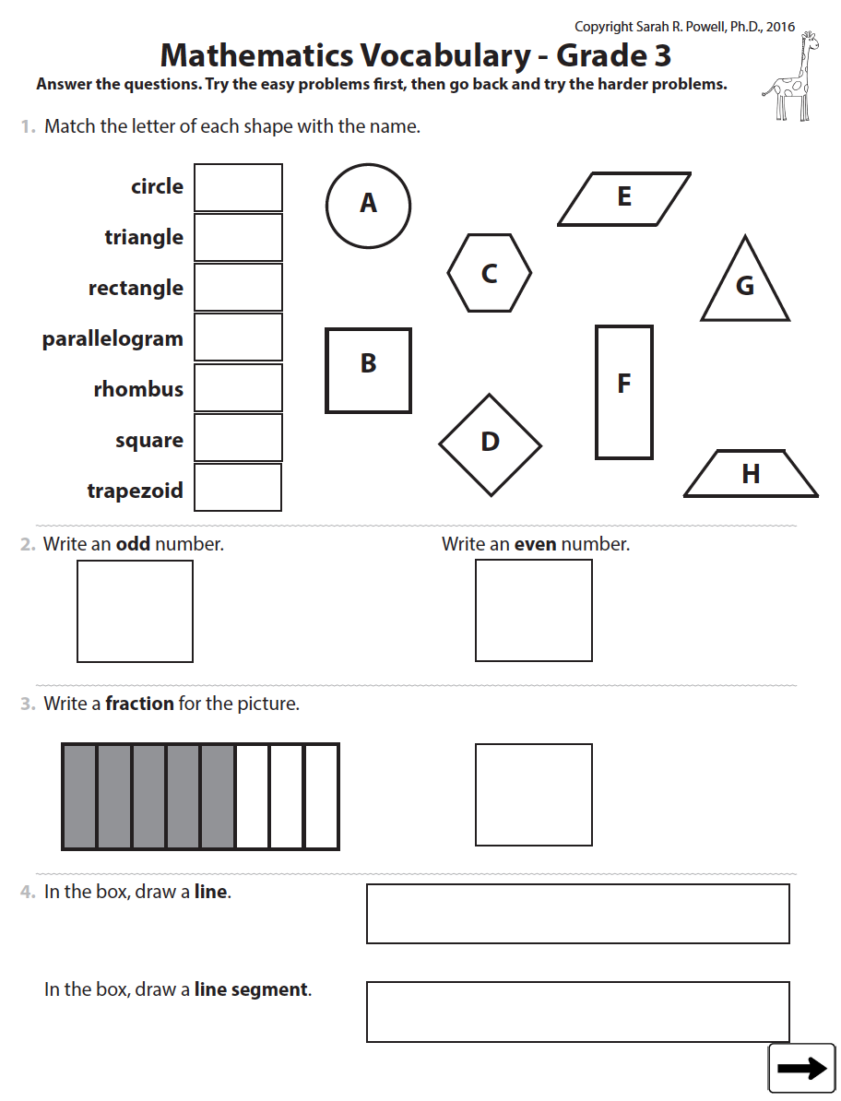
circle
triangle
rectangle
parallelogram
rhombus
square
trapezoid
odd
even
fraction
line
line segment

Slide 59
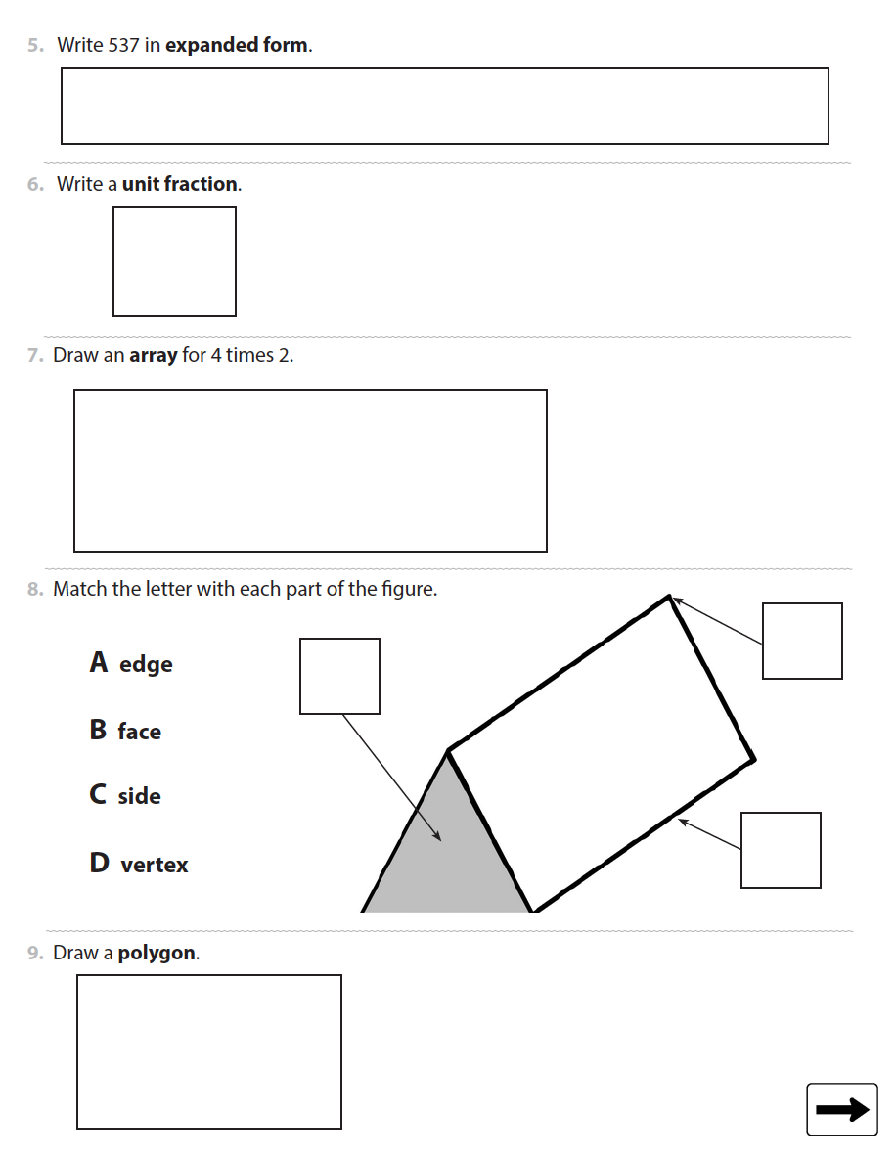
expanded form
unit fraction
array
edge
face
vertex
polygon

Slide 60
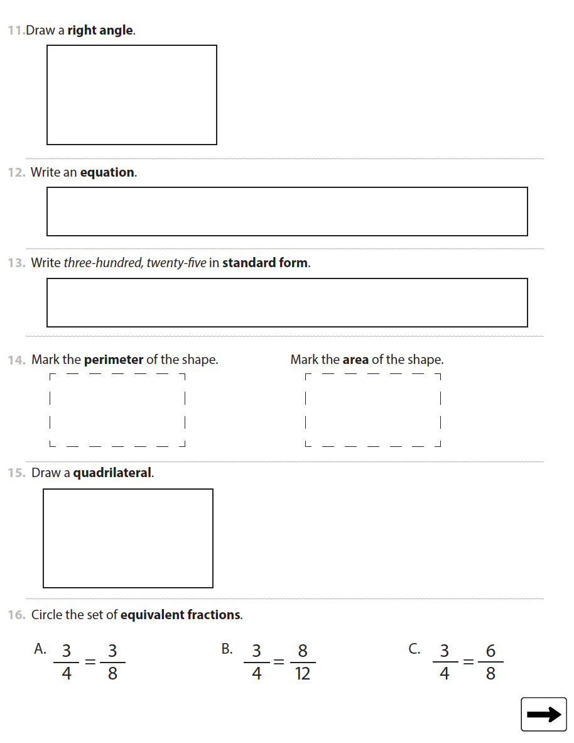
right angle
equation
standard form
perimeter
area
quadrilateral
equivalent fractions

Slide 61
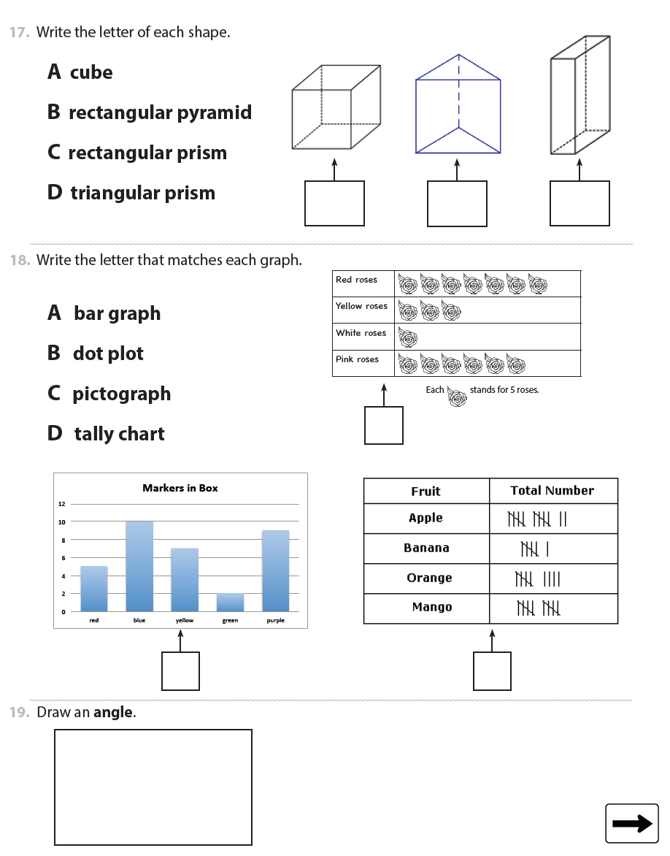
cube
rectangular pyramid
rectangular prism
triangular prism
bar graph
dot plot
pictograph
tally chart
angle

Slide 62
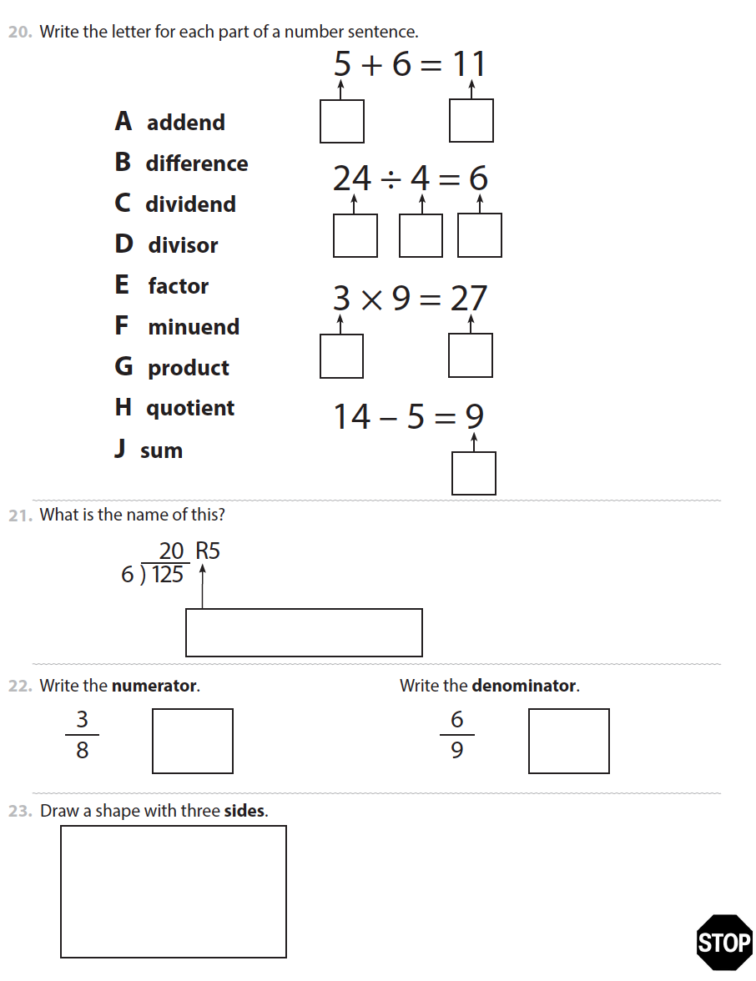
addend
difference
dividend
divisor
factor
minuend
product
quotient
sum
remainder
numerator
denominator
sides

Slide 63
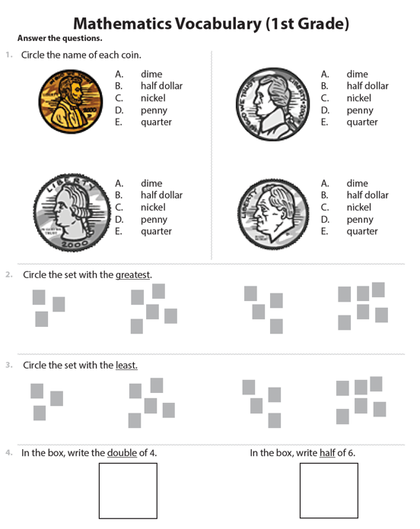
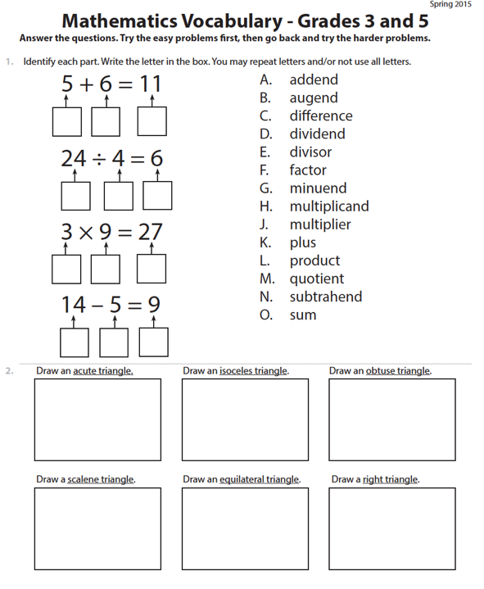
www.sarahpowellphd.com

Slide 64
srpowell@austin.utexas.edu

Slide 65
Thank you!
Sarah R. Powell
The University of Texas at Austin
srpowell@austin.utexas.edu
@sarahpowellphd

