Slide 2
Our Agenda
From Friday after the game weekend thoughts
Weekday Thoughts
Friday Pre-Game
Bonus Material at the end
PowerPoint is at CoachJerryGordon.com

Slide 3
Game Week Background
23rd year Coaching HS (VA and MA) 5 different HS’s
8 Years 1AA (FCS) Northeastern, UMass, and Yale
1 Year Boston College as a Recruiting Specialist
1 Year USFL as Defensive GA

Slide 4
Game Week Who Are We?
40 Kids in the whole program 9-12
5 Paid Coaches and 3 Volunteers
1 platoon We keep O-line intact
HS football is a game of recovery/attrition

Slide 5
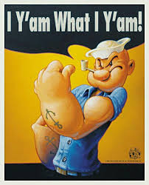
Game Week Who Am I?
Earn it!
Planned Gambles
Index Funds
Bill Parcells

Slide 6
Game Week Friday Night
Relief or Pissed off
Make sure to get into the locker room after a loss
Who is the kid you need to talk to after a win?
Rally your leaders. What is being said at home?

Slide 7
Game Week Friday Night
ODK Game with a cool beverage
Enter in Call and Coverage
Will try to get D&D later (not me)
We Do NOT grade the game.
How do we get better? DMGB

Slide 8
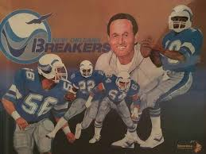
Game Week Friday Night
Not into stats unless I am going to make a change? Can you get lined up? Are you near the ball?
Self- Scout? Not going to change because of numbers (Dick Coury) Use it to make teach tape
Will talk more about stats later

Slide 9
Game Week Saturday AM
Dunkin Donuts Win or Lose
7:30- 8:00 Meet on previous game. Thoughts?? DMGB
Personnel, Corrections, We do NOT grade.

Slide 10
Game Week Saturday AM
Begin breakdown
9:00 kids here. Greet them. See kids Love ‘em up. Lift
10:00 Film with kids Always start together (Play List) I am the bad guy

Slide 11
Game Week: Breakdown Musts
DC: ODK play, formation, Motion Fld/Bnd
DL: Run/Pass Hash Strength Team
DB: Name Pass Plays (strong to weak)
Offensive Guys: Dn/Dist/Yard
Try to be done by Saturday Doodling Sat PM

Slide 12
Game Week: Breakdown thoughts
Watch film fast…then slow use Misc column
I mess around with HUDL reports stats
Do look at what’s next
I do an excel sort.. Hand to head

Slide 13
Game Week: Breakdown thoughts
Who are they??
Wing-T Make sure to track motions, why are they unbal? Tackle over? Who is getting the ball in crunch. Are they really Wing-T? or just in the formations? What are they on 3rd and long?

Slide 14
Game Week: Breakdown thoughts
Triple Teams- will the qb pitch to his left? What are the splits? Are they a 4th down team. Do they have all the goodies
Zone Read- can you tell zone read from power read. Is QB the man? How good are they at RPO

Slide 15
Game Week: Breakdown thoughts
Passing Thoughts- Is the QB really reading? What about in crunch time? Who is his buddy? Can he hit an out? Does he throw at the sticks? Which way does he flush? Does he throw on the run? To his left? Do they throw over the middle? Can you rattle him? Pass Pro ½ slide? Roll out

Slide 16
Game Week: Breakdown Gen’l Tips
QB licking fingers, wiping a towel, slightly different slant of feet. Guards off ball
Centers head before snap? Can’t see #’s?
Towel? Socks? Wrist tape? Stance? T-shirt?
Start of a Drive 2nd and 10?

Slide 17
Game Week Data Distortion
Need to note: Score, Time in game, 2 minute drive, Some teams when they get up they practice throwing if they are run team. 4 minute offense to end the game
Are they giving a kid a rest?

Slide 18
Game Week Data
How much data do you actually need to make a difference? I like to have at least 125 GOOD plays
Need to consider → Who are you?

Slide 19
Defensive Game Week: Sunday
Breakfast w Bride THEN Game Plan
Thinking: Formations, Studs, Plays, D&D
Meet via Zoom 5pm Talk with HC before
Our Personell! Go Over Ready List
Send Out Hudl tips

Slide 20
Defensive Game Week: Formations
Must get lined up! Assign and Align Top Priority
Who are you? Defend the formation, Defend the player, Defend the play, Defend the field,
Running the same defensive structure for 21 years

Slide 21
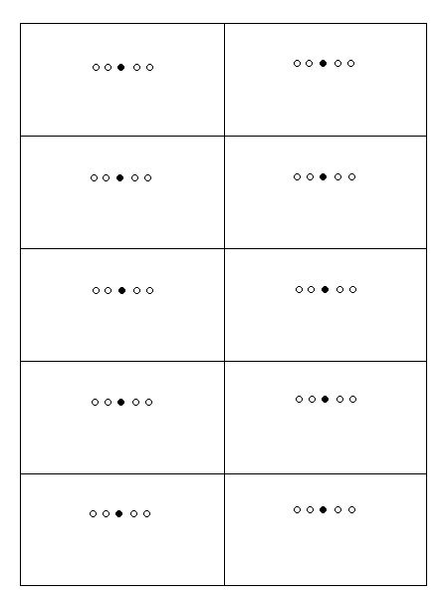
Defensive Game Week: Formations
List top formations Motions, Trades
Over, Under, 3-4
2 Read, 3 Hot, cover 2
Are we going to introduce a different alignment?
How will we teach it? Is there time to drill it?

Slide 22
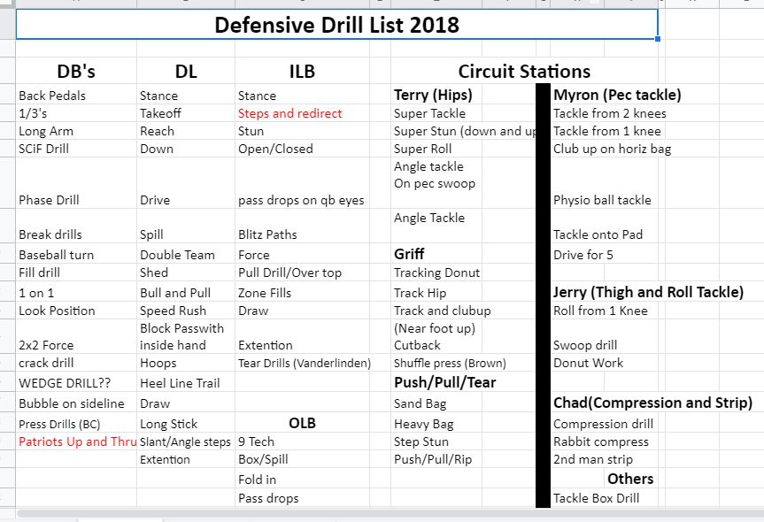

Slide 23
Defensive Game Week: Players
Defend the player: Do we need an extra player in the box? Do we need to double a receiver? Is he just throwing to his friend?
OLine: Is there a weak link in pass pro? Does the team run behind a particular side. Run to right? Run to 3 Man Surface

Slide 24
Defensive Game Week: D&D
Watch the Screen
Watch the Pass
Watch the Draw
How many times has it not worked for you?
We use it but it is not the bible

Slide 25
Defensive Game Week: D&D
FLD/BND big for me
We see more screens and draws on 3rd down
We see more 3 step than what is shown
We see more boundary plays than what is shown
Know your defense and how to fix it!

Slide 26
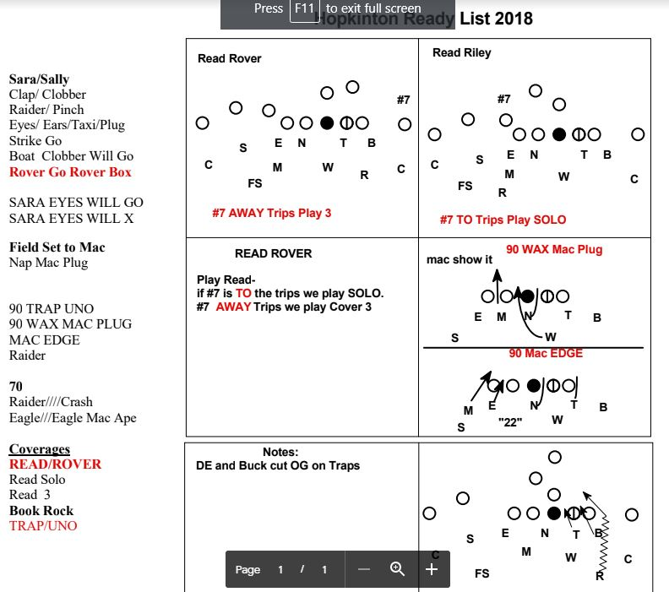
Defensive Game Week: Ready List
New things in red
Will often let kids
change the name
Quick to throw out
Things that don’t work
Print it and send PDF

Slide 27
Defensive Game Week: Hudl Tips

Slide 28
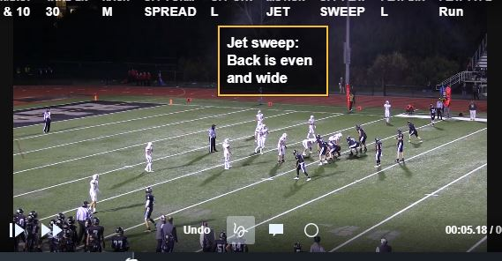
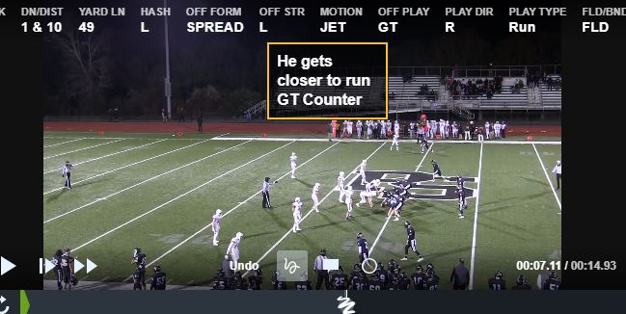
Defensive Game Week: Hudl Tips

Slide 29
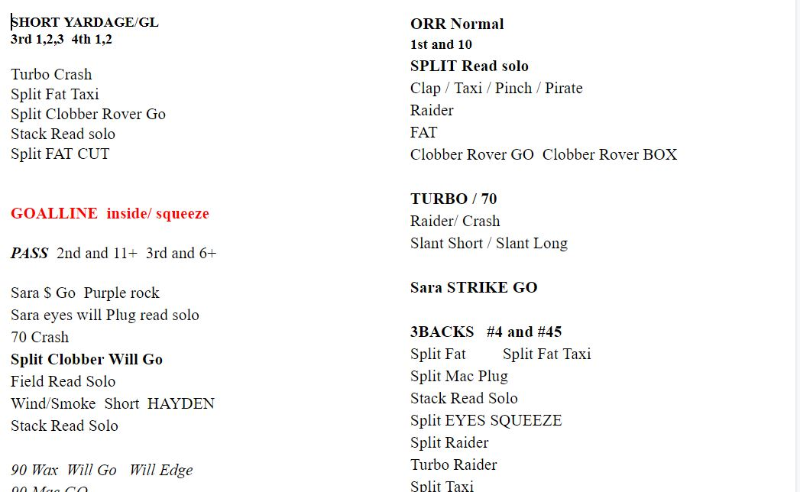
Defensive Game Week: Call Sheet

Slide 30
Defensive Game Week: Monday
10 Min Pursuit (40 kids) JV games this year
15 Min Individual Reads and opponent focused
10 Assign and Align Formations (TIC) and Tendency
10 Min Group work (ISR DB’s 1v1 or ½ line)
15 Team- We MIX in the 2’s (Film) we go slow
Total Practice is never over 2:30 (150 min)

Slide 31
Defensive Game Week: Tuesday
10 Min Tackle Circuit 4 groups mix in Sr’s
15 Min Individual Technique focused
10 Assign and Align Trades Motions Bunches etc
10 Min Group work (7v7) Run the same route or the same coverage multiple times in a row DL Pass rush
15 Team- Run heavy unless New Concepts (Film)

Slide 32
Defensive Game Week: Wednesday
20 Min Individual Indy Tackle Db’s Sideline etc
Special Techniques DL cross face LB vs #3
10 Assign and Align The tough stuff problems
15 Min Group work (Mixture and blitzes) ½ Line?
15 Team- We MIX in the 2’s (Film)

Slide 33
Defensive Game Week: Thursday
Review Subs Review Transitions
Assign and Align
15-18 Plays Normal, 3rd Down plan, GoalLine
QB Sneak
We will also practice regular to punt return and if a team muddle huddle

Slide 34
Defensive Game Week: Friday
Assign and Align or 10-12 Play Video
Box: Subs, Hash, D&D, Watch Top
Field: Make Educated Guesses, 2 signalers
Call Sheet

Slide 35
Favorite Resources
Complete Linebacking - Lou Tepper
Football’s Eagle and Stack Defense- Vanderlinden
Twitter!
Quarters Coverage Made Simple - Shap Boyd
Twitter: @JerryGordonFB
Email: jgordon0508@yahoo.com

Slide 36
Bonus Slides

Slide 37
Tackle Circuit
5 Stations. 2:30 per station 30 sec change. TEACH
6 point ext. 6 point tackle..6 point shed Angle Tackle
Pec to Pec...Start from a knee...We use a pad
Hawk Tackle ...Bags and wheel
Tracking We use a wheel here too
Compression and also strip later in the year

Slide 38
Strip Circuit (only during camp)
Tomahawk Rip/Rake
Punch
Second Man in
Scoop and Score
Cradle Knees to chest, Chin tucked
DL Block Pass with inside arm

Slide 39
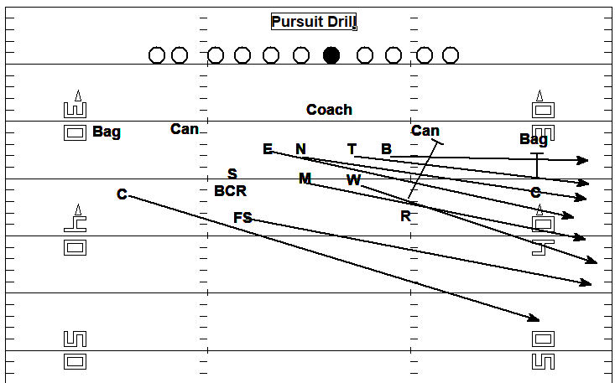
Pursuit Drills
w
Align
Stances
Hit it
Run
Demeanor!

Slide 40
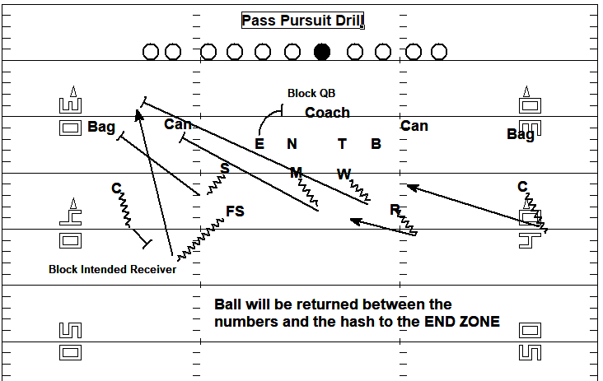
Pursuit Drills
w

Slide 41
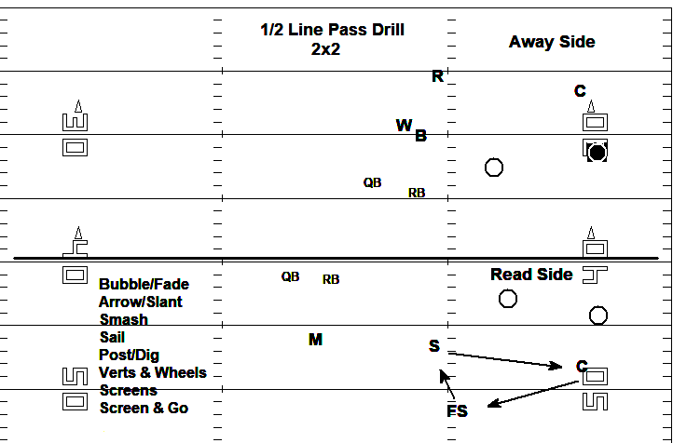
1 / 2 Line Pass

Slide 42
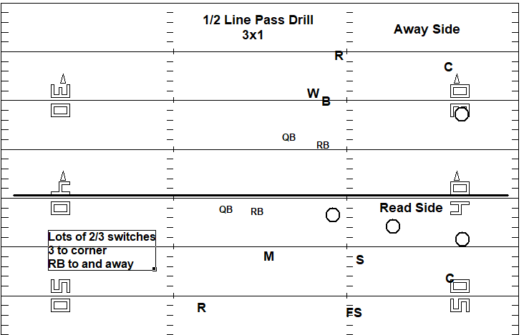
1 / 2 Line Pass

Slide 43
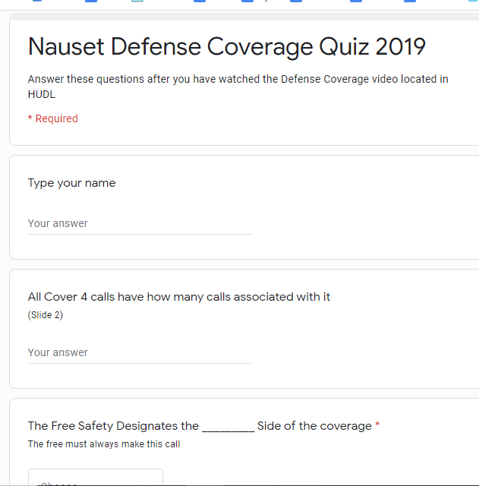
Google Forms
Read Coverage Quiz

Slide 44
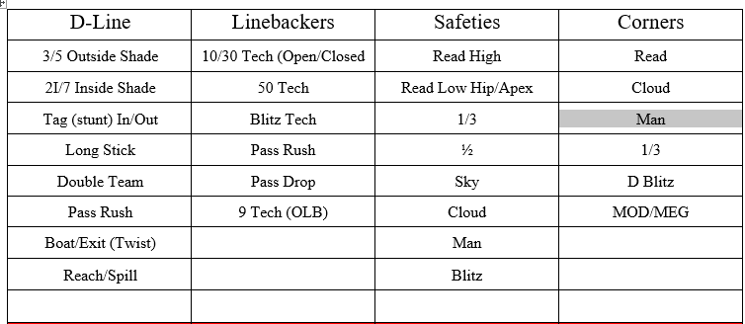
Position Techniques Required
w

Slide 45
Google Forms
Create a Study Guide
Read Coverage Quiz

Slide 46
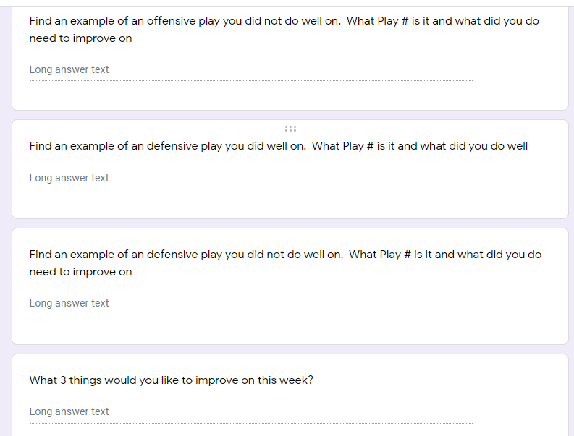
Defensive Staff Game Week

Slide 47
Google Forms

