Slide 1
Doing business in Mexico

Slide 2
Kalypso is a global consulting firm. We help our clients deliver better results from innovation in a digital world.
Established in 2004
18 Partners
200+ Professionals
2 Technical Centers
Privately Held
Over 70% of our engagements are with global companies with $5 Billion or less in annual revenues.
We have delivered over
100 + Product Development, Quality and Regulatory projects.
We operate in 3 industries (industrial/high tech, retail/CPG and life sciences)
Notes:
Kalypso is a global consulting firm focused on innovation and product development.
We help organizations deliver better results from innovation in a digital world.

Slide 3
We act as leaders behind the leaders
Our core values govern how we work with our clients
and manage our firm
We deliver with professionalism, integrity and quality
We are a team of characters with character
We have a passion for developing people
We are committed
to our business partners
We believe in the power of creativity and innovation to change the world
Notes:
Our core values govern how we deliver for our clients and manage our firm.
We deliver work for our clients according to our values. Leaders behind the leaders and passion for developing people means we work alongside you every step of the way to ensure you are personally successful.
We advance our people based on our values, they inform our internal culture and we hold each other accountable to live them every day.

Slide 4
Kalypso Services
Industrial & High Tech | Life Sciences | Retail & Consumer
Strategy & Operations
PLM & Core
Technologies
Digital & Emerging Technologies
Digital Innovation
PPM (Project Portfolio Management)
IoT
Innovation Strategy
PLM (Product Lifecycle Management)
Cloud
Breakthrough & Business Model Innovation
EIM (Enterprise Information Management)
RIM (Regulatory Information Management
Machine Learning
Foresight & Ideation
Modeling & Simulation
New Product Development Execution
3D Digital Product Creation
Discovery & Ideation
Augmented Reality/Virtual Reality
Strategic Sourcing
Portfolio Management
Pricing & Value Management
Quality & Compliance Management
Outsourced & Managed Services
Mergers, Acquisitions & Alliances

Slide 5
We have a strong local and near-shore operating model
Great communication and client service with highly competitive fees
  Kalypso London Ltd.
  New office location located within UK
  Office location in London
  Kalypso Europe BV (Netherlands)
  10 Client Service professionals in the Netherlands and France
  Headquarters of Kalypso Europe
  Office location in Amsterdam
  Kalypso L.P.
  200+ Client Service professionals located near major cities throughout the US & Canada
  Office locations in Texas (3) and Ohio
  Kalypso GmbH
  15 Client Service professionals
  located within Germany
  Office location in Hamburg
  Monterrey Technical Center – Monterrey, Mexico
100+ resources
Deep technical skills - Staff recruited from top colleges in Mexico and Germany and Global Fortune 100
100+ clients served
Notes:
Near-Shore Benefits
World-class, cost efficient data science and engineering services
Minimizes communication issues due to cultural differences
Geographic proximity and similar time-zones
Serves complex, diverse projects
Increased face-to-face interaction
Can obtain TN visas (renewable 1 year term) easily
Cost savings can be equal to that of offshore location

Slide 6
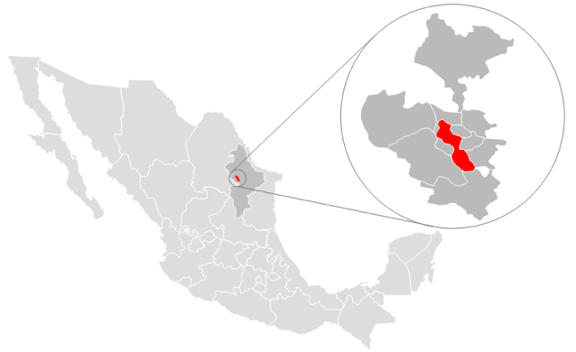
Why a Technical Center?
Why Monterrey?
World-class cost efficient services
Minimize communication issues due to cultural differences
Geographic proximity and similar time-zones
Serving more complex types of projects
Increased face-to-face interaction
Cost savings can be equal to that of offshore location
Support in the delivery of large-scale implementation deals
Provide quality work with competitive billing rates
Eliminate 3rd party contracting
Enable new services and delivery models

Slide 7
What are the major challenges a foreign business faces when trying to enter the Mexican market?
Cultural differences
  Mexican Kalypsonians have a hard time saying NO
  American Kalypsonians are not used to build personal relationships and use it for networking
Our prices are in USD. Mexican Peso has gone through a rollercoaster ride during and after the American election time
Business practices. Mexican clients demand for our American leadership to be on-site even for brief meetings
Mexican companies do not invest a significant amount in innovation

Slide 8

What strategies and resources would you recommend for businesses wanting to successfully enter the Mexican market?
American Chamber of Commerce Monterrey chapter has been a huge asset that has provided many information to establish our Monterrey Technical Center
Create partnerships with local universities. Kalypso has a close relationship with Tecnológico de Monterrey, the largest private university in Mexico and ranked 8th best Business School in the world according to the Wall Street Journal
Understand the needs and objectives for your Mexican employees. Mexicans are used to work with American firms but they appreciate if you build close relationships as well as provide international opportunities
Be aware of your competitive advantages. Even though Mexican companies are price sensitive, Kalypso has been able to leverage its experience with worldwide leaders
Take advantage of NAFTA. You can get a visa for employment for as little ass a 100 USD a year (works the same for Mexicans, Americans & Canadiens)

Slide 9
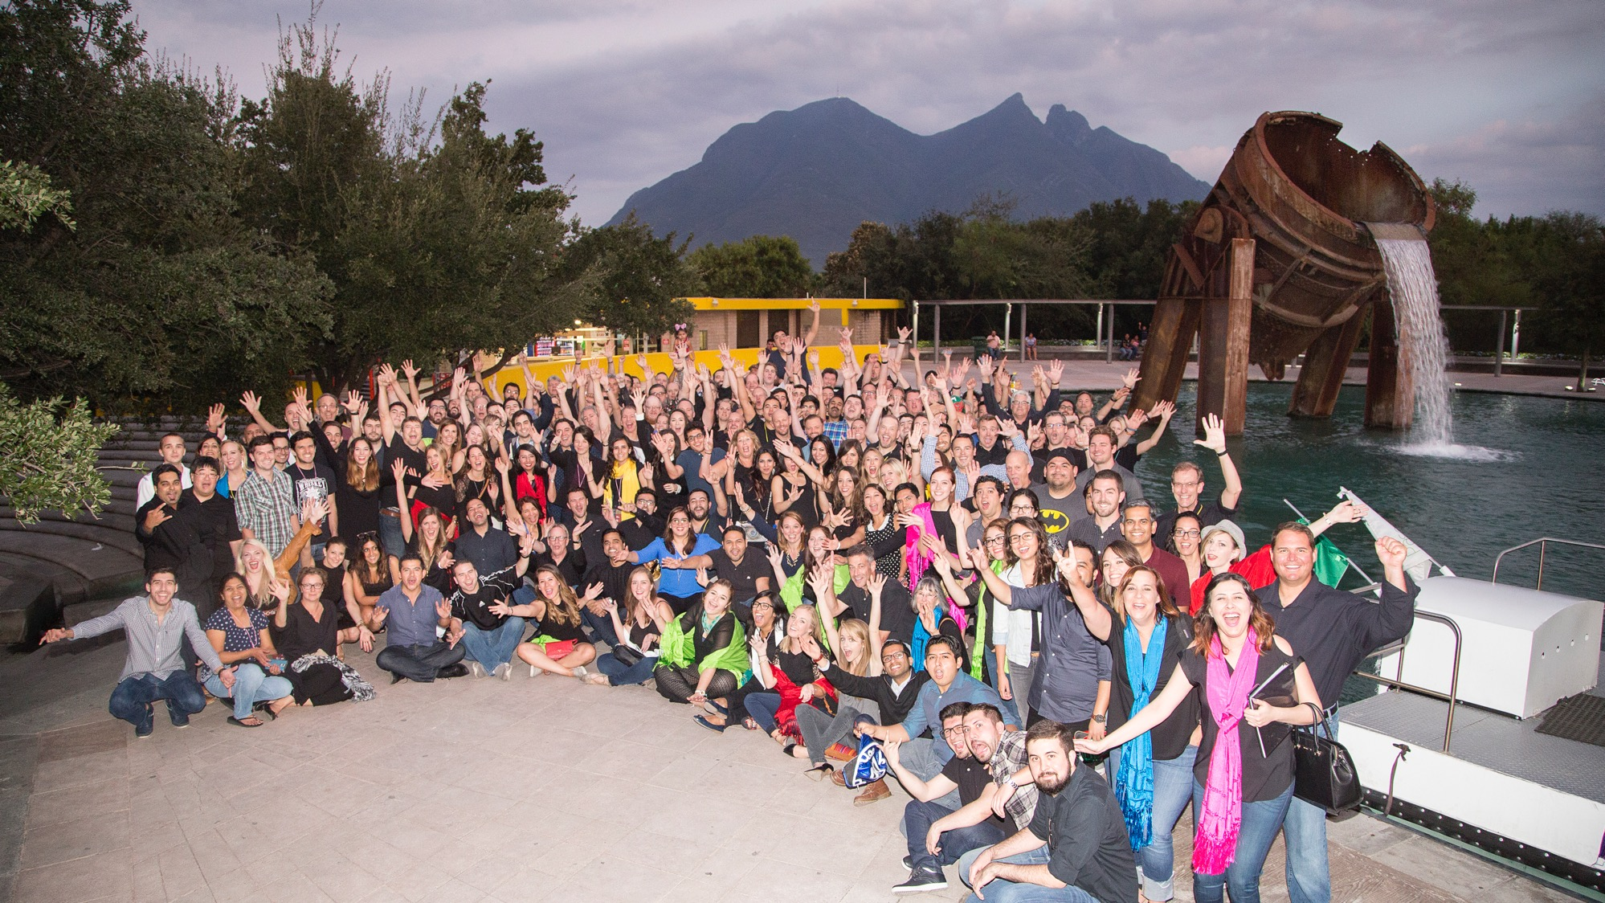

Slide 10




linkedin.com/company/kalypso
twitter.com/kalypsolp
facebook.com/kalypsolp
instagram.com/kalypsolp

