Slide 1
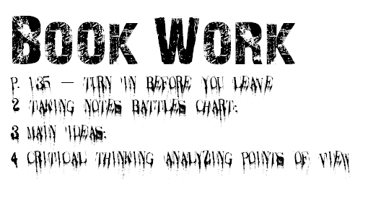
Vocabulary Define the following in your spiral
Ch 5.3 The French and Indian War
French and Indian War Albany Plan of Union Battle of Quebec Treaty of Paris (1763) Pontiac’s Rebellion Proclamation of 1763
Book Work
p. 135 – Turn in before you leave
2 Taking Notes, Battles Chart
3 Main Ideas
4 Critical Thinking, Analyzing Points of View

