Slide 1
TOP TEN ENDANGERED ARCHAEOLOGICAL SITES IN JORDAN
DR. JACQUELINE TAYLOR BASKER
NEW YORK INSTITUTE OF TECHNOLOGY
AMMAN, JORDAN

Slide 2
Current Crisis in Jordan
On April 12, 2011, Mega Jordan was launched:
This is an online database that locates 11,00 0 archaeological sites on Google Earth-type Interface. The database was created by the Getty Conservation Institute and the World Monuments Shows density of archaeological sites – 20,000+ to exist in Jordan
This is the world's largest online antiquities database, which details every archaeological site in the country and aims to help preserve its treasures. Its creators said the Web platform could be a model for Iraq, where looters have plundered its ancient heritage.
Experts said the Middle Eastern Geodatabase for Antiquities is the first such countrywide system. The site uses Geographic Information System, similar to Google Earth, to map 11,000 registered sites in the country , and a click on each reveals inventories of what they contain and reports on their conditions.

Slide 3
tested the site by searching for and quickly finding Tal Jalul, Hesban, and Gadara. The database does not appear to contain entries for the biblical sites of Penuel/Peniel and Mahanaim.

Slide 4
The public can use the material for planning visits. Scholars and inspectors approved by Jordan's Antiquities can update the information in a user-friendly way for other professionals to follow and for authorities to keep track of threats to the sites.
Jordan hosts a number of World Heritage sites, most famously the 2,000 year-old rose rock city of Petra , but also Umm er-Rassas, a city dating back to the 5th century that features ancient Byzantine churches, and Qasr Amra, an 8th century Islamic castle. It is also dotted with sites dating from the Neolithic Age, through Biblical times to the Crusades.
The $1 million MEGA program was developed in cooperation with Getty Institute of Los Angeles and the New York-based World Monuments Fund.

Slide 5
"Jordan is at the forefront of safeguarding its heritage," Getty's director Tim Whalen said at an Amman press conference with antiquities chief Ziad al-Saad unveiling the system.
The quantity and quality of data contained in MEGA-Jordan depends on the research and observations of many individuals and institutions over substantial periods of time. The locations of many archaeological sites were recorded using topographic maps prior to the use of global positioning system (GPS) technology, thus limiting their accuracy and precision. Reports generated from MEGA-Jordan summarize the existing information in the system at the time that the reports are produced. The data in MEGA-Jordan and the reports produced from it should never be regarded as final statements on the archaeological sites being considered, nor should they be substituted for on-site surveys.
For the past year, since the project begun however, there has been no Chief of Antiquities in Jordan. This has caused many problems, delays, and lack of oversight.

Slide 6
Many Challenges
Major urban and infrastructural development
Thousands have disappeared or are threatened
Lack of qualified personnel, awareness, financial support

Slide 7
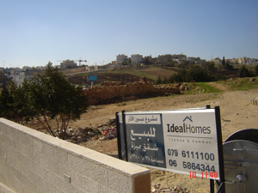
1. ABDOUN, AMMAN BYZANTINE WINE & OIL PRESS

Slide 8
ABDOUN, AMMAN
The best preserved olive oil and wine presses in Jordan from 6-8th century Byzantium with pipes, storage and pipes all in excellent condition is now for sale by developers, and new buildings are being constructed over it. A Real Estate sign in Albdoun advertises that a “historical Project is for Sale.” From 1996 – made new buildings of the area sold is under the Dept. of Antiquities. but some is from private owners.

Slide 9
2. AIN GAZAL, AMMAN

Slide 10
AIN GAZAL
This important Neolithic site was discovered in the 1974 by developers who were building a road through the area. Excavation began in 1982, however by this time, however approximately 600 meters (1,970 ft) of road ran through and divided the site. Despite the damage urban expansion brought, what remained of 'Ain Ghazal provided a wealth of information and continued to do so until 1989. In 1983. A road was constructed through the middle of the site. While examining a cross section of earth in a path carved out by a bulldozer, archaeologists came across the edge of a large pit 2.5 meters (8 ft) under the surface containing plaster statues. Another set of excavations was made in early 1990s with significant discoveries. The site was included in the 2004 World Monuments Watch Fund to call attention to the threat of urban development. Despite the obvious historic significance of the site, a new university was built on the site in 2011, The Hashimite University. A treatment station for sewerage movement was also put in by the city.

Slide 11
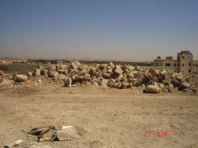
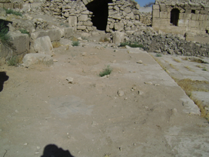
3. Ummayad Desert Castle & Palace, Al Qastal

Slide 12
Al Qastal
- Stones were prepared by Italian team for restoration, then owners of the land moved it in 2006.. Al-Qastal lies 25 km south of Amman, on the highway leading to Queen Alia International Airport. Unfortunately, the site has been built on, and a arge portion of the main building, the qasr (palace), has been built on by a modern house. To the north of the qasr is the mosque with a round tower resting on a square base. This tower, with its spiral staircase, is all that remains of a minaret, which may well be, the earliest surviving minaret in the Islamic world. More than 100 cisterns and substantial barrage, 400 m long and 4.25 m wide have been identified within a one kilometer radius from the qasr. There are plans to restore the qasr and ancient water system, but the site continues to be endangered today. The mosaics are exposed and unprotected as seen in the second photograph.

Slide 13
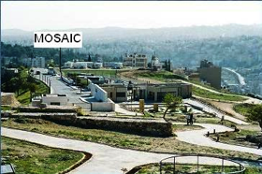
4. The Citadel, Amman

Slide 14
The Citadel
mman Citadel: firs millennium BC was capital of Ammonite Kingdon, Rabbat Ammon)
Dept. of Antqquities have worked hard to preserve 5000 years of history.
Unfortunately many of the people who work with town planning do not have the appreciation of archaeological heritage of country. Some sites excavated and restored, Byzantine Church. Cistern, pillars of Hercules temple.
Some decrative piec
Unfortunately number of structures just constructed with or without Dept. of Antiquities permission ie. Resthouse in middle of citadel and edges of citadel.
– one of the most important site archaeological sites in Jordan dating from Neolithic through Roman, Byzantine and Ummayad periods , has had a recent restoration and expansion of the Tourist Center built over the site of a the Church with USAID funding. Under a gate they discovered the ancient Byzantine Church whose mosaics are now under a parking lot.

Slide 15
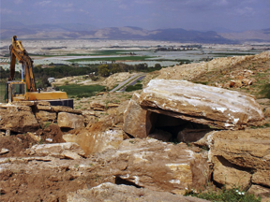
5. Damiya Dolmen Field

Slide 16
5. Damiya Dolmen Field
Damiya, Jordan Valley, BC 3600-3000 - In the lower foothills of the Jordan Valley, hundreds of megalithic blocks rest silently on the arid slopes of the Damiya Dolmen Field. During the Early Bronze Age (3600-3000 B.C.), these massive slabs of Ramla sandstone and travertine were used to create burial chambers known as dolmens. The dolmens, with their lower upright stones supporting enormous, horizontal capstones, convey the sense of delicate balance that has endured on this terrain for some five millennia. Roughly 300 dolmens survive in the Damiya Dolmen Field. Along with several other rock-cut tombs and circular stone-cut features, the mortuary structures of the Damiya Dolmen Field together form a highly significant and rare landscape. Dolmen sites throughout Jordan are being lost at an alarming rate, and the unparalleled landscape of Damiya is now threatened by developmental pressures from quarrying operations. With only a negligible barrier left to protect them, many of the fragile dolmens are now suspended on quarried pillars and left vulnerable to collapse. Despite efforts by the Jordanian Department of Antiquities to document the structures, they are unable to abate the destruction that these highly invasive quarrying processes will exact on these ancient vestiges. Watch listing aims to raise awareness about the plight of this extraordinary landscape and ensure its protection. UPDATE In December 2010, Jordan’s Department of Antiquities announced the creation of the Damiya Dolmen Archaeological Park, which will protect dozens of dolmens in situ. In addition, 23 others within the quarrying concession will be relocated to the park to spare them from destruction.

Slide 17
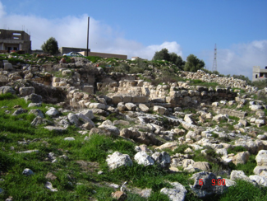
6. Mabara el Bahav – El Bahhath – Wadi Sir

Slide 18
6. Mabara el Bahav – El Bahav Wadi Sir
This important archaeological site was excavated 1994 without any care or professional archaeological methods, Now the site has all but disappeared. It is full of rubbish and building materials. While developers were building a new building they found a Byzantine and Ummayad period factory complete with presses, rooms and equipment for the storage of materials and area agricultural products that were brought to the site, which reveals much about the historic economies of this region. No one currently knows about it in Department now. It does not appear in any of the websites or maps that document historical monuments in Jordan.

Slide 19
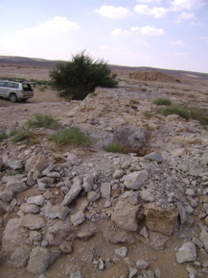
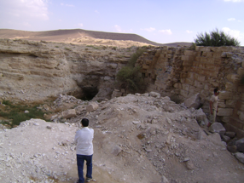
7. Jelat Dam

Slide 20
7. Jelat Dam
Jelat Dam represents a pervasive problem in Jordan for archaeological sites. This is a well-constructed Ummayad dam in desert area, on the site of Roman and Byzantine construction, 40 km SE of Amman. It is much damaged by people hunting for gold in the ruins. Rumors are pervasive in Jordan that gold was buried in the past and people start looking for gold in ancient sites as here, that are unprotected. Farmers have reported discovering gold in their fields as they were plowing, which fuels the gold fever in the local populace, who believe that ancient ruins, already cut deep into the earth, can be a hiding place for gold.

Slide 21
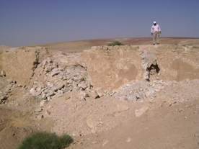
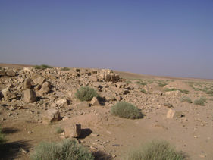
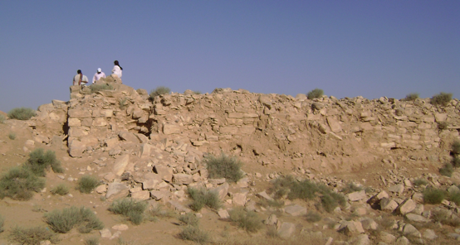
8. The MUSASH CISTERN

Slide 22
8. THE MUSHASH CISTERN
8. The Mushash Cistern, the famous well, part of the archaeological ruins of the Ummayad Palace, Qasr Mushash, south of Amman, in the desert also shows the pervasive damage done to ancient ruins created by people looking for gold. Although this rather large (2 sq km) Umayyad settlement was once a grand city in the easterndesert, today Mushash sadly lies in virtual ruin. There is evidence of a large number of substantial buildings, and the remains of the palace, with a courtyard, baths, rooms, cisterns and walls. These ruins. Reached only by a 4WD, are continually vbandalized by gold hunters.

Slide 23
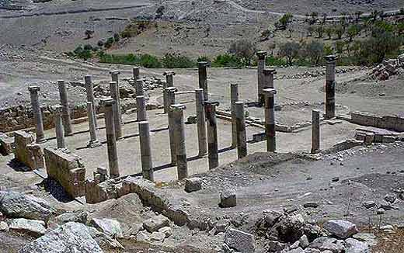
9. Abila or Ancient Raphana

Slide 24
9. Abila
lies (15 km) to the north of Irbid, east of Umm Qais, 2 km (1 mi) east of Hartha. The largest site is located amidst verdant agricultural fields near the modern Ain Quweilbeh spring. Abila contains Roman temples, Byzantine churches and early mosques lie amidst olive groves and wheat fields. Excavations indicate that the site was inhabited more than 5000 years ago in the early Bronze Age, and appears to have been continually used by man since then. The site was in use from the Neolithic period until the Abbasid/Fatimid and Ayyubid/Mamluk periods, though its use in these later periods was limited. While several of its ancient structures have been excavated including aqueducts, tombs, gates and public buildings, Abila is especially fascinating because so much of its remains unexcavated, yet visible of the surface of the ground. The main threats to the site have been identified as development pressures, insufficient management, unsustainable tourism, water erosion (rain and spring). Both urban and agricultural development pressures are increasing in the area, due to its fertile soil, gentle climate and water availability. Tourism is unmonitored and there is little interpretation and no facilities provided for tourists.

Slide 25
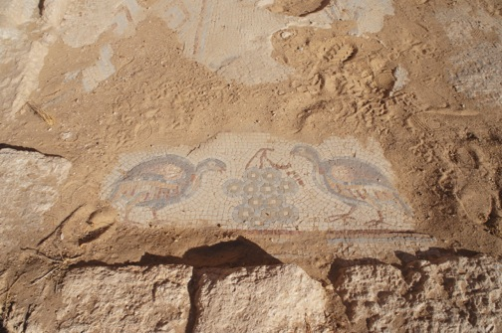
10. Umm al Rasas

Slide 26
10. Umm al-Rasas
an important archaeological site that was declared a World Heritage Site in 2004. This site has been inhabited since at least the Iron Age (7th century BC), as attested by artifacts such as a basalt pillar base and a stone scarab. In ancient times, it was a Moabite town called Kastron Mefaa. Its structures date from the 3rd to 9th centuries and most have not yet been excavated. The site is especially known for its magnificent Byzantine mosaics, which have been uncovered in two churches dating from the 6th and 8th centuries. However, many mosaics are unprotected, and are much endangered. Excavations began in 1986 at the north end of the site and have continued ever since. Most of the site still remains buried under rubble.

