Slide 1
EdVestors
March 8, 2018

Slide 2
Contact Information
Sarah Powell, Ph.D
The University of Texas at Austin
srpowell@austin.utexas.edu
@sarahpowellphd
119

Slide 3
School-Level Support for Students with Mathematics Difficulties

Slide 4
Tier 1
Core instruction utilizes evidence-based programs or strategies
All students screened
Students scoring below a cut-score are suspected at risk for math difficulties
Suspected at-risk students monitored for 6 to 10 weeks during primary prevention using progress monitoring
4

Slide 5
Think-Pair-Share
What is the current landscape for Tier 1 in your school?
What evidence-based mathematics interventions?
How is fidelity monitored?
What is the screening?
What is the progress monitoring?
Who makes decisions?
5

Slide 6
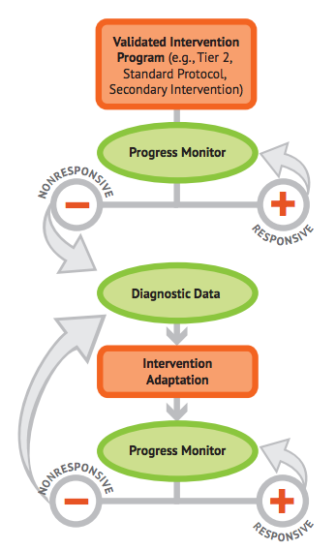
Intensive Intervention
6

Slide 7
Intensive Intervention
Students in a tiered intervention program who have not responded to evidence-based secondary interventions
Students with very low academic achievement who are not making adequate progress in their current intervention program
Students with disabilities who are consistently not making adequate progress in meeting their IEP goals

Slide 8
Tier 2
Students are tutored in small groups using evidence-based practices
Tutoring takes place 3 to 4 times a week
Each tutoring session lasts 30 to 60 minutes
Tutoring lasts 10 to 20 weeks
Tutoring is conducted by classroom teacher or others
Progress monitoring continues weekly

Slide 9
Think-Pair-Share
What is the current landscape for Tier 2 in your school?
What evidence-based mathematics interventions?
Who implements?
How is fidelity monitored?
What is the progress monitoring?
Who makes decisions?
9

Slide 10
Tier 3
A diagnostic is conducted to understand strengths and weaknesses
Adaptations made to instruction
Tutoring lasts 10 to 20 weeks
Progress monitoring continues weekly

Slide 11
Think-Pair-Share
What is the current landscape for Tier 3 in your school?
What evidence-based mathematics interventions?
Who implements?
How is fidelity monitored?
What is the progress monitoring?
Who makes decisions?
11

Slide 12
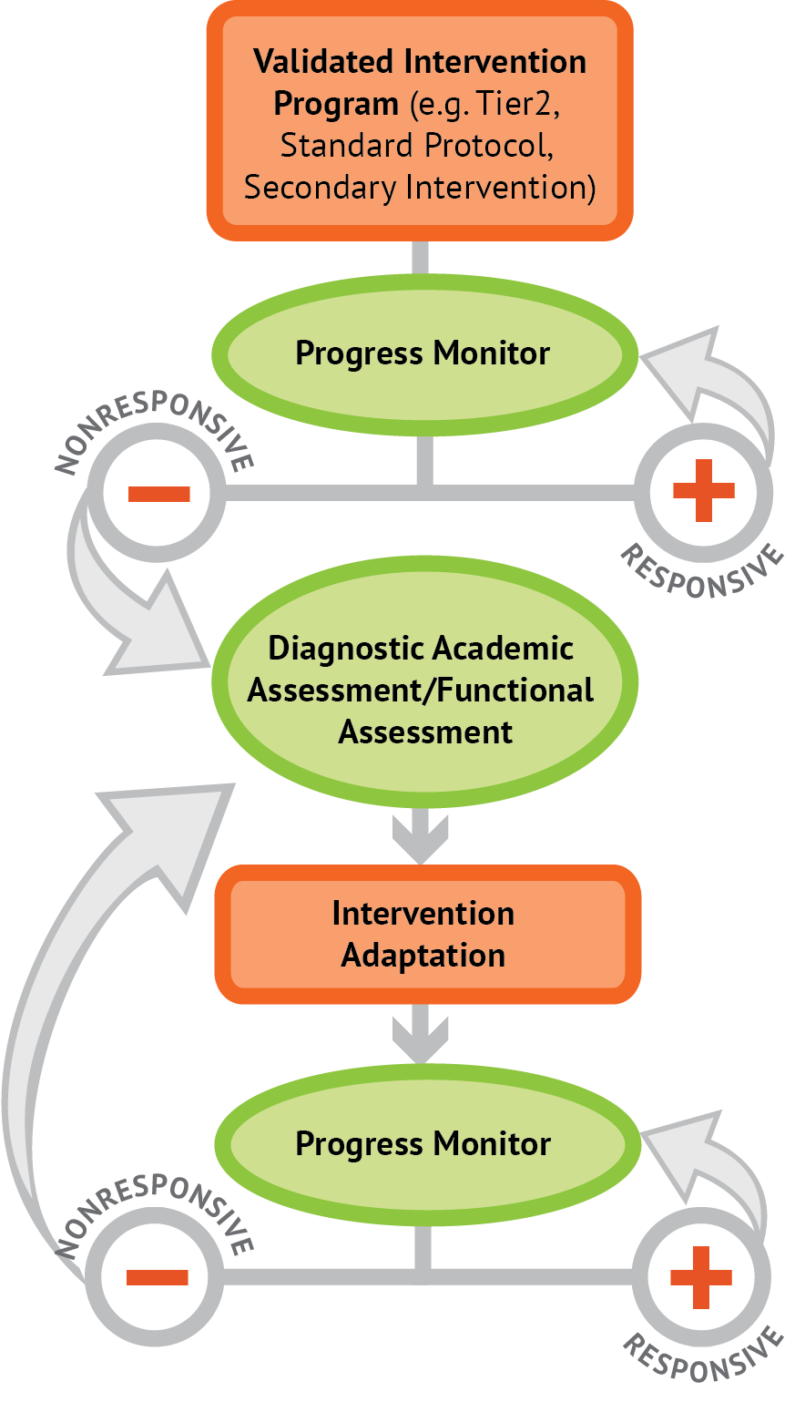
Intervention: Occurs frequently and with intensity
Assessment: Formative
Assessment: Diagnostic
Intervention adaptation: Content, dosage, explicit instruction, attention to transfer
Assessment: Formative

Slide 13
Intervention: Occurs frequently and with intensity

Slide 14
Mathematical Content of Intervention

Slide 15
Where student NEEDS TO BE
Where student IS

Slide 16
Fluency

Slide 17
Fluently add and subtract within 5.
continuum of mathematics learning

Slide 18
Fluently add and subtract within 5.
Add and subtract within 20, demonstrating fluency for addition and subtraction within 10.

Slide 19
Fluently add and subtract within 5.
Add and subtract within 20, demonstrating fluency for addition and subtraction within 10.
Fluently add and subtract within 100 using strategies based on place value, properties of operations, and/or relationships.

Slide 20
Fluently add and subtract within 5.
Add and subtract within 20, demonstrating fluency for addition and subtraction within 10.
Fluently add and subtract within 100 using strategies based on place value, properties of operations, and/or relationships.
Fluently multiply and divide within 100, using strategies such as the relationship between multiplication and division…

Slide 21
Fluently add and subtract within 5.
Add and subtract within 20, demonstrating fluency for addition and subtraction within 10.
Fluently add and subtract within 100 using strategies based on place value, properties of operations, and/or relationships.
Fluently multiply and divide within 100, using strategies such as the relationship between multiplication and division…
Fluently add and subtract multi-digit whole numbers using the standard algorithm.

Slide 22
Fluently add and subtract within 5.
Add and subtract within 20, demonstrating fluency for addition and subtraction within 10.
Fluently add and subtract within 100 using strategies based on place value, properties of operations, and/or relationships.
Fluently multiply and divide within 100, using strategies such as the relationship between multiplication and division…
Fluently add and subtract multi-digit whole numbers using the standard algorithm.
Fluently multiply multi-digit whole numbers using the standard algorithm.

Slide 23
Fluently add and subtract within 5.
Add and subtract within 20, demonstrating fluency for addition and subtraction within 10.
Fluently add and subtract within 100 using strategies based on place value, properties of operations, and/or relationships.
Fluently multiply and divide within 100, using strategies such as the relationship between multiplication and division…
Fluently add and subtract multi-digit whole numbers using the standard algorithm.
Fluently multiply multi-digit whole numbers using the standard algorithm.
Fluently add, subtract, multiply, and divide multi-digit decimals using the standard algorithm.

Slide 24
Where student NEEDS TO BE
Fluently add and subtract within 5.
Add and subtract within 20, demonstrating fluency for addition and subtraction within 10.
Fluently add and subtract within 100 using strategies based on place value, properties of operations, and/or relationships.
Fluently multiply and divide within 100, using strategies such as the relationship between multiplication and division…
Fluently add and subtract multi-digit whole numbers using the standard algorithm.
Fluently multiply multi-digit whole numbers using the standard algorithm.
Fluently add, subtract, multiply, and divide multi-digit decimals using the standard algorithm.

Slide 25
Where student IS
Where student NEEDS TO BE
Fluently add and subtract within 5.
Add and subtract within 20, demonstrating fluency for addition and subtraction within 10.
Fluently add and subtract within 100 using strategies based on place value, properties of operations, and/or relationships.
Fluently multiply and divide within 100, using strategies such as the relationship between multiplication and division…
Fluently add and subtract multi-digit whole numbers using the standard algorithm.
Fluently multiply multi-digit whole numbers using the standard algorithm.
Fluently add, subtract, multiply, and divide multi-digit decimals using the standard algorithm.

Slide 26
Where student IS
Where student NEEDS TO BE
Fluently add and subtract within 5.
Add and subtract within 20, demonstrating fluency for addition and subtraction within 10.
Fluently add and subtract within 100 using strategies based on place value, properties of operations, and/or relationships.
Fluently multiply and divide within 100, using strategies such as the relationship between multiplication and division…
Fluently add and subtract multi-digit whole numbers using the standard algorithm.
Fluently multiply multi-digit whole numbers using the standard algorithm.
Fluently add, subtract, multiply, and divide multi-digit decimals using the standard algorithm.

Slide 27
Operations and Algebraic Thinking – Kindergarten, 1, 2, 3, 4, 5
Work with addition and subtraction equations. Determine the unknown whole number in an equation relating three whole numbers.
Use four operations with whole numbers to solve problems (using drawings and equations with a symbols for the unknown number).
Understand addition and subtraction (for any number 1 to 9, find the number that makes 10).
Write and interpret numerical expressions.
Represent and solve problems involving multiplication and division. Determine the unknown whole number in an equation relating three whole numbers.
Represent and solve problems involving addition and subtraction (using drawings and equations with a symbol for the unknown).

Slide 28
4
5
Understand addition and subtraction (for any number 1 to 9, find the number that makes 10).
Work with addition and subtraction equations. Determine the unknown whole number in an equation relating three whole numbers.
Represent and solve problems involving addition and subtraction (using drawings and equations with a symbol for the unknown).
Represent and solve problems involving multiplication and division. Determine the unknown whole number in an equation relating three whole numbers.
Use four operations with whole numbers to solve problems (using drawings and equations with a symbols for the unknown number).
Write and interpret numerical expressions.
continuum of mathematics learning

Slide 29
Where student IS
Where student NEEDS TO BE
Explain why addition and subtraction strategies work, using place value and the properties of operations.
Understand that the two digits of a two-digit number represent amounts of tens and ones.
Use addition and subtraction within 100 to solve one- and two-step word problems…
Fluently add and subtract within 100 using strategies based on place value, properties of operations, and/or relationships.
Apply properties of operations as strategies to multiply and divide….
Fluently multiply and divide within 100, using strategies such as the relationship between multiplication and division…
Use multiplication and division within 100 to solve word problems…
Fluently add and subtract multi-digit whole numbers using the standard algorithm.
Find whole number quotients and remainders with up to four-digit dividends and one-digit divisors, using strategies based on place value, the properties of operations, and/or the relationship between multiplication and division.
Solve multi-step word problems posed with whole numbers and having whole-number answers using the four operations…
Understand that the three digits of a three-digit number represent amounts of hundreds, tens, and ones.
Fluently multiply multi-digit whole numbers using the standard algorithm.
continuum of mathematics learning

Slide 30
Instruction Within the Platform

Slide 31
Intervention: Occurs frequently and with intensity

Slide 32
Instructional Platform
INSTRUCTIONAL DELIVERY
Explicit instruction
Multiple representations
Concise language
INSTRUCTIONAL STRATEGIES
Fluency building
Problem solving instruction
Motivation component

Slide 33
Explicit Instruction
I Do
Modeling
Practice
Clear Explanation
Guided
Practice
We Do
Planned
Examples
Independent Practice
You Do
Supporting Practices
Asking the right questions
Eliciting frequent responses
Providing immediate specific feedback
Maintaining a brisk pace

Slide 34
How do you use explicit instruction within intensive intervention?
Model steps using concise language
Provide guided practice opportunities
Provide independent practice opportunities
Use supporting practices during modeling and practice
Ask the right questions
Elicit frequent responses
Provide feedback
Be planned and organized

Slide 35
Multiple Representations
ABSTRACT:
Numbers, symbols, and words
CONCRETE:
Hands-on materials
REPRESENTATIONAL:
Two-dimensional images

Slide 36
How should multiple representations be used within intensive intervention?
Use three-dimensional concrete materials to teach concepts and procedures
Use two-dimensional representations to teach concepts and procedures
Ensure students understand mathematics with numbers and symbols (i.e., the abstract)

Slide 37
Focus on Language
precise
concise

Slide 38
How do you attend to language within intensive intervention?
Understand why formal mathematical language is important
Plan for mathematical language to be precise
Plan for mathematical language to be concise

Slide 39
Fluency
Addition
Subtraction
Multiplication
Division
Students must understand the concepts
Students should learn and use strategies to solve the facts
Students should develop fluency with facts

Slide 40
How to build fact fluency within intensive intervention?
Teach the concepts of the operations
Teach strategies to understand how facts fit together
Practice building fluency with a variety of activities and games

Slide 41
Problem Solving
SIGNS
Survey questions
Identify key words
Graphically draw problem
Note operations
Solve and check
SOLVE
Study the problem.
Organize the facts.
Line up the plan.
Verify the plan with computation.
Examine the answer.

Slide 42
Problem Solving
When teaching about word problems, students should learn the schema of the word problem.
Additive
Multiplicative
Jitendra & Star (2011); Riley & Greeno (1988); Van de Walle, Karp, & Bay-Williams (2010)
Total
Equal Groups
Difference
Comparison
Change
Ratios/
Proportions

Slide 43
How do you incorporate effective problem-solving strategies within intensive intervention?
Don’t use key words tied to operations
Do teach students an attack strategy
Do teach students schemas
Do explicitly teach problem solving
Do provide problem-solving instruction regularly (i.e., several times a week)
Do practice schemas that students will encounter regularly

Slide 44
Motivation Component
on task
keep attention
regulate behavior

Slide 45
How do you incorporate a motivational component within intensive intervention?
Utilize a motivational component, when necessary

Slide 46
Instructional Platform
INSTRUCTIONAL DELIVERY
Explicit instruction
Multiple representations
Concise language
INSTRUCTIONAL STRATEGIES
Fluency building
Problem solving instruction
Motivation component

Slide 47
How to Measure Progress

Slide 48
Intervention: Occurs frequently and with intensity
Assessment: Formative

Slide 49
Progress Monitoring
Measures with alternate forms
Must be administered frequently
Weekly or bi-weekly
Must be reliable and valid

Slide 50
Decision Making
Is Maria making adequate progress?

Slide 51
Setting Goals
Once the scores are graphed, it’s time to set goals.
Is Maria making adequate progress?

Slide 52
Setting Goals
Several options for setting goals
Benchmark
Slope (ROI)
Intra-individual

Slide 53
Benchmark
Identify appropriate grade-level benchmark
Mark benchmark on student graph with an X
Draw goal-line from baseline progress monitoring scores to X

Slide 54
Benchmark
Identify appropriate grade-level benchmark
Grade | Computation | Concepts and Applications
1 | 20 digits | 20 points
2 | 20 digits | 20 points
3 | 30 digits | 30 points
4 | 40 digits | 30 points
5 | 30 digits | 15 points
6 | 35 digits | 15 points
http://www.rti4success.org/resource/rti-implementer-series-module-2-progress-monitoring

Slide 55
Benchmark
Identify appropriate grade-level benchmark
Grade | Computation | Concepts and Applications
1 | 20 digits | 20 points
2 | 20 digits | 20 points
3 | 30 digits | 30 points
4 | 40 digits | 30 points
5 | 30 digits | 15 points
6 | 35 digits | 15 points
Maria: 2nd-grade student using Computation
http://www.rti4success.org/resource/rti-implementer-series-module-2-progress-monitoring

Slide 56
Benchmark
Mark benchmark on student graph with an X
Draw goal-line from baseline progress monitoring scores to X
X

Slide 57
Setting Goals
Several options for setting goals
Benchmark
Slope (ROI)

Slide 58
Slope (ROI)
Locate slope (i.e., rate of improvement – ROI)
Multiply ROI by number of weeks left in intervention
Add to baseline of progress monitoring scores
Mark goal on student graph with an X
Draw goal-line from baseline progress monitoring scores to X

Slide 59
Slope (ROI)
Locate slope (i.e., rate of improvement – ROI)
Grade | Computation—Slope for Digits Correct | Concepts and Applications — Slope for Points
1 | 0.35 | No data available
2 | 0.30 | 0.40
3 | 0.30 | 0.60
4 | 0.70 | 0.70
5 | 0.70 | 0.70
6 | 0.40 | 0.70
http://www.rti4success.org/resource/rti-implementer-series-module-2-progress-monitoring

Slide 60
Slope (ROI)
Locate slope (i.e., rate of improvement – ROI)
Grade | Computation—Slope for Digits Correct | Concepts and Applications — Slope for Points
1 | 0.35 | No data available
2 | 0.30 | 0.40
3 | 0.30 | 0.60
4 | 0.70 | 0.70
5 | 0.70 | 0.70
6 | 0.40 | 0.70
Maria: 2nd-grade student using Computation
http://www.rti4success.org/resource/rti-implementer-series-module-2-progress-monitoring

Slide 61
Slope (ROI)
Locate slope (i.e., rate of improvement – ROI) 0.30

Slide 62
Slope (ROI)
Locate slope (i.e., rate of improvement – ROI) 0.30
Multiply ROI by number of weeks left in intervention 0.30 $×$

Slide 63
Slope (ROI)
Number of weeks left in intervention

Slide 64
Slope (ROI)
Locate slope (i.e., rate of improvement – ROI) 0.30
Multiply ROI by number of weeks left in intervention 0.30 $×$ 10 = 3

Slide 65
Slope (ROI)
Locate slope (i.e., rate of improvement – ROI) 0.30
Multiply ROI by number of weeks left in intervention 0.30 $×$ 10 = 3
Add to baseline of progress monitoring scores 3 +

Slide 66
Slope (ROI)
Baseline: 7 + 5 + 8 = 20
20 $÷3=6.7$

Slide 67
Slope (ROI)
Locate slope (i.e., rate of improvement – ROI) 0.30
Multiply ROI by number of weeks left in intervention 0.30 $×$ 10 = 3
Add to baseline of progress monitoring scores 3 + 6.7 = 9.7

Slide 68
Slope (ROI)
Mark goal on student graph with an X
Draw goal-line from baseline progress monitoring scores to X
X

Slide 69
Setting Goals
Several options for setting goals
Benchmark
Slope (ROI)
Intra-individual

Slide 70
Intra-individual
Identify student’s (slope)
Multiply slope by 1.5
Multiply by number of weeks until end of intervention
Add to student’s baseline score
Mark goal on student graph with an X
Draw goal-line from baseline progress monitoring scores to X

Slide 71
Intra-individual
Identify student’s (slope)
SLOPE CALCULATION:
3rd median – 1st median
#data points – 1

Slide 72
Intra-individual
SLOPE CALCULATION:
3rd median – 1st median
#data points – 1
Identify student’s (slope)
6.5 – 4.5
6 – 1
0.4
(4 + 5) $÷$ 2 = 4.5
(8 + 5) $÷$ 2 = 6.5

Slide 73
Intra-individual
Identify student’s (slope) 0.4

Slide 74
Intra-individual
Identify student’s (slope) 0.4
Multiply slope by 1.5 0.4 $×$ 1.5 = 0.6

Slide 75
Intra-individual
Identify student’s (slope) 0.4
Multiply slope by 1.5 0.4 $×$ 1.5 = 0.6
Multiply by number of weeks in intervention 0.6 $×$

Slide 76
Intra-individual
Number of weeks left in intervention

Slide 77
Intra-individual
Identify student’s (slope) 0.4
Multiply slope by 1.5 0.4 $×$ 1.5 = 0.6
Multiply by number of weeks in intervention 0.6 $×$ 10 = 6

Slide 78
Intra-individual
Identify student’s (slope) 0.4
Multiply slope by 1.5 0.4 $×$ 1.5 = 0.6
Multiply by number of weeks in intervention 0.6 $×$ 10 = 6
Add to student’s baseline score 6

Slide 79
Intra-individual
Baseline: 7 + 5 + 8 = 20
20 $÷3=6.7$

Slide 80
Intra-individual
Identify student’s (slope) 0.4
Multiply slope by 1.5 0.4 $×$ 1.5 = 0.6
Multiply by number of weeks in intervention 0.6 $×$ 10 = 6
Add to student’s baseline score 6 + 6.7 = 12.7

Slide 81
Intra-individual
Mark goal on student graph with an X
Draw goal-line from baseline progress monitoring scores to X
X

Slide 82
To Review
Several options for setting goals
Benchmark
Slope (ROI)
Intra-individual

Slide 83
Determining Response

Slide 84
Determining Response
Four most recent, consecutive scores
Trendline

Slide 85
Determining Response
Four most recent, consecutive scores
If at least 6 weeks of instruction have occurred:
If all four most recent scores fall above the goal-line, increase the goal.

Slide 86
Determining Response
Four most recent, consecutive scores
Raise the goal
X

Slide 87
Determining Response
Four most recent, consecutive scores
If at least 6 weeks of instruction have occurred:
If all four most recent scores fall above the goal-line, increase the goal.
If all four most recent scores fall below the goal-line, adapt the intervention.

Slide 88
Determining Response
Four most recent, consecutive scores
Adaptation
X

Slide 89
Determining Response
Four most recent, consecutive scores
If at least 6 weeks of instruction have occurred:
If all four most recent scores fall above the goal-line, increase the goal.
If all four most recent scores fall below the goal-line, adapt the intervention.
If the four most recent scores fall both above and below the goal-line, continue monitoring data.

Slide 90
Determining Response
Four most recent, consecutive scores
Continue monitoring
X

Slide 91
Determining Response
Four most recent, consecutive scores
Trendline

Slide 92
Determining Response
Trendline
If the trend-line is steeper than the goal line, then increase the goal.

Slide 93
Determining Response
Trendline
Raise the goal
X

Slide 94
Determining Response
Trendline
If the trend-line is steeper than the goal line, then increase the goal.
If the trend-line is flatter than the goal line, then adapt the intervention.

Slide 95
Determining Response
Trendline
Adaptation
X

Slide 96
Determining Response
Trendline
If the trend-line is steeper than the goal line, then increase the goal.
If the trend-line is flatter than the goal line, then adapt the intervention.
If the trend-line and goal-line are fairly equal, continue monitoring progress.

Slide 97
Determining Response
Trendline
Continue monitoring
X

Slide 98
To Review
Several options for setting goals
Benchmark
Slope (ROI)
Intra-individual

Slide 99
To Review
Four most recent, consecutive scores
Trendline

Slide 100
How to Make Adaptations

Slide 101
Intervention: Occurs frequently and with intensity
Assessment: Formative
Assessment: Diagnostic

Slide 102
Content for Intensive Intervention
Diagnostic assessment:
Data gathered before or during learning to understand strengths and weaknesses.
Measure multiple areas of mathematics
Provide detailed score profiles
Number and Operations
Geometry
Measurement
Algebra
Data Analysis

Slide 103
Content for Intensive Intervention
Error Analysis:
Types of errors and the possible causes of the errors.
5 4 7
+ 6 7 3

Slide 104
Intervention: Occurs frequently and with intensity
Assessment: Formative
Assessment: Diagnostic
Intervention adaptation: Content, dosage, explicit instruction, attention to transfer

Slide 105
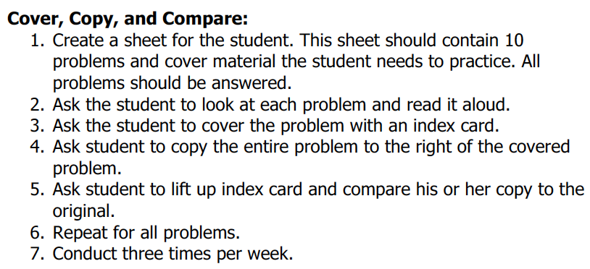
Implement with greater fidelity
Adaptation
Ensure that you are implementing the intervention or strategy with fidelity

Slide 106
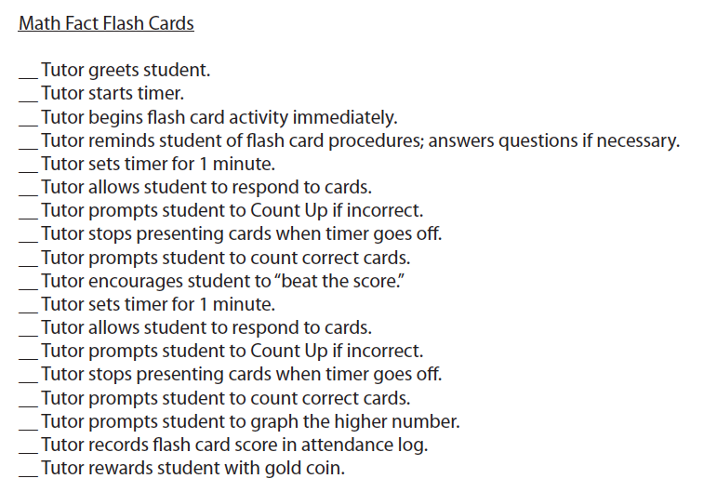
Implement with greater fidelity
Adaptation
Ensure that you are implementing the intervention or strategy with fidelity

Slide 107
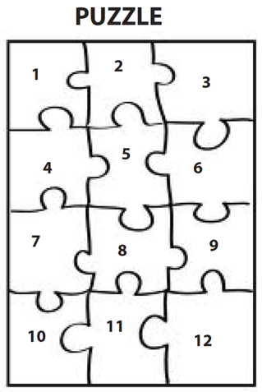
Implement with greater fidelity
Adaptation
Embed behavioral supports
May want to incorporate strategies to improve self-regulation and minimize nonproductive behavior

Slide 108
Implement with greater fidelity
Adaptation
Embed behavioral supports
May want to incorporate strategies to improve self-regulation and minimize nonproductive behavior
UPSCheck
Understand
Plan
Solve
Check

Slide 109
Implement with greater fidelity
Adaptation
Embed behavioral supports
Increase dosage
Conduct longer sessions, more sessions per week, or more weeks within DBI

Slide 110
Implement with greater fidelity
Adaptation
Embed behavioral supports
Increase dosage
Conduct longer sessions, more sessions per week, or more weeks within DBI

Slide 111
Implement with greater fidelity
Adaptation
Embed behavioral supports
Increase dosage
Conduct longer sessions, more sessions per week, or more weeks within DBI
Number of weeks left in intervention

Slide 112
Implement with greater fidelity
Adaptation
Embed behavioral supports
Increase dosage
Adapt mathematics content
Where student IS
Where student NEEDS TO BE
Alter the scope and sequence
Explain why addition and subtraction strategies work, using place value and the properties of operations.
Use addition and subtraction within 100 to solve one- and two-step word problems…
Fluently add and subtract within 100 using strategies based on place value, properties of operations, and/or relationships.
Apply properties of operations as strategies to multiply and divide….
Fluently multiply and divide within 100, using strategies such as the relationship between multiplication and division…
Understand that the three digits of a three-digit number represent amounts of hundreds, tens, and ones.
Find whole number quotients and remainders with up to four-digit dividends and one-digit divisors, using strategies based on place value, …
Solve multi-step word problems posed with whole numbers and having whole-number answers using the four operations…
Understand that the two digits of a two-digit number represent amounts of tens and ones.
Use multiplication and division within 100 to solve word problems…
Fluently add and subtract multi-digit whole numbers using the standard algorithm.
Fluently multiply multi-digit whole numbers using the standard algorithm.
continuum of mathematics learning

Slide 113
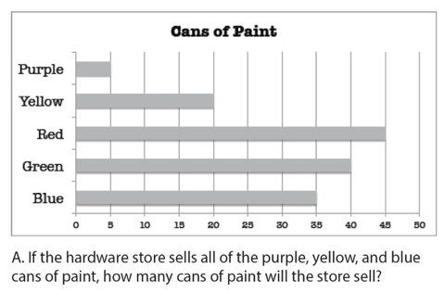
Implement with greater fidelity
Adaptation
Embed behavioral supports
Increase dosage
Solve
Adapt mathematics content
Write equation
Break down problems into smaller steps
Draw picture
Identify schema
Label graph
Underline labels
Read the problem

Slide 114
Implement with greater fidelity
Adaptation
Embed behavioral supports
Increase dosage
Adapt mathematics content
precise
Focus on the language of mathematics
concise

Slide 115
Implement with greater fidelity
Adaptation
Embed behavioral supports
Increase dosage
Adapt mathematics content
Focus on the language of mathematics
MATH JOURNAL

Slide 116
Implement with greater fidelity
Adaptation
Embed behavioral supports
Increase dosage
Adapt mathematics content
Define: | Characteristics:
Example: | Non-example:
Focus on the language of mathematics

Slide 117
Implement with greater fidelity
Adaptation
Embed behavioral supports
Increase dosage
“Tell me how you solved this problem.”
Adapt mathematics content
“What were you thinking about when you regrouped?”
Engage student in more discourse
“How would you teach this problem to another student?”
“Describe the word problem in 10 words or less.”

Slide 118
Implement with greater fidelity
Adaptation
Embed behavioral supports
Increase dosage
“Talk through this problem with me.”
Adapt mathematics content
Provide worked examples
405
+ 16
405
+ 16
411
521

Slide 119
Implement with greater fidelity
Adaptation
Embed behavioral supports
Increase dosage
Adapt mathematics content
Utilize more three-dimensional representations
Abstract
Representational
Concrete

Slide 120
Implement with greater fidelity
Adaptation
Embed behavioral supports
Increase dosage
Adapt mathematics content
Utilize more two-dimensional representations
Abstract
Representational
Concrete

Slide 121
Implement with greater fidelity
Adaptation
Embed behavioral supports
Increase dosage
Adapt mathematics content
Ensure student understand the abstract
Abstract
Representational
Concrete

Slide 122
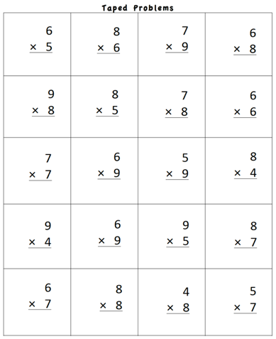
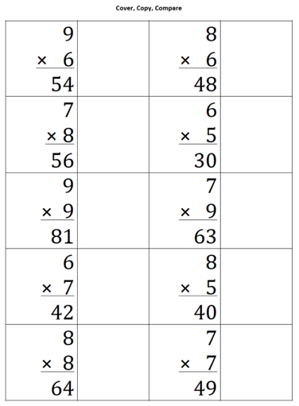
Implement with greater fidelity
Adaptation
Embed behavioral supports
Increase dosage
Adapt mathematics content
Focus on fact fluency

Slide 123
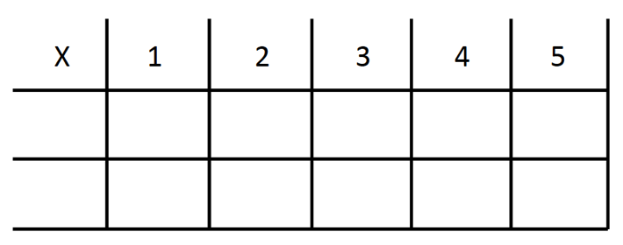
Implement with greater fidelity
Adaptation
Embed behavioral supports
Increase dosage
Adapt mathematics content
Focus on other types of fluency
-3 + (-4) = ___ 5 – (-6) = ___

Slide 124
Implement with greater fidelity
Adaptation
Embed behavioral supports
Increase dosage
Adapt mathematics content
Teach alternate algorithms

Slide 125
Implement with greater fidelity
Adaptation
Embed behavioral supports
Increase dosage
Adapt mathematics content
Explicitly teach problem solving
Additive
Multiplicative
Total
Equal Groups
Difference
Comparison
Change
Ratios/
Proportions

Slide 126
Implement with greater fidelity
Adaptation
Embed behavioral supports
Increase dosage
Adapt mathematics content
Encourage alternate methods and solutions
405
+ 16
405
+ 16
500
10
+ 11
521
521

Slide 127
Implement with greater fidelity
Adaptation
Embed behavioral supports
Increase dosage
Adapt mathematics content
Modeling
Practice
Utilize explicit instruction
Clear Explanation
Guided
Practice
Make sure you’re doing it! And do it well!
Planned
Examples
Independent Practice
Supporting Practices
Asking the right questions
Eliciting frequent responses
Providing immediate specific feedback
Maintaining a brisk pace

Slide 128
Implement with greater fidelity
Adaptation
Embed behavioral supports
Increase dosage
405
+ 16
4305
+ 216
Adapt mathematics content
Utilize explicit instruction
Explicitly teach transfer
Marney baked 89 cookies and sold 40 cookies at the bake sale. How many cookies does Marney have left?
Explicitly teach how current learning relates to other learning
Marney had $89 and spent $40 on shoes. How many much does Marney have left?
Marney had $89 and spent $40 on shoes. How much money will Marney have after buying the shoes?

Slide 129
Implement with greater fidelity
Adaptation
Embed behavioral supports
Increase dosage
Adapt mathematics content
Utilize explicit instruction
Explicitly teach transfer

Slide 130
Intervention: Occurs frequently and with intensity
Assessment: Formative
Assessment: Diagnostic
Intervention adaptation: Content, dosage, explicit instruction, attention to transfer
Assessment: Formative

Slide 131
To Review

Slide 132
Instructional Platform

Slide 133
Conduct a diagnostic of the student’s strengths and weaknesses
Design a scope and sequence
Identify instructional platform (evidence-based intervention or strategy)
Instructional Platform

Slide 134
Conduct a diagnostic of the student’s strengths and weaknesses
Design a scope and sequence
Identify instructional platform (evidence-based intervention or strategy)
Instructional Platform
Occurs frequently (3-4 times a week for 20-40 min/session)
Delivered with fidelity

Slide 135
Conduct a diagnostic of the student’s strengths and weaknesses
Design a scope and sequence
Identify instructional platform (evidence-based intervention or strategy)
Instructional Platform
Occurs frequently (3-4 times a week for 20-40 min/session)
Delivered with fidelity
Occurs weekly
Using a reliable and valid assessment with alternate forms
Goals are set

Slide 136
Conduct a diagnostic of the student’s strengths and weaknesses
Design a scope and sequence
Identify instructional platform (evidence-based intervention or strategy)
Instructional Platform
Occurs frequently (3-4 times a week for 20-40 min/session)
Delivered with fidelity
Occurs weekly
Using a reliable and valid assessment with alternate forms
Goals are set
After 6 to 10 weeks, data is interpreted using decision rules

Slide 137
Conduct a diagnostic of the student’s strengths and weaknesses
Design a scope and sequence
Identify instructional platform (evidence-based intervention or strategy)
Instructional Platform
Occurs frequently (3-4 times a week for 20-40 min/session)
Delivered with fidelity
Occurs weekly
Using a reliable and valid assessment with alternate forms
Goals are set
After 6 to 10 weeks, data is interpreted using decision rules
Conducted to understand strengths and weaknesses
Determines adaptations

Slide 138
Conduct a diagnostic of the student’s strengths and weaknesses
Design a scope and sequence
Identify instructional platform (evidence-based intervention or strategy)
Instructional Platform
Occurs frequently (3-4 times a week for 20-40 min/session)
Delivered with fidelity
Occurs weekly
Using a reliable and valid assessment with alternate forms
Goals are set
After 6 to 10 weeks, data is interpreted using decision rules
Conducted to understand strengths and weaknesses
Determines adaptations
Occurs frequently (3-4 times a week for 20-40 min/session)
Delivered with fidelity

Slide 139
Conduct a diagnostic of the student’s strengths and weaknesses
Design a scope and sequence
Identify instructional platform (evidence-based intervention or strategy)
Instructional Platform
Occurs frequently (3-4 times a week for 20-40 min/session)
Delivered with fidelity
Occurs weekly
Using a reliable and valid assessment with alternate forms
Goals are set
After 6 to 10 weeks, data is interpreted using decision rules
Conducted to understand strengths and weaknesses
Determines adaptations
Occurs frequently (3-4 times a week for 20-40 min/session)
Delivered with fidelity
Occurs weekly
Using a reliable and valid assessment with alternate forms
Goals are set

Slide 140
Conduct a diagnostic of the student’s strengths and weaknesses
Design a scope and sequence
Identify instructional platform (evidence-based intervention or strategy)
Instructional Platform
Occurs frequently (3-4 times a week for 20-40 min/session)
Delivered with fidelity
Occurs weekly
Using a reliable and valid assessment with alternate forms
Goals are set
After 6 to 10 weeks, data is interpreted using decision rules
Conducted to understand strengths and weaknesses
Determines adaptations
Occurs frequently (3-4 times a week for 20-40 min/session)
Delivered with fidelity
Occurs weekly
Using a reliable and valid assessment with alternate forms
Goals are set
After 6 to 10 weeks, data is interpreted using decision rules

Slide 141
Contact Information
Sarah Powell, Ph.D.
The University of Texas at Austin
srpowell@austin.utexas.edu
@sarahpowellphd
119

