Slide 1
Targeted and Chemotherapeutic Approaches to Management of Metastatic Colorectal Cancer
Nicole M. Ross, MSN, CRNP, AOCNP
Fox Chase Cancer Center

Slide 2
Learning Objectives
Critically evaluate current clinical trial evidence supporting the use of targeted and chemotherapeutic approaches, and their combinations, in the management of metastatic colorectal cancer (mCRC0 across multiple lines of treatment.
Explain which factors driving patients’ segmentation (prognostic and predictive biomarkers, comorbidities, patients’ preference) impact the treatment decision-making process in different clinical scenarios across disease progression
Review current best practices for the management of adverse effects associated with targeted therapies in mCRC and how to maximize tolerability and adherence to different therapeutic regimens

Slide 3
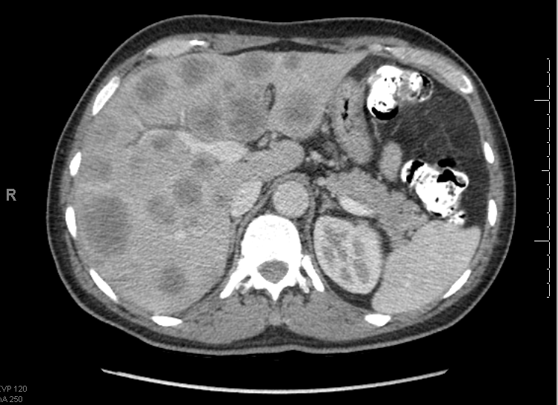
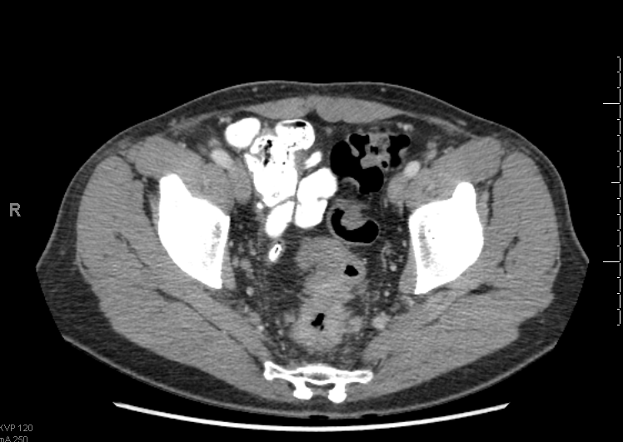
Case: F.F.
49 year old otherwise healthy man presented with constipation for 3 months and abdominal pain.
30 lb weight loss over the last 3 months.
Low grade fever, increasing right upper quadrant pain

Slide 4
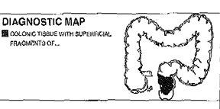
Case: F.F.
CEA- 702
LFT mildly elevated, bilirubin normal
Colonoscopy nearly obstructive mass in the recto-sigmoid junction
Biopsy – moderately differentiated adenocarcinoma

Slide 5
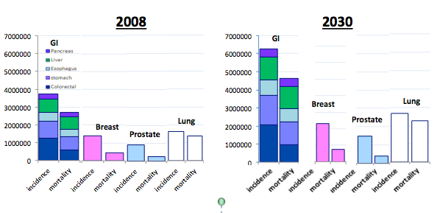
Worldwide Cancer Statistics
Bray F et al. Lancet Oncol. 2012;13:790-801; http://www.cancer.org/aboutus/globalhealth

Slide 6
Epidemiology
Estimated US incidence (new cases): 142,820
Estimated US mortality: 50,830
Third most common malignancy in man and woman.
15% Stage I
25% Stage IV
25% Stage II
35% Stage III
Siegel R et al. CA: Cancer J Clin. 2013;63:11-30.
Notes:
Using a combination of these procedures, patients with CRC receive an initial workup to determine disease stage (I-IV), which guides subsequent treatment decisions.
While staging techniques vary worldwide, clinicians in the United States rely on Dukes’ and TNM (tumor/node/metastasis) staging techniques for disease staging.²
Stage II disease demonstrates invasion through the muscularis propria without nodal involvement or distant metastases.² The role of adjuvant therapy for stage II colon cancer remains controversial.
Patients with stage III disease have nodal involvement without distant metastases and are treated using adjuvant chemotherapy.²
Stage IV disease has metastatic involvement of distant lymph nodes and/or distant organs.²
Most patients present with stage II (24.5%) or III (32.6%) disease.³
Unresectable and metastatic stage IV disease is generally fatal.
1. Treatment Algorithms: Colorectal Cancer. 5th ed. Datamonitor. January 2003:59.
2. Treatment Algorithms: Colorectal Cancer. 5th ed. Datamonitor. January 2003:73.
3. Treatment Algorithms: Colorectal Cancer. 5th ed. Datamonitor. January 2003:50.
6

Slide 7
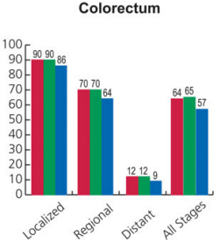
Epidemiology
5-yr survival for metastatic disease is about 10%
All Races
White
African American
Siegel R et al. CA: Cancer J Clin. 2013;63:11-30.
Notes:
Data from cancer stat 2013. reporting 5y survival by stage and race from data between 2002-2008. Estimating 5y OS of about 10% for patients with metastatic disease.

Slide 8
Colon Cancer: More Than One Disease
Molecular
  MSI vs MSS
  RAS WT vs MUT
Anatomic
  Right versus left
  Rectal versus colon

Slide 9
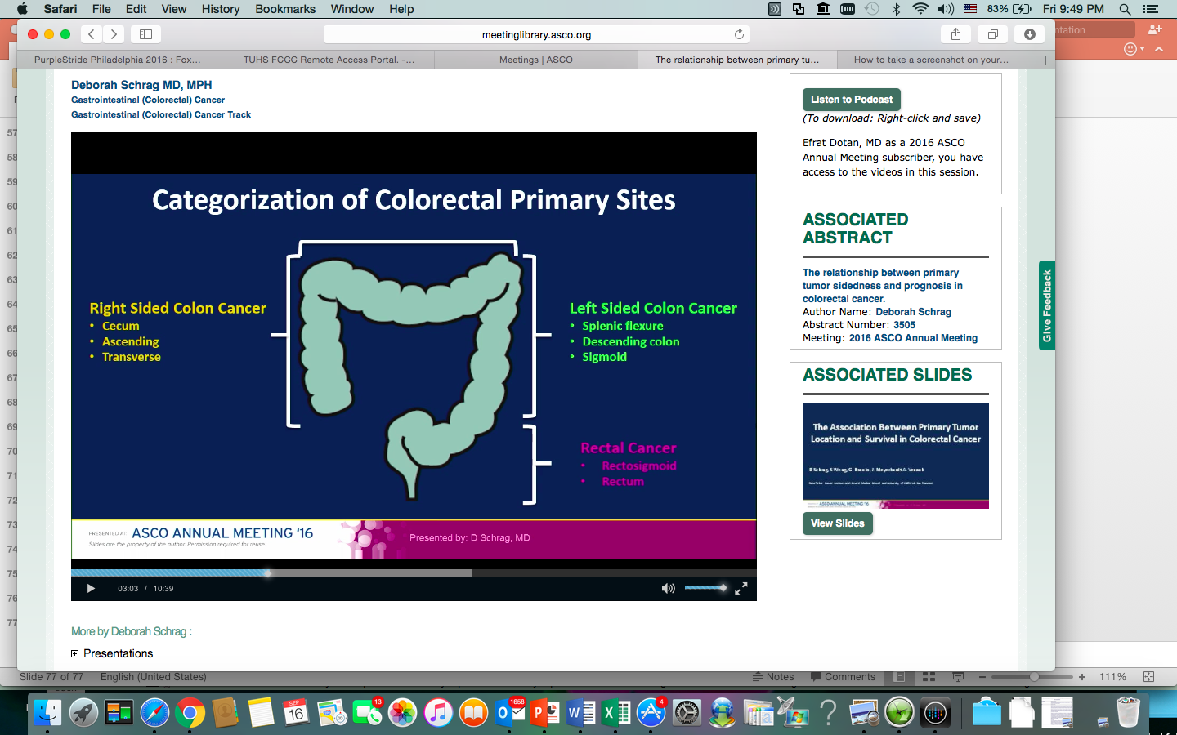
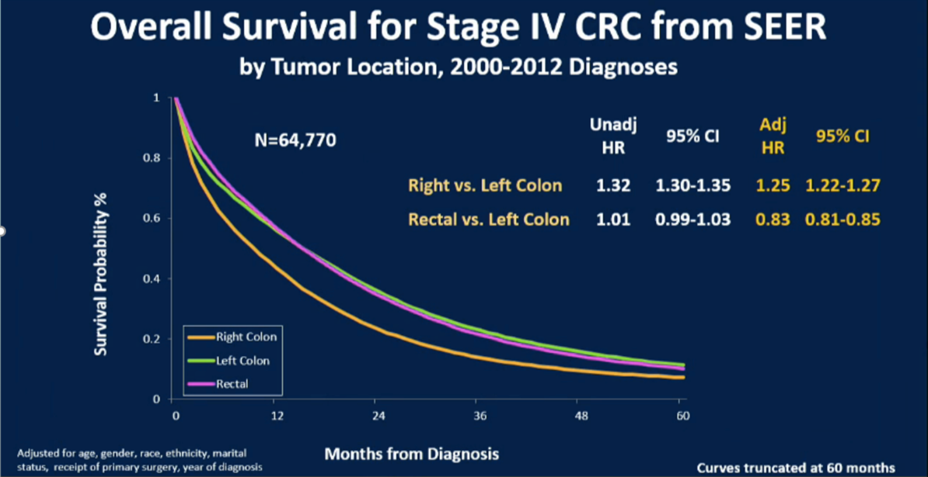
Right vs. Left: Sidedness Matters
Median age at diagnosis:
Right sided: 70.2 years
Left sided: 65 years
Schrag D et al. J Clin Oncol. 2016;34(suppl; abstr 3505). Abstract 3505.
Notes:
OS of stage IV CRC, right vs. left adjusted HR – 1.25.
Right side tumors have slightly worst prognosis, decreased OS.
The data was also seen in stage III, but not as strong.
This may be due for lead time diagnosis – left sided are diagnosed earlier.
Schrag D, Weng S, Brooks G, et al. The relationship between primary tumor sidedness and prognosis in colorectal cancer. J Clin Oncol 34, 2016 (suppl; abstr 3505). Abstract 3505.

Slide 10
Pre-Treatment Evaluation in mCRC
Imaging:
CT chest/abdomen/pelvis
PET-CT and MRI useful for specific questions i.e. resection.
Lab/Pathology/Molecular testing
Confirm path/ biopsy of metastases
Baseline CEA
KRAS mutation status (all patients) prior to anti-EGFR therapy
BRAF mutation (?)
MSI status
UGT1A1*28 (not recommended routinely, consider before irinotecan)
Notes:
MSI- as per the NCCN this is recommended for all patients <50yo with CRC due to the risk of Lynch syndrome. Now more indication to test due to data of immune therapy.
BRAF – there is some data to point to worst prognosis, and less response to tx. But it is not consider a definitive marker.

Slide 11
Resection of Primary Tumor in mCRC
C-10 phase II multicenter study.
86 patients, front line FOLFOX+Bev with intact primary tumor.
Primary end point surgical resection required due to symptoms related to primary tumor.
 | N | %
Surgery due to symptoms from primary tumor | 10 | 11.6
Death with symptoms from primary tumor | 2 | 2.3
Primary tumor resected with curative intent | 8 | 9.3
Patient died with intact tumor | 28 | 32.6
Patient was alive at last follow up with intact tumor | 35 | 40.7
McCahill LE et al. JCO. 2012;30:3223-3228.
Notes:
Cumulative incidence of major morbidity and competing events: National Surgical Adjuvant Breast and Bowel Project C-10 trial
This study showed improvement in symptoms related to the primary tumour in 1-2 weeks from treatment initiation.
Since the rate of complications from an intact primary tumour are rare, delaying systemic therapy is not recommended.
NCCN does not recommend resection – “the risks of surgery outweigh the benefit of this intervention”
Resection should be considered in a patient with risk of imminent obstruction, or uncontrolled bleeding.
Median f/u was 20.7m.

Slide 12
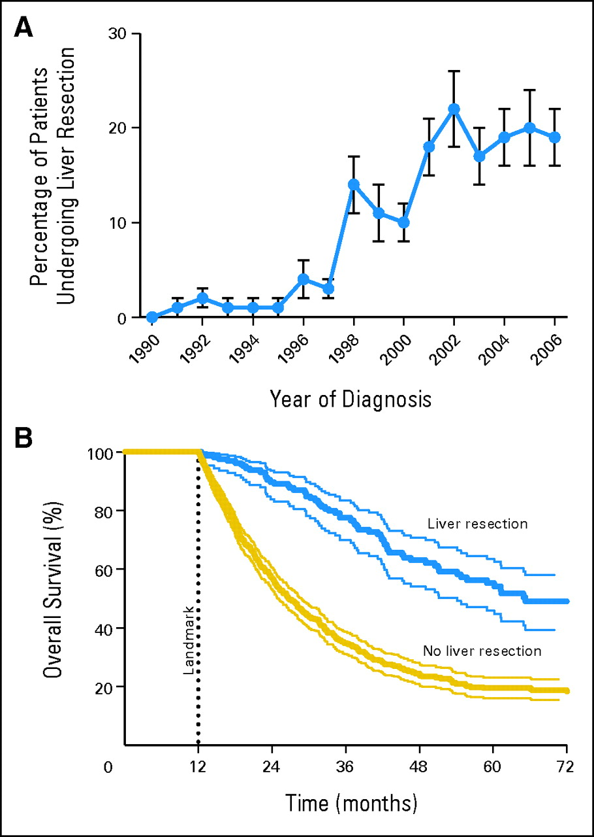
Resection of Metastatic Site
Data from MD Anderson + Mayo 2,470 patients. 231 underwent hepatic resection.
Rates of resection increased.
Survival improved with resection.
Kopetz S et al. J Clin Oncol. 2009;27:3677-3683.
Notes:
This is the previous study I showed earlier about the improvement in outcomes of patients with mCRC in MD Anderson and Mayo 2,470 patients.
They looked at hepatic resection which occurred in 231 patients. About 20%.
The rates of resections increased over the years.
Survival was better among patients who underwent resection.
Percentage of patients undergoing liver resection by date of diagnosis increased significantly for patients diagnosed in 1998 and stabilized around 20% for patients diagnosed in 2000 to 2006.

Slide 13
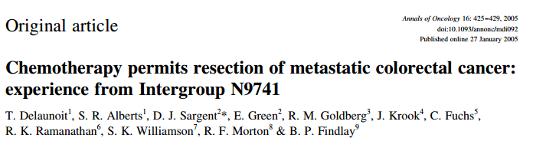
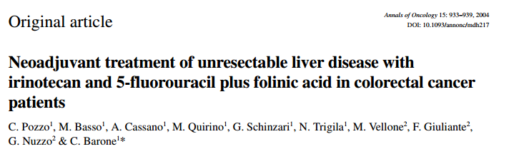
Treatment – Conversion to Surgery
Notes:
These are two papers showing conversion of an unresectable tumor liver met to resectable disease.
N9741: study using IFL, FOLFOX, IROX – 24 patients were converted to resectable disease. With 42m survival.
The second study was a 40pt study with FOLFIRI showed a 32.5% of patient turning into resectable cases. mTTP with resected cases was 14.3m.
Conversion for resectability with FOLFOXIRI- data didn’t show any benefit over FOLFOX. (TRIBE study).

Slide 14
Advances in the Treatment of mCRC
1980
1985
1990
1995
2000
2005
2012
Best supportive care (BSC)
5-FU
Irinotecan
Capecitabine
Oxaliplatin
Cetuximab
Bevacizumab
Panitumumab
Overall Survival (months)
Ziv-Aflibricept
Regorafenib
Median overall survival
Ramucirumab
TAS-102
Year
Notes:
This image shows the improvement in therapeis over the last almost 3 decades, as well as the improvement in OS.
ziv-Aflibricept (approved 2012)and Regorafenib (2013), Ramucirumab (2015); TAS-102 (2015)
The overall survival has been updated based on the recent presentation of the CALGB study 80405 showing OS in the range of 30 months.

Slide 15
More Agents Available Now…
BSC
Fluoropyrimidine
Irinotecan
Ongoing debate between the “best” schedule and sequencing of these agents
Oxaliplatin
Bevacizumab
Cetuximab
Regorafenib / TAS-102
Aflibercept /Ramucirumab
Panitumumab
Notes:
So there are many agents but the main questions is what is the best way to combine therapy? Sequence them?

Slide 16
2005 Update:11 Phase 3 Trials – 5768 pts
22
21
20
19
18
17
16
15
14
13
12
First-Line Therapy
Infusional 5-FU/LV
+ Irinotecan
Infusional 5-FU/LV
+ Oxaliplatin
Bolus 5-FU/LV
+ Irinotecan
Irinotecan
+ Oxaliplatin
Bolus 5-FU/LV
LV5FU2
FOLFOXIRI
CAIRO
Median OS (months)
P = 0.0001
0 10 20 30 40 50 60 70 80
Patients With 3 Drugs (%)
OS (months) = 13.2 + (% patients with 3 drugs x 0.1), R² = 0.85
Grothey A, Sargent D. J Clin Oncol. 2005;23:9441-9442. Reprinted with permission. ©2005 American
Society of Clinical Oncology. All rights reserved.
Notes:
Pooled analysis from 11 phase III clinical trials which showed improvement in OS with receipt of all three drugs.
This model showed a correlation between the % of patients recieving 3 drugs therapy and the median OS.

Slide 17
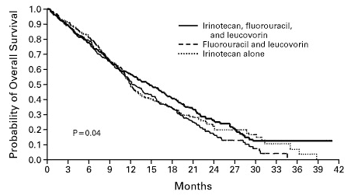
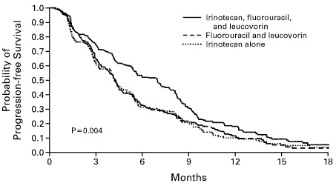
Addition of Irinotecan
PFS: 4.3m vs. 7.0m (p=0.004)
OS: 12.6m vs. 14.3m (p=0.04)
Saltz LB et al. N Engl J Med. 2000;343:905-914.
Notes:
The study that showed the benefit of addition of Irinotecan to 5FU.
683 patients randomized between 5FU/LV, Irinotecan alone and IFL. PFS was improved from 4.3m o 7m p=0.004
OS was improved from 12.6m to 14.3m p=0.04
Higher rates of diarrhea with the irinotecan.

Slide 18
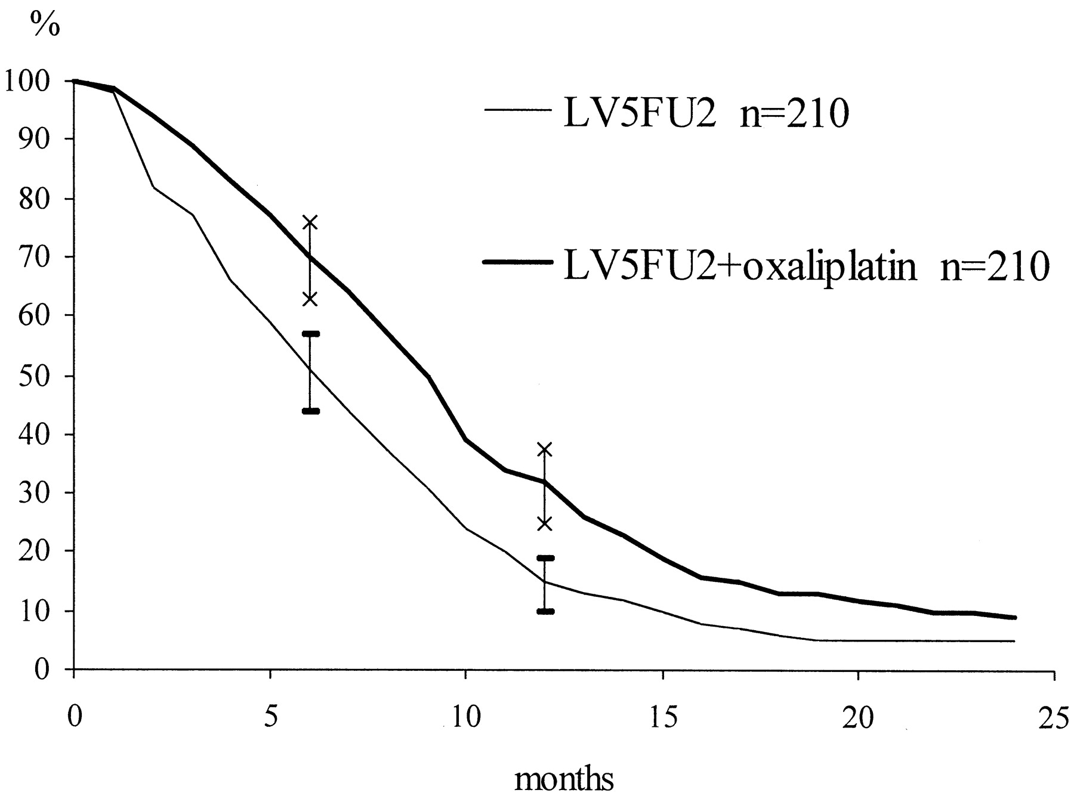
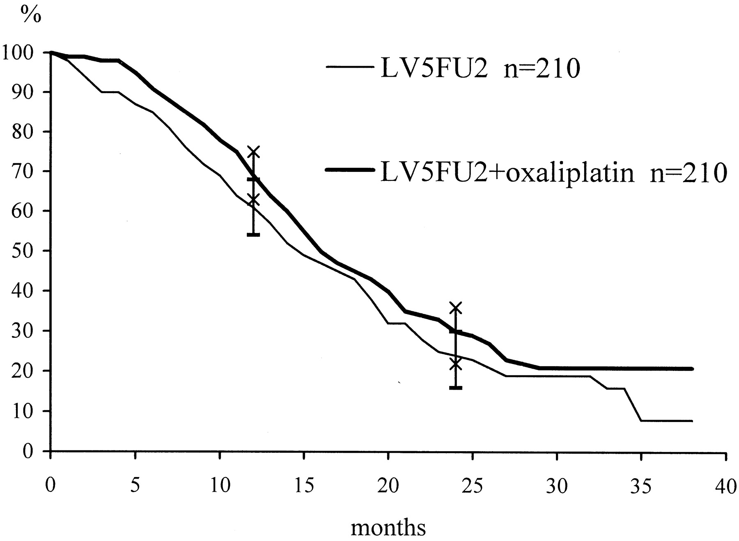
Addition of Oxaliplatin
Progression free survival
9.0 vs 6.2m p=0.0003
Overall survival
16.2 vs 14.7m p=NS
de Gramont A et al. J Clin Oncol. 2000;18:2938-2947
Notes:
420 patients.
5FU/LV vs. FOLFOX 4.
Oxaliplatin was a/w more neutropenia, diarrhea and PN.

Slide 19
F.F. Treatment Plan
Metastatic adenocarcinoma, multiple liver metastasis (10+)
MSS
KRAS wild type
Discussion with oncologist.
  Goal: best shot to live as long as possible; needs to keep working; insurance carrier for family
  Has teenage children in high school
  Decision to avoid surgery and initiate FOLFIRI/Cetuximab

Slide 20
Biologic Agents- Monoclonal Antibodies
Fab
Fc
Murine Ab
“momab”
Chimeric
mouse-human Ab
“ximab”
Humanized Ab
“zumab”
Human Ab
“mumab”
Anti- EGFR
Cetuximab
Panitumumab
Anti-VEGF
Bevacizumab
Troiana T et al. Expert Opin Investig Drugs. 2012;21:949-959.
Notes:
We currently have 3 monoclonal antibodies for treatment of CRC.
One targeting VEGF – bevacizumab and 2 targeting EGFR – Cetuximab and Panitumumab.
This slide shows the difference between these antibodies. The Cetuximab being a chimeric mouse-human ab, the bevacizumab- a humanized ab, and the panitmumab – a human ab.
Ramucirumab - VEGF-R2 monoclonal antibody.

Slide 21
EGFR Targeted Therapy
Ligand
Extracellular
EGF-R
Ras
PI3K
PTEN
Raf
Intracellular
Akt
MEK
MAPK
Cell survival
DNA
Cell motility
Proliferation
Angiogenesis
Metastasis
Yaron M, Jonker DJ. Discov Med. 2011;11:95-105.
Notes:
This is the EGFR pathway which activates a cascade of proteins which cause cell proliferation, angiogenesis and survival.
The antibody cetuximab/panitumumab target the receptor and are supposed to inactivate the pathway.
The Ras protein is of significant importance when targeting this pathway since a KRAS mutation causes a constant activation of the pathway regardless of the receptor status.

Slide 22
EGFR Targeted Therapy
Ligand
Extracellular
EGF-R
Ras
PI3K
PTEN
Raf
Intracellular
Akt
MEK
MAPK
Cell survival
DNA
Cell motility
Proliferation
Angiogenesis
Metastasis
Yaron M, Jonker DJ. Discov Med. 2011;11:95-105.
Notes:
KRAS has become a predictive biomarker in this disease.

Slide 23
FOLFIRI Cetuximab
Port placement
Given every 14 days
Infusion room time and 46 hour infusion at home
Pre-meds
Anti-emetics for home

Slide 24
Diarrhea
Brat diet
Imodium
Lomotril
Hydration
Check electrolytes
Review other medications (antihypertensives, diuretics)
Consider admission when needed
Grade I | Increase of <4 stools per day over baseline
Grade II | Increase of 4-6 stools per day over baseline
Grade III | Increase of >7 stools per day over baseline; hospitalization indicated; limits self care ADL’s
Grade IV | Life-threatening consequences; urgent intervention
Grade V | Death

Slide 25
Adverse Effects of EGFR Inhibition
Cutaneous adverse effects
  Papulopustular reaction involving skin
  Can affect compliance and QOL
  Leaves skin vulnerable to bacterial overgrowth and infection
  Skin rash can lead to dose modification or treatment discontinuation
  Sun protection
  Topical clindamycin 2% / 1% hydrocortisone cream
  Oral doxycycline if moderate to severe
  Consider dermatology if needed
Dry eyes

Slide 26
Case: F.F.
First CT at 3 months with great response to treatment
Stable disease after 9 months
Increasing diarrhea and neutropenia requiring Neulasta
Restaging CT 2 months later for new cough. New pleural effusion + malignancy

Slide 27
But What Impacts the Patient’s Decision Making?
Patient goals
Quality of life
Side effect profile of drugs
Comorbid conditions
Logistics
Notes:
Goals – to be comfortable, to make it long enough to see a granchild born?
QOL – piano player, think about folfiri over folfox
Comorbid conditions – sensory neuropathy from diabetes, think about folfiri over folfox
Logistics – infusion schedule? Trying to work? Think capeox over folfox

Slide 28
Next Steps in Treatment
FOLFOX/bevacizumab
PleurX catheter placement
Palliative care consult
Patient education

Slide 29
VEGF Inhibitors
PlGF
VEGF-B
VEGF-A
VEGF-C
VEGF-D
Y
Bevacizumab
Ramucirumab
Y
Regorafeib
Aflibercept
(VEGF Trap)
Functions
VEGF-R1
(FLT1)
Migration
Invasion
Survival
VEGF-R2
(KDR/Flk-1)
Proliferation
Survival
Permeability
VEGF-R3
(FLT4)
Lymphangiogenesis
Troiana T et al. Expert Opin Investig Drugs. 2012;21:949-959.
Notes:
29
The VEGF pathway has a role in angiogeneis, and proliferation
Today we have 3 approved agents targeting the VEGF pathway:
Bev- a monoclonal antibody targeting VEGFR1. and Aflibrecept which is a VEGF Trap protein that targets both VEGFR A and B.
Ramicirumab is another antibody which is targeting the receptor VEGF-R2 approved 2015 for mCRC.
IMC-18F1 – Icrucumab an antibody to VEGFR-1 receptor – under investigation.
The VEGF pathway is also targeted by Regorafenib which is a multi-kinase inhibitor (targets VEGF-R2) which is currently approved for late stages of CRC. Will discus further in this talk.

Slide 30
Bevacizumab Risks
Hypertension (~20%)
Arterial thrombosis (2-5%)
  SCD, MI, CVA, TIA
  Increased with poor PS or age > 65
GI perforation (1-2%)
Grade 3-4 bleeding (2-5%)
Post-operative bleeding/wound healing (1-2%)
  Perforation, fistula, abscess, surgery within 60 days
Kozloff M et al. The Oncologist. 2009;14:862-870.
Notes:
As seen on previous slides the benefit of using bevacizumab is not as impressive as we would expect.
It does carry risks.

Slide 31
Nursing Implications for the Patient Receiving FOLFOX
Patient education
  Nausea
  Diarrhea
  Cold sensitivity
Ask about peripheral neuropathy
  Assessment CTCAE grading
  Management
Infusion pump safety

Slide 32

Peripheral Neuropathy
Numbness
Tingling
Pain
Like walking on broken glass
Off balance
Stiffness

Slide 33
CTCAE v4.0 Peripheral Neuropathy
Grade I | Asymptomatic, lost of DTRs or paresthesia
Grade II | Moderate symptoms; limiting instrumental ADL’s
Grade III | Severe symptoms limiting self care ADLs
Grade IV | Life – threatening consequences
Grade V | Death

Slide 34
Management Strategies
Assessment via CTCAE
Considering of modification of dose/holding drug
Gabapentin, Cymbalta, Lyrica
PT/OT
B-complex

Slide 35
Case: F.F.
Disease progression after 9 months of FOLFOX/bevacizumab
HTN managed with ACE inhibitor
Grade II peripheral neuropathy - stable
Middle child graduated from high school
New lung metastasis and increasing liver metastasis

Slide 36
F.F. Treatment Decision
Consideration of clinical trial
TAS 102
Regorafenib

Slide 37
RECOURSE: TAS-102 in Refractory mCRC
RANDOM I ZAT I ON
TAS-102
Primary Endpoint: OS
Refractory Metastatic CRC
2 : 1
Placebo
Stratification
Region
KRAS status
Time form diagnosis of mets to randomization
TAS-102 Treatment Schedule
35mg/m2 BID 5 days per week with 2 days rest, 2 weeks on 2 weeks off.
Mayer R et al. NEJM. 2015;3872:1909-1919.

Slide 38
RECOURSE: TAS-102 in Refractory mCRC – PFS
Adverse Event | Grade 3-4 (%)
Neutropenia | 38%
Febrile Neutropenia | 4%
Anemia | 18%
Thrombocytopenia | 5%
Stomatitis | <1%
Hand foot syndrome | 0
Cardiac ischemia | <1%
Diarrhea | 3%
Fatigue | 4%.
Mayer R et al. NEJM. 2015;3872:1909-1919.

Slide 39
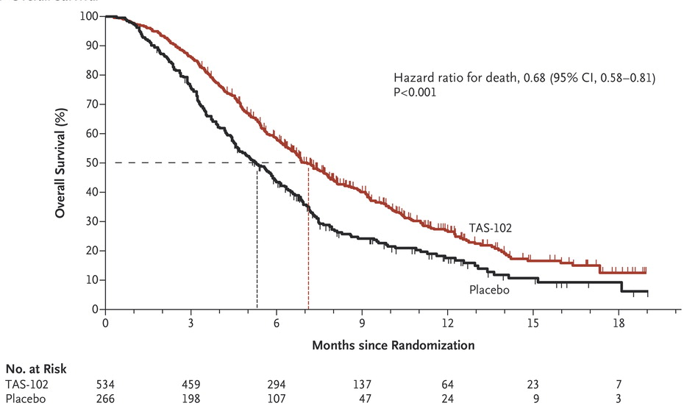
RECOURSE: TAS-102 in Refractory mCRC – Overall Survival
mOS: TAS-102: 7.1m
Placebo: 5.3m
Mayer R et al. NEJM. 2015;3872:1909-1919.

Slide 40
Nursing Considerations with TAS-102
Patient education for schedule
  Calendars
  Prefer a Monday start date (M-F, M-F, off 2 weeks)
Watch for s/s of bleeding
Diarrhea management
Labs
  Labs at Day 14 and prior to start of next cycle

Slide 41
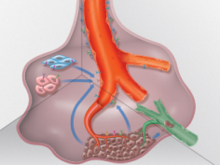
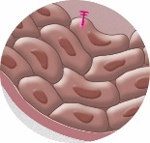
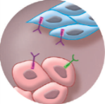
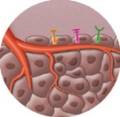
Regorafenib Multikinase Inhibitor
Biochemical Activity | Regorafenib IC₅₀ mean ± SD nmol/L (n)
VEGFR1 | 13 ± 0.4 (2)
Murine VEGFR2 | 4.2 ± 1.6 (10)
Murine VEGFR3 | 46 ± 10 (4)
TIE2 | 311 ± 46 (4)
PDGFR-β | 22 ± 3 (2)
FGFR1 | 202 ± 18 (6)
KIT | 7 ± 2 (4)
RET | 1.5 ± 0.7 (2)
RAF-1 | 2.5 ± 0.6 (4)
B-RAF | 28 ± 10 (6)
B-RAF^{V600E} | 19 ± 6 (6)
    O
    Cl
    O
    O
    N
    H
    F
    N
    H
    N
    H
    N
    F
    F
    F
    Regorafenib
Inhibition of proliferation
Inhibition of tumor microenvironment signaling
Inhibition of
angiogenesis
    KIT
    PDGFR
      RET
    PDGFR-β
    FGFR
    VEGFR1-3
    TIE2
Wilhelm SM et al. Int J Cancer. 2011;129:245-255;
Mross K et al. Clin Cancer Res. 2012;18:2658-2667;
Strumberg D et al. Expert Opin Invest Drugs. 2012;21:879-889.
Notes:
Oral multi-kinase inhibitor.

Slide 42
*CORRECT Study Design
RANDOM I ZAT I ON
Regorafenib + BSC 160 mg orally once daily
3 weeks on, 1 week off
Primary Endpoint: OS
Metastatic CRC after standard therapy
2 : 1
Placebo + BSC
3 weeks on, 1 week off
Multicenter, randomized, double-blind, placebo-controlled, Phase 3
  2:1 randomization
  Stratification factors: prior anti-VEGF therapy, time from diagnosis of metastatic CRC, geographical region
Global trial: 16 countries, 114 active centers;1052 screened, 760 enrolled
Secondary endpoints: PFS, ORR, DCR
Grothey A et al. Lancet. 2013;381:303-312.

Slide 43
CORRECT: Overall Survival
1.00
Regorafenib
  Placebo
Median 6.4 months 5.0 months
95% CI 5.9-7.3 4.4-5.8
0.75
Hazard ratio: 0.77 (95% CI, 0.64-0.94)
P = 0.0052
0.50
Survival Distribution Function
0.25
Placebo N = 255
Regorafenib N = 505
0
0
50
100
150
200
250
300
350
400
450
Days From Randomization
Grothey A et al. Lancet. 2013;381:303-312.

Slide 44
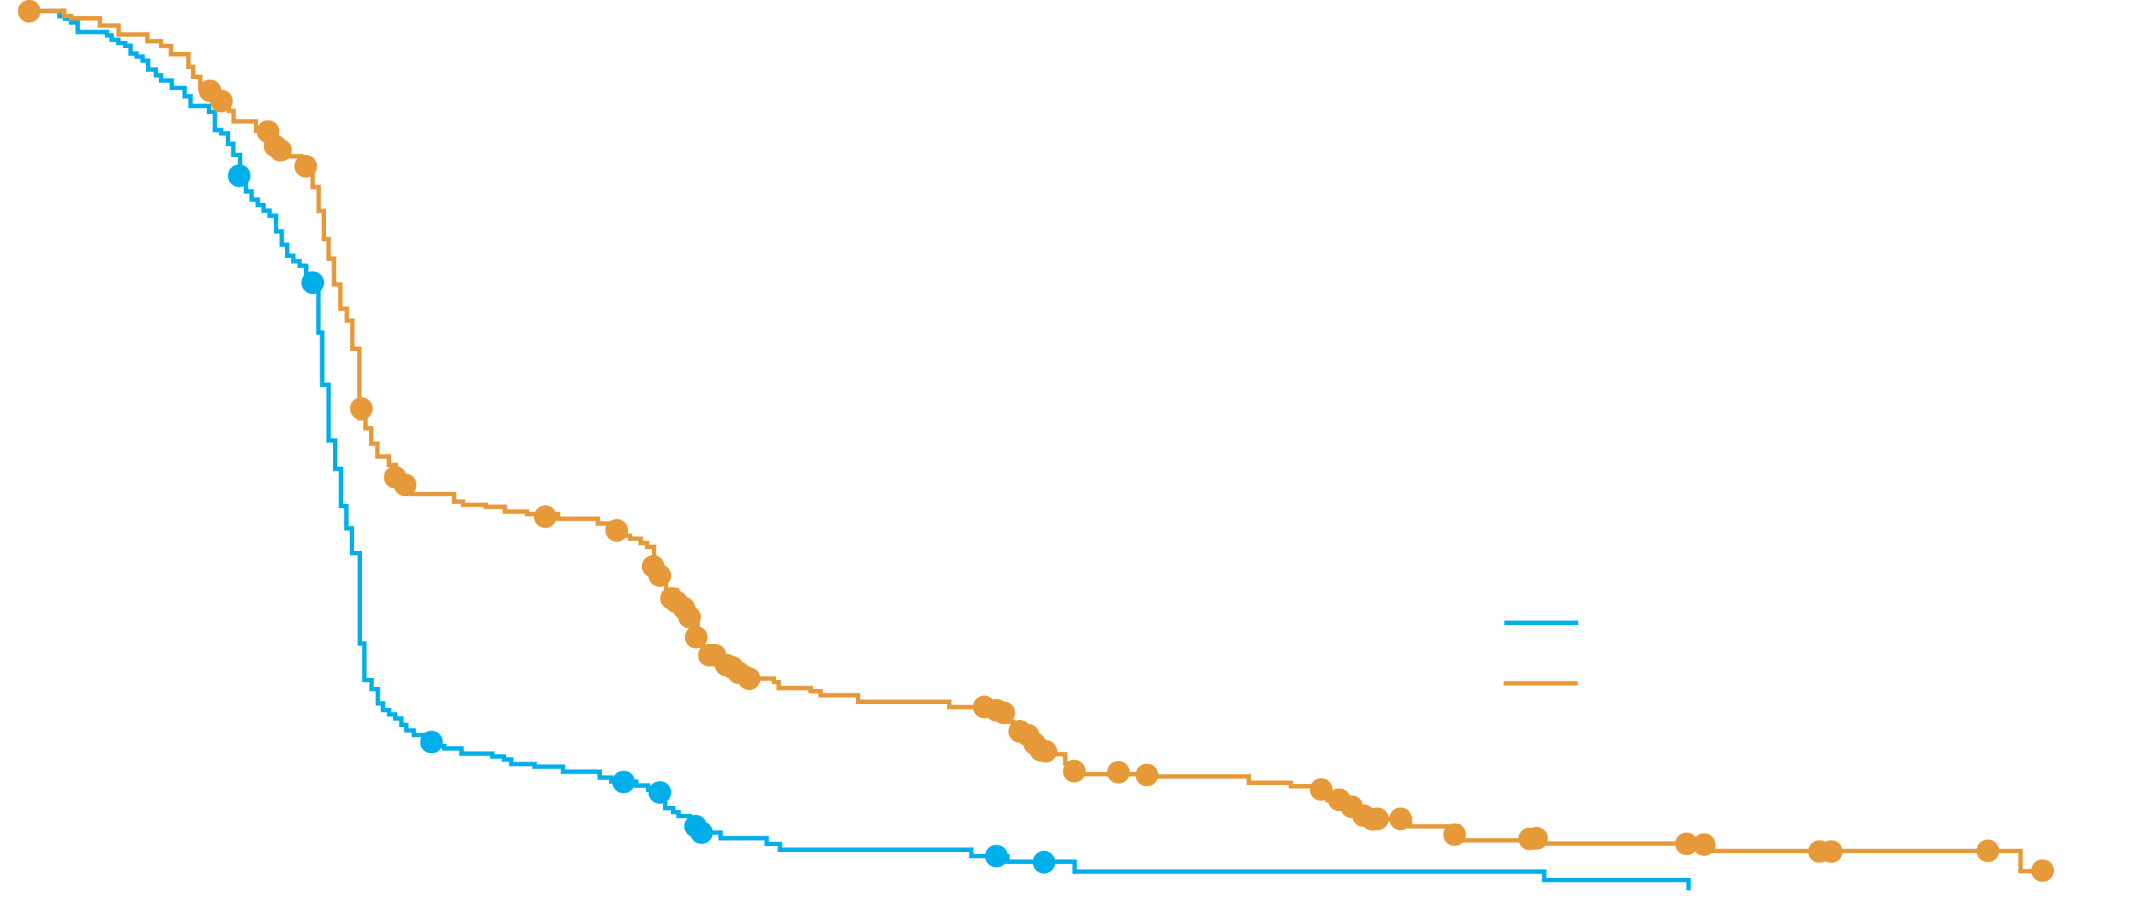
CORRECT: PFS
1.00
  Regorafenib Placebo
Median PFS 1.9 m 1.7 m
0.75
Hazard ratio: 0.49 (95% CI, 0.42-0.58)
1-sided P<0.000001
Survival Distribution Function
0.50
Placebo N = 255
0.25
Regorafenib N = 505
0
0
50
100
150
200
250
300
350
Days From Randomization
Grothey A et al. Lancet. 2013;381:303-312.

Slide 45
CORRECT: Adverse Events
Adverse event, % | Regorafenib N = 500 |  |  | Placebo N = 253
 | All Grades | Grade 3 | Grade 4 | All Grades | Grade 3 | Grade 4
Hand–foot skin reaction | 46.6 | 16.6 | 0 | 7.5 | 0.4 | 0
Fatigue | 47.4 | 9.2 | 0.4 | 28.1 | 4.7 | 0.4
Hypertension | 27.8 | 7.2 | 0 | 5.9 | 0.8 | 0
Diarrhea | 33.8 | 7.0 | 0.2 | 8.3 | 0.8 | 0
Rash/desquamation | 26.0 | 5.8 | 0 | 4.0 | 0 | 0
Anorexia | 30.4 | 3.2 | 0 | 15.4 | 2.8 | 0
Mucositis, oral | 27.2 | 3.0 | 0 | 3.6 | 0 | 0
Thrombocytopenia | 12.6 | 2.6 | 0.2 | 2.0 | 0.4 | 0
Fever | 10.4 | 0.8 | 0 | 2.8 | 0 | 0
Nausea | 14.4 | 0.4 | 0 | 11.1 | 0 | 0
Bleeding | 11.4 | 0.4 | 0 | 2.8 | 0 | 0
Voice changes | 29.4 | 0.2 | 0 | 5.5 | 0 | 0
Weight loss | 13.8 | 0 | 0 | 2.4 | 0 | 0
Grothey A et al. Lancet. 2013;381:303-312.

Slide 46
Management of Patients on Regorafenib
Home BP log; weekly BP checks in office.
Skin care
Weekly LFT’s for first 2 cycles
Safe administration (calendars)
Hand-foot skin reaction
Treatment of diarrhea
Notes:
Skin care – observe feet, udder cream, watch for pressure points (cane or walker)

Slide 47
Hand-Foot Syndrome
AE Term | Definition | Management
Grade I | Changes or dermatitis without pain | Udder cream, Eucerin Monitor
Grade II | Skin changes with pain limiting function | Hold drug Resume when grade I Moisturize
Grade III | Severe skin changes with pain limiting ADLs | Hold drug Moisturize Treat pain, topical lidocaine

Slide 48
Microsatellite Instability
Hypermutatable phenotype
  10-100X somatic mutation rate
Characterized by loss of DNA mismatch repair activity and simple repetitive sequences of DNA
More likely to be:
  Right-sided/proximal colon
  Poorly differentiated
  Younger, female patients
  Contain lymphocyte infiltrates
Less likely to be KRAS or p53 mutated
Associated with hereditary colon cancer syndromes (Lynch Syndrome)
Overall better prognosis
Boland CR, Goel A. Gastroenterology. 2010;138:2073-2087.
Le DT et al. NEJM. 2015;372:2509-2520.

Slide 49
Immunotherapy
10-15% of sporadic colon cancers will have microsatellite instability
Pembrolizumab IV infusion given every 3 weeks

Slide 50
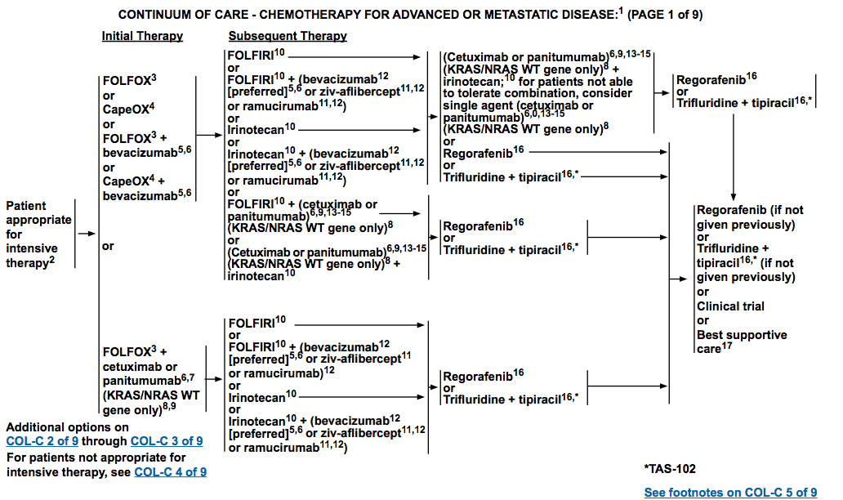
NCCN Guidelines 2.2016: Treatment of Advanced or Metastatic CRC

Slide 51
Summary
The prognosis of patients with mCRC has improved over the last decade.
Standard of care in the 1st and 2nd line setting: combination chemotherapy and biologic agent
Additional studies are needed for identification of novel targets and better biomarkers

Slide 52
Fight Colorectal Cancer:
Guide in the Fight
https://fightcolorectalcancer.org/fight/library/your-guide-in-the-fight/

Slide 53
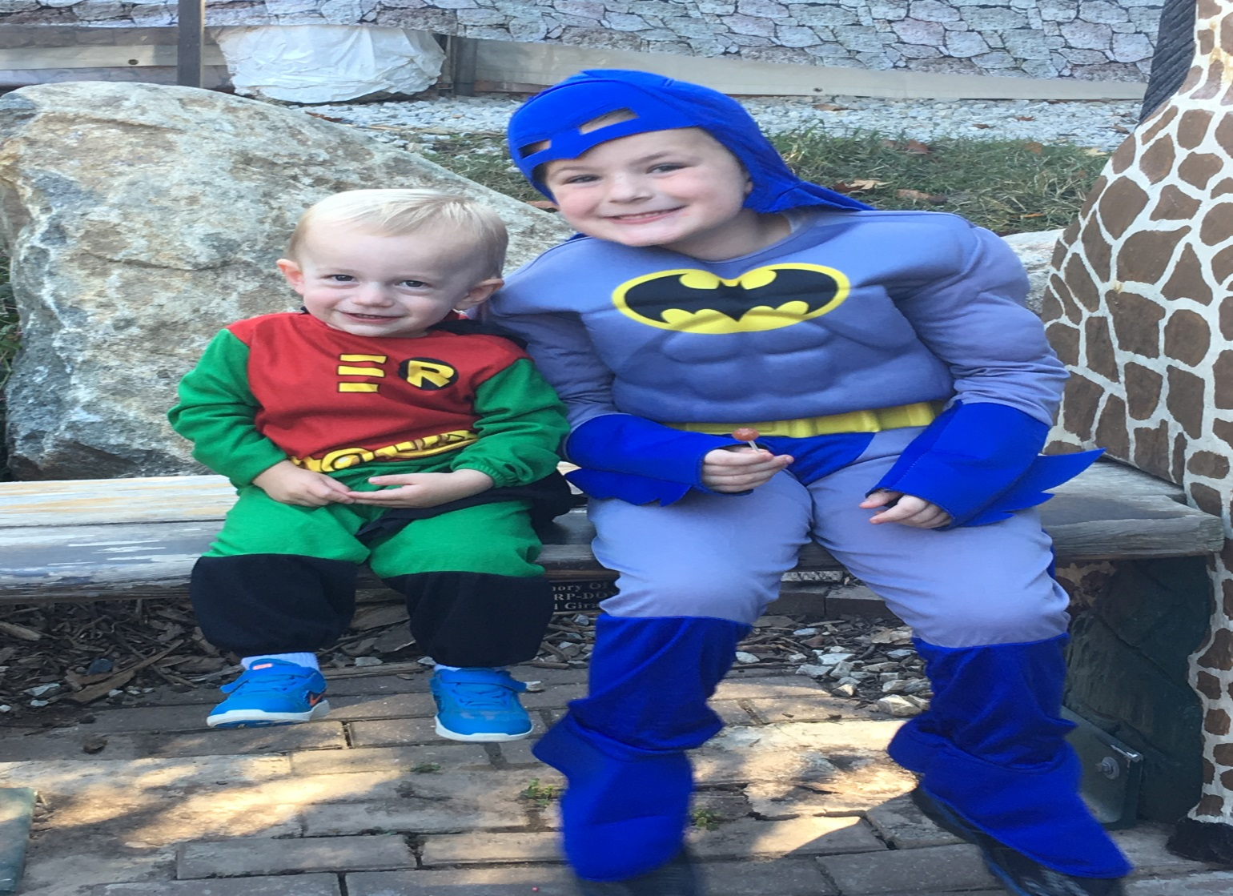
Thank You!

