Slide 1
Integrating Technology into Problem and Project Based Learning
Global learn 2016
Limerick ireland

Slide 2

Why Problem and Project Based Learning?

Slide 3
Why Problem and Project Based Learning?
Kids Speak Out on Student Engagement
Edutopia
"Students are most interested when the curriculum applies to more than just the textbook. The book is there -- we can read a book. If we're given projects that expand into other subjects and make us think, it'll help us understand the information.”
"I like to explore beyond the range of what normal textbooks allow us to do through hands-on techniques such as project-based learning. Whenever I do a project, I always seem to remember the material better than if I just read the information straight out of a textbook."

Slide 4

Why Problem and Project Based Learning?

Slide 5
Problem Based Learning
Students conducting research
Integrate theory and practice
Apply knowledge and skills to solve a problem.

Slide 6
Project Based Learning
Standards based content
Meaningful problem or challenge
Rigorous process of asking questions, discovering resources, and applying new and previous knowledge

Slide 7
Making these activities relevant
Teachers report that students demonstrate a stronger connection between what they were learning and their own world when incorporating project and problem based learning (Boss & Krauss, 2014).
For project and problem based assignments to now be relevant to students, it is essential to incorporate digital tools (Boss & Krauss, 2014).
These tools do not need to be elaborate or expensive. However, digital tools must incorporate seamlessly into the activity and mirror skills students will practice in a professional setting.

Slide 8
Why Problem and Project Based Learning?
When completing project based assignments students report higher levels of elaboration, critical thinking, and metacognition while project based assignments resulted in a higher perception of learning autonomy (Stefanou, et al, 2013).

Slide 9
Communication and Collaboration
For learning to take place, students must build relationships while interacting with the content and each other using communication and collaboration tools
  Discussion Board
  Twitter
  Google Plus
  Google Hangout
  Today’s Meet
  FaceBook

Slide 10
Today’s Meet
TodaysMeet
https://todaysmeet.com/GlobalLearn-2016

Slide 11
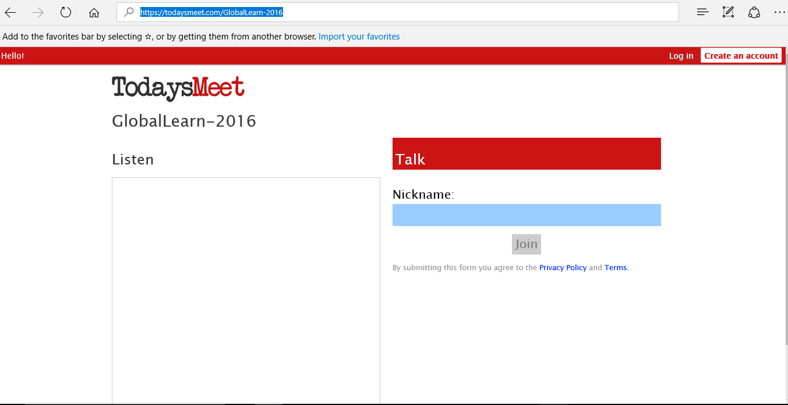
Today’s Meet https://todaysmeet.com/GlobalLearn-2016

Slide 12
Communicate With Experts in the Topic
Wetoku
Skype
ooVoo

Slide 13
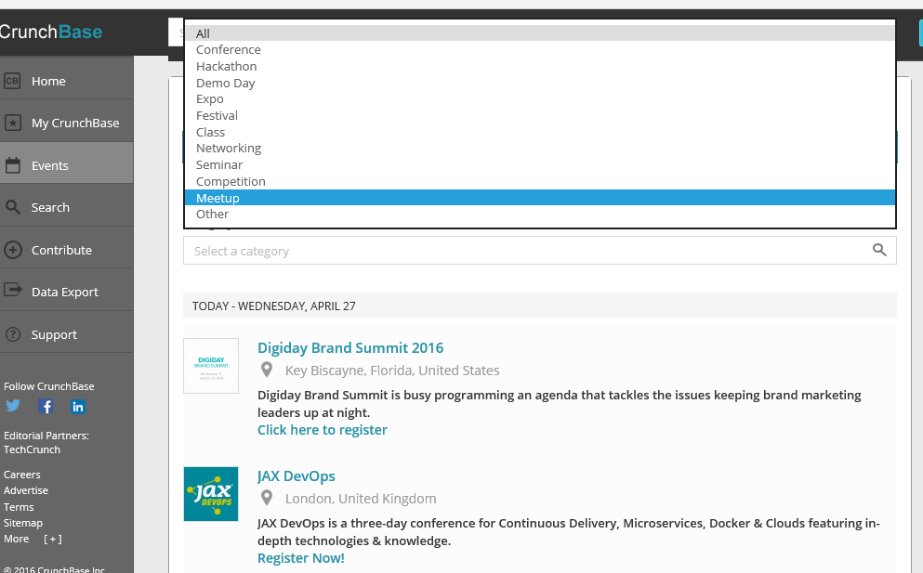
Wetoku https://www.crunchbase.com/organization/wetoku#/entity

Slide 14
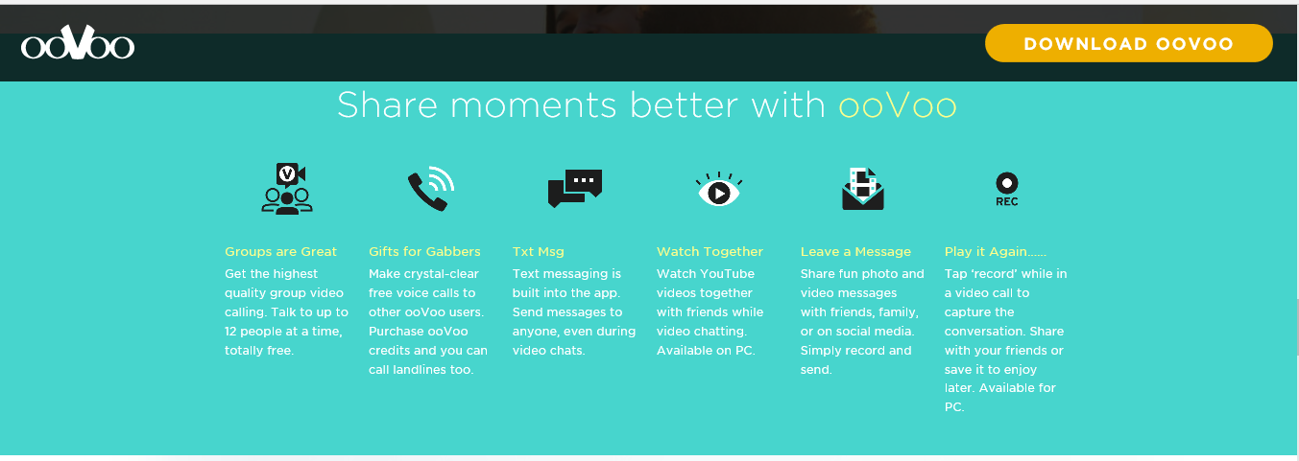
oVoo http://www.oovoo.com/

Slide 15
More than just communicating……
Vygotsky explained that cultural artifacts are important to learning (Fire, 2009). Both project based and problem based activities require students to construct a product of some type to demonstrate assimilation of information.
Teacher Created
  Online resources: FlashCard Machine, the BBC Learning Zone, and the Library of Congress Digital Collection
Student Created
  Linoit
  Padlet, or a graphic organizer using Popplet.

Slide 16
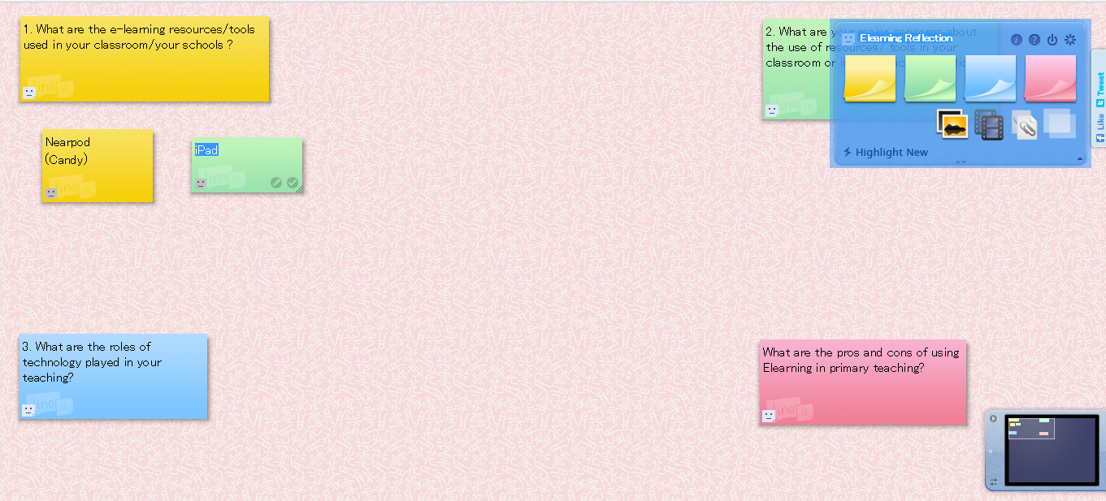
Linoit http://en.linoit.com/

Slide 17
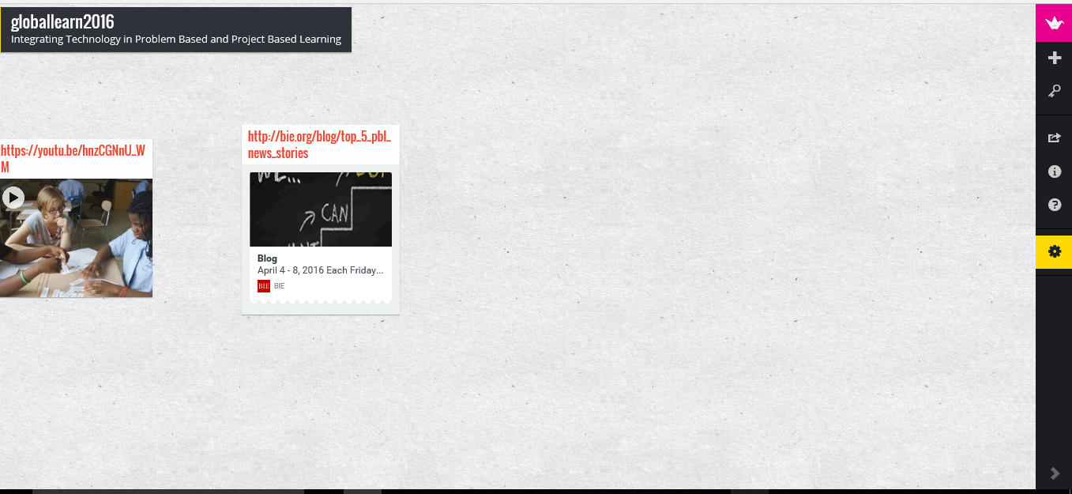
Padlet https://padlet.com/

Slide 18
Student Centered Activities
When completing project and problem based learning, students are granted a degree of autonomy as they design specific products.

Slide 19

  Smore https://www.smore.com/
Notes:
Already created libraries
templates

Slide 20
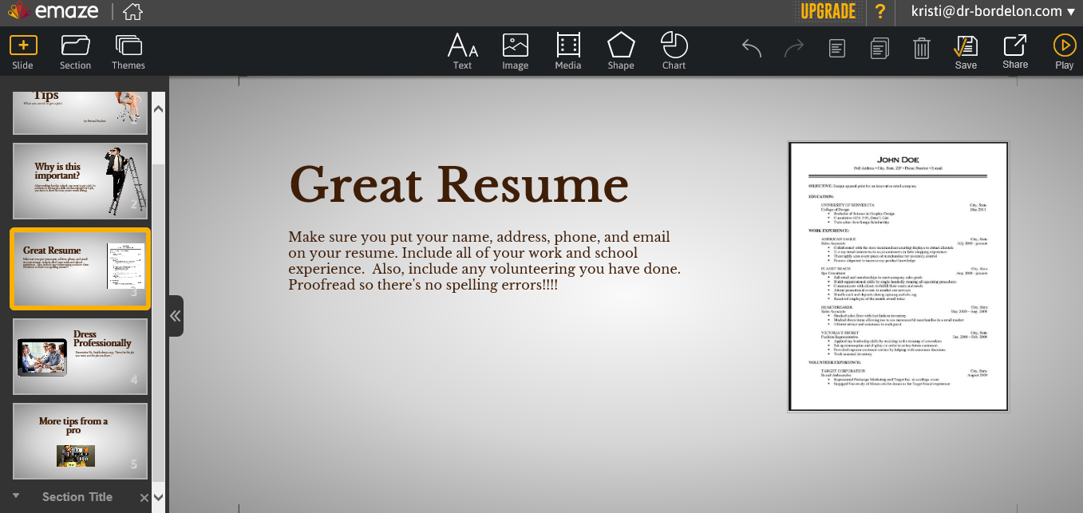
  EMaze https://www.emaze.com
Notes:
Online presentation maker and can include video and audio files.

Slide 21
Organization and Creating….
Online resources such as Livebinders and Text to Mindmap allow students the opportunity to organize materials.
Tools such as Educannon, Emaze, and Instagrok can be used to combine the materials into a cohesive artifact.
Students can use tools such as Trello and Google + to communicate, collaborate, and track their progress on the final product.
Informal peer reviews and self-reflections can take place using Poll Anywhere and EasyGenerator.

Slide 22
Trello https://trello.com/

Slide 23
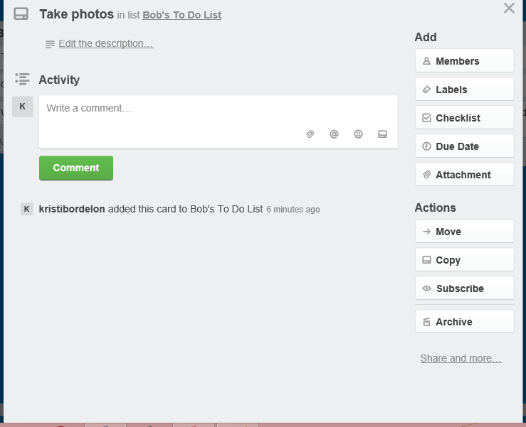

Slide 24
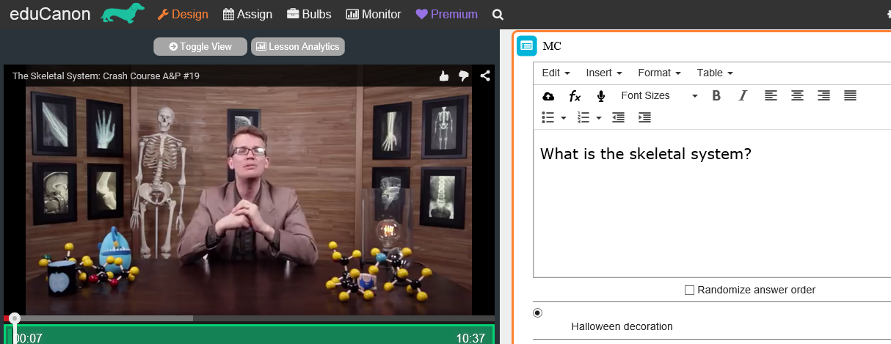
  eduCanon http://www.educanon.com/
Notes:
Educanon - Create a video, add questions, flipped classroom or have students create lectures / quizzes

Slide 25
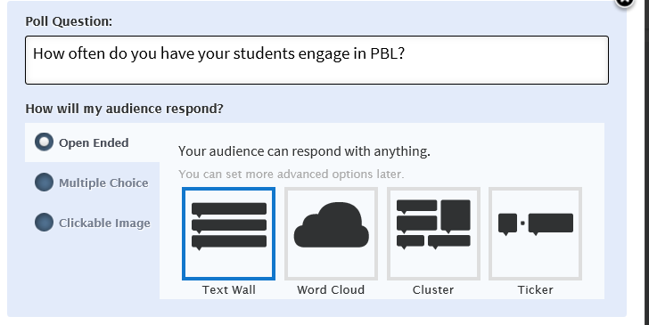
Poll Everywhere http://www.polleverywhere.com/

Slide 26
Poll Everywhere http://www.polleverywhere.com/

Slide 27
Familiar Sites, Different Uses
Social networking sites such as Pinterest and Learnist can be used to share student created products with the outside world.
For long term projects, student groups can create podcasts to share new knowledge and update classmates and others on their progress. To demonstrate the understanding of the various components of the projects, students can use Rubistar, iRubric, or the Rubric Machine

Slide 28
Why Problem and Project Based Learning?
Problem and project based learning brings content to life and demonstrates the relevance to the real world. Integrating technology tools into the process increases the relevance and prepares the students to use the new knowledge in a professional setting

Slide 29

Why Problem and Project Based Learning?

Slide 30
Thank you!
Kristi@dr-bordelon.com http://www.dr-bordelon.com/research.html

