Slide 1
MAGIC
Progress Report
October 24, 2019

Slide 2
Activities
Tall buildings
  Wake effects
  Roof detail
Field studies
  Cambridge
  London
Ventilation modelling
New team member
Puff ventilation
Planning advice

Slide 3
Activities
Tall buildings
  Wake effects
  Roof detail
Field studies
  Cambridge
  London
Ventilation modelling
New team member
Puff ventilation
Planning advice

Slide 4
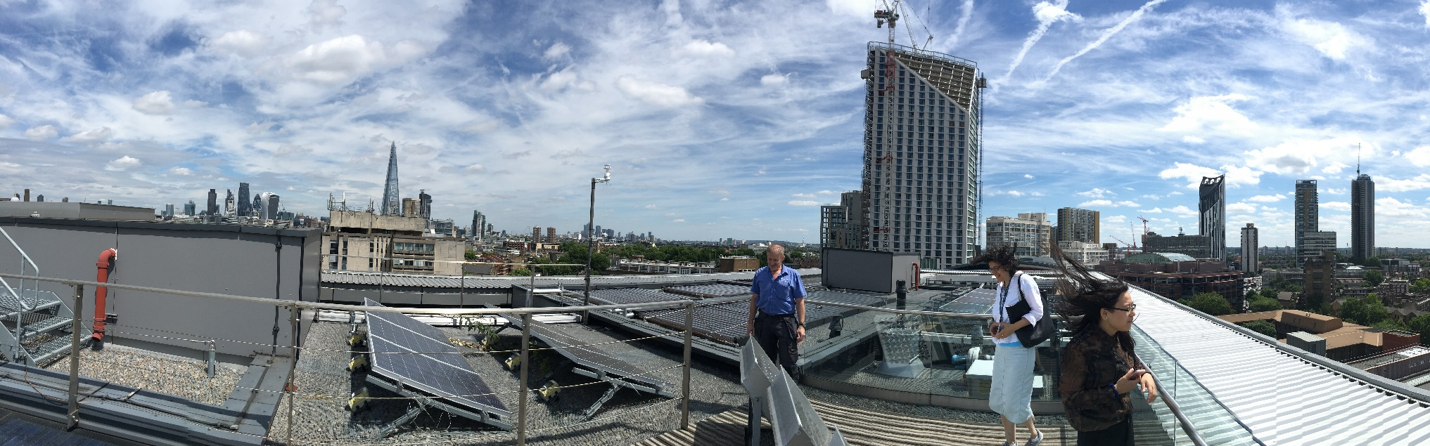
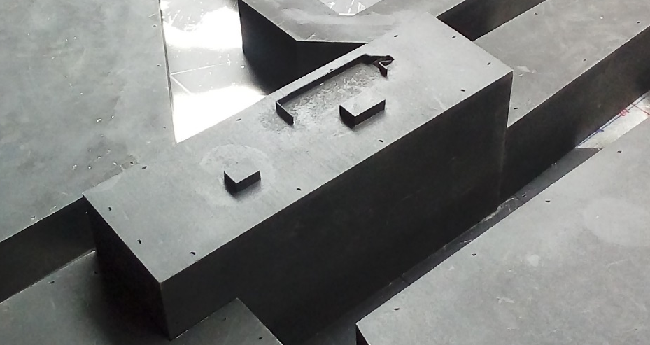
Tall buildings
Tall building to SE
2.8 m

Slide 5
Detailed roof vs flat roof model
Cross-stream mean at 3 heights
Wind from SE (140° met)

Slide 6
Effect of upstream tall building on K2 mean velocities
0.35
0.7

Slide 7
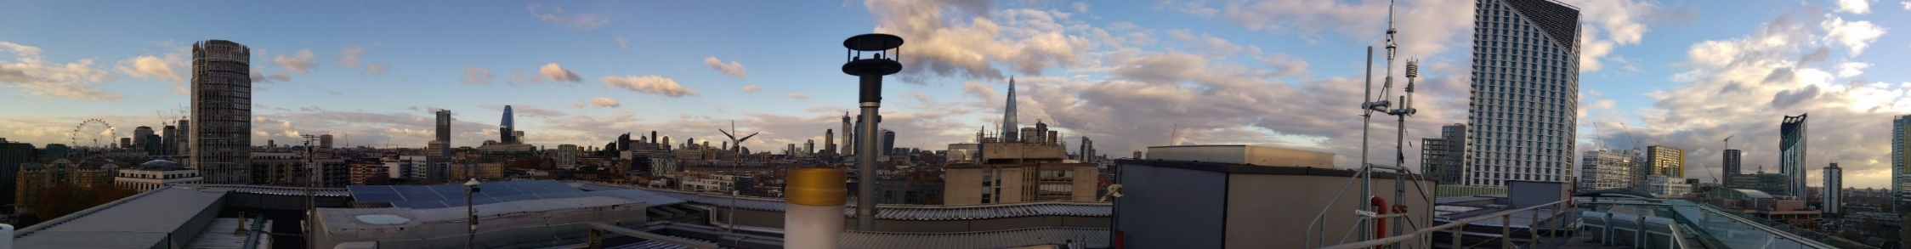
Lidar Update
Department of Meteorology
Natalie Theeuwes, Hannah Gough, and Janet Barlow

Slide 8
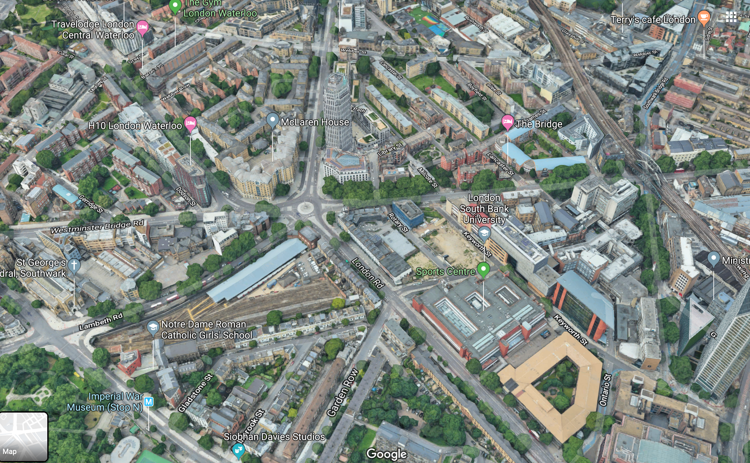
Halo Doppler Lidar
~ 27 m a.g.l.

Slide 9
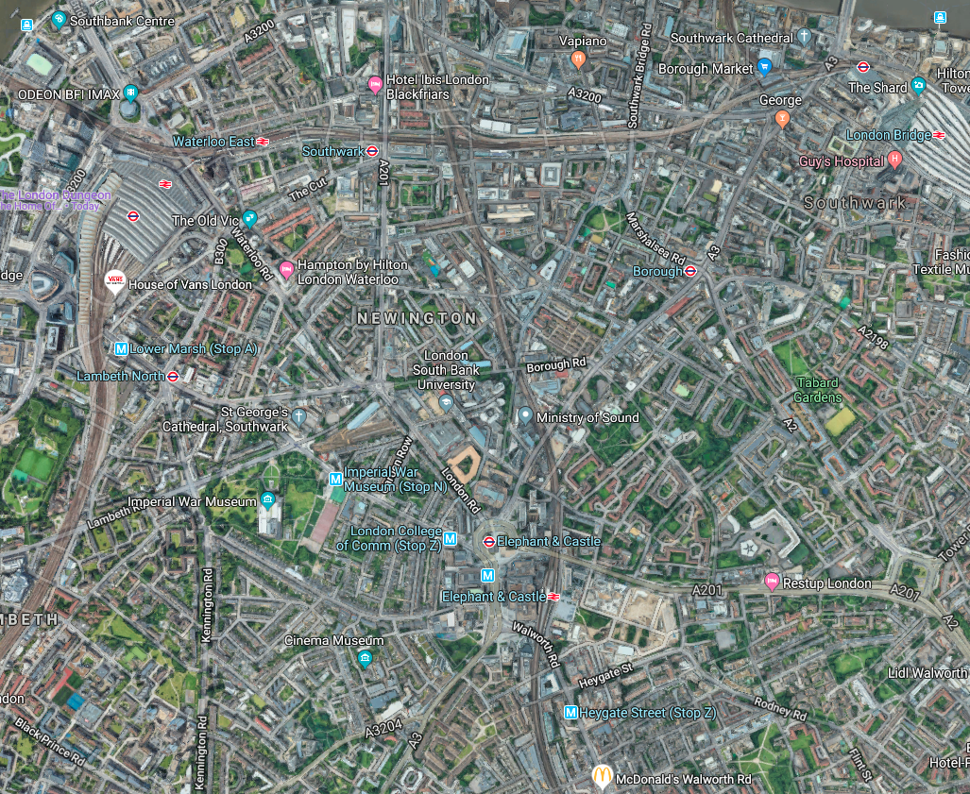

Can we see building wakes?

Slide 10
Can we see building wakes?
81 m

Slide 11
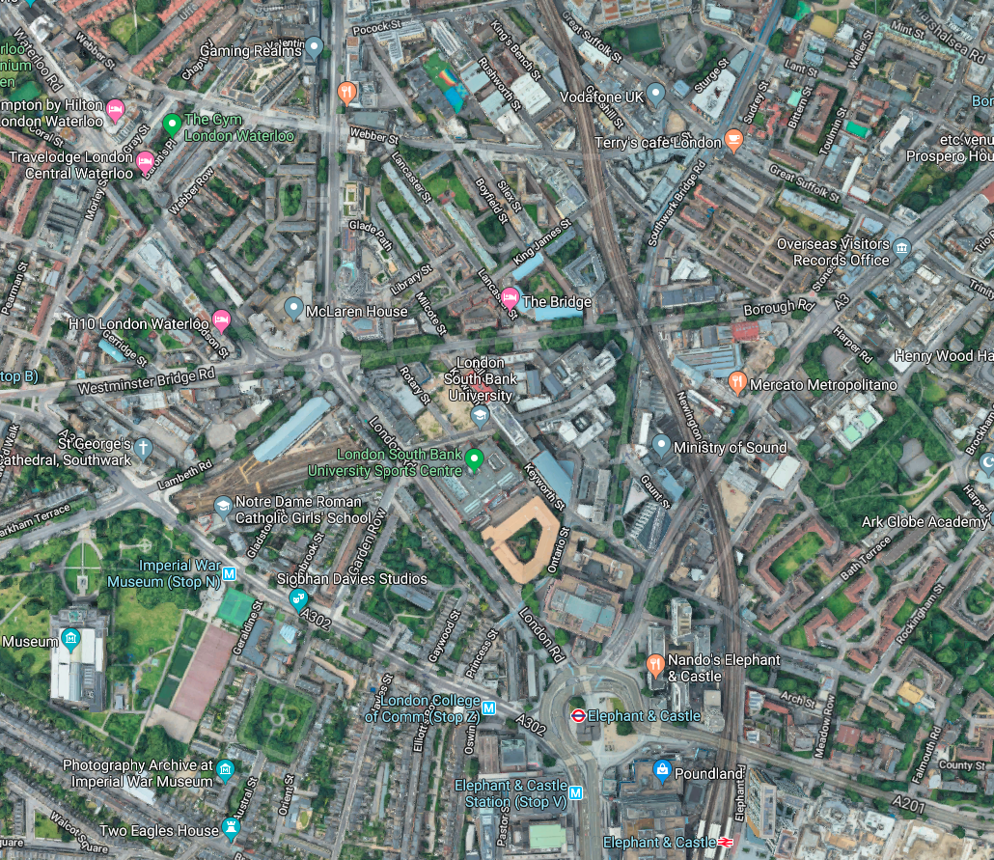
Wake 310-320°
~ 150 m

Slide 12
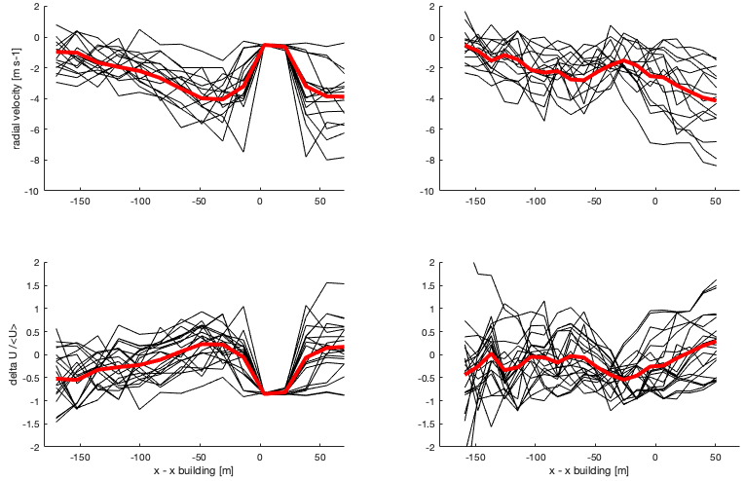
Cross-sections through the wake
Gate = 11 → 200 m from the lidar
Just downwind building T81
Gate = 7 → 126 m from the lidar
~70 m away from building T81
Black lines – individual scans
Red lines – mean of scans
Velocity deficit
Velocity deficit

Slide 13
Pollutant entrainment by tower wake
Wind tunnel result:
Low pollutant concentrations found in a vertical profile taken in tower wake
Fluidity simulation by L. Mottet:
Tower
Source

Slide 14
Street-level pollutant concentration in two model scales for wind from SW 220°
N.B. Interpolated contours for illustrative purposes only

Slide 15
Above-canopy pollutant concentration in two model scales for wind from SW 220°

Slide 16
Activities
Tall buildings
  Wake effects
  Roof detail
Field studies
  Cambridge
  London
Ventilation modelling
New team member
Puff ventilation
Planning advice

Slide 17
Cambridge field study
June - September

Slide 18
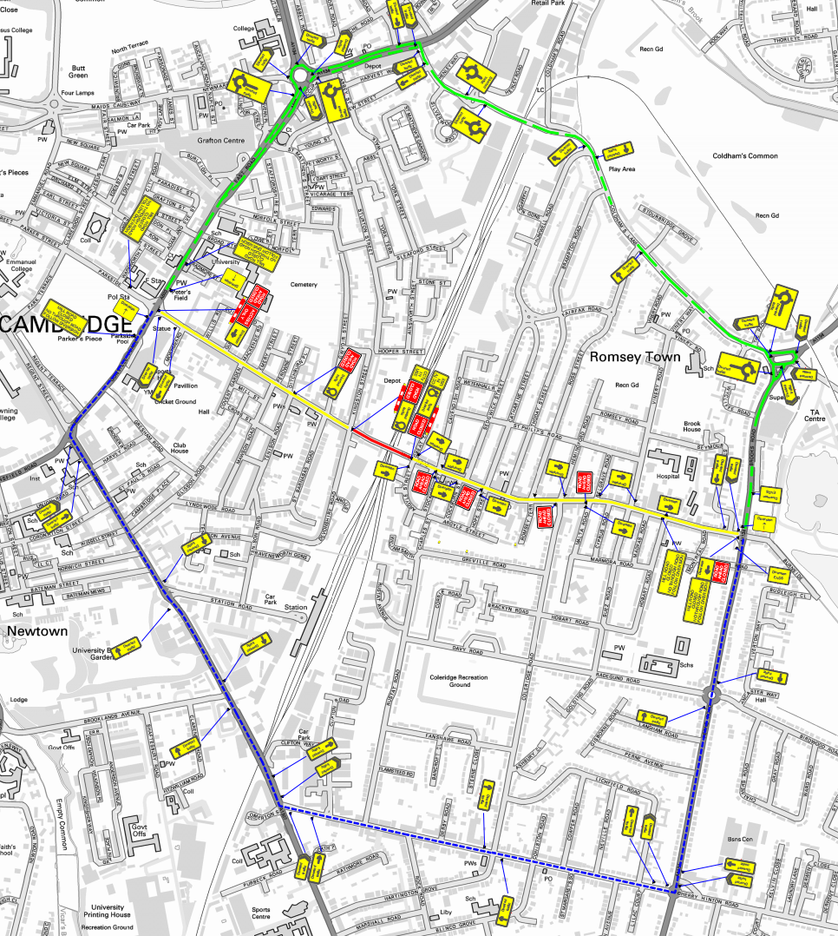
Road closure

Slide 19
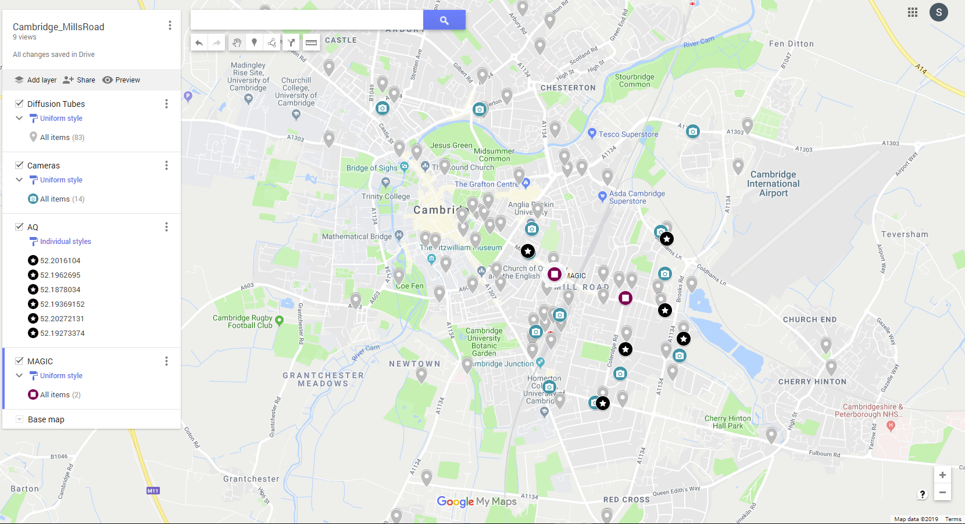
Installed MAGIC Monitors
1 St. Barnabas Church indoor AND outdoor monitors
- deployed on 28 Jun 2019
- retrieve on 27 Sep 2019 (planned)
3. Romsey Mill indoor AND outdoor monitors
- deployed on 24 Jun 2019
- retrieve on 27 Sep 2019 (planned)
Cambridge Mill Road Study
(Cambridge Councils)
(Cambridge Councils)
(Cambridge Councils)
1
Traffic is expected to reduce
3
Bridge
2
4
Traffic is expected to increase as an alternative route city centre

Slide 20
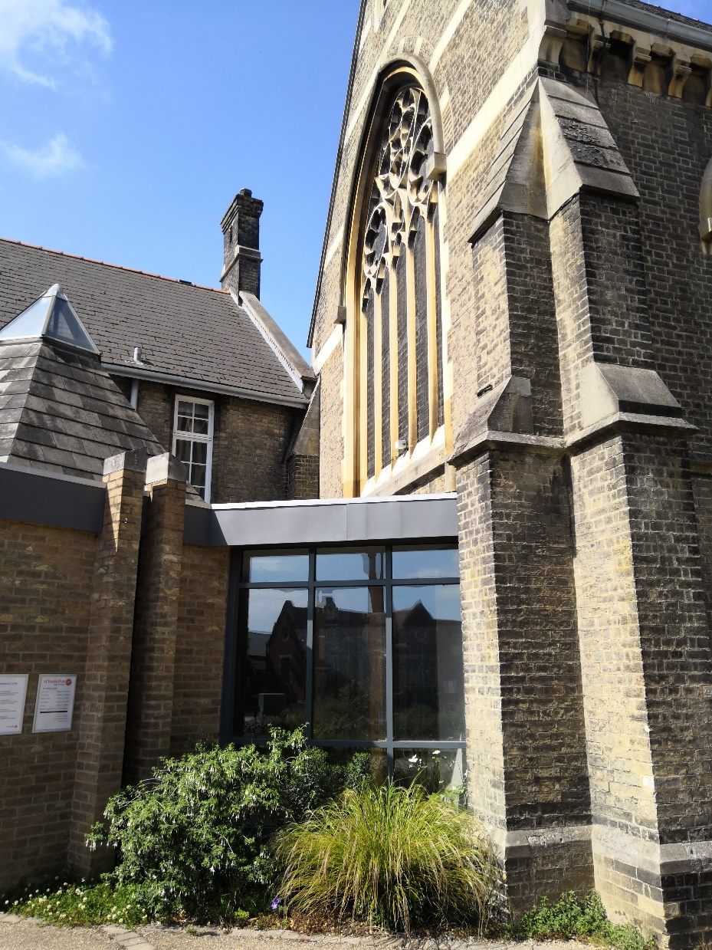
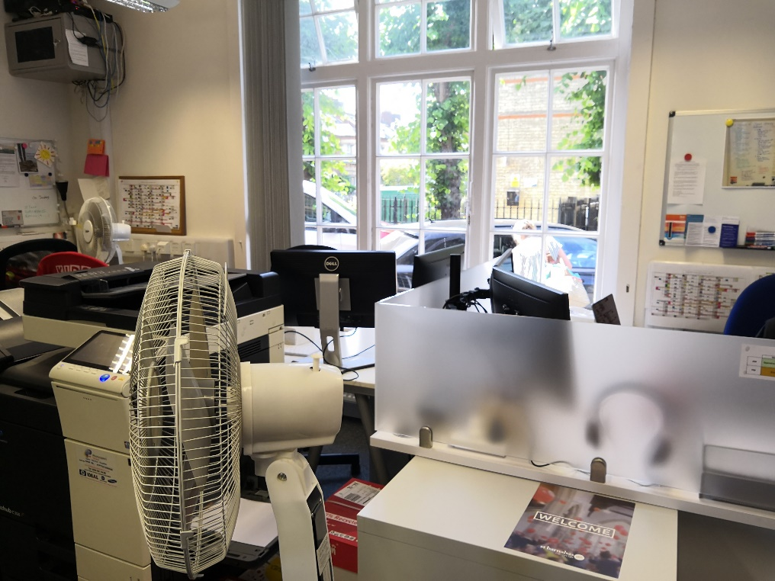
Outdoor
St. Barnabas Church
Indoor: office with windows facing to courtyard (open quite often)
Outdoor: on the exterior church wall close to Mill road
MAGIC monitor
Indoor
MAGIC monitor

Slide 21
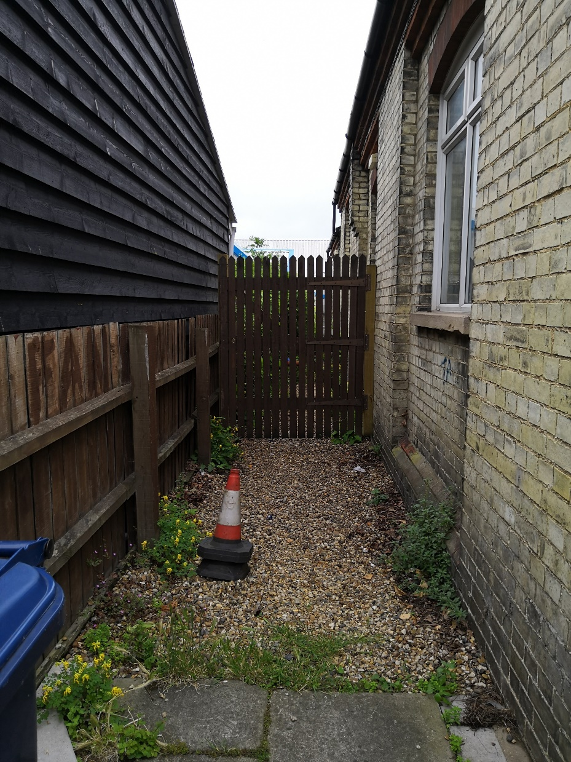
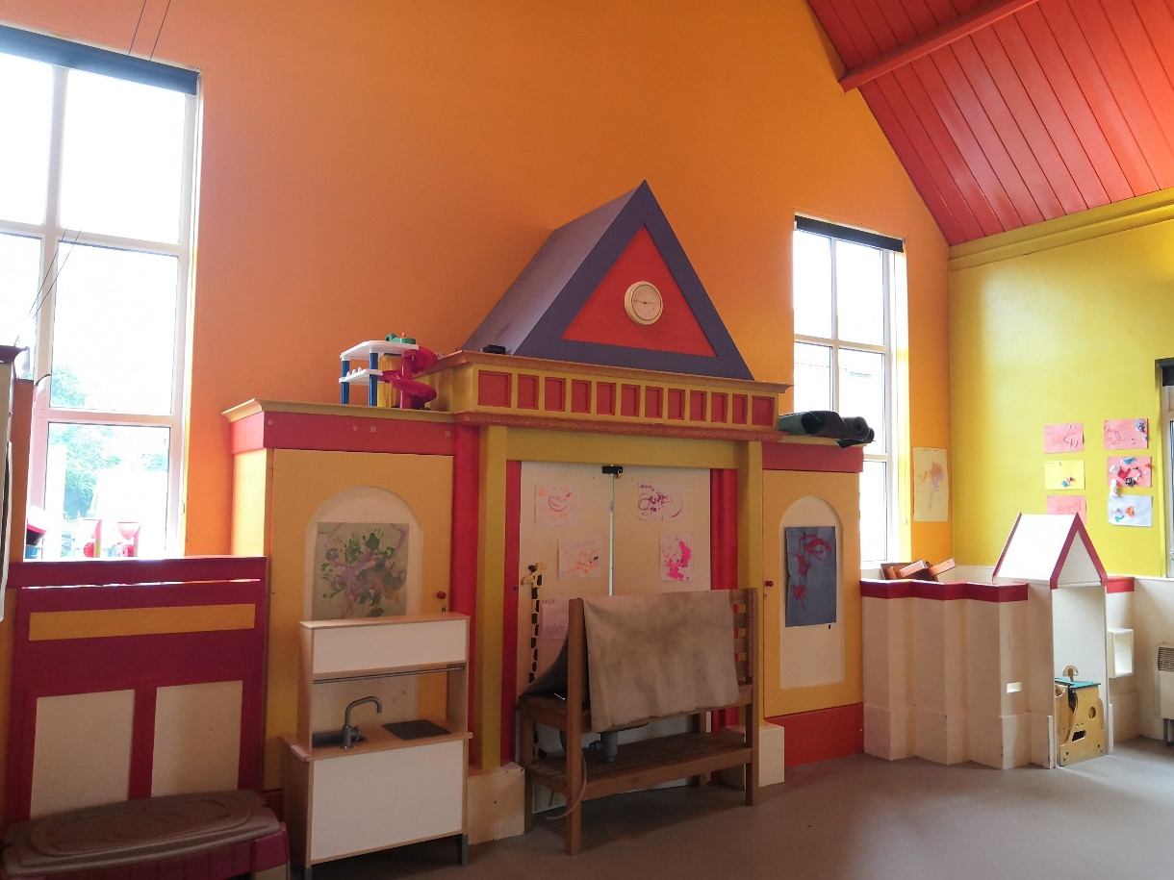
Outdoor
Romsey Mill
Indoor: Pre-school room – door open every morning
Outdoor: gate next to the road
MAGIC monitor
MAGIC monitor
Indoor

Slide 22
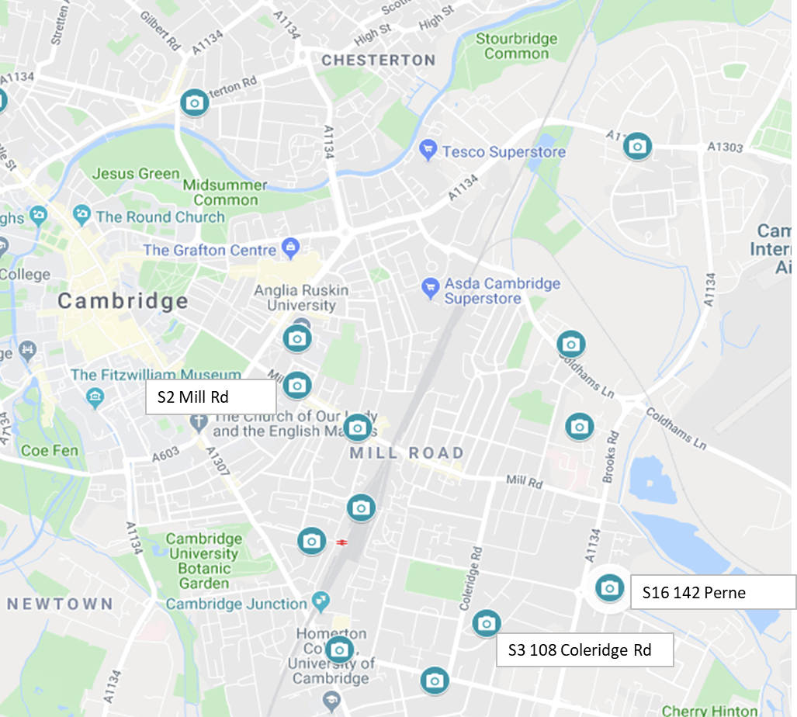
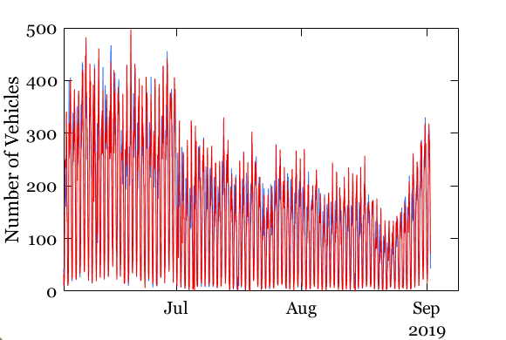
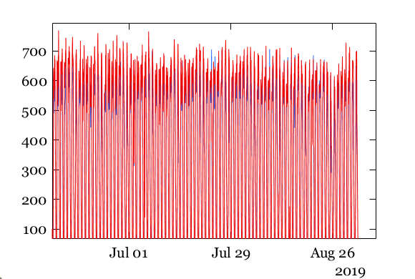
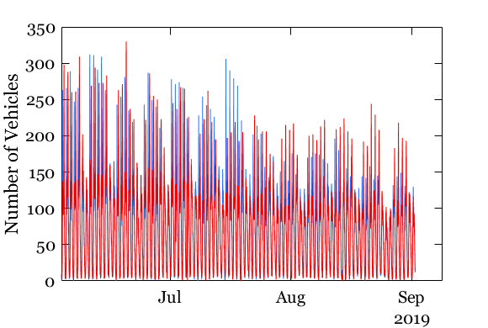
Traffic Counts
Mill Road
Perne Road
Coleridge Road

Slide 23
London field study
September 16-27

Slide 24
Wind speed & direction during campaign
0° VAD
75° VAD
75° VAD

Slide 25
Wind rose
16- 27 Sept.
400 m
120 m
27 m
Campaign
‘Normal’

Slide 26
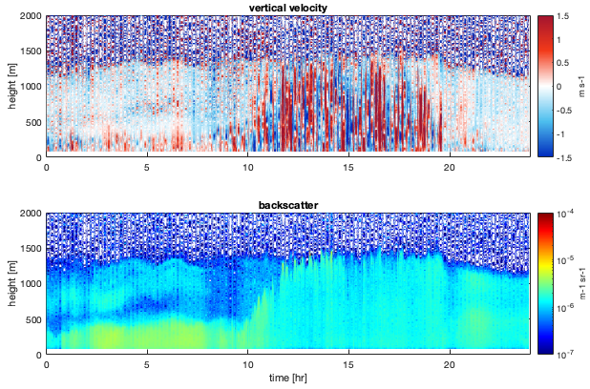
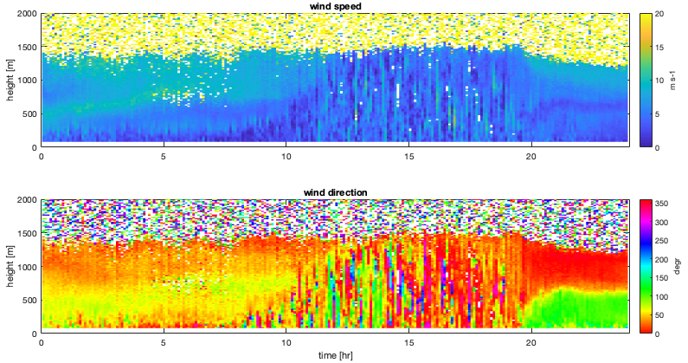
Examples of the campaign days
Convective boundary layer
Wednesday, September 18, 2019

Slide 27
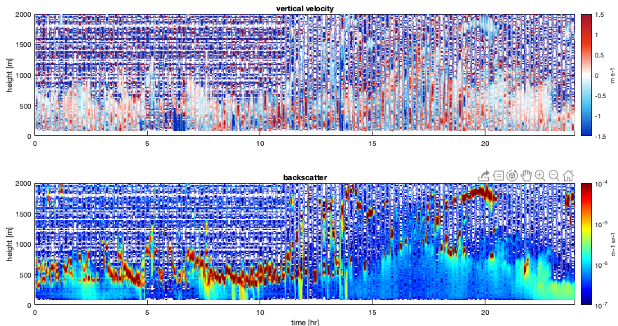
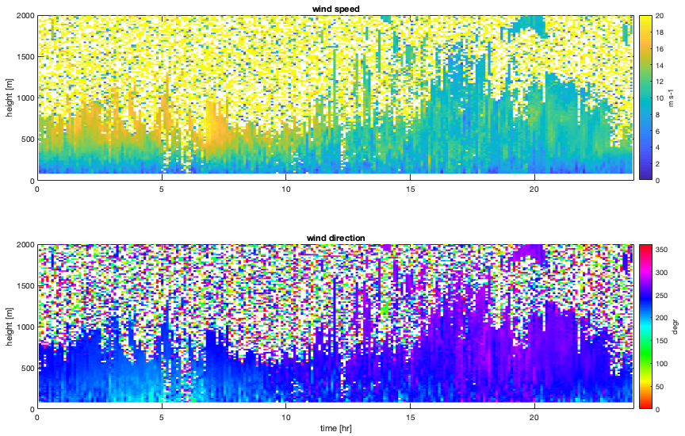
Examples of the campaign days
Rainy/cloudy day
Wednesday, September 25, 2019

Slide 28
Activities
Tall buildings
  Wake effects
  Roof detail
Field studies
  Cambridge
  London
Ventilation modelling
New team member
Puff ventilation
Planning advice

Slide 29
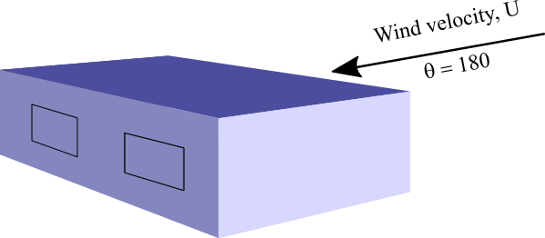
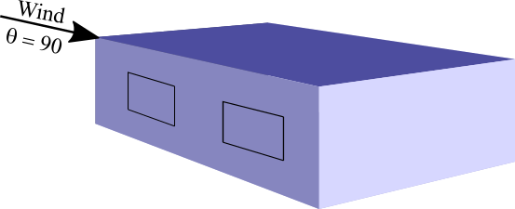
Single-sided ventilation
Vortex shedding
Shear driven

Slide 30
Activities
Tall buildings
  Wake effects
  Roof detail
Field studies
  Cambridge
  London
Ventilation modelling
New team member
Puff ventilation
Planning advice

Slide 31

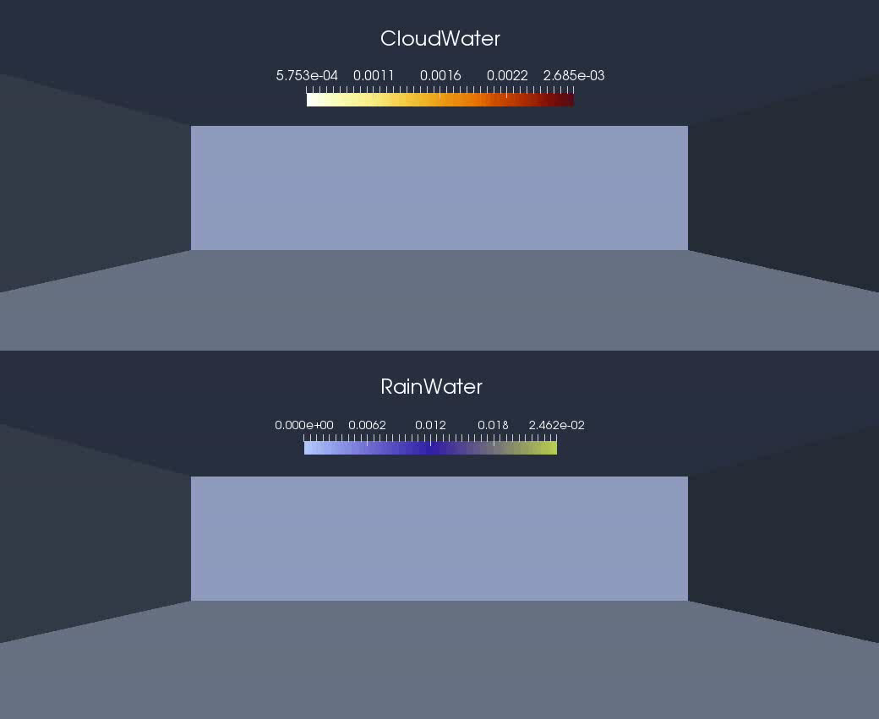
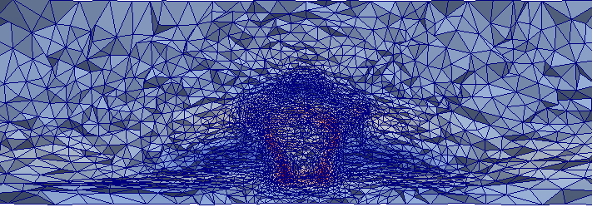
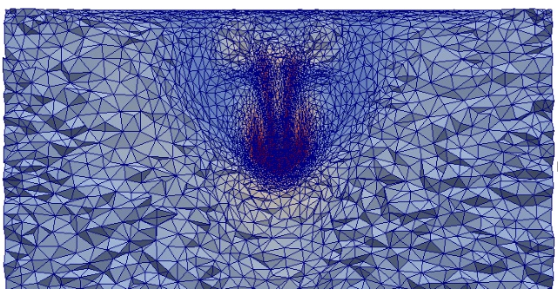
Dr Jinxi Li. PKU
Supercell Formulation
(b) Adaptive Mesh at y-cross-section
(c) Adaptive Mesh at z-cross-section
(a) Formulation of Cloud Water and Rain Water

Slide 32
Activities
Tall buildings
  Wake effects
  Roof detail
Field studies
  Cambridge
  London
Ventilation modelling
New team member
Puff ventilation
Planning advice

Slide 33
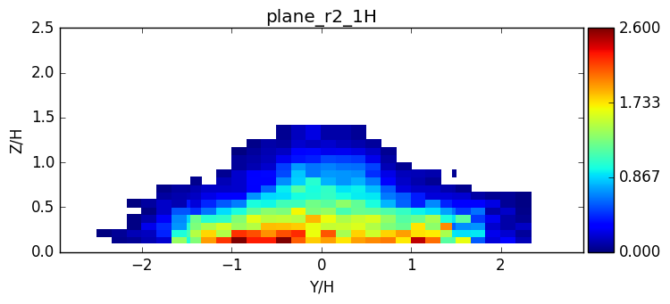
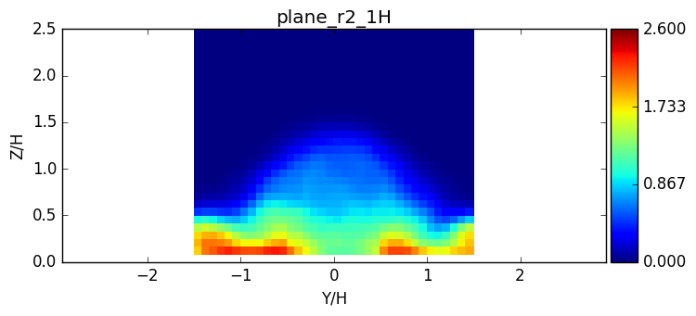
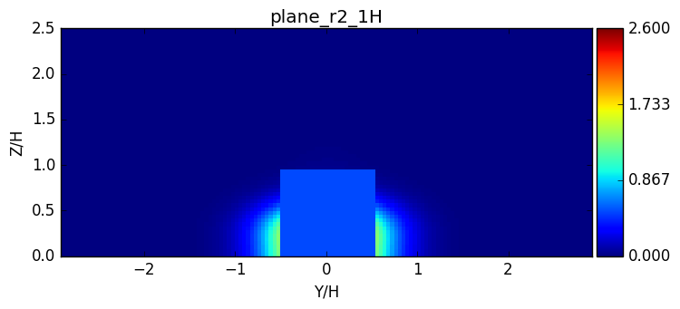

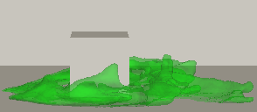
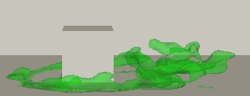
Modelling of short range dispersion of puffs
Using Fluidity and wind tunnel experiments to model the dispersion of short puff releases.
Comparisons made with ADMS in order to review the strengths and limitations of Gaussian plume models for use at short time and length scales.
Evaluating Fluidity’s ability to capture peak concentrations from puff releases.
Wind tunnel
Fluidity
ADMS
Puff release

Slide 34
Conclusions
Tall buildings
  Significant wake effects observed
  Roof detail unimportant
Field studies
  Cambridge: road closure effects
  London: TfL traffic signals to be analysed
Ventilation and Fluidity modelling continuing
Puff ventilation: see later presentation
Planning advice developing

Slide 35
Planning guidance

Slide 36
Scenarios
Residential
  Currently recommend that windows remain shut: inform architects and planners
    Location of ventilation intakes?
    Seasonal/daily opening
    Conflict Noise / Air Quality / Overheating
    Natural v mechanical ventilation
    Single v dual aspect housing
Mixed use: offices, bars, restaurants
    CHP
    Location of exhausts in relation to surrounding buildings
    Heat removal means flue gases no longer buoyant
  Odour
    Complaints from an existing restaurant from occupants of a new building

Slide 37
Current modelling constraints
Current CFD cannot address
  High level releases
  Hourly exceedances
  Vertical variations in pollution concentration
  Low wind speeds
  Exposure in high-emission areas
  Exposure at junctions, bus stops etc.
  Hourly variation of emissions

Slide 38
Rules of thumb
Pollution levels decrease with height?
Always place ventilation inputs on the roof?
Trees reduce street level pollution? May hinder dispersion due to canopy cover
How many buildings make a street canyon?
When can we open windows?
Response to rush hour?
Tall buildings cause more vertical mixing? Sphere of influence of a tall building?

Slide 39
Questions
What is the most useful form of advice?
How do you see MAGIC producing it?

