Slide 1
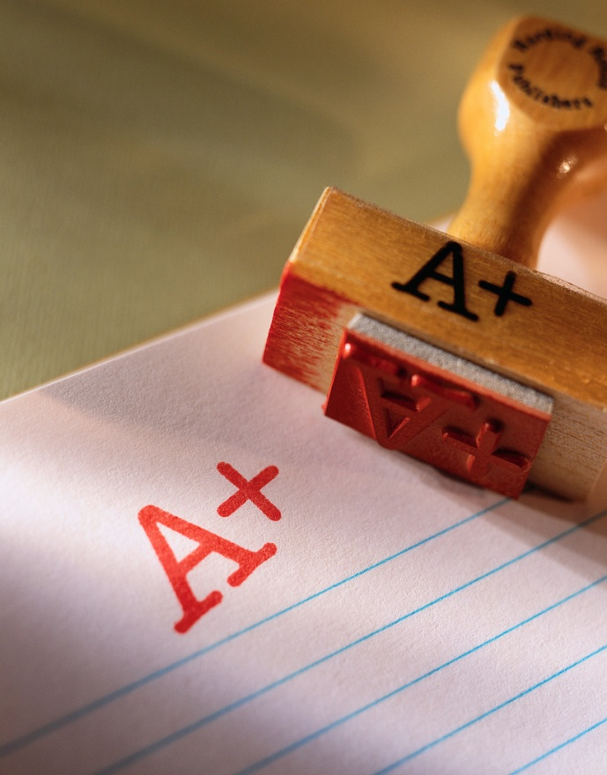
VOCABULARY QUIZ
*Get out a piece of paper
*Label it “Ch3 Vocabulary Quiz”
*Make sure your name is on it
*Number 1 to 10
*You may use your notes on the quiz

Slide 2
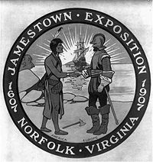
First permanent English settlement

Slide 3
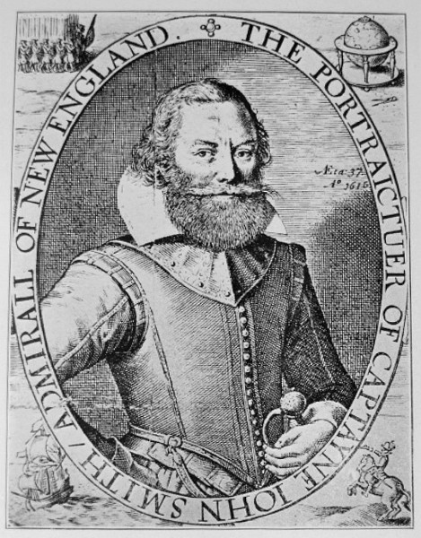
2) Soldier and adventurer that saved Jamestown

Slide 4
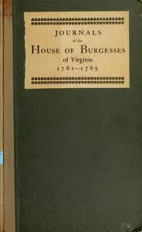
3) First representative assembly in the colonies

Slide 5
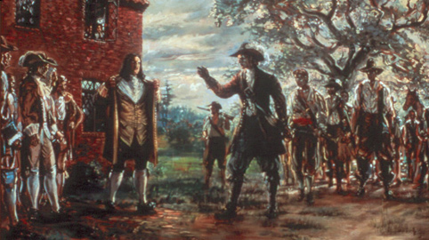
4) Nathaniel Bacon’s attempt to take over Jamestown

Slide 6
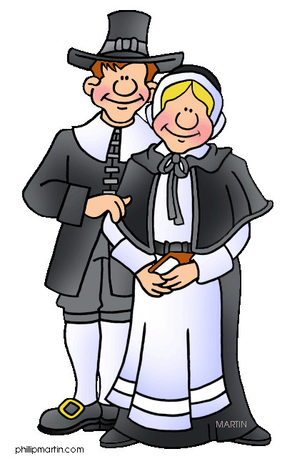
5) Separatist group that went to the New World for religious freedom (Not Puritans or Quakers)

Slide 7
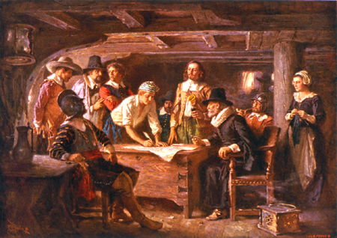
6) Self government agreement signed by men on the Mayflower

Slide 8
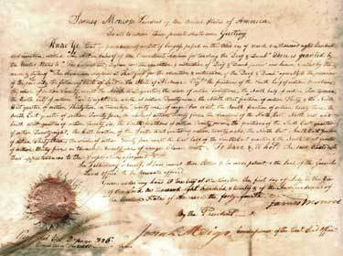
7) First written Constitution written in the Americas

Slide 9
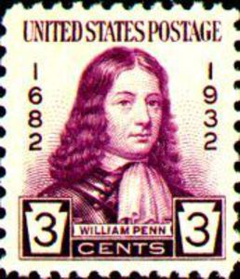
8) A Quaker leader who started Pennsylvania

Slide 10
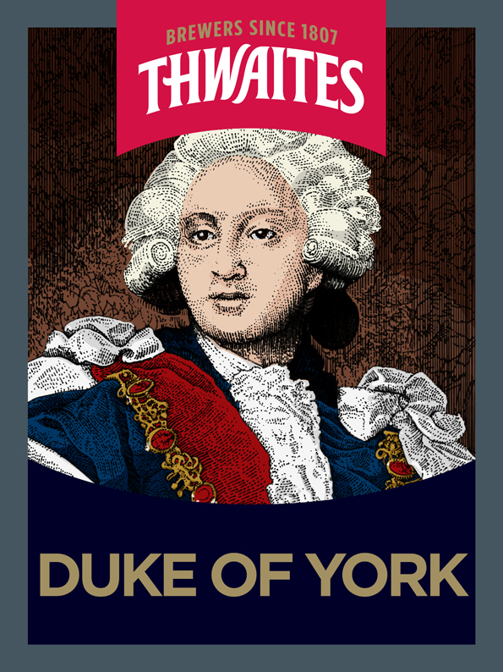
9) The proprietor of New York and brother of King Charles II

Slide 11
10) What year was Jamestown established

Slide 12
First permanent English settlement
Soldier and adventurer that saved Jamestown
First representative assembly in the colonies
Nathaniel Bacon’s attempt to take over Jamestown
Separatist group that went to the New World for religious freedom (Not Puritans)
Self government agreement signed by men on the Mayflower
First written Constitution written in the Americas
A Quaker leader who started Pennsylvania
The proprietor of New York and brother of King Charles II
What year was Jamestown established

