Slide 1
Civil Liberties
The bill of rights guarantees civil rights and individual liberties to American citizens and residents.

Slide 2
Section 1: Protecting Constitutional Rights
The United States was formed out of a belief that individuals had certain important liberties and rights. The Constitution’s bill of rights protects these liberties and rights.

Slide 4
I. The Bill of Rights
After Independence
States had bills of rights but federal constitution did not.
The ratification process
Americans did not trust any gov’t, even their own
The ten amendments
Civil liberties: Basic freedoms to think and to act that all people have and that are protected against gov’t abuse.
Civil rights: rights of fair and equal status and treatment and the right to participate in gov’t.

Slide 5
II. Limits on Civil liberties & rights
Conflicting Rights
Limit on liberties if harming others (smoking in public)
Free speech? Limit speech that aids the enemy during war
Role of the Courts
Interest groups: NAACP, ACLU, MALDEF file lawsuits against laws that limit liberties
Courts not involved in liberties until the early 1900s

Slide 6
III. Civil liberties & the 14th amendment
Due Process Clause: Following established & complete legal procedures
14th amendment to protect rights of former slaves
Bill of rights applies to the states
Selective Incorporation: Courts merged bill of rights & 14th amendment
Key Cases
CBQ Railroad v. Chicago: State compensate for taking property.
Gitlow v. New York: States must respect free speech (Gitlow not allowed to plot to overthrow the gov’t.)
3 & 7 amendments not incorporated.

Slide 7
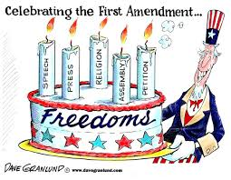
Section 2: First Amendment Freedoms
The first amendment protects five fundamental freedoms that are central to the American notion of liberty: the freedoms of religion, speech, the press, assembly, and petition.

Slide 9
I. Religious Freedom
Establishment Clause: Gov’t. can’t create an official religion or support one over another.
Public Displays: Acknowledgement of a religion doesn’t mean support.
Religion vs. education: Money can be used on private schools if open to all private schools and not dealing with religious aspects.
Free Exercise Clause: Guarantees the right to hold any religious belief.

Slide 10
ii. Freedom speech & of the press
Why free speech & press: Allows openness in making decisions.
Limits on freedoms
Slander: Spoken defamation
Libel: Written Defamation
Treason: Making war against the U.s.
Sedition: Speech or actions leading to revolt against u.s.
Prior restraint: Gov’t. seeks to prevent news from being published.
Symbolic speech: Communication of ideas through symbols and actions.

Slide 11
III. Freedoms of Assembly & Petition
Limits on assembly & petition: Only stop assemblies if inciting violence.
Freedom of Association: Right to join with others, share ideas, and work toward a common purpose.

Slide 12
1. Thomas Jefferson argued that the free exercise clause of the Constitution built a “wall of separation between Church & State.”
2. Slander and symbolic speech are two forms of free speech that the Supreme Court has determined are not protected by the First Amendment.
3. The government uses the Second Amendment to determine whether laws violate the establishment clause.
4. In Near v. Minnesota (1931), the Supreme Court ruled that burning the American flag was a protected act of free speech.
5. The Supreme Court has determined that the freedoms guaranteed by the First Amendment together establish a right to privacy.

Slide 13
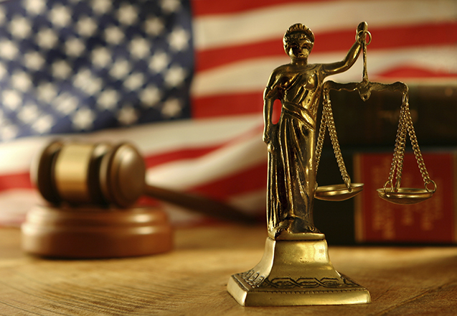
Section 3: Protecting Individual Liberties
A key purpose of the Bill of rights is to protect individuals from government abuses. Several amendments limit the government’s power and protect individual rights against government actions.

Slide 14
Do Now
Are you willing to give up some of your liberty to feel more secure? Explain your answer either way.

Slide 15
Learning Goals
Objectives
Essential question
Explain the purposes of and limits on the right to keep and bear arms.
Describe how the bill of rights guarantees the security of home and person.
Analyze how the right to privacy has developed.
Describe how and why the constitution guarantees due process of the law.
How does the 4th amendment imply a right to privacy?

Slide 17
I. Bear arms & privacy
2nd Amendment: The right to bear arms
Some restrictions on weapons used generally by criminals.
State & local gov’ts can’t overly restrict guns either.
Right to Privacy
Not explicitly stated in the constitution
Implicit by 4th, 5th, 14th amendments.
Roe v. Wade: State can’t stop an abortion during 1st 3 months due to privacy of the woman.

Slide 18
ii. Security of home & person
3rd Amendment: Troops can’t order you to let them stay in your house.
Probable Cause: Strong likelihood that they would find evidence of a crime.
Search Warrant: Document that gives police legal authority to search private property.
Exclusionary Rule: Evidence obtained illegally may not be used against a person in court.

Slide 19
III. Due process of the law
Police Power: its ability to regulate behavior for the common good.
Procedural due process: Gov’t. follow certain procedures before punishing a person.
Substantive due process: Concerns whether the laws themselves are fair and just.

