Slide 1
Parish Path Warden Report
22nd May 2017

Slide 2
Maintenance Programme
Improvements and Projects
ST Resilience Project
2017-18 Plans

Slide 3
General/Maintenance Programme
Waymarking and stile stepovers
Tree Removals
Strimming/Brushcutting
WCC Working Parties – Royal Hunters Walks

Slide 4
Stile stepover – Bourne Castle

Slide 5
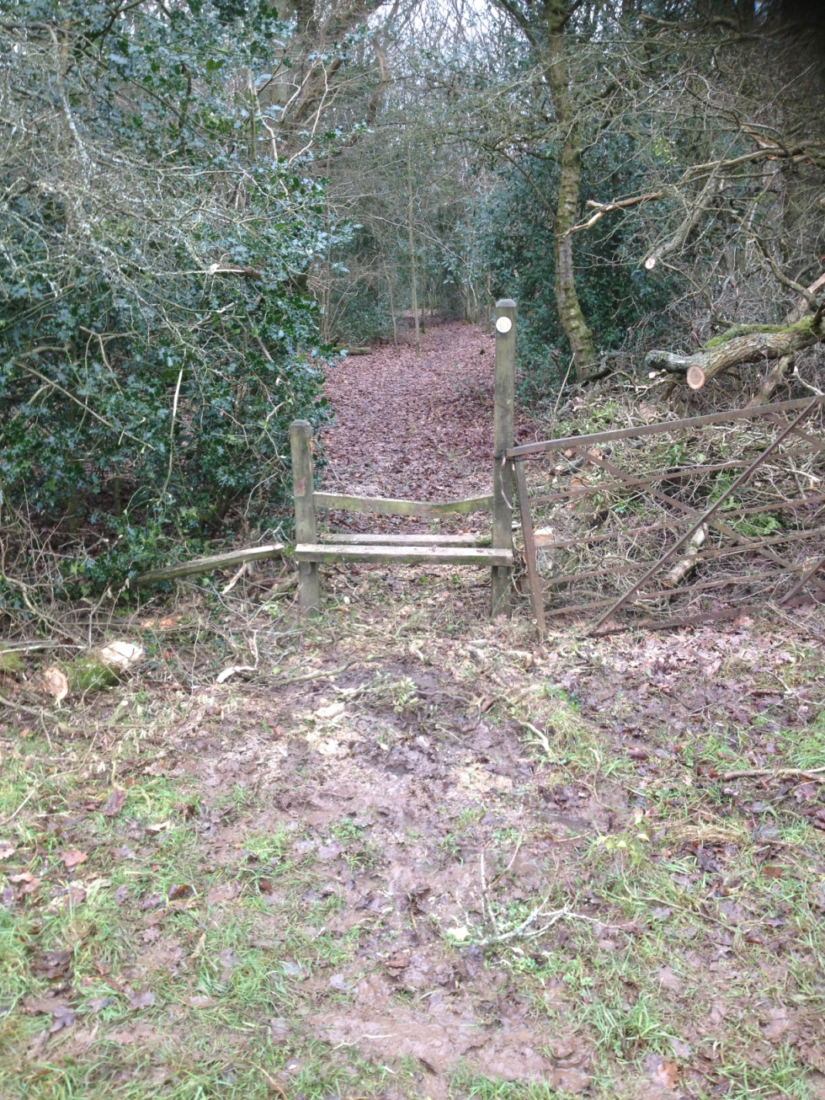
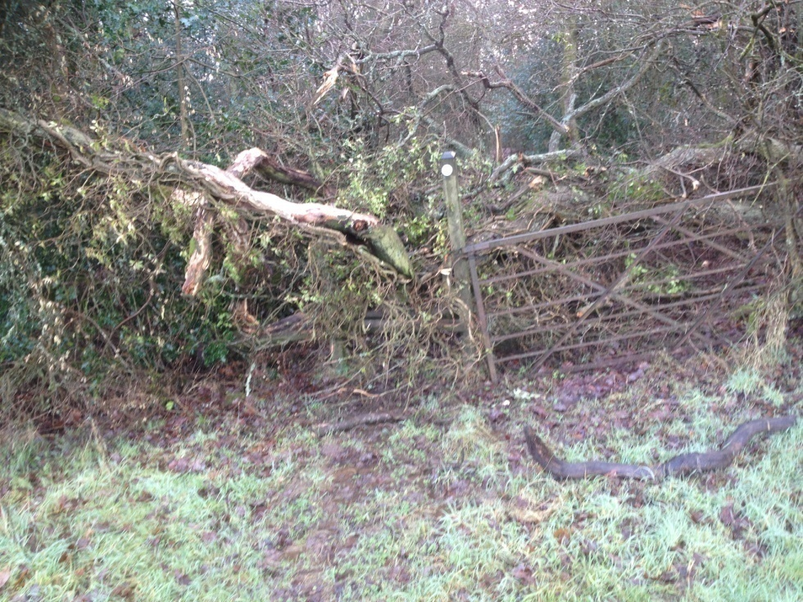
Tree down – Nutmells Wood

Slide 6
Moor Hall Farm - Emergency Path Closure

Slide 7
Improvements/Projects WCC Funded Contractors
New bridge and steps on path from Hurst Farm to Wood Lane
Widening and cutting back on Munches Lane
Repairs and improvements on bank of brook opposite Queens

Slide 8
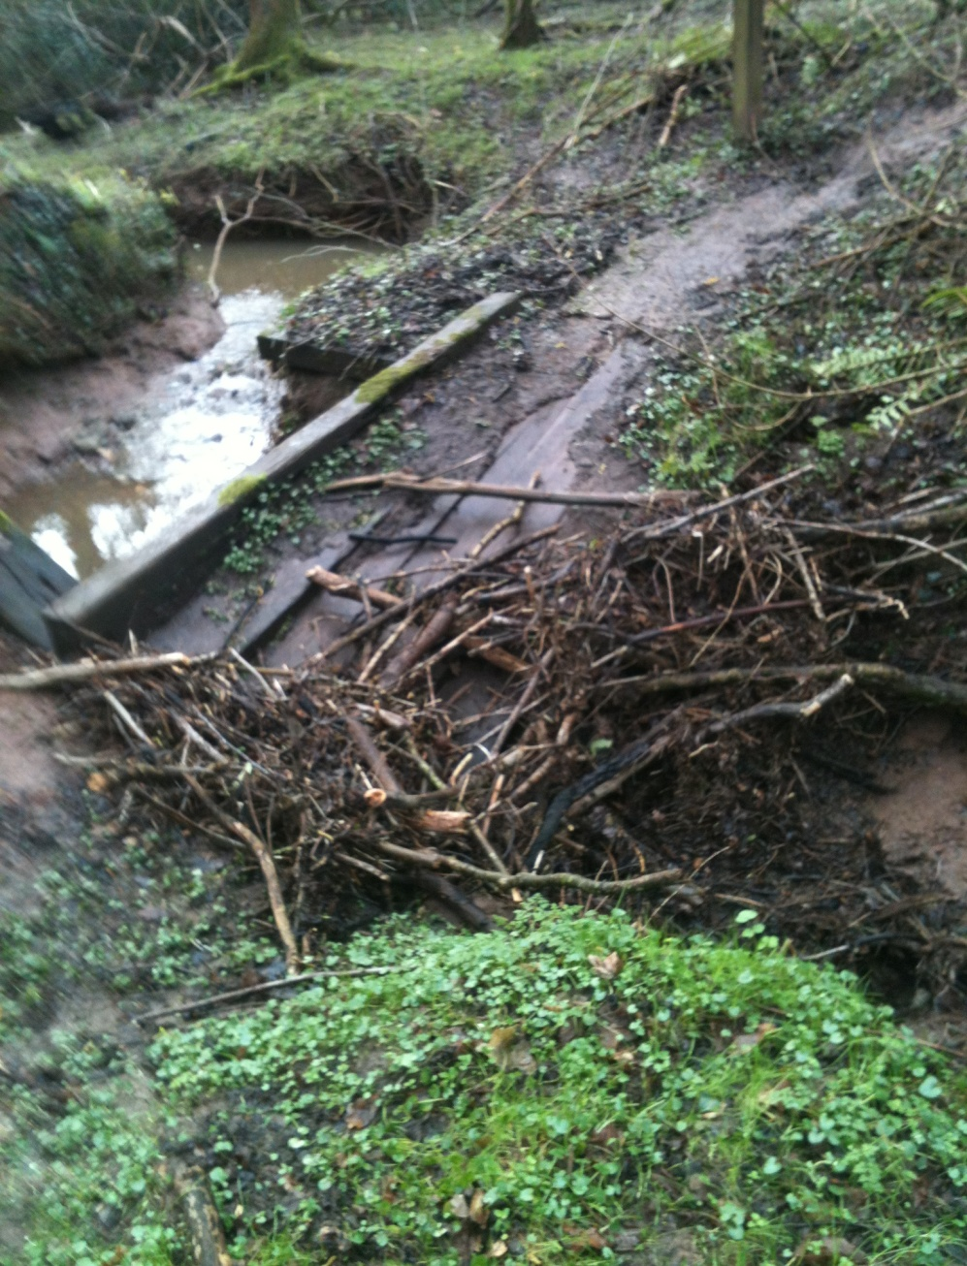
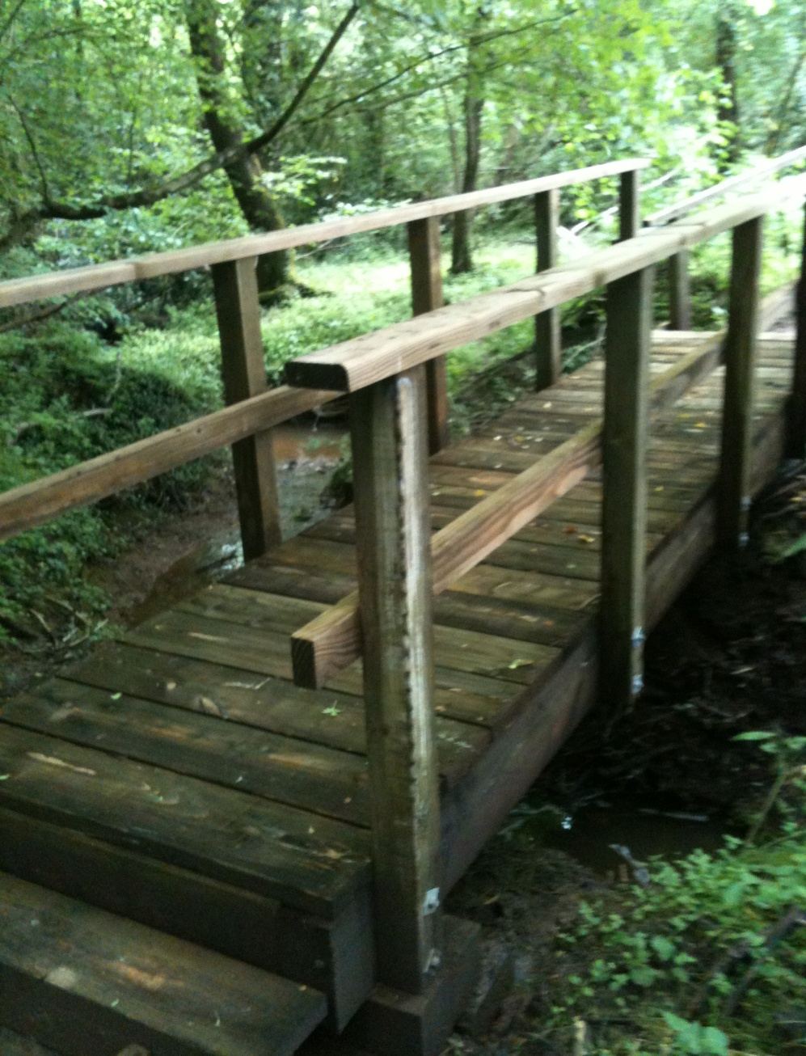
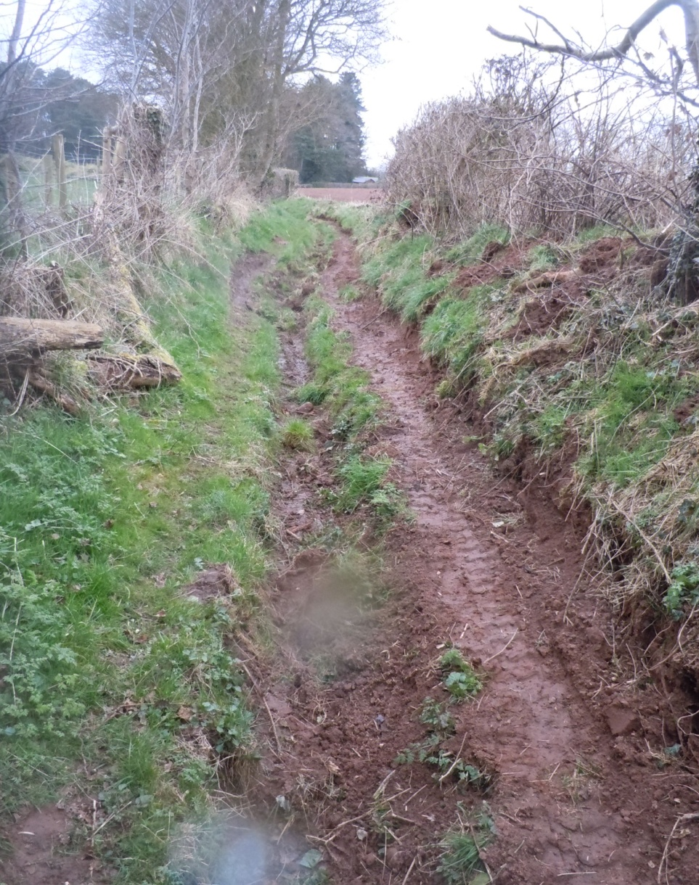
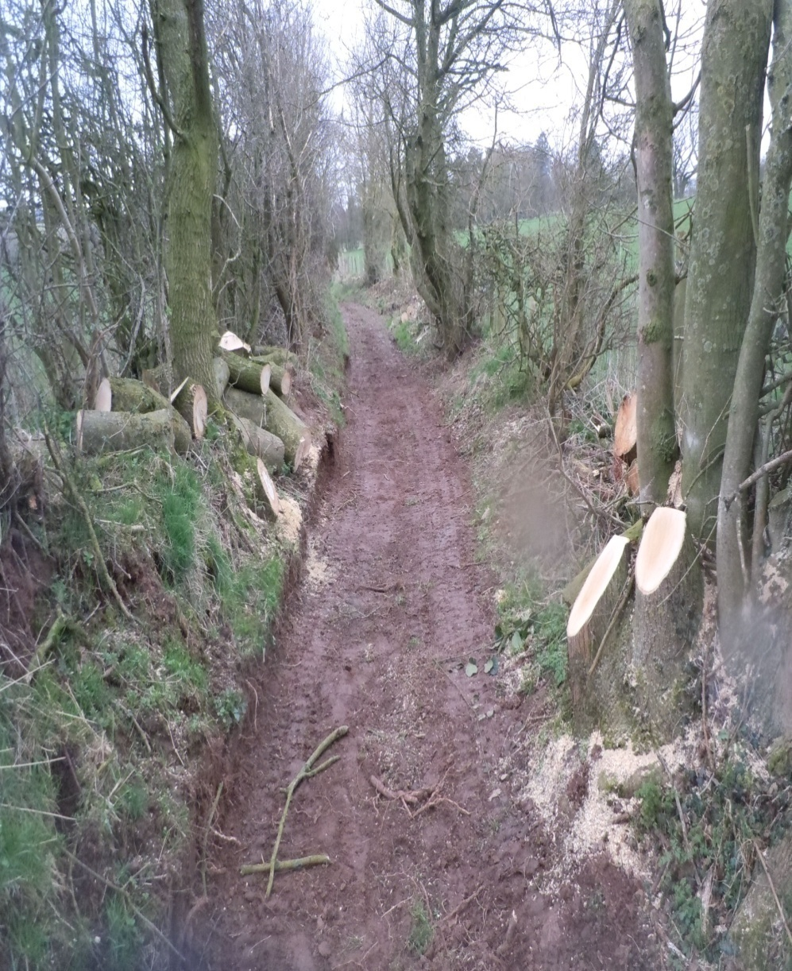
New Bridge

Slide 9
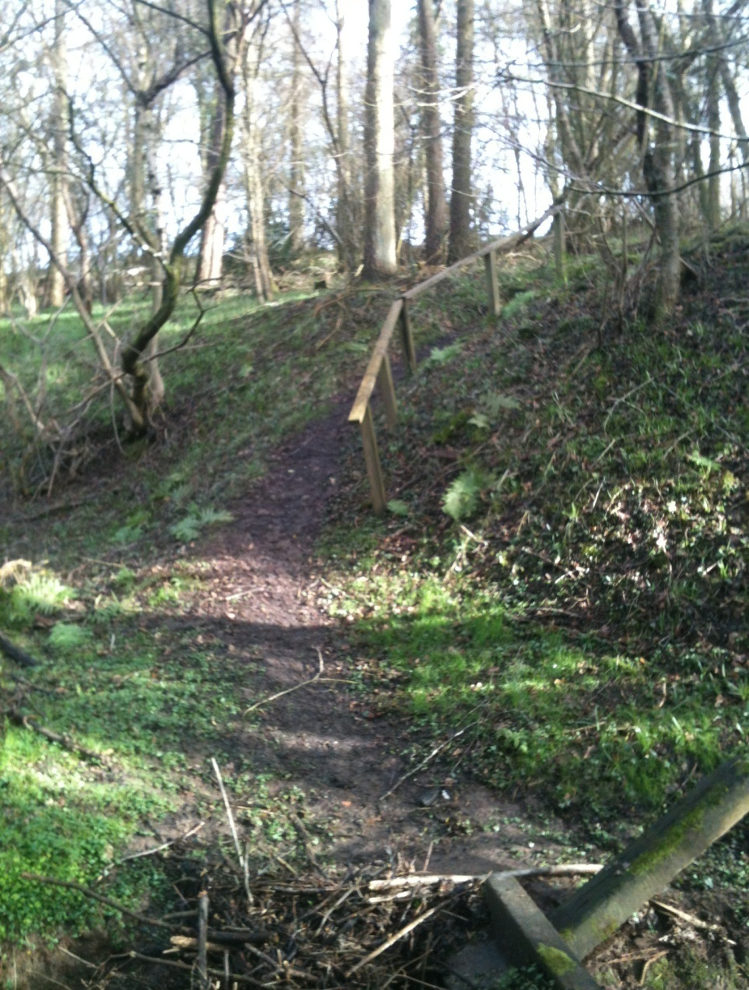
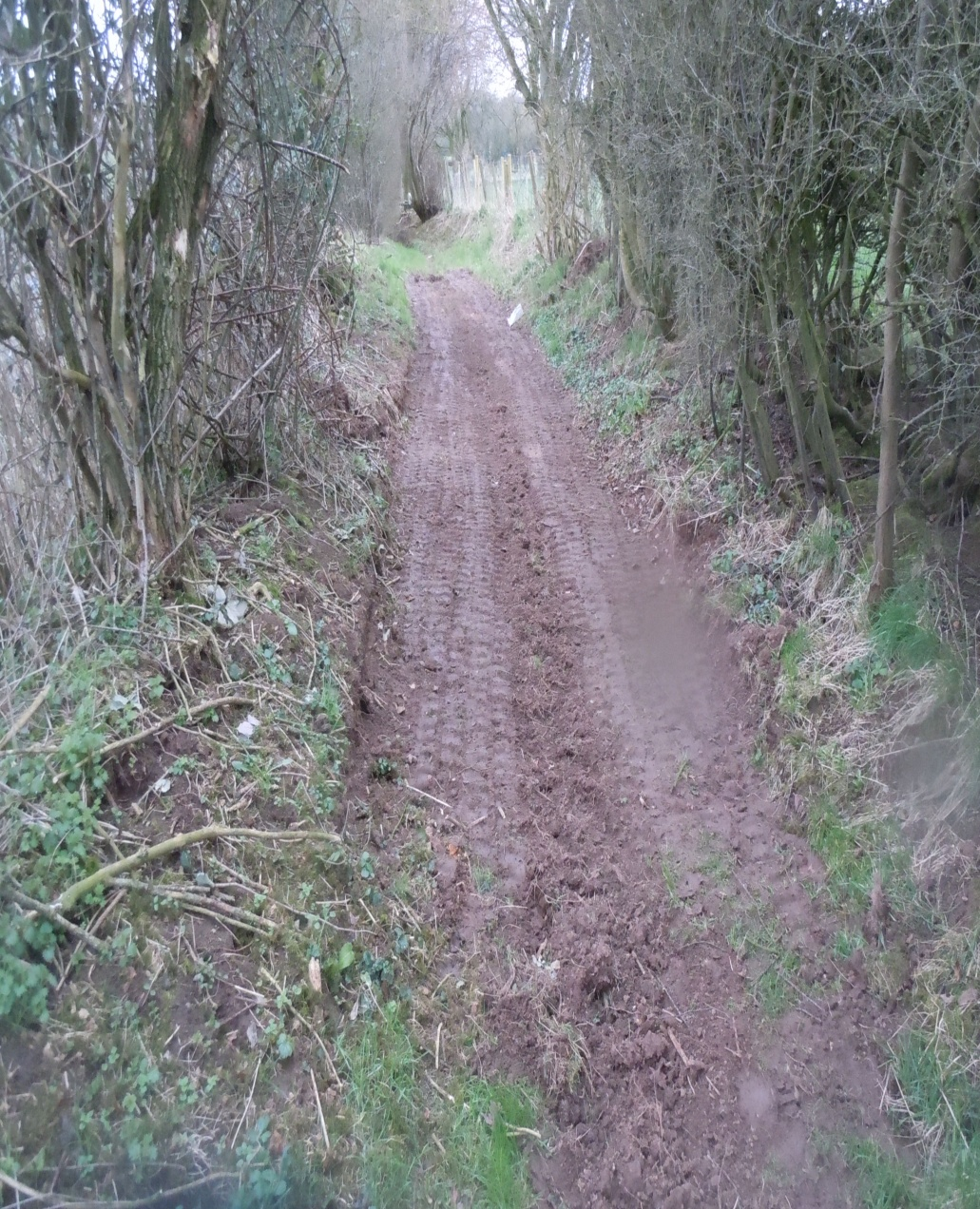
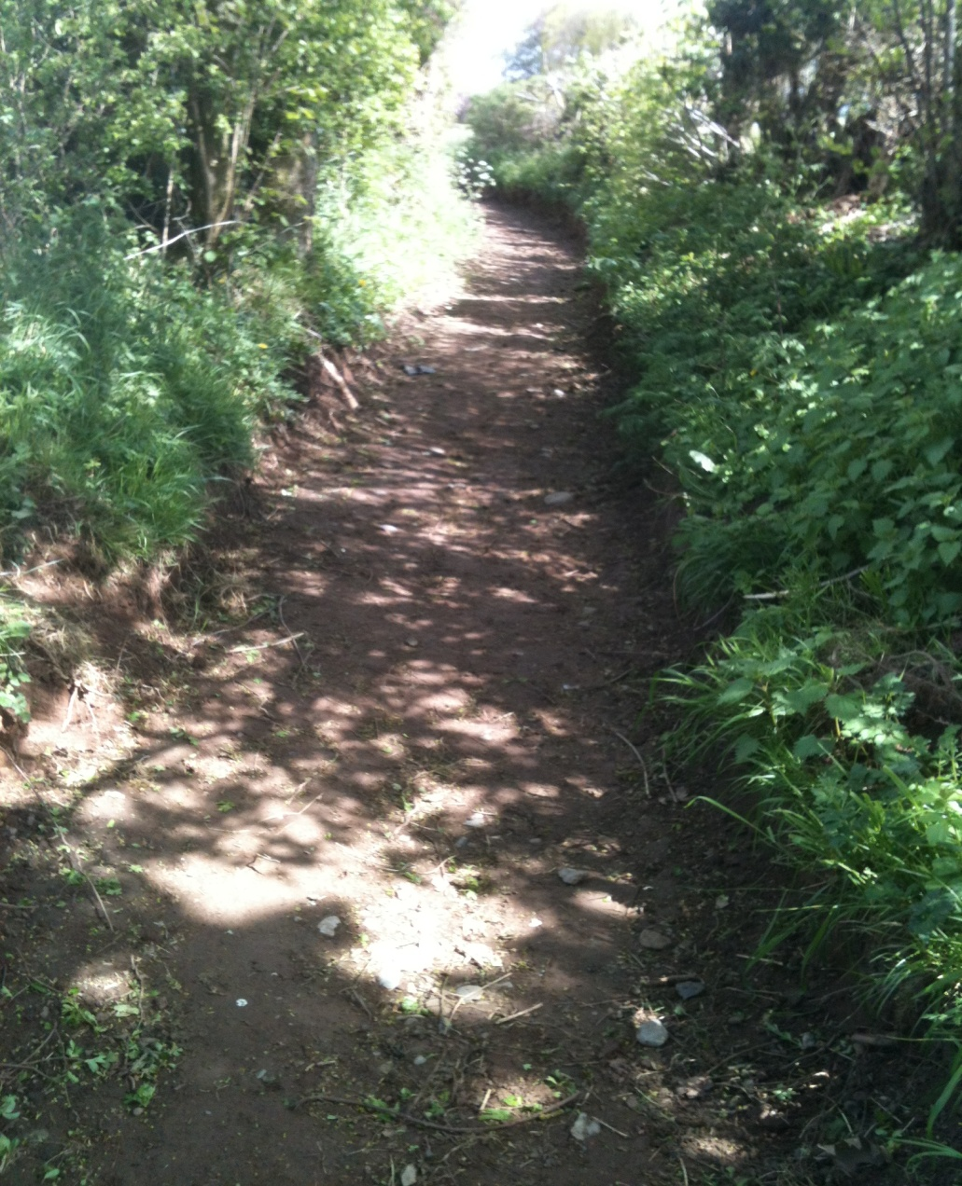
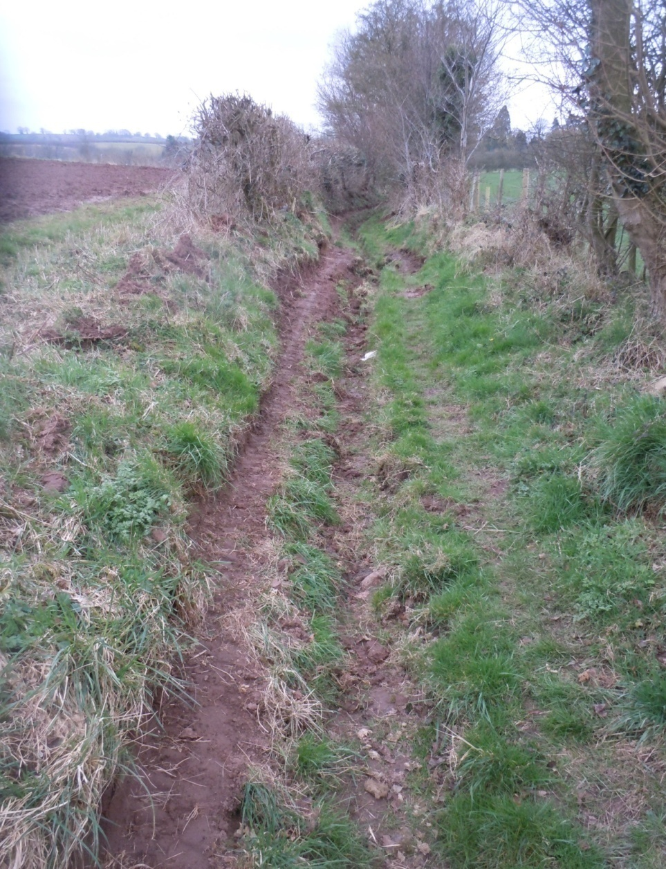
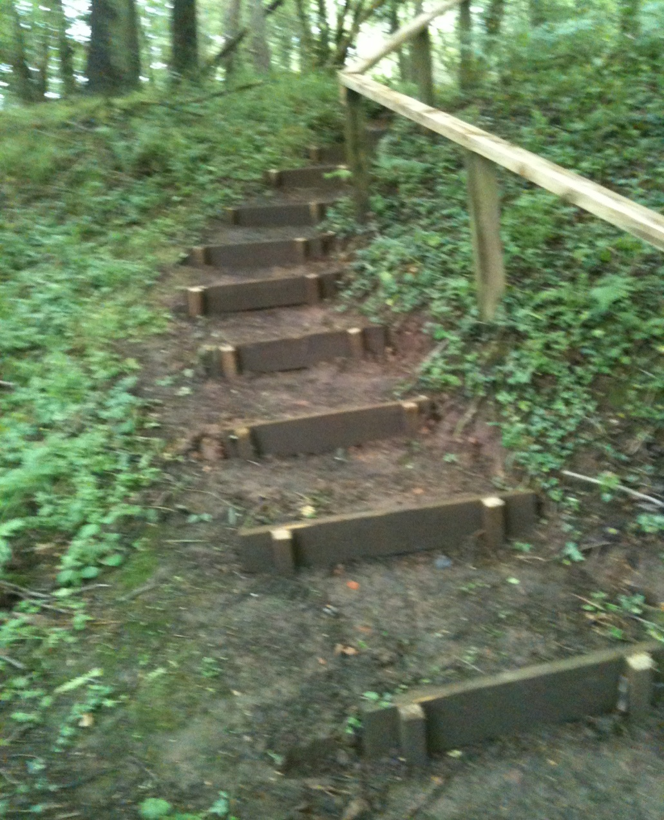
New Bridge Approaches

Slide 10
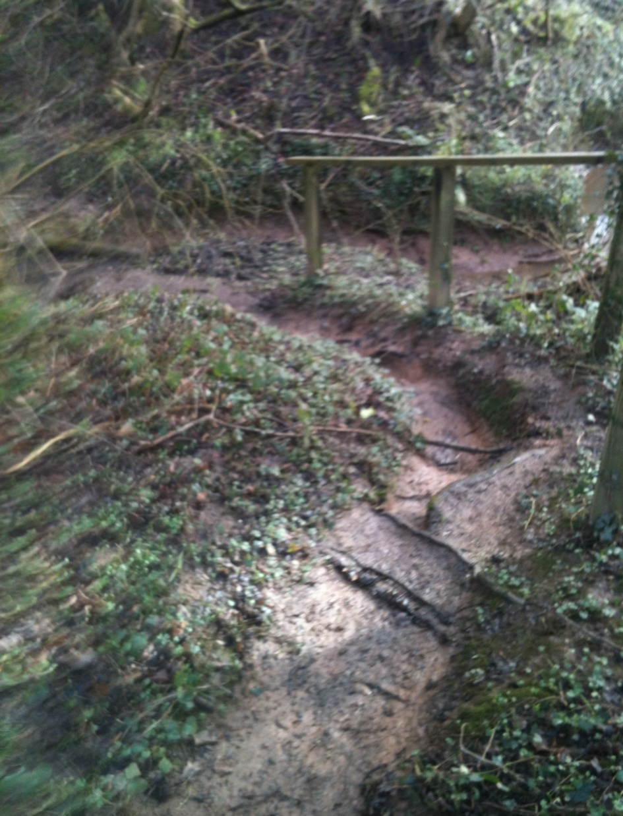
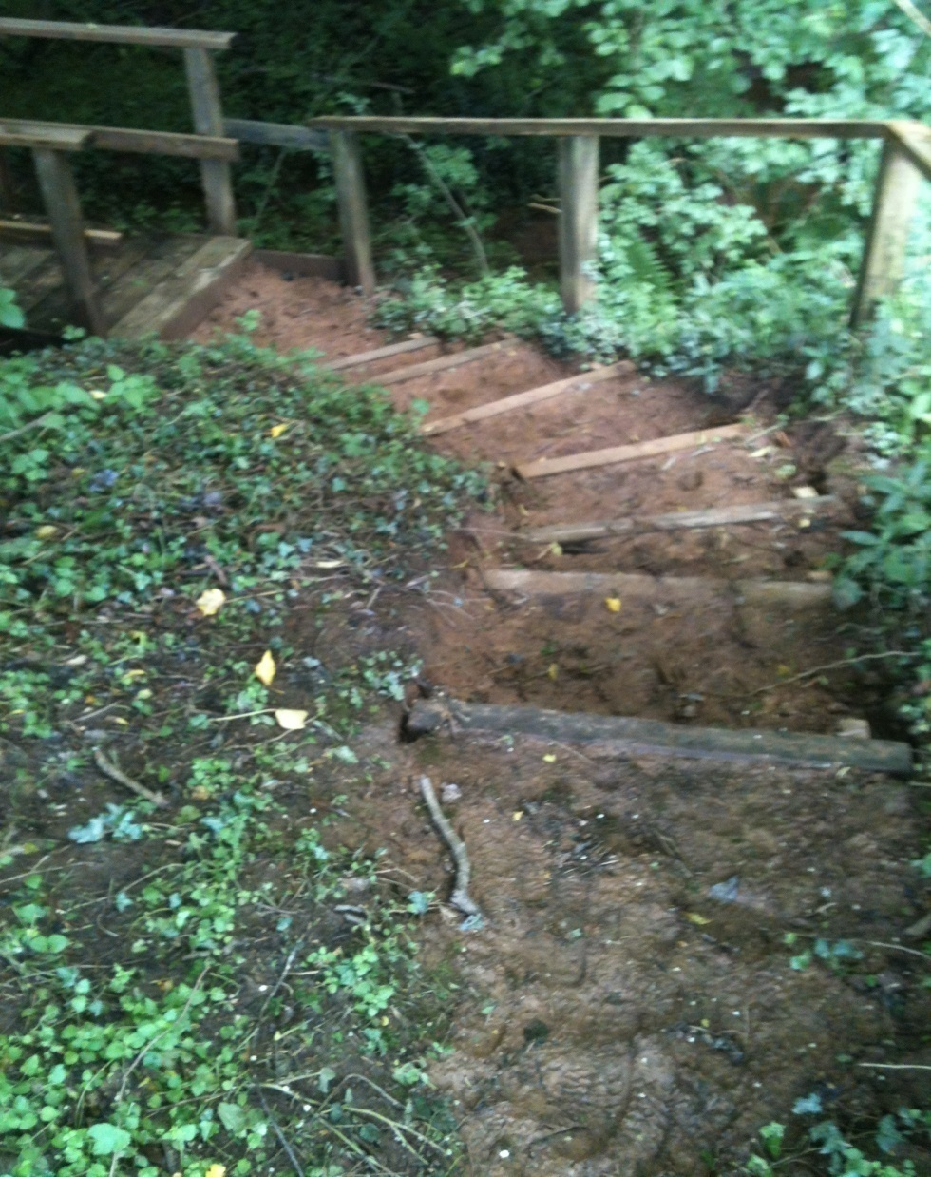
New Bridge Approaches

Slide 11
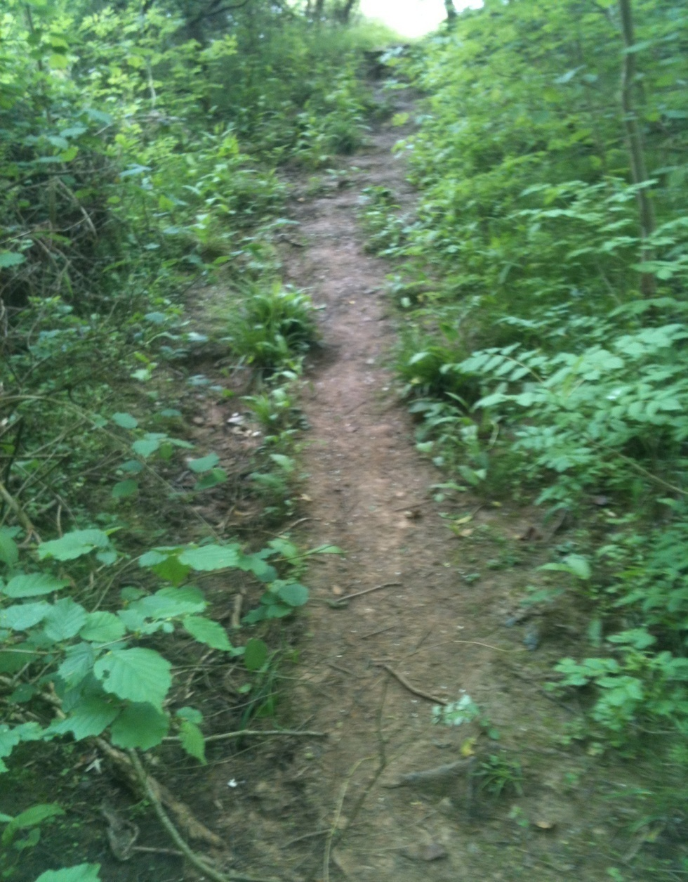
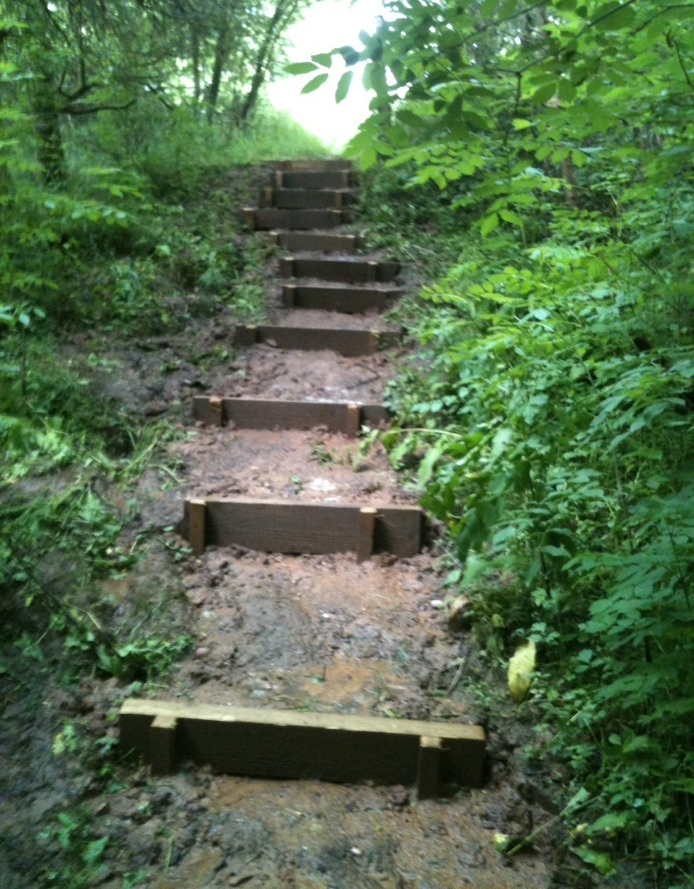
New steps near Wood Lane

Slide 12
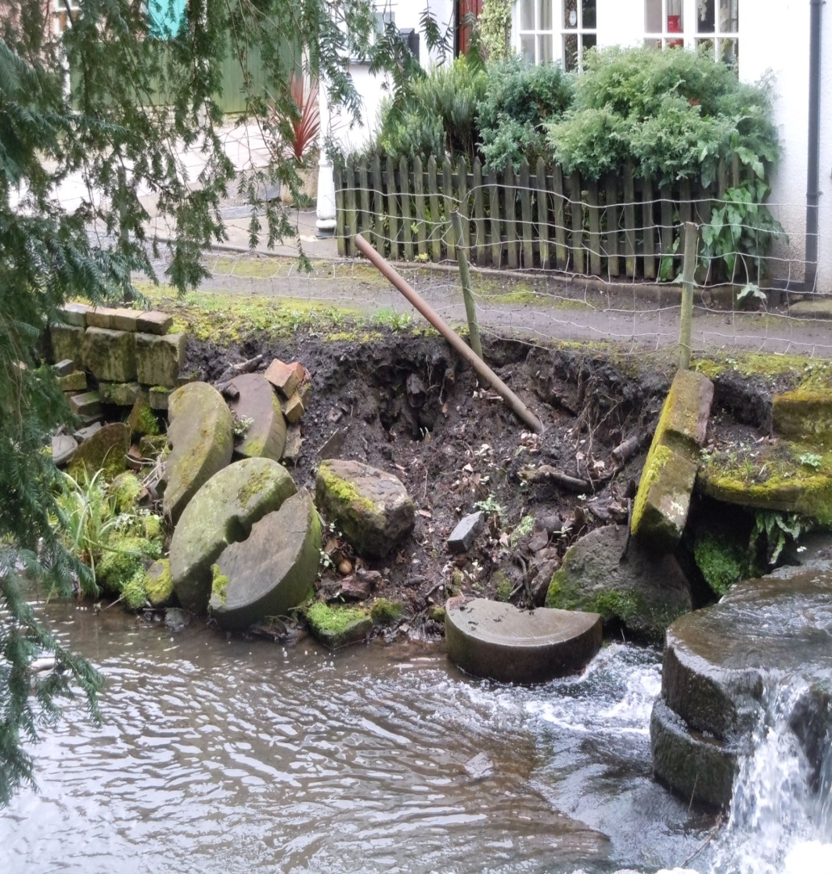
Brook Bank opposite Queens

Slide 13
Widening and surfacing of path from Waystone Lane to Bradford House
Financed by Parish Council using WCC contractors

Slide 16
ST Resilience Project
Route now fenced off ready for start
To last approx 18 months
Several crossover points on footpaths
Major footpath disruptions around New Barn area

Slide 17
Severn Trent Pipeline

Slide 18
Severn Trent Pipeline

Slide 19
2017 Plans
Change to brushcutting programme: –
WCC to take over the longer/harder sections as trial for this year.
Continued maintenance programme
Monitoring ST Pipeline issues
Ongoing plan to divert path through Brookfield Farm
Evaluate project for year

Slide 20
Finally
Any problems or improvement suggestions
Lynne and Paul Hardcastle
01562 730511

