Slide 1
Discrimination Supervision Model
Zoricelis Davila, LMHC, LPC-S

Slide 2
Introduction & Background
The Strength of the model: It is among the most researched
Created in the 1970’s to assist supervisors in training to discriminate or judge the needs of their supervisees and choose how to interact with them to meet those needs.
Supervisors tailor or customize their responses to the supervisees needs
Is considered one of the best-known models of supervision with a strong empirical support
The model can be viewed and taught at various levels, simple to complex, depending on the readiness of the supervisor.
The supervisor will be assessing the supervisee’s developmental stage and needs in order to choose the appropriate foci and role to address that need or stage.
IT is considered a process model and it differentiates between two aspects of the supervisory relationship: functioning and role.
(Bernard & Goodyear, 2014; Borders & Brown, 2005)

Slide 3
Key Concepts
The DM attend to three foci for supervision and three supervisory roles.
The 3 Primary Foci, are those among which supervisors may choose to focus on any or all of a supervisee’s following skills.
The 3 Roles will be determined by the supervisor according to the supervisees abilities within each focus area.
(Bernard & Goodyear, 2014)

Slide 4
Three Foci
Intervention: What skill level - What the supervisee is doing in the session that is observable by the supervisor. ls are being demonstrated, how well counseling interventions are delivered, etc.
Conceptualization: How the supervisee understands what is occurring in the session, identifies patterns or chooses interventions.
Personalization: How the supervisee interfaces a personal style with counseling at the same time that he or she attempts to keep counseling uncontaminated by personal issues and countertransference responses.
Professional Issues: helpful for supervisors when monitoring supervises beyond their counseling interactions with clients.
(This is a fourth added focus area considered at times)
(Bernard & Goodyear, 2014)

Slide 5
Three Roles
Teacher – a role assumed when the supervisor believes that the supervisee needs structure and includes instruction, modeling, and giving direct feedback.
Counselor – a role assumed when the supervisor wishes to enhance supervisee reflectivity, especially their internal reality rather than cognitions.
Consultant - a more collegial role assumed when the supervisor withes for supervisees to trust their own insights and feelings about their work or when the supervisor believes it is important to challenge supervisees to think and act on their own.
(Bernard & Goodyear, 2014)

Slide 6
Focus-Role Intersections
(Bernard & Goodyear, 2014, p. 53)
Focus of Supervision | Teacher | Counselor | Consultant
Intervention | Supervisee struggles to exhibit immediacy with clients | Supervisee appears unable to challenge one of her clients | Supervisee is intrigued by the prospect of using music in his counseling with middle-school children
Conceptualization | Supervisee does not identify the core of the client’s presenting concern | Supervisee assesses a young Black male client at a drug rehab unit being hostile and resistant | Supervisee shares that he would like to know more about Motivational Interviewing
Personalization | Supervisee treats his older female client in a manner that the supervisor finds condescending | Supervisee’s desire to avoid making any mistakes leaves her distant over controlling in her counseling sessions. | Supervisee shares that she is attracted to one of her clients

Slide 7
Warning
Be cautious of being rigid with only one role or foci because of habit or personal preference and neglect the needs of the supervisee.
The effective supervisor is prepared to address all foci and use all roles at any level.
(Bernard & Goodyear, 2014)

Slide 8
Situation Specific
Supervisors should consider all choices as there may be instances where any of the nine choices may be a best fit for the supervision task.
The roles and foci of the supervisor may change across and within a session according to needs of the supervisee.
(Bernard & Goodyear, 2014

Slide 9
Supervisory Styles
 | High Support | Low Support
High Direction | Supportive Teacher | Directive or Expert Teacher
Low Direction | Counselor | Consultant
(Bernard & Goodyear, 2014)

Slide 10
Literature

Slide 11
Literature
It’s generally supported by research
The role of consultant has remained elusive due to experienced supervisors being able to differentiate among the roles of teachers and counselor roles but not consultant roles.
It is model that has been adopted widely by many supervisors because of primarily being a tool to consider options within the supervision process and the flexibility of its adaptation.
(Bernard & Goodyear, 2014)

Slide 12
The use of narrative techniques
Narrative Therapy – Techniques
The use of Narrative Techniques complements and enhances the 3 Foci
It helps the supervisee to
Reduce Anxiety
Promotes creativity
Identifies and solidifies career choices and values
Facilitates a respectful, collaborative supervisory relationship
Advantages:
simplicity, flexibility, and research support
(Timm, 2015)

Slide 13
Narrative Techniques
“Taking it back” - the client is provided with information on how, through the therapeutic encounter, he or she provided something valuable to either the counselor or to future clients struggling with a similar problem.
In supervision - the supervisor is assuming a consultant role. It helps the supervisee assign meaning to his or her experience and “extend the field of influence” of the problem by placing the supervisee in the position of others who may also have struggled with a given issue.
Facilitates Role—Shift
Used effectively in Group Supervision
Understanding the Narrative - is used where understanding the supervisees’ “grand narrative” or personal story can “reveal specific life themes that foreshadow perception and adaptation to career development tasks”
The narrative approach of constructing a “preferred story” may assist in developing supervisee confidence in the intervention focus
(Timm, 2015)

Slide 14
Integrating creativity
(Koltz, 2008)

Slide 15
Integrating Creativity in DM
The integration of creative activities addresses both logical and intuitive components of supervision
Help supervisees connect with their intuition and imagination
Provide a visual image that supervisees can "internalize, one that helps them reflect on their lessons and the process of becoming a counselor”
Helps to increase introspection and awareness regarding self and the impact of self upon others.
Creative Metaphors – assist when supervisees cannot conceptualize the value of certain counseling skills or behaviors promoting growth and development when the supervisee avoids talking about their work and choose to talk about their personal situations instead
Helps the supervisor help the supervisee uncover the effect of the client on him or her and any countertransference issues.
(Koltz, 2008)

Slide 16
Creative Techniques
Drawing Illustration
Ask the supervisee to take out three pieces of paper and draw three different clients that he or she is working with.
The 1st picture depicts the client that the supervisee is having a difficult time using a broad array of skills with.
The 2nd picture depicts a client with whom the supervisee believes that he or she is demonstrating the use of a variety of skills.
The 3rd picture represents a client with whom the supervisee is still building a relationship using primarily feeling reflections.
(Koltz, 2008)

Slide 17
Drawing – Process Questions
What are the themes and patterns that connect the three drawings?
What is different about the three drawings?
On the basis of this assessment, what inferences can be drawn with regard to the use of skills with each of these clients?
What is different for the counselor with regard to the drawing of the client with whom the counselor is having a difficult time using more advanced skills?
What is the supervisee doing with this client that might be useful with the other clients?
(Koltz, 2008)

Slide 18
Clay – Play Dough
Helps the supervisee conceptualize a client whom he or she is having difficulty with.
The supervisor will ask the supervisee to sculpt a client for whom the supervisee is having a difficult time conceptualizing themes and patterns.
Sculpt themselves in relationship to the client.
After the sculpting or during the sculpting, the supervisor may ask process questions to the supervisee.
This activity helps the supervisee move beyond the facts of a client's situation to the development of pattern and theme using their intuitive impressions and experiences with the client.
(Koltz, 2008)

Slide 19
Write a Letter
Ask the supervisee to write a letter.
The letter can be written to the client
To a person in the supervisees' past or present, or to self.
The letter to self might be from the present or from the future.
If the letter is from the future, it would be written from an older and more experienced self.
The importance of this technique as the supervisor, is to go back and reflect frequently with the supervisee about what was written and learned.
(Koltz, 2008).

Slide 20
Supervisees at an Adolescent Residential Treatment
Turnover rates for staff working in adolescent residential treatment facilities are estimated at 20 and 40%, with some agencies reporting over 50%
Report higher rates of a general sense of anxiety and a need for structure and direction while working with this population
The DM can be adapted to reduce turn over and anxiety
3 Focus Areas (the strengths of the model)
Intentionality
Flexibility
Professionalism
Limitations - Choose appropriate setting for supervision due to the dynamics of a residential treatment in “splitting staff” positions/roles and dynamics.
(Byrne & Sias, 2010)

Slide 21
Spirituality in Supervision
An intricate part of a Bio-Psycho-Social-Spiritual Assessment
The integration of the DM proposes that any given supervision issue can potentially be addressed from the perspective of any of the three focus/roles areas
Provides a framework for examining how the spiritual issues that arise in supervision may be addressed from any of the DM perspectives and how the DM can be integrated into the supervision issues.
(Polanski, 2003)

Slide 22
Benefits of Spirituality in Supervision in the DM
Organizes components to address the supervisees competence in working effectively with spiritual and religious issues of clients
Allows the counselor to anticipate how to address the clients spiritual/religious beliefs and practices
Helps the counselor to integrate those issues more effectively into the present situations.
The supervisors position of power suggests that his or her attitudes toward spirituality and counseling will set the tone for how these issues are addressed
Demonstrating readiness to address these issues with supervisees is essential for supervisors to ensure appropriate client care and to enhance professional development in counselors
(Polanski, 2003)

Slide 23
DM in School Counseling Supervision

Slide 24
DM in School Counseling Supervision
38 school counselors surveyed about their perceptions of the DM model
No Specific consensus about the there are some differences between mental health counselor supervisors' and school counselor supervisors' perceptions of the DM, partially challenging the assumption that supervision using the DM is a common pedagogy across supervisory contexts.
(Luke, Ellis, & Bernard, 2011)

Slide 25
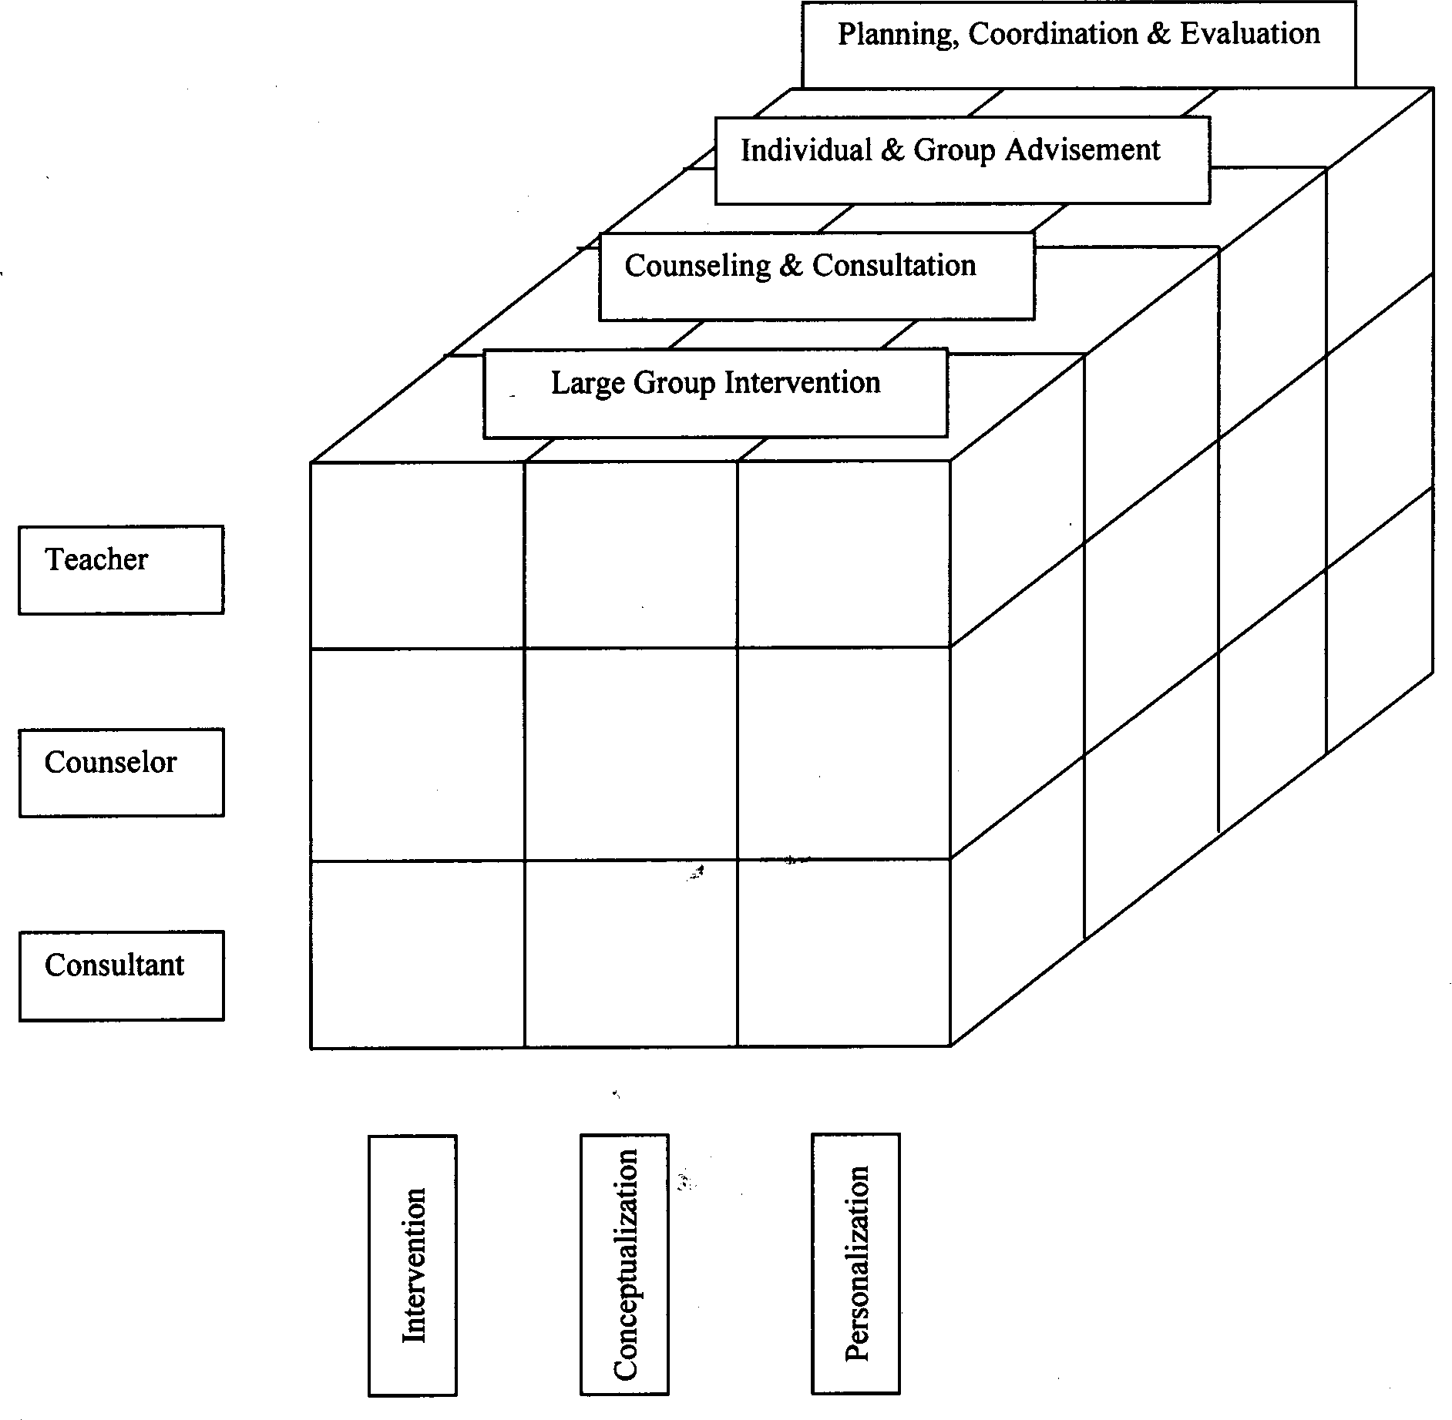
School Counselor Supervision MOdel
(Luke, Ellis, & Bernard, 2011)

Slide 26
Supervision of group-Work Model
(Rubel & Okech, 2006)

Slide 27
Supervision of Group Work Model
The purpose is:
To provide a tentative structure to help novice group work supervisors understand and make sound decisions regarding their supervisory roles and technical focus,
Particularly at the interpersonal and group-as-a-system level
Supervisees are usually unfamiliar with the processe above
(Rubel & Okech, 2006)

Slide 28
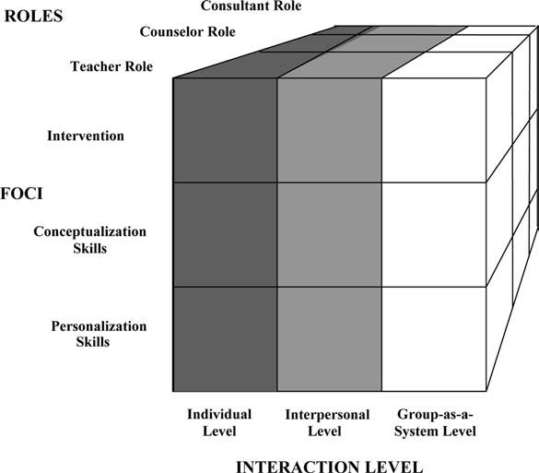
The Supervision of Group Work Model
Rubel & Okech, 2006)

Slide 29
The Group-as-a-System Level of Interaction
The group-as-a-system level of interaction is characterized by interactions that involve the whole group.
Group leaders can address concerns experienced by the entire group.
Issues may include the group’s ability to tolerate anxiety, group developmental phase, group cohesion level, group norms, and group issues that block progress, etc.
Supervision of intervention skills consists of assisting supervisees in providing effective group interventions.
(Rubel & Okech, 2006)

Slide 30
The use of Sandtray

Slide 33
Strategies
The supervisor may ask the supervisee to speak from the perspective of one of the miniatures or to have a conversation between a few of the miniatures (e.g., “If this miniature could talk, what would it say to this other miniature?”)
Have the supervisee look at the sandtray from a variety of angles.
Supervisees may select miniatures and do not place them in the tray. Supervisors may ask to process items that were selected but not placed in the tray (e.g., “You initially chose the rainbow, but decided to not place it in the tray. Tell me about that.”).
After completion of processing, the supervisor may invite the supervisee take a picture of the tray
(Carnes-Holt, Meany-Walen, & Felton, 2014)

Slide 34
Conclusions
The use of narratives help the supervisee assign meaning to his or her experience and extend their field of influence over the problem by placing the supervisee in the position of others who may also have struggled with a given issue.
Creativity in the DM model provides an excellent means to carry out all the functions and roles that emerge in supervision
The model when applied to youth residential treatment supervisees may reduce a general sense of anxiety and turnover
The integration of spirituality in supervision helps to consider the client’s and supervisees spiritual and religious beliefs and how those will be addressed
More clinical supervision specifically within the context of school counseling is needed to address the functions of a school counselor

Slide 35
Conclusions
Sandtray is an effective clinical intervention that can serve to provide rounded professional development.
The Supervision in Group-Work model provides a description of the knowledge and skills that competent group work supervisors should possess.
The model emphasizes identifying supervisee needs, as well as skills and knowledge that supervisors must acquire to provide competent group work supervision.

Slide 36
References
Bernard, J. M., & Goodyear, R. K. (2014). Fundamentals of clinical supervision. Boston: Pearson.
Borders, L. D.,&Brown, L. L. (2009). The new handbook of counseling supervision. New York: Routledge.
Byrne, A. M., & Sias, S. M. (2010). Conceptual application of the discrimination model of clinical supervision for direct care workers in adolescent residential treatment settings. Child and Youth Care Forum, 39(3), 201–209. http://doi.org/10.1007/s10566-010-9100-z
Carnes-Holt, K., Meany-Walen, K., & Felton, A. (2014). Utilizing Sandtray Within the Discrimination Model of Counselor Supervision. Journal of Creativity in Mental Health, 9(4), 497–510. http://doi.org/10.1080/15401383.2014.909298
Koltz, R. L. (2008). Integrating creativity into supervision using bernard’s discrimination model. Journal of Creativity in Mental Health, 3(4), 416–427. http://doi.org/10.1080/15401380802530054
Luke, M., Ellis, M., & Bernard, J. (2011). School counselor supervisors’ perceptions of the discrimination model of supervision. Counselor Education and Supervision, 50(5), 328–343. http://doi.org/10.1002/j.1556-6978.2011.tb01919.x
Luke, M., & Bernard, J. M. (2006). The school counseling supervision model: An extension of the discrimination model. Counselor Education and Supervision, 45, 282–295.
Polanski, P. J. (2003). Spirituality in supervision. Counseling and Values, 47(2), 131–141. http://doi.org/10.1002/j.2161-007X.2003.tb00230.x
Rubel, D., & Atieno Okech, J. E. (2006). The Supervision of Group Work Model: Adapting the Discrimination Model for Supervision of Group Workers. The Journal for Specialists in Group Work, 31(2), 113–134. http://doi.org/10.1080/01933920500493597
http://southernsandtray.com/10-commandments-of-sandtray-therapy/
Timm, M. (2015). Creating a Preferred Counselor Identity in Supervision: A New Application of Bernard’s Discrimination Model. Clinical Supervisor, 34(1), 115–125. http://doi.org/10.1080/07325223.2015.1021499

