Slide 1
ARTS-PR INTERNATIONAL
SUPPORT FOR THE ARTS

Slide 2
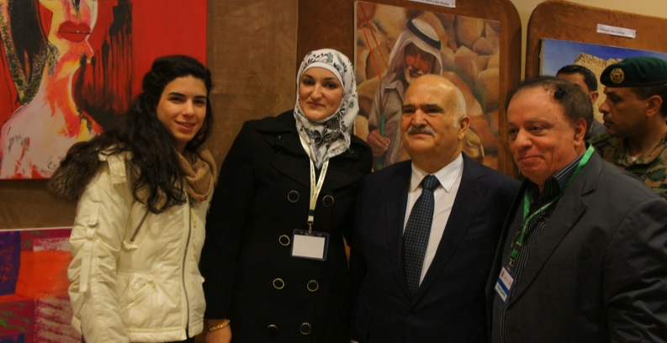
SUPPORT FOR ARTISTS
PRINCE HASSAN AND ARTISTS REEM SAMADI, IHSAN BANDAK

Slide 3
OUR MISSION
ArtsPR-International provides support for the arts and cultural preservation. Prince Hassan Bin Talal of Jordan, an advocate for art and culture, at the World Archaeological Congress (WAC7) in Jordan, lamented over the “current destruction in this region of its arts, culture, monuments and museums, due to violence, willful greed or wanton neglect.” ArtsPR-International is determined to help reverse this process through support of artists of all media and their important contribution to human culture. Artists reveal the soul of a society, and provide a voice for those who cannot speak. Their imagery communicates both who we are, and who we hope to be.

Slide 4
Our Team
ArtsPR-International offers the skills of talented professionals in the US and in the Middle East.
Dr. Jacqueline Taylor Basker, Ph.D . Art Consultant, Artist, Art Historian, Critic, Editor
Jonah Shepp, editor, writer, formerly with the Jordan Times
Ahmad Azzouni, Graphic Design, Websites, Animation
Henk Bos, photographer, photography tours and classes
Ihsan Bandak, Gallery & Arts School Director

Slide 5
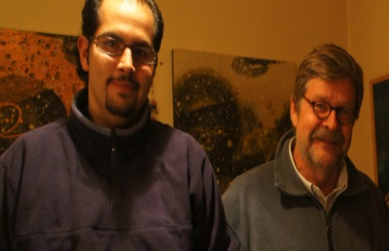
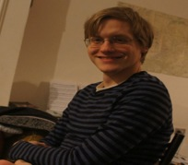
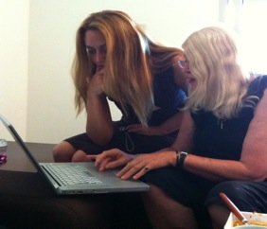
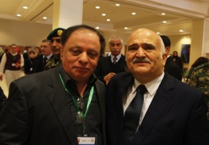
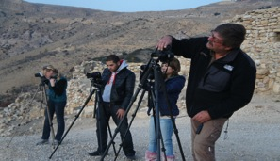
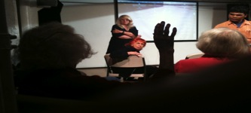
OUR TEAM AT WORK
AHMAD AZZOUNI HENK BOS JONAH SHEPP JACQUI TAYLOR BASKER
JACQUI TAYLOR BASKER IHSAN BANDAK & PRINCE HASSAN HENK BOS

Slide 6
Help to develop your career in the arts!
The art world is a very competitive place. Yet most creative people prefer to do their projects, rather than spend a great deal of time marketing, looking for grants and creating PR (Public Relations).
Artists of all disciplines are often not good at writing about themselves and their work, especially in a language other than their own. Their PR, press releases, catalogues, brochures, artist statements may contain spelling and grammar mistakes, and not be as well written as their work deserves.
This can disqualify them from advancing their careers, receiving grants, or move to international galleries and performances.
If a website or video on your work and your PR (Public Relations) are not highly professional, it will discourage collectors and critics from taking you and your talent seriously.

Slide 7
WHAT WE OFFER
ArtsPR-International offers artists of all disciplines contacts with experienced professionals, who will present you so you will look your best!
ArtsPR-International will help you advance your creative work both locally and internationally.
ArtsPR-International offers both technical and creative support. It helps you develop strategies to advance your career, and nurture your creative strengths.
ArtsPR-International will help you write applications for grants, scholarships, artist residencies, exhibits, contests, and funding. It will research the best possibilities for you and your needs.
ArtsPR-International is a community of talented professionals who are creative people themselves and who care deeply about the arts and artists.

Slide 8
CONTACT US
NY: 155 Bank Street Suite A624
New York, NY 10014 +347-628-1616
Jordan: PO Box 850540, Amman, Jordan 11181 +0776718190
http://www.artsprinternational.com

