Slide 1
Dr. Paul K. Chafetz
Psychologist
Dallas, TX
PaulKChafetz.com
DAGS Fall Forum, October 18, 2018
Notes:
Thank you! Good morning, everyone!
It is a pleasure to be here with you, at DAGS again.
THANK: _________________________.
I have a very soft spot in my heart for DAGS, having been witness to, and even played a small part in, its founding back around 1984, with Dr. George Foelker.
I am a psychologist.
By way of background …..

Slide 2
Credentials
Brown University
University of Florida
Duke University Medical Center
TX Research Inst. of Mental Sciences
(TRIMS)
Do you want to say this… with different words
.
Notes:
A word about my training. I completed my ….
Bachelors degree at Brown University
PhD in Clinical and Health Psychology at the University of Florida
Clinical Psychology internship at Duke University Medical Center
Two-year post-doctoral fellowship at T.R.I.M.S. in the Houston Medical Center

Slide 3
Thirty-five Years in Clinical Psychology
1982
1992
2002
2012
Part-Time Private Practice
Full-Time Private Practice
Ass’t Prof., TWU
Associate Professor,
UT Southwestern Medical Center
Dr. Chafetz has maintained a private practice since 1982.
Notes:
And a word about my career path.
I opened my private practice of clinical psychology when I arrived in Dallas in 1982.
It was part-time until 2004, and has been
full-time since 2004.
Along the way, I also taught psychology at
Texas Woman’s University for 2 years
and at UTSWMC as an associate professor
for 20 years.
But what I’m here to talk about is ……

Slide 4
Non-compliance
THE PSYCHOLOGY OF NON-COMPLIANCE
!
Go To
Notes:
But I am here to talk about “the psychology of non-compliance,”
Or, As I like to put it, “Go to L”
Relax. I am not cursing, especially as we sit in this beautiful and holy location.
My meaning for this phrase will become clear as we move along today.

Slide 5
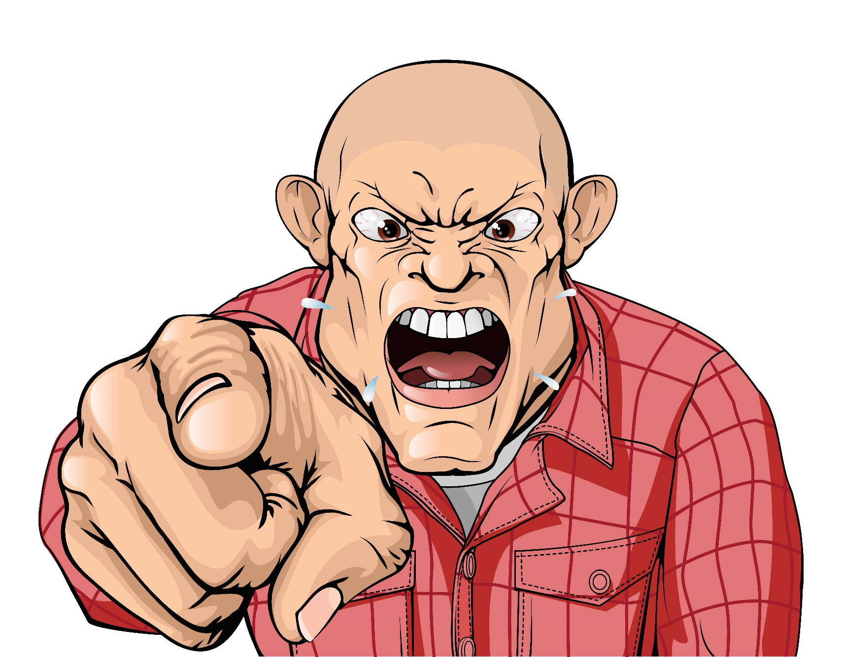
Non-compliance
Influence
Notes:
Non-compliance. A very interesting term.
Basically, Joe wants Jim to do or not do something, and
tries to make that happen, but it doesn’t.
It is actually a very profound thing.
My term for the general idea going on here is INFLUENCE.
Let’s start by talking about this idea of Influence in general.
I think of it as a CONTINUUM: Starting with a caveman.
A caveman who wants another caveman to leave his cave might just pick the guy up and throw him out on his ear.
This is direct action.
This evolved into ways of showing a readiness to push/pull or hurt to cause movement.
This is called gesture.
This evolved into verbal or other symbolic indications of this;
This is called language.

Slide 6
Non-compliance
Influence
Notes:
This evolved into enticement to move through promised reward or punishment at some later time (“education”);
This civilization, internalization of expectations, norms.
So this CONTINUUM: Action - gesture - language - norms
can be heard still today, in the words we apply to various forms of influence, like:
Control, dominate, manipulate, direct, train, teach, educate, invite, request, hint.
This is what is happening with Joe, the influencer.

Slide 7
Non-compliance
Resistance
Notes:
And what about Jim, the subject of Joe’s efforts?
Resistance by the subject is also a fascinating concept.
There is always a minority or competing opinion, a downside, a cost, to acting as requested.
It is, “I hear you, BUT …”
The minority opinion, and therefore the resistance, might be conscious or unconscious for the client.
The strength of Jim’s, the client’s, minority opinion is manifested in the degree of noncompliance.
(How I respond to the phrase, “You need to …” “Who the L do you think you are?!”)
Full and effortless compliance in our world is almost a miracle, and
only happens when the parties agree to their respective roles and the rules of the game.
They agree on who is the expert and who is the supplicant, the subject,
Who is on high and who is below.
They agree that the expert will share their wisdom in return for money,
and the supplicant will happily part with money in return for the value to them of the expert’s wisdom.
However, often is no such agreement!
Sometimes the expert thinks there is agreement, when in fact they have not yet truly “made a sale.”
This is when noncompliance happens.
The client’s WORDS say yes, but his behavior says, “L, NO!”
Imagine the audacity of a client to not follow our advice!!
I mean, I would never fail to follow my doctor’s advice, and you wouldn’t either, right?
Oh, Wait! Do I take my cholesterol medicine EVERY night?
Oh, Wait! Do I do my PT exercises for my loose SI joint twice every day, without fail?
Oh, Wait! Do I limit my carb intake to 90 grams every day?
So, resistance isn’t always total or obvious. It doesn’t always look like this fellow.

Slide 8
Non-compliance
Resistance
Notes:
Sometimes resistance, noncompliance, looks like this fellow.
His smile and his words say one thing, but his behavior will say something else.
So, let’s be honest. Since neither you nor I are totally compliant with all of our doctors and professionals,
for us to use the term noncompliant is pretty audacious,
because we’re saying that:
We know everything,
We know we’re right.
The client is clearly making a big mistake by not obeying us.

Slide 9
Non-compliance
MEDICAL NON-COMPLIANCE
Dangerous
Treatment exists
Access exists
Refusal is rare and dangerous
Notes:
Kleinsinger’s (2003) suggests 4criteria that must be satisfied before he’ll use this hazardous term.
Kleinsinger’s four criteria are
The patient’s medical problem is potentially serious and poses a clinically significant risk to length or quality of life;
At least one treatment exists that, if followed correctly, will markedly reduce this risk;
The patient has easy access to the treatment or treatments; and
The patient deviates significantly from most patients with a similar problem in degree of compliance with my advice, treatment, or follow-up, in a way that directly or potentially jeopardizes the patient’s health or quality of life.
These are good. They are behavioral.
Underneath the behavior, though, is the critical element of the client’s buy-in to the provider as an expert whose wisdom has true value to the client.

Slide 10
Non-compliance
EXAMPLES
Medication
Appointments
Records
Therapy
Assignments
Referrals
Diet
Exercise
Alcohol
Positioning
Devices
Notes:
Manifestation areas:
taking medication
keeping appointments
Keeping records (glucose log)
attending therapy
completing assignments
Adhering to a diet
exercising
Avoiding alcohol
following through on referrals
positioning: bedrest, elevating feet
Using walker or cane

Slide 11
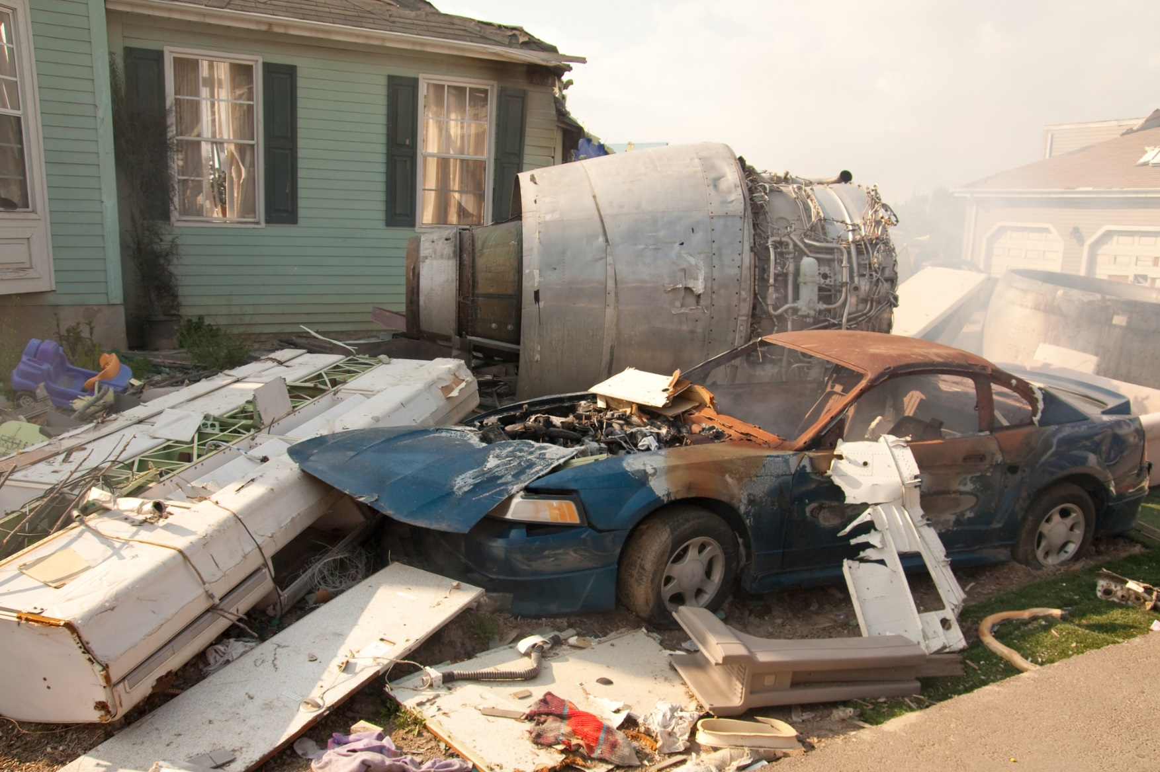
Non-compliance
SCOPE
Notes:
SCOPE Compliance is not just a matter of convenience or enjoyment, but a matter of life and death.
Think of the health implications of skipping hemodialysis or leaving the hospital AMA.
Medical noncompliance is a worldwide epidemic.
The World Health Organization reports that:
11% of hospital admissions and 40% nursing home admissions result from patient noncompliance, and
approximately 125,000 people with treatable ailments die each year in the US because they do not take their medication properly.
Dr. David Nash, chairman of the Dept of health policy at Jefferson Medical College in Philadelphia, has written that
“The cost of patient noncompliance is easily in the tens of billions of dollars a year in needless complications and hospitalizations.
If we could improve compliance, we’d be well on our way to fixing the healthcare system, regardless of what reforms are ultimately passed.”
Now, the recommendations YOU and I make, that our clients do not comply on, may not be quite as momentous as life and death, but then again, they might!

Slide 12
Non-compliance
Notes:
You know, it’s funny. If Peggy Pappert had invited a sociologist to give this talk, you’d be hearing about the sociology of noncompliance.
If she had invited a biologist, you’d be hearing about the biology of noncompliance.
She asked a psychologist (ME!), so of course you’re hearing about the psychology of noncompliance.
Therefore, I suppose anything I say about noncompliance is by definition psychological????
Well, in fact, I do believe that a great deal of the problem is PSYCHOLOGICAL, i.e., based on their:
thoughts,
feelings/emotions,
memories/experiences,
observations of others’ behavior and experiences,
expectations,
goals, etc.
Obviously, the causes of and solutions to noncompliance are multidimensional, and these multiple factors are often intertwined.

Slide 13
Non-compliance
Notes:
So, get ready, This is where the entire talk goes straight to “L”!
Get it?
Let’s talk about tools available that all END in the sound, ‘EL.’

Slide 14
Non-compliance
WHAT TO DO ??
ConceptuaL orientation
PracticaL approach
InterventionaL options
Notes:
ConceptuaL orientation
PracticaL approach
InterventionaL options

Slide 15
Non-compliance
CONCEPTUAL ORIENTATION
Legal
Directional
Successful
Quizzical
Respectful, Graceful
Incremental
Tactical
Ethical
Notes:
CONCEPTUAL APPROACH
1. LEGAL - Whose decision is it? Does Pt have a veto? What are their rights?
2. DIRECTIONAL - Is it THEM, or is it US?!
Is someone to blame, because they didn’t fulfill their responsibility?
Can someone fix it, because they have effective tools in their hands, and the authority to use them?
3. SUCCESSFUL –
We should send the message that we anticipate success.
Conceptualize this client’s noncompliance as a dilemma to solve together,
a challenge for each of you to grow into,
rather than a failure on the part of either of you.
4. QUIZICAL: When patients do not do as we ask them,
rather than label them (noncompliant, defiant, resistant),
we should be curious, pause, and ask ourselves, “WHY?”
5. RESPECTFUL - It is their life, not yours.
GRACEFUL: Accept the limits on your ability to make anything happen.
INCREMENTAL - Meet the client where they are.
I am perfectly happy to see a client progress slowly, as long as we’re moving in the right direction.
7. TACTICAL – Be strategic. Pick your battles.
Focus your efforts toward influencing the Pt to comply in the area that is most worth struggling over.
8. ETHICAL - Never promise more than you can deliver.

Slide 16
Non-compliance
PRACTICAL APPROACH
Subtle
Accessible
Familial, cultural, spiritual
Conversational
Historical
Emotional
Approval
Defensible
Categorical
Collegial
Notes:
Your practical approach
1. SUBTLE - How many of you drive?
How many of you drive in the rain?
How many of you drive on ice?
Driving on ice requires a continuous sequence very small adjustments, planning far ahead, a light/subtle touch, patience, weighing many variables simultaneously.
This requires finesse, diplomacy, the soft sell.
Front door (reasoning) vs side door & windows (finesse).
This is your job as a professional.
The magic touch comes from having a larger perspective, knowledge of more approaches, thinking outside the box, clarity of your ultimate goal.
It is vital to be able to distinguish content from process.
To this point, I want to mention my book that came out last year.
Even though it is not directly on the topic of noncompliance, it does address at length both
the various causes of resistance and other difficult behaviors, and
several very robust strategies for finessing people into behaving better, for their own good.
It addresses such issues as:
Is the difficult client sick or bad?
The need for realism, and
A recipe for avoiding pointless confrontations with irrational people.
2. ACCESSIBLE - Every health care organization should provide every patient with “a named, identifiable, and readily accessible (contact) person” who can be relied upon, over time, as an entry point, an ally, and a guide.
3. FAMILIAL/CULTURAL/SPIRITUAL - Many of our patients:
See faith and prayer as methods of healing
They see local and herbal healers at the same time they see us
Believe in supernatural forces (voodoo) that hurt or heal
Believe in fate or the ‘will of God’
Believe foods or weather cause disease
Believe that hospitals, doctors, medicines kill people
Believe that the ER is better quality care
Believe that they could never be understood by educated, professional, intelligent, articulate people like us, but are too intimidated to tell us so.
So, be on the lookout for indications that any of these are in play in your situation.
4. CONVERSATIONAL - Schedule time to just talk with the client, to learn about them. LISTEN. Hear their history.
Ask about their concerns, expectations.
Ask what their visions are for the best possible outcome, the worst possible outcome, and the most likely outcome.
Ask about their preferences.
Kleinsinger 2003: “The most helpful things I have ever done with noncompliant patients have been to ask questions, to not lecture, and to be willing to listen to what patients say.” “I’ll just be quiet and listen as nonjudgmentally as possible.”
Inquire about life hassles that compete with Pt’s self-care (finances, difficult or needy relatives, living circumstances, etc.).
There is no lab test to discover these root causes.
There is NO APP for this!
They are discovered only via conversation, history taking, patiently listening, open-ended questions, in the context of a relationship that instills in the patient an adequate level of trust and confidence in the professional.
All of this takes TIME.
Without learning the whole story (the real patient, the authentic LIFE of your customer), the WHY of these behaviors will never be clear to you.
A client is not a disease, but a human being. They make their own decisions.
As Thomas Dahlborg explains, by learning the inside story of our clients, “we position them for compliance, engagement, activation, and optimal health.”
5. HISTORICAL - Pts’ memories of their own LIFE EXPERIENCES: abuse, neglect, deceit, exploitation, pain, abandonment, poverty, hunger, discrimination, failure, conflicting messages, fragmented care. What conclusions have they reached, consciously or unconsciously, from their experiences?
6. EMOTIONAL: Identify Pt’s emotions: fear, mistrust, dissatisfaction, lack of understanding (confusion), grief, anger, guilt
APPROVAL – Empower and encourage every Pt to speak up if they dislike our message, disagree with our message, or don’t understand our message.
Empathize with their dilemma!!
“Your point of view makes sense to me.”
8. DEFENSIBLE- Assess maturity level of their defense mechanisms. (Vaillant)
Know how to recognize a defense mechanism when you see one, especially denial.
Never take away someone’s defense mechanism without giving them something better.
9. CATEGORICAL – Based on all the information you now have, decide if this client cannot or will not behave as requested.
Are they unable or unwilling?
Are they non-compliant or just defiant?
10. COLLEGIAL – Consult with colleagues about your tough cases.

Slide 17
Non-compliance
INTERVENTIONAL OPTIONS
Measurable
Treatable
Educational, informational, bilingual
Audio-visual
Provisional
Financial
Criminal
Logistical, environmental
Technological
Variable
Committal
Dismissal
Notes:
Your interventional approach
1. MEASURABLE –
Assess for the four D’s: Denial, Depression, Dementia, and Substance Dependence.
Assess cognitive function (memory, judgment, education level, reality testing, orientation); review meds that may impair cognition.
Most fundamentally, does the Pt have capacity to make these decisions?
2. TREATABLE –
Refer for psychiatric medication for treatable mental disorders such as Major Depressive d/o, Mania, psychosis.
Refer for psychotherapy for neurotic level disorders that respond to insight, verbal processing, value and goal clarification, and skill-building.
3. EDUCATIONAL/INFORMATIONAL/BILINGUAL –
Language skills. The Pt may be too polite to reveal that they do not understand, like, or agree with what we’re saying to them.
They suffer in silent bewilderment.
Various studies have shown that Pts leave the office understanding less than 50% of what they were told.
Misunderstanding of “side effects.”
Talk with the patient in language they can understand (education), and
give them your message, including conclusions and instructions, in a written (VISUAL) form.
Would you find it easy or hard to manage your own insulin on a sliding scale?
4. AUDIO-VISUAL - Is the Pt vision or hearing impaired? Have they received all the help available to remediate these deficits?
5. PROVISIONAL - Ask if the Pt would be willing, in light of their concerns and obstacles, to follow your plan for a brief trial period (“for now”), to see if it produces the feared bad results or the hoped-for good results.
6. FINANCIAL – Review their financial picture.
Look for opportunities to connect Pt with additional resources and to remove nonmandatory liabilities.
(If you had to choose between buying food, paying your rent, or buying medicine, what would you do?).
Minimum wage is now $7.25/hr. FT is $14,500/yr
It takes an average of 2.5 FT min wage jobs to afford living in an average market-value 2-BR apt.
An overwhelmed patient is usually ineffective at self-care.
Secondary gain: disability payments
7. CRIMINAL - Is a relative or neighbor systematically stealing the Pt’s money? A
re they being conned?
Is it time to call the police or FBI?
8. LOGISTICAL/ENVIRONMENTAL – Does the client live too far away from the clinic, pharmacy, or your office?
Do they face too many stairs?
Do they lack transportation or a phone?
9. TECHNOLOGICAL – Electronic reminders to take meds, etc.
10. VARIABLE – Have a variety of approaches in your toolkit: finesse, hard-sell (threatening consequences), act without Pt’s prior approval or knowledge.
11. COMMITTAL – Does the client show behavior that presents a danger to himself or others due to a psychiatric condition?
Does it warrant evaluation for inpatient psychiatric treatment?
12. DISMISSAL – Know how to give notice, e.g., 30 days.
But do it carefully, to avoid being sued for abandonment or discrimination (ADA).

Slide 18
Non-compliance
Notes:
Which one of the thirty or so strategies we’ve just reviewed is THE MAGIC BULLET ??
NO TRUE MAGIC BULLET,
BUT
Of all the tools, I do have a favorite starting point, my GO-TO, in fact my …

Slide 19
Non-compliance
“GO-TO”
Notes:
MY “GO-TO L” And that is … “conversational”.
Ask the client about it.
Talk with the client about it.
Listen to the client.
Hear the client.
So, in summary, what do we do?

Slide 20
Non-compliance
YOUR FRIENDS
ConceptuaL orientation
PracticaL approach
InterventionaL options
8
10
12
30
Notes:
What we do is …
Remember that the L’s are your friends!
You have
8 conceptual orientations,
10 practical approaches, and
12 interventional options.
( REVEAL) Thirty tools! You’re in good shape!

Slide 21
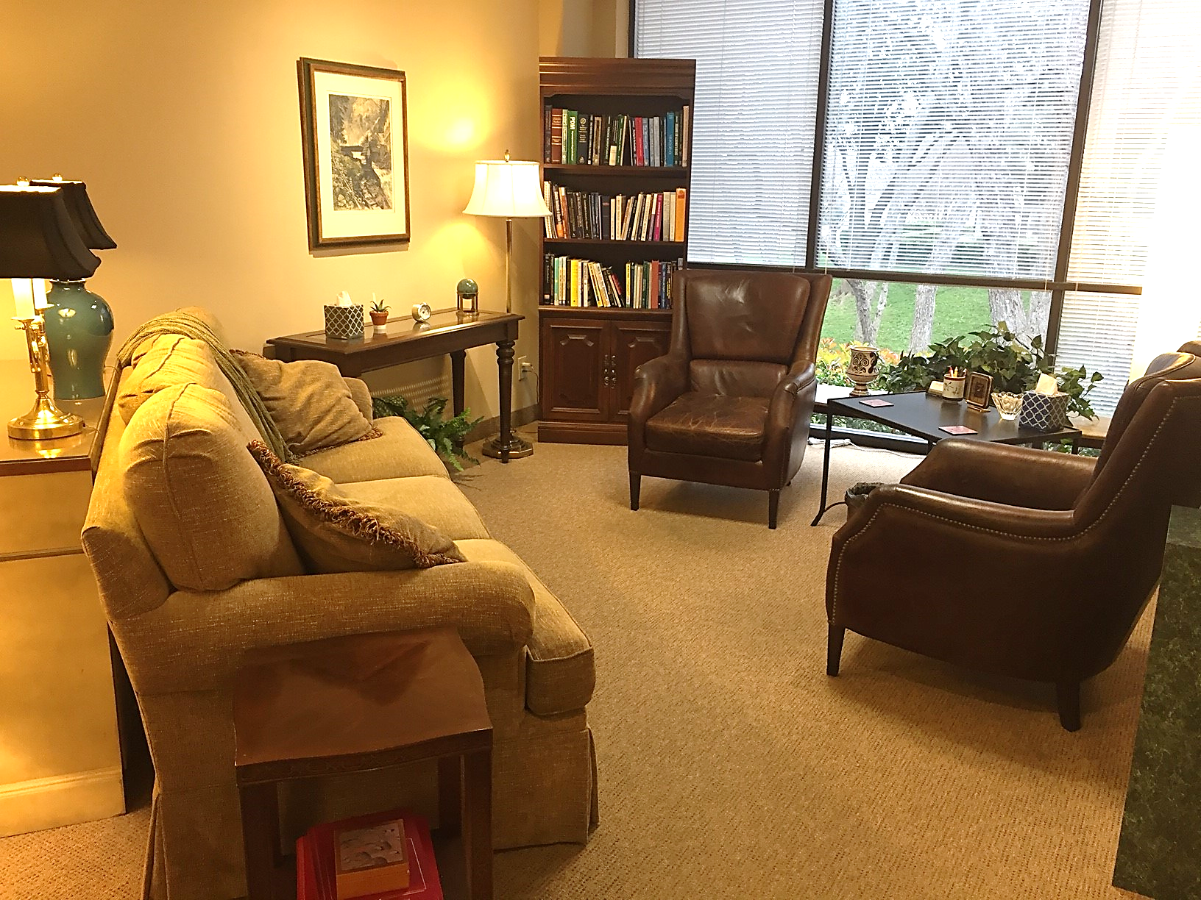
WORKING WITH DR. PAUL
Notes:
This is where I live.
The meaning in my life comes from:
a. helping my patients to see:
themselves, their situation, their future,
and the entire world
with new eyes, and a newly courageous attitude.
And from seeing my fellow professionals
devote real time and effort
to increasing their skills and expertise, and
growing into amazing resources
for our entire North Texas region.
I hope that the material we have covered today
will be of use to you.

Slide 22
CHILDREN OF DIFFICULT OLDER PARENTS
In 2nd Printing!
Notes:
Completed in 2017.
Does your difficult relative make you feel like a failure?
Does your friend have a difficult older parent?
Be a friend, and get them a copy of this book.
Just $13.

Slide 23
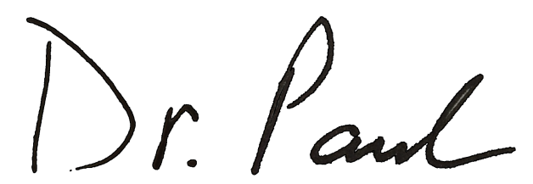
Thank You!
DrPaul@PaulKChafetz.com
469-233-5566
PaulKChafetz.com
Notes:
I appreciate the opportunity to visit with you today, and I hope this has been helpful.
Questions?
Thank you!

