Slide 1
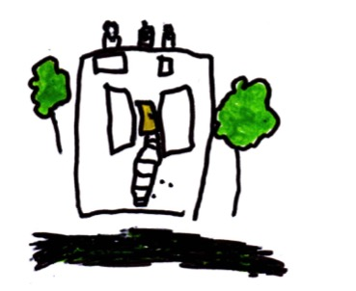
How do children learn?
Welcome to Moss Hall Nursery School
Notes:
Today is not about individual children – that will happen (KPs will arrange meetings with you)
Today is a vey brief overview of the way that children learn and how we organise the environment and interactions to support that learning.

Slide 2
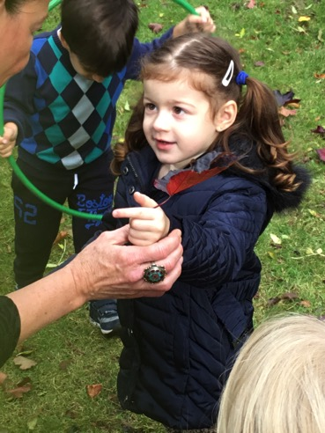
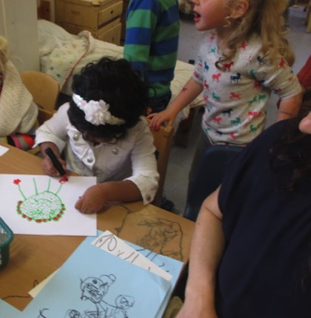
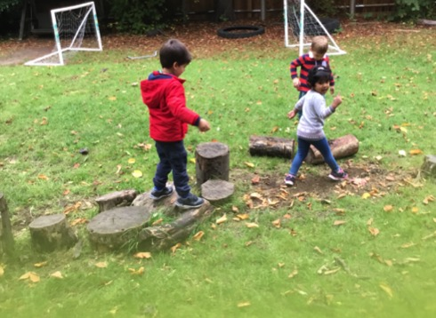
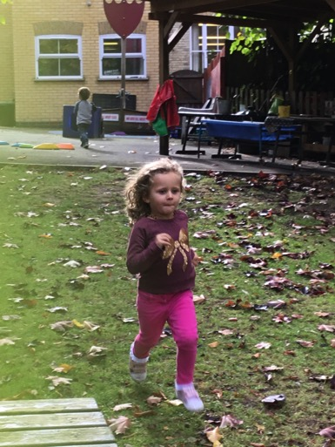
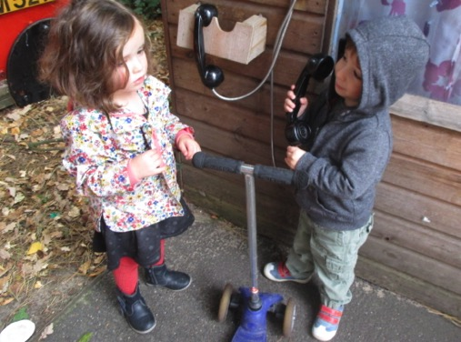
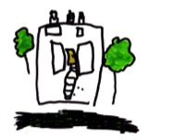
Everything I really needed to know I learned at Kindergarten…

Slide 3
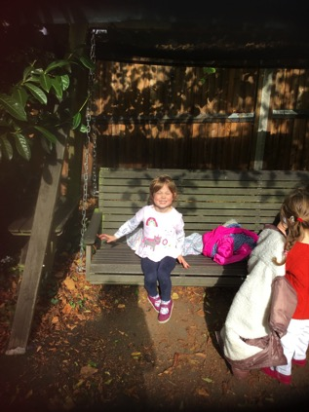
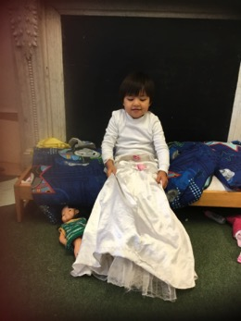
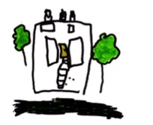
What kind of children do we want?
We want children to:
Be confident
Be able to manage their feelings
Develop social and communication skills - form positive relationships, respect one another, to listen, to challenge, to negotiate and to compromise
Be creative
Be imaginative
Be curious
Be problem solvers
Develop a positive disposition to learning – so that they become lifelong learners (it is much more than getting children “ready for school”)

Slide 4
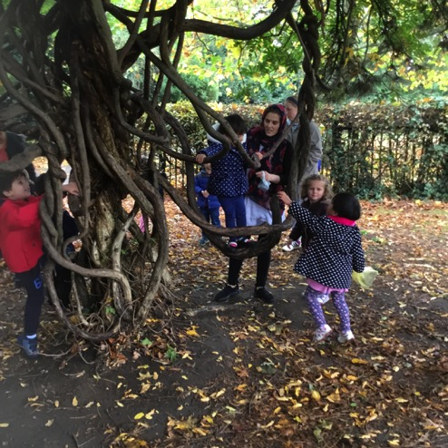
Characteristics of Effective Learning
Playing and Exploring
Children need to
Investigate
Experience things
Have a go
Notes:
What is this? What does it do? What if…? What else….? ( the questions of a scientist)
Initiate activities, seek challenges, take risks, develop a “can do” attitude

Slide 5
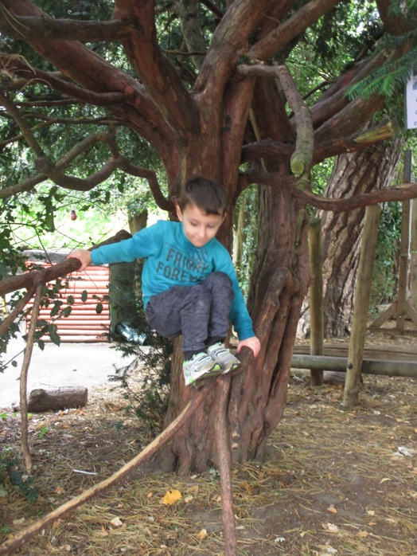
Characteristics of Effective Learning
Active Learning
Children need to
Concentrate
Keep on trying if they encounter difficulties
Enjoy their achievements
Notes:
Children will do this if they are intrinsically motivated – importance of self chosen activities – this is where you see children’s energy, focus, tenacity

Slide 6
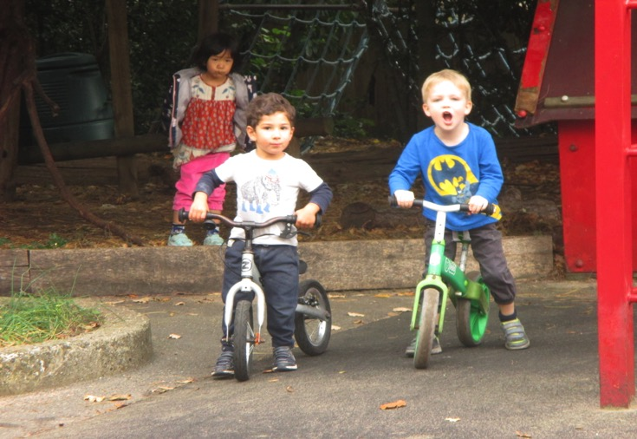
Characteristics of Effective Learning
Creating and thinking critically
Children need to:
Develop their own ideas
Make links between ideas
Develop strategies for doing things
Notes:
Thinking skills

Slide 7
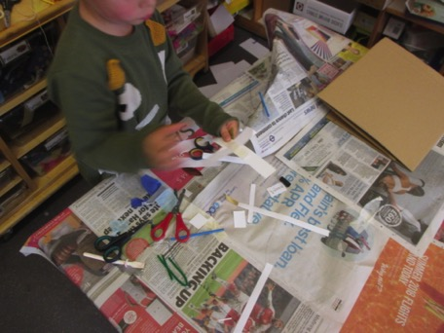
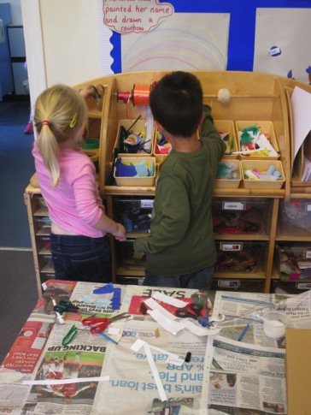
An enabling environment
We provide time, space and freedom for children to follow their ideas
We provide open-ended resources that can be used in many ways
Notes:
Build on children’s innate desire to learn

Slide 8
Positive relationships
We respect children
We delight in their company
We use genuine interactions
We bring out the best in a learning moment
We encourage children to keep wondering
We avoid focus on end products and external expectations
Notes:
Importance of process, genuine conversations, knowing children well

Slide 9
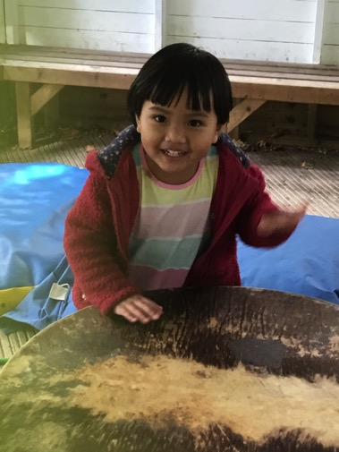
Getting it right
We know we have got it right when we see:
High levels of wellbeing
High levels of involvement
Notes:
Brain development – neural connections, effect of cortisol on higher cortex, frontal lobes ….

Slide 10
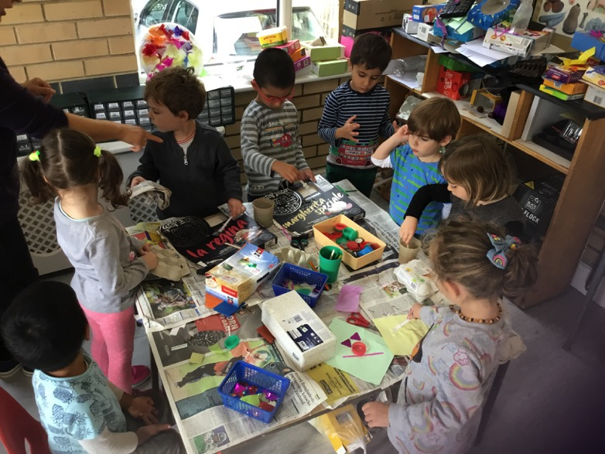
Find out more …..
www.foundationyears.org.uk
Talk to us. We love to talk about children!

