Slide 1
Coding and BEP Funding
Maryanne Durski (Maryanne.Durski@tn.gov), Executive Director, Local Finance
Trish Kelly (Trish.Kelly@tn.gov), Executive Director, Data Governance
Tennessee Data & Attendance Supervisors Conference
September 14, 2017

Slide 2
Session Overview
BEP Funding
Background
Changes
Timeline
English Learner (EL) BEP Funding
BEP Funding for English Learners
Relevant English Language Background Classifications
Count and Timeline
At-Risk: Economically Disadvantaged (ED)
BEP Funding for At-Risk/ED Students
ED Subgroup & Student Classifications
Members
Direct Participants in SNAP/TANF
Foster Care
Migrant
Homeless
Runaway
Checking Your Data in SIS and EIS

Slide 3
BEP Funding

Slide 4
BEP Funding - Background
BEP is the state’s funding formula for education.
Based on 45 components necessary for a basic education
Average daily membership (ADM) is the primary driver of the formula
Determines number of positions funded for each district
Determines funding for textbooks, instructional materials and supplies, equipment, capital outlay, etc.
EIS is system of record

Slide 5
BEP Funding - Background
Formula uses specific attendance months and weights them
Month 2 12.5%
Month 3 17.5%
Month 6 35.0%
Month 7 35.0%
Formula also uses month 5 to determine the number of school-based positions
Principal
Assistant principal
Librarian
Library assistants
School secretaries

Slide 6
BEP Funding - Changes
BEP Enhancement Act of 2016 was first major change to BEP formula since 2007
Special education options for funding were collapsed from 10 to 4
Pupil-teacher funding ratios for English Learners changed from 1:30 to 1:20; translator ratios from 1:300 to 1:200
Early graduation penalty was eliminated – coding of early graduates remains the same
At-risk was redefined

Slide 7
BEP Funding - Changes
At-risk definition
Prior to 2016 at-risk was defined as eligible for free or reduced price lunch through school nutrition program
New definition
Students directly certified (receiving benefits through SNAP or TANF)
Migrant
Homeless
Runaway
Foster Care
At-risk is funded at $863.25 per student – so correct coding is important to the district’s funding

Slide 8
BEP Funding - Timeline
Several key months during the year when ADMs are pulled for funding purposes
January – BEP growth funding
BEP estimates for upcoming year are sent out in
April
May
June
Final BEP for upcoming year is calculated the first week in July, after all ADMs for prior year are approved in EIS

Slide 9
English Learner (EL) BEP Funding

Slide 10
BEP Funding for English Learners
BEP formula provides positions specifically for English Learners
Teachers are funded at one per 20 EL students
Translators are funded at one per 200 EL students
Unit cost for teachers and translators in FY18 is $46,225 plus benefits (FICA, Medicare, TCRS, medical insurance)
Correct coding of EL students is critical to the funding of the district

Slide 11
Relevant English Language Background Classifications
Four English language background classifications determine English Learner (EL) BEP funding:
English Learner (L) - first language is not English and qualifies for/receives direct ESL services
Waived Direct ESL Services (W) - an English learner who declined direct ESL services in order to receive ESL services in a regular classroom
Transitional Year 1 (T1 or 1) - first transition year from ESL
Transitional Year 2 (T2 or 2) - second transition year from ESL

Slide 12
Count and Timeline
The number of students with the L, W, 1, and 2 English language background classifications enrolled on October 1, 2017 determines state BEP funding for English Learners (ELs) for SY 2018-19.
Consolidated Planning & Monitoring (CPM) will
provide districts two preliminary counts in September/October,
pull the data for the final count in on Friday, October 27, 2017, and
forward the final count to LEAs and Finance in early November.
LEAs review their data and upload revisions as needed.

Slide 13
At Risk: Economically Disadvantaged (ED)

Slide 14
BEP Funding for At-Risk/ED Students
BEP provides additional funding to districts for at-risk students based on an October 1 count
Amount per student in FY18 is $863.25
Districts in general have fewer direct certification students that students eligible for free or reduced price lunch
Amount of per student funding for at-risk was increased when the change was made in 2016
Some districts saw their overall at-risk funding decreases, some saw an increase, some remained the same – overall the change was neutral at state level

Slide 15
ED Subgroup
The economically disadvantaged subgroup for accountability and BEP funding consists of students eligible for free school meals due to
direct certification of economic disadvantage (J) as participants in federal/state income/nutrition programs (e.g., TANF, SNAP) or due to
categorical eligibility through their status as homeless (H), migrant (I), runaway (U) and foster care (FOS01) students.

Slide 16
ED Student Classification Summary
Participants in federal/state income/nutrition programs (e.g., TANF, SNAP)
coded with the J- Direct Cert student classification
Homeless, migrant, runaway, and foster care students
coded with the J- Direct Cert student classification AND
the H-Homeless, I-Migrant, U-Runaway, and FOS01-Foster Care student classifications, respectively.

Slide 17
Direct Participants in SNAP/TANF
LEAs identify direct participants in federal/state income/nutrition programs (e.g., SNAP, TANF) from the list that Human Services provides School Nutrition each month via secure server.
LEA School Nutrition or Technology staff
match the list against enrollment,
flag participants enrolled in the district in SIS (student information system) as
J-Direct Certification of Economic Disadvantage, and
upload the J-Direct Cert student classification to EIS (the department’s database).

Slide 18
Foster Care Students
LEAs identify foster care students from the list that DCS (Department of Children’s Services) provides School Nutrition each month via secure server.
LEA School Nutrition or Technology staff
match the list against enrollment,
flag foster care students enrolled in the district (regardless of replacement) in SIS as
FOS01-Foster Care AND
J-Direct Certification of Economic Disadvantage, and
upload these student classifications to EIS.

Slide 19
Migrant
Conexion Americas, acting on behalf of the department, certifies students as migrant based on qualifying moves that are tied to a qualifying arrival date (QAD).
QADs of 9/2/2014 or later required to qualify as migrant in 2017-18.
LEAs identify migrant students from the migrant student lists posted each month in the Resources folder in the TNMigrant website (http://tn.msedd.com).
LEAs code migrant students in SIS/EIS with the
Migrant (I) student classification AND
J-Direct Cert student classification.
For access to the TNMigrant website, migrant liaisons should contact Elena Cruz at Conexion Americas (elena@conexionamericas.org).

Slide 20
Migrant Student List in TNMigrant
Pay close attention to the Action_Needed column (rightmost column), which lists one of three actions:
Remove the migrant (I) student classification in SIS/EIS; the student is not migrant.
Add the migrant (I) student classification in SIS/EIS to identify the student as migrant.
None; the migrant (I) student classification is correct in SIS/EIS.

Slide 21
Homeless
The homeless student classification (H) is the core homeless identifier for funding as well as for accountability and assessment.
Homeless nighttime residence is also required for federal reporting.
Code homeless students with the
H-Homeless student classification, AND
J-Direct Cert student classification, AND
one of the four homeless nighttime residence codes:
01 - shelters or transitional housing,
02 - doubled up (living with other persons due to economic reasons).
03 - unsheltered (cars, parks, campgrounds, trailer parks, abandoned building), or
04 - hotels/motels due to lack of alternative adequate accommodations.

Slide 22
Runaway
A runaway is a youth under the age of 18 who leaves his/her home/legal residence without the permission of a parent or guardian.
Code runaway students with the
U-Runaway student classification AND
J-Direct Cert student classification.

Slide 23
Checking Your Data in EIS

Slide 24
Compare SIS and EIS Data
Take advantage of on-line and on-site opportunities to learn about your student information system (SIS) and EIS.
Meet regularly with program and technology staff as well as EIS contacts to review your data in SIS and EIS.
If your district permits program staff to access EIS, request a login.
Use the EIS Research Queries to compare the data in EIS with the data in your SIS.
Work with your technology team to identify and resolve discrepancies.
For assistance, contact the EIS Help Desk
(800) 495-4154 or (615) 532-6215
eis.help@tn.gov

Slide 25
Running EIS Research Queries
Log into EIS as a district or school user.
Select Data Reports / Research Queries.
Choose a research query from the list on the left side of the screen.
Enter year as the “fall” part of the school year.
Use 2017 for 2017-18 and 2016 for 2016-17.
In the School box, select All Schools for a district report.
Choose other filters if desired (e.g., grade, gender, race-ethnicity).
Select View Report (right side of the page).
To download the data to csv or Excel format, select the file icon (to the right of Find | Next).

Slide 26
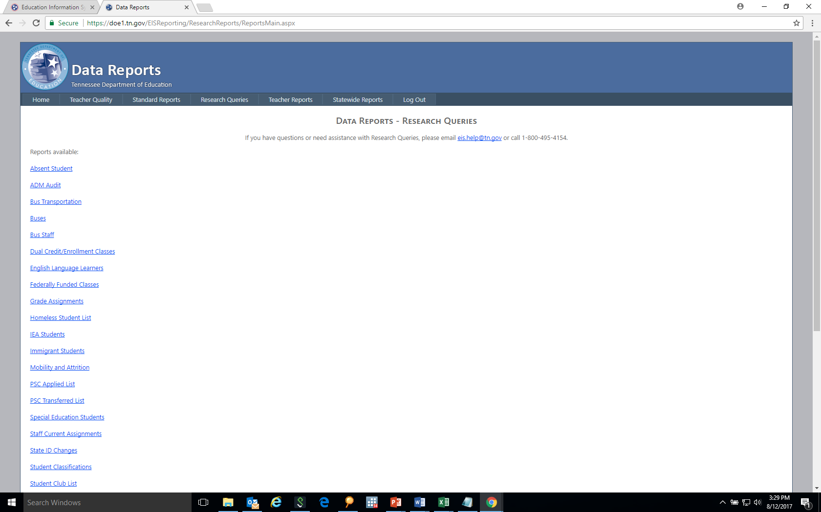
Research Query List

Slide 27
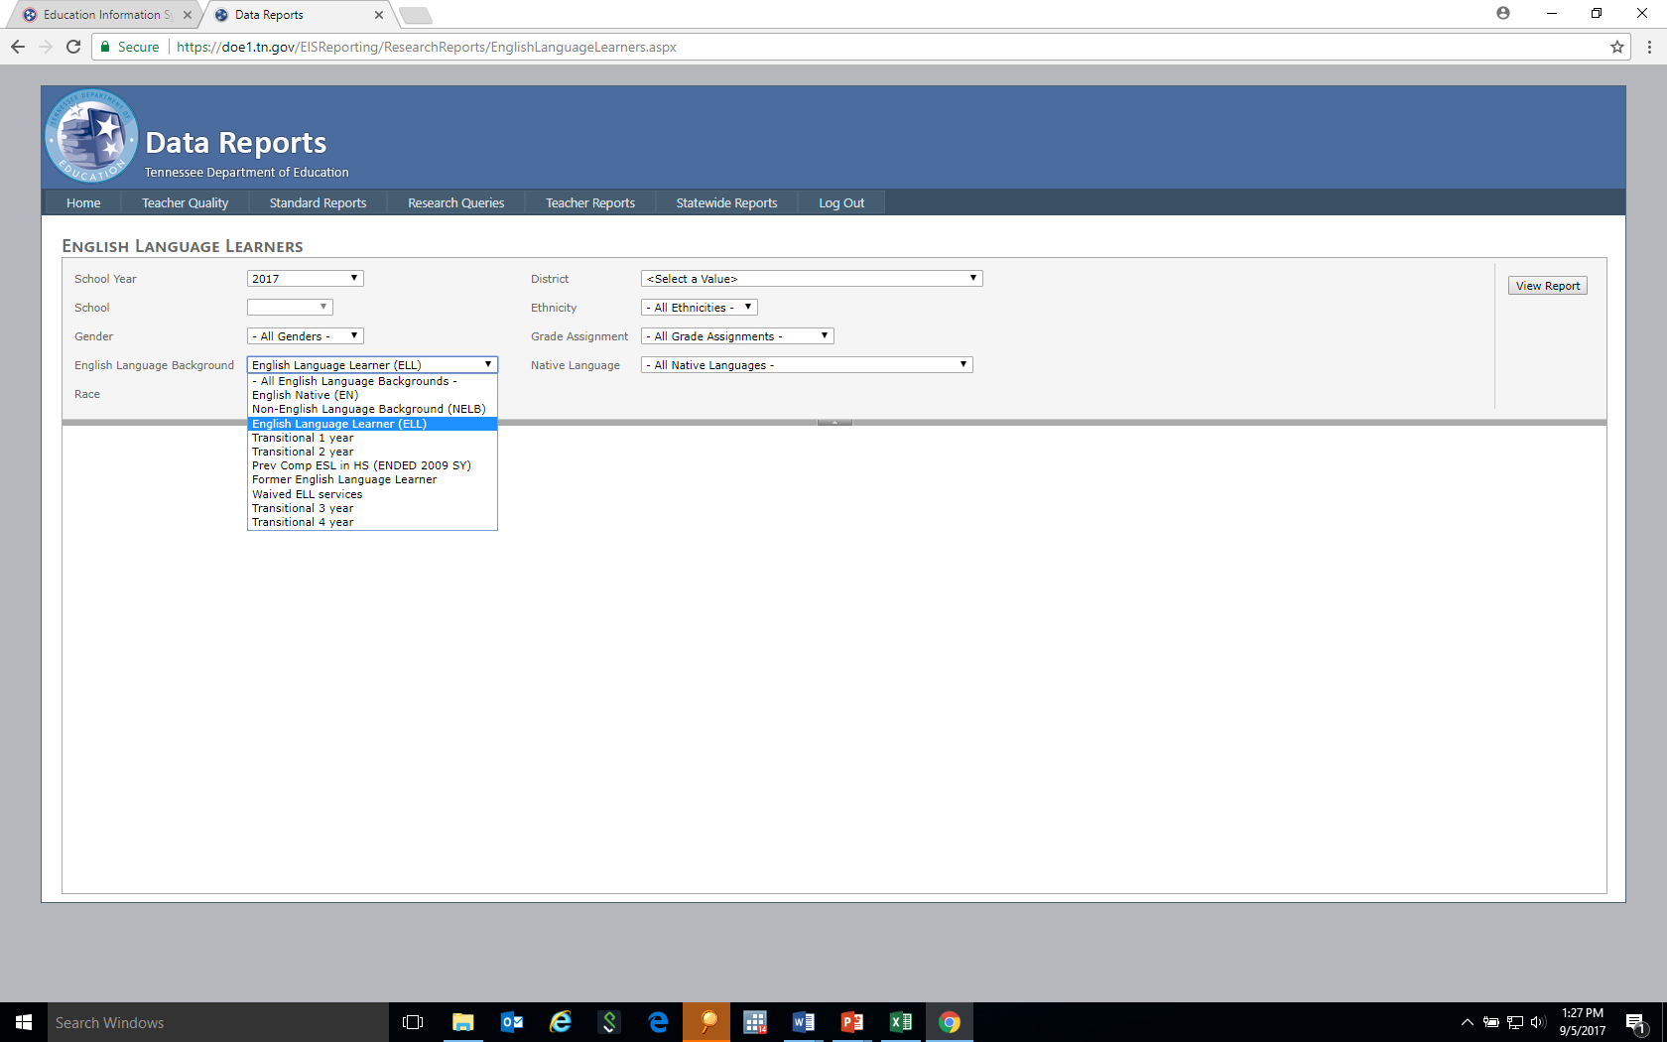
English Language Learner Research Query

Slide 28
English Language Learners Research Query
Select Data Reports / Research Queries / English Language Learners.
Select All English Language Backgrounds or choose one of the following:
English Language Learner (EL or ELL)
Transitional Year 1 (T1 or 1)
Transitional Year 2 (T2 or 2)
Waived Direct ESL Services (W)
Select Year and other filters if desired / View Report / Download as csv or Excel (file icon to the right of Find | Next).

Slide 29
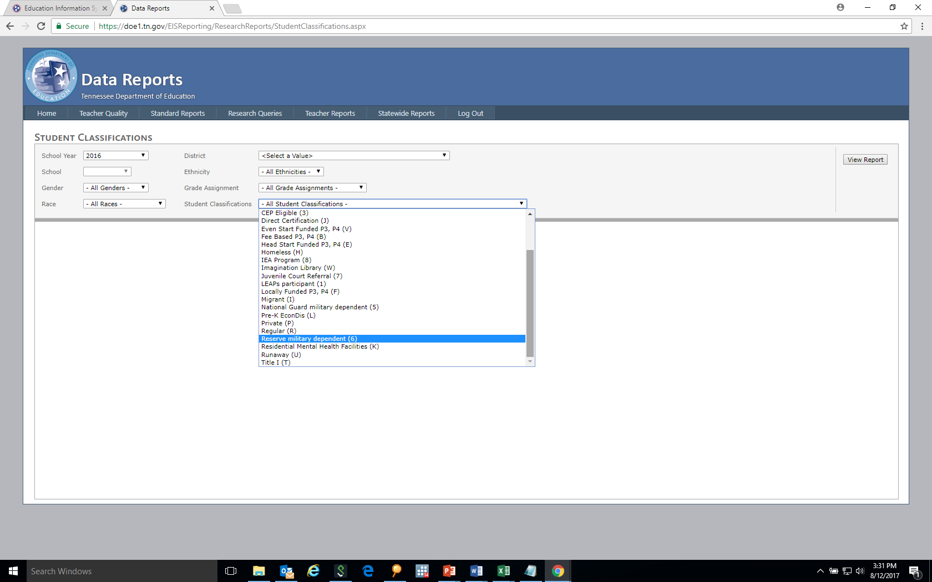
Student Classifications Research Query

Slide 30
Student Classifications Research Query
Select Data Reports / Research Queries / Student Classifications.
Select a Student Classification from the alphabetized list:
Direct Certification (J),
Foster Care (FOS01),
Homeless (H),
Migrant (I), or
Runaway(U).
Select Year and other filters if desired / View Report / Download as csv or Excel (file icon to the right of Find | Next).

