Slide 1
Arctic Cat Village
Pennington County Fair July 18-22, 2018
Thief River Falls, MN

Slide 2
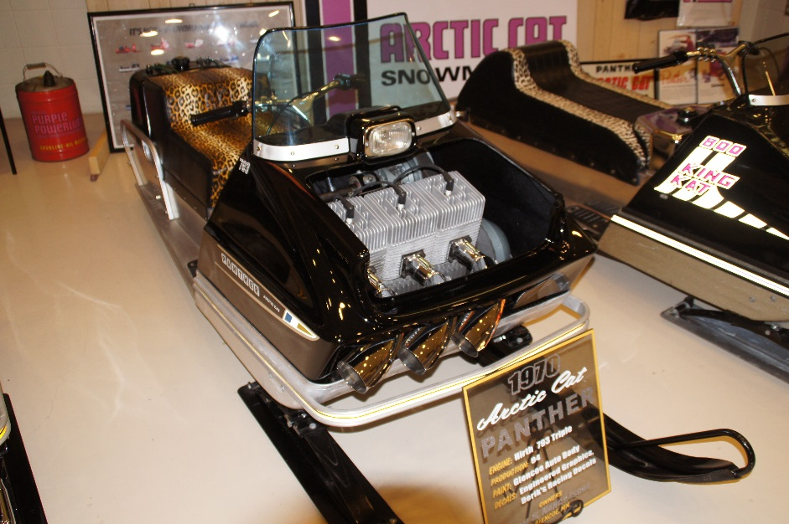
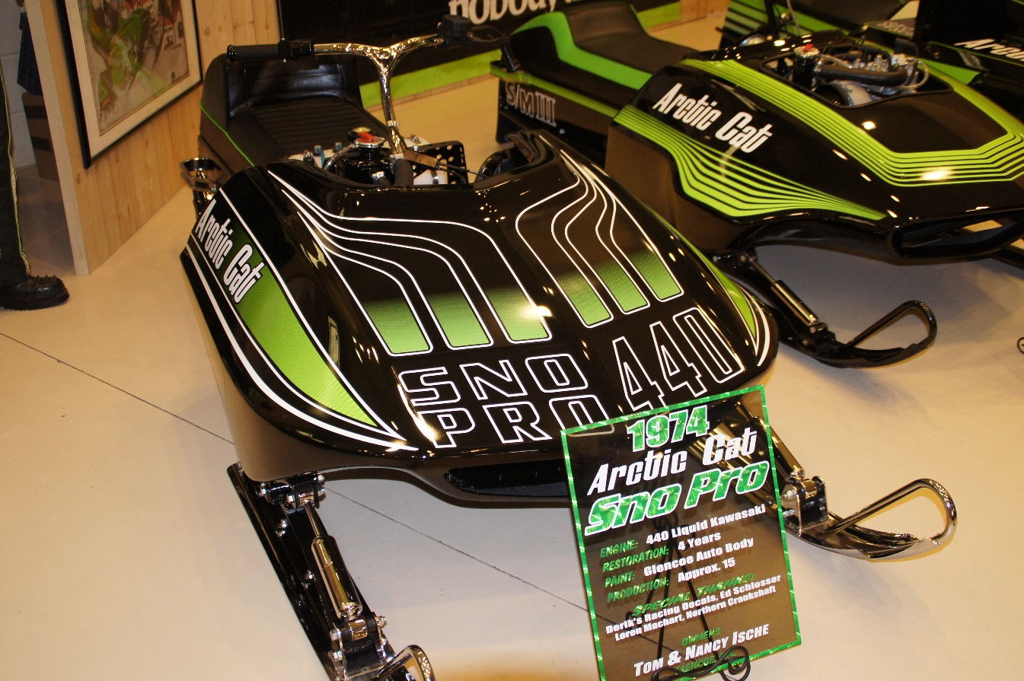
Tom Ische Vintage collection Display in TRF Archery building

Slide 3
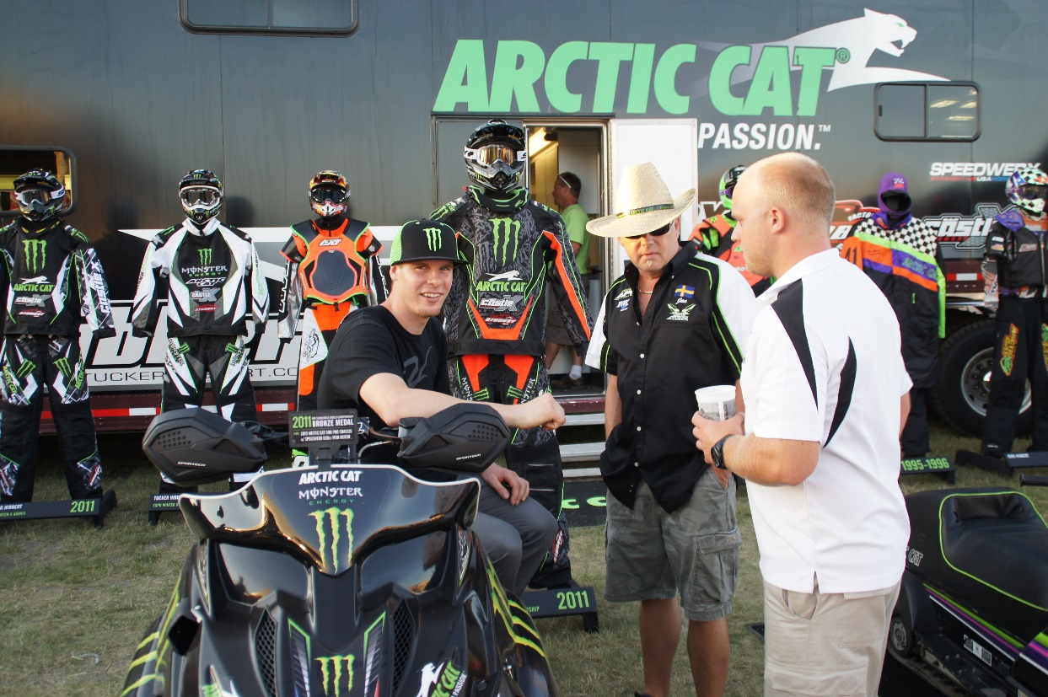
Race Teams & Trailers Team Arctic Autograph Session 5:00 to 7:00pm Thursday July 19th

Slide 4
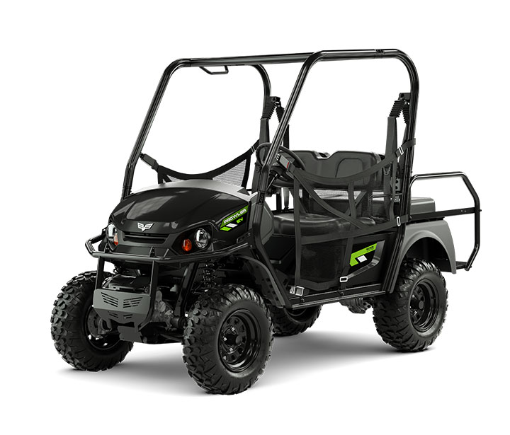
Raffle Grand Prize
Prowler EV
4 passenger
1,000 lbs towing capacity
Full-Time 4WD
72V AC Electric drivetrain
$10,499 USD MSRP

Slide 5
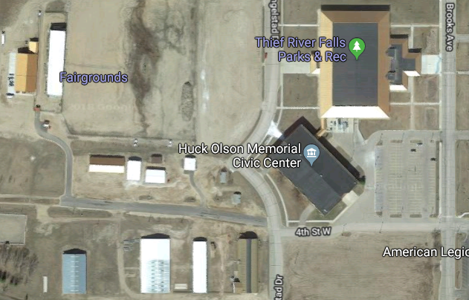
Archery building
Team Arctic race trailers

