Slide 1
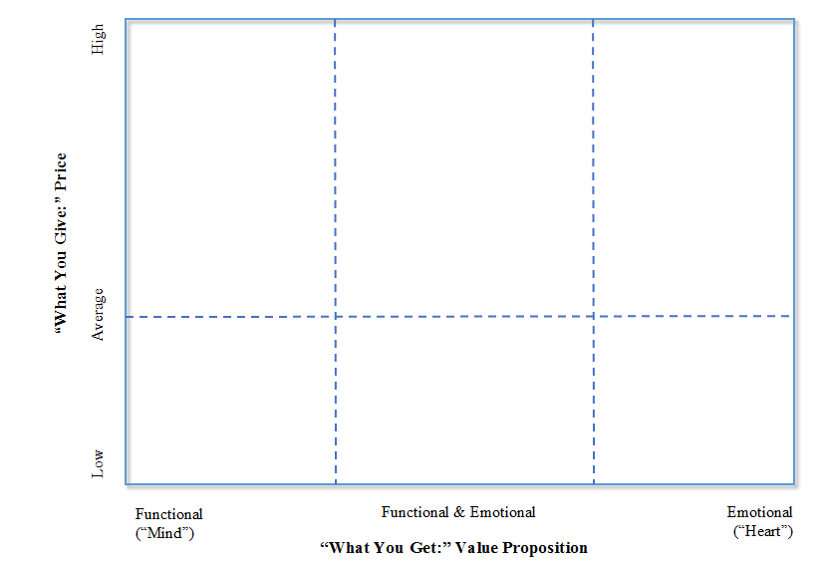
Customer propositions for global brands based on the fundamental components of market exchange

Slide 2
Value brands – adequate quality for a low price
Value
Brands

Slide 3
Global value brands

Slide 4
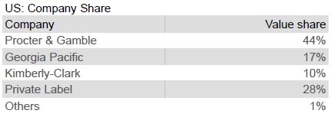
Price vs. quality

Slide 5
Brand relevance and brand loyalty in CPG
Brand
loyalty
China
Brazil
India
USA
Russia
Italy
Spain
Brand relevance
UK
France
Sweden
Norway
Denmark
Germany
Netherlands
Source: Own research based on survey among 22,000 consumers
© Prof. J-B.E.M. Steenkamp
Not to be reproduced without permission

Slide 6
Mass brands - high quality priced slightly above market average
Mass
Brands
Value
Brands

Slide 7
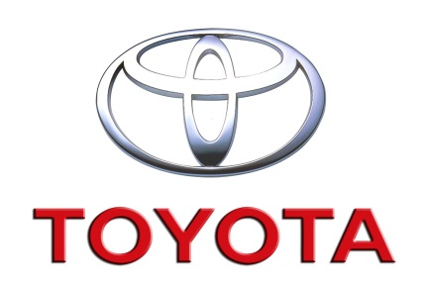
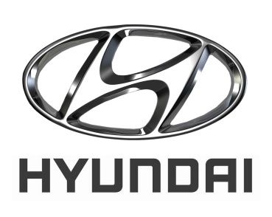
Global mass brands

Slide 8
Premium brands – Combining compelling logic and tantalizing magic
Premium
Brands
Mass
Brands
Value
Brands

Slide 9
Advertising a premium brand
https://www.youtube.com/watch?v=e7gR7EYjcP8

Slide 10
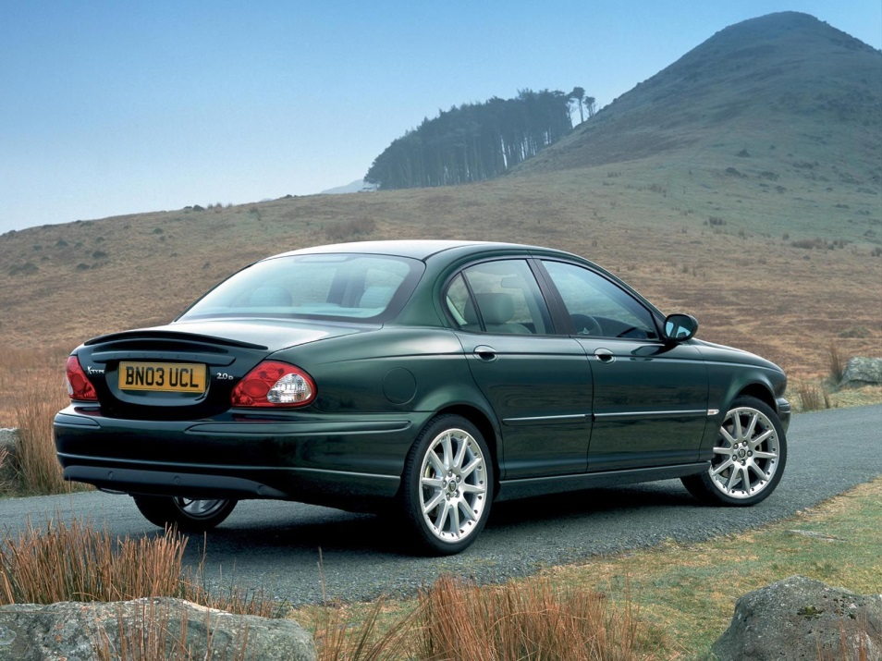
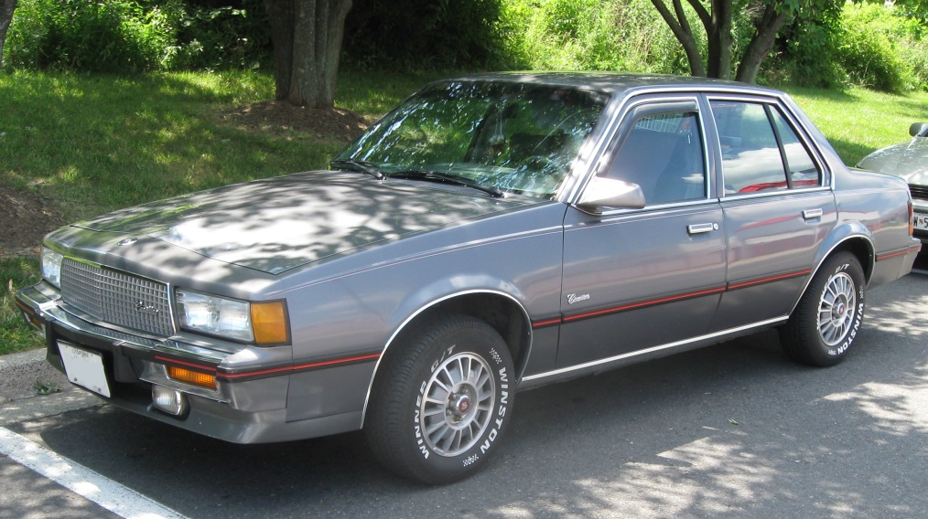
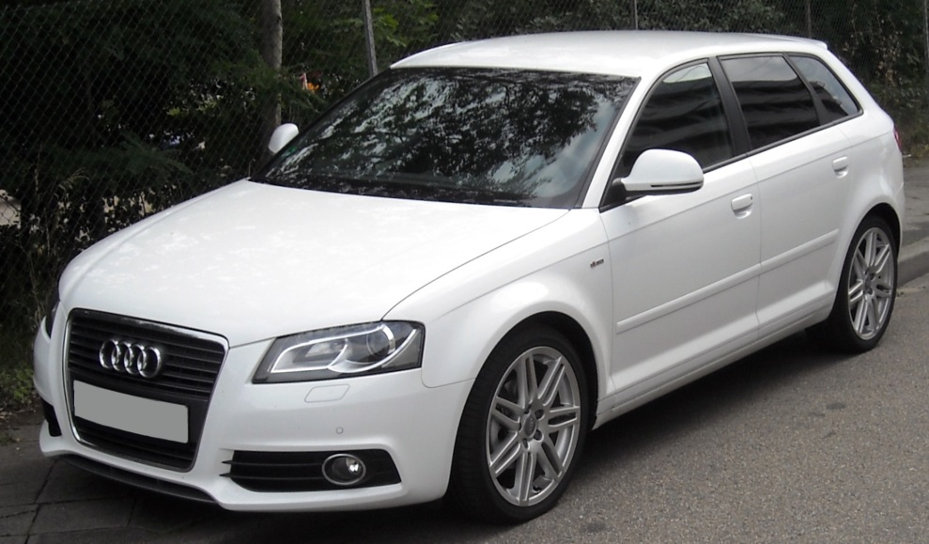
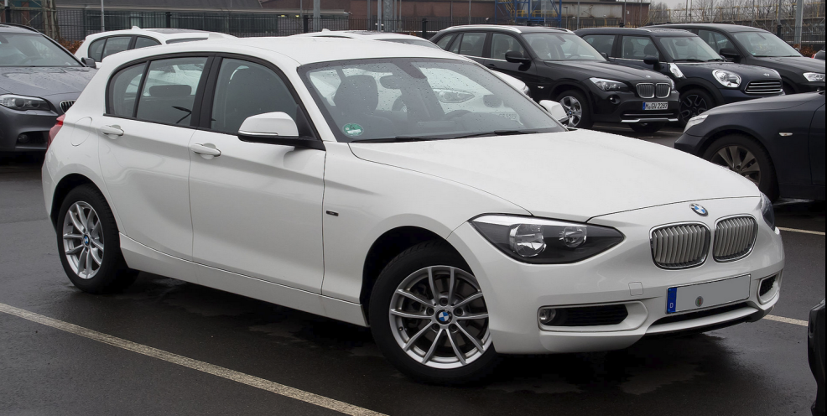
Premium brand challenge in action

Slide 11
Prestige brands – Aspirational and selective – exclude the many to appeal to the few
Prestige
Brands
Premium
Brands
Mass
Brands
Value
Brands

Slide 12
Global prestige brands

Slide 13
Prestige brands use global (deterritorialized) brand imagery
© Prof. J-B.E.M. Steenkamp
Not to be reproduced without permission

Slide 14
When you have it all ….
https://www.youtube.com/watch?v=TDuLS7SPe8A

Slide 15
Fun Brands – catering to the universal need for stimulation and new experiences
Prestige
Brands
Premium
Brands
Mass
Brands
Value
Brands
Fun
Brands

Slide 16
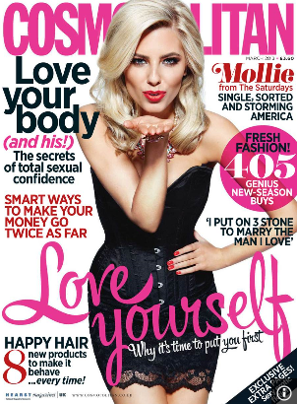
Global fun brands

Slide 17
Enjoyneering?
“At SEAT everything we know is everything you feel. We are Spanish and German and are passionate perfectionists. When you get behind the wheel of a SEAT car, you don't just go for a drive you go for an experience.”
https://www.youtube.com/watch?v=JngsC3QRD1k
https://www.youtube.com/watch?v=Lxnv1fx9FeY

Slide 18
Developing a meaningful and compelling customer proposition for your brand
Criteria:
Serves the needs and characteristics of your global target segment;
Drives purchase decisions;
Fit with firm capabilities;
Turns a profit in the short and long run; and
Distinguishes your brand from competitors.

Slide 19
Summarize your customer proposition in a single sentence
For ............... (definition of the global target segment), Brand X is ............ (definition of the category) which gives the most ......... (definition of differentiating benefits), because of .......... (reason to believe).

