Slide 1
2020 CASHA Workshop Cleft Palate and VPI: Overview, Assessment and Treatment
October 26, 2020
Jackie Klein, MA, CCC-SLP, MBA

Slide 2
Feeding and Swallowing Overview
Issues of Feeding
Issues of Swallowing

Slide 3
From Winston, April. Eating and Drinking Difficulties in Children. UK: Speechmark Publishing, LTD, 2005.

Slide 4
Assessment of Feeding
Bed side Swallow assessment
Videofluoroscopic Swallow Study
FEES

Slide 5
Feeding Concerns
Aspiration - Paramount Concern
Is the child SAFE to eat?
Established through bedside swallow evaluation with videofluoroscopic imaging if needed – likely dealing with a structural issue
Frequent upper respiratory infections – “muddies the waters”
Weight Gain
Small stature common and concerning – low percentiles for weight
Need dietary/nutrition involvement
If infant: birth weight vs. current weight
Failure to thrive?

Slide 6
Feeding Issues for Cleft Lip/Palate
Need to establish safe/efficient feeding techniques
Type of bottle
Positioning
Cleft care following feeds
Pre-op and post-op feeding techniques
Nasal reflux and retrograde flow (may not be consistent with VPI)
Need to consider both pre/post op instructions in therapy (e.g. Don’t teach sippy cup/straw if can’t use)
Caregiver anxiety large component in therapeutic processes

Slide 7
Feeding Techniques
Upright positioning
Jaw and cheek support
Positioning of nipple or breast
Burping due to excessive air
Limited feeding time
ASHA.org, 2020; Dailey, 2013

Slide 8
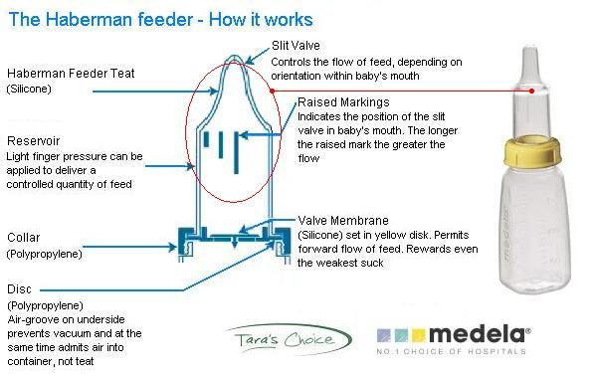
Haberman

Slide 9
Feeding- Behavioral
Behavioral approaches
Food chaining/webbing
Sensory play

Slide 10
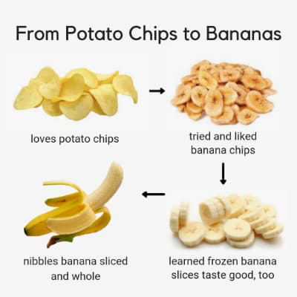
Food Webbing

Slide 11
Contact Information
Jackie Klein, MA, CCC-SLP, MBA
jklein@bethlehemspeechservices.com
518-536-4021

Slide 13
Works Cited
American Speech-Language-Hearing Association. (2016a). Code of ethics[Ethics]. Available from www.asha.org/policy/.
The Best Hemifacial Microsomia Surgery Providers in Delhi | Dr Arun Kumar. (n.d.). Www.Delhicraniofacialsurgery.Com. Retrieved from https://www.delhicraniofacialsurgery.com/hemifacial-microsomia
Brito, L. A., Castro Meira, J. G., Kobayashi, G. S., & Passos-Bueno, M. R. (2012). Genetics and management of the patient with orofacial cleft.Plastic Surgery International, 2012. Retrieved fromhttps://www.ncbi.nlm.nih.gov/pmc/articles/PMC3503281/. Advance online publication. doi:10.1155/2012/782821
Comprehensive Assessment for Cleft Lip and Palate. (2013). Asha.Org. Retrieved from https://www.asha.org/Practice-Portal/Clinical-Topics/Cleft-Lip-and-Palate/Comprehensive-Assessment-for-Cleft-Lip-and-Palate/
Dailey, S. (2013). Feeding and swallowing management in infants with cleft and craniofacial anomalies. Perspectives on Speech Science and Orofacial Disorders, 23, 62–72.
Dhillon RS. The middle ear in cleft palate children, pre and post palatal closure. J R Soc Med. 1988;81:710–3.
García Velasco, M., Ysunza, A., Hernandez, X., & Marquez, C. (1988). Diagnosis and treatment of submucous cleft palate: A review of 108 cases. The Cleft Palate Journal, 25, 171–173.
Goldenberg, D. C., Hiraki, P. Y., Marques, T. M., Koga, A., & Gemperli, R. (2016). Surgical Treatment of Facial Infantile Hemangiomas. Plastic and Reconstructive Surgery, 137(4), 1221–1231. doi: 10.1097/prs.0000000000002016
Golding-Kushner, K. J. (2001). Therapy techniques for cleft palate speech and related disorders. Clifton Park, NY: Delmar Learning.
Grames, L. M., & Patel, K. (2016). Current Practices and Controversies in Management of the Submucous Cleft Palate. Perspectives of the ASHA Special Interest Groups, 1(5), 59–69. doi: 10.1044/persp1.sig5.59
Hess, D. A., & McDonald, E. T. (1960). Consonantal Nasal Pressure in Cleft Palate Speakers. Journal of Speech and Hearing Research, 3(3), 201–211. doi: 10.1044/jshr.0303.201
The Human Body Interactive Notebook (Circulatory, Respiratory, Nervous Systems). (n.d.). Teachers Pay Teachers. Retrieved from https://www.teacherspayteachers.com/Product/The-Human-Body-Interactive-Notebook-Circulatory-Respiratory-Nervous-Systems-3523860?st=c0942b027693948d2c01c9e42bc89694 Consonantal nasal pressure in cleft palate speakers. 1. Speech Heating Res., 3, 201-211 (1960).

Slide 14
Works Cited Continued
Kelly, A. B. (1910). Congenital insufficiency of the palate. The Journal of Laryngology, Rhinology, and Otology, 25, 281–300.
Kummer, A. W. (2014). Speech and Resonance Disorders Related to Cleft Palate and Velopharyngeal Dysfunction: A Guide to Evaluation and Treatment. Perspectives on School-Based Issues, 15(2), 57. doi: 10.1044/sbi15.2.57
Mossey, P. A., Little, J., Munger, R. G., Dixon, M. J., & Shaw, W. C. (2009). Cleft lip and palate. The Lancet, 374, 1773–1785.
Parker, S. E., Mai, C. T., Canfield, M. A., Rickard, R., Wang, Y., Meyer, R. E., Correa, A. (2010). Updated national birth prevalence estimates for selected birth defects in the United States, 2004-2006. Birth Defects Research Part A: Clinical and Molecular Teratology, 88, 1008–1016.
Philadelphia, T. C. H. of. (2014, May 12). Hemifacial Microsomia. Www.Chop.Edu. https://www.chop.edu/conditions-diseases/hemifacial-microsomia
Price, MD, A. (n.d.). Positional Plagiocephaly – Symptoms, Diagnosis and Treatment. Www.Aans.Org. Retrieved from https://www.aans.org/en/Patients/Neurosurgical-Conditions-and-Treatments/Positional-Plagiocephaly
Reiter R, Brosch S, Wefel H, Schlömer G, Haase S. The submucous cleft palate: diagnosis and therapy. Int J Pediatr Otorhinolaryngol. 2011 Jan;75(1):85-8. doi: 10.1016/j.ijporl.2010.10.015. Epub 2010 Nov 26. PMID: 21112097.
Tomes, L.A., Kuehn, D.P., & Peterson-Flazone, S.J. (2004). Behavioral treatment of velopharyngeal impairment. In K.R. Bzoch (Ed.), Communicative disorders related to cleft lip and palate (5th ed). Austin: Texas: Pro-Ed.
Videofluoroscopy. (n.d.). Vcfvcfs. Retrieved from https://www.vcfscenter.com/videofluoroscopy
Winston, A. (2005). The practical management of eating and drinking difficulties in children April Winstock The practical management of eating and drinking difficulties in children Speechmark Publishers Ltd No of Pages: 124 £31.50 0863883761 0863883761. Paediatric Nursing, 17(4), 10–10. doi: 10.7748/paed.17.4.10.s12
World Health Organization. (2001, December). Global registry and database on craniofacial anomalies: Report of a WHO registry meeting on craniofacial anomalies. Bauru, Brazil: Author.

