Slide 1
Populations
Chapter 2 (Part 2)

Slide 2
Measuring Populations
Why do scientists measure populations?

Slide 3
Measuring Populations
Scientists measure populations because the information can indicate whether or not a population is healthy and growing
Population counts also help identify if a population could be in danger of disappearing

Slide 4
Measuring Populations
How do scientists measure populations?

Slide 5
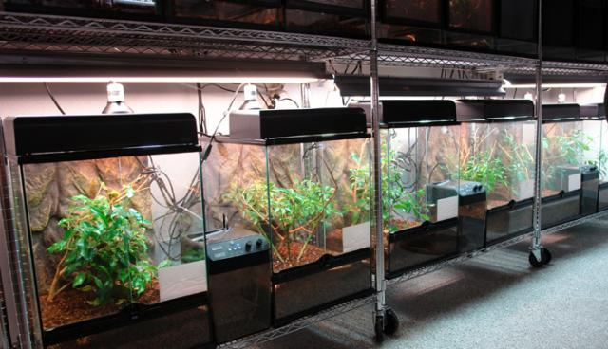
Masuirng Populations
One way is calculating population density.

Slide 6
Population density
Population density is the number of individual species per specific area
You could count all of the crickets in each tank or you could calculate the number of crickets per a specific area and then compare that to other containers (tanks)

Slide 7
Measuring Crickets
Crickets are tricky. They are small and move around a lot.
Counting them is difficult.
What if you wanted to measure the number of crickets in a field?

Slide 8
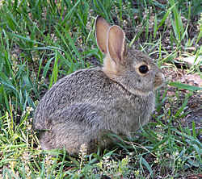
Measuring Populations
Scientists have problems measuring wildlife populations as well
One of the methods they use is called
trap and release

Slide 9
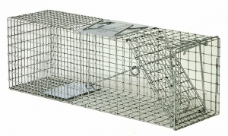
Trap and Release for Estimating Population Size
Ecologists set traps
Captured rabbits are marked and releseased
Later, another sample of rabbits is captured
Some will have marks, some will not
By comparing the number of
marked and unmarked rabbits
in the second sample,
ecologists can estimate population size

Slide 10
Sample Counts for Estimating Population Size
Wildebeests

Slide 11
Sample Counts
To estimate the number of wildebeests in 100 acres you could count the number of wildebeests in 1 acre and multiple by 100.
This method is called sample counting

Slide 12
Review
What is population density?
What are 3 ways that ecologists can measure a population?

