Slide 1
Anton Ulrich
John Wietfeld
Joseph Coleburg Casper Gotten
Jacob Boiven
Henry D. Warnack Richard Baker
Henry Herman
John Gahlert Harz Becker
Sophie Hagerman Wietfeld John Vallah
Larry Burger
farmer potter potter farmer weaver potter laborer
laborer
potter laborer
homemaker laborer servant
John Wietfeld / Anton Ulrich Pottery
1836 - 1876
The life-long partnership of two half brothers accounts for one of the greatest longevities of any Illinois potters, spanning four decades. Their Upper Alton pottery operated 1836 to 1876. Farmer Antony Ulrich and potter John Wietfeld emigrated in 1836 to Upper Alton from Westphalia, Prussia. The brothers brought their trade to America from the Rheinish Valley, where the technique of salt glaze stoneware was developed in the 16th Century, and greatly impacted the Upper Alton pottery center.
Notes:
The Ulrich/Wietfeld Pottery was ---- The life-long partnership of two half brothers accounts for one of the greatest longevities of any Illinois potters. Their Upper Alton pottery operated 1836 to 1876. Farmer Antony Ulrich and potter John Wietfeld emigrated in 1836 to Upper Alton from Westphalia, Prussia. The brothers brought their trade to America from the Rheinish Valley, where the technique of salt glaze stoneware was developed in the 16th Century, and greatly impacted the Upper Alton pottery center. Antony Ulrich and John Wietfeld developed a farm and pottery south of College Road and one fourth a mile east of Seminary Street, near the toll gate.

Slide 2
Notes:
THE BLACK ARROW DESGNATES LOCATION OF THE ULRICH-WIETFELD FARM AND POTTERY
at south side of College Ave , quarter mile east of Seminary St.

Slide 3
FIGURE 30: The Ulrich-Wietfeld Farm and Pottery south side of College Road one third mile east of Seminary Street in Upper Alton, Illinois. Three men wear potter aprons. Two stand at left in front of fence and potter Anton Ulrich Jr. is standing behind fence The little girl in front of fence, by horses nose, is the eight year old daughter of John and Sophie Wietfeld, Eleonore Helena Wietfeld. Antony Ulrich is behind her. Directly behind horse is John Wietfeld and the lady in gate opening, immediately behind front wagon wheel, is Sophie (Hagerman) Wietfeld. Appearing in immediate left background of house is the pottery kiln chimney. A rack behind carriage stores stoneware vessels. cc: 1865.
Photograph courtesy of Jacqueline Brashear, great-granddaughter of John and Sophie Wietfeld. The little girl in front of fence is Mrs. Brashear’s maternal grandmother, Eleonore Helena Wietfeld.
Notes:
HERE WE HAVE AN INCREDIBLY IMPORTANT HISTRORICAL ALTON ARCHIVE ...... This photograph is courtesy of Jacqueline Brashear, the great-granddaughter of potter John and Sophie Wietfeld. The little girl in front of fence is Mrs. Brashear’s maternal grandmother, Eleonore Helena Wietfeld.
PLEASE NOTE THE LOCATION OF THE RED ARROW ….. The little girl in front of fence, by horses nose, is the eight year old daughter of John and Sophie Wietfeld, Eleonore Helena Wietfeld. Antony Ulrich is behind her. Directly behind horse is John Wietfeld and the lady in gate opening, immediately behind front wagon wheel, is Sophie (Hagerman) Wietfeld.

Slide 4
General proximity of Ulrich-Wietfeld farm and pottery
West of Homer Adams Pky, South of College Ave.
GRAVE OF SOPHIA HAGERMAN WIETFELD
Notes:
Here, we have some Modern Ulrich-Wietfeld related photography
THE RED ARROW…………SOUTH OF COLLEGE AVE, WEST OF HOMER ADAMS PKWY, the General location of farm and pottery.
The child, is my young daughter at 7 yrs old , MEREDITH FINDING SHARDS…… (she’s now 31)
The lady is Wietfeld descendant, JACQUELINE BRASHEAR IN 1998, PLACING FLOWERS BY GRAVE OF HER GREAT GRANDMOTHER SOPHIA HAGERMAN WIETFELD

Slide 5
Sample of Ulrich-Wietfeld vessels.
Notes:
This is a sample of Ulrich-Wietfeld vessels. The Ulrich-Wietfeld pottery predominately manufactured utilitarian salt glazed stoneware. Some bear a unique impressed capacity stamp encircled by dentates. This circular perimeter dentate mark has a specific dot configuration and dentate count that securely signifies a vessel produced at the Ulrich-Wietfeld site. This dentate mark is securely identified, based on numerous State and amateur site excavations of the pottery known waster dumps, and surviving whole vessels within private collections.

Slide 6
FIGURE 34: Impressions of dentate capacity stamps of Ulrich-Wietfeld wares, taken directly off Type I and Type II vessels. The above 1, 2 (top left) 3, 4, 5, and 6 gallon dentated capacity marks are Type I with a diameter of 2.0 cm. The capacity “2” at top center is the Type II variety with a diameter of 2.5 cm. Type II dentate capacity marked vessels are scarce, where one 1 gallon ovoid jar, one 2 gallon ovoid storage necked jar, and one 2 gallon ovoid jug, are known in private collections.. Known Type II vessels or shards are not two-toned. NOTE: Type I complete vessels in the 1, 2, 3, and 5, gallon capacities bear a 22 count of dentates while 4 and 6 gallon capacity Type I vessels bear a 20 dentate count. One 1 pint (above bottom right) bears the unique Type III, 1.5 diameter, 24 count, dentate impressed mark. One 6 gallon and two 3 gallon Type I dentate marked jars include an added “U.C.” (Ulrich & Co.) stamping. Any deviation to the Type I and Type II dentate count, configuration, and impressed numeral design, is virtually non-existent. Vessels produced by the hands or student potters at the Ulrich–Wietfeld Pottery College most likely used the dentated mark stamp. For example, one known 1 gallon ovoid jug bears an impressed “J. MILLER” and the Type I 2.0 cm diameter, 24 count, dentated mark. This vessel is unique (See page 89).
Notes:
PLEASE NOTE THE YELLOW ARROWS. The circular dentated capacity stamps are the distinct marks featured at the Ulrich-Wietfeld pottery. A series of small rectangular blocks form a perimeter and enclose an ornate styled number that designates the gallon capacity of the vessel. The dentate capacity stamp helps tie the vessel time frame with a vessel style and dentate configuration is one of the major identifying characteristics, traits, or habits, of Ulrich-Wietfeld stoneware.
Curiously, 1, 2, 3, and 5 gallon vessels feature a dentated circle stamp that contains exactly twenty-two blocks. All known 4 and 6 gallon vessels have a dentated circle of twenty blocks.

Slide 7
Type I dentate bowls, everted rim with kiln marks, and 1 groove primary exterior treatment.
Notes:
Type I dentate bowls, everted rim with kiln marks, and 1 groove primary exterior treatment.

Slide 8
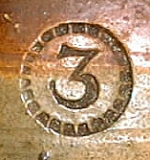
Notes:
Ulrich-Wietfeld impressed Dentate Stamp (Type I (diameter 2.0 cm) -------- 1, 2, 3, 5, have 22 dentates, 4 and 6 have 20 dentates.)

Slide 9
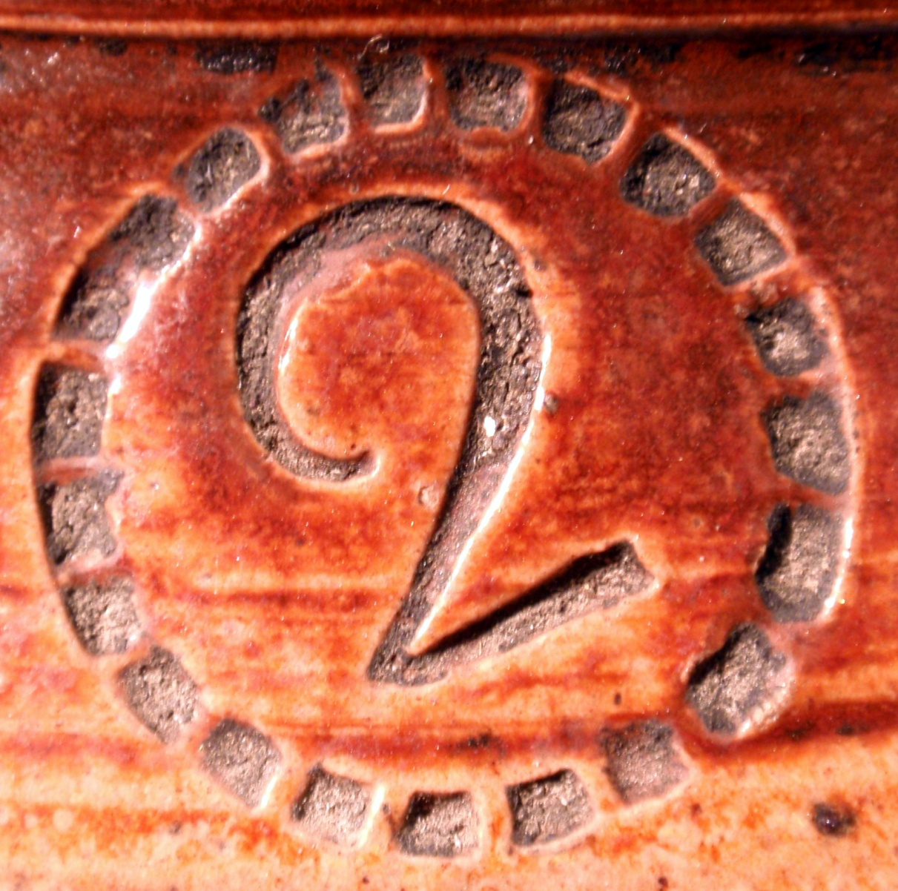
Notes:
Type I 2 gallon capacity mark………. Circle diameter of 2.0 cm with 22 dentates (yellow arrow)/

Slide 10
FIGURE 35: 5 gallon Ulrich-Wietfeld storage jar
featuring an everted rim, rectangular kiln furniture
marks, short slip height, ridged cordon primary
exterior treatment, smooth lug handles with finder welds,
and the Type I, 2.0 cm diameter, 22 count, dentate mark.
cc: 1860
Notes:
gallon Ulrich-Wietfeld storage jar featuring an everted rim, rectangular kiln furniture marks, short slip height, ridged cordon primary exterior treatment, smooth lug handles with finder welds, and the Type I, 2.0 cm diameter, 22 count, dentate mark. cc: 1860
The precise diameters of the Type I, Type II, and Type III circles are respectively 2.0cm, 2.5cm and 1.5cm.

Slide 11
Type II dentate
1 gallon ovoid jar. cc: 1840
Notes:
Ulrich Wietfeld type II mark with diameter of 2.5cm.
one gallon ovoid jar. cc: 1840,
(also featuring 22 dentates)

Slide 12
Type II mark, 2.5 cm diameter, 22 dentate count, 2 gallon ovoid jar.
cc: 1840
Notes:
2 gallon ovoid storage jar bearing Type II, 2.5 cm diameter, 22 dentate count, (type II are early cc: 1840)

Slide 13
FAMILY PORTRAITS
AND HEIRLOOMS
OF
JOHN WIETFELD.
Notes:
WIETFELD FAMILY PHOTOGRAPHS

Slide 14
Notes:
THESE ARE WIETFELD FAMILY HEIRLOOMS THAT WERE PASSED DOWN PASSED BY JOHN WIETFELD’S DAUGHTER ELONORE.
PICTURED ARE BOOKS, THEIR FAMILY GERMAN BIBLE, DUGAREOTYPE TINS, AND AN AUTOGRAPH BOOK OF ARTISTIC PERSONALIZED CARDS FROM ELEONORE’S HIGH SCHOOL FRIENDS.

Slide 15
Upper Alton potter John Wietfeld. cc: 1832
Notes:
THIS IS A VERY IMPORTANT PHOTOGRAPH OF
Upper Alton potter John Wietfeld. cc: 1832
About the time coming to Upper Alton

Slide 16
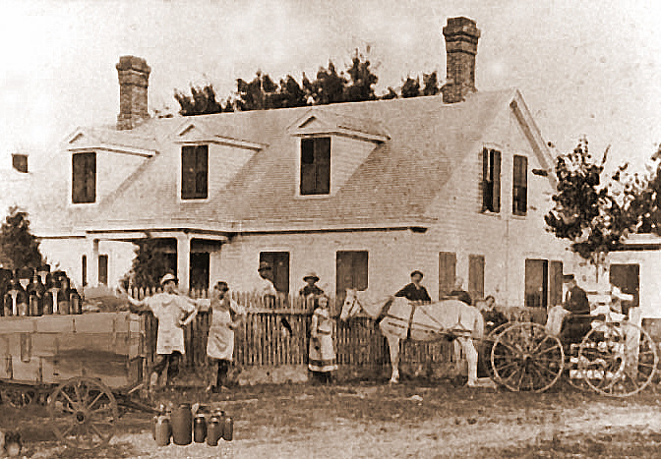
Notes:
RED ARROW (at bottom center) 8 yr old child - Eleonore Helena Wietfeld in front of horse
BLUE ARROW -John Wietfeld behind horse shoulder
GREEN ARROW -Sophia Hagerman Wietfeld behind carriage front wheel

Slide 17
John Wietfeld cc: 1865
Sophie Hagerman Wietfeld
Sophie E. Wietfeld 1858 - 1880
Notes:
AT TOP John Wietfeld cc: 1865 Sophie Hagerman Wietfeld cc: 1865
BELOW IS Sophie E. Wietfeld 1858 - 1880

Slide 18
Sophie and child Eleonore Wietfeld cc: 1860
Notes:
This is John Wietfeld’s wife Sophie Hagerman Wietfeld and child Eleonore Wietfeld cc: 1860

Slide 19
Eleonore Wietfeld Koordt
cc: 1900 / 1939
Notes:
More on that little girl in front of horse…….. Eleonore Wietfeld Koordt 1900 / 1939

Slide 20
Notes:
worth reviewing again is the red arrow……..
RED ARROW (at bottom center) 8 yr old child - Eleonore Helena Wietfeld in front of horse
BLUE ARROW -John Wietfeld behind horse shoulder
GREEN ARROW -Sophia Hagerman Wietfeld behind carriage front wheel

Slide 21
Wietfeld family heirloom photograph
of Infantry Private Union Soldier.
Pencil scratching at right may read
(Henry D.) “Warnack.”
Notes:
Wietfeld family heirloom photograph of Infantry Private Union Soldier.
Pencil scratching at right may read (Henry D.) “Warnack.”

Slide 22
Advertisement in the 1866 Gazetteer of Madison County.
Warnack and Ulrich-Wietfeld, neighboring stoneware manufacturers, advertising together.
Notes:
Advertisement in the 1866 Gazetteer of Madison County.
Warnack and Ulrich-Wietfeld, neighboring stoneware manufacturers, advertising together

Slide 23
Isaac Warnack Henry Warnack Frederick Warnack Thomas Warnack George L. Warnack Henry D. Warnack Henry Bundock Samuel Bundock
carpenter farmer/potter potter
potter apprentice potter apprentice
potter
neighbor / potter neighbor / potter
Isaac E. Warnack & Son
1843 - 1868
Warnack, Isaac E. & Son
Isaac E. Warnack was born in Pennsylvania in 1801. He emigrated from Knoxville, Knox County, Tennessee, where attempts to make alkaline glazed stoneware began in the 1820s by neighboring farmers, Jacob Harmon and Jacob Lonas, on the Lonas tract. However, no absolute connection has surfaced between the Warnacks, Harmons, and Lonas families and the shards recovered on the Lonas farm in Tennessee. In 1832, Isaac Warnack settled in the village of Salu with his mother Elizabeth, and his brother Henry Warnack. Indicated in the Madison County Record Book 26:165-166 is Warnack’s purchase of 34 acres where the pottery was established 1834 north of Salu Street on west side of Seminary. The census of 1850 lists:
Isaac E. Frederick Thomas Susan George L.
49 yrs., Carpenter.
25 yrs. Potter.
13 yrs.
10 yrs.
9 yrs.
In 1850, residing at the Anthony Ulrich residence was Isaac E. Warnack’s son, twenty-one year old Henry D. Warnack. Likely, Henry D. Warnack was a student and apprentice potter at the Ulrich- Wietfeld site and joined the Warnack pottery in about 1854. The Warnack pottery employed five men in 1850. Their techniques of dipping salt glazed vessels, creating a distinctive two-tone effect, made a great impact on the Upper Alton pottery center and among competitors and employees that may have later utilized this technique in potting elsewhere in Upper Alton and at other nearby communities. Jacob Stizelberger lived in St. Louis and St. Charles, Missouri, in close proximity to Upper Alton, and settled in Belleville, St. Clair County. Three two-toned churn attributed to Jacob Stizelberger pottery bearing impressed stamp “Belleville, Ills” exist in private collections.
Notes:
Next is the pottery of Warnack, Isaac E. & Son ----- Isaac E. Warnack was born in Pennsylvania in 1801. He emigrated from Knoxville, Knox County, Tennessee, where attempts to make alkaline glazed stoneware began in the 1820s by neighboring farmers, Jacob Harmon and Jacob Lonas, on the Lonas tract. In 1832, Isaac Warnack settled in the village of Salu with his mother Elizabeth, and his brother ( another family member named Henry Warnack.)

Slide 24
FIGURE 50: Warnack pottery, north of Salu Avenue, west of Seminary Street.
FIGURE 51 Warnack waster dump located behind tree at center
On west side of Seminary Street.
VIVINITY NORTH OF SALU ST. , WEST OF SEMINARY ST.
Notes:
The Warnack pottery was located north of Salu, west of Seminary Street.
Indicated in the Madison County Record Book 26:165-166 is Warnack’s purchase of 34 acres where the pottery was established 1834 north of Salu Street on west side of Seminary.

Slide 25
Sample of marked “H.D. Warnack / Upper Alton, Ill.”
Impressed type set style mark.
Notes:
HERE IS A SAMPLE of marked “H.D. Warnack / Upper Alton, Ill.”
Impressed type set style mark.

Slide 26
Sample of marked “H.D. Warnack / Upper Alton, Ill.”
Impressed type set style mark.
Notes:
HERE, ANOTHER Sample of marked “H.D. Warnack / Upper Alton, Ill.”
Impressed type set style mark.

Slide 27
The “H.D. Warnack / Upper Alton, Ill.”
Impressed type set style mark.
“Bullet” style 5 capacity stamp
Notes:
The “H.D. Warnack / Upper Alton, Ill.”
Impressed type set style mark.

Slide 28
ISAAC E. WARNACK
FAMILY PHOTOGRAPHY
AND GENEALOGY
Notes:
POTTERY OF ISAAC E. WARNACK
FAMILY AND GENEALOGY

Slide 29
Susan Warnack, daughter of Isaac E. Warnack, married Irwin B. Randle. Their daughter, Nellie Randle (right) married James Drum,
Their son (L), Charles L. Drum was maternal grandfather of Sherron Logan.
The Randles have been in Upper Alton since about 1815, and the Warnacks since about 1830.
Notes:
AT TOP, Susan Warnack, daughter of Isaac E. Warnack, married Irwin B. Randle. Their daughter, Nellie Randle (right) married James Drum,
BOTTOM, Their son (L), Charles L. Drum was maternal grandfather of Sherron Logan.
NOTE: The Randles have been in Upper Alton since about 1815, and the Warnacks since about 1830

Slide 30
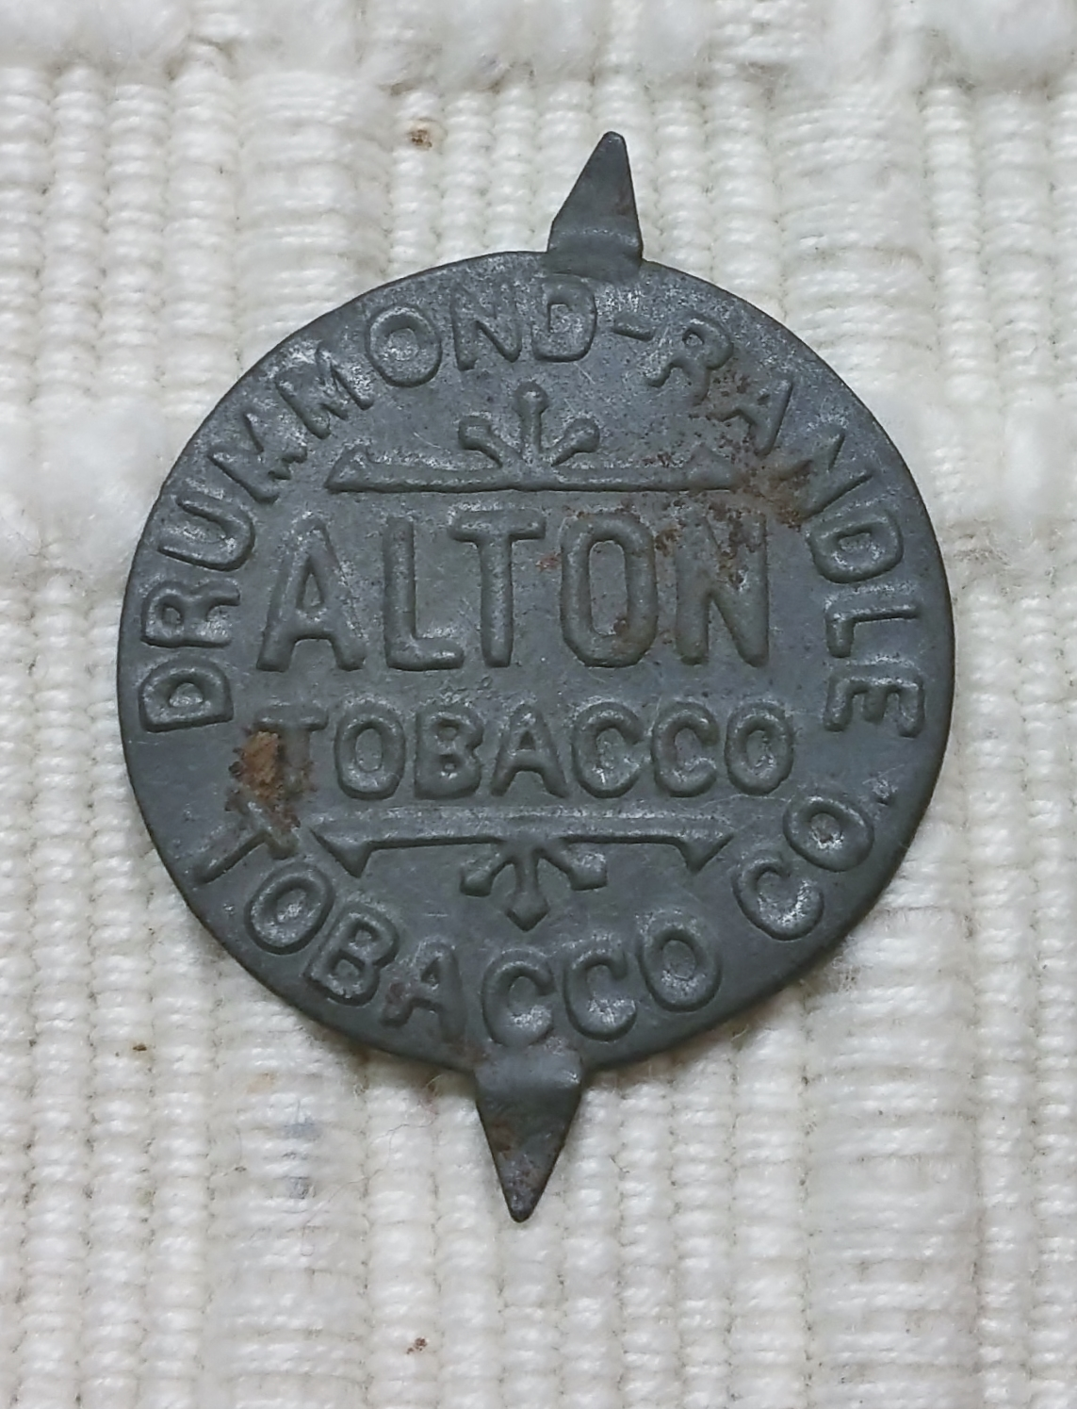
Notes:
THIS IS A TOBACCO TIN OF THE DRUMMOND-RANDLE TOBACCO CO.
THIS WAS A LARGE ST LOUIS/ALTON BUSINESS OF THE PERIOD. RANDLE’S SHARE OF THE BUSINESS EVENTUALLY SOLD FOR A MILLION DOLLARES, AN ASTRONOMICAL AMOUNT IN THAT TIME.
VERY INTERESTING IS THE RANDLES WERE IN-LAWS TO ISACC WARNACK.
PLEASE SEE THE GENEALOGICAL CHART ON DISPLAY

Slide 31
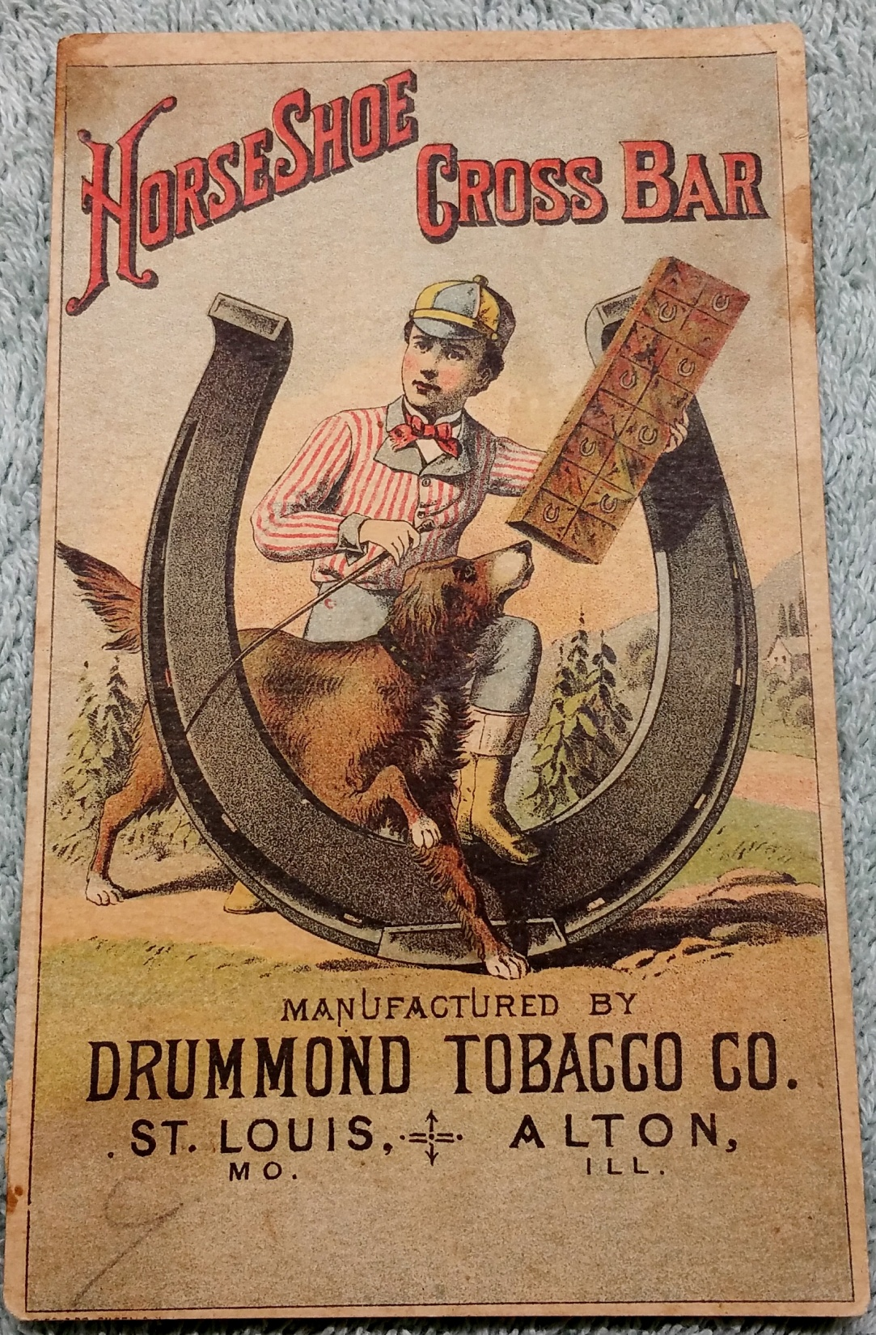
Notes:
THIS IS AN ORNATE “DRUMMOND TOBACCO COMPANY ST. LOUIS + ALTON” CARD

Slide 32
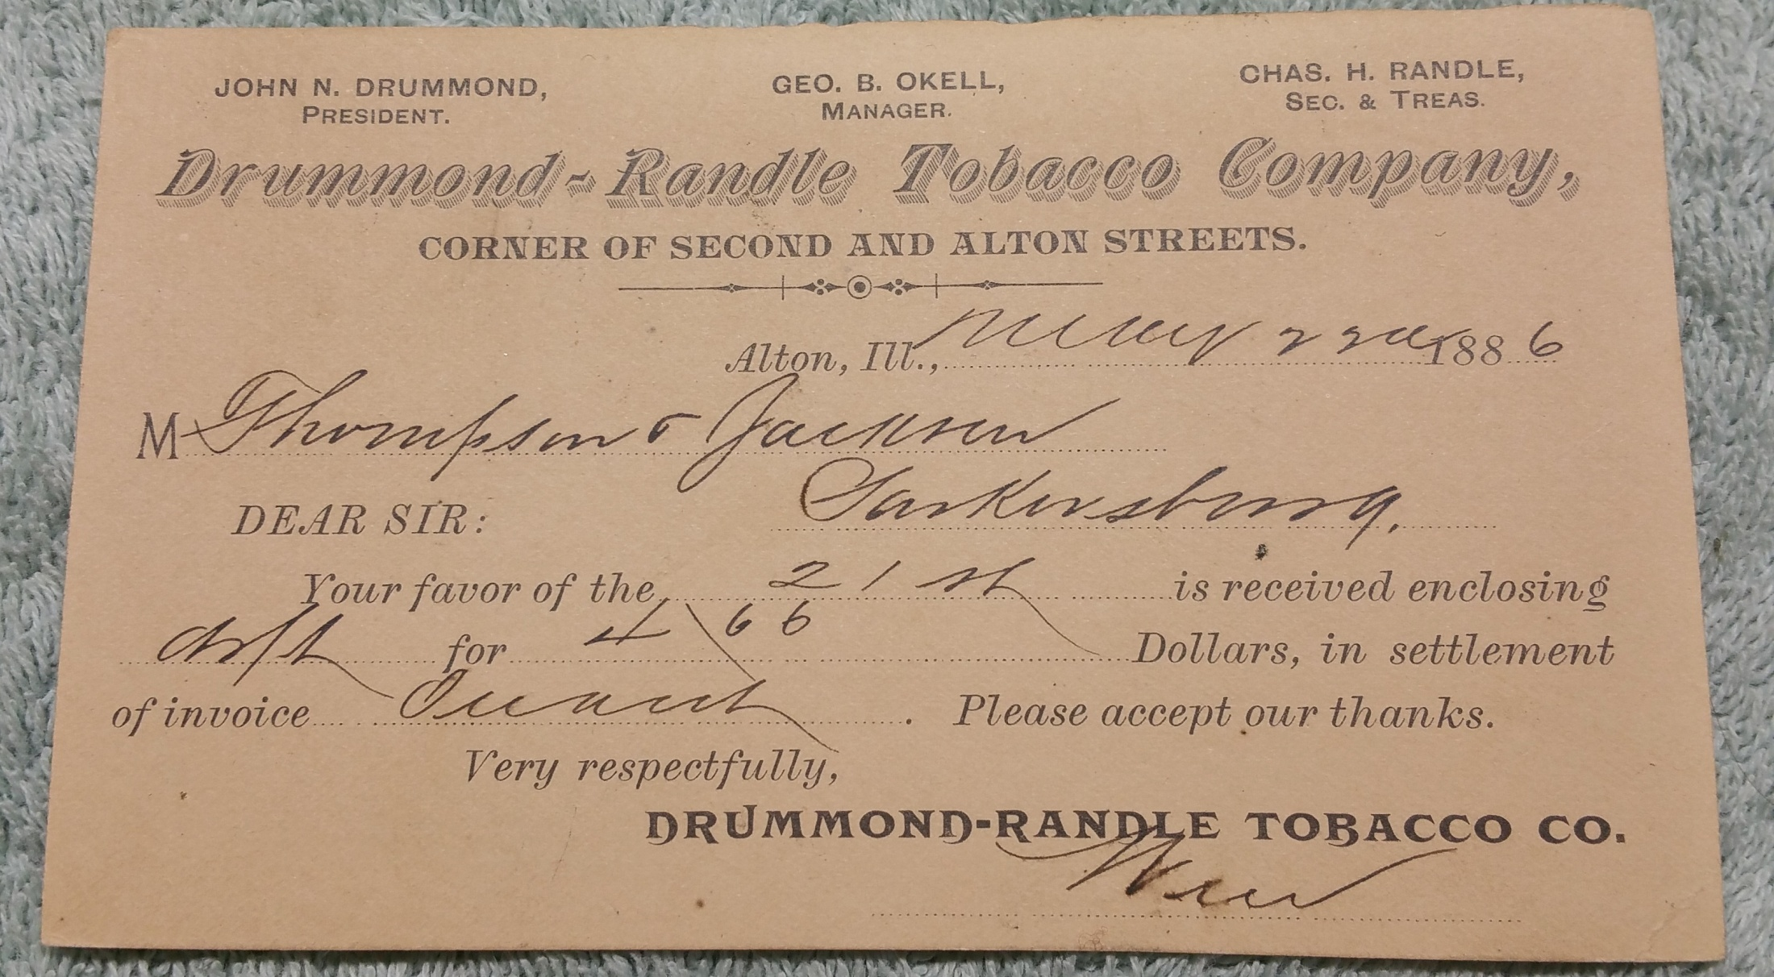
Notes:
HERE IS A POST BILLINING CARD FROM THE “DRUMMOND- RANDLE TOBACCO COMPANY” CORNER OF SECOND AND ALTON STREETS
SIGNIFYING……
JOHN DRUMMOND, PRESIDENT
CHARLES RANDLE, SEC & TREAS

Slide 33
Sherron Logan visiting with Meredith Mathis in 2004 at the location of the Warnack family property, Seminary Street and Salu Avenue, Upper Alton, Illinois. Sherron Logan visited the family gravesites of Isaac E. Warnack.
Notes:
Here is Sherron Logan visiting with my daughter Meredith Mathis in 2004, at the location of the Warnack family property at Seminary St. and Salu St., Upper Alton, Illinois.
The Warnack descendant Sherron Logan visited her family member gravesites, including that of Isaac E. Warnack.

Slide 34
SALU VILLAGE LAND PURCHASES.
Notes:
INTERESTING AND INTRIGUING TO RESEARCH ARE COUT HOUSE RECORDS ABOUT SALU VILLAGE LAND PURCHASES.

Slide 35
THE TENNESSEE FAMILY ROOTS TENNESSEE CENSUS OF KNOX COUNTY 1830
WARNACK (black),
LONAS (blue),
and
HARRISON (red) FAMILIES
Notes:
NOW, NOW AGAIN PLEASE TAKE A MOMENT TO SEE THE GENEALOGICAL INFORMATION CHART FOLLLOWING OUR DISCUSSION. THIS CENUS RECORD TIES TO THE CHART…….SHOWING ……
THE TENNESSEE FAMILY ROOTS TENNESSEE ORIGIN CENSUS OF KNOX COUNTY 1830
WARNACK (black),
LONAS (blue),
and HARRISON (red) FAMILIES

Slide 36
Potter Land Purchases in Salu Village.
Nathaniel W. Parker to
Elizabeth and Henry D. Warnock (sic) April 23, 1832 8-224
Lots 6, 7, 8 of block 16 in Salu for sum of $100. Recorded Apr 23, 1832 J. T. Lusk, clerk. MADISON COUNTY, EDWARDSVILLE, ILLINOIS, DEED RECORD BOOK 8-224
Robert Harrison to Isaac Warnock (sic)
Lot 3 and West half of lot 2 block 16 in Salu for sum of $15. Recorded August 8, 1833 J. T. Lusk,
August 8, 1833
10-263
George Smith JP.
MADISON COUNTY, EDWARDSVILLE, ILLINOIS, DEED RECORD BOOK 10-263
Erastus Brown EXE to Isaac E. Warnock (sic) August 24, 1833
10-265 Lots 256, 257, 258, 259 in the Brown, Whitney, Sangworth Addition of Upper Alton By Probate Judge of Madison County for the public auction highest and best bid of $6.50.
Executer Gersham Flagg, Recorded Oct 29, 1833 J.T. Lusk, George Smith JP. MADISON COUNTY, EDWARDSVILLE, ILLINOIS, DEED RECORD BOOK 10-265
Robert Harrison to Henry Warnock (sic) August 8, 1833 10-266
Lot 1 and East half of lot 2 in Salu for sum of $15.
Recorded October 29th, 1833 J.T. Lusk, George Smith JP.
MADISON COUNTY, EDWARDSVILLE, ILLINOIS, DEED RECORD BOOK 10-266
Thomas Stanton to Isaac E. Warnack Dec 13, 1836 14-396
Lots 9 and 10 in block 1 in Stanton’s Addition to Middleton and fronting on Union Street a reference to the Platt of said Town on record with more fully show for sum of $200.
Recorded Jan 5, 1837 J. T. Lusk rec John Randle JP.
MADISON COUNTY, EDWARDSVILLE, ILLINOIS, DEED RECORD BOOK 14-396
Notes:
SPECIFICALLY, Here are a few of the Potter Land Purchases in Salu Village.

Slide 37
Notes:
Gershome Flagg executor to estate of Erastus Brown transfer of property, lots 256, 257, 258, 259, to Isaac Warnack in Upper Alton at
Public auction Bid $6.50

Slide 38
Robert Harrison to Henry Warnock (sic) Block 16 by Salu Park, Town of Salu, 1832.
Notes:
An early Madison County historic detail needs be made. History shows that among the first potters were William Heath and Nathaniel Pinkard, off Shield’s Branch at Bozzatown (Alton Proper)by river, around 1819. Potter Robert Harrison, joined them in the late 1820’s.
The above court recording depicts a sale from Robert Harrison to Henry Warnock (sic) Block 16 by Salu Park, Town of Salu, 1832.
Deed Record Book page 195…….Lot 1 and Lot 2……… for the sum of $15

Slide 39
Isaac Warnack mortgaged to Anthony Ulrich and John Wietfeld acreage east of Seminary, north of Salu May 15, 1846
Notes:
This Deed Book record reflects where Isaac E. Warnack mortgaged to Anthony Ulrich and John Wietfeld acreage east of Seminary, north of Salu May 15, 1846........ For the sum of $150

Slide 40
FIGURE 85: Section of Township Five North Range 9 West Warnack
Ulrich & Company Frederich Hagerman
H. N. Kendall
NOTE: Red arrows are properties of Ulrich and Company of Ulrich/Wietfeld. Black arrows are properties of Warnack. Grey arrows are properties of Warnack.
Notes:
Section of Township Five North Range 9 West
Warnack
Ulrich & Company Frederich Hagerman
H. N. Kendall
NOTE: Red arrows are properties of Ulrich and Company of Ulrich/Wietfeld.
Black arrows are properties of Warnack. Grey arrows are properties of Warnack

Slide 41
Isaac E. Warnock | to |  |  | Frederick E. Warnack | 1850 | 36-427
Isaac E. Warnock (sic) | t o |  |  | Daniel M. Kettinger | 1855 | 46-753
Elizabeth Warnock | to |  |  | H P Randle | 1837 | 16-73
Isaac E. | to |  |  | H P Randle | 1837 | 16-71
Isaac E. | to |  |  | B. Edmond | 1837 | 16-81
Warnock & Barton | to |  |  | E. T. Gardner | 1837 | 17-204
Warnock & Barton | to |  |  | Wm Churchill | 1837 | 17-353
Isaac E. | to |  |  | George Collier | 1844 | 26-298
Isaac E. | to |  |  | Alexander M. Wilson | 1856 | 50-115
Isaac E. | to |  |  | Richard E. Lowe | 1858 | 58-533
Isaac E | to |  |  | Ann Robinson | 1858 | 58-359
Thomas Warnock Estate |  | to |  | Augustus Chouteau ES | 1858 | 58-259
Thomas Warnock Estate |  | to |  | Robert Tansey | 1860 | 64-251
Isaac E. Warnock to |  | to |  | Henry D. Warnock (sic) | 1860 | 66-16
Isaac E. & Henry D. War | nock | to |  | Franklin Derick | 1862 | 69-447
Isaac E. | to |  |  | Isaac N. Carver | 1865 | 81-523
Isaac E. | to |  |  | Chas W. Dimmock | 1865 | 83-279
Isaac E. | to |  |  | George W. Carr | 1867 | 93-230
George L. Warnack | to |  |  | Wm. Reader | 1867 | 90-244
Frederick C. Warnack | to |  |  | Hiram N. Kendall | 1867 | 93-275
Warnock Henry D. By Master |  |  | to Isaac E. Warnock (sic) |  | 1867 | 93-328
Warnock Thomas L. By Master |  |  | to Hiram N. Kendall |  | 1868 | 98-523
Mary J. Warnack & Estate |  |  | Ttoo Al & Ben Drapper |  | 1868 | 94-384
Isaac E. Warnack |  |  | to Samuel and Henry Bundock |  | 1868 | 96-137
Peter Merrill |  |  | to Ulrich and Wietfeld |  | 1842 | 22-307
Ezra Guttle |  |  | to Ulrich and Wietfeld |  | 1845 | 27-20
Joel Ginch John A. Maxey | to to |  |  | Ulrich and Wietfeld Ulrich and Wietfeld | 1845 1845 | 27-398 27-512
William Steer | to |  |  | Ulrich and Wietfeld | 1845 | 27-513
Isaack E. Warnock (sic) | to |  |  | Ulrich and Wietfeld | 1847 | 25-360
Ebenezer Rodgers | to |  |  | Anthony Ulrich Et al | 1850 | 36-38
John Bostwicks | to |  |  | Upper Alton Addition | 1850 | 34-508
James Meadows | to |  |  | Ulrich and Wietfeld | 1851 | 38-180
George Holland | to |  |  | Ulrich and Wietfeld | 1851 | 40-99
John Firsback | to |  |  | Ulrich Wietfeld | 1856 | 51-381
James R. Nebb | to |  |  | Ulrich Wietfeld | 1856 | 50-670
Adam Burger | to |  |  | Ulrich Wietfeld | 1856 | 52-545
John Mabe | to |  |  | Ulrich Wietfeld | 1856 | 52-455
Jacob Miller | to |  |  | JohnWietfeld/Ulrich | 1856 | 52-535
Joseph Suppiger | to |  |  | Francis Ulrich | 1856 | 53-457
A M Wilson | to |  |  | Ulrich Weitfeld | 1857 | 58-117
Robert L. King | to |  |  | Ulrich Wietfeld | 1858 | 60-456
Jacob Miller by Trust | to |  |  | John W. Utt | 1858 | 64-205
Jacob Miller | to |  |  | John W. Utt | 1858 | 60-366
Benjamin Rose | to |  |  | Ulrich Wietfeld | 1858 | 68-388
John Matthews by atty | to |  |  | Anthony Ulrich | 1863 | 76-81
Joseph Machin | to |  |  | Anton Ulrich | 1873 | 114-118
Clemens De Talleur | to |  |  | Anton Ulrich | 1873 | 106-246
Land Deeds
Warnack
Ulrich Wietfeld
Notes:
ON LAND DEED RECORDS THE WARNACKS AND ULTICH/WIETFELD HAVE NUMERIOUS PURCHASES AND SALES
ISAAC WARNACK TO FREDERICK WARNACK BLUE ARROW
WARNACK TO ULRICH WIETFELD RED ARROW

Slide 42
SEE GENEALOGY CHART
INTERTWINED FAMILY ROOTS OF
WARNACK, LONES, RANDLE, HARRISON, AND COOPER
FROM --- KNOX COUNTY, TN,
TO --- MADISON COUNTY, IL, TO --- SALU VILLAGE.
Notes:
PLEASE DO SEE GENEALOGY CHART ----- INTERTWINED FAMILY ROOTS OF
WARNACK, LONES, RANDLE, HARRISON, AND COOPER
FROM --- KNOX COUNTY, TN,
TO --- MADISON COUNTY, IL,
TO --- SALU VILLAGE.

Slide 43
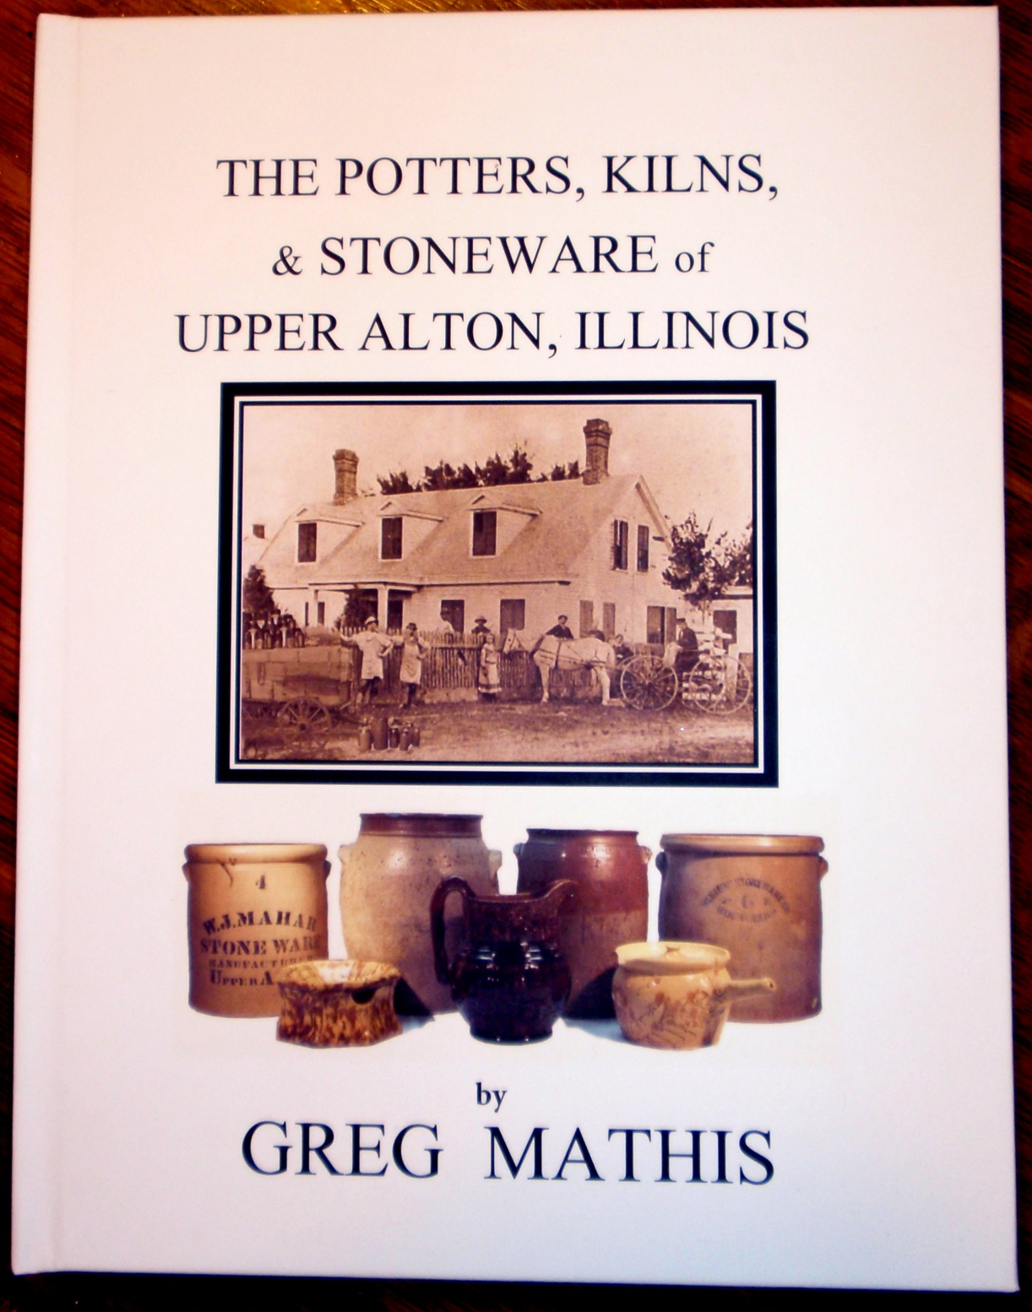
Notes:
FOR MUCH MORE INFORMATION, PASSIONATE RESEARCHERS AND COLLECTORS MAY WANT MY WRITING “The Potters, Kilns, & Stoneware of Upper Alton, Illinois.”
A copy is exhibited in the museum display case.
This is a very comprehensive work about Upper Alton potters and their wares.

Slide 44
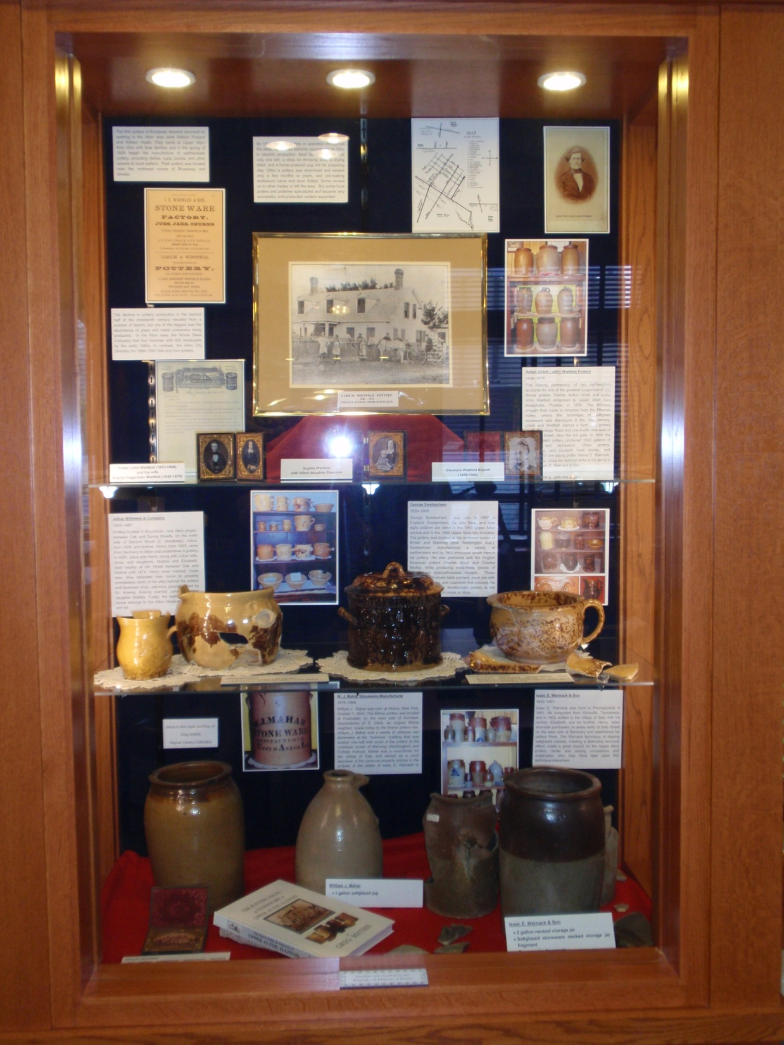
Notes:
THANK YOU LACY AND THE HAYNER GENEALOGY AND LOCAL HISTORY LIBRARY……… FOR THE GREAT DISPLAY.

Slide 45
The Pride of the Upper Alton Mother
TREASURES
by
Marilyn Trainor
Recited by
Mary M. Mathis
272
Notes:
I CLOSE …….with an excellent poem written in 1996 by an Illinois poet, Marilyn Trainor. It was recited twenty years ago at the Alton Museum of History and Art, December 1996.

Slide 46
Notes:
END

Slide 47
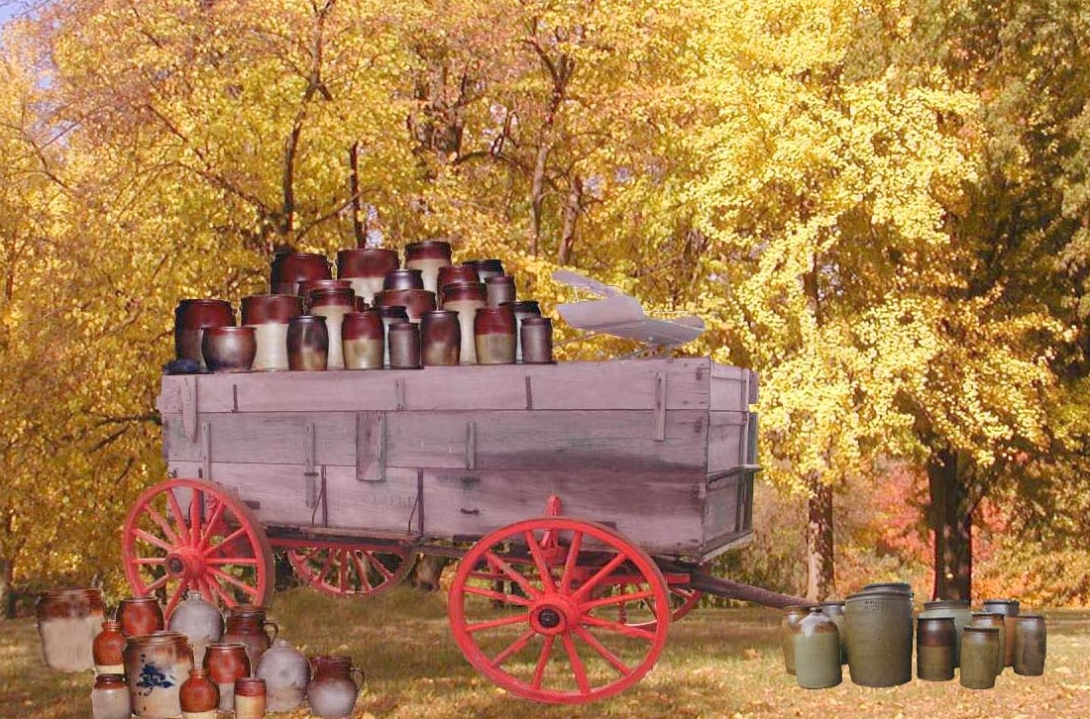
Notes:
FOR the researcher, the collector, and the student of Upper Alton, Madison County, Illinois.
This DREAM PICTURE might well have been a common seen in the village of Salu around 1860.
Thanks Everyone for your time today. HAPPY HOLIDAYS !!!!!

