Slide 1
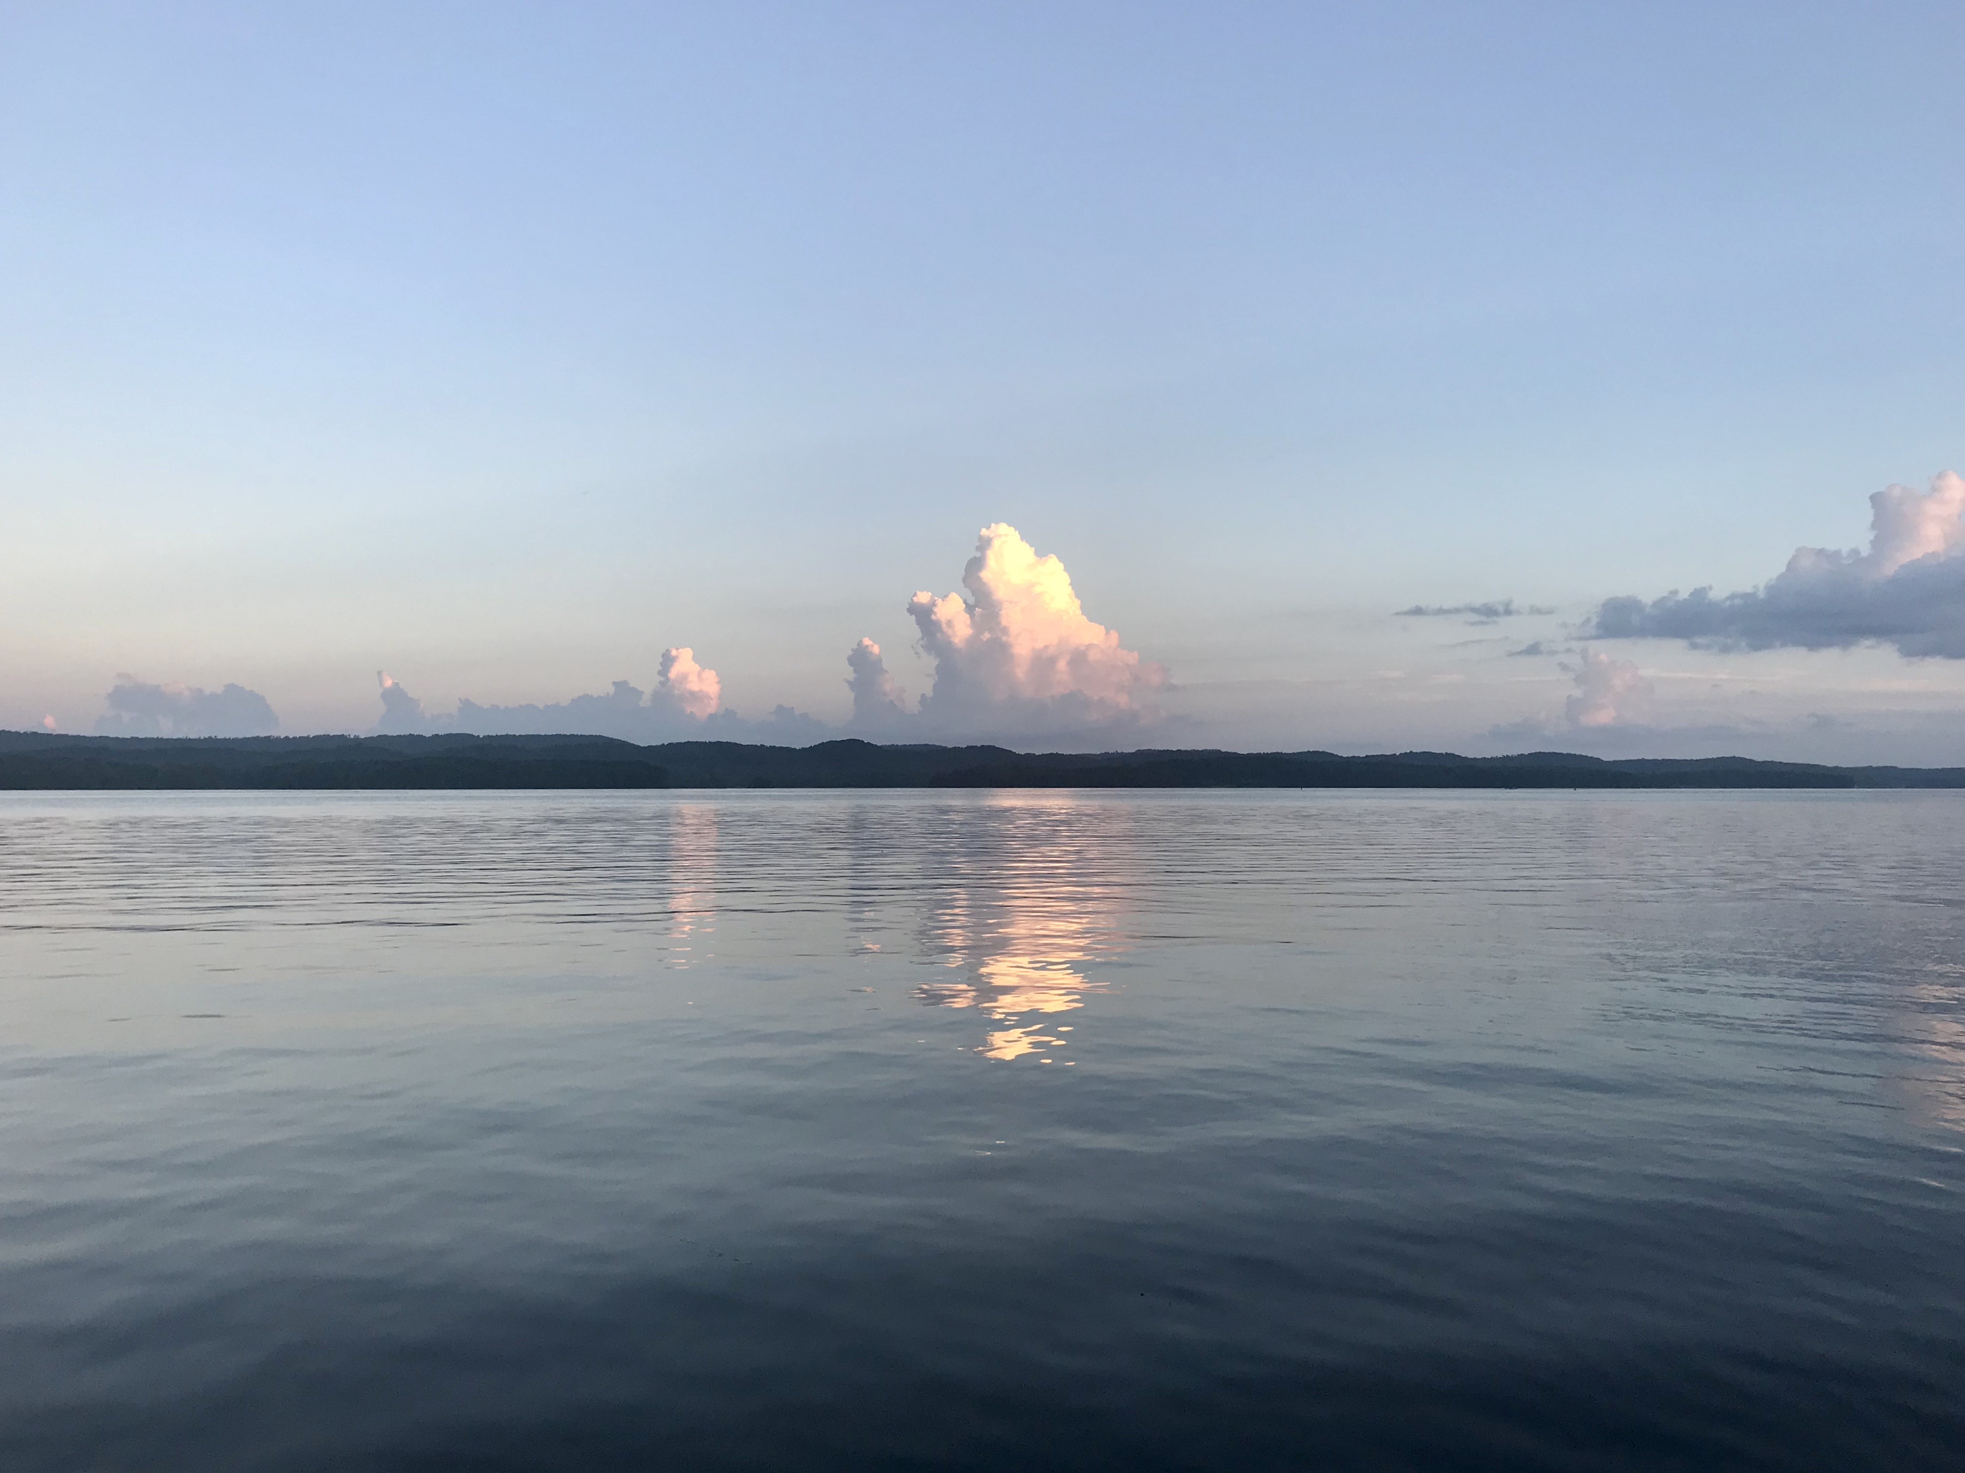
Caring for Immigrant populations
Isabel C. Scarinci, PhD, MPH
Division of Preventive Medicine
O’Neal Comprehensive Cancer Center
UNIVERSITY OF ALABAMA AT BIRMINGHAM
Lake Guntersville, Alabama

Slide 2
Our hiking path today
Immigrants in the United States and Alabama
Relevant Definitions
Importance of knowing your target audience
Cultural considerations
Suggested strategies

Slide 3
“My Lens” or “Biases”
PROFESSIONAL
Clinical Psychologist
Master’s in Public Health
Development, implementation, and evaluation of cancer prevention and control programs in low-resource settings in the U.S. and abroad
PERSONAL
Grew up in a multicultural environment in South Brazil – grandparents were immigrants
Immigrant in the U.S. & Honorary Consul of Brazil in Alabama
Three citizenships – Brazil, Italy, and U.S.
Spent half of my life in a “rich state” in a low-middle income country and the other half in a “poor state” in a high-income country
Application of Behavior Change Principles at the Population Level

Slide 4
U.S. & Alabama population
21.5% speak another language at home in the U.S.
5.2% speak another language at home
About 255,000 people in Alabama
39,000 in Jefferson County
18,000 in Shelby County

Slide 5
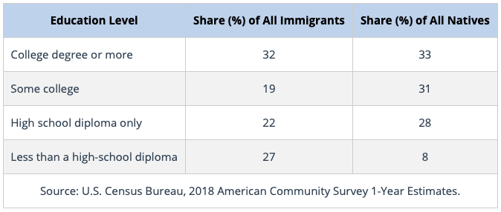


Immigrants in the U.S.
1 in 7 U.S. residents is an immigrant
1 in 8 residents is a native-born U.S. citizen with at least one immigrant parent
TOP COUNTRIES OF ORIGIN
Mexico (25%)
India (6%)
China (5%)
Philippines (4%)
El Salvador (3%)
1 in 6 U.S. workers are immigrants
https://www.americanimmigrationcouncil.org/research/immigrants-in-the-united-states

Slide 6
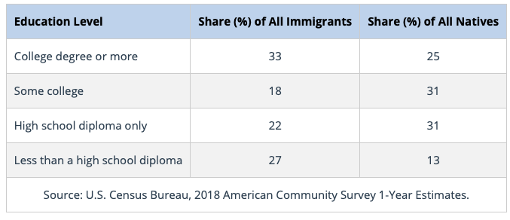
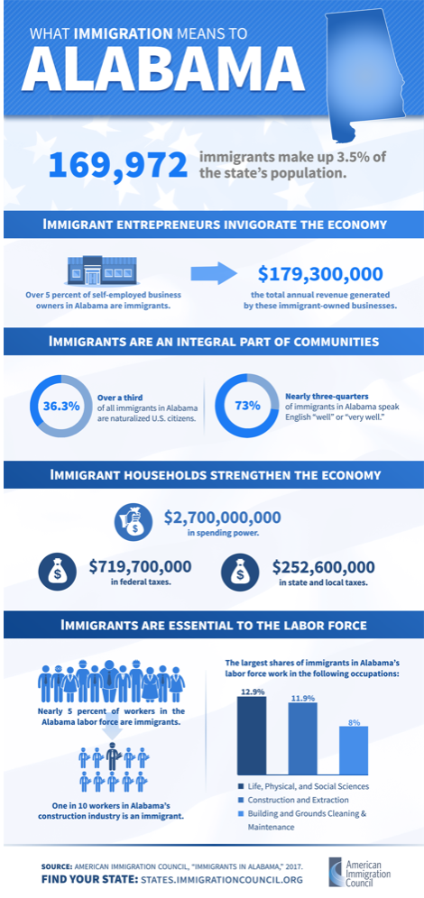
TOP REGIONS OF ORIGIN
Latin America (47.5%) – Mexico and Central America
Asia (32.2%) – China and India
Europe (12.8%) -Western Europe and Germany
Africa (5.1%) – Western Africa
https://www.americanimmigrationcouncil.org/sites/default/files/research/immigrants_in_alabama.pdf
https://www.migrationpolicy.org/data/state-profiles/state/demographics/AL

Slide 7
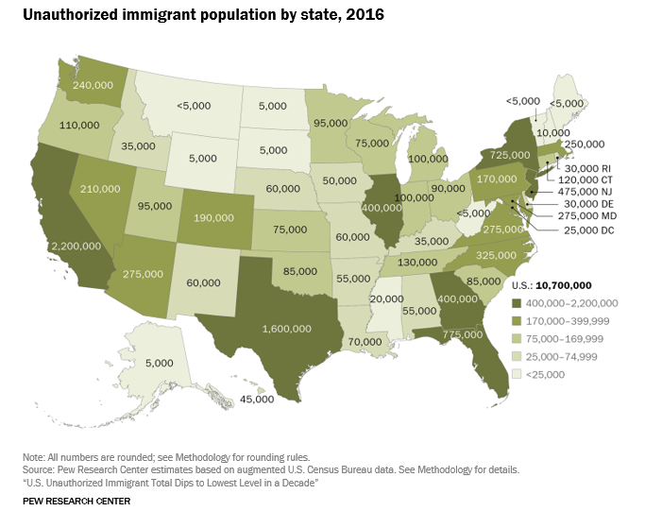
UNDOCUMENTED POPULATION
24% of the immigrant population in the U.S. is undocumented (3% of the total population)
  34% in Alabama (1.2% of total population)
Approximately 650,000 active DACA recipients lived in U.S. as of March, 2020
  3,970 in Alabama
(American Immigration Council; Pew Research)

Slide 8

Relevant definitions
Documented
Undocumented
Unauthorized
Political asylum
Latinx vs. Hispanic
Remember that it is important to consider that just because an individual is from a particular country he/she won’t always fit that “country profile”
  We need to consider a lot of issues before we generalize – income, education, acculturation, language, family composition, reasons for immigration.
Ten Fingers, All of Different Lengths
-Chinese Proverb

Slide 9
Cultural Competence
“A process for effectively working within the cultural context of an individual or community from a diverse cultural or ethnic background” (Campinha-Bacote, 1994).
Barriers to cultural competent care or to multicultural health education/awareness, assessment, and treatment
  Ethnocentrism vs. ethnosensitivity
  Cross-cultural communication
  Environment/social context

Slide 10
Multicultural Competent Care
Client
EnvironmentContext
Provider

Slide 11
PROVIDER PERSPECTIVE
Cultural Sensitivity
Cultural Competence
Cultural Knowledge
The
Process
Of Cultural
Competence
Cultural Awareness
Cultural Desire
(Adapted from: Campinha-Bacote J, 1998)

Slide 12

CULTURAL COMPETENCE
CULTURAL DESIRE
➕
CULTURAL AWARENESS
CULTURAL KNOWLEDGE
CULTURAL SENSITIVITY
➕
➕
Motivation
Knowing yourself, your values
Being aware of your biases and assumptions regarding people who are different from you
Learning about other “cultures” and people who are different from you
Bits and pieces that you acquire over time
Becoming sensitive to the behaviors, beliefs, and attitudes of people from backgrounds different than yours
AWARENESS & KNOWLEDGE must be in accordance with your true feelings
Competence or Simply COMMON SENSE

Slide 13
UNCONSCIOUS BIAS
”We are physicians. Of course we are objective.”
”In order to do our work we need to leave our biases at the parking lot.”
Unconscious bias play a role on how we react to others
Implicit bias among health care providers
  Hall et al., 2015, American Journal of Public Health [Systematic review of the literature] - “Most health care providers appear to have implicit bias in terms of positive attitudes toward Whites and negative attitudes toward people of color.”
Make an attempt to at least increase awareness of your biases
Do not suppress them (“rebound effect”)
Short breaks between patients
Implicit bias test
Blindspot: Hidden Biases of Good People

Slide 14
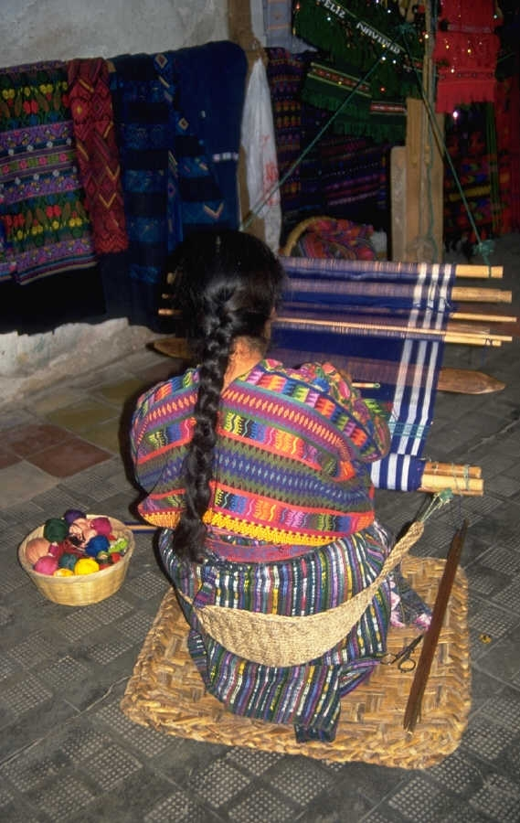
CLIENT PERSPECTIVE
Become familiar with your client/patient culture, values, beliefs
Ask (and listen to the answers) questions
  Medical history is critical to the process
Critical to understand where patients grew up which can assist in differential diagnosis
  Chagas, Dengue, Hepatitis B
  But, do not narrow your focus to that
Do not make assumptions; ask directly
Acculturation vs. assimilation
”Repeat back” is a powerful tool

Slide 15
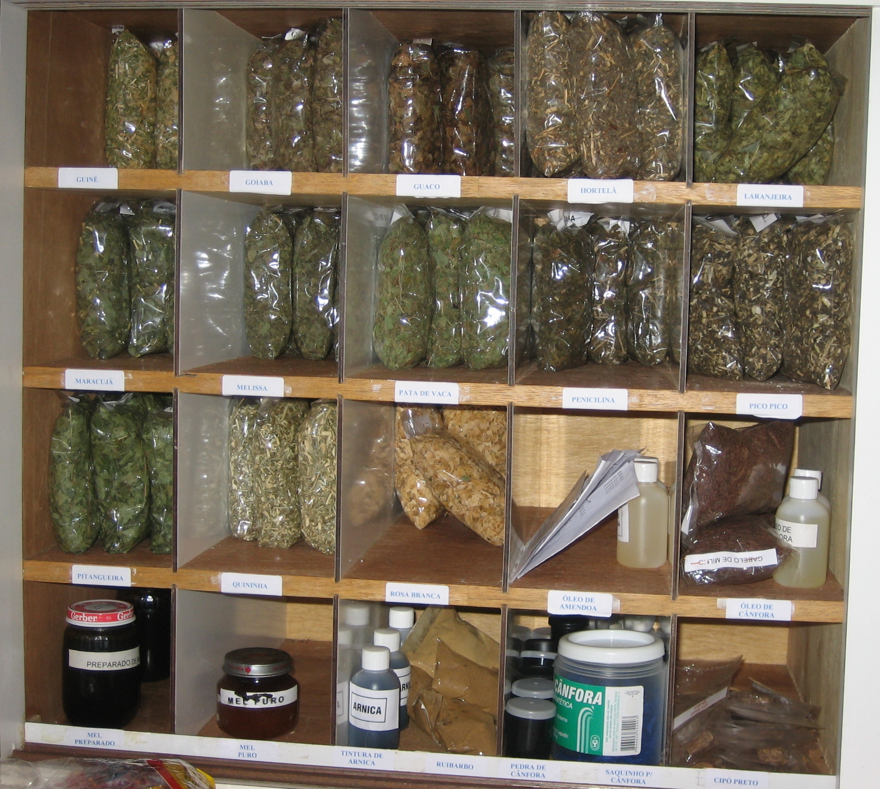
Some Examples
Infection/STIs Cervical Cancer
If not treated
Male partner
Unsterilized gynecological instruments
”Not washing yourself after having sex”
“…I think that first there is a fungus, then an infection, then a lesion, and then you develop cancer or something like that…”
“I think that (cervical) cancer is developed when you do not treat an infection”

Slide 16
KLEIMAN’S QUESTIONS
What do you think has caused your problem?
Why do you think it started when it did?
What do you think your sickness does to you?
How severe is your sickness?
Will it have a short or long course?
What kind of treatment do you think you should receive?
What are the most important results you hope to receive from this treatment?
What are the chief problems your sickness has caused for you?
What do you fear most about your sickness?
Kleinman, A., Eisenberg, L., Good, B. (1978)

Slide 17
BELIEF
Beliefs about health (What caused your illness/problem?)
Explanation (Why did it happen at this time?)
Learn (Help me to understand your belief/opinion.)
Impact (How is this illness/problem impacting your life?)
Empathy (This must be very difficult for you.)
Feelings (How are you feeling about it?)
Dobbie, A.E., Medrano, M., Tysinger, J., Olney, C. (2003).

Slide 18
Working with an interpreter
The interpreter is a professional in communication and that is his/her role in the patient-provide encounter
  Engage him/her in a brief conversation to “assess” his/her English proficiency
  Set your rules (e.g., everything to be interpreted in the first person)
  Interpreter is there to “translate” and not to explain what you are saying
  EVERYTHING that is said is the encounter must be translated (including comments from family members)
Talk to the patient rather than to the interpreter
Short sentences with pauses, avoid idiomatic speech and/or complicated sentence structure
Ask patient to repeat back

Slide 19
SOME CLUES – TIME TO CHANGE TACTICS
Lose eye contact
Patient is responding “yes” or nodding for everything you ask
Family member intervenes and start speaking in their native language with the patient
Interpreter is “talking too much”
  Caveat: Some languages (e.g., Spanish, Portuguese) uses more words; some concepts may not have linguistic equivalent in other languages

Slide 20
Environmental/Context Considerations
Local, state climate toward immigrants (e.g., HB56 in Alabama)
Legal mandates – Compliance with Title IV of Civil Rights
History of your institution in a particular community
Health care system and access
Trained staff – EVERYONE is responsible for patient care
Patient’s legal status and access to resources
Social determinants of health

Slide 21
LESSONS LEARNED AS AN IMMIGRANT
MY PERSPECTIVE
We will always be immigrants
Being an immigrant gives me PERSPECTIVE
We become great listeners and observers of behavior because we need adapt. This helps us to be great problem solvers
Most of us are here by choice. Choice comes with responsibilities
It has been an amazing journey ☺

Slide 22
Cultural differences are not barriers
They are learning opportunities !

Slide 23

Questions/sharing of experiences
Thank You

