Slide 1

Legal Updates and Hot Takes
2022 TDASC
Christy Ballard
General Counsel

Slide 3
Role of Office of General Counsel (OGC)
OGC staff provide legal advice and support to the Commissioner of Education, Tennessee Department of Education (TDOE) personnel, the Achievement School District, and the State Special Schools.
OGC staff provide legal resources to LEAs to ensure compliance with education laws.
OGC staff speak at conferences and trainings across the state for LEAs and state education and child-focused organizations.
OGC attorneys do not represent or provide specific legal advice to LEAs or the general public.
17 members of the OGC (2 current vacancies) lead or provide legal support for TDOE operations and compliance matters including IDEA compliance, civil rights compliance, general LEA compliance and LEA Approval.
OGC is also called upon to respond to parent, student, and legislative requests and concerns.
  How do we respond?

Slide 4

Christy
Ballard
General Counsel
Joanna
Collins
Assistant GC for Procurement
Gillian
Jones
Staff Attorney
Vacant
Deputy General Counsel
Lee
Danley
Legal Counsel for ASD & SSS
Shaundraya
Hersey
Assistant GC
for Civil Rights
Keith
Minor
Staff Attorney
Nattaly Perryman
Staff Attorney
Nikkie
Kiene
Paralegal
LaQuisha
Oliver
Director of LEA Approval
Kim
Pomeroy
Executive Assistant
Kristen
McKeever
Chief of Staff
Taylor
Jenkins
Assistant GC for Special Education
David
Oldham
Staff Attorney
Dana
Johnson
Special Ed Investigator
Tricia
Craig
Special Ed Investigator
Vacant
Staff Attorney
September 2022

Slide 5
Powers and Duties of Commissioner of Education
T.C.A. § 49-1-201
  The commissioner is responsible for the implementation of law or policies established by the general assembly or the state board of education (SBE).
  The commissioner shall see that the school laws and the regulations of the SBE are faithfully executed.
  The commissioner shall distribute in electronic format to the local boards of education, at the conclusion of each regular session of the general assembly, copies of newly enacted public chapters pertaining to public education.

Slide 6
Annual Legislative Report
Reports are generally sent in Commissioner’s Update for Directors email and then posted on the legal services page of the TDOE website: https://www.tn.gov/education/legal-services/legal-resources.html
2022 TDOE Legislative Report

Slide 7
Annual LEA Compliance Report
The annual compliance report is one mechanism the TDOE uses to ensure education laws and SBE rules are faithfully executed.
Each LEA must submit the report annually and, if applicable, the corresponding corrective action plan.
The 2022 LEA Compliance Report is due on November 30. The report template is scheduled for inclusion in the September 22 edition of the Commissioner’s Update for Directors.
The TDOE has now formally reinstated LEA approval classifications as outlined in SBE Rule 0520-01-02-.01. Annual compliance report data may inform an LEA’s approval classification.

Slide 8
LEA Approval
LEA approval classifications, which are outlined in SBE Rule 0520-01-02-.01, will be provided to LEAs annually each July.
Preliminary approval classifications were provided to directors of schools in July 2022, with official approval letters disseminated in August 2022.
LEAs classified as conditionally approved are eligible for a classification update upon resolution of noncompliance (e.g., completion of a department-issued corrective action plan, successful remonitoring).
The 2022-23 LEA Approval Manual is slated for October 2022 release, and LEAs scheduled for 2022-23 monitoring in employee background checks, employments standards, and class size will receive official notification via email.

Slide 9
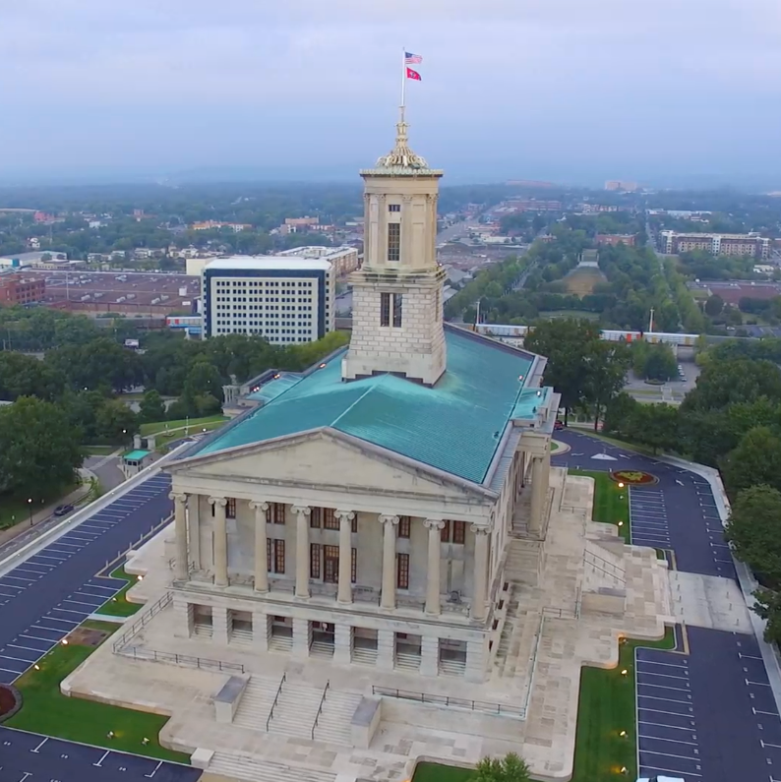
Legal Updates and Hot Takes

Slide 10
New Laws Regarding Remote Instruction

Slide 11
Chapter 838 of the Public Acts of 2022
Specifies that an adult high school may provide virtual instruction in accordance with the Virtual Public Schools Act. Requires an adult high school that provides virtual instruction to satisfy the instructional time requirements established for adult high schools by the State Board of Education. Effective April 19, 2022
TDOE Contact: Christy.Ballard@tn.gov

Slide 12
Chapter 897 of the Public Acts of 2022
Authorizes LEAs to provide up to 2 days, per semester, of the required 180 days of classroom instruction through remote instruction in the event of dangerous or extreme weather conditions, serious outbreaks of illness, or during required TCAP and end-of-course testing. Effective April 19, 2022
TDOE Contact: Christy.Ballard@tn.gov

Slide 13
Chapter 936 of the Public Acts of 2022
Requires LEAs to conduct remote learning drills at least once each school year, but cannot require a student to transition to remote learning as part of the learning drill. Requires that educator preparation providers (EPPs) provide instruction on skills to administer virtual instruction to candidates seeking licensure to teach. Effective July 1, 2022
TDOE Contact: Lisa.Coons@tn.gov

Slide 14
Chapter 960 of the Public Acts of 2022
Enacts the "School Safety and Removal Act". Authorizes alternative schools and alternative programs to provide remote instruction to students attending the school or program. Effective April 29, 2022 and July 1, 2022
TDOE Contact: Christy.Ballard@tn.gov

Slide 15
Coding Student Absences

Slide 16
Attendance Codes Related to Quarantine/Self Isolation
For the 2022-23 school year, a new attendance code (Y) was added to record absences due to quarantine or self-isolation in support of the P-EBT program.
After further discussion and clarification, the following attendance codes will be adjusted:
  "D" - Absence due to quarantine or self-isolation where student is actively participating in remote learning. This code will be disabled for SY 22-23 going forward. Per State Board Rule, the option for interactive remote learning while quarantined is no longer allowed and the "D" code should no longer be used.
  "Y" - Absent due to quarantine or self-isolation (excused).
  "Z" - (NEW) Absent due to quarantine or self-isolation (unexcused).
Once implemented, districts should only use either the Y or Z code to record students absent due to quarantine or self-isolation events. All other attendance codes will remain the same for the 22-23 school year.
When the new codes are implemented and the D code removed, Districts should go back and cleanup records where they marked D.

Slide 17
New Law Regarding the Enrollment of Nonresident Employees’ Children

Slide 18
Chapter 709 of the Public Acts of 2022
Broadens the category of nonresident employees, from only teachers to all LEA employees, whose children may attend a school within the LEA that employs the child's parent, including out of state employees of an LEA whose children attend the LEA, and who may be exempt from a tuition requirement, pursuant to local board policy. Effective July 1, 2022
TDOE Contact: Christy.Ballard@tn.gov

Slide 19
#10 –New Law on Student Driver’s Licenses

Slide 20
Chapter 878 of the Public Acts of 2022
Removes authority of the Department of Safety to deny a license to a minor for unsatisfactory academic progress; retains provisions for denial of a license, with certain exceptions, to a minor when the person is a student who is not enrolled in school. Effective April 14, 2022
TDOE Contact: Christy.Ballard@tn.gov

Slide 21

Thank You!
Delta Rose

