Slide 1
Endovascular Cooling in Modern Comprehensive Critical Care
St. Vincent’s East
October 7, 2019
Michael C. Kurz, MD MS FACEP FAHA
Associate Professor
Department of Emergency Medicine
University of Alabama School of Medicine
Birmingham, Alabama

Slide 2
Disclosures
Current Support
  UABHSF-GEF–01 ED-ICU Data and support
  1U01MH110925-01 (AURORA)
  5U01DK096037 (STONE)
  K23AG038548 (Elderly Crash)
  R01GM101197 (PRoACT)
  R01GM103799 (RACE)
  F150929006 (NMB-OHCA)
  Society for Critical Care Medicine (2016 SCCM Vision Grant)
  Emergency Medicine Foundation (2016 Innovation Grant)
  Zoll Medical Corp (VPAC)
  American Heart Association (RQI)
Previous Support
  2U01HL077881-09 (ROC)
  R01AR056328 (Crash AA)
  UAB Lister Hill Foundation (ACRDC)
  Boehringer-Ingelheim (Reverse-AL)
  Abbott Molecular (IRIDICA)
  Rapid Pathogen Screening (FebriDx)
Other relationships
  American Heart Association, Volunteer and 2015 Guidelines Author
  The Joint Commission, Comprehensive Cardiac Center Task Force Member
  Member, Board of Directors, Rapid Oxygen Company

Slide 3
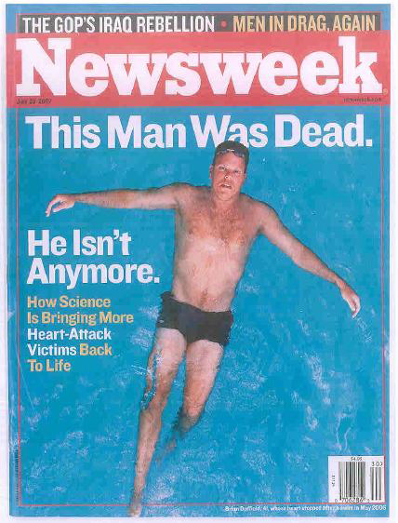
Overview
Describe the unique benefits of TTM
Review the incidence and unique physiology of Post-Cardiac Arrest Syndrome (PCAS)
Discuss how PCAS challenges are overcome in the most progressive centers
Discuss practical consideration of implementing TTM

Slide 4
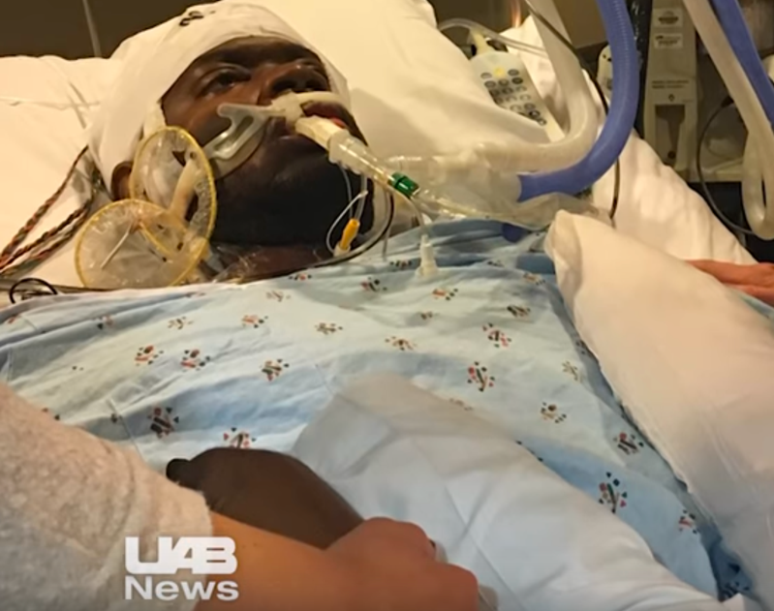
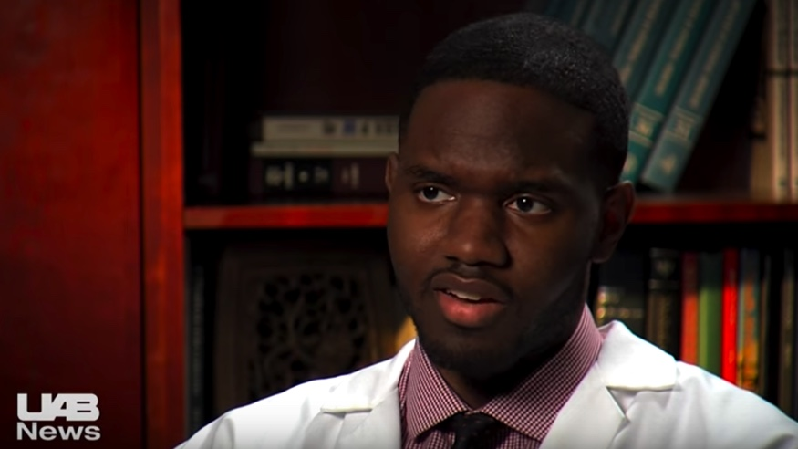

Slide 5
OHCA and AMI by the numbers…
OHCA
AMI
347,332 OHCA in US annually
25% have no preceding symptoms
23% have shockable presenting rhythm
1,055,000 AMI in US annually
An additional 50K are “silent”
73% of deaths occur outside hospital (i.e. OHCA)
Mortality rate = 89.6% IH Mortality rate = 5.1%
Survival rate = 10.4% IH Survival rate = 94.9%
Deaths/year = 311,201 IH Deaths/year = 53,805
~6x more deaths/year from OHCA than AMI
Benjamin E, et. al. Circulation 2019

Slide 6
Coute R, et. al. Circulation: Cardiovascular Quality and Outcomes, 2019

Slide 7
OHCA Survival
30% ROSC rate
10% survive 24h
5% survive to hospital discharge
Why the difference?
Weil and Tang 1999

Slide 8
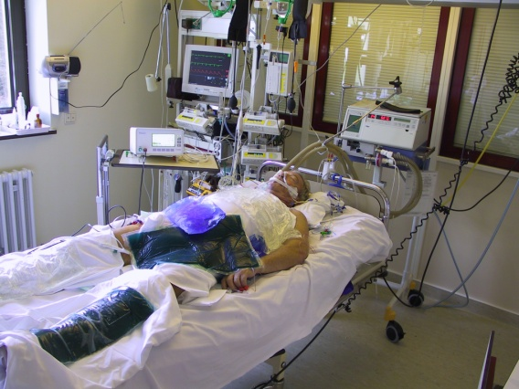
Post-Cardiac Arrest Syndrome
Unique pathophysiological process involving multiple organs
Whole body ischemia
  Global tissue and organ injury (no flow)
  CPR (low-flow)
  Epinephrine (high-flow) reperfusion injury
Nolan JP, Neumar R, Resuscitation 2008
Neumar RW et. al. Circulation 2008 18:2452-2483
Notes:
The severity of these disorders post ROSC are not uniform and will vary in individual patients based on the severity of the ischemic insult, the cause of the arrest, state of health pre arrest.

Slide 9
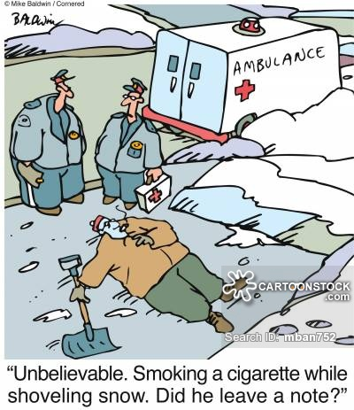
Post-Cardiac Arrest Syndrome
Brain Injury
  Coma
Myocardial Dysfunction
  Hypotension
Systemic ischemia/reperfusion
  “Sepsis-like” syndrome / coagulation abnormalities
Persistent Pathology
  What ever caused the arrest in the first place
Neumar RW et. al. Circulation 2008 18:2452-2483

Slide 10
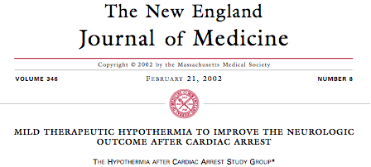

Modern Era of TTM:

Slide 11
Who Should Receive TTM?
2015 AHA Guidelines (Neumar, 2015: Circ) and
2015 ERC Guidelines (Nolan, 2015: Resus) endorse TTM for all rhythms and all locations (Class 1)
  TTM is standard-of-care
  Presenting rhythm and location are irrelevant,
  Other class 1 recommendations: depth and rate of CPR, defibrillation for VF, etc.
Guidelines allow for the selection of any temp between 32 and 36C
  36C is TTM, not fever suppression.
  Higher temp = less cushion to fever = precision more important
Glover GW, Critical Care, 2016,

Slide 12
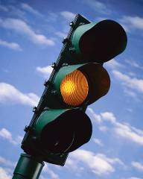
Contraindications
Absolute
  Awake patient
  DNR
  Active non-compressible bleeding
  Need for immediate surgery
Relative
  Trauma
  Exsanguination
  Intracranial hemorrhage
  Environmental hypothermia
  Recent surgery
  Pregnancy
  Sepsis
  Brief/No CPR
Most contraindications are relative

Slide 13
Neilsen, NEJM 2013
Reports of the Death of Therapeutic Hypothermia
are GREATLY exaggerated…
Notes:
EMS environment is chaotic

Slide 15
Trends in TTM --
Khera R, Circ: CQO 2018.

Slide 16
After the change from a TTM target of 33◦C to 36◦C, we report low compliance with target temperature, higher rates of fever, and a trend towards clinical worsening in patient outcomes. Hospitals adopting a 36 ◦ C target temperature to need to be aware that this target may not be easy to achieve, and requires adequate sedation and muscle-relaxant to avoid fever. -- Janet Bray

Slide 17
HYPERION Trial
Lascarrou, et. al. NEJM, 2019.

Slide 18
We concur with the AAN experts that less is not more and cooling should be harder, better, faster, stronger, in the sense that neurologists should be hard- liners who embrace cooling as a default mode for nearly all cardiac arrest survivors, making it harder to exclude patients, while using cooling techniques that are the better ones, starting as quickly as possible after ROSC, and that 33C is stronger than 36C. --- Lance Becker, MD

Slide 19
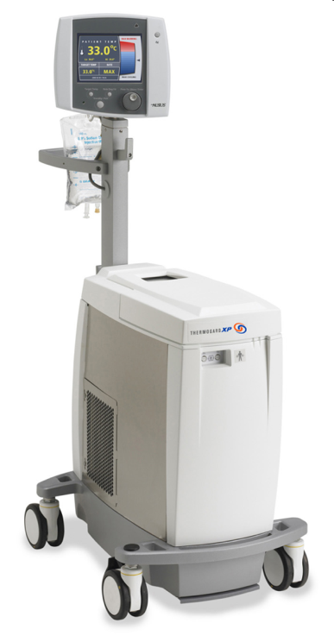
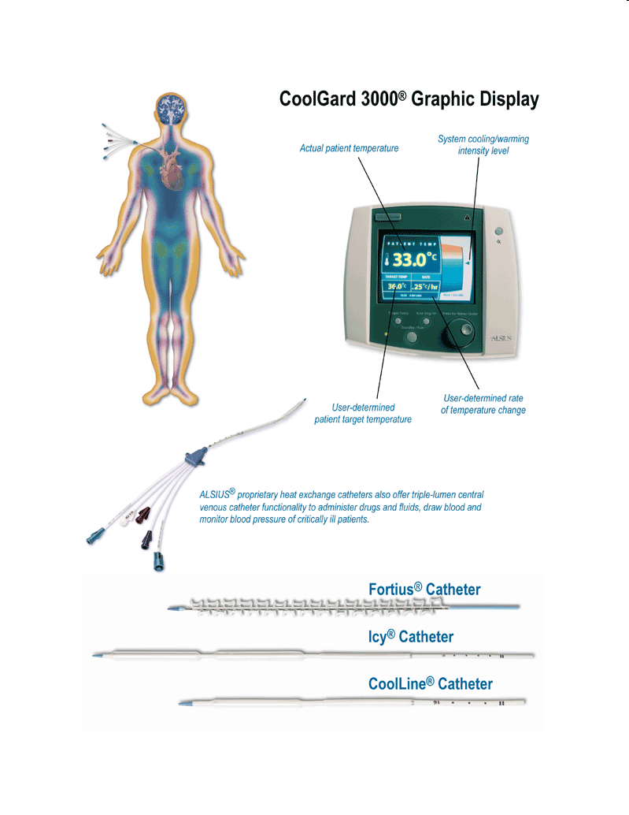
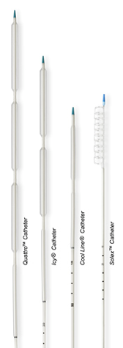
Endovascular Catheters
(Zoll)

Slide 20
UAB HYPOTHERMIA RECIPE
Therapeutic Hypothermia
  Cool rapidly to 33°C
  Maintain at 33°C for 24 hours
  Warm slowly to 37°C
  Maintain at 37°C for 3 days

Slide 21
Evidence for a Bundle Including TTM
Single center – 233 pt.
72% VF; 50% MI; 40% arrhythmia
All IVTM @ 33C; 96% CCL; 39% MCS or ECMO; 26% CRRT
63% Survival despite 27% PEA and 48% Shock
Akin, JACC:CI 2018

Slide 22
Akin, JACC:CI 2018

Slide 23
What evidence is clear?
A system based approach is probably best…
Neurologic
  TTM – Modeling How…
  Minimal Sedation and Paralysis
  Early EEG for Status and Rx
  72 Moratorium w/ Adoption of Nielsen
Pulm
  Oxygen and Volume limiting ventilation
  Consensus on Abx
Renal
  Consensus on initiating CRRT
  Strict I/O
  Avoidance of Contrast
Hemodynamics
  Consensus on admission service and CCL
  Early line(s) placement
  Consensus on MAP / ECMO
  Coagulopathy and Modified Heparin / NAPT Dosing
GI/FEN/Nutrition
  GI Prophylaxis
  Mod. BG / Electrolytes
Rehabilitation
  Neurocog eval prior to d/c
  Psychiatry
  Linkage to care, Survivor resources

Slide 24

PRACTICAL CONSIDERATIONS

Slide 25
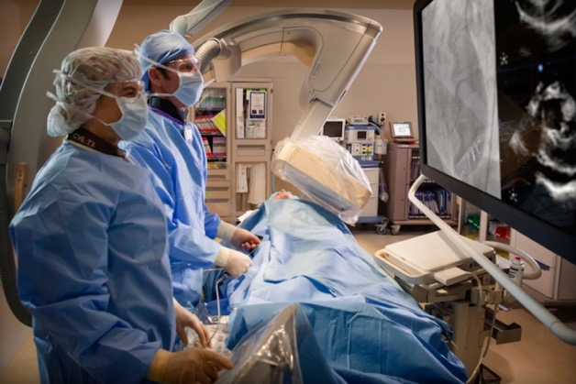
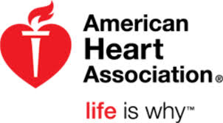
Who should go to the CCL?
AHA and ERC 2015 guidelines:
OHCA should receive PCI, STEMI class I,
NSTEMI or suspect cardiac origin class II
  Independent of exam
  Endorsed by EAPCI

Slide 26
Camugila AC et. al. Resuscitation. 2014

Slide 27
COACT Trial
552 OHCA, no STEMI, RCT 1:1 CCL now or “delayed”
No difference in 90d survival
CCL = 40m delay in TTM (5.4 vs 4.7h)
Lemkes et. al.: NEJM 2019

Slide 28
Lemkes et. al.: NEJM 2019

Slide 29
While 67% have CAD, < 20% had unstable lesions; <40% got PCI
Same issues with TROICA trial
Over 70 with CAD +++ survival; young and no CAD no difference
ACCESS and DISCO coming: address these limitations
Abella and Gaieski: NEJM 2019

Slide 30
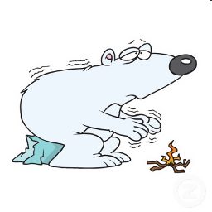
Shivering
Inconvenient – not directly harmful
Slows cooling
May indicate better prognosis
Solutions:
  Surface counterwarming (Beir Hugger)
  Increase sedation (↑fentanyl)
  Dexmedetomidine (if uncontrolled and stable)
  Single-dose neuromuscular blockade (for dive)
  Add benzo IV boluses (2mg versed, avoid)
  Continuous neuromuscular blockade infusion (avoid)

Slide 31
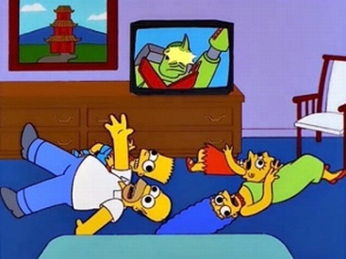
Aggressively Treat all Seizures
Seizures in ~20% of post-arrest patients
  Most are non-convulsive
From cardiac arrest brain injury – not hypothermia
→ Continuous EEG on all post-arrest patients
→ Early neuro consult
→ Aggressive seizure control
  Includes “myoclonus”
Notes:
We are suspect that we have been under-recognizing and under-treating seizure activity.
Seizures are common and may involve 15-20% of post-arrest patients.
Seizures predict poor outcomes.
The scary part – many are non-convulsive and can’t be seen.
To this end, we are in active discussions with the neurology service for 1) early neuro involvement, and 2) continuous EEG on all post-arrest patients.
Our peer institutions recommend aggressive treatment, including myoclonus.

Slide 32
When to Start Cooling?
VF
ROSC
Cardiac Arrest
0 1 2 3 4 5 6 7 8
Time
Pre-arrest
Elefteriades, 2010
Ueda, 2010
Bachet, 2010
Intra-arrest
Abella, 2004
Katz, 2002
Tang, 2008
Wang, 2010
HACA, 2002
Nielsen, 2013
ASAP after ROSC
Sterz, 1991
Kuboyama, 1993

Slide 33
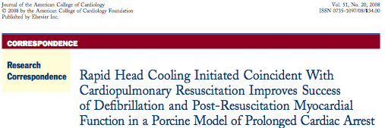
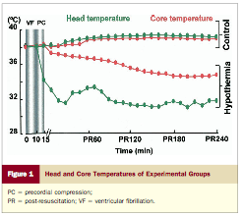
Animals with
  10 min of VF,
  5 min of CPR,
  1 dose of epi, defibrilliation
  ROSC and continued cooling for 4 hours.

Slide 34
Resuscitation events
 | Control | Cooled
 | N=8 | N=8 | P
Weight (kg) | 40.8±1.9 | 40.4±.0.7 | 0.613
CPP before initial electric shock (mm Hg) | 17.7±5.6 | 21.3±9.6 | 0. 370
No. of electric shock | 14.6±8.6 | 8.1±4.6 | 0.08
Initial electric shock success (%) | 38% | 75% | 0.315
Total electric shock success (%) | 66±19% | 88±18% | 0.034
CPR duration (sec) | 612.9±227.3 | 364.6±42.4 | 0.009
Epinephrine dosage (μg/kg) | 60±32.1 | 30±0 | 0.01
ROSC | 7(88%) | 8(100%) | 1

Slide 35
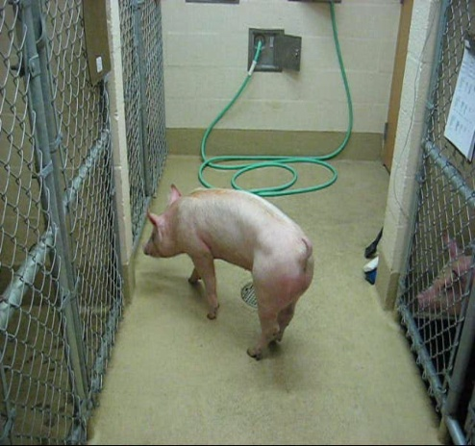
Neurological Deficit Scores
Nasal Cooling (8)
Normal
0
48 Hr after ROSC
200
Resuscitated Controls (7)
Death
400
24
48
72
96
Hours after ROSC

Slide 36
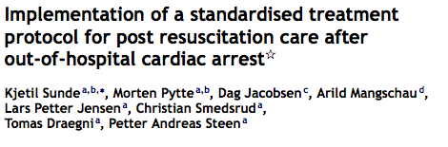

Resus, Aug 2006
Post-Resuscitation “Bundle”
  Therapeutic Hypothermia
  Respiratory Support
  Hemodynamics
  Metabolic and Fluid Support
  Neurologic Evaluation and Seizure Management
  When to decide to approach End-of-Life Decisions

Slide 37
What evidence is clear?
A system based approach is probably best…
Neurologic
  TTM – Modeling How…
  Minimal Sedation and Paralysis
  Early EEG for Status and Rx
  96h Moratorium w/ Adoption of Nielsen
Pulm
  Oxygen and Volume limiting ventilation
  Consensus on Abx
Renal
  Early initiation of CRRT
  Strict I/O
  Avoidance of Contrast
Hemodynamics
  Consensus on admission service and CCL
  Early line(s) placement
  Consensus on MAP / ECMO
  Coagulopathy and Modified Heparin / NAPT Dosing
GI/FEN/Nutrition
  GI Prophylaxis
  Mod. BG / Electrolytes
Rehabilitation
  Neurocog eval prior to d/c
  Psychiatry
  Linkage to care, Survivor resources

Slide 38
In the past…
JAMA, 1986

Slide 39
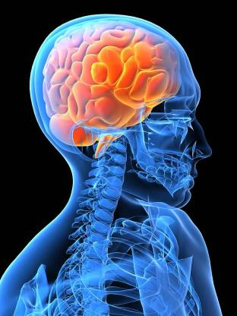
Neurologic Prognostication
“72 Hour Rule”
“96 Hour Rule”
Should not prognosticate solely on circumstances or neuro exam
  Should wait >96 hours after ROSC
  Wijdicks, et al., Neurology 2006; Booth, et al, JAMA 2004
Likely longer after hypothermia
  Europe: 1 week

Slide 40
Every year in the US 2300 OHCA that would otherwise live have N-WLST, of which 1600 would go on to functional neurologic outcome.

Slide 41
Every Program Has a Poster Child…

Slide 42



Thanks…
Josie, Madeline, Claire, Liam
Department of Emergency Medicine @ UAB
The Hypothermia Team @ UAB
Alabama Resuscitation Center
Notes:
ROC and my coauthors, specifically David Prince from CTC

Slide 43
Contact
  Michael C Kurz, MD MS FACEP FAHA
  Department of Emergency Medicine
  University of Alabama at Birmingham
  619 19th St. South, OHB 251
  Birmingham, AL 35249
  (205)-934-3611
  mckurz@uabmc.edu

Slide 45
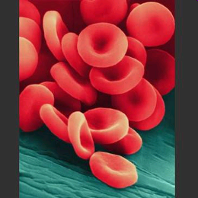
Coagulopathy and Bleeding
Most feared complication of hypothermia
Cold → impaired coagulation
  Altered platelet and factor enzyme function
  Fibrinolytic activity
Options:
  Alter Heparin Dosing
  Follow anti-Xa levels
Fibrinolysis is not a contraindication

Slide 46
HACA Trial: Adverse Events
 | Normothermic (n=138) | Hypothermic (n=137)
Bleeding | 19% | 26%
Arrhythmia | 32% | 36%
Pneumonia | 29% | 37%
Sepsis | 7% | 13%
Pancreatitis | 2% | 1%
Renal Failure | 10% | 10%
Pressure Sores | 0% | 0%
** None of these differences were statistically significant
HACA, 2002

Slide 50
Cold Diuresis
Hypothermia → Cold diuresis → electrolyte shifts
  Results in ↓K and ↓Mg
  Volume loss
  Frequently monitor and replenish electrolytes
  Prevent hypovolemia/shock
Opposite during re-warm
  Anti-diuresis - ↓urine output
  May result in ↑K and ↑Mg

Slide 51
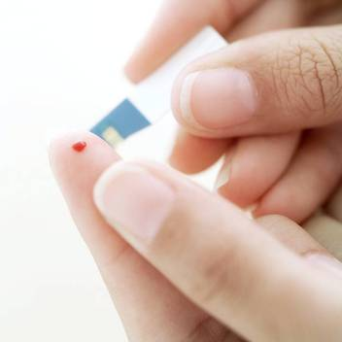
Hyperglycemia
Hypothermia may worsen insulin resistance
  Increased glucose
  May be worse than typical patient
  Glycemic control per standard ICU practice (insulin infusion, moderate glucose control)

Slide 52

Re-Warm SLOWLY
SLOW CONTROLLED re-warm
No faster than 0.25°C/hr
  At least 12-16 hours
AVOID RAPID RE-WARM
  Causes cerebral edema

Slide 53
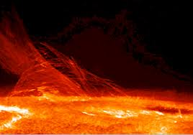
Post-Rewarm Fever
Fever + Brain Injury = BAD
→ Aggressively suppress post-rewarm fevers
  Continue Normothermia control as long as needed
Notes:
There are compelling data suggesting that fever + brain injury is a very bad combination.
To this end, we recommend aggressive fever suppression, including the prolonged use of the Arctic Suns

Slide 54
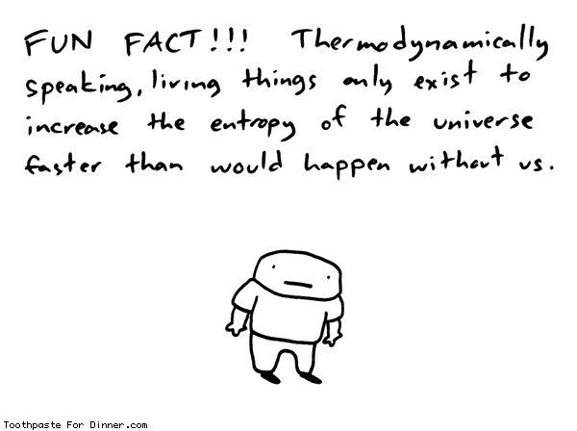
The Answer: Apply the Physics

Slide 55
When to Start Cooling?
ROSC
Cardiac Arrest
0 1 2 3 4 5 6 7 8
Time
Intra-arrest
Abella, 2004
Katz, 2002
Tang, 2008
Soon after ROSC
Sterz, 1991
Kuboyama, 1993
HACA, 2002
Nielsen, 2013

Slide 56
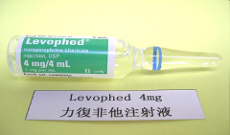
Hypotension
Cardiogenic shock common after cardiac arrest – sometimes delayed and refractory
May need higher dosages of vasopressors
Some experts recommend MAP ≥80 mmHg
    Impaired cerebral autoregulation
    Sundgren, et al., Stroke 2000

Slide 57
Multivariable Odds Ratios and Estimates for Predictor Variables Versus Survival
 | Unit | OR (95% CI) | Maximum Likelihood Estimate | Standard Error | Likelihood- Ratio Χ² | p-value
Gender (M) | 1.0 | 0.639 (0.186, 2.197) | -0.4481 | 0.6303 | 0.518 | 0.4715
Race (C) | 1.0 | 0.910 (0.255, 3.245) | -0.0941 | 0.6485 | 0.021 | 0.8846
Witnessed (Y) | 1.0 | 0.300 (0.052, 1.731) | -1.2053 | 0.8948 | 1.944 | 0.1632
Bystander CPR (Y) | 1.0 | 1.791 (0.532, 6.027) | 0.5825 | 0.6193 | 0.890 | 0.3454
Age (years) | 10.0 | 0.652 (0.391, 1.088) | -0.0427 | 0.0261 | 2.864 | 0.0906
T2T (minutes) | 100.0 | 1.320 (0.856, 2.036) | 0.0028 | 0.0022 | 1.730 | 0.1885
Initial Temp (⁰C) | 1.0 | 0.534 (0.259, 1.100) | -0.6275 | 0.3686 | 3.093 | 0.0786
Log (hypothermic/ischemic ratio) | 0.1 | 1.256 (1.109, 1.423) | 2.2797 | 0.6354 | 20.668 | <0.0001

Slide 58
The Problems:
There is a dearth of data about TTM that matters
That which exists ignores the fundamental thermodynamic realities of this therapy
Those realities are known:
  We sent a man to the moon in the 1960’s
  There are real, proven equations that describe our treatment

Slide 59
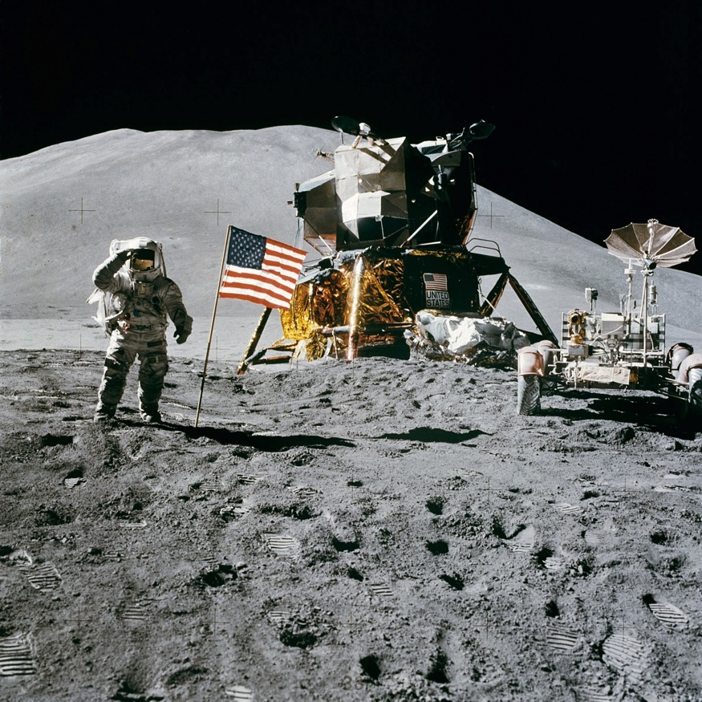
Those realities are known…

Slide 60
Shivering
Inconvenient – not directly harmful
Slows cooling
Solutions:
  Increase sedation (↑propofol rate)
  Add opioid or benzo IV boluses (-e.g., 50 mcg fentanyl)
  Single-dose neuromuscular blockade
  Continuous neuromuscular blockade infusion (avoid)

Slide 61
There are but two Equations:
First Law of Thermodynamics:
  Energy cannot be created nor destroyed, simply transformed from one state to another.
  ΔU = Q – W
Core body temperature is defined similarly:
  ΔT_{human body} = (Q_{Produced} ± Q_{exchanged}) x M x C
    M = mass of human body
    C = specific heat capacity of the human body

Slide 62

The Energy Source:
The fundamental purpose of the human body is to transform energy:
Characterized by the BMR + extra metabolism
  (Q_{Produced} ± Q_{exchanged}) , or
  Q – W

Slide 64
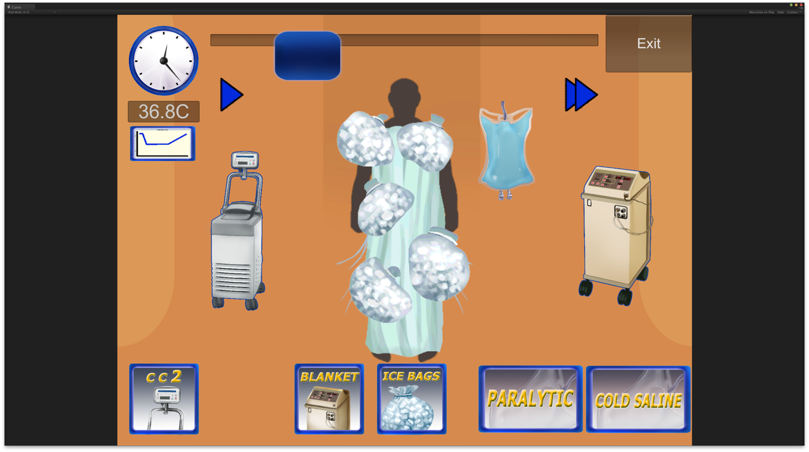

Slide 65
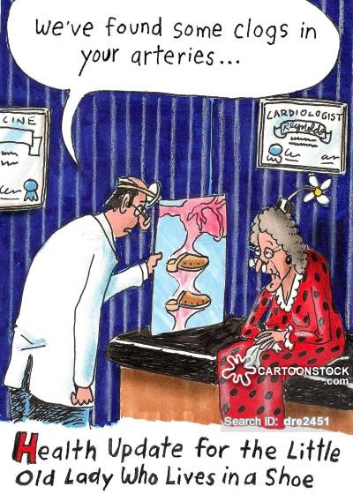
Coagulation following arrest…

Slide 66
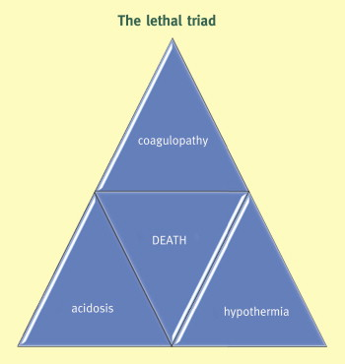
Significant reluctance: as ACS refers to dreaded triad of death

Slide 67
HACA Trial: Adverse Events
 | Normothermic (n=138) | Hypothermic (n=137)
Bleeding | 19% | 26%
Arrhythmia | 32% | 36%
Pneumonia | 29% | 37%
Sepsis | 7% | 13%
Pancreatitis | 2% | 1%
Renal Failure | 10% | 10%
Pressure Sores | 0% | 0%
** None of these differences were statistically significant
HACA, 2002

Slide 68
Coagulation as part of PCAS

Slide 69
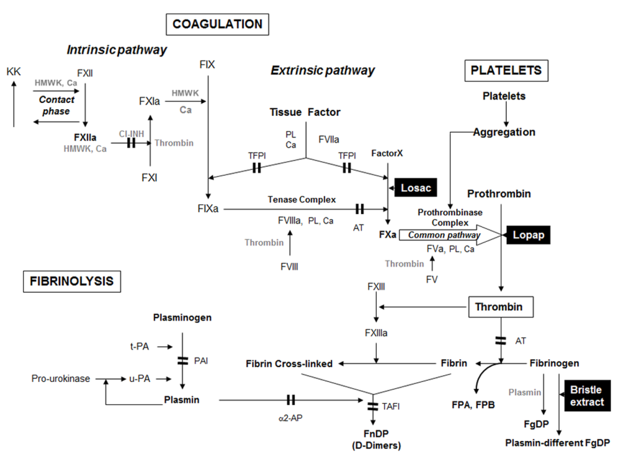
The Coagulation Landscape
Others:
PT/PTT/INR/PT ratio
Lactate
Multiplate
Glycocalyx:
Syndecan-1
Heparan Sulfate (HS)
aPC
TEG
Adrie C, et. al. JACC 2005
Weidman, JL, et. al.. Anesthesiology. 2014:120;1009-14
Böttiger BW, et. al. Circulation 1995; 92:2572–8 Grundmann S, et. al. Resuscitation, 2012
White N, et. al. Circulation 2012

Slide 70
Coagulopathy
Hypercoaguable
ROSC
120m
60m
24h
48h
OHCA
OHCA + TH
Hypocoaguable

Slide 71
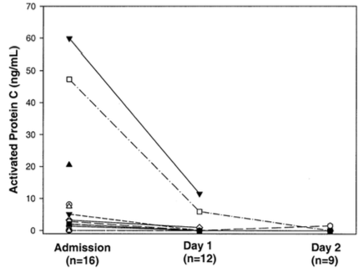
Adrie C, et. al. J Am Coll Cardiol 2005; 46:21-8

Slide 72
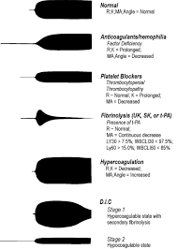
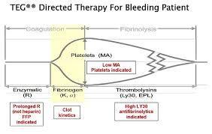
Thromboelastrography - (TEG)

Slide 73
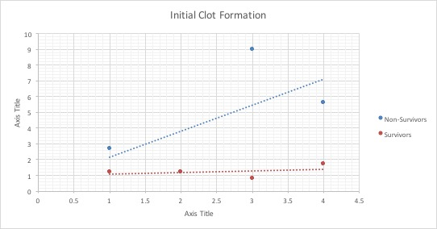

Slide 74
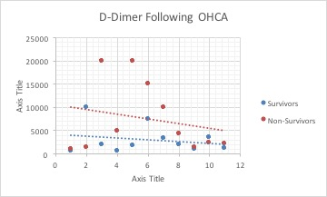

Slide 75
Before TTM…
We recommend the earliest time to prognosticate a poor neurologic outcome using clinical examination in patients not treated with TTM is 72 hours after cardiac arrest (Class I, LOE B-NR).
Callaway CW, Part 8: Post–Cardiac Arrest Care
2015 American Heart Association Guidelines Update for Cardiopulmonary Resuscitation and Emergency Cardiovascular Care , Circulation 2015
JAMA, 1986

Slide 76
Neurologic Prognostication
“72 Hour Rule”
“96++ Hour Rule”
This time until prognostication can be even longer than 72 hours after cardiac arrest if the residual effect of sedation or paralysis confounds the clinical examination (Class IIa, LOE C-LD).
Operationally, the timing for prognostication is typically 4.5 to 5 days after ROSC for patients treated with TTM.
Callaway CW, Part 8: Post–Cardiac Arrest Care
2015 American Heart Association Guidelines Update for Cardiopulmonary Resuscitation and Emergency Cardiovascular Care , Circulation 2015

Slide 77
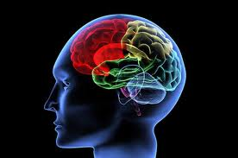
Neuro-cognition following TH…
Each Survivor gets:
  R-BANS
  CPC-E
  SF-12v2
  WTAR
What we are discovering:
  Victims have specific brain injury signature
  Rapidly improving short term memory gaps
  Impaired executive function
  Increased incidence anxiety and depression

Slide 78
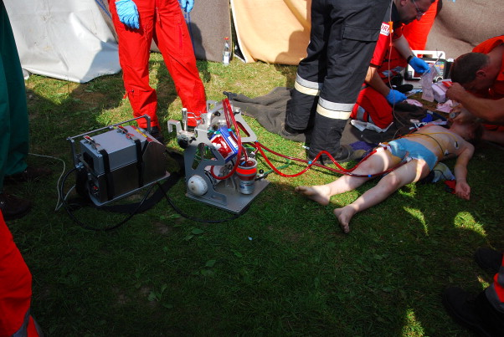
What the future holds…

Slide 79
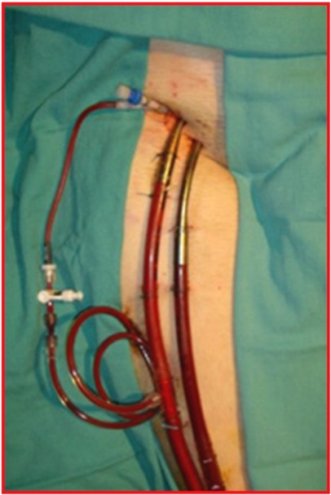
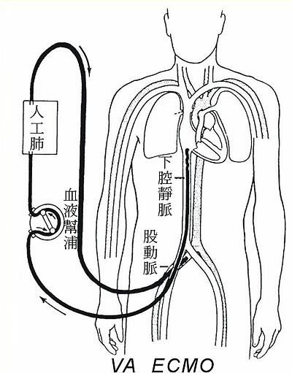
When do I need ECPR (ECMO)?
Unable to maintain acceptable oxygenation and hemodynamics
Considerations:
  Bridge to recovery / transplant
  Chronic conditions
  Previous function
Notes:
INCLUSION CRITERIA:
Witnessed cardiac arrest.
Initial rhythm VF or VT.
Bystandard or EMS initiated CPR/ACLS within 10 minutes of witnessed arrest.
ROSC prior to or soon after arrival to the Emergency Department with persistent cardiogenic shock.
(These criteria can be broadened once there has been enough experience with ECPR).
EXCLUSION CRITERIA:
Total arrest time >30 minutes.
Age >65
Other comorbid conditions that would predict a poor survivability (i.e. malignant cancer, advanced neurodegenerative disease, etc).
Initial rhythm asystole.
Advantages: Femoral access (i.e. percutaneous) at Bedside, minimally invasive, 15-19 Fr catheters based upon size… can be made readily available, Complete circulatory (i.e. biventrcular) support, pulmonary support.
Disadvantages: Labor intensive, patient immobilized and largely non-mobile (i.e. not going to the scanner), , Non-pulsitile flow… LV distension

Slide 80
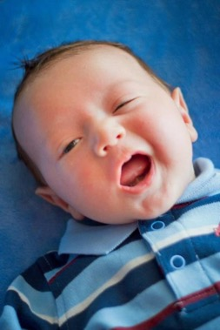

Thanks…
Josie, Madeline, Claire, Liam
Department of Emergency Medicine @ UAB
The Hypothermia Team @ UAB
Drs. Wang and Pittet
Notes:
ROC and my coauthors, specifically David Prince from CTC

Slide 81
PRACTICAL CONSIDERATIONS

Slide 82
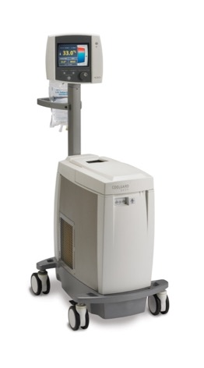
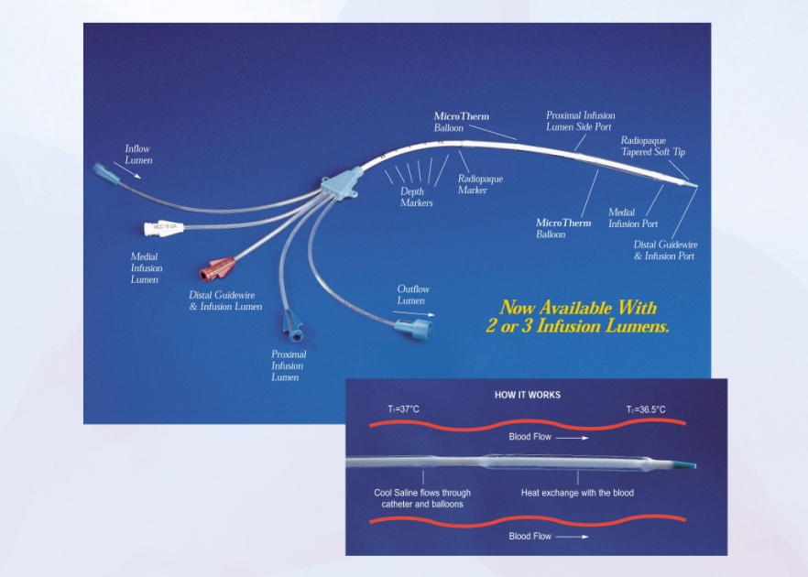
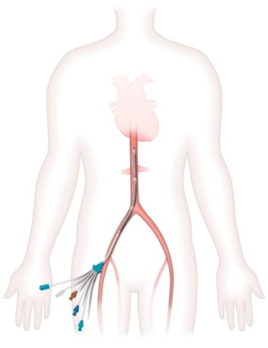
Intravascular Cooling:

Slide 83
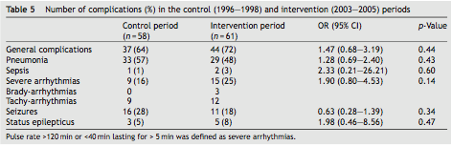
Sunde: Adverse Events w/ Bundle

Slide 84
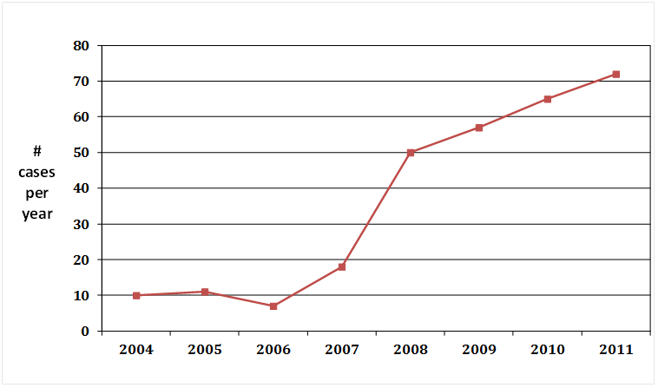
ARCTIC Program Volume

Slide 85
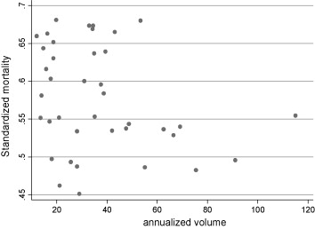
Inter-Hospital Variability in Post Cardiac Arrest Mortality
.
Hospitals w/ >50 CA/ y had significantly better survival than those treating <20 CA/ y OR 0.62, 95% CI 0.45-0.86
Carr et al. Resuscitation 2009;80:31-34

Slide 86
However Survival Remains Stagnant
Improvements in survival from AEDs not CPR
No change in Survival in 40 years
CPR = 911 early?
$$ Incentives to keep CPR around (read: AHA)
CPR is harmful
CPR causes recurrent VF??

