Slide 1
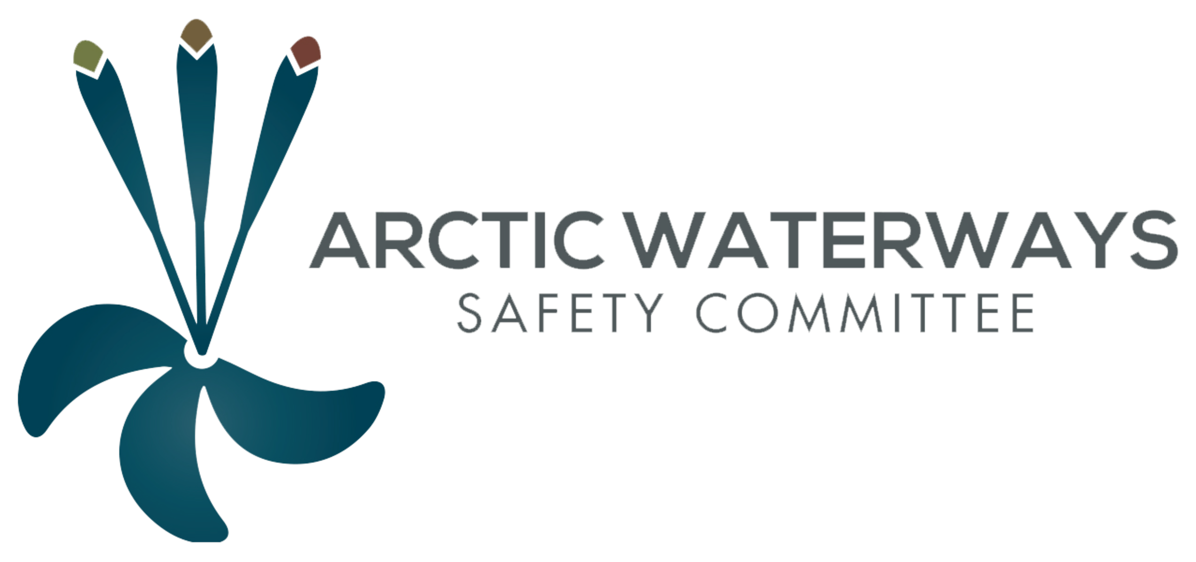
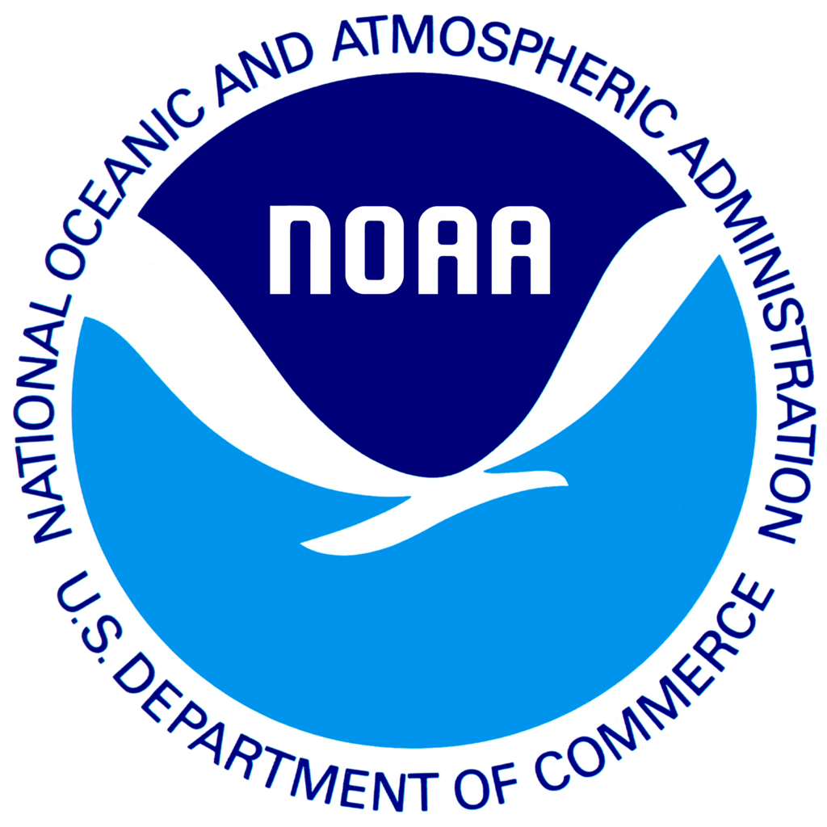
Anchorage, Alaska
December 10th, 2015

Slide 2
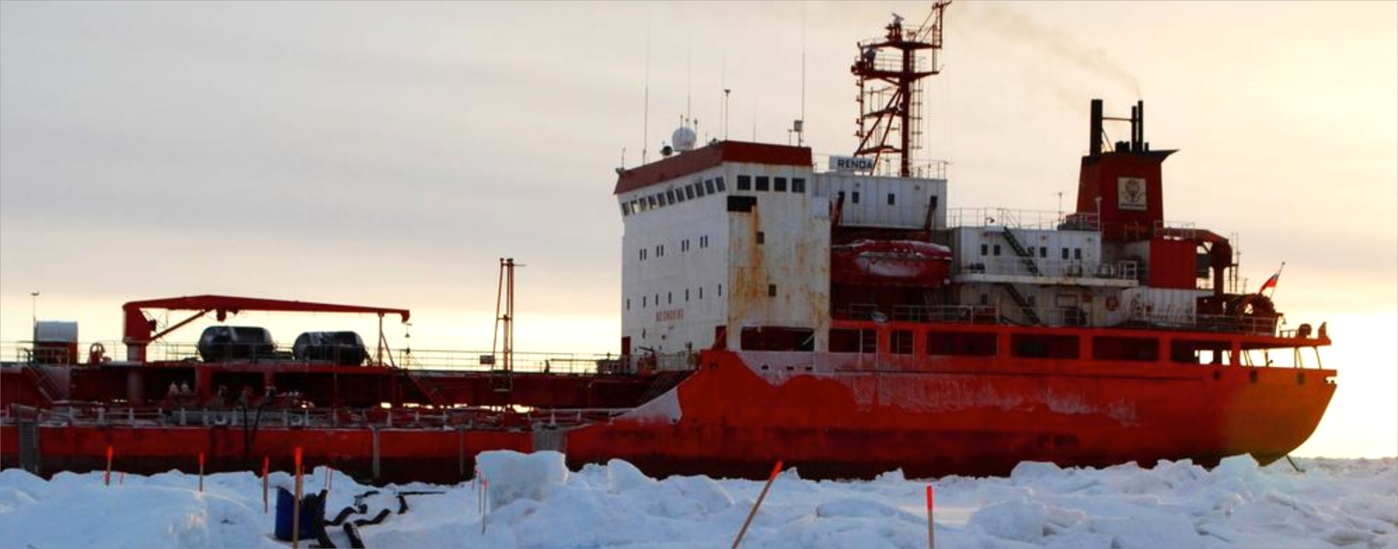
The Arctic Waterways Safety Plan Martin Robards PhD
Martin Robards

Slide 3
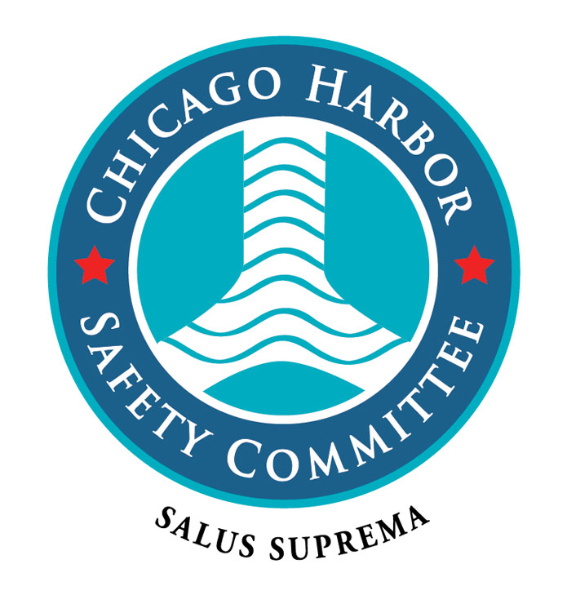
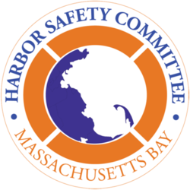
The role of a Safety Plan

Slide 4
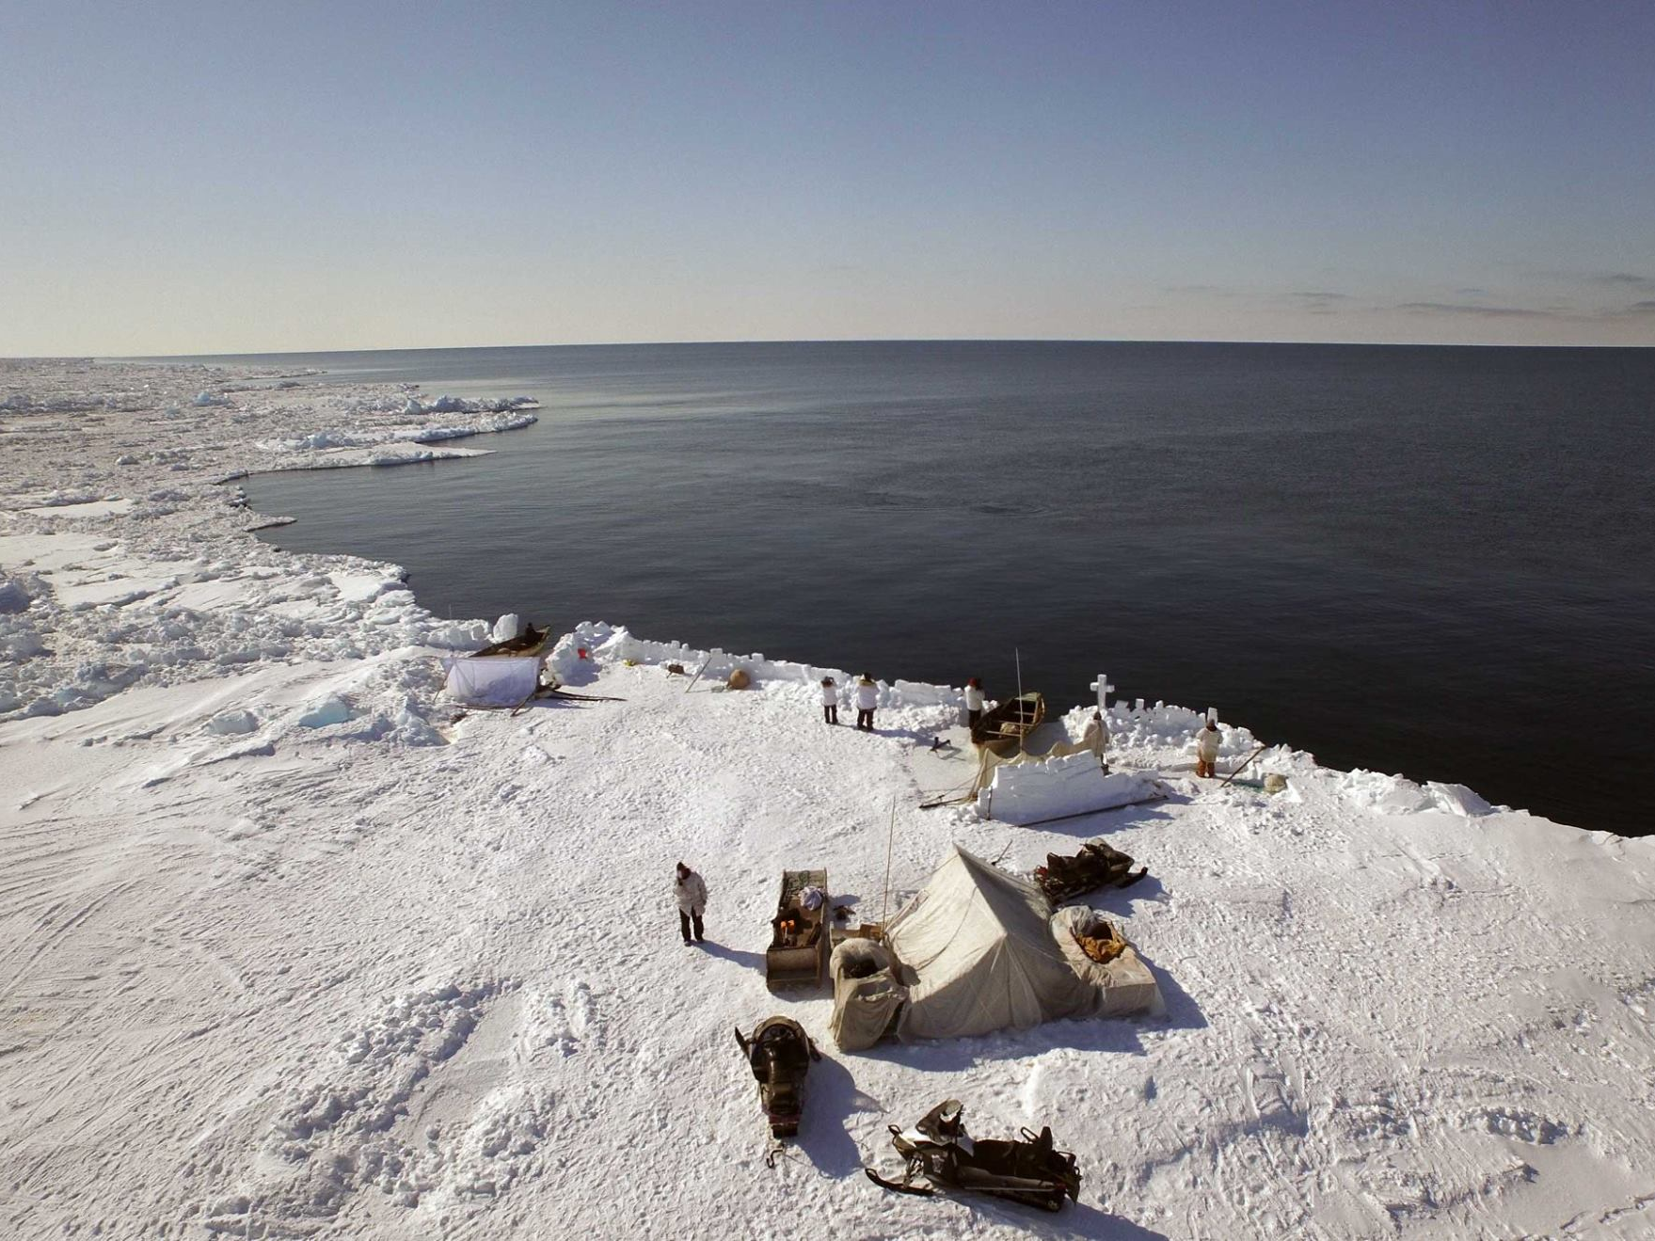
Arctic Waterways Safety Plan Fundamentally Different Considerations
Note Sea ice elsewhere
Subsistence
Photo: Peak 3/AEWC

Slide 5
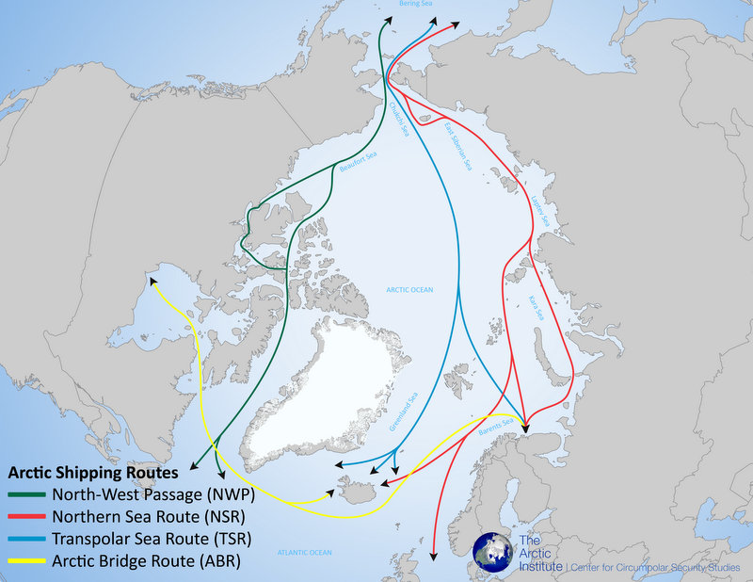
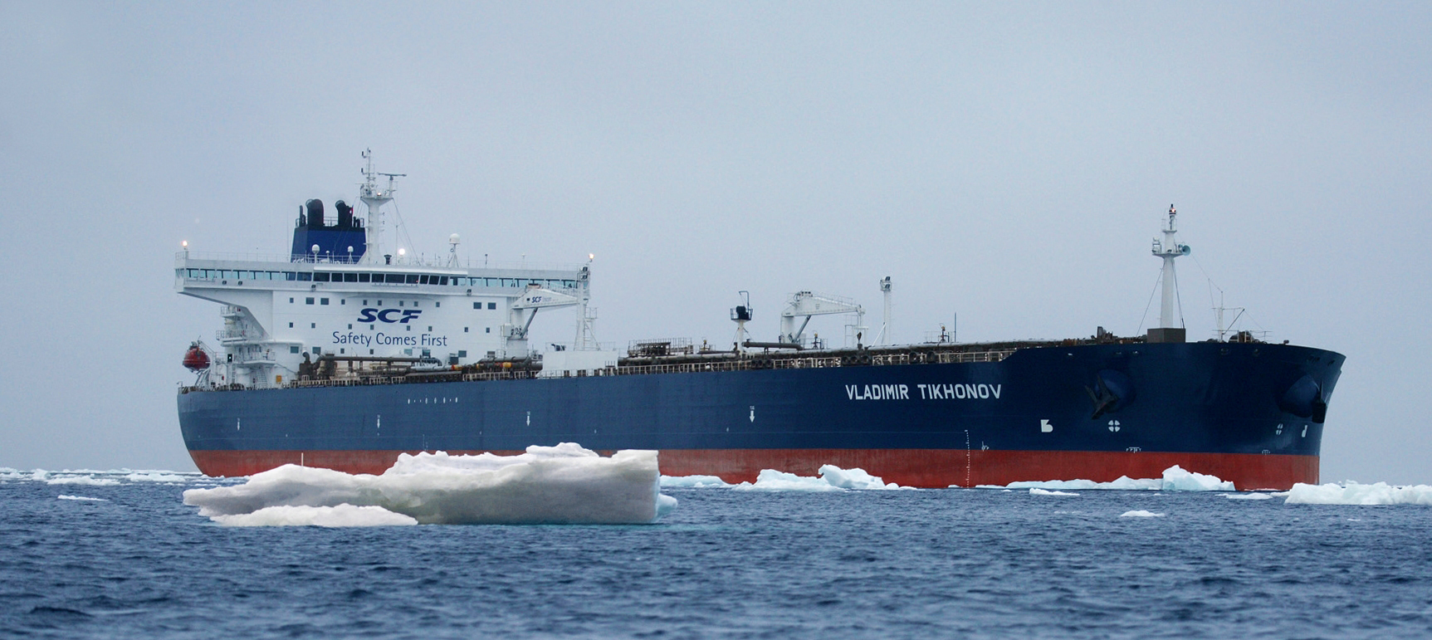
A Place in Rapid Change
New Visitors to the Region &
New Risks

Slide 6
History of AMMC and AWSC
March 2012 Anchorage AMMC
August 2014 Anchorage AWSC
November 2014 Juneau “
February 2015 Juneau “
June 2015 Anchorage “

Slide 7
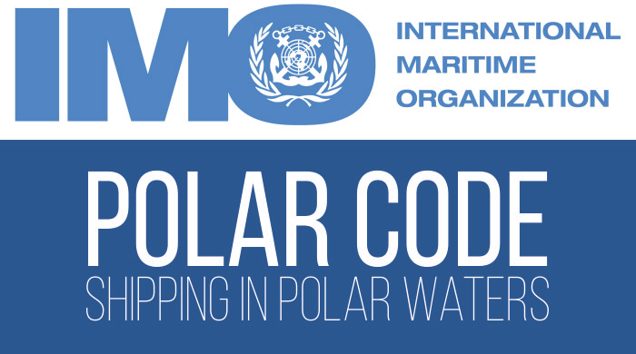
Arctic Waterways Safety Plan and the Polar Code
Within the Polar Code, vessel captains are required to: “minimize threats to marine mammals and indigenous subsistence hunters by avoiding no-go areas.”

Slide 8
Arctic Waterways Safety Plan Draft Structure
Letter of Promulgation
Table of Contents
INTRODUCTION
Statement of Purpose
The purpose of the Arctic Waterways Safety Committee is to bring together local marine interests in the Alaskan Arctic in a single forum, and to act collectively on behalf of those interests to develop best practices to ensure a safe, efficient, and predictable operating environment for all current and future users of the waterway. Recognizing this need, the Mission of the Arctic Waterways Safety Committee, as stated in their By-Laws …

Slide 9
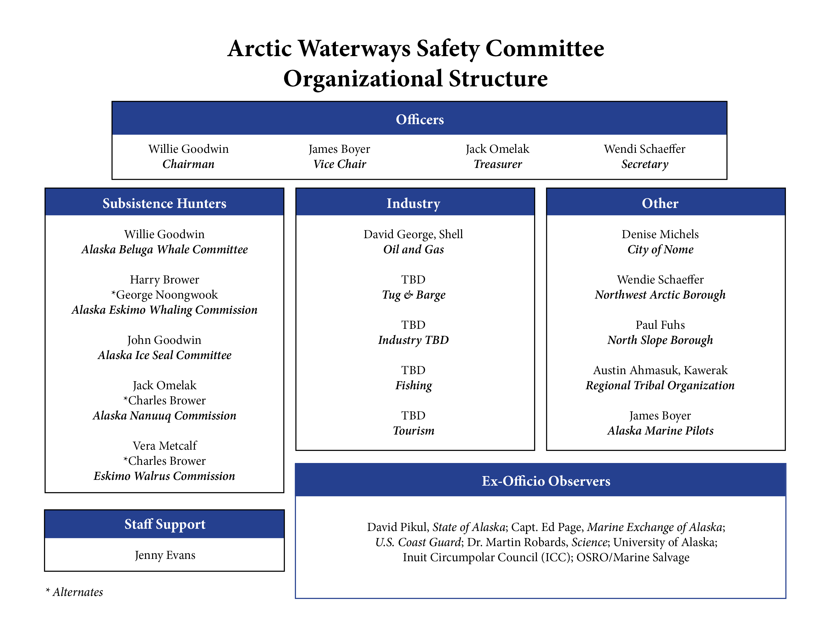
Arctic Waterways Safety Plan
Draft Structure

Slide 10
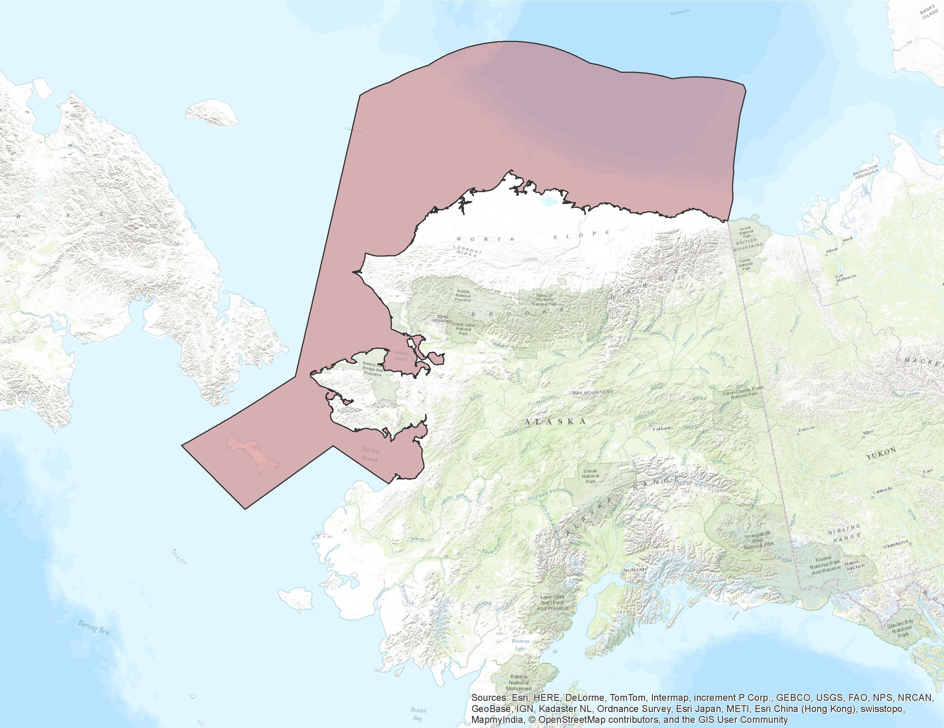
The Arctic Area of Interest Kawerak, Inc., NWAB, and NSB

Slide 11
General Information
Polar Code and Port Access Route Study (PARS)
Federal Regulations (USCG, BOEM, BSEE, NPFMC)
Coast Pilot and Charts
Aids to Navigation
Oil Spill Response Organizations (OSROs)
Mandatory Pilotage
Automatic Identification System
Alternative Planning Criteria
Accredited Providers
Geographic Response Strategies
Areas of Seasonal Marine Mammal Subsistence Use
Subsistence Use Conflict Resolution
Environmentally Sensitive Areas
Advance Notice of Arrival or Transit for Key Areas
Port of Nome
Communications Local Lifeboats

Slide 12
Standards of Care
Procedures and practices, beyond regulatory requirements, that experienced and prudent maritime professionals follow to ensure safe, secure, efficient and environmentally responsible maritime operations;
... are “good marine practices” that are developed and published to provide a guide for maritime professionals to consider and incorporate into their decision making process;
Mariners should be mindful that if they are involved in a maritime incident when not following relevant “Standards of Care” they could be subject to legal action based on a rebuttable presumption of negligence.

Slide 13
Standards of Care
Lightering
Federal (exempt) Research Vessels
State and Federal tank and non-tank vessel contingency plan
Maritime Tourism and Village visit practices
Bridge Team Management
Navigation through the Bering and Anadyr Straits
Heavy Weather and Harbors of Refuge
Ice and ice Breaking/Escorts
Restricted Visibility
Equipment Failures
Towing Operations
Underkeel Clearance
Vessels in Innocent Passage
Transboundary Response and Coordination
Maritime Insurance

Slide 14
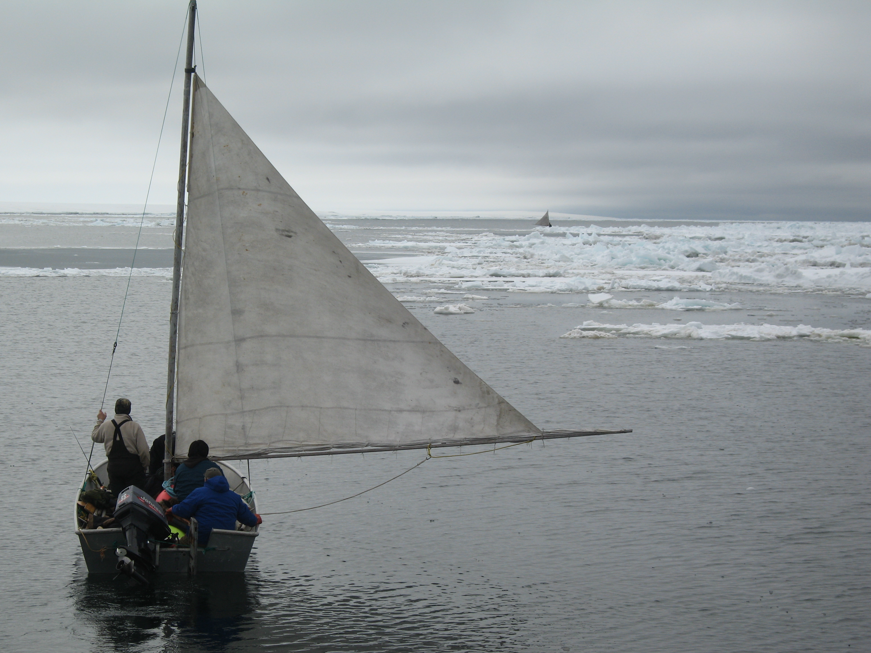
Questions?

