Slide 1
Using Manipulatives to Teach Fraction Concepts

Slide 2
srpowell@austin.utexas.edu
@sarahpowellphd
119

Slide 3
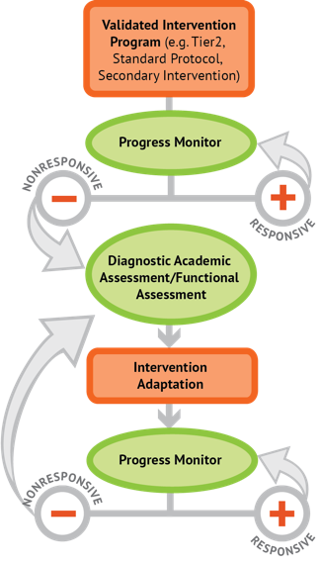
Instructional Platform
INSTRUCTIONAL DELIVERY
Explicit instruction
Precise language
Multiple representations
INSTRUCTIONAL STRATEGIES
Fluency building
Problem solving instruction
Motivation component

Slide 4
Explicit Instruction
Modeling
Practice
Clear Explanation
Guided
Practice
Planned
Examples
Independent Practice
Supporting Practices
Asking the right questions
Eliciting frequent responses
Providing immediate specific feedback
Maintaining a brisk pace

Slide 5
Precise Language
Use formal math language
concise
Use terms precisely

Slide 6
Multiple Representations
Abstract
Pictorial
Concrete

Slide 7
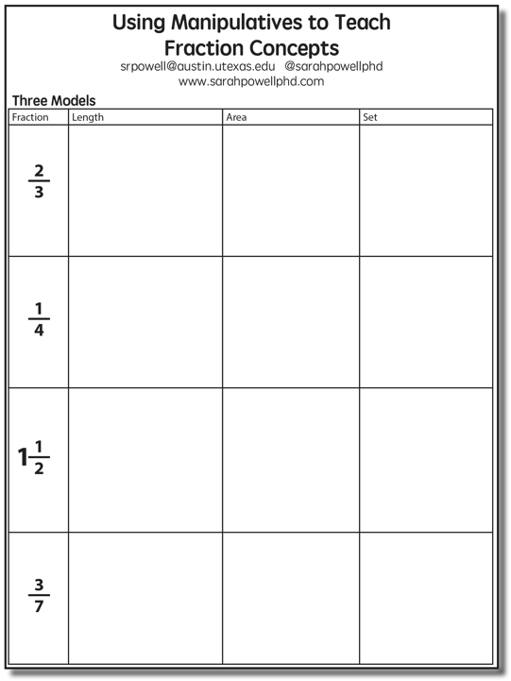

Slide 8
Length/Measurement
Fractions are appropriated by length
Fraction tiles/bars

Slide 9
Length/Measurement
Fractions are appropriated by length
Cuisenaire rods

Slide 10
Length/Measurement
Fractions are appropriated by length
Number line

Slide 11
Select a fraction and teach using the length model.
Explicit instruction
Precise language
Multiple representations

Slide 12
Area/Region
Shapes divided into equal sections
Fraction circles

Slide 13
Area/Region
Shapes divided into equal sections
Geoboards

Slide 14
Area/Region
Shapes divided into equal sections
Pattern blocks

Slide 15
Area/Region
Shapes divided into equal sections
Legos

Slide 16
Select a fraction and teach using the area model.
Explicit instruction
Precise language
Multiple representations

Slide 17
Set/Discrete
Individual shapes match the fraction
Two-color counters

Slide 18
Set/Discrete
Individual shapes match the fraction

Slide 19
Select a fraction and teach using the set model.
Explicit instruction
Precise language
Multiple representations

Slide 20
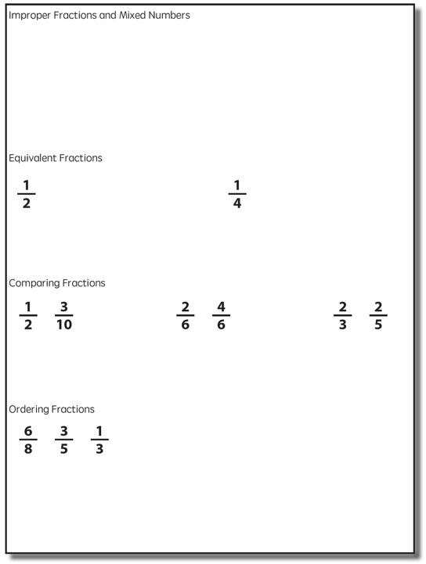

Slide 21
Improper Fractions
Fractions equal to or greater than 1
Numerator is equal to or greater than denominator
Select a fraction and teach using two models of fractions.
Explicit instruction
Mixed Numbers
Precise language
A mix of a whole number and a fraction
Multiple representations

Slide 22
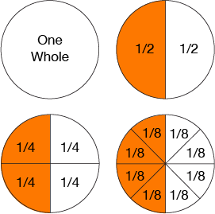
Equivalent Fractions
Determine equivalent fractions.
Explicit instruction
Precise language
Multiple representations

Slide 23
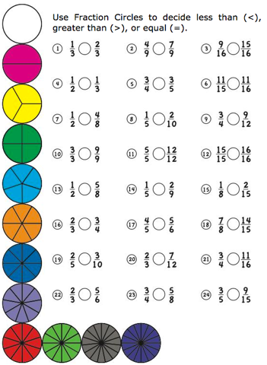
Comparing Fractions
Compare two fractions.
Explicit instruction
Precise language
Multiple representations

Slide 24
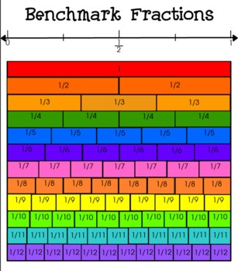
Ordering Fractions
Compare to benchmark fractions
Order three fractions.
Explicit instruction
Precise language
Multiple representations

Slide 25
Instructional Platform
INSTRUCTIONAL DELIVERY
Explicit instruction
Concise language
Multiple representations
INSTRUCTIONAL STRATEGIES
Fluency building
Problem solving instruction
Motivation component

Slide 26
srpowell@austin.utexas.edu
@sarahpowellphd
119

