Slide 1
Lesson 10: Gender and Sexuality
Robert Wonser
Introduction to Sociology

Slide 2
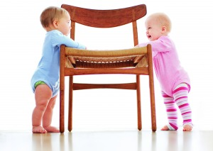
Gender ≠ Sex ≠ Sexuality
Sex refers to an individual’s membership in one of two biologically distinct categories—male or female.
  Examples include: female, male, intersex
Gender refers to the physical, behavioral, and personality traits that a group considers normal for its male and female members.
  Examples include: man, woman, transgender, etc.
Notes:
Breakdown of Facebook’s gender identities: http://www.thedailybeast.com/articles/2014/02/15/the-complete-glossary-of-facebook-s-51-gender-options.html

Slide 3



Slide 4
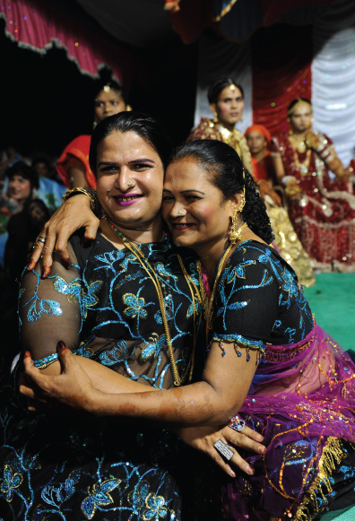
Intersex
About 1 babies in 1,000 are born intersexed, someone whose chromosomes, gonads (i.e., ovaries or testes), hormonal profiles, and anatomy do not conform to the expected configurations of either male typical or female typical bodies.
Some intersex conditions are apparent at birth, while others are noticed around puberty or later (if ever).
Gender is different because it relates to the way that a person behaves based on their biological sex.
Hijras embracing at a wedding.
Notes:
Bullet point number two: See ISNA.org
http://www.thedailybeast.com/articles/2014/02/15/the-complete-glossary-of-facebook-s-51-gender-options.html

Slide 5

As nature made him
David Reimer was subjected to gender reassignment surgery at 18 months old. What does his story tell us about the relationship between biological sex and gender identity?

Slide 6

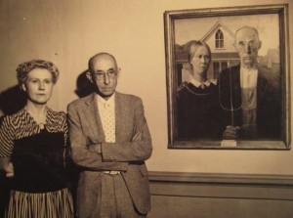
Constructionist Approach to Gender Identity
Sociologists use a constructionist approach and see gender as a social construction and acknowledge the possibility that the male–female categories are not the only way of classifying individuals.
Gender is constructed, or created, through our interactions with other members of society.
Your behavior creates your gender
Unlike many other animals, humans have low levels of sexual dimorphism.

Slide 7





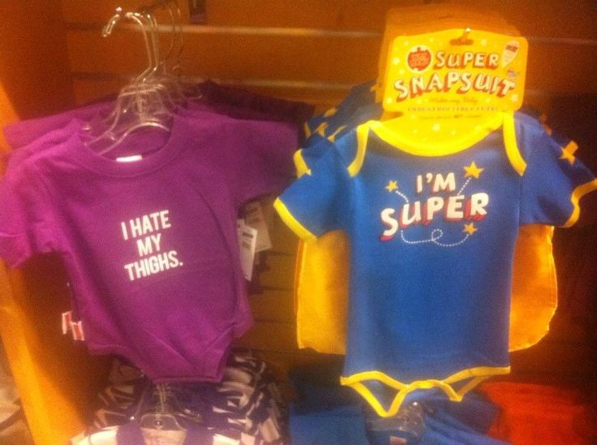
Constructing Gender
Notes:
http://thesocietypages.org/socimages/2008/02/02/hasbro-teachers-girls-to-be-good-housewives/
https://www.pinterest.com/socimages/needlessly-gendered-products/

Slide 8
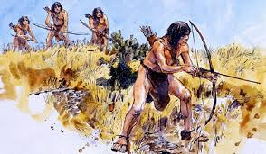
Gender Inequality
Gender inequality can be found in all past and present societies.
The activities that women could participate in were limited because they had less physical strength and because of the demands of bearing and raising children.
Men delivered the most important resources to the group, such as food from hunting or land from warfare, and became powerful by controlling the distribution of these resources.
There are several sociological theories that attempt to explain why this inequality has persisted in contemporary societies. We’re going to discuss several of these theories now.

Slide 9
Theories on Gender Inequality
Functionalists:
  Believe that there are social roles better suited to one gender than the other, and that societies are more stable when certain tasks are fulfilled by the appropriate sex (instrumental and expressive roles).

Slide 10
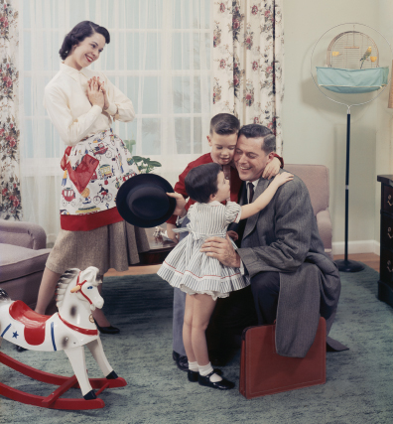
Theories on Gender Inequality
In the 1950s, Talcott Parsons advanced the idea that the nuclear family effectively reared children to meet the labor demands of a capitalist system.
According to Parsons:
  Men were more suited for an instrumental role (the person who provides the family’s material support and is often an authority figure).
  Women were more suited for an expressive role (the person who provides the family’s emotional support and nurturing).

Slide 11
Theories on Gender Inequality
Conflict theorists:
  Believe men have historically had access to most of society’s material resources and privileges.
  Therefore, it is in their interest to try to maintain their dominant position by creating and reproducing patriarchal intuitions maintain systems of inequality favoring hegemonic masculinity (power, sexual dominance and activity, wealth, aggression, independence, and lack of emotion).

Slide 12
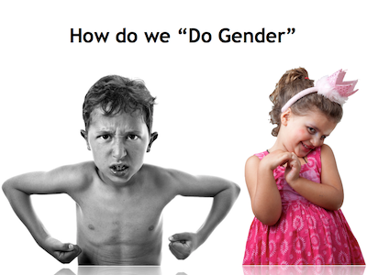
Theories on Gender Inequality
Symbolic Interactionists emphasize how the concept of gender is socially constructed, maintained, and reproduced in our everyday lives.
Doing Gender is the idea that in Western culture, gender, rather than being an innate quality of individuals, is a psychologically ingrained social construct that actively surfaces in everyday human interaction.

Slide 13
Who Farts and Who Cares?
Heterosexual men were the most likely to think it was funny and the most likely to engage in “intentional flatulence.”
“Guys would say it’s raunchy and then say ‘Nice one,’” explained one heterosexual guy, “because if it’s strong it’s more manly. You know, because women would not try to clear a room with a fart.”
Heterosexual women felt like they were violating gender norms if their farts were stinky: “The worse it stinks,” said one, “the nastier they think I am.”
Notes:
http://thesocietypages.org/socimages/2015/03/09/who-farts-and-who-cares/

Slide 14
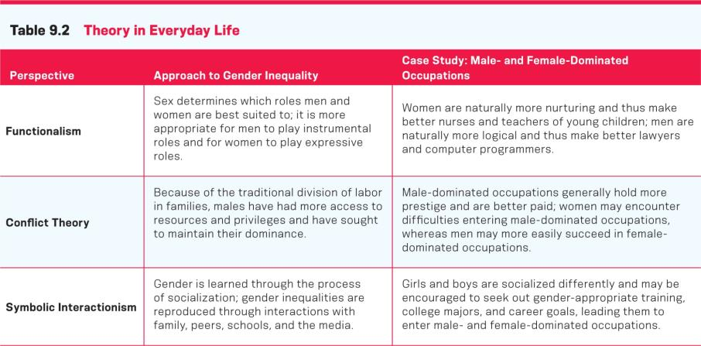
Sociological Theories of gender overview

Slide 15
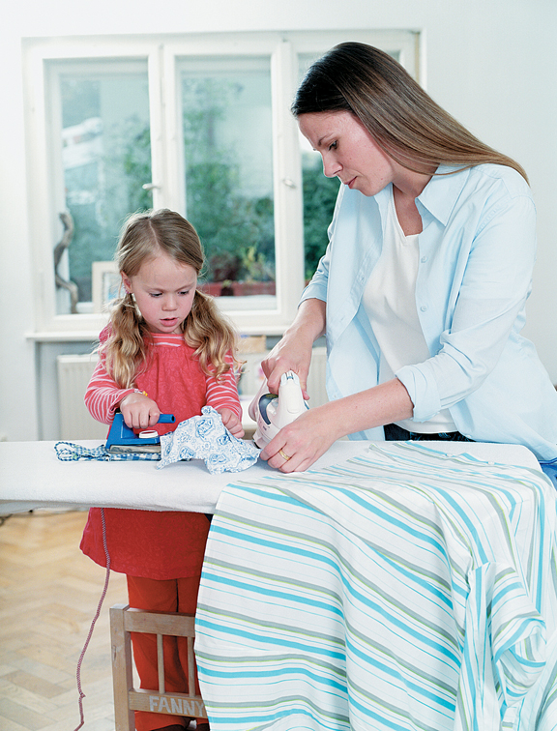
Gender Role Socialization
Gender role socialization is the lifelong process of learning to be masculine or feminine, primarily through four main agents of socialization: families, schools, peers, and the media.

Slide 16
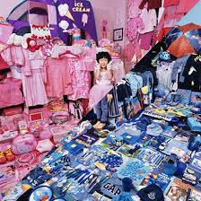
Gender Role Socialization
Families are usually the primary source of socialization and greatly impact gender role socialization.
Social learning theory suggests that the babies and children learn behaviors and meanings through social interaction and internalize the expectations of those around them.
  we learn gender, we are not born knowing who wears pink

Slide 17
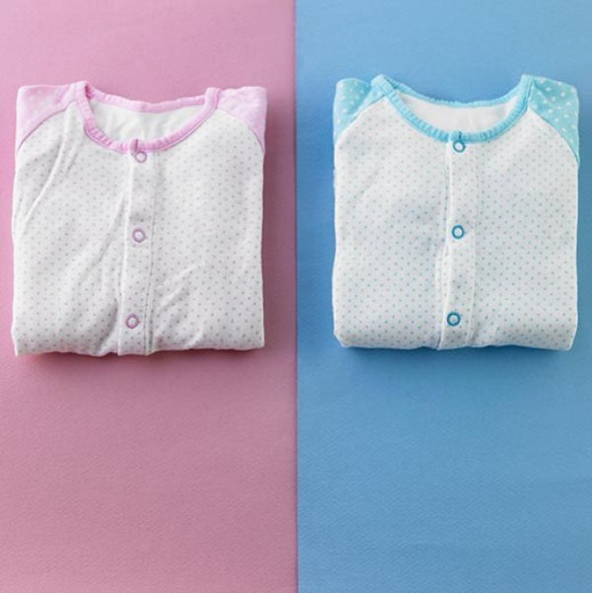
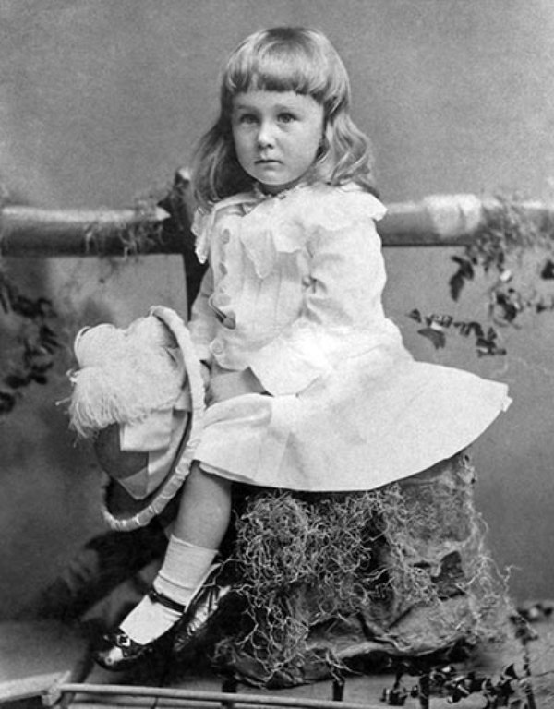
Incidentally…
Pink and blue didn’t become gender signifiers until just before WW1
Social convention of 1884, when FDR was photographed at age 2 1/2, dictated that boys wore dresses until age 6 or 7, also the time of their first haircut. Franklin’s outfit was considered gender-neutral.
a June 1918 article from the trade publication Earnshaw's Infants' Department said, “The generally accepted rule is pink for the boys, and blue for the girls. The reason is that pink, being a more decided and stronger color, is more suitable for the boy, while blue, which is more delicate and dainty, is prettier for the girl.”
Notes:
Source: http://www.smithsonianmag.com/arts-culture/when-did-girls-start-wearing-pink-1370097/?no-ist

Slide 18

Gender Role Socialization
Schools also socialize children into their gender roles.
For instance, research shows that teachers treat boys and girls differently.
This may teach children that there are different expectations of them, based on their perceived sex.
Boys tend to get more attention in the classroom than girls (positive and negative).

Slide 19

Gender Role Socialization
In Western societies, peer groups are an important agent of socialization.
Teens are rewarded by peers when they conform to gender norms and stigmatized when they do not.
Ex: Gender Policing

Slide 20

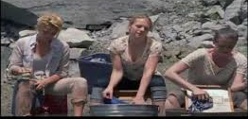


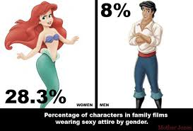
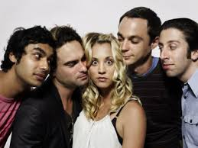

Gender Role Socialization
Stereotypical manner in all forms of the media: television, movies, magazines, books, video games, and so on.

Slide 21
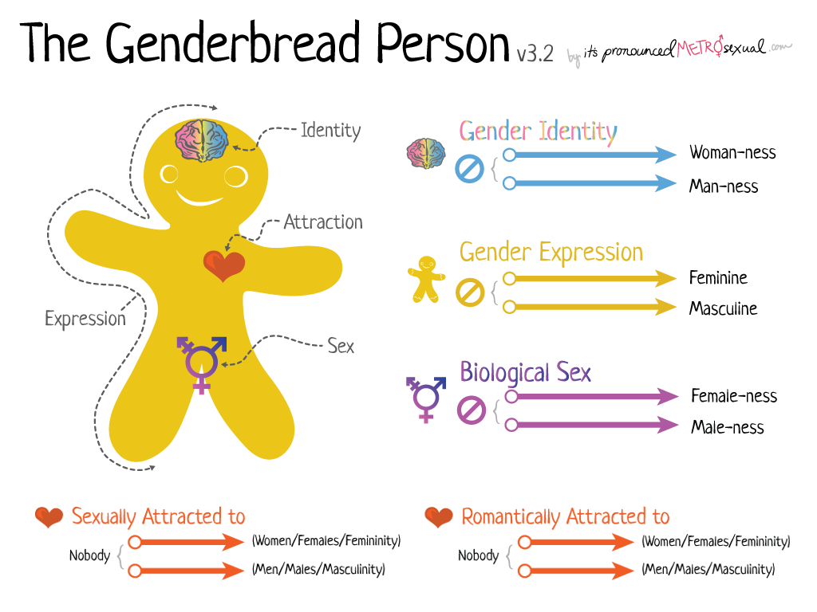
Gender is (Re)Constructed: Gender is maintained structurally, institutionally, interactionally and individually.
Notes:
Individually: Gender identity - One's innermost concept of self as male, female, a blend of both or neither – how individuals perceive themselves and what they call themselves. One's gender identity can be the same or different from their sex assigned at birth.
Interactionally: Gender expression - External appearance of one's gender identity, usually expressed through behavior, clothing, haircut or voice, and which may or may not conform to socially defined behaviors and characteristics typically associated with being either masculine or feminine.
http://www.hrc.org/resources/sexual-orientation-and-gender-identity-terminology-and-definitions
http://itspronouncedmetrosexual.com/2015/03/the-genderbread-person-v3/

Slide 22
Outcomes of a Gendered Society
Sex and gender affect almost every significant aspect of our lives, life chances.
Even lifespan is different by gender!
Women are disadvantaged in institutional settings in our society. Women tend to:
  Do a disproportionate amount of housework
  Earn less on average than their male peers at work
  Remain more likely to live in poverty

Slide 23
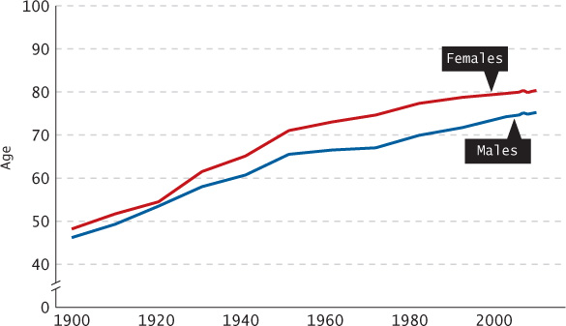
U.S. Life Expectancy by Gender, 1900–2007

Slide 24
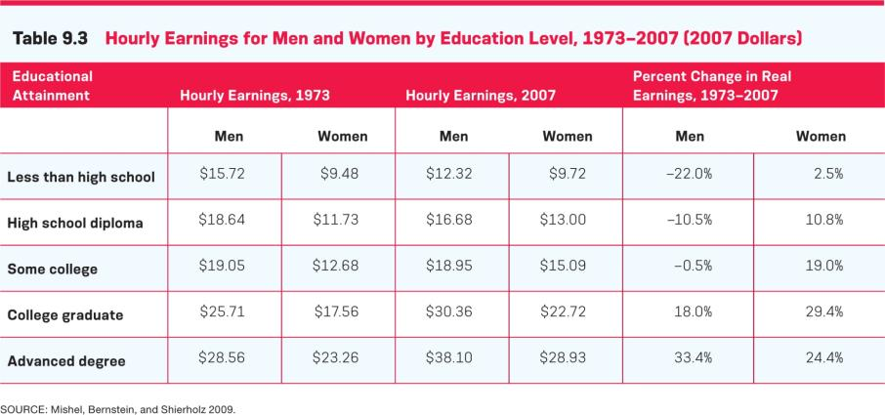
Hourly Earnings for Men and Women by Education Level (1973-2007)

Slide 25
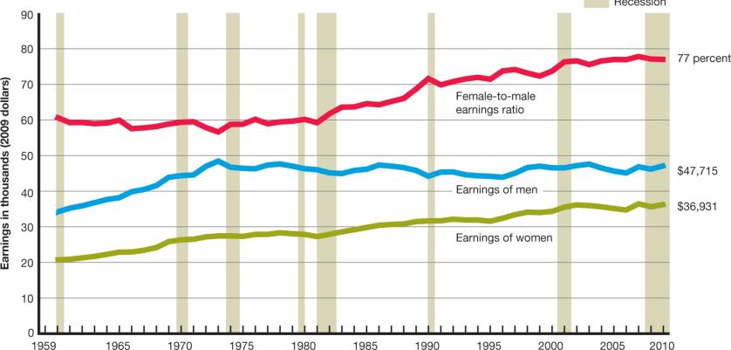
Female-to-Male Earnings Ratio, 1960-2010
Notes:
Gender gap in pay a myth? Not quite. The studies that claim it is still describe a gender gap in pay, they just don’t explain it all through discrimination. Further reading:
Source: http://www.aauw.org/research/the-simple-truth-about-the-gender-pay-gap/
http://www.huffingtonpost.com/entry/no-the-gender-pay-gap-isnt-a-myth-and-heres-why_us_5703cb8de4b0a06d5806e03f
Doctor example: http://mobile.nytimes.com/2016/07/12/health/women-doctors-salaries-pay-gap.html?smid=fb-nytimes&smtyp=cur&referer=http://m.facebook.com
http://thinkprogress.org/economy/2014/04/08/3424043/gender-wage-gap-myth/

Slide 26
Sex, Gender, and Life Chances
This has led to a situation called the feminization of poverty, which is the economic trend showing that women are more likely than men to live in poverty, due in part to:
  the gendered gap in wages,
  the higher proportion of single mothers compared to single fathers,
  and the increasing cost of childcare.

Slide 27
Sex, Gender, and Life Chances
Even our language and vocabulary tend to reflect a hierarchal system of gender inequality.
  What’s the difference between a stud and slut?
  Mankind, mailman, guys

Slide 28
Feminism and the Women’s Movement
Feminism is the belief in the social, political, and economic equality of the sexes and the social movements organized around that belief.
In the United States, the history of the women’s movement can be divided into three historical waves.

Slide 29
The Women’s Movement
The first wave was the earliest period of feminist activism and included the period from the mid-nineteenth century until American women won the right to vote in 1920.
The campaign organized around gaining voting rights for women was called the suffrage movement.

Slide 30
The Women’s Movement
The second wave was the period of feminist activity during the 1960s and 1970s often associated with the issues of women’s equal access to employment and education.
The third wave is the most recent period of feminist activity and focuses on issues of diversity and the variety of identities that women can possess.

Slide 31
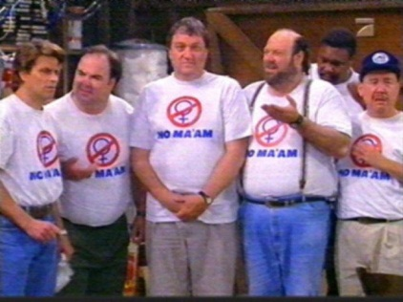
The Men’s Movement
Although originally broadly sympathetic with feminism, the men’s movement has now split into the men’s rights movement (a group that feels that feminism creates disadvantages for men) and the pro-feminist men’s movement (a group that feels that sexism harms both men and women and wants to fundamentally change society’s ideas about gender).

Slide 32
Sexual Orientation
Sexual orientation is the inclination to be heterosexual (attracted to the opposite sex), homosexual (attracted to the same sex), or bisexual (attracted to either sex), or to not be sexually attracted to anyone (asexual).
Sexuality is far more fluid than commonly assumed.

Slide 33
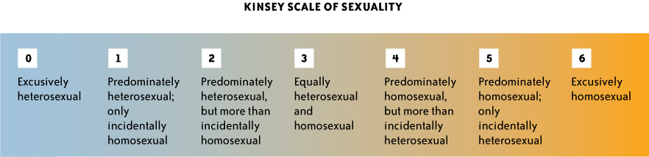
Sexual Orientation
Is sexual orientation a continuum rather than a few simple categories?
Those who are asexual may simply reject any sexual identity at all.
33
Notes:
Alfred Kinsey was suggesting that human sexuality was far more diverse than was commonly assumed. His own studies led him to believe that people were not exclusively heterosexual or homosexual but could fall along a wide spectrum.
33

Slide 34
Homophobia
Homophobia is a fear of or discrimination toward homosexuals or toward individuals who display purportedly gender-inappropriate behavior.
Some argue that the term “homophobia” represents a biased attitude because the term “phobia” implies a psychological condition, thus excusing intolerance.
34
Notes:
Despite a great deal of change in recent years, homophobia is still common in American society. Some argue that the term “homophobia” represents a biased attitude because the term “phobia” implies a psychological condition, thus excusing intolerance.
34

Slide 35
Heterosexism
Homophobia refers to individual beliefs and behaviors, not institutionalized discrimination.
Heterosexism refers to the antihomosexual beliefs and practices embedded in social institutions.

Slide 36
Lesson Quiz
True or False: Sociologists believe that sex and gender are essentially the same thing.
    a. True
    b. False
36
Notes:
36
ANS: B

Slide 37
Lesson Quiz
2.Which theoretical perspective generally believes that there are still social roles better suited to one gender than the other?
      a. Conflict theory
      b. Functionalism
      c. Labeling theory
      d. Symbolic interactionism
37
Notes:
37
ANS: B

Slide 38
Lesson Quiz
3. The physical, behavioral, and personality traits that a group considers normal for its male and female members is referring to:
      a. sex
      b. gender
      c. sexual orientation
      d. the functionalist theory of gender
38
Notes:
38
ANS: B

Slide 39
Lesson Quiz
4. The economic trend showing that women are more likely than men to live in poverty is called:
      a. gender inequity
      b. the suffrage movement
      c. gender role socialization
      d. the feminization of poverty
39
Notes:
39
ANS: D

Slide 40
Lesson Quiz
5. What was the cause most identified with the first wave of the women’s movement?
      a. Equal pay for women
      b. Equal access to education for women
      c. The right to vote for women
      d. The celebration of diversity
40
Notes:
40
ANS: C

