Slide 1



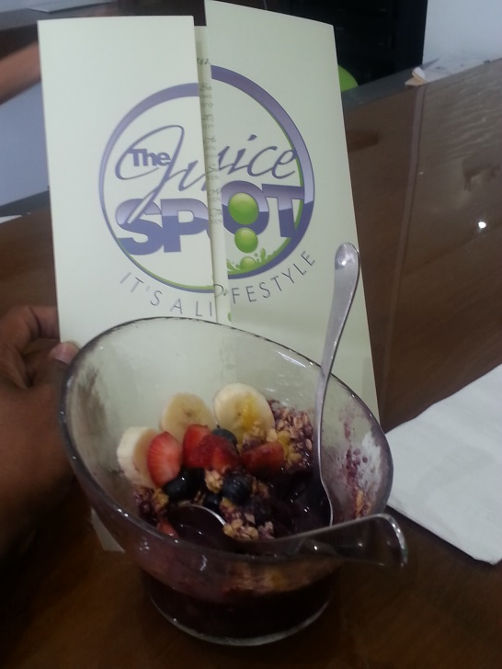

LouddMouth Radio’s T.E.A Time
Sonny & Jazzie at the Juice Spot with Lebron James in Miami
LouddMouthRadio.com introduces a new talk series this summer to the online network called T.E.A Time an abbreviation of (The Entrepreneurial Academy)- a recent rejuvenated project of LouddMouth Radio Producer Sonny. “The Mission Statement behind T.E.A which also is a slogan acronym for “Thirst For Enrichment & Achievement For You Small Business Development” is a project that has been idle from over 6 1/2 years that was created to provide small business development resources to new & existing entrepreneurs” says Sonny. Once I launched the radio network, I decided that our online network is a great platform to establish T.E.A officially to the world. Sonny will be the host & have the shared task of scheduling eager radio guest & producing the format of each broadcast that will be unique to the content of each show. “This is a great tool for small business owners to create a prominent presence & exposing their business to the public as well as a great economical introduction to our radio network and our growing listening audience, concludes the growing network producer. The advantages of being an online network, we are able to expand our territory on the ground where these small businesses live.”
“Once the broadcast goes live you can invite people that you want to listen in to introduce your business too, after the broadcast goes live it becomes a podcast marketing tool for you to utilize for your own personal business marketing efforts.” LouddMouthradio.com provides live content & streaming podcast to over 4 million in car-dashboard listeners through the network’s individual website, broadcasting on the Blog Talk Radio platform & the popular growing on-demand app STITCHER which streams the LouddMouth Radio Network into over 30 high end vehicles, domestic and import makes & models including mobile devices- I-phones and android users. The new series presents a personal 30 minute interview of the business owner which also includes their business advertising during the broadcast on air & social media announcement of the episode schedule, in some instances on location broadcast will take place live on location based upon the level of advertisement agreed upon.
For Advertisement & interviews
Contact LouddMouth Media Offices: 706.363.3895

