Slide 1
AMA INTERNATIONAL UNIVERSITY – BAHRAIN
COLLEGE OF ADMINISTRATIVE
AND FINANCIAL SCIENCES
Dr. FAISAL ALI
Professor
BSBI 622
CHAPTER 8
PM – PROJECT HR MANAGEMENT

Slide 2
10. Project Human Resource Management
Monitoring &
Controlling Processes
Planning
Processes
Enter phase/
Start project
Initiating
Processes
Closing
Processes
Exit phase/
End project
Executing
Processes
Knowledge Area | Process
 | Initiating | Planning | Executing | Monitoring & Control | Closing
Human Resource |  | Develop Human Resource Plan | Acquire Project Team Develop Project Team Manage Project Team

Slide 3
Project Human Resource Management
Include the process that organize, manage, and lead the project team.
Early involvement and participation of team members benefits:
add their expertise during the planning process
strengthens their commitment
Tips: Understand clearly the role and responsibilities of Project Sponsor/Initiator, the team, stakeholders, functional manager, PM, portfolio manager, program manager

Slide 4
9.1 Develop Human Resource Plan
The process of identifying and documenting project roles, responsibilities, and required skills, reporting relationships and creating a staffing management plan.
Inputs
Activity resource requirements Enterprise environmental factors Organizational process assets
Tools & Techniques
Organization charts and position descriptions Networking Organizational theory
Outputs
Human resource plan
.

Slide 5
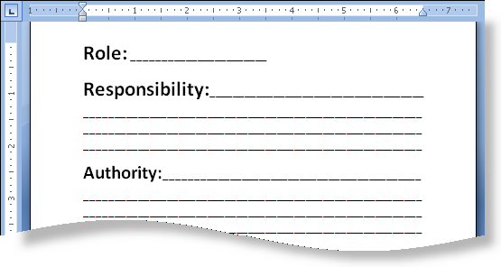
Organization Chart & Position Desc. (Tools & Techniques)
Ensure that each work package has an unambiguous owner.
All team members have a clear understanding of their roles and responsibility.
Types of R&R:
Hierarchical e.g. Organizational Breakdown Structure (OBS)
Matrix e.g. Responsibility Assignment Matrix (RAM) e.g. RACI (responsible, accountable, consult, inform)
Text-oriented
Activity | Role-1 | Role-2 | Role-3 | Role-4
Aaaaaa | R | R | C | I
Bbbbb |  | R | A | I
Ccccc | R | A | C | I

Slide 6
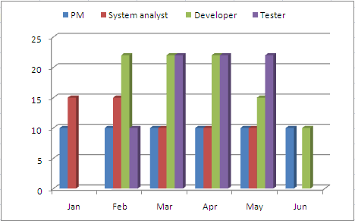
Human Resource Plan (Output)
HR plan includes (but not limited to)
Roles and responsibilities
Role
Authority
Responsibility
Competency
Project Organization Chart
Staffing Management Plan
Staff Acquisition
Resource calendars
Staff release plan
Training needs
Recognition and rewards
Compliance, Safety.
Resource Histogram
Bar chart shows number of resource used per time period
This is an output of
Acquire Project Team process

Slide 7
9.2 Acquire Project Team
The process of confirming human resource availability and obtain the team necessary to complete project assignments.
Inputs
Project management plan Enterprise environmental factors Organizational process assets
Tools & Techniques
Pre-assignment Negotiation Acquisition Virtual teams
Outputs
Project staff assignment Resource calendars Project management plan updates
Read as “Acquire final project team.”

Slide 8
Acquire Project Team
Pre-assignment
Resources who are assigned in advance
Negotiation
For gaining resources within the organization or external vendors, suppliers, contractors, etc (in contract situation)
Acquisition
Acquiring/hiring from outside resources (outsource)
Virtual teams
Think the possibilities of having group of people even little or no time spent to meet face to face.

Slide 9
9.3 Develop Project Team
The process of improving the competencies, team interaction, and the overall team environment to enhance project performance.
Inputs
Project staff assignment Project management plan Resource calendar
Tools & Techniques
Interpersonal skills Training Team-building activities Ground rules Co-location Recognition and rewards
Outputs
Team performance assessments Enterprise environmental factors updates
.

Slide 10
Develop Project Team (Tools & Techniques)
Interpersonal skills (soft skills)
Training
Can be formal (classroom, online) or non-formal (on-job training, mentoring, coaching)
Ground rules
Guidelines that establish clear expectation regarding acceptable behavior by teams
Discussion to create it by all team members
Co-location
Placing many or all the most active team members in the same physical location
Can be temporary for strategy to enhance communication & build sense of community
Recognition & reward
It will only be effective if it is satisfies/valued by individual.
Plans concerning how to do it are developed during Develop Human Resource Plan.

Slide 11
Team Building Activities (Tools & Techniques)
Tuckman’s stage of team formation and development:
FORMING
The team meets and learns about the project and what their roles and responsibilities.
STORMING
Address the project work, technical decisions and the project management approach. Conflict/disagreement may occurs.
NORMING
Work together and adjust work habits and behavior that support the team.
PERFORMING
Being a well-organized unit
ADJOURNING
Team completes the work and move on from the project.
Ground Rules
..will establish clear expectation regarding acceptable behavior by project team members

Slide 12
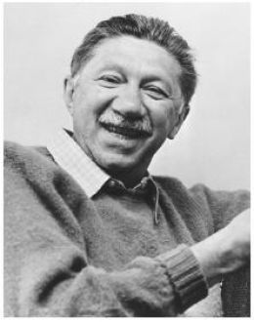
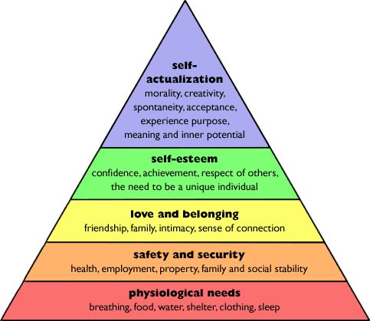
Motivation Theory: Maslow’s Hierarchy of Needs
Higher Level of Needs
Basic Needs

Slide 13
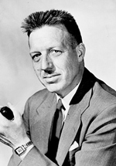
Motivation Theory: McGregor’s X & Y Theory
Theory X
People tends to be negative, passive e.g. incapable, avoid responsibility, need to be watched
Extrinsic Motivation
Theory Y
People tends to be positive e.g. want to achieve, willing to work without supervision, can direct their own effort
Intrinsic Motivation

Slide 14
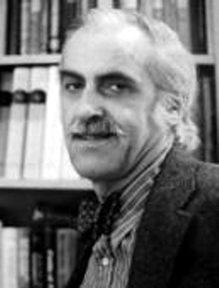
Motivation Theory: Acquired Needs Theory
David McClelland’s Theory People are motivated by one of the three needs
Needs | Behavioral Style
Achievement (N-Ach) | These people should be given projects that are challenging but are reachable They like recognition
Affiliation (N-Affil) | These people work best when cooperating with others They seek approval rather than recognition
Power (N-Pow) | People whose need for power is socially oriented, should be allowed to manager others These people like to organize and influence others

Slide 15
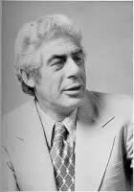
Motivation Theory: Two Factors Theory
Herzberg’s Theory
Job dissatisfaction due to lack of hygiene factors
Job satisfaction due to motivation factors
Hygiene Factors - Working condition - Salary - Personal life - Relationship at work - Security - Status
Motivation Factors - Responsibility - Self actualization - Professional growth - Recognition

Slide 16
9.4 Manage Project Team
The process of tracking team member performance, providing feedback, resolving issues, and managing changes to optimize project performance.
Inputs
Project staff assignments Project management plan Team performance assessments Performance reports Organizational process assets
Tools & Techniques
Observation and conversation Project performance appraisals Conflict management Issue log Interpersonal skills
Outputs
Enterprise environmental factors updates Organizational process assets updates Change requests Project management plan updates
.

Slide 17
Conflict Management.
Conflicts can be beneficial (an opportunities for improvement)
Conflicts is an inevitable consequence of organizational interactions.
Conflicts in the team are caused due to the following reasons in decreasing order of occurrences.
Schedules
Project priorities
Resources
Technical opinions
The most common cause of conflicts in projects are issues related to schedules (not personality differences).
Conflict is best resolved by those involved in the conflict.

Slide 18
Conflict Management
General techniques to resolve conflict
Forcing Pushing one’s viewpoint at the expense of others; Offers only win-lose solutions.
Compromising Searching for solution that bring some degree of satisfaction to all parties.
Collaborating Incorporating multiple viewpoints and insights from differing perspectives; Leads to consensus and commitment.
Smoothing/Accommodating Emphasizing areas of agreement rather than areas of difference.
Withdrawing/Avoiding Retreating from an actual or potential conflict situation.
Behaviors that focused on self
Confronting & Problem Solving Treating conflict as problem to be solved by examining alternatives; Requires a give and take attitude and open dialogue.
Behaviors that focused on others

Slide 19
Exercise: Conflict Management
Description | Type of Resolving
“It seems that the real problem here is not a lack of communication, but a lack of knowledge of what needs to be done and when. Here is a copy of the project schedule. It should help you understand what you need to know.” | Confronting
"Do it my way!" | Forcing
"Let's calm down and get the job done!" | Smoothing
“Let us do a little of what both of you suggest” | Compromising
“Let's deal with this issue next week" | Withdrawal
“Sandy and Amanda, both of you want this project to cause as little distraction to your departments as possible. With that in mind, I am sure we can come to an agreement on the purchase of equipment and what is best for the project." | Smoothing
“We have talked about new computers enough. I do not want to get the computers, and that is it!" | Forcing
"Sandy, you say that the project should include the purchase of new computers, and Amanda, you say that the project can use existing equipment. I suggest we perform the following test on the existing equipment to determine if it needs to be replaced." | Confronting
“Let's what everyone thinks, and try to reach a consensus” | Collaborating

Slide 20
Problem Solving
The important thing to realize about problems is if they are not solved completely, they just return again and again.
The process of problem solving has these steps
Define the cause of the problem
Analyze the problem
Identify solution
Implement a decision
Review the decision, and confirm that the problem is solved.

Slide 21
Project Manager Power
A Project Manager may yield authority over the project team in one of the following ways
Formal (Legitimate) - Power due to Project Managers position
Reward – Power stems from giving rewards.
Penalty (Coercive) – Power due to afraid of the power the Project Manager holds.
Expert (Technical) – Comes from being technical or project management expert.
Referent – Power of charisma and fame. Make another person liking/respecting the Project Manager.
The best forms of power: EXPERT and REWARD. Earned on your own: EXPERT
The worst choice: PENALTY
Derived from position in the company: FORMAL, REWARD and PENALTY.

Slide 22
Management & Leadership Style
Autocratic
Top down approach. The manager has power to do whatever she/he wants.
Sometime appropriate when decisions must be made for emergency situation or time pressure.
Democratic/Participative
Encouraging team participation in the decision making process
Best used for people whose behavior fit with theory Y
Laissez-faire - a French term means “leave alone”
The manager is not directly involve in the work of the team.
Effective for highly skilled team

Slide 23
Important Terms
Halo Effect The assumption that because the person is good at technical, he will be good as a project manager.
Arbitration A method to resolve conflict. A neutral party hears and resolve a dispute.
Expectancy Theory - Victor H. Vroom This is a motivation factor. People put in more efforts because they accept to be rewarded for their efforts.
Perquisites (Perks) Some employees receives special rewards e.g. parking spaces, corner offices, executive dining.
Fringe Benefits Standard benefits formally given to all employees, such as insurance, education benefits and profit benefits.

Slide 24
PM Responsibilities (PMI-ism)
Determine what resources you will need
Negotiate with resource manager for optimal available resources
Create a project team directory
Create project job descriptions for team members and other stakeholders
Make sure all roles and responsibilities on the project are clearly assigned
Understand team members’ needs for training related to their work on the project, and make sure they get the training.
Insert reports of team members’ performance
Send out letters of commendation to team members and their bosses
Make sure team members’ needs are taken care of
Create recognition & rewards system

Slide 25
Project Manager Interpersonal Skills
Leadership
Team building
Motivation
Communicating
Influencing
Decision Making
Political and cultural awareness
Negotiation

Slide 26
EISENHOWER MATRIX
The Eisenhower Matrix is one of the simplest tools that can quickly make you a lot better at managing your time. As TimeGT has always had support for organizing your tasks according to this system, let’s take a closer look and see why it’s important to understand this method.
Although this method was made popular by Stephen Covey in his book “First Things First”, the concept is originally credited to US President Dwight D. Eisenhower, pictured right.
Whenever confronted with something that needed to be done, he would ask himself two questions. First, is the task important? Second, is it urgent?

Slide 27
EISENHOWER MATRIX
Based on this, the task would end up in one of four categories:
Urgent and Important – for example the kitchen catching fire, a deadline to submit tax reports, a baby crying
Not Urgent and Important – doing exercises, long term planning, working on a project
Urgent and Not Important – various interruptions, facebook updates (not that Eisenhower used Facebook at his time), dealing with annoying people
Not Urgent and Not Important – activities that just waste time,

Slide 28
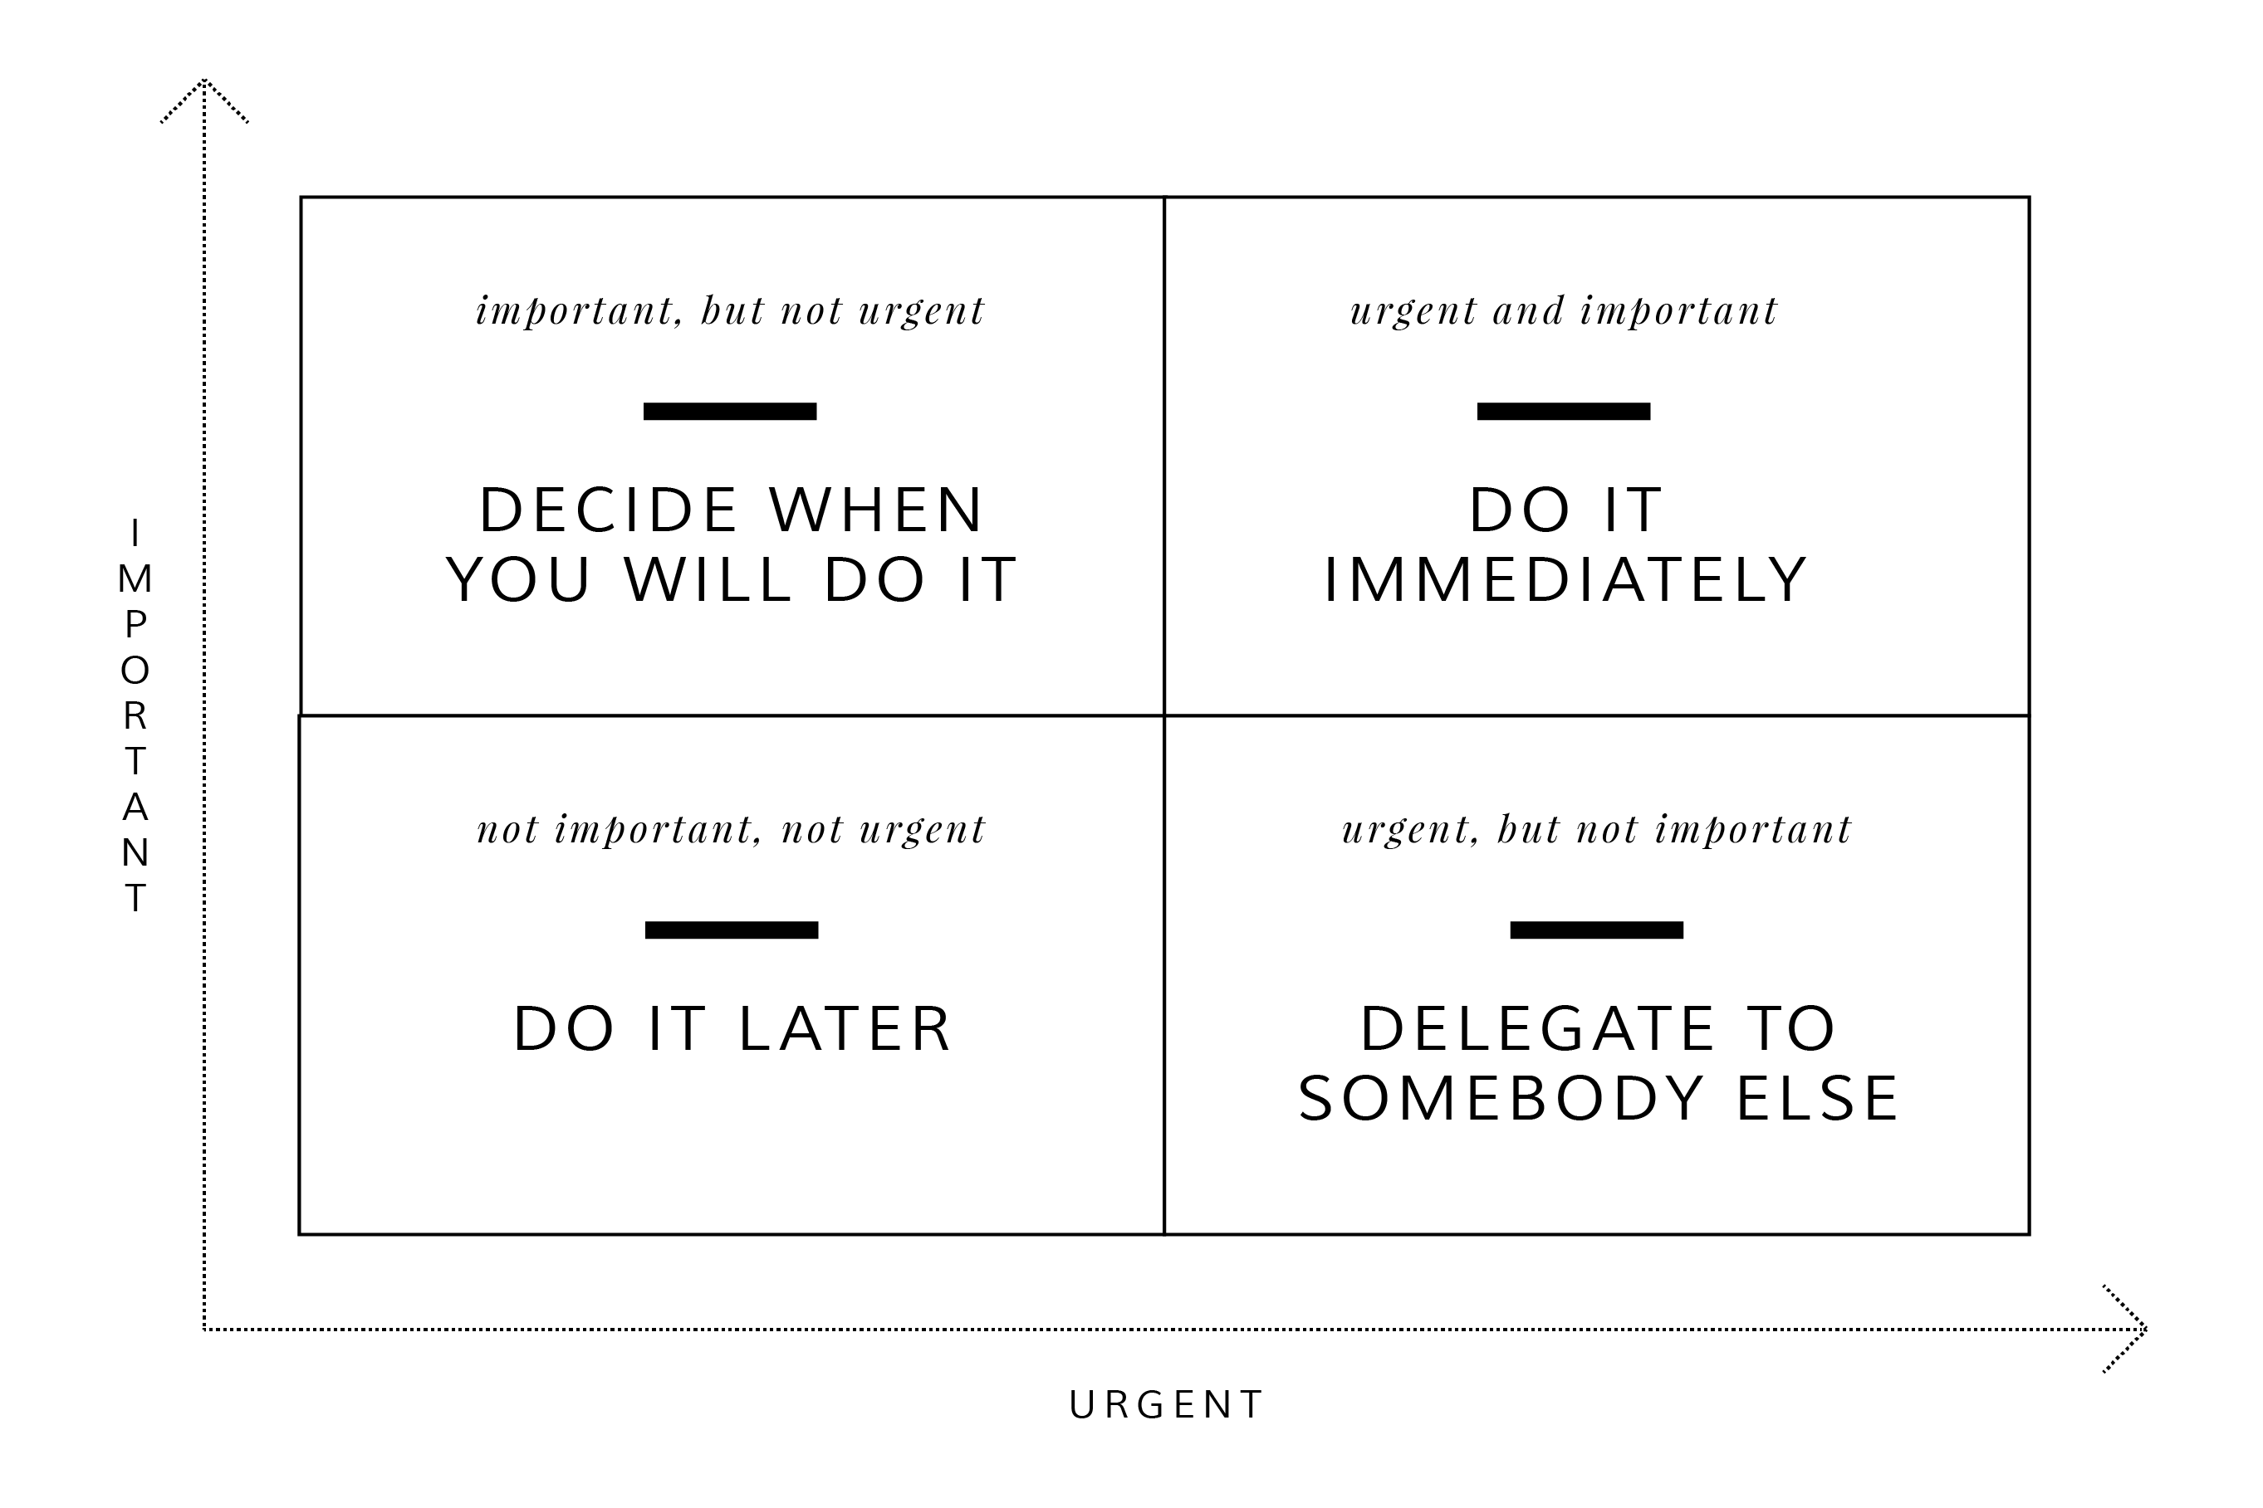
EISENHOWER MATRIX The Four Quadrants

Slide 29
RACI CHARTING
RACI denotes Responsible, Accountable, Consulted and Informed, which are four parameters used in a matrix used in decision making. RACI chart tool outlines the activities undertaken within an organization to that of the people or roles.
In an organization, people can be allocated or assigned to specific roles for which they are responsible, accountable, consulted or informed.
RACI chart tool is a great tool when it comes to identifying employee roles within an organization. This tool can be successfully used when there is role confusion within the company. Role confusion may lead to unproductive work culture.

Slide 30
RACI CHARTING
Parameters in RACI Chart Tool
RACI chart tool represents four parameters as we have already noted in the Introduction. Following are the meanings for each of these parameters:
Responsible: This is a person, who performs a task or work and he/she is responsible for the work.
Accountable: Primarily the person in charge of the task or work.
Consulted: Person, who gives feedback, contribute as and when required.
Informed: Person in charge who needs to know the action or decision taken.

