Slide 1
Capturing benefits and incentives to enable sustainable, sympathetic and viable maturity of a community
30th April 2018
Belbroughton Church Hall
Notes:
What is it all about
Where has it come from
what are the other terms associated with the idea.

Slide 2
Putting Communities in charge of Planning

Slide 3
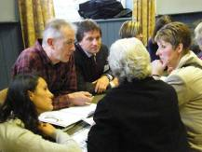
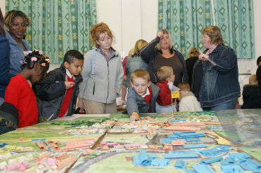
Basic Principles:
Planning at neighbourhood level
Empowers Communities to take control
Is Community NOT Parish Council led
Can Inspire improving innovation and creativity
Explore ways of enabling community development and maturity
Notes:
While the exact details of the Government’s neighbourhood planning policy are still in development we certainly have a strong feel for the direction of travel and we have clauses for the Localism Bill that support that Direction of Travel. So what are the key principles – at their heart is genuine and active community engagement and empowerment and planning’s role as an enabler of change. There are some basic principles which have stayed consistent:
reducing local authority decision-making on development and planning in neighbourhoods
the ability for neighbourhoods to be self-defined (but within constraints)
a neighbourhood-owned and community-initiated process – not an LPA led process (they are far more in a supportive role)
creating a light-touch testing process, ensuring that examinations with public hearings will be the exception rather than the rule
using the planning process and decentralisation to maximise creativity and innovation at a local level
through the granting of pp it reduces the amount of small scale development in the planning system
it is an entirely permissive regime – there is no requirement to have a neighbourhood plan– you can still apply for planning permission through the normal LPA application route

Slide 4
Neighbourhood planning cannot
Switch off....Town & Country Planning regulations
Override….Strategic plans or national policy
Go beyond.... Local authority policies on development
Promote....less.. but can promote more suitable development
Notes:
Neighbourhood plans will not replace Local Plans – they are in addition to comprehensive coverage of local authority plans
Once adopted neighbourhood plans become part of statutory development plan
Despite rumours to the contrary, we will still be encouraging LPAs to produce Local Plans that set out their policies for the development and use of land across the LPA area
Neighbourhood plans will need to sit “within” the framework of Local Plans and national policy but they can promote more development than in the strategic plan and include more detailed policies (e.g. on design, car parking, landscaping)
One of the key issues for neighbourhood planning is funding the process, and thus another key principle is that development which gains permission through the NDO route, and is thus not subject to a planning application fee, will pay a charge to the LPA at the commencement of development

Slide 5
WHAT CAN A NEIGHBOURHOOD PLAN DO ?
Be expensive
Divert precious resources
Absorb energy of a community
Divide a community
Be ineffective if legally challenged
Fail to engage with the community wishes
Ineffectually absorb the time and enthusiasm of volunteers
An initiative that fails because of change of national government policy.

Slide 6
An Ambition Restore the idea that development can be a force for good, rather than something to be resisted at all costs
Capturing Benefits and Incentives
Notes:
Finally, and apologies for the very quick trawl, but to conclude we must go back to the beginning.
Neighbourhood planning is a key part of the must wider agenda of turning the tables on the development discussion. From communities resisting development because they only see the costs to communities welcoming development because they have had a role in controlling its form and nature, they feel ownership towards it and they feel collective responsibility for the future of their communities. They also have the incentives to see the tangible difference development has on their own lives and to gain real pride in their surroundings which they have helped to change.

Slide 7
An Ambition
Can we enhance the the aspects of the villages that we like by sympathetic, sustainable development?
Viability and sustainability
Developing a safer place to work, play, live and progress to “maturity”
Developing a community that “cares”
Keeping schools viable
Custom for village businesses
Ensuring a good mix of ages to prevent an aging population dominating
Increasing demand for facilities that benefit the community
Greater voice at District and County levels
More opportunities for local employment, reducing commuting and associated pollution
Opportunities for affordable housing for people associated , past or present, with our communities
“doing our bit” for the housing situation
Protecting the green belt from overdevelopment
Capturing Benefits and Incentives
Notes:
Finally, and apologies for the very quick trawl, but to conclude we must go back to the beginning.
Neighbourhood planning is a key part of the must wider agenda of turning the tables on the development discussion. From communities resisting development because they only see the costs to communities welcoming development because they have had a role in controlling its form and nature, they feel ownership towards it and they feel collective responsibility for the future of their communities. They also have the incentives to see the tangible difference development has on their own lives and to gain real pride in their surroundings which they have helped to change.

Slide 8
Protest Say NO louder AND LOUDER
Or engage, challenge, argue on planning grounds

Slide 9
26th March 2018 7pm Jubilee Room Belbroughton
Facing up to Reality or Fiction
The Hearn Report
Councillor Bob Morgan
Belbroughton and Fairfield Parish Council NHP lead

Slide 10
Birmingham Housing Market Area
Strategic Growth Study
The national Planning Policy Framework and the Localism Act 2011 requires local authorities to work together though the “Duty to co-operate” across the relevant Housing Market Area ( HMA) to identify and then meet housing need where it is sustainable to do so

Slide 11
Birmingham Housing Market Area
Strategic Growth Study

Slide 12
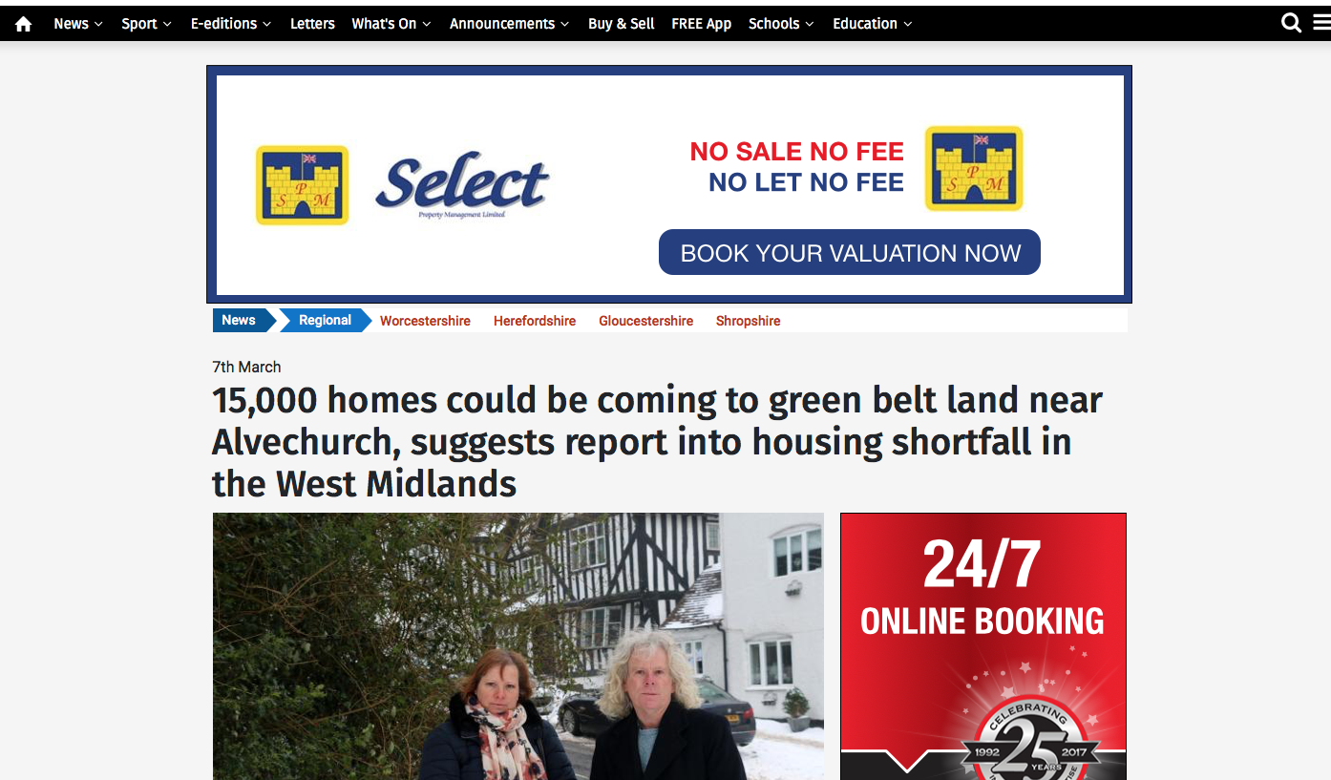

Slide 13
A Strategic Growth Study into the Greater Birmingham and Black Country Housing Market Area
G L Hearn and Wood PLC
February 2018

Slide 14
Study Brief
It has been established that there is a shortfall in planned provision to meet the housing requirements in the Greater Birmingham and Black Country Market Area
Source Birmingham Development Plan (BDP) 2017
The Birmingham Development Plan (BDA) contains a clause requiring adjacent local Authorities to work together to address the shortfall
Source Black Country Core Strategy Review
A series of studies indicates a major shortfall
Source G L Hearn

Slide 15
Study Brief
“consider the development potential and suitability of any large previously developed sites within the Green Belt that may lie in sustainable locations. “
“Should a shortfall remain ….undertake a full strategic review of the Green Belt within the HMA utilising a consistent Green Belt Review methodology, which assesses Green Belt against its five purposes”

Slide 16
Purposes of the Green Belt
To check the unrestricted sprawl of large built-up areas
To prevent neighbouring towns merging into one
another
To assist in safeguarding the countryside from
encroachment
To preserve the setting and special character of historic
towns
To assist in urban regeneration, by encouraging the recycling of derelict and other urban land.

Slide 17
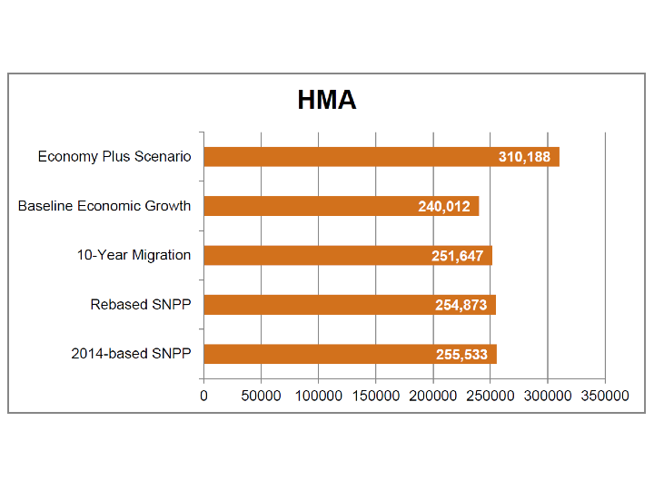
Dwellings needed by 2032
Greater Birmingham and Black Country Market Area

Slide 18
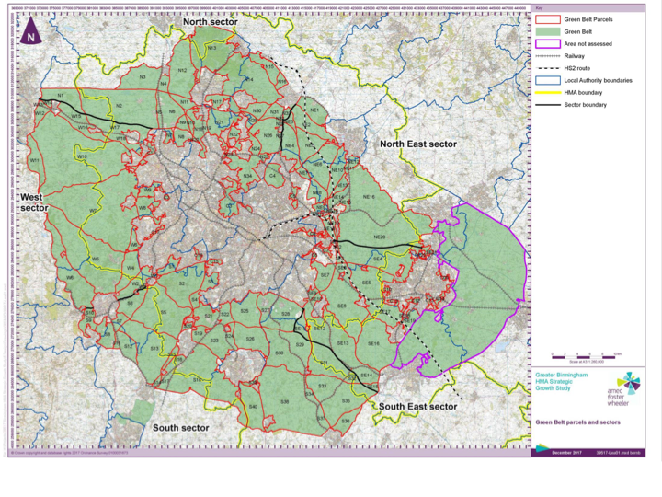

Slide 20
Recommendations
Implications for Bromsgrove is that the report is suggesting further testing of the following scenarios
Proportionate dispersal of a range smaller of sites of 500 to up a combined total of 2,500 houses in total
South of of Bromsgrove by the train station, South of
Birmingham in and around the Wythall area.
iii Urban extension circa 1,500 - 7,500 houses on the South of
Dudley in close proximity to Hagley
New Settlement circa 10,000+ houses in the Barnt Green/
Alvechurch area

Slide 21
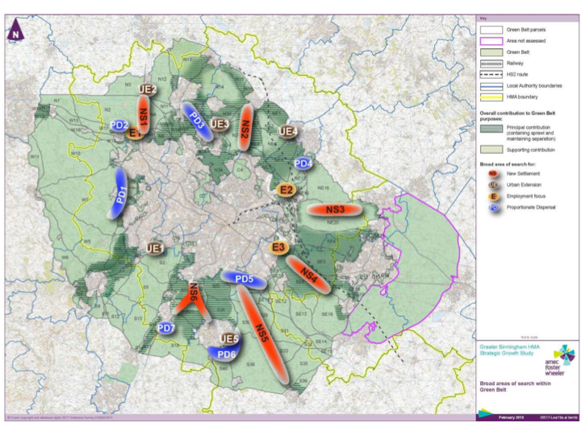

Slide 22
Next Steps for Bromsgrove District Council
Testing the strategic Review
Bromsgrove local Plan review
Issues and options consultation
Green Belt review methodology Autumn 2018
Site selection methodology Late 2018

Slide 23
Parish Council has approved some funding
Considering if Localities Commission to be approached for further funds
Steering Group formed and active with three open meetings held
Executive group identified but needs to be developed
BDC have approved an application to designate the Parish area
Notes:
What is it all about
Where has it come from
what are the other terms associated with the idea.

Slide 24
We need to :-
Develop volunteers into an effective team
Identify areas where no experienced volunteers exist:
Project planning
Expert advice on the correct approach to plan development
Cost the above……Catshill will be spending Circa £15,000
Engage with the community at every stage
Engage with BDC and other active groups
Educate our community on the issues enabling informed judgements
Focus on how engagement and consultation can effect improvements in our community
Notes:
What is it all about
Where has it come from
what are the other terms associated with the idea.

Slide 25
Your views ?
Notes:
What is it all about
Where has it come from
what are the other terms associated with the idea.

