Slide 1
The Future of Bodycare 2017
Global annual review: what's now and what's next for the bodycare market
By David Tyrrell
© 2016 Mintel Group Ltd. All Rights Reserved. Confidential to Mintel.
January 2017
Read on mintel.com

Slide 2
Mintel recommends
Natural/organic is key driver
Be honestly sustainable
Evolve the omnichannel strategy
Brands need to develop a strong natural/organic proposition and mix a hero foodie (for example vitamin C-enriched gac or kakadu plum) and mix in other "superfoods" or organic extracts to produce a new line of natural skin boosters (e.g., vitamins A, C, E, F) - but nothing synthetic.
Companies/brands need honestly to act to reduce their human footprint as this will attract younger consumers to purchase their products and retain them longer term
Brands need to communicate a fun, yet informative message (think video ads), and allow consumers to seamlessly interact with them through social media and the newest AI bot technologies.
© 2016 Mintel Group Ltd. All Rights Reserved. Confidential to Mintel.
2
Read on mintel.com

Slide 3
Superfoods promise an enriched source of nutrients to boost wellbeing
The foodie skin vocabulary is always adding new entrants to build off the more traditional sources, such as apples, avocado, spinach and flaxseed, to add new naturals that can even have an exotic flair, such as gac (which is high in vitamin A, C, E, F) and kakadu plum (enriched in vitamin C).
Brands need to use an assortment of different multivitamin products using nature's chemistry.
© 2016 Mintel Group Ltd. All Rights Reserved. Confidential to Mintel.
3
Read on mintel.com

Slide 4
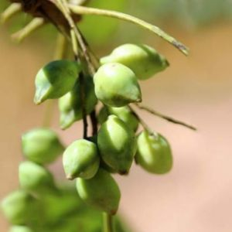
Kakadu plum superfruit offers a vitamin C punch
Although it has plum in its name, kakadu plum looks more like an almond than a plum in appearance. Demand for the Australian superfood is expected to grow, in particular for East Asian diets.
The plum is extremely high in vitamin C (100 times higher than oranges) - a vitamin that is universally known among consumers for its health benefits.
Indigenous Australians currently harvest the fruit, and are establishing cooperatives. The ethical sourcing of kakadu plum can be used in marketing messages by brands to entice iGens and Millennials to trial.
Currently the demand for the plum is high. Its adoption in skincare, however, will be tempered until production of the natural product can be ramped up.
© 2016 Mintel Group Ltd. All Rights Reserved. Confidential to Mintel.
Packed with kakadu plum & other naturals
4
Read on mintel.com

Slide 5
Food/drink taps into nutritional wellness of fruits/plants
Food and drink brands are embracing the high value consumers have for natural/organic ingredients, and are using elements of plants and fruits to fortify their products. This infusion of nutrition seamlessly fits into the wellness goals for many consumers.
© 2016 Mintel Group Ltd. All Rights Reserved. Confidential to Mintel.
5
Read on mintel.com

Slide 6
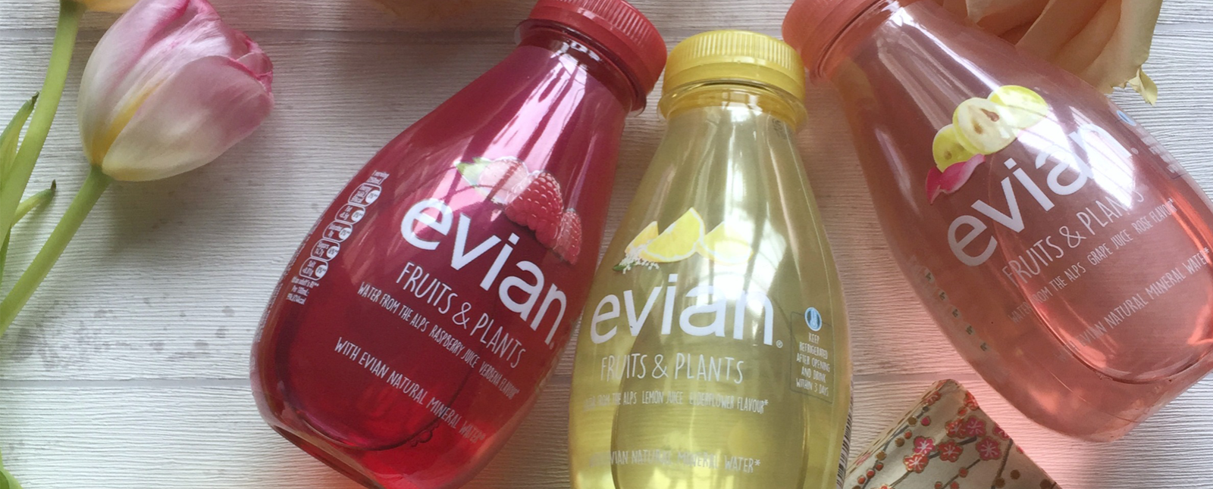
Evian Fruits & Plants Raspberry and Verbena Flavoured Alpine Water
© 2016 Mintel Group Ltd. All Rights Reserved. Confidential to Mintel.
Source: Mintel
6
Read on mintel.com

